Slide 1


Slide 2
Self-Monitoring of Blood Glucose
Bita mirzaei MD
Endocrine Fellow
Shahid Beheshti University Of Medical Science
2015 October

Slide 3
AGENDA
Introduction
History(brief)
SMBG Techniques ( basic principles )
the accuracy and limitations of current point-of-care glucose monitoring devices (POCGMDs).
the present status of glucose biosensors in the clinical practice
SMBG in type 2 diabetes (systematic review)
Recommendation and Guideline
Conclusion

Slide 4
AGENDA
Introduction
History(brief)
SMBG Techniques ( basic principles )
the accuracy and limitations of current point-of-care glucose monitoring devices (POCGMDs).
the present status of glucose biosensors in the clinical practice
SMBG in type 2 diabetes (systematic review)
Recommendation and Guideline
Conclusion

Slide 5
introduction
One of the most commonly used measures to monitor glucose control is glycated hemoglobin (A1c).
However, in a large subgroup of people with diabetes, an estimated
15% of A1c values might be misleading.
Specifically, certain ethnic groups, people with sickle cell anemia, and
patients with severe kidney disease have A1c levels that do
not correlate with average glycemia
. Additionally, in patients with widely variable glucose levels, the A1c will not provide a true picture of detrimental recurrent hypo and hyperglycemic episodes.
For these patients, frequent GM or continuous GM is virtually the only way to assess glucose control over time.
AACE/ACE Consensus: Glucose Monitoring, Endocr Pract. 2015;

Slide 6
Introduction…
There is little argument regarding the value of SMBG for people with type 1 diabetes or insulin-requiring type 2 diabetes.
However, controversy exists regarding the value of SMBG for people with diabetes who are not treated with insulin.
The effectiveness of self monitoring in patients with type 2 diabetes who do not use hypoglycemic agents is less certain.

Slide 7
Introduction…
During the last 50 years, glucose biosensor technology including point-of-care devices, continuous glucose monitoring systems and noninvasive glucose monitoring systems has been significantly improved.
However, there continues to be several challenges related to the achievement of accurate and reliable glucose monitoring.

Slide 8
AGENDA
Introduction
History(brief)
SMBG TECHNIQUE( basic principles )
the accuracy and limitations of current point-of-care glucose monitoring devices (POCGMDs).
MARKET
SMBG in type 2 diabetes (SYSTEMATIC REVIEW)
Recommendation and Guideline
Conclusion
brief history,,
analytical performance, and the present status of glucose biosensors in the clinical practice

Slide 9
Point-of-care Glucose Monitoring Devices
During the 1970s, POCGMDs were originally designed for home self-monitoring of blood glucose (SMBG) for diabetes patients to improve glucose control during regular life.
J Diabetes Sci Technol Vol 6, Issue 2, March 2012

Slide 10
Historical Perspectives of Glucose Biosensors
Although a variety of glucose sensors are available, the glucose biosensor has changed little in principle over several years .
However, the first blood glucose meter was not a biosensor. It was the Ames Reflectance Meter (ARM) based on a reflectometer introduced in 1971.
Dextrostix, the first blood glucose strip, had been available since 1965.
Early versions of glucose-sensing devices were based on the reflectometer.

Slide 11
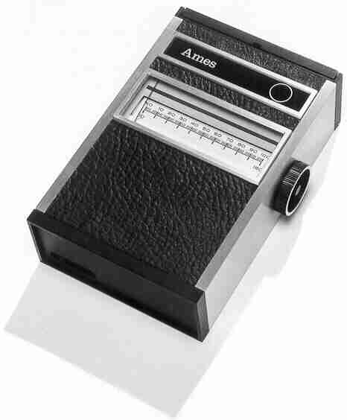
نسل اول
نیم قرن پیش
شستشوی نوار
2 دقیقه زمان
عقربه ای
اندازه یک رادیو
ساخت ژاپن
Notes:
دستگاه های اولیه ای که در اواخر دهه 60 میلادی وارد بازار شدند، ژاپنی و به اندازه یک رادیو بود، 25 سانتیمتر و 1/5 کیلوگرم بود و به 2 دقیقه زمان نیاز داشت که نتیجه قند را بگوید. دیجیتالی نبودند، با برق شهری کار می کرد. این دستگاه Ames Reflectance Meter نام داشت و توسط Anton H. Clemons ساخته شد. که فقط پزشکان می توانستند آن را داشته باشند و به افراد دیابتی فروخته نمی شد. چه بسا قیمت بالایی هم داشت: 650 دلار.
دستگاه دیگری هم توسط Clark and Lyons در سال 1962 در Cincinnati Children’s Hospital در کنار برنامه غذایی دیابتی و ورزش استفاده می شد.
There were two “first” glucose meters that were the beginning of the modern glucose meter. In the 1970s there was the Ames Reflectance Meter, which was first made by Anton H. Clemons. It was about ten inches long, ran on electrical power, and took about a minute to determine the glucose level. The glucometer traces its origin to 1965, when the Ames Company marketed paper strips called Dextrostix--an invention of Ernie Adams--to physicians. To use Dextrostix, your applied a drop of blood to the paper strip and waited for one minute before washing it off.
The other was used in 1962 in the Cincinnati Children’s Hospital and was made by Clark and Lyons. This meter was used in conjunction with diabetic diet, diabetic recipes, and exercise, and determined the glucose level by measuring how much oxygen was consumed by an enzyme called glucose oxidase that was placed on an oxygen electrode.

Slide 12

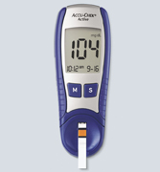
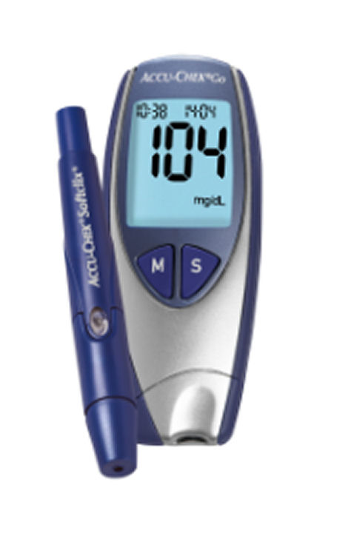
نسل دوم
روش نور سنجی
کاهش زمان اندازه گیری
کوچکتر شدن سایز
عدم نیاز به پاک کردن نوار
Notes:
در نسل بعدی، دستگاه ها کوچکتر و سبکتر شدند، با باتری کار می کردند، زمان تست به چند ثانیه کاهش یافت، نوارها یکبار مصرف بودند.

Slide 13
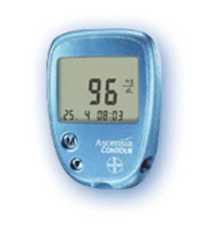
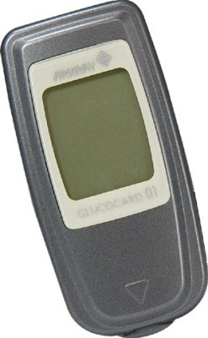
نسل سوم
واکنش الکتروشیمیایی
دقت بسیار بالا
حساسیت بالا به تکنولوژی ساخت
خون کم
Notes:
نسل سوم که فعلا پیشرفته ترین نسل دستگاه ها هستند، به خون بسیار کمی نیاز دارند، دقت خیلی بالا و سیستم هایی در آنها به کار رفته است که تداخلات را بسیار کاهش داده است.

Slide 14
AGENDA
Introduction
History(brief)
SMBG TECHNIQUE( basic principles )
the accuracy and limitations of current point-of-care glucose monitoring devices (POCGMDs).
MARKET
SMBG in type 2 diabetes (SYSTEMATIC REVIEW)
Recommendation and Guideline
Conclusion
brief history,,
analytical performance, and the present status of glucose biosensors in the clinical practice

Slide 15
Enzymatic amperometric glucose biosensors are the most common devices commercially available, and have been widely studied over the last few decades.
Generally, glucose measurements are based on interactions with one of three enzymes:
hexokinase
glucose oxidase (GOx)
glucose-1-dehydrogenase (GDH)
The hexokinase assay is the reference method for measuring glucose using spectrophotometry in many clinical laboratories
Glucose biosensors for SMBG are usually based on the two enzyme families, GOx and GDH.

Slide 16
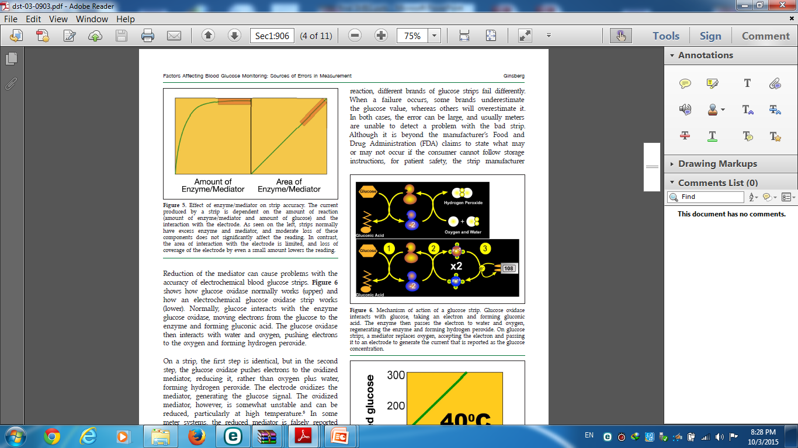
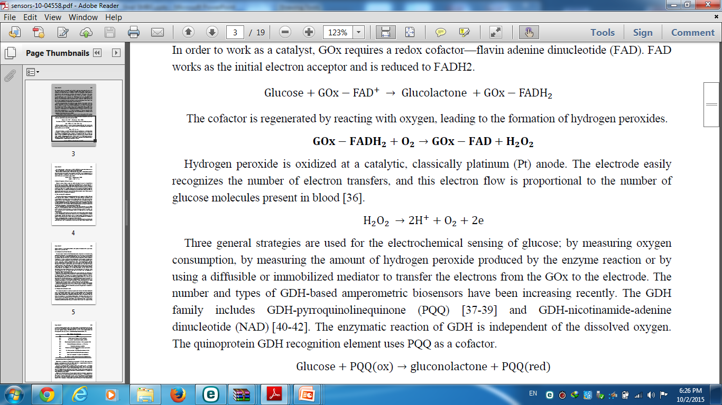
Glucose Oxidase
This measurement technique uses glucose oxidase (GOX) as a catalyst for oxidation of glucose to gluconic acid and hydrogen peroxide; the amount of hydrogen peroxide produced is proportional to the glucose concentration in the blood sample.
J Diabetes Sci Technol Vol 6, Issue 2, March 2012

Slide 17
This change in the hydrogen peroxide concentration can be measured by using a color change as an indicator using a photometric technique or in newer devices, which rely on the production of an electrical current (amperometric technique).

Slide 18
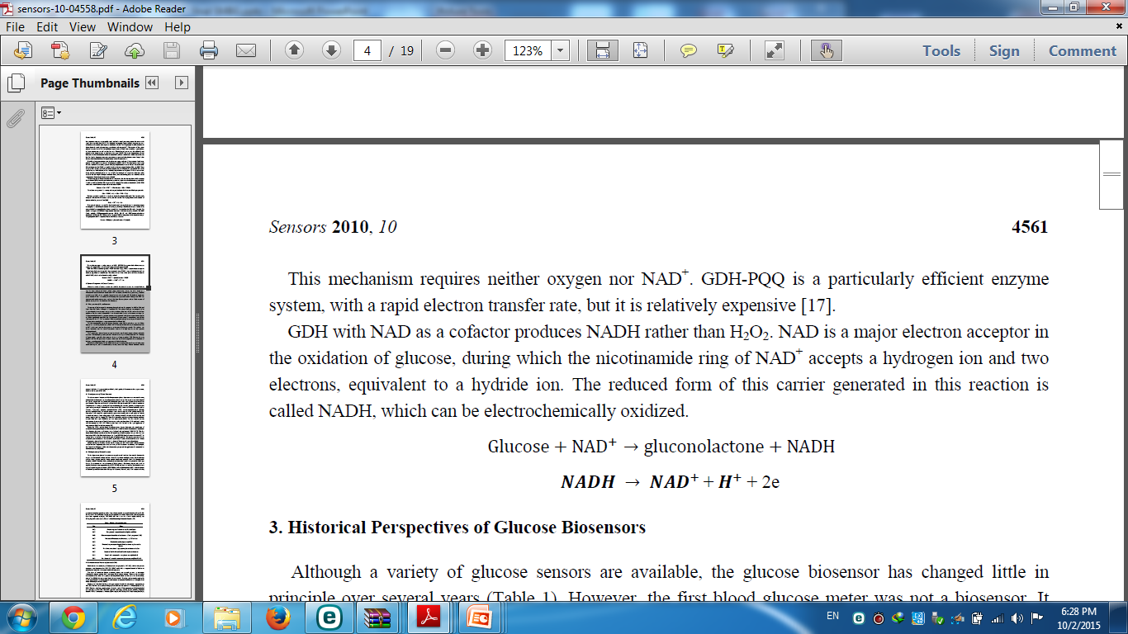
Glucose-1-dehydrogenase
This measurement technique uses glucose-1-dehydrogenase (GDH) to convert glucose to gluconolactone with older devices using a coenzyme to convert nicotinamide adenine dinucleotide (NAD) to NADH (reduced form of NAD).
J Diabetes Sci Technol Vol 6, Issue 2, March 2012

Slide 19
The NADH concentration is measured and is proportional to the BG concentration. The NADH concentration can be measured using a photometric or amperometric technique
J Diabetes Sci Technol Vol 6, Issue 2, March 2012

Slide 20

Newer POCGMDs use the coenzyme pyrroloquinoline quinone (PQQ) because of less sensitivity to ambient oxygen and electrochemical interference.
J Diabetes Sci Technol Vol 6, Issue 2, March 2012

Slide 21
the hexokinase assay is the reference method for measuring glucose using spectrophotometry in many clinical laboratories
The YSI (Yellow Springs Instruments, Yellow Springs, OH) has been used in many studies as a glucose reference.
The YSI uses GOX to measure the hydrogen peroxide produced with an amperometric technique.
Rarely, a radioactive labeled isotope assay is used for instrument validation.
Diabetes Sci Technol Vol 6, Issue 2, March 2012

Slide 22
AGENDA
Introduction
History(brief)
SMBG TECHNIQUE( basic principles )
The accuracy and limitations of current point-of-care glucose monitoring devices (POCGMDs).
the present status of glucose biosensors in the clinical practice
SMBG in type 2 diabetes (SYSTEMATIC REVIEW)
Recommendation
and Guideline
Conclusion

Slide 23
Measuring Accuracy
Accuracy of a blood glucose meter is a measure of how closely the average of a series of values reflects the reference value.

Slide 24
A few years ago, the International Standards Organization (ISO), in conjunction with international regulatory authorities, health care providers, and device manufacturers in many countries, established a standard for evaluating the accuracy of blood glucose meters Called ISO 15197.

Slide 25
The existing data indicate that accuracy of GM correlates with increased patient confidence in using GM devices, resulting in better adherence, more confident insulin adjustments, and improved quality of life.
The participant experts identified the 2013 ISO standards for accuracy, precision, and bias,
with the realization that the standard applied at low glucose levels may need to be more stringent to avoid clinically inappropriate decisions.
AACE/ACE Consensus: Glucose Monitoring, Endocr Pract. 2015;

Slide 26
In 1987, ADA recommended that the acceptable error for POCGMDs from all sources (user, analytical, etc.) should be less than 10% for glucoses ranging from 30 to 400 mg/dl at all times
The ADA decreased the maximum allowable analytical error to <5% in 1996.
Diabetes Sci Technol Vol 6, Issue 2, March 2012

Slide 27
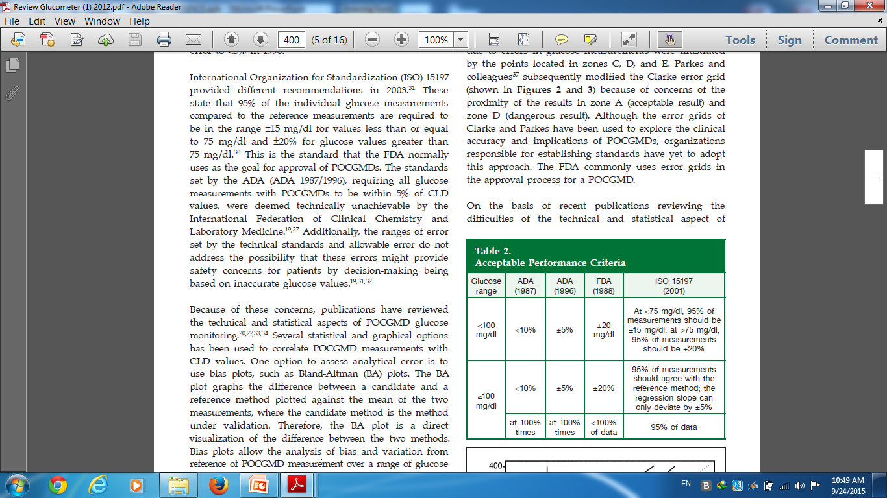
Diabetes Sci Technol Vol 6, Issue 2, March 2012

Slide 28
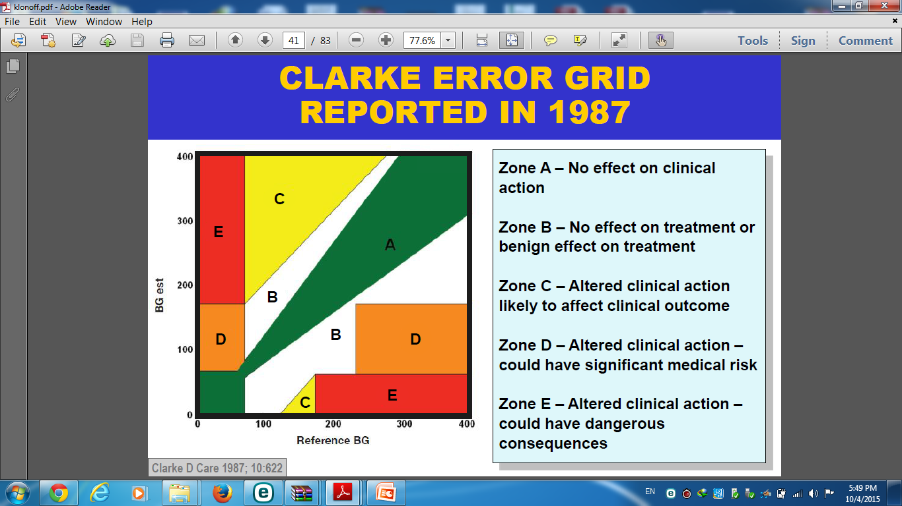
Clarke and colleagues developed the error grid to evaluate the accuracy of the clinical decision-making based on the measured glucose value.
To asses analytical error :Clarke error grid the results in zone A (acceptable result) and zone D (dangerous result).
The grids define several zones: zone A, points with no clinical implication because of clinically accurate measurement; zone B, points still lead to accurate clinical decisions zone C, misinterpretation of euglycemia as hyper- or hypoglycemia; and zone D/E, points lead to overestimation of hypo-glycemia or underestimation of hyperglycemia.;

Slide 29
Although the error grids of Clarke and Parkes have been used to explore the clinical accuracy and implications of POCGMDs, organizations responsible for establishing standards have yet to adopt this approach. The FDA commonly uses error grids in the approval process for a POCGMD.

Slide 30
The inaccuracy of glucose monitoring systems comes from 4 sources:
Patient factors
Physical factors
Strips factors
Pharmacological factors.
J Diabetes Sci Technol Vol 3, Issue 4, July 2009

Slide 31
SOURCES OF ERROR IN SMBG:
Operator :
Errors in self monitoring of blood glucose (SMBG) are most frequently attributed to operator error:
Problems arise from: failure to use test strips appropriate to the meters, calibrate the meter correctly, dirty meters, inadequate hand washing, or improper storage of the test strips .
Recommendation:
The glucose meter and strips should be brought in for clinic visits. The patient's method of testing should be observed periodically and any technical mistakes corrected.
Patients should be queried regarding storage of strips.

Slide 32
Not Hand washing
Hand washing has always been a problem, but now, with microsample meters, the smallest amount of contaminant can significantly raise the blood glucose.
Smallest amount of contaminant → BG.
With a sample of 0.3 μl, 1 μg of glucose (the weight of a dust particle) → BG by 300 mg/dl.
J Diabetes Sci Technol Vol 3, Issue 4, July 2009

Slide 33
HCT:
Some studies documented the influence of Hct variation, especially when acute anemia develops in certain patient populations (e.g., cardiac surgery), while others report accuracy over a wide range of Hcts.
Newer POCGMDs correct for Hct variation with several amperometric methods, involving a new technique called dynamic electrochemistry.

Slide 34
Three naturally occurring substances interfere with electrochemical glucose oxidase based strips:
triglycerides, oxygen, and uric acid.
(The water content of the plasma can be affected )
Hypertriglyceridemia( usually at very high levels) and paraproteinemias decrease the water concentration in the whole blood sample, potentially causing a “pseudohypoglycemia,” measured by POCGMDs.
.
J Diabetes Sci Technol Vol 3, Issue 4, July 2009

Slide 35
Uric acid is seldom a problem, except in patients with values that would lead to severe gout.
J Diabetes Sci Technol Vol 3, Issue 4, July 2009

Slide 36
Both GOX and GDH measurement techniques present limitations:
J Diabetes Sci Technol Vol 6, Issue 2, March 2012

Slide 37
Blood oxygenation affects POCGMD glucose measurement techniques with GOX and not with GDH.
Although values may not differ significantly within the normal oxygen range, errors with GOX measurement techniques can be 15% or more when PaO2 (blood oxygen content) exceeds 100 mm Hg or falls below 44 mm Hg depending on the type of test strip and measurement method.
Diabetes Sci Technol Vol 6, Issue 2, March 2012

Slide 38
Glucose oxidase biosensor strips → sensitive to O2 concentration
Mediator & O2 can compete to take electrons from the reduced form of the glucose oxidase.
If the O2 content of the sample is high → active mediator will be lower → value underestimated.
J Diabetes Sci Technol Vol 3, Issue 4, July 2009

Slide 39
When there are high levels of dissolved oxygen in the sample (e.g., hyperoxia), oxygen is readily available for the GOX reaction and can cause an underestimation of blood glucose
conversely, hypoxemia may falsely elevate GOX glucose measurements.
J Diabetes Sci Technol Vol 6, Issue 2, March 2012

Slide 40
Altered temperatures can also influence blood glucose readings in other ways.
Low temperature diminishes circulation to the skin. This does not dramatically influence glucose taken from a fingertip since the arteriovenous shunts of the fingers stay open, but the blood flow to the skin of the forearm is dramatically decreased.
Alternative site testing, which normally has a lag of 15–30 min, can have a lag of up to an hour when the arm is cooled.
. Active warming may improve measurements; conversely, the effects of fever are unknown
J Diabetes Sci Technol Vol 3, Issue 4, July 2009

Slide 41
Therefore, it has been recommended to minimize the oxygen tension effect on glucose testing variability by using oxygen-insensitive test methods in critically ill patients with PaO2 >100 mm Hg or patients with unpredictable blood PO2 levels
Diabetes Sci Technol Vol 6, Issue 2, March 2012

Slide 42
The GDH technique using PQQ has limitations as well.
This coenzyme reacts with other sugars (e.g., maltose, galactose, mannose, xylose, and ribose) and detects them as glucose
alternate techniques should be used when these other sugars are present.
For example, icodextrin (a substance commonly used in peritoneal dialysis fluid) is broken down to maltose, which is reported as glucose with the GDH-PQQ POCGMDs. Because of this substance interference, the POCGMD over reports the BG level and, in some cases, can lead to critical treatment errors with significant consequences of hypoglycemia.
J Diabetes Sci Technol Vol 6, Issue 2, March 2012

Slide 43
plasma PaCO2 contributed to the difference between CLD and POC glucoses in critically ill patients after Hct correction.
In summary, the influence of carbon dioxide tension on the POCGMD accuracy remains controversial and is most likely minimal.
Diabetes Sci Technol Vol 6, Issue 2, March 2012

Slide 44
pH : As with any enzymatic reaction
Changes in pH may affect the performance of the POC meter.
This has not been shown to be a major source of error at a pH range of 6.97–7.84 (32) or at lower pH (6.8 –7.55)
However, Kilpatrick et al. found significant deviation in glucose measurement at pH 6.95 and 7.85, with 15% from the central laboratory whole-blood method using an older POC method.
this may be cause for concern in cases of severe acidosis (e.g., diabetic ketoacidosis, leading to clinically significant interpretation errors.
Diabetes Sci Technol Vol 6, Issue 2, March 2012

Slide 45
The influences of peripheral edema, hypotension, vaso-pressor, or catecholamine therapy on POCGMD accuracy in critically ill patients had been the subject of several investigations
Fewer than 80% of the capillary samples were in agreement with the CLD measurement.
When hypotension was present, this agree-ment further decreased to less than 70% .
With the presence of edema or when patients were receiving vasopressor medications and BG levels were <80 mg/dl, only 25% of the capillary POCGMD measurements and less than 55% of arterial POCGMD measurements were accurate when compared with CLD results .
Diabetes Sci Technol Vol 6, Issue 2, March 2012

Slide 46
Glucose strips :
Common errors include leaving the lid off for periods of time, with exposure to heat, moisture, and humidity, and mixing lots of strips into one can for convenience.
Patients may forget to match the code on the strip.
Most newer meters overcome this problem by automatically recognizing codes for strips.

Slide 47
Sample source can also significantly impact glucose concentration measurements.
Potential sampling sites include arterial, venous, or capillary (e.g., finger tips, ear lobes, etc.).
As a general rule, the highest to lowest glucose concentration by sampling site is artery, capillary, and then venous.
The difference in glucose concentrations between capillary and venous blood can be altered by the patient’s metabolic state, with insignificant differences in the absence of stress and fasting.
In a critically ill patient, the presence of a hypermetabolic state and other stressors, including fasting, can cause significant differences between these values.
Diabetes Sci Technol Vol 6, Issue 2, March 2012

Slide 48
In the past, glucose meters reported whole blood glucose values, which made it difficult to compare finger stick results with results from a laboratory, which are always plasma.
However, the majority of available glucose meters now provide plasma equivalent values rather than whole blood glucose values.
Thus, results from most available glucose meters and commercial laboratories should now be comparable.

Slide 49
Site of testing :
Several blood glucose meters are now available that use sites other than the finger to obtain blood samples in an effort to reduce the discomfort involved with finger sticks.
Monitoring from alternate sites, such as the skin of the forearm, may give slightly lower results than those taken at the fingertips, since they may sample venous blood rather than capillary blood.
While this should not be a problem if the patient uses one or the other site exclusively, the betweentest variability will increase if numerous sites

Slide 50
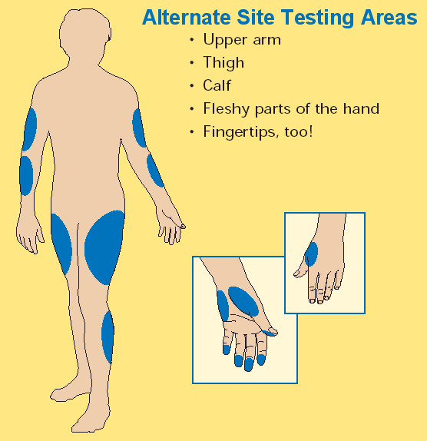

Slide 51
During times when the blood glucose concentration is either rising rapidly (such as immediately after food ingestion) or falling rapidly (in response to rapidly acting insulin or exercise), blood glucose results from alternate sites may give significantly delayed results compared with fingerstick readings

Slide 52
Drugs may interfere with both GOX and GDH glucose measurement methods, including but not limited to ascorbic acid and acetaminophen.
The presence of high doses of ascorbic acid has the potential to read falsely low in GOX- and GDH-based devices.( may consume peroxide and diminish its reaction with the dye, thus resulting in lower readings)
Acetaminophen, in therapeutic concentrations, results in lower and higher glucose measurements with the GOX and GDH POCGMD techniques, respectively.
Diabetes Sci Technol Vol 6, Issue 2, March 2012

Slide 53
This may be particularly problematic in overdose patients,in whom hypoglycemia may develop in the presence of hepatic failure. Other reports had similar findings, and there may be a reduction in glucose measurements in patients given only1.5–2 g acetaminophen
ABETES CARE, VOLUME 30, NUMBER 2, FEBRUARY 2007

Slide 54
Newer amperometric POC devices have attempted to compensate for this by introducing a third electrode that reduces background current.
ABETES CARE, VOLUME 30, NUMBER 2, FEBRUARY 2007

Slide 55
Dopamine increased glucose values on GDH-based POC systems, primarily at high drug concentrations
Mannitol increased glucose oxidase– based POC readings, possibly through detection by the analyzer or by a nonspecific osmotic effect
Finally, interferences with salicylates nitroprusside have been described in past literature but not more recently
ABETES CARE, VOLUME 30, NUMBER 2, FEBRUARY 2007

Slide 56
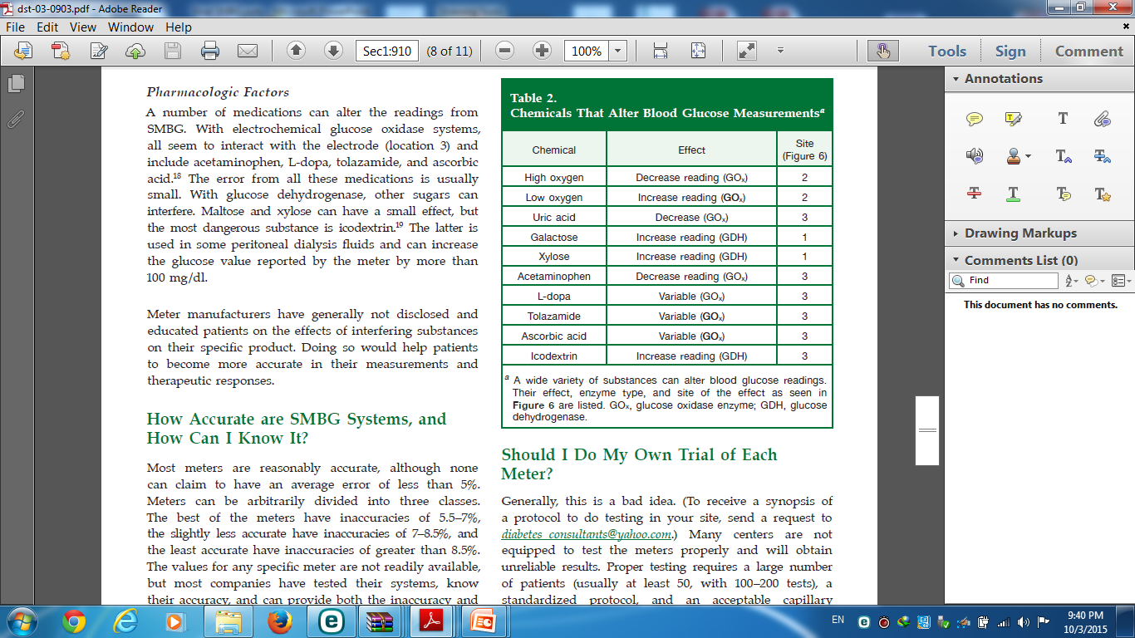

Slide 57
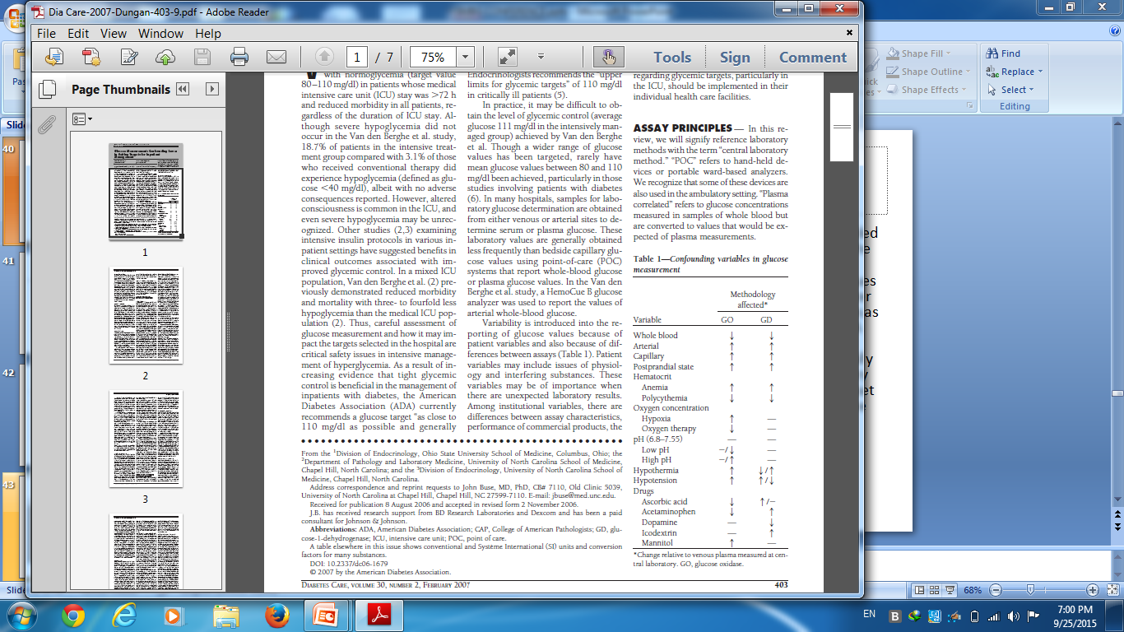
ABETES CARE, VOLUME 30, NUMBER 2, FEBRUARY 2007

Slide 58
AGENDA
Introduction
SMBG TECHNIQUE( basic principles )
History(brief)
the accuracy and limitations of current point-of-care glucose monitoring devices (POCGMDs).
The present status of glucose biosensors in the clinical practice
SMBG in type 2 diabetes (SYSTEMATIC REVIEW)
Recommendation
and Guideline
Conclusion

Slide 59
Most meters are reasonably accurate, although none can claim to have an average error of less than 5%.
Meters can be arbitrarily divided into three classes. The best of the meters have inaccuracies of 5.5–7%, the slightly less accurate have inaccuracies of 7–8.5%, and the least accurate have inaccuracies of greater than 8.5%.
The values for any specific meter are not readily available, but most companies have tested their systems, know their accuracy, and can provide both the inaccuracy and the ISO numbers as described earlier.

Slide 60
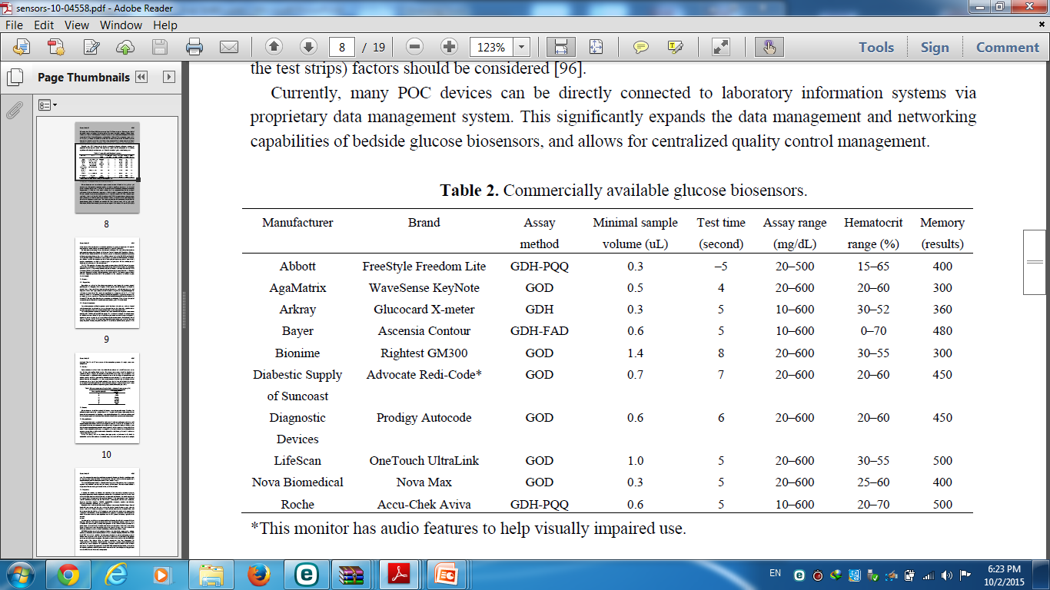
Notes:
Historical Perspectives of Glucose Biosensors
Although a variety of glucose sensors are available, the glucose biosensor has changed little in
principle over several years (Table 1). However, the first blood glucose meter was not a biosensor. It
was the Ames Reflectance Meter (ARM) (Miles Laboratories, Elkhart, IN, USA) based on a
reflectometer and the Dextrostix introduced in 1971. Dextrostix, the first blood glucose strip, had been
available since 1965, and was originally designed to show color changes [43-46]; the blood sample was
gently washed off after one minute, before inserting the strip into the meter. Although the ARM was
expensive and cumbersome to use, it replaced the Ames Eyetone glucose analyzer. Early versions of
glucose-sensing devices were based on the reflectometer.

Slide 61
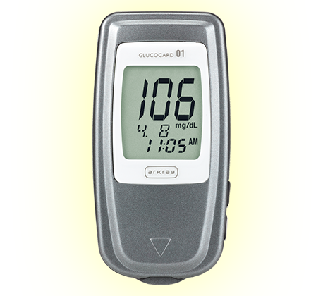
GLUCOCARD 01
GOX

Slide 62
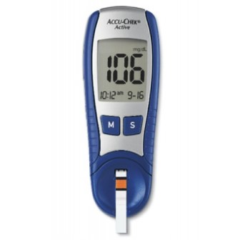
ACCUA CHECK
GDH

Slide 63
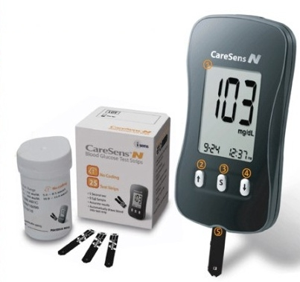
CARESENSE
Biosensor –
Non Enzymatic

Slide 64
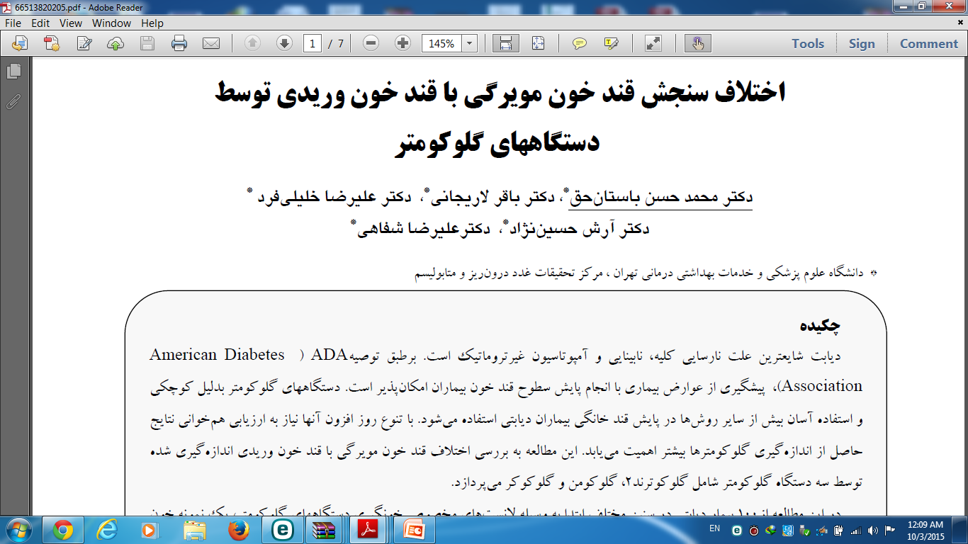

اين مطالعه به بررسي اختلاف قند خون مو يرگي با قند خون وريدي اندازه گيري شده توسط سه دستگاه گلوكومتر شامل گلوكوترند 2، گلوكومن و گلوكوكر در 100 بیمار دیابتی مي پردازد
دانشگاه علوم پزشكي و خدمات بهداشتي درماني تهران ، مركز تحقيقات غدد درون ريز و متابوليسم 1382

Slide 65
AGENDA
Introduction
History(brief)
SMBG Technique ( basic principles )
the accuracy and limitations of current point-of-care glucose monitoring devices (POCGMDs).
the present status of glucose biosensors in the clinical practice
SMBG in type 2 diabetes (SYSTEMATIC REVIEW)
Recommendation and Guideline
Conclusion

Slide 66
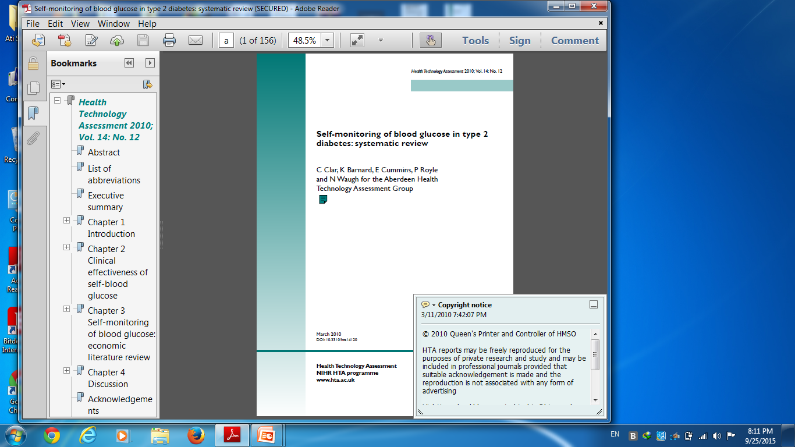
Health Technology Assessment 2010; Vol. 14: No. 12

Slide 67
Main question
Is self-monitoring of blood glucose worthwhile in people with type 2 diabetes not treated with insulin, or on only basal insulin in combination with oral agents, in terms of glycemic control, hypoglycaemia, quality of life and other relevant outcomes?
Health Technology Assessment 2010; Vol. 14: No. 12

Slide 68
Methods
Review of systematic reviews published since 1996, and a systematic review and meta-analyses of randomized controlled trials (RCTs) identified from the reviews, and from searches for more recent trials
Health Technology Assessment 2010; Vol. 14: No. 12

Slide 69
Results
Eleven systematic reviews published in the last 10 years, most in the last few years
Most were of good quality
They contained from three to 13 RCTs out of a total of 20
Inconsistent results were observed
Health Technology Assessment 2010; Vol. 14: No. 12

Slide 70
What was the reason for disagreement?
What was the level of HbA1c which was considered to prove benefit? since the differences in meta-analysis were often of the order of 0.2%, which can be statistically significant, but not clinically important.
Studies in which patients were given feedback in response to SMBG values and /or in which SMBG results were used to modify therapeutic regimens were more effective than those without feedback or use of SMBG for therapy modification
Effects also tended to be larger for patients with higher baseline HbA1c values
Health Technology Assessment 2010; Vol. 14: No. 12

Slide 71
Results
Twenty six RCTs, ranging in size from under 30 to over 800 patients, and in duration from 12 weeks to 30 months
Only four trials scored highly on quality assessment
Components of the SMBG interventions were not well described in many cases

Slide 72
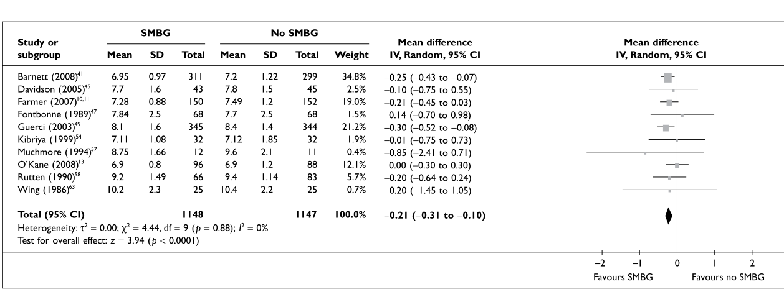
Self-monitoring of blood glucose (SMBG) versus no SMBG – HbA1c
Ten trials compared “simple” SMBG with no SMBG, and found a reduction in HbA1c of 0.21%, which was statistically significant but of doubtful clinical significance.

Slide 73
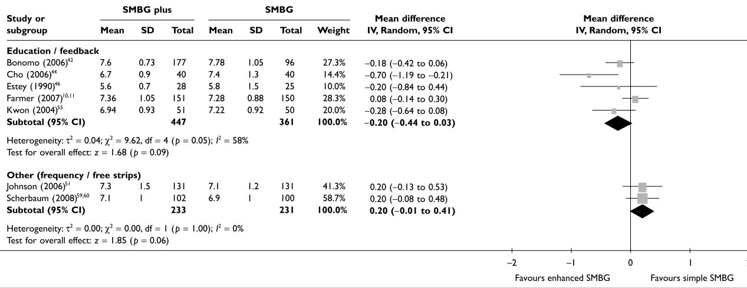
Enhanced/more frequent SMBG versus only/less frequent SMBG – HbA1c
.
Four trials of “enhanced” SMBG (for example, with education, feedback, etc) showed a bigger reduction in HbA1c, of 0.52% compared to no SMBG.

Slide 74
Results
Differences in the frequency of hypoglycemic episodes were inconsistent
There was no difference in weight or body mass index (BMI)
There was no increase in medication changes with SMBG versus no SMBG, which may explain why HbA1c is not improved
Two studies ( DiGEM , ESMON) reported a net adverse effect on anxiety and/or depression

Slide 75
Conclusions
SMBG is of limited clinical effectiveness in improving glycemic control in people with type 2 diabetes or oral agents, or diet alone, and is therefore unlikely to be cost-effective

Slide 76
Conclusions…..
SMBG can only be expected to lead to improved glyaemic control in the context of appropriate education – both for patients and health care professionals – on how to respond to the readings, in terms of lifestyle and treatment adjustment
It may be more effective if patients are able to self-adjust drug treatment

Slide 77
Conclusions…
Further research is required on the type of education and feedback that are most helpful
Characteristics of patients benefiting most from SMBG
Optimal timing and frequency of SMBG,
Circumstances under which SMBG causes anxiety and/or depression.

Slide 78
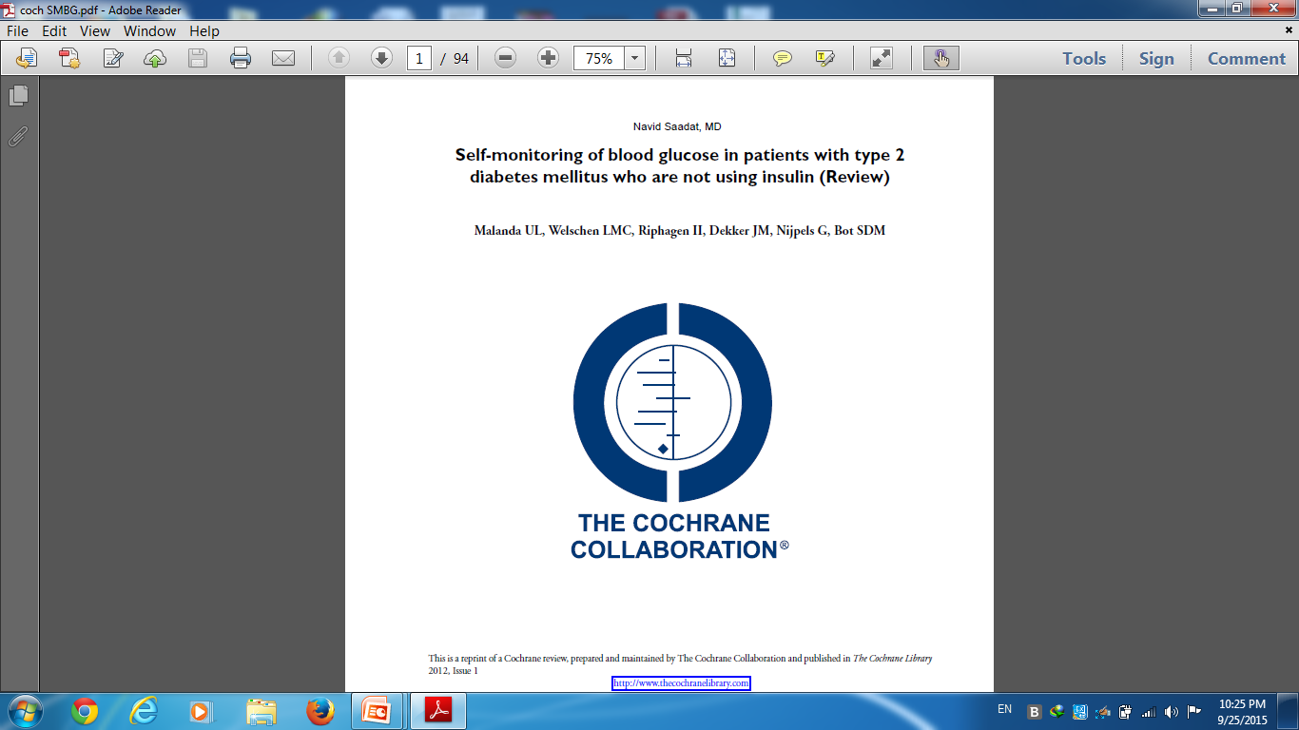
2012 The Cochrane Collaboration. Published by JohnWiley & Sons

Slide 79
Background
Self-monitoring of blood glucose (SMBG) has been found to be effective for patients with type 1 diabetes and for patients with type 2 diabetes using insulin.
There is much debate on the effectiveness of SMBG as a tool in the self-management for patients with type 2 diabetes who are not using insulin.
Self-monitoring of blood glucose in patients with type 2 diabetes mellitus who are not using insulin (Review) 2012 The Cochrane Collaboration.

Slide 80
Objectives
To assess the effects of SMBG in patients with type 2 diabetes mellitus who are not using insulin.
Selection criteria
Randomised controlled trials investigating the effects of SMBG compared with usual care, self-monitoring of urine glucose (SMUG) or both in patients with type 2 diabetes who where not using insulin.
Studies that used HbA1c as primary outcome were eligible for inclusion.
Self-monitoring of blood glucose in patients with type 2 diabetes mellitus who are not using insulin (Review) 2012 The Cochrane Collaboration.

Slide 81
Primary outcomes were HbA1c, health related quality of life, well-being and patient satisfaction.
Secondary outcomes were fasting plasma glucose level, hypoglycaemic episodes, morbidity, adverse effects and costs.
Self-monitoring of blood glucose in patients with type 2 diabetes mellitus who are not using insulin (Review) 2012 The Cochrane Collaboration.

Slide 82
Co-variates thought to be effect modifiers
• baseline glycaemic control
• change in hypoglycaemic medications
• duration of diabetes at baseline
• age
• compliance to the intervention.
Timing of outcome assessment
• short-term: up to six months of follow-up;
• medium-term: between six and twelve months of follow-up;
• long-term: twelve months or more after start of follow-up.
Self-monitoring of blood glucose in patients with type 2 diabetes mellitus who are not using insulin (Review) 2012 The Cochrane Collaboration.

Slide 83
Main results
Twelve randomised controlled trials were included and evaluated outcomes in 3259 randomised patients.
Intervention duration ranged from 6 months (26 weeks) to 12 months (52 weeks).
Self-monitoring of blood glucose in patients with type 2 diabetes mellitus who are not using insulin (Review) 2012 The Cochrane Collaboration.

Slide 84
Nine trials compared SMBG with usual care without monitoring, one study compared SMBG with SMUG, one study was a three-armed trial comparing SMBG and SMUG with usual care and one study was a three-armed trial comparing less intensive SMBG and more intensive SMBG with a control group
Seven out of 11 studies had a low risk of bias for most indicators.

Slide 85
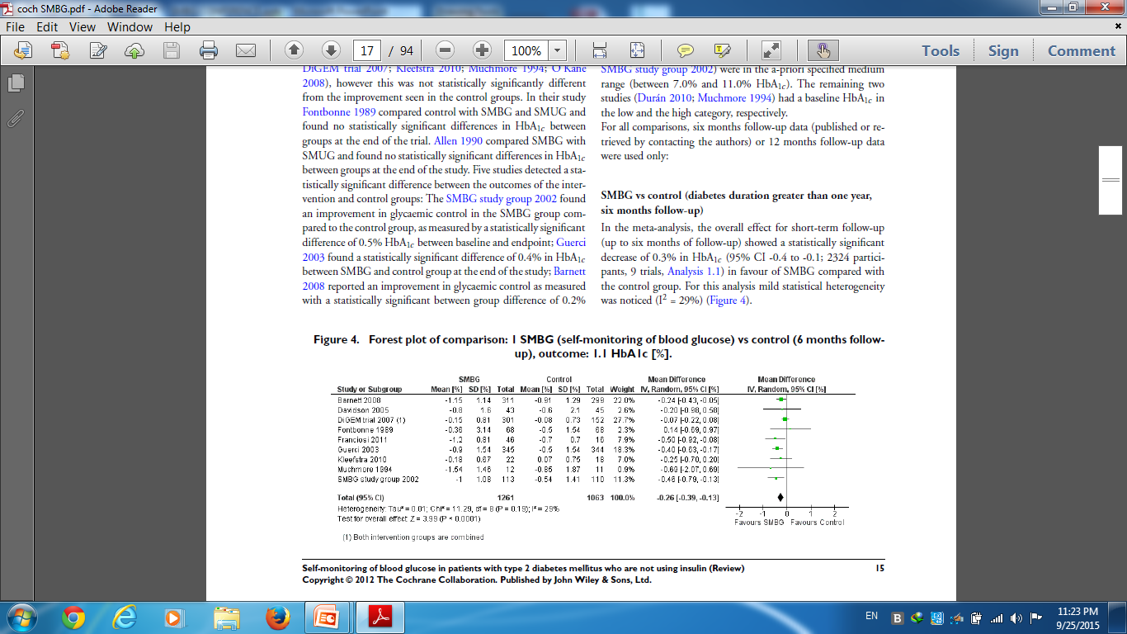
SMBG vs control (diabetes duration greater than one year, six months follow-up)
In the meta-analysis, the overall effect for short-term follow-up (up to six months of follow-up) showed a statistically significant decrease of 0.3% in HbA1c (95% CI -0.4 to -0.1; 2324 participants in favour of SMBG compared with
the control group. For this analysis mild statistical heterogeneity was noticed (I2 = 29%)
Self-monitoring of blood glucose in patients with type 2 diabetes mellitus who are not using insulin (Review) 2012 The Cochrane Collaboration.

Slide 86
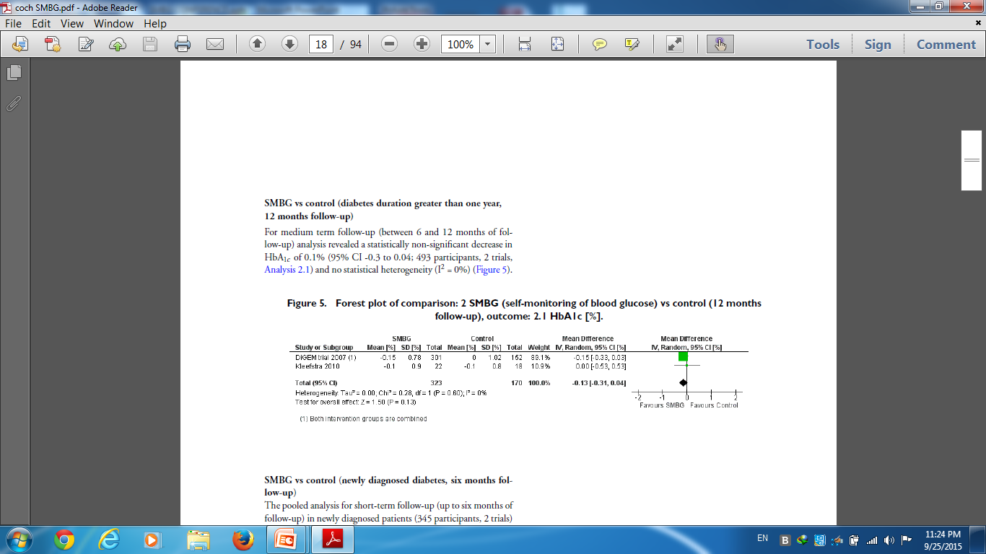
SMBG vs control (diabetes duration greater than one year,
12 months follow-up)
For medium term follow-up (between 6 and 12 months of follow-
up) analysis revealed a statistically non-significant decrease in HbA1c of 0.1% (95% CI -0.3 to 0.04; 493 participants, and no statistical heterogeneity (I2 = 0%)
Self-monitoring of blood glucose in patients with type 2 diabetes mellitus who are not using insulin (Review) 2012 The Cochrane Collaboration.

Slide 87
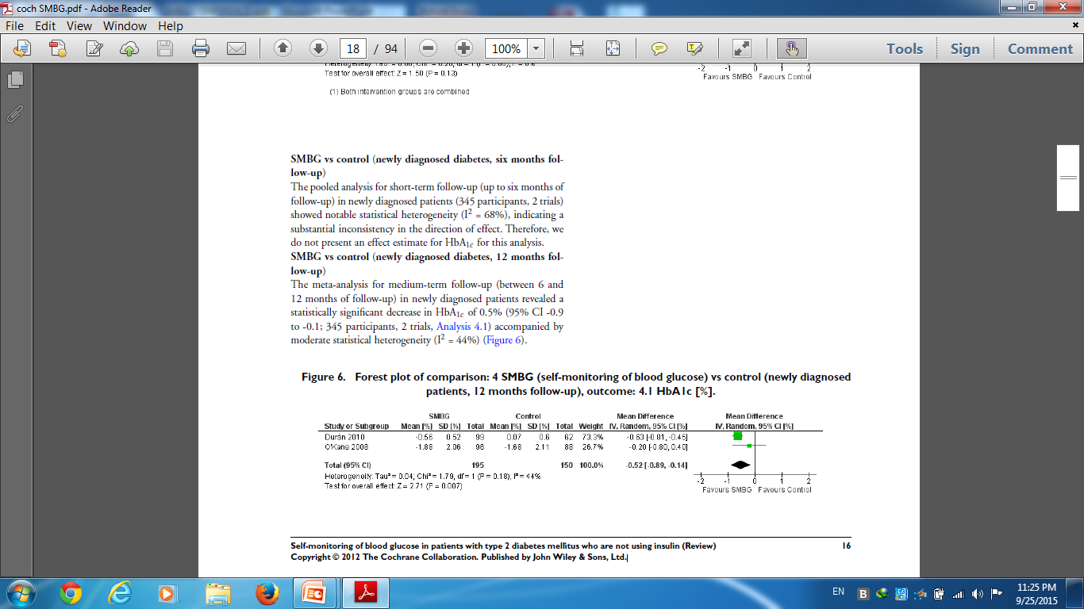
Forest plot of comparison: 4 MBG (self-monitoring of blood glucose) vs control (newly diagnose patients, 12 months follow-up), outcome: HbA1c [%]
The meta-analysis for medium-term follow-up (between 6 and
12 months of follow-up) in newly diagnosed patients revealed a
statistically significant decrease in HbA1c of 0.5% (95% CI -0.9 to -0.1; 345 participants, accompanied by moderate statistical heterogeneity (I2 = 44%)

Slide 88
Qualitative analysis of the effect of SMBG on well-being and quality of life showed no effect on patient satisfaction, general well-being or general health-related quality of life. Two trials reported costs of self-monitoring
There were few data on the effects on other outcomes and these effects were not statistically significant.
None of the studies reported data on morbidity.

Slide 89
conclusion
Implications for practice
Self-monitoring of blood glucose (SMBG) in newly diagnosed type 2 diabetes patients who are not using insulin is beneficial in lowering HbA1c.
However, when diabetes duration is over one year, the overall glycaemic effects of SMBG are small at short-term and subside after one year.
Despite possible glycaemic benefits we conclude that SMBG has no relevant effect on general well-being and health related quality of life.
In addition, patients performing SMBG are equally satisfied with their treatment as those not using SMBG.

Slide 90
Authors’ conclusions
when diabetes duration is over one year, the overall effect of self-monitoring of blood glucose on glycaemic control in patients with type 2 diabetes who are not using insulin is small up to six months after initiation and subsides after 12 months.
research is needed to explore the psychological impact of SMBG and its impact on diabetes specific quality of life and well-being, as well as the impact of SMBG on hypoglycaemia and diabetic complications.

Slide 91
AGENDA
Introduction
SMBG TECHNIQUE( basic principles )
History(brief)
the accuracy and limitations of current point-of-care glucose monitoring devices (POCGMDs).
the present status of glucose biosensors in the clinical practice
SMBG in type 2 diabetes (SYSTEMATIC REVIEW)
Recommendation and Guideline
Conclusion

Slide 92
ADA 2015
Recommendations
When prescribed as part of a broader educational context, SMBG results may help guide treatment decisions and/or self-management for patients using less frequent insulin injections B or noninsulin therapies. E
When prescribing SMBG, ensure that patients receive ongoing instruction and regular evaluation of SMBG technique, SMBG results, and their ability to use SMBG data to adjust therapy. E

Slide 93
ADA 2015
Patients on multiple-dose insulin or insulin pump therapy should perform SMBG prior to meals and snacks, occasionally postprandially, at bedtime, prior t exercise,( For many patients, this will require testing 6–10 (or more) times daily, although individual needs may vary)
When they suspect low blood glucose, after treating low blood glucose until they are normoglycemic, and prior to critical tasks such as driving. B

Slide 94
ADA 2015
When used properly, CGM in conjunction with intensive insulin regimens is a useful tool to lower A1C in selected adults (aged ˂25 years) with type 1 diabetes. A
Although the evidence for A1C lowering is less strong in children, teens, and younger adults, CGM may be helpful in these groups. Success correlates with adherence to ongoing use of the device. B
CGM may be a supplemental tool to SMBG in those with hypoglycemia unawareness and/or frequent hypoglycemic episodes. C
Given variable adherence to CGM, assess individual readiness for continuing use of CGM prior to prescribing. E
When prescribing CGM, robust diabetes education, training, and support are required for optimal CGM implementation and ongoing use. E

Slide 95
AACE/ACE Consensus Statement
people with type 2 diabetes who are treated with medications that can cause hypoglycemia (e.g., basal insulin and sulfonylurea), especially the elderly, are more prone to hypoglycemia and should have more frequent monitoring. Although there is a lack of robust data, the consensus of expert opinion suggested GM from 3 to 5 times per day in this population
AACE/ACE Consensus: Glucose Monitoring, Endocr Pract. 2015;

Slide 96
Because controlled trials in people with type 2 diabetes Patients managed with lifestyle modification or medications with low risk of hypoglycemia are lacking, participant expert opinion suggested that such patients should monitor glucose as clinically indicated, from 1 to 4 times per day.
Experts suggested that pregnant, insulin-treated patients should monitor their glucose at least 8 times daily, while those managed with lifestyle modifications or low-hypoglycemia risk medications need less frequent monitoring, perhaps 4 to 6 times per day. Large, randomized trials areneeded to validate these expert clinical opinions.
AACE/ACE Consensus: Glucose Monitoring, Endocr Pract. 2015;

Slide 97
CGM usage has improved clinical diabetes outcomes by reducing hypoglycemia
CGM is recommended in all patients with type 1 diabetes and should be available all type 2 diabetes on multiple insulin injections, basal insulin, or sulfonylureas. CGM should also be used in all patients who are at risk for hypoglycemia and/or have hypoglycemia unawareness
While studies using CGM in type 2 diabetes are limited, experts in clinical practice realize that it can be useful in identifying and correcting postprandial glycemic excursions .
AACE/ACE Consensus: Glucose Monitoring, Endocr Pract. 2015;

Slide 98
It was the participant expert opinion that intermittent use of CGM (usually 1-2 weeks) in patients with type 2 diabetes might be more effective than daily glucose fasting glucose in guiding the need for medication adjustment or advancing to new medications.
AACE/ACE Consensus: Glucose Monitoring, Endocr Pract. 2015;

Slide 99
AGENDA
Introduction
SMBG TECHNIQUE( basic principles )
History(brief)
the accuracy and limitations of current point-of-care glucose monitoring devices (POCGMDs).
the present status of glucose biosensors in the clinical practice
SMBG in type 2 diabetes (SYSTEMATIC REVIEW)
Recommendation and Guideline
Conclusion

Slide 100
Conclusions
SMBG is of limited clinical effectiveness in improving glycemic control in people with type 2 diabetes or oral agents, or diet alone, and is therefore unlikely to be cost-effective

Slide 101
Conclusions…..
SMBG can only be expected to lead to improved glyaemic control in the context of appropriate education – both for patients and health care professionals – on how to respond to the readings, in terms of lifestyle and treatment adjustment

Slide 102
Conclusions…
Further research is required on the type of education and feedback that are most helpful
Characteristics of patients benefiting most from SMBG
Optimal timing and frequency of SMBG,
Circumstances under which SMBG causes anxiety and/or depression.

Slide 103

THANK YOU

