Slide 1
Case presentation
In the name of God
Prepared by : Dr Atoosa Larijani

Slide 2
Patient history
A 18-year-old woman
Born & live in Tehran
Source of History : Patient & Mother, reliable
Chief complaint : delayed Puberty
Student

Slide 3
Present Illness
A 17-year-old woman
Breast budding at the age of 15
Axillary and pubic hair growth at the age of 16
In 1397, due to delay Puberty they are going to Shahid Fahmideh Hospital
According to the patient's mother probably Growth hormone injections may be started for the patient after the necessary tests

Slide 4
Lab Test 1397
IGF1 :242 | LH: 19.4 mIU/ml
DHEAS : 116 | FSH: 56 mIU/m
Cortisol 8AM : 7.6 | Estradiol: <10 pg/ml
ACTH : 12.7 pg/ml | TSH : 1.2
HCG: 1.4 | T4 : 8.1
17OHP : 0.9 ng/ml | ANTI TPO : <1

Slide 5
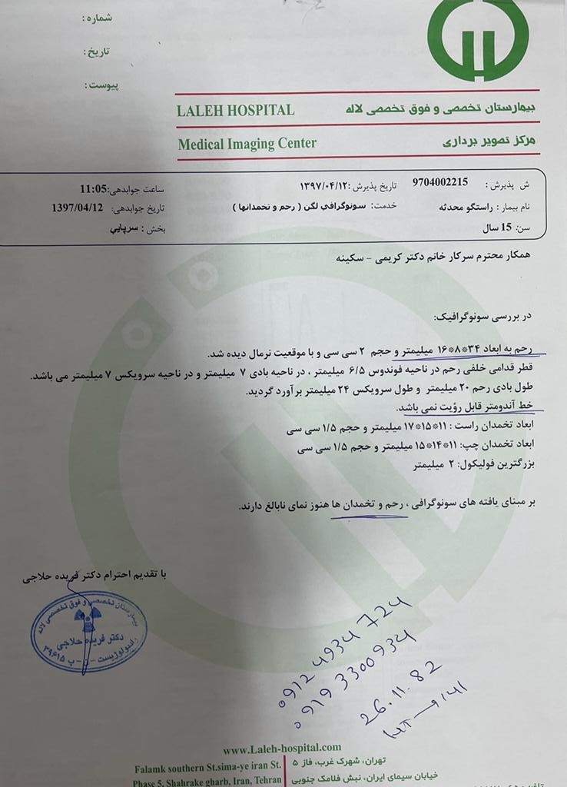
1397
Sonography

Slide 6
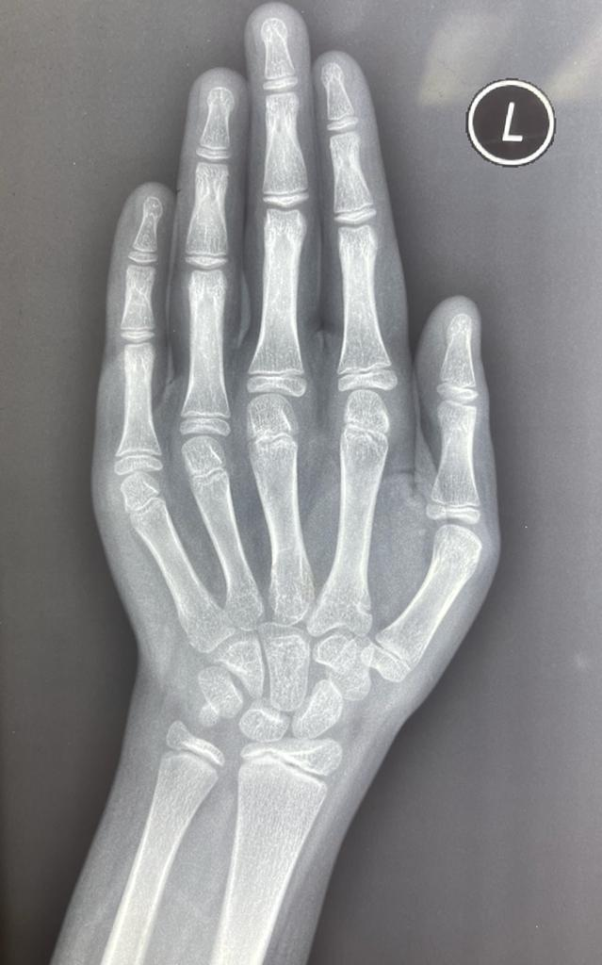
1397
Bone age: 11 years
14 years

Slide 7
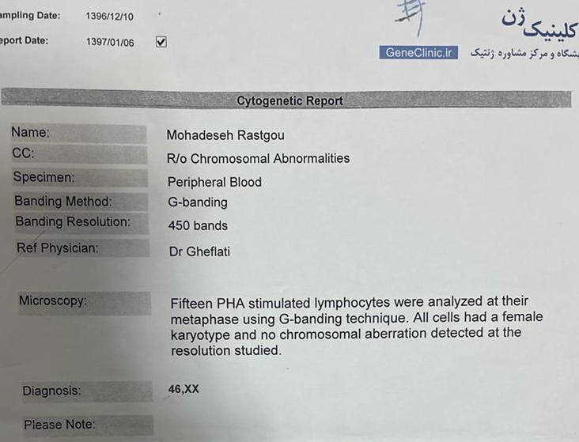
1397
Karyotype

Slide 8
Present Illness
10 ampoules of growth hormone are given to the patient for a month
It is recommended that treatment should be continued for 2 years
but the patient's mother does not continue the treatment because she thought it would improve spontaneously

Slide 9
Present Illness
Headache (Neg)
Nausea (Neg)
Changes in vision (Neg)
Anosmia (Neg)
Hearing problem (Neg)
Abdominal pain (Neg)
Constipation (Neg)
Diarrhea (Neg)
Changes in weight (Neg)
Hair loss (Neg)

Slide 10
Past history
Birth weight : 2500 g
No history of genital ambiguity after birth
The mother did not have any problems during pregnancy such as hirsutism and hoarseness
No history of radiotherapy or chemotherapy
No history of infection

Slide 11
Family history
The patient's parents were cousin
Her mother’s onset of puberty was at the age of 10
Her mother’s cousin onset of menstruation at the age of 16
She has a healthy 21-year-old brother

Slide 12
Physical examination
A 17-year-old woman
BP: 110/70 PR: 85
BMI: 29.2 Height :149.5 Weight : 65 kg
Arm span : 126cm Upper segment: 79cm Lower segment : 72cm
Genitalia : normal infantile female pattern without ambiguity
Tanner staging B3P3
Webbed neck , Cubitus valgus ,Widely spaced nipples ,Scoliosis , low hairline (Neg)
Acne, male pattern baldness, hirsutism, clitoral enlargement, voice deepening (Neg)
Abdominal exam : NL
Striae, moon face, buffalo hump, central obesity (Neg)

Slide 13
Lab test (1400)
LH: 15.3 IU/L | TSH: 2.09 uIU/ml | FBS: 84
FSH: 40.9 IU/L | T4: 8.42 Mg/dl | HbA1C: 5.2
Estradiol: < 5 pg/ml | DHEAS: 125.6 Mg/dl | TG : 108 mg/dl
Progesterone : 0.101ng/ml | Testosteron free 1.28ng/dl | LDL : 100 mg/dl
Cortisol: 14.3 Mg/dl | Prolactin: 8.7 ng/ml | HDL: 36 mg/dl
ACTH: 20.7 pg/ml | Ca : 9.6 mg/dl | Chol: 146
GH: 0.08 ng/ml | Na : 142 | AST: 37
IGF1: 218.6 ng/ml | K: 4 | ALT: 43
Aldosteron: 13 ng/dl | Cr: 0.7 mg/dl | P: 4.4 mg/dl

Slide 14
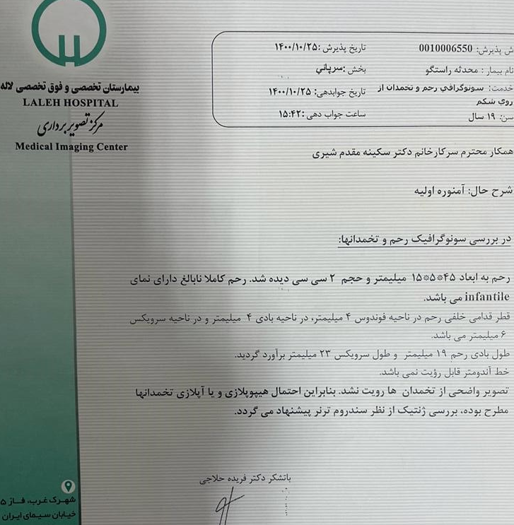
1400
Sonography

Slide 15
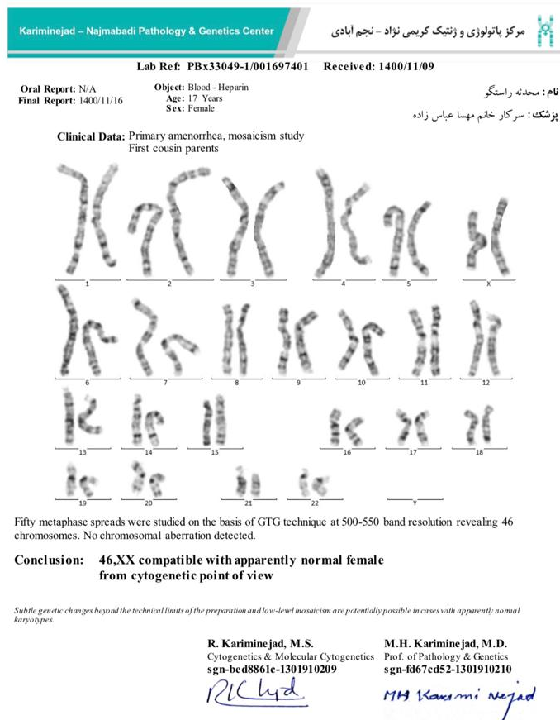
1400
Karyotype

Slide 16
Problems List
A 17-year-old woman
Tanner staging B3P3
High FSH, LH and low estradiol
Infantile ovaries and uterus
Female karyotype (XX)

Slide 17
AGENDA
What is approach to delayed puberty?
What are the differential diagnosis?
What is the diagnosis?
What mutations can cause the disease?
How is fertility in these patients?
How much is malignany risk?
What is treatment?

Slide 18
Williams text book

Slide 19
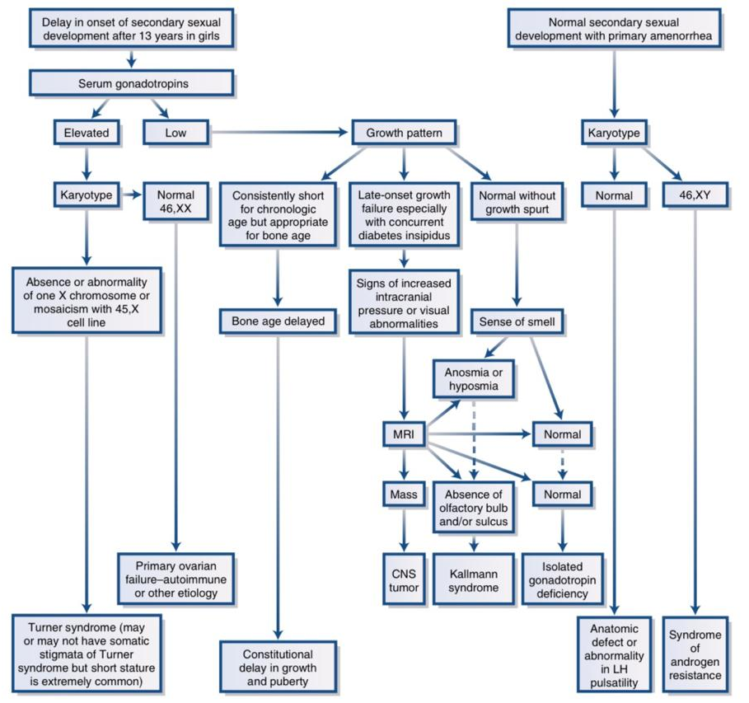
Willimas text book

Slide 20
Evaluation of delayed puberty: what diagnostic tests should be performed in the seemingly otherwise well adolescent?
2016 Aug;101(8):767-71

Slide 21
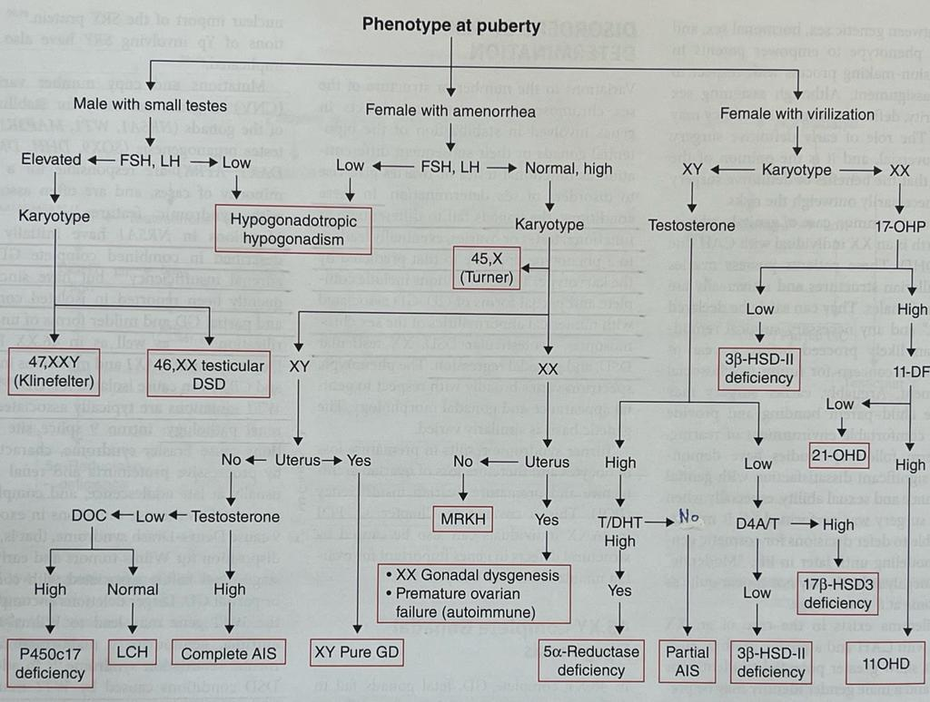

Slide 22
Common causes of delayed puberty
Williams text book

Slide 23
AGENDA
What is approach to delayed puberty?
What are the differential diagnosis?
What is the diagnosis?
What mutations can cause the disease?
How is fertility in these patients?
How much is malignany risk?
What is treatment?

Slide 24
Differential Diagnosis
Pure gonadal dysgenesis
Polyglandular autoimmune syndrome (PGA)
FSHR mutations : Ovarian estrogen production may be blocked by gonadotropin resistance. In contrast, ovaries in girls with FSHR mutations are small and follicular development is halted to primary stage due to the block in FSH action
Mutations in steroidogenic enzymes (e.g. CYP17A1, CYP19A1):
17-hydroxylase deficiency (mutation in CYP17A1) may present as an adolescent girl with lack of pubertal development, low-renin hypertension and hypokalemia . Adrenal crisis is prevented by high corticosterone levels that substitute cortisol.
Aromatase deficiency (CYP19A1 mutation) in a girl is usually detected already at birth due to virilization, which worsens at puberty and no breast development is observed . Ovarian cysts may be present in both conditions due to high gonadotropin stimulation.

Slide 25
AGENDA
What is approach to delayed puberty?
What are the differential diagnosis?
What is the diagnosis?
What mutations can cause the disease?
How is fertility in these patients?
How much is malignany risk?
What is treatment?

Slide 26
Diagnosis
Pure gonadal dysgenesis

Slide 27
Pure gonadal dysgenesis :
Phenotypic females 46 XX without choromosomal abnormalities.
Normal stature
Sexual infantilism
Bilateral streak gonad (occasionally produces estrogens or androgens)
Normal female internal and external genitalia
Primary amenorrhea.
Absent or incomplete pubertal development
Low in estrogen levels and has high levels of FSH and LH (hypergonadotropic hypogonadism)
Without the somatic stigmata characteristic of Turner syndrome
Williams text book

Slide 28
46,XX DSD presenting as pubertal delay or primary amenorrhea
Can occurs sporadically or with autosomal recessive
ovarian insufficiency may be caused by mutations in genes involved in gonadal development (ovarian dysgenesis) or ovarian estrogen production.
The clinical presentation of ovarian dysgenesis is absent or incomplete pubertal development with normal female reproductive organs except for streak ovaries.
Incomplete forms of this condition : hypoplastic ovaries that produce enough estrogen to cause some breast development and few menstrual periods (secondary amenorrhea)

Slide 29
Perrault syndrome :
autosomal recessive condition caused by compound heterozygous mutation in the 17-β-hydroxysteroid dehydrogenase IV (HSD17B4, 5q23)
Sensorineural deafness in both males and females
Ovarian dysgenesis in females.
Some patients also have neurologic manifestations,(including mild mental retardation and cerebellar and peripheral nervous system involvement)
The blepharophimosis-ptosis-epicanthus inversus syndrome:
caused by a heterozygous mutation in the forkhead transcription factor gene FOXL2
Pediatric Endocrinology and Inborn Errors of Metabolism. 2017

Slide 30
Uptodate 2021

Slide 31
Uptodate 2021

Slide 32
AGENDA
What is approach to delayed puberty?
What are the differential diagnosis?
What is the diagnosis?
What mutations can cause the disease?
How is fertility in these patients?
How much is malignany risk?
What is treatment?

Slide 33
Perrault syndrome
In 1951, Perrault reported the association of gonadal dysgenesis and sensorineural deafness, now called Perrault syndrome
Currently, mutations in 6 different genes :
LARS2 , HSD17B4, HARS2 , TWNK, ERAL1, CLPP

Slide 34
familial ovarian dysgenesis : isolated 46,XX GD is inherited as an autosomal recessive condition.
SOH1H1 : that homozygous-truncating mutations in SOHLH1 cause female nonsyndromic hypergonadotropic hypogonadism.
Translocations involving the critical region Xq13.3-q26
Mutation in BMP15 :
The lack of these active proteins is believed to have connections to decreased follicle production as well as depletion of ovarian follicles altogether
Mutations in gene for the NR5A1 Receptor:
this gene are the only monogenic mutation associated with spermatogenic and ovarian failure in 46 XY and 46 XX gonadal dysgenesis.
Homozygous mutations of the PSMC3IP392 or MCM9
The molecular basis for 46,XX GD remains unknown for the majority of patients.
Pediatric Endocrinology and Inborn Errors of Metabolism. 2017
Homozygous loss-of-function mutations in SOHLH1 in patients with nonsyndromic hypergonadotropic hypogonadismEpub 2015 Mar 16.

Slide 35
AGENDA
What is approach to delayed puberty?
What are the differential diagnosis?
What is the diagnosis?
What mutations can cause the disease?
How is fertility in these patients?
How much is malignany risk?
What is treatment?

Slide 36
which is a consequence of the primary ovarian insufficiency
in them, has been shown to be treatable through IVF with
donor oocytes

Slide 37
Pure gonadal dysgenesis and spontaneous pregnancy: A case report 2009 in Turkey
A 19-year-old a case of pure gonadal dysgenesis with streak gonads in which spontaneous conception occurred 10 years after the diagnosis.
Her pregnancy proceeded as normal, and she gave birth to a live baby at term by cesarean section.
A lactation period lasting for 1 year and afterwards proceeded as amenorrheic.
Gonadotropins measurements in post-lactational period were at the menopausal levels again.
this is the first case of pure gonadal dysgenesis with streak gonads in which spontaneous conception occurred.

Slide 39
AGENDA
What is approach to delayed puberty?
What are the differential diagnosis?
What is the diagnosis?
What mutations can cause the disease?
How is fertility in these patients?
How much is malignany risk?
What is treatment?

Slide 40
Dysgerminoma and gonadoblastoma constitute the most prevalent tumors in patients with dysgenetic gonads. Majority of these are associated with Y chromosome or mosaicism for Y chromosome.
46XX gonadal dysgenesis, with dysgerminoma in one ovary and other streak ovary with hilar nests of leydig cells.
It is exceptionally rare to find dysgerminoma in a dysgenetic gonad with no Y chromosome and so is the presence of leydig cells in the contralateral streak ovary in a patient with 46XX pure gonadal dysgenesis.

Slide 41
46XX pure gonadal dysgenesis with dysgerminoma along with leydig cells: a unique presentation 22 April 2020
A 23-year-old woman, married for 1 year, presented to us with continuous dull aching pain in lower abdomen since 10 days
As this case patient didn’t show turner’s phenotype and had 46XX karyotype, she was diagnosed as 46XX pure gonadal dysgenesis.

Slide 43
In contrast to the slow growing epithelial ovarian tumors, germ cell malignancies grow rapidly and commonly present with pelvic pain related to capsular distention, hemorrhage or necrosis.

Slide 44
AGENDA
What is approach to delayed puberty?
What are the differential diagnosis?
What is the diagnosis?
What mutations can cause the disease?
How is fertility in these patients?
How much is malignany risk?
What is treatment?

Slide 45
Initiating treatment between age 11 and 12 years of age
Dose increases approximately every 6 months until adult levels are reached.
In some situations, treatment may be delayed to permit more time for linear growth
When adult dosing is reached, progestins are also used to protect uterine health and allowing regular menstruation, or combined continuously when menstrual bleeding is not preferred.
Treatment is continued until the average age of menopause
Transdermal estrogens are considered the most physiologic replacement and theoretically might have fewer associated risks. (transdermal 17β-estradiol)
Review of Hormone Replacement Therapy in Girls and Adolescents with Hypogonadism P460-468, OCTOBER 01, 2019

Slide 46
Review of Hormone Replacement Therapy in Girls and Adolescents with Hypogonadism P460-468, OCTOBER 01, 2019

Slide 47
General Protocols for Hormone Replacement
Method—Start With: | Principle | Timing | Aim
Typically start out with 1/8–1/4 of adult dose: Conjugated estrogen equine, synthetic, or esterified – 0.3 mg orally daily or every other day; may promote rapid epiphyseal fusion Or ethinyl estradiol 2–5 μg orally daily Or 17β-estradiol 0.25 mg orally daily Or 17β-estradiol transdermal patch starting with half or one quarter of a 0.025-mg patch weekly or twice weekly depending on the preparation | Unopposed estrogen for a 2–2.5 years add progesterone if breakthrough bleeding occurs Start with a low dose and increase to adult doses Evaluate breast growth at least every 6 months | 12–14 years, depending whether patient achieved satisfactory height | Induction of breast growth skip this step if breast development has occurred to Tanner stage 4–5
28-d cycles with hormone intake for 21 of these days and hormone free for 7 d; estrogen for 21 d; on d 15–21 of taking the estrogen, add: Medroxyprogesterone 2.5–5 mg orally daily Or Norethindrone 0.5–1 mg orally daily Or Norethindrone 0.14–0.25 mg patch twice weekly with estradiol as combination patch Or Levonorgestrel 0.015 mg patch with estradiol as combination patch Alternatively, combined oral contraceptive pills may be used Note: Dose of conjugated estrogens can be increased to 1.25 mg daily when cyclical progesterone is added Ethinyl Estradiol is not available as a single formulation in US | Cyclical progesterone for 7–10 days in a cycle to prevent development of endometrial cancer | 2–2.5 years after starting unopposed estrogen therapy, sooner if breakthrough bleeding occurs | Hormone replacement to maintain sexual health and bone mass
Pediatric Endocrinology and Inborn Errors of Metabolism. 2017

Slide 48
Uptodate 2021

Slide 49
Thank you for your attention

