Slide 1
RECURRENCE IN CUSHING DISEASE
بسم الله الرحمن الرحيم
A.H. Ghanooni M.D
Fellow of endocrinology
February 2017

Slide 2
Agenda
Cushing disease and mortality
defining and rate of remission after surgery,
Rate of recurrent CD after surgery and dependant factors
challenges in diagnosing early recurrent hypercortisolemia.
evaluate a patient with CD recurrence as well as the risk benefit ratio of repeat surgery

Slide 3
Cushing disease and mortality
If untreated, the death rate may approach 50% at 5 years
standard mortality ratio (SMR) of 2.5 (95% confidence interval 1.4-4.2).
Mortality appears to remain higher in patients with CD even after initial biochemical remission
Hypopituitarism, including persistent adrenal insufficiency (AI) after surgery, has also been suggested to enhance the mortality risk.

Slide 5
from 1975 to 2014
Eight cohort studies
766 patients were included.

Slide 6
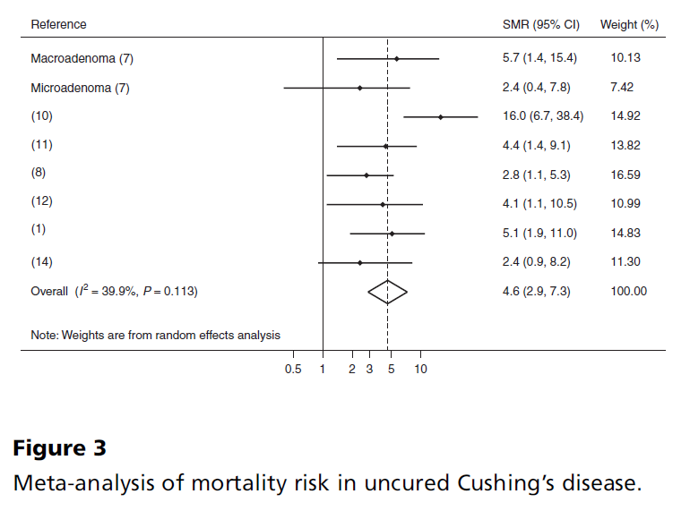

Slide 7
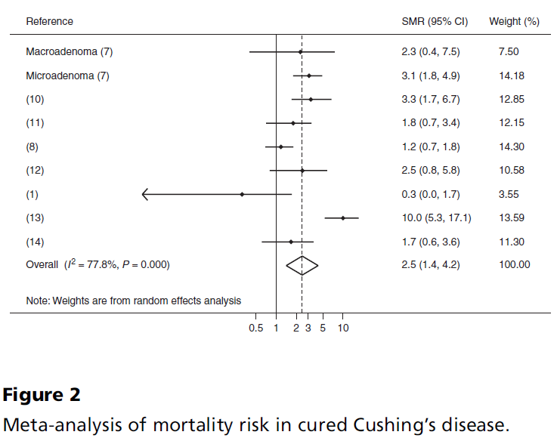

Slide 8
Key Messages
standard mortality ratio (SMR) of 2.5 (95% CI 1.4-4.2).
Mortality appears to remain higher in patients with CD even after initial biochemical remission.
Hypopituitarism, including persistent adrenal insufficiency (AI) after surgery, has also been suggested to enhance the mortality risk

Slide 9
Agenda
Cushing disease and mortality
defining and rate of remission after surgery
Rate of recurrent CD after surgery and dependant factors
challenges in diagnosing early recurrent hypercortisolemia.
evaluate a patient with CD recurrence as well as the risk benefit ratio of repeat surgery

Slide 10
ASSESSING REMISSION AFTER PITUITARY SURGERY IN CD
Criteria for disease remission vary significantly from study to study but include:
resolution of clinical symptoms related to hypercortisolism
need for corticosteroid replacement for >6 months after TSS
hypocortisolemia/eucortisolemia
the presence of clinical and laboratory signs of low serum cortisol and AI
Low serum cortisol in the immediate postoperative period and normal UFC and LNSC appear to have a higher sensitivity and specificity for determining remission compared to other biochemical markers .
Diagnosing Recurrent Cushing Disease, Endocr Pract. 2016;22(No. 12) 1437

Slide 12
44 studies with clear definitions of remission and recurrence.
6400 patients

Slide 13
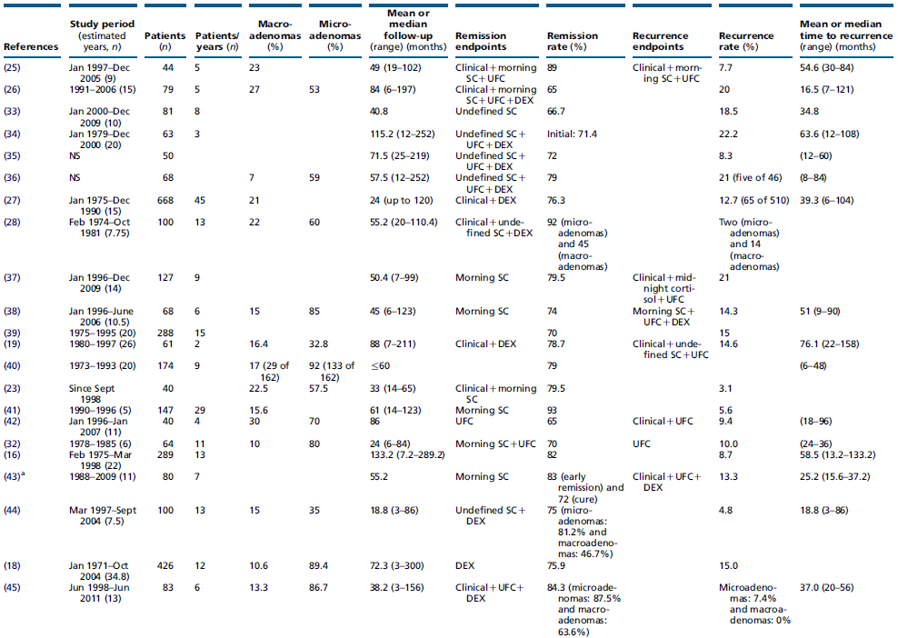

Slide 14
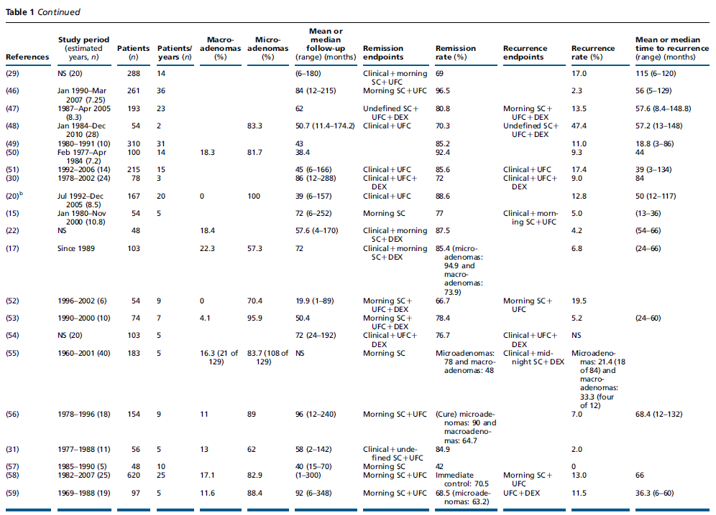

Slide 15
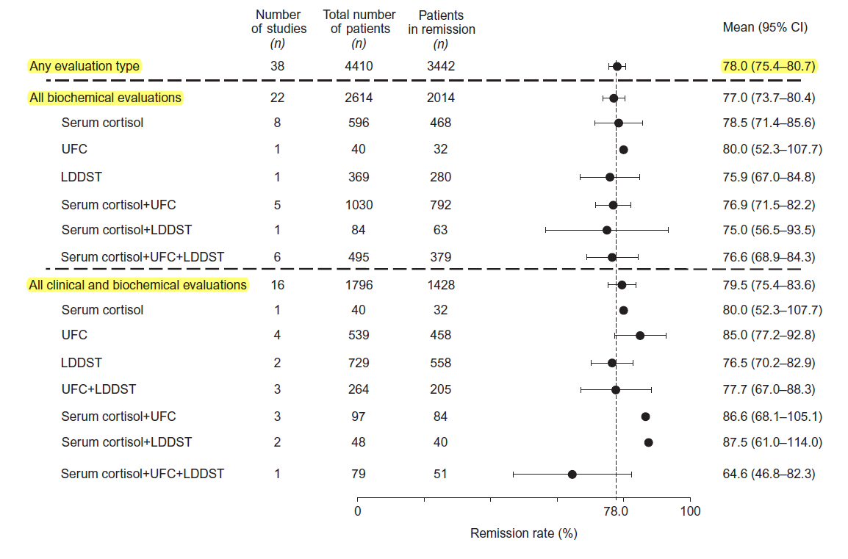

Slide 16
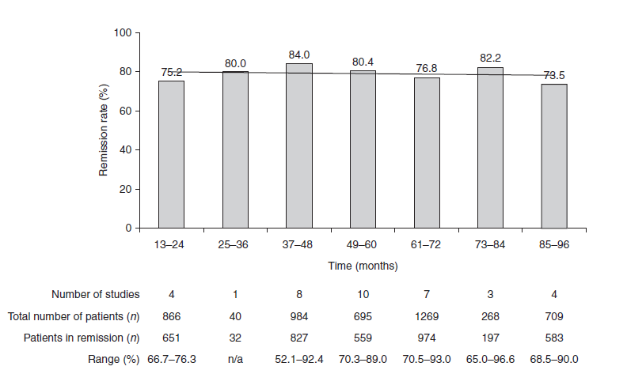

Slide 17
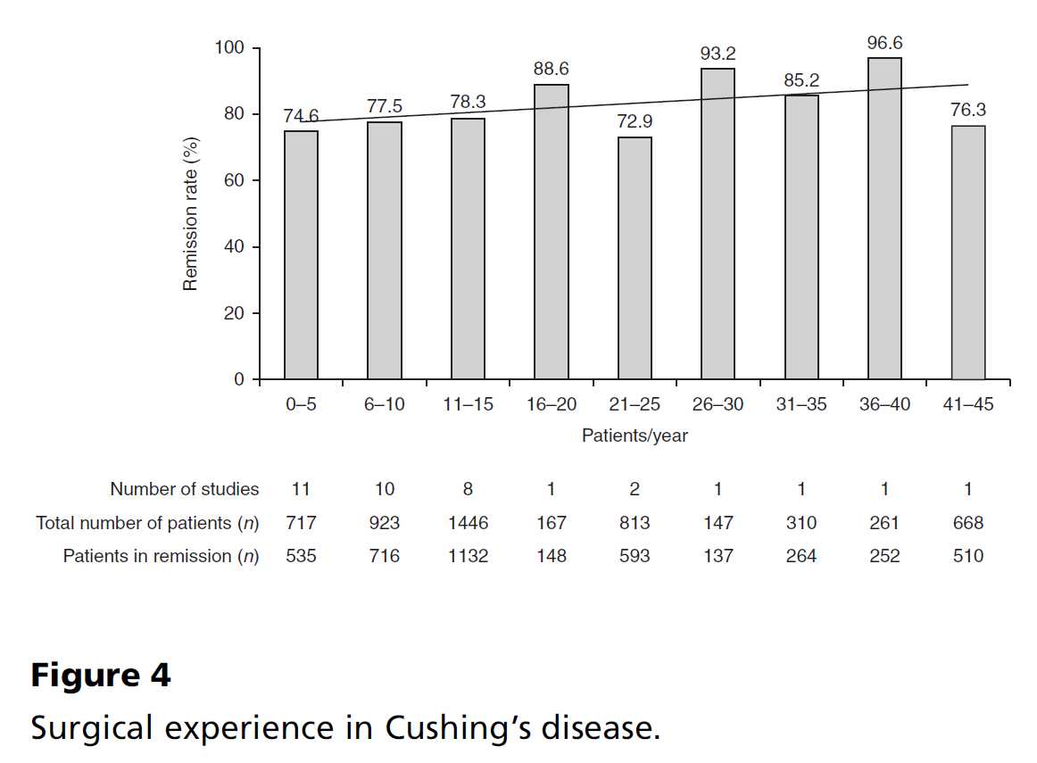
No change in remission rate was observed by decade of publication date (r=0.2; P=NS)

Slide 18
Agenda
Cushing disease and mortality
defining and rate of remission after surgery,
Rate of recurrent CD after surgery and dependant factors
challenges in diagnosing early recurrent hypercortisolemia.
evaluate a patient with CD recurrence as well as the risk benefit ratio of repeat surgery

Slide 20
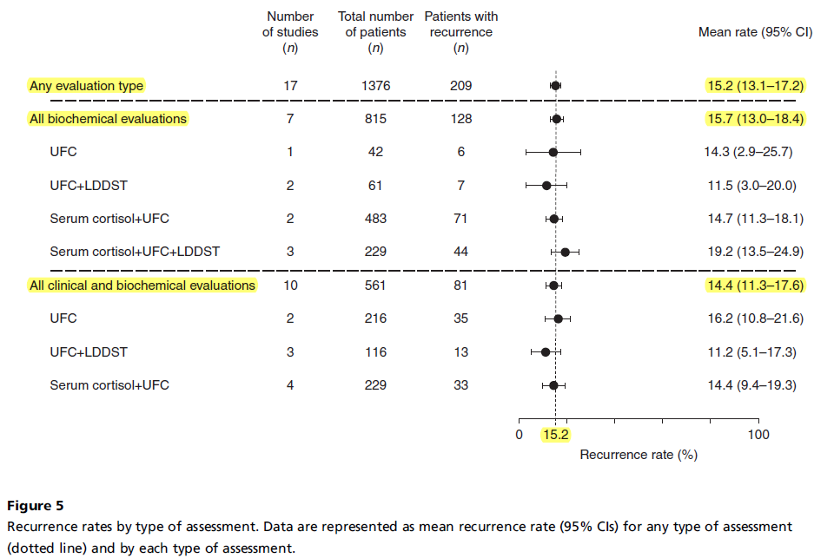

Slide 21
Key messages
remission (42.0–96.6%; median, 77.9%) and recurrence (0–47.4%; median, 11.5%).
Better remission and recurrence outcomes were achieved for microadenomas vs macroadenomas;
however, no correlations were found with other parameters, other than improved safety with longer surgical experience.

Slide 22
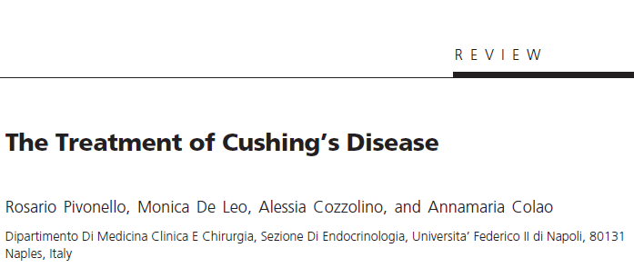

Slide 23
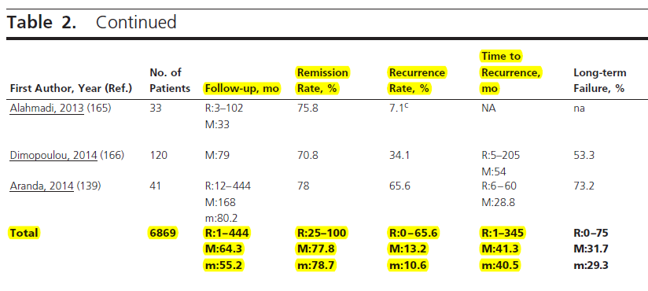

Slide 24
key message
In 74 studies (from 1976 to 2014)
totaling 6,091 CD patients treated with TSS as first-line therapy,
the recurrence rates ranged from 0 to 65.5% (mean 13.4%, median 10.6%).
Interpretation of this data summary is significantly limited by the heterogeneity of the studies included, definition of recurrence, number of patients in each study (range 6-668) and duration of follow-up (1-444 months, median 54.6 months).

Slide 25
Key Messages
Recurrence of hypercortisolemia after initial treatment of Cushing disease (CD) is more common than previously thought, with a third of patients suffering a recurrence over their lifetime.
Awareness of this high rate and delayed timeline (sometimes decades) of potential recurrence is critical and patients with CD should be monitored at regular intervals throughout their lives.
Diagnosing Recurrent Cushing Disease, Endocr Pract. 2016;22(No. 12) 1437

Slide 26
Effective factors on remission & recurrence
Rates of surgical remission depend significantly on:
tumor size
location of tumor
neurosurgeon skill and experience
the biochemical criteria used to assess remission

Slide 27
The effect of tumor size on recurrence :
As with remission, slightly better outcomes were seen with microadenomas than with macroadenomas;
a slightly higher but not statistically significant recurrence rate (17.6%; 19/108 patients; range 0.0–80%) was reported in patients with macroadenomas compared with those with microadenomas (13.4%; 101/752 patients; range 2.0–35%).

Slide 28
The effect of surgical experience:
the highest recurrence rate (13.6%) was seen when ten or fewer patients were operated per year of study duration (in 18 studies),
while the lowest rate (6.7%) was seen when 31–40 patients were operated per year of study duration (r2=0.3; P=NS; albeit these data are from only two studies)

Slide 29
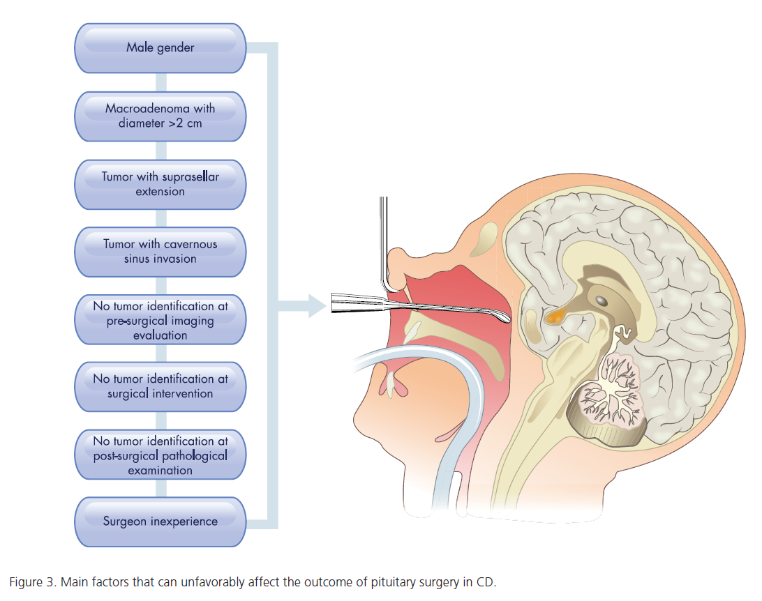

Slide 30
Predict recurrence in remission by biochemical criteria
no cut-off values seem predictive of which patients will experience recurrence,
lower postoperative serum cortisol levels are associated with a lower risk of recurrence.
The addition of ACTH to cortisol measurements may increase the accuracy of remission assessments.
Although an early postoperative plasma ACTH level <20 pg/mL has been suggested as an additional criteria predicting long-term remission ,this finding has not been noted in all studies.

Slide 31
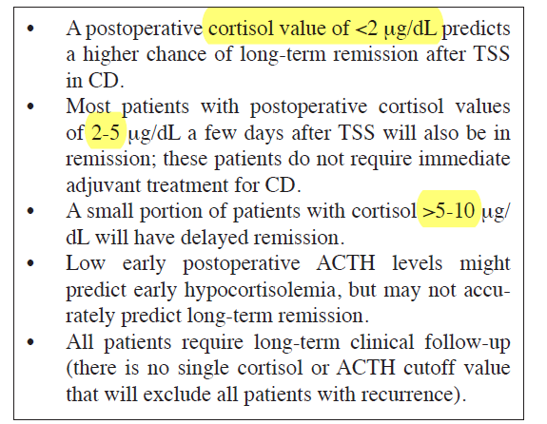
Predict recurrence in remission by biochemical criteria
Diagnosing Recurrent Cushing Disease, Endocr Pract. 2016;22(No. 12) 1437

Slide 32
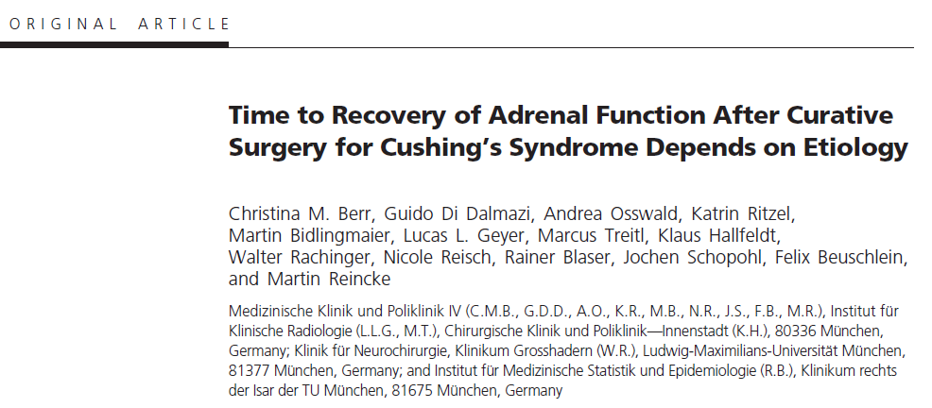

Slide 33
a retrospective analysis based on the case records of 230 patients with CS
1983–2014
mean follow-up time was 8 years
included 91 patients of the three subtypes of CS undergoing curative intended surgery
Results: The probability of recovering adrenal function within a 5 years follow up (P = .001) :
82% in ectopic CS,
58% in CD
38% in adrenal CS.
median time to recovery (P = .002) :
0.6 years (interquartile range [IQR], 0.03–1.1 y) in ectopic CS
1.4 years (IQR, 0.9 –3.4 y) in CD
2.5 years (IQR, 1.6 –5.4 y) in adrenal CS
probability of recovery was associated with younger age (hazard ratio, 0.896; 95% confidence interval, 0.822–0.976; P .012),
independently of sex, body mass index, duration of symptoms, and basal ACTH and cortisol levels.

Slide 34
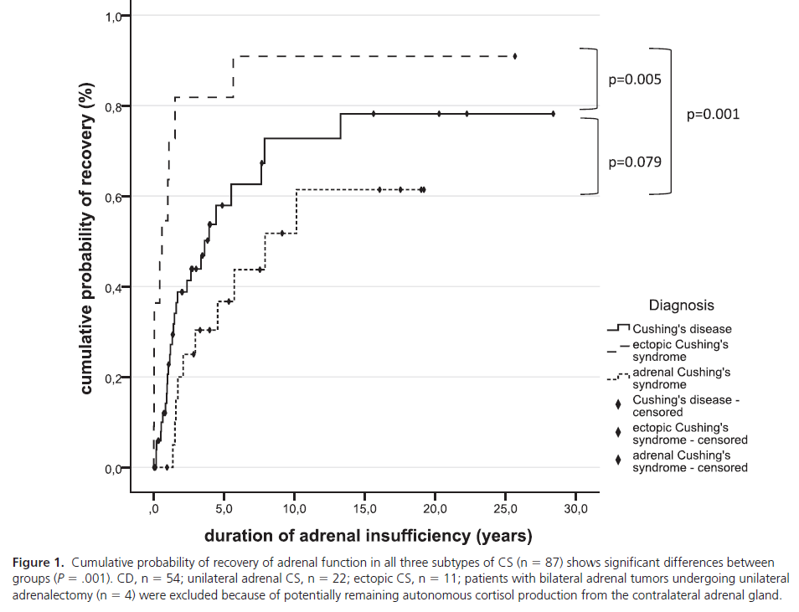

Slide 35
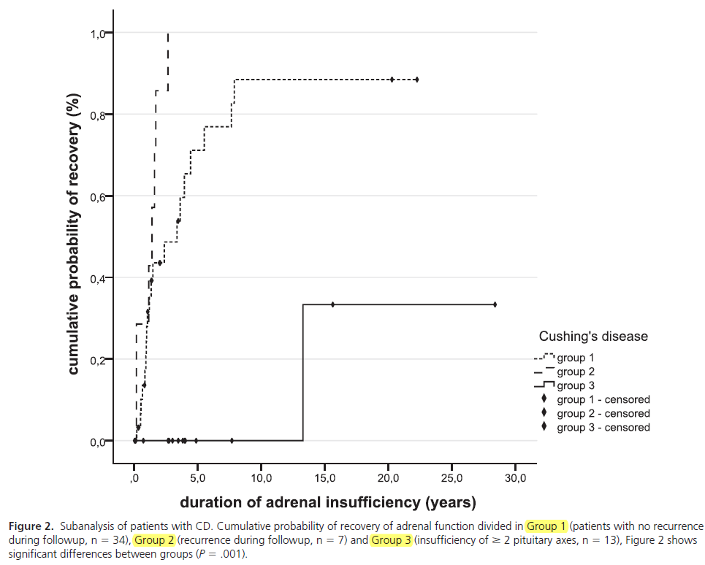

Slide 36
Key Message
the time needed to achieve HPA axis recovery was the only significant predictor of recurrence,
with patients who had a protracted course of secondary AI following pituitary surgery being less likely to develop CD recurrence

Slide 37
Agenda
Cushing disease and mortality
defining and rate of remission after surgery,
Rate of recurrent CD after surgery and dependant factors
challenges in diagnosing early recurrent hypercortisolemia.
evaluate a patient with CD recurrence as well as the risk benefit ratio of repeat surgery

Slide 38
DIAGNOSIS OF RECURRENCE OF CD
The definition of recurrence of CD is not well established and varies significantly among studies.

Slide 39
Twenty-Four Hours Urinary Free Cortisol
Urinary free cortisol (UFC) test becomes abnormal relatively late in the course of CD recurrence
Both the reliability and reproducibility of UFC are very important.

Slide 40
Late Night Salivary Cortisol
LNSC seems to be the best early predictor of recurrence
there was major within-patient variability of LNSC from day to day and that the best screening strategies for recurrence required 3 or 4 samplings.

Slide 41
164 CD patients who were in biochemical remission following TSS
at a median follow up of 53.5 months

Slide 42
Key Messages
LNSC at a cutoff of 7.4 nmol/L (higher than the upper limit of normal [ULN] for that assay; 4.3 nmol/L) was linked to recurrence. (AUC=0.87)
Recurrence was established by LNSC (75% sensitivity and 95% specificity) and a 24-hour UFC 1.6-fold above normal (68% sensitivity and 100% specificity, respectively)
(Recurrence was considered definite if confirmed surgically or prompted radiotherapy.)
However, LNSC in the first 3 postoperative months did not predict recurrence.

Slide 43
Key Messages
Salivary cortisol measured by immuno-assay might be better diagnostically than LC-MS.
However, LC-MS is better in identifying samples contaminated with dermal preparations of hydrocortisone.
Age, sex, sampling time, smoking, and metabolic syndrome are all known factors that can affect salivary cortisol rhythm.

Slide 44
Overnight or Low-Dose Dexamethasone Suppression Test
The diagnostic accuracy appears to be good for both tests, but the 2-day low dose had slightly less diagnostic accuracy than the overnight test.
A serum cortisol <1.8 mg/dL (50 nmol/L) is now considered to be a normal response to the ODST; this is a more stringent cut-off than the previous value of 5 mg/dL.

Slide 46
CRH Stimulation Test
It has been suggested that a CRH stimulation test in the postoperative period might help predict recurrence.
However, despite the presence of higher average values of CRH-stimulated cortisol and ACTH in patients who recurred compared to those in remission, no basal or stimulated ACTH or cortisol cut-off value predicted all cases of recurrence.

Slide 47
Desmopressin Stimulation Test
both to differentiate CD from pseudo Cushing syndrome and to detect recurrences.
a persistent postoperative ACTH and cortisol response to desmopressin in the first week after surgical treatment increases the probability of CD recurrence.

Slide 48
Coupled Dexamethasone Desmopressin Test (CDDT)
a possible confirmatory role in detecting patients at risk of recurrence

Slide 49
Combined LDDST/CRH Testing
This test is performed on an outpatient basis; after LDDST, CRH is administered intravenously 2 hours after the last dexamethasone dose.
This test may be useful in ruling out CD in patients who present with indeterminate results after screening.
It has been also studied in few patients to evaluate remission and/or recurrence, but its role in such patients needs to be determined.

Slide 50
Which test ? When?

Slide 51
BIOCHEMICAL TESTING AFTER TSS: SEQUENCE AND TIMELINE OF TESTING
The choice of which test to perform first depends on individual patient characteristics and the pitfalls of each test ; most patients require multiple tests to confirm recurrence.
Salivary cortisol is the preferred initial test, and more than 2 to 3 samples are recommended.
The timeline for repeat testing also varies based on clinical circumstances. All patients will require lifelong annual evaluations.

Slide 52
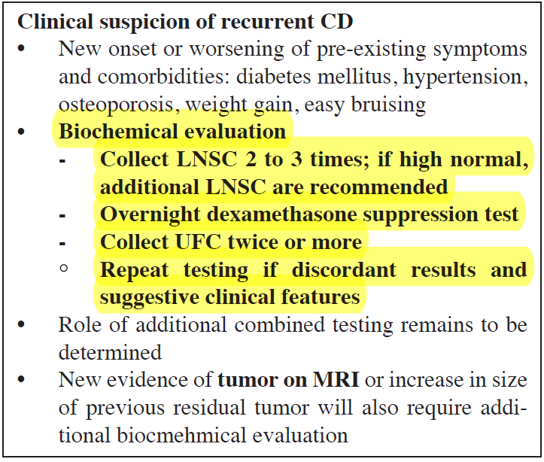
Work-Up of Recurrent Hypercortisolemia in Patients in Remission After TSS

Slide 53
Agenda
Cushing disease and mortality
defining and rate of remission after surgery,
Rate of recurrent CD after surgery and dependant factors
challenges in diagnosing early recurrent hypercortisolemia.
evaluate a patient with CD recurrence as well as the risk benefit ratio of repeat surgery

Slide 54
Repeat pituitary surgery
Several options in persistant CD or recurrence:
Repeat TSS → immediate postoperative period, if :
a pituitary tumor is visualized at preoperative imaging before the initial pituitary surgery
a tumor was found intraoperatively,
a corticotroph lesion was documented in the removed pituitary tissue after the initial pituitary surgery
IPSS → If : no tumor is detected during initial surgery or findings on preoperative imaging are
is only 50% accurate in predicting tumor laterality during repeated TSS, because the venous drainage of the gland changes position during the initial surgery, causing false-positive results, or the drainage becomes impeded, causing false-negative results

Slide 55
Repeat pituitary surgery…
Repeat pituitary surgery :
early (within 2months)
delayed
Advantages of early repeat TSS:
First, it allows a reapproach to the pituitary tumor with minimal additional trauma because it is undertaken before the formation of scar tissue and the modification of surgical anatomy .
Second, the surgeon is often able to recall particular anatomical details of the earlier operation, which may be essential for reoperation .
Finally, early repeat surgery has been suggested to have a relatively low morbidity, compared with delayed repeat surgery but this finding needs to be confirmed.

Slide 56
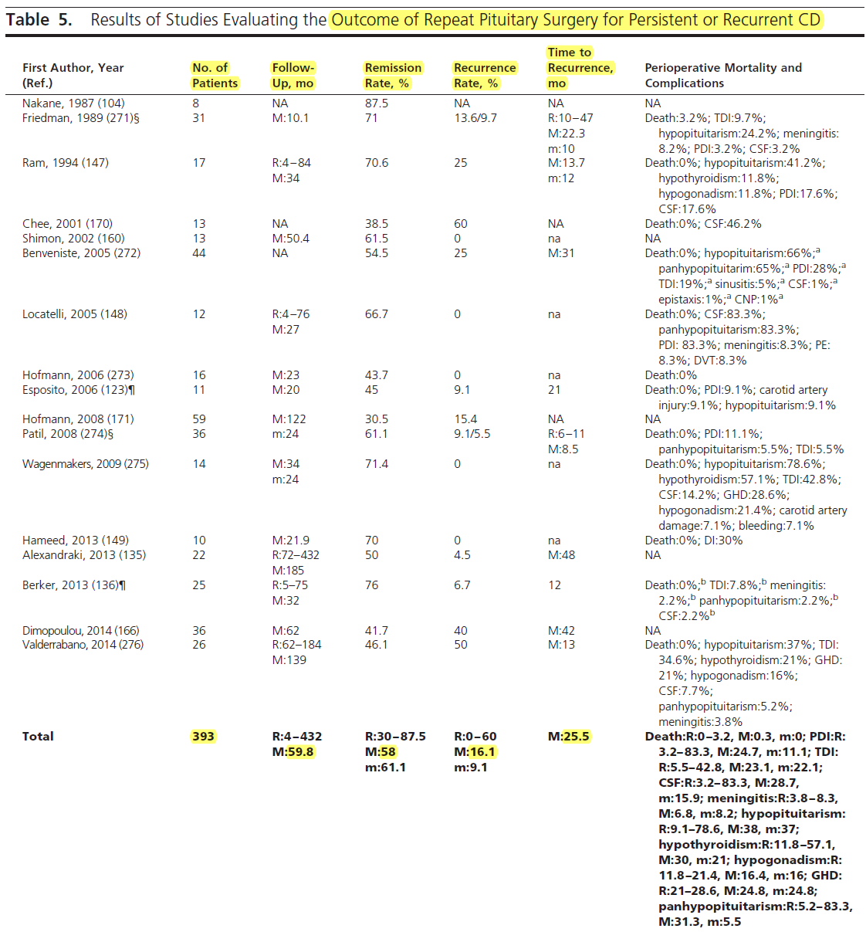

Slide 57
Conclusion
Criteria for disease remission include resolution of clinical symptoms ,need for corticosteroid replacement for >6 months after TSS, hypocortisolemia/eucortisolemia, clinical and laboratory signs of low serum cortisol and AI.
Hypercortisolemia can recur in approximately a third of patients who were initially in remission after TSS.
no cut-off values seem predictive of which patients will experience recurrence
lower postoperative serum cortisol levels are associated with a lower risk of recurrence
protracted course of secondary AI following pituitary surgery being less likely to develop CD recurrence

Slide 58
Conclusion
Salivary cortisol is the preferred initial test, and more than 2 to 3 samples are recommended.
LNSC is more sensitive and less specific rather than UFC.
ODST,LDDST, CRH stimulation Test, Desmopressin stimulation Test, are alternative tests depends on individual patient characteristics and the pitfalls of each test.
The time of work up for recurrence should be performed in clinical or imaging suspicion.
otherwise annually evaluation by biochemical measurement is required.

