Slide 1
61 y/o man CKD on hemodialysis for 11 yr & gout received ca-carbonate/calcitriol/EPO /allopurinol
Stress FX /bone deformity/osteoporesis
Pancytopnea/spleenomegally
High ca/alk ph/pth ?Parathyroid adenoma in MIBI
What is diagnosis ?
What is proper management?

Slide 2
Chronic kidney disease mineral & bone disorder

Slide 3
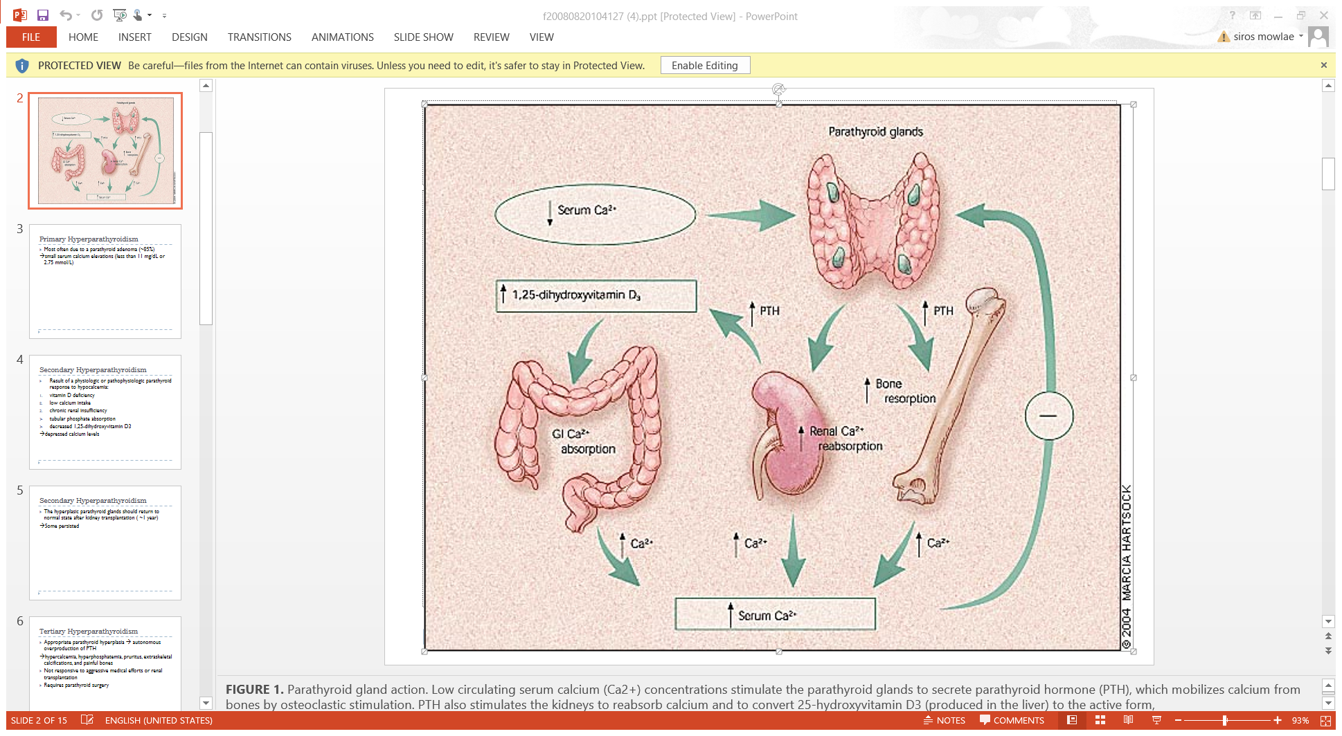

Slide 4
Pathogenes
Decreased Phosphate excretion
→HypoCa→Increase PTH
Decreased calcitriol

Slide 5
Clinical features
Renal bone disease(renal osteodystrophy)
Asymptomatic/weakness/bone& muscle pain/FX/avascular necrosis
Osteitis fibrosa cystica(high bone turn over)
Adynamic bone disease(low bone turn over) osteomalacia(severe bone pain & myopathy)
Mixed
Vascular calcification

Slide 6
Increased risk of all cause & CVD mortality with
Elevated phosphate/calcium/PTH & FGF-23
TREATMENT OF 2DRY HPT IN CKD ON DIALYSIS
1- Treat severe hyperphosphatemia & hypocalcemia
GOAL ph=3.5-5.5mg/dl ca=8.4-9.5mg/dl ca x ph <55 mg/dl
2-iPTH GOAL =150-300pg/ml
Phosphate binders(calcium or non calcium containing)
Calcitriol or vit D analogs(paricalcitol survival advantage)
Calcimimetics

Slide 7
PTH levels correlate with bone histology
Osteitis fibrosa & mixed uremic osteodystrophy associated with iPTH>400 pg/ml
PTH>300 ph<5.5 ca<9.5 →calcitriol/syn vit D ph>5.5 ca>8.4 →cinacalcet ph<5.5 ca>9.5 →cinacalcet
Add cinacalcet to vitD if inadequate PTH drop ph<5.5 & ca>8.4

Slide 8
Calcitriol/vitD analog
High dose eg 1.5 mcg/dialysis calcitriol(7-8 mcg/wk)
Physiologic dose eg 0.5 mcg/dialysis + calcimimetic
Contraindication : ph>5.5 ca>9.5
Calcimimetics(cinacalcet) increase sensitivity of caSR
Increase PT% in goal of PTH
Reduced risk of PTX /FX & CVD hosptalization
In EVOLVE RT no decrease in risk of death CV event
Hypocalcemia & GI upset are side effects

Slide 9
Treatment failure(tertiary HPT)
Elevated PTH & spontaneous hypercalcemia persisted &progressive elevated PTH not responded to vitD or cinacalct(180 mg/d) need parathyroidectomy
Pathogenesis(autonomous transformation)
Delayed /inadequate therapy
Persistant hyperphosphatemia
Increase in parathyroid mass polyclonal proliferation(diffuse proliferation) & monoclonal proliferation(adenomatous like tissue)

Slide 10
Indication for parathyroidectomy in CKD
Severe HPT refractory to medical therapy with related sign & symptom
PTH threshold unknown but most PTX with iPTH>800
Sign & symptom warrant need for PTX
Severe hypercalcemia progressive & debilitating bone disease
Refractory pruritus
Progressive extra skeletal calcification /calciphylaxis unexplained myopathy
PTX for asymptomatic pt is controversial but may be perform in pt<65 y/o /few comorbidity/PTH >1000pg/ml

Slide 11
The most life-threatening indication for PTX in patients with secondary HPT is calciphylaxis, which occurs in only 4% of pt undergoing surgery. expanding, painful, cutaneous, purpuritic lesions that cause tissue calcification and ischemic necrosis, which lead to dry gangrene if untreated .
Overwhelming sepsis and wound breakdown cause significant mortality, as high as 87% in one report.
In patients with calciphylaxis who are urgently treated with total PTX wound healing is enhanced and median survival is prolonged. surgery avoid amputation, decrease pain, and reduce the use of narcotics

Slide 13
No matched RCT compare long term effect of medical vs surgical treatment(asymptomatic)
Two observational studies suggested improved long term survival with surgery.
HPT resolve in many pt after kidney Tx but persistent HPT & hypercalcemia cause decreased graft function
PTX after kidney TX may graft dysfunction
R/O aluminium exposure before PTX

Slide 14
Preoperation localization studies may help for ectopic or extra gland
Operative approaches
Subtotal parathyroidectomy (removal of 3 and one-half glands leaving a remnant in situ),
Total parathyroidectomy (4-gland resection) with autotransplantation,
Total parathyroidectomy without autotransplantation

Slide 15
The surgical procedure performed is often due to surgeon’s preference
Total parathyroidectomy with autotransplantation and cryopreservation of the remaining parathyroid tissue for treatment of patients with secondary HPT (Fig. 2). When performing this procedure, marking the reimplanted tissue in the forearm with nonabsorbable silk suture and a hemoclip is important
For tertiary HPT, subtotal PTX that leaves the native blood supply to half of a parathyroid intact and, theoretically, reduced risk of hypocalcemia

Slide 17
limited or less-than-subtotal parathyroid resection in select patients with only 1 or 2 diseased glands has been described in patients with tertiary HPT, but remains controversial.
tertiary HPT also can result from a single or double adenoma, asymmetric hyperplasia, or incomplete resolution of all hyperplastic glands in up to 30% of patients. Intraoperative PTH (ioPTH) measurement can aid in identifying these cases with the goal being more than a 50% drop at 10 minutes. Studies have shown equivalent (more than 95%) success rates using a limited approach compared with subtotal or total PTX
Triponez et al reported a 5.2 times greater risk of persistent or recurrent HPT after limited resection for tertiary HPT.

Slide 18
Techniques such as intraoperative PTH monitoring and radioguided surgery have advanced surgical procedures by eliminating the need for frozen section and decreasing operative times.
For patients with tertiary HPT, simultaneous thymectomy can be performed with either subtotal or total parathyroidectomy. Some surgeons routinely resect the thymus bilaterally because ectopic glands are frequently found within the thymic tissue.
Resect the thymus if an inferior gland cannot be found or when the radioguided probe suggests increased activity within an area of the thymus

