Slide 1
به نام خدا
CaSE PRESENTATION
A 59 Y/O MALE with weakness and vertigo
Bilateral adrenal mass
Presented by :
Mehr 1396
Taleghani hospital
sbmu

Slide 2
Present illness
We herein present the case of a 59 year-old man was admitted to our endocrine ward for a work up of bilateral adrenal masses.
He had a history of abdominal and low back pain, headache, weakness, and malaise since 7 months ago; abdominal Ultrasonography and then CT scan revealed bilateral adrenal masses and hormonal work ups showed that they are non-functional.
Medical history revealed headache, light headedness, dizziness, difficulties with gait and vertigo since approximately 4 month ago: he also complained about weight loss, anorexia, weakness and orthostatic hypotension, hyponatremia and hyperkalemia, diagnosed with adrenal insufficiency (serum cortisol level 6.6 mcg/dl) and has been taking glucocorticoids since the diagnosis.

Slide 3
Contrast enhanced abdominal CT scan showing bilateral adrenal masses (right adrenal 4.4×8 cm and left adrenal 4.0×6.1 cm); no lymphadenopathy.
For further work – up adrenal biopsy was performed. Two days later he presented with loss of consciousness; brain CT- Scan showed hydrocephalous and obstruction of 4th ventricle and a posterior fossa (48 * 37mm) mass highly suggestive of a malignant lesion.
Chest CT revealed 2 pulmonary nodules 12 and 16 cm in the left lung, lingual lobe.
Fine needle aspiration cytology smear of adrenal mass reported to be undifferentiated carcinoma. The origin remained unknown. IHC staining was done and positive staining was observed for ki 67 markers (60%).
The patient is a heavy smoker. He had MI 15 years ago that culminated to heart failure with EF 20%.

Slide 4
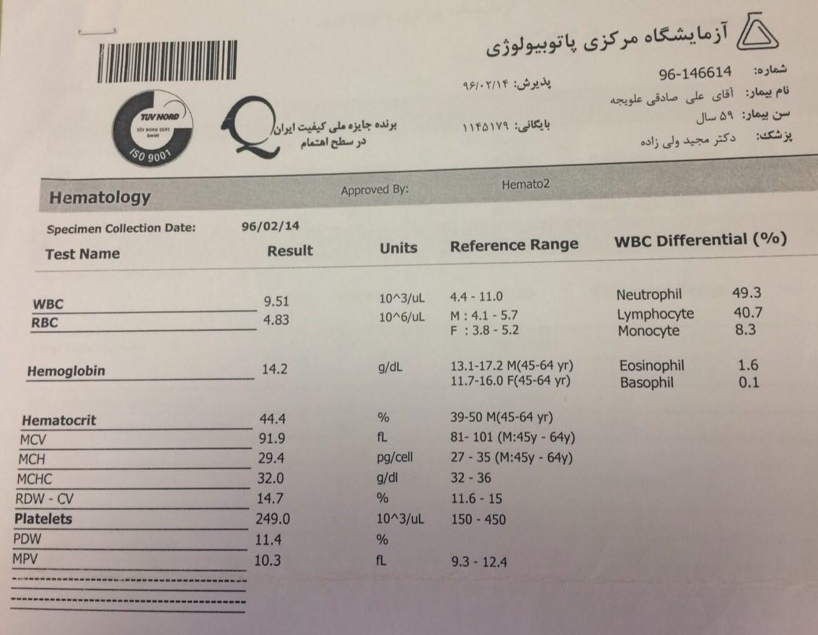

Slide 5
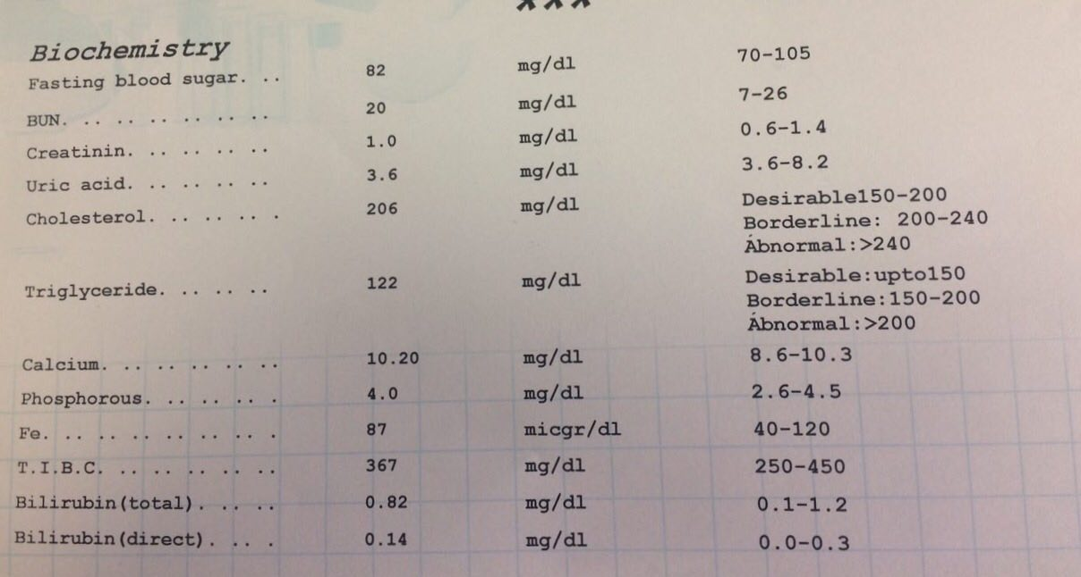

Slide 6
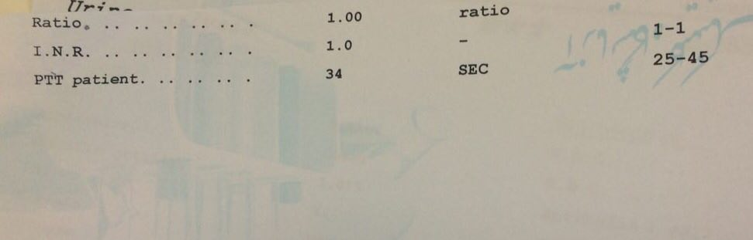

Slide 7
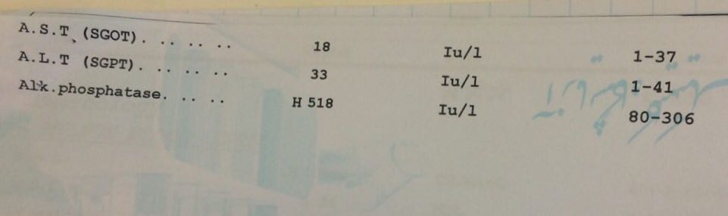

Slide 8
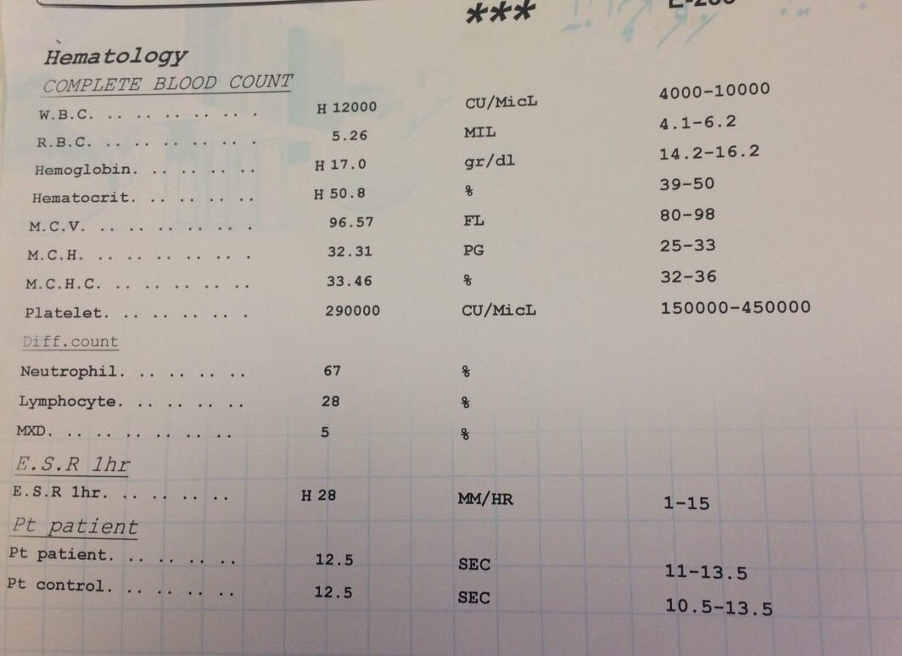

Slide 9
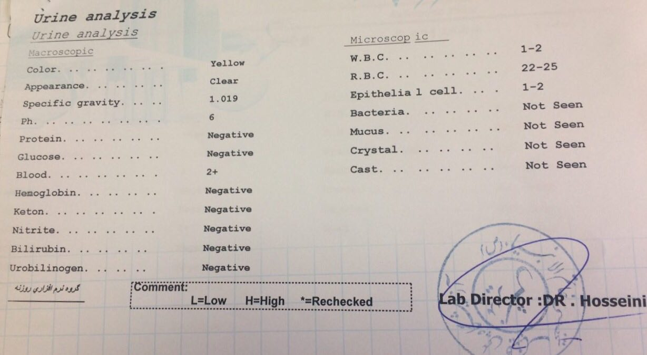

Slide 10
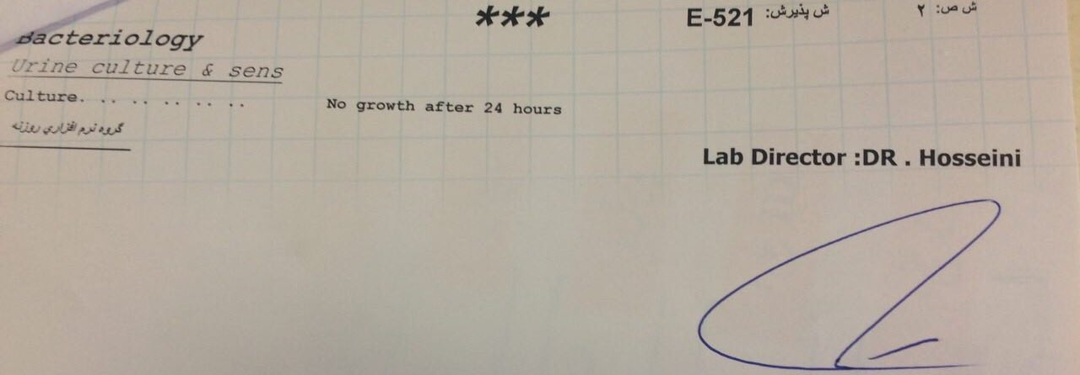

Slide 11
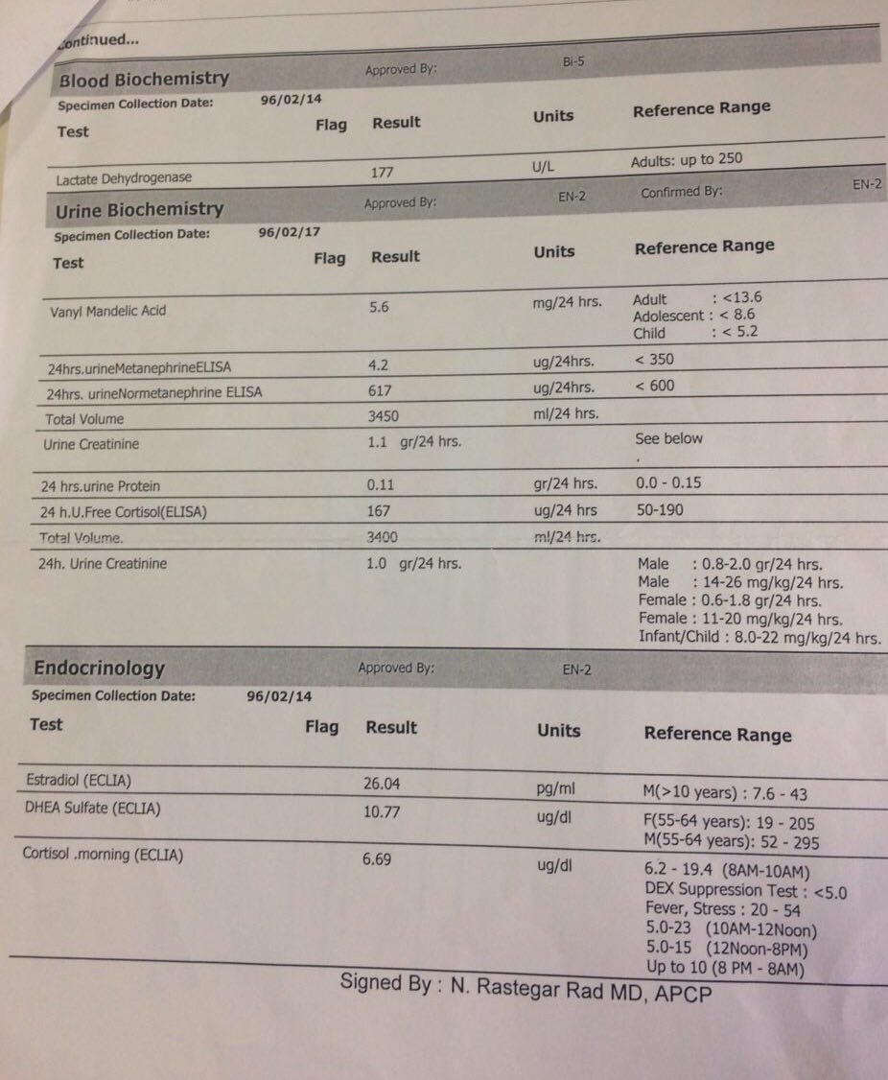

Slide 12
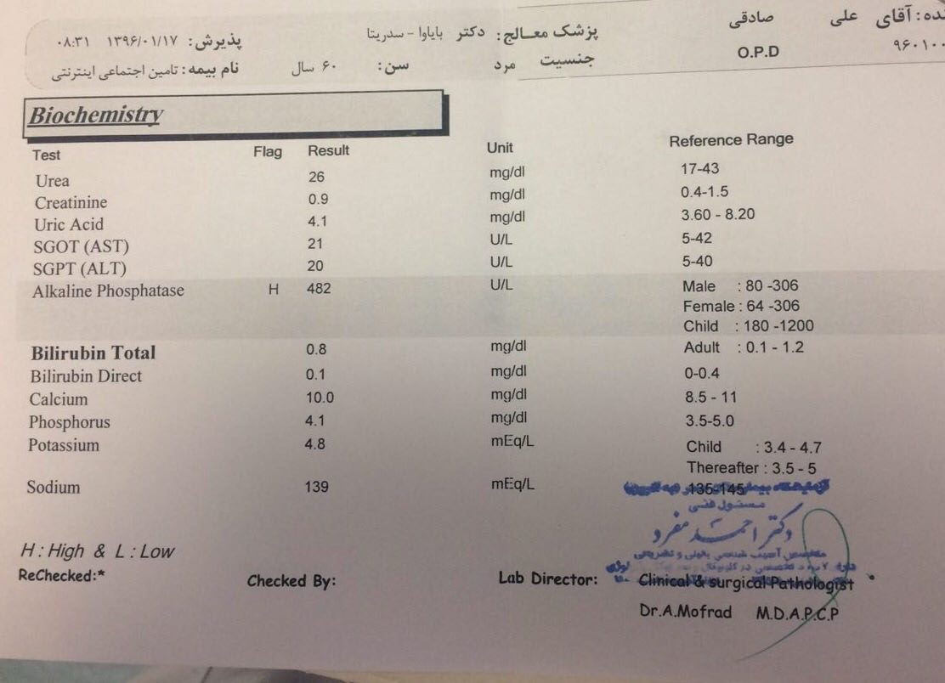

Slide 13
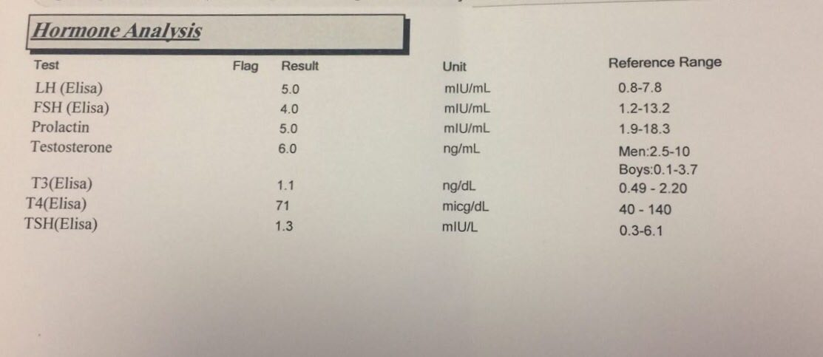

Slide 14
.
    Na:125….>127….>134….>136….>138
    K:5.1….>4.9….>4.3….>3.8….>3.6
    Cr:0.8
    Wbc:15300….>19400….>17400….>15500….>18100
    Neutrophil:79.4….>83….>86.1….>76….>91.6

Slide 15
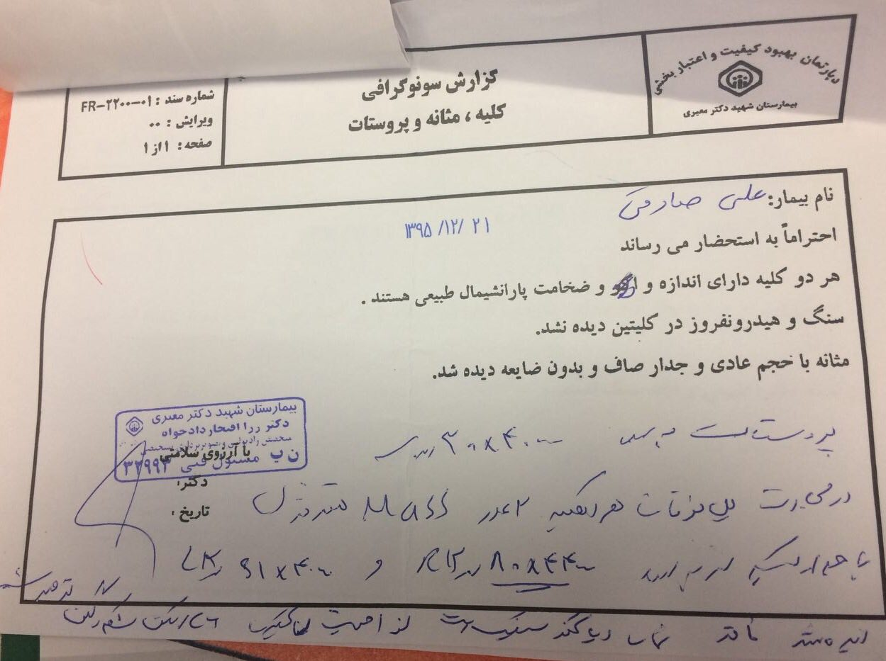

Slide 16
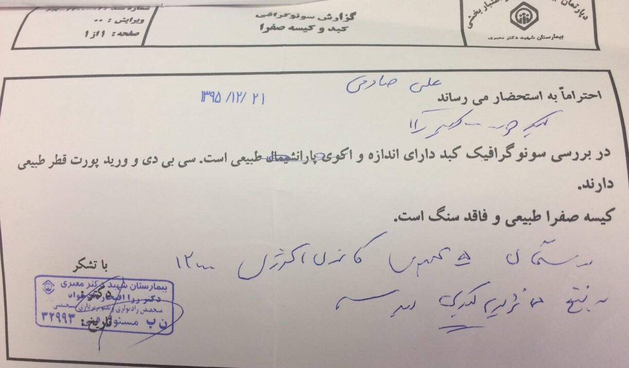

Slide 17
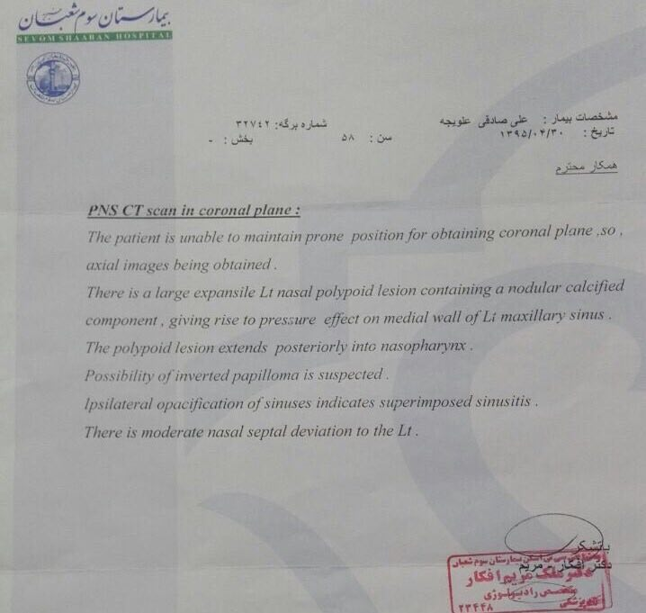

Slide 18
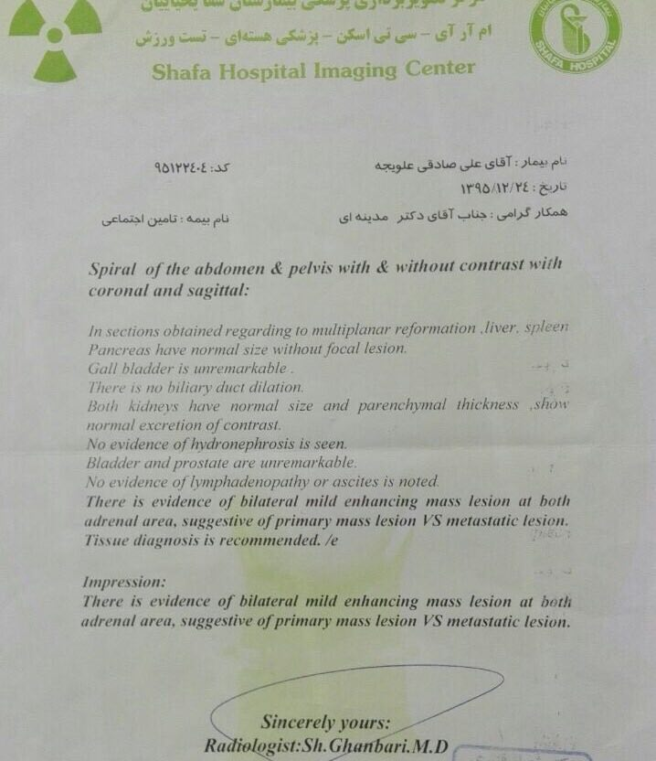

Slide 19
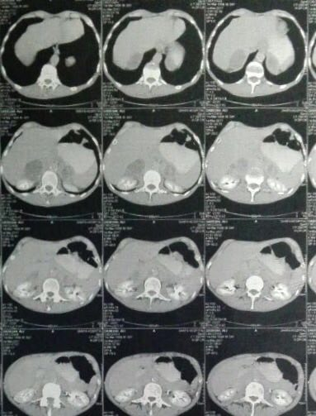

Slide 20
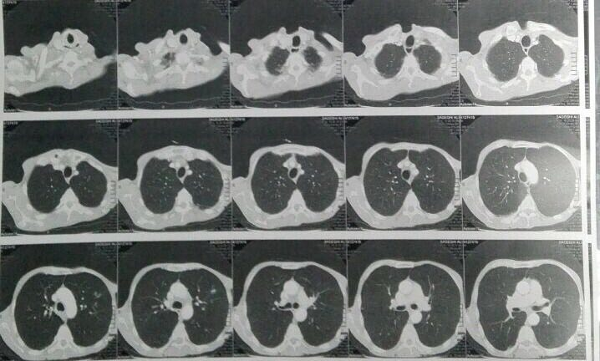

Slide 21
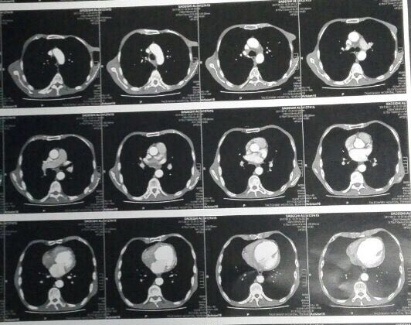

Slide 22
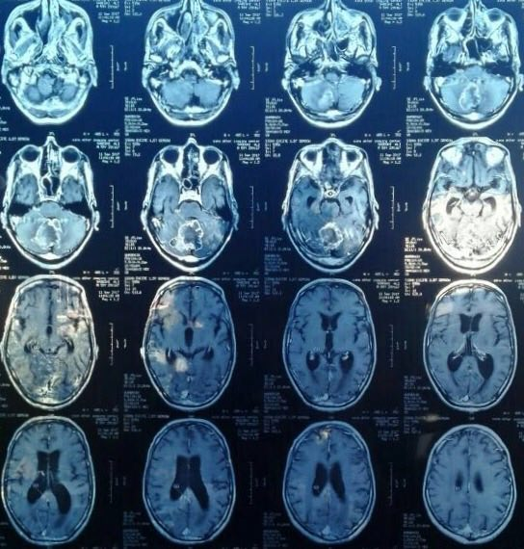

Slide 23
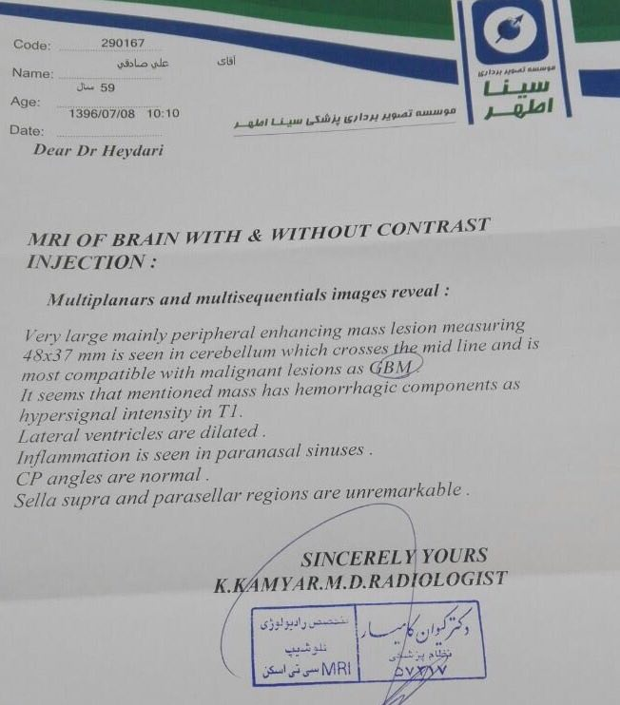

Slide 24
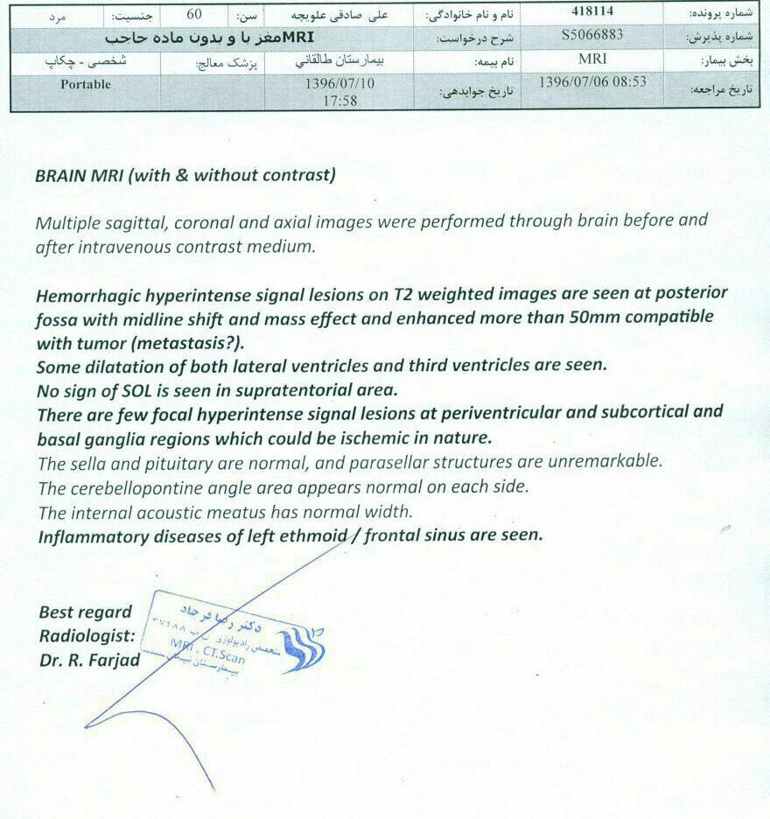

Slide 25
Drug and PMH
70p/y
Psychosomatic disease
ACS
Proteinuria
Tab prednisolone 5mg daily

Slide 26
Family history
DM in his brother
ESRD in his mother

Slide 27
Review of system no fever anorexia weight loss 5 kg/2 month ago abdominal pain weakness true vertigo low back pain

Slide 28
Physical examination
BP:110/60 PR:70 W:48 H:181 BMI:15 no skin pale and icter no pigmentation in skin and mucosa pupil reflex is normal conjective is pale thyroid is soft and without nodularity no LAP flank tenderness abdomin is soft without tenderness and organomegali no edema and clubbing muscle force is normal

Slide 29
Problem list
A 59 years old male bilaterall adrenal mass weakness,vertigo,headace anorexia,nausea,vomiting felank pain,abdominal pain,low back pain

