Slide 1
Incidentaloma

Slide 2
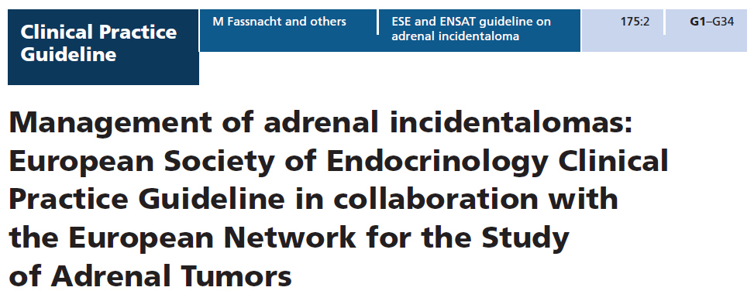

Slide 3
Definition
An adrenal incidentaloma is an adrenal mass detected on imaging not performed for suspected adrenal disease.
The imaging study is not done for symptoms related to adrenal hormone excess (e.g. pheochromocytoma, Cushing’s or Conn’s syndrome) or an otherwise suspected adrenal mass .
Screening imaging in patients with a hereditary syndrome leading to adrenal tumors is outside the definition of an adrenal incidentaloma.
Adrenal masses discovered on an imaging study performed during tumor evaluation for extra-adrenal malignancies (‘tumor staging’ or follow-up) do not meet the strict definition of adrenal incidentaloma.

Slide 4
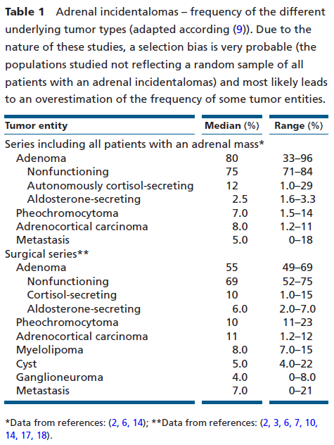

Slide 5
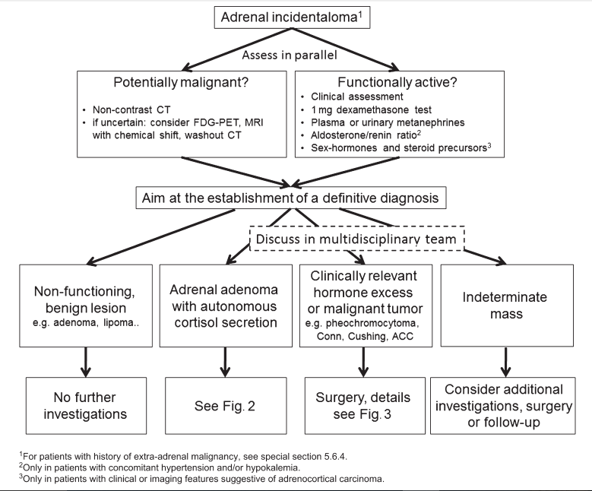

Slide 6
Assessment of the risk of malignancy
We recommend aiming to establish if an adrenal mass is benign or malignant at the time of initial detection.
We recommend that all adrenal incidentalomas undergo an imaging procedure to determine if the mass is homogeneous and lipid-rich and therefore benign (⊕OOO). For this purpose, we primarily recommend the use of noncontrast CT (⊕OOO).

Slide 7
We suggest that if the noncontrast CT is consistent with a benign adrenal mass (Hounsfield units ≤10) that is homogeneous and smaller than 4 cm, no further imaging is required (⊕OOO).

Slide 8
If the adrenal mass is indeterminate on noncontrast CT and the results of the hormonal work-up do not indicate significant hormone excess, there are three options that should be considered by a multidisciplinary team acknowledging the patient’s clinical context:
immediate additional imaging with another modality,
interval imaging in 6–12 months (noncontrast CT or MRI)
or surgery without further delay.

Slide 9
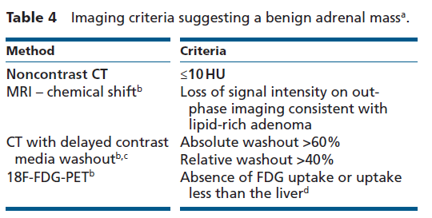

Slide 10
We recommend against the use of an adrenal biopsy in the diagnostic work-up of patients with adrenal masses unless there is a history of extra-adrenal malignancy .

Slide 11
Assessment for hormone excess
We recommend that every patient with an adrenal incidentaloma should undergo careful assessment including clinical examination for symptoms and signs of adrenal hormone excess.
We recommend excluding pheochromocytoma by measurement of plasma-free metanephrines or urinary fractionated metanephrines.

Slide 12
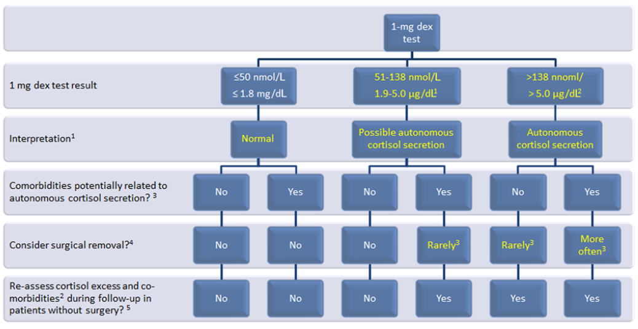

Slide 13
In patients with concomitant hypertension or unexplained hypokalemia, we recommend the use of the aldosterone/renin ratio to exclude primary aldosteronism.
We suggest measurement of sex hormones and steriod precursors in patients with imaging or clinical features suggestive of adrenocortical carcinoma.

Slide 14
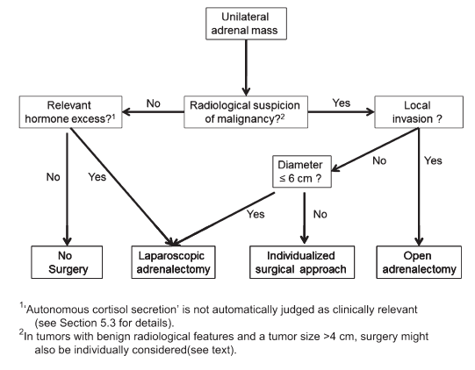

Slide 15
Follow-up of patients not undergoing adrenal surgery after initial assessment
We suggest against further imaging during follow-up in patients with an adrenal mass <4 cm with clear benign features on imaging studies (⊕OOO).
Some panel members argued that one follow-up imaging (noncontrast CT or MRI) after 6–12 months might be considered in lesions >4 cm.

Slide 16
In patients with an indeterminate adrenal mass (by imaging), opting not to undergo adrenalectomy following initial assessment, we suggest a repeat noncontrast CT or MRI after 6–12 months to exclude significant growth (⊕OOO).
We suggest surgical resection if the lesion enlarges by more than 20% (in addition to at least a 5 mm increase in maximum diameter) during this period.
If there is growth of the lesion below this threshold, additional imaging again after 6–12 months might be performed.

Slide 17
We suggest against repeated hormonal work-up in patients with a normal hormonal work-up at initial evaluation unless new clinical signs of endocrine activity appear or there is worsening of comorbidities (e.g. hypertension and type 2 diabetes) (⊕OOO).

Slide 18
Subclinical pheocromocytoma

Slide 20
Small Phaeo/sPGL in their early stages of development are generally associated with few or mild symptoms.
Also large Phaeo/sPGL with extensive internal necrotic/haemorrhagic areas may be associated with a mild clinical picture.

Slide 21
Patients with adrenaline-secreting tumors present more often with paroxysmal signs and symptoms, but outside the secretory crisis the patient can present with normotension and clinical silence.
In patients with predominantly noradrenaline-secreting tumors the clinical picture can be mild, resembling essential hypertension. In some of them , the continuously higher plasma concentrations of noradrenaline may induce a down-regulation of adrenoceptors , which cause a milder clinical picture, sometimes to a normal blood pressure profile.

Slide 22
Rarely, large tumours may be asymptomatic even in the absence of intra-tumoural necrosis. Such tumours, which have been reported in patients with succinate dehydrogenase subunit B (SDHB) mutations , have an undifferentiated catecholamine biosynthetic phenotype, contain low or negligible concentrations of catecholamines and can reach large sizes before secreting sufficient amounts of catecholamines to produce signs and symptoms.

Slide 23
PGLs that do not produce or secrete catecholamines :
Parasympathetic in origin and located in the head and neck region (HNPGL) or in the upper/anterior mediastinum.
Phaeo/PGL that do not secrete catecholamines but metabolize them to inactive compounds.
Do not even synthesize or contain catecholamines as a result of a defect in tyrosinehydroxylase.

Slide 24
Normotensive Incidentally Discovered Pheochromocytomas Display Specific Biochemical, Cellular, and Molecular Characteristics

Slide 25
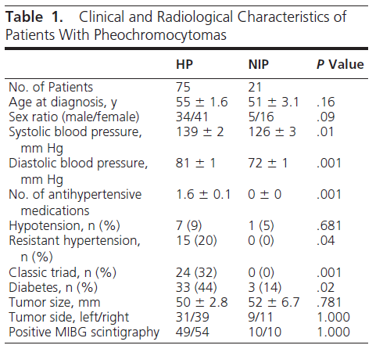

Slide 26
