Slide 1
Diagnosis of Osteoporosis
Mahtab Niroomand M.D.
Assistant Professor of Endocrinology
SBUMS

Slide 2
Lecture outline
Epidemiology of osteoporosis
Definition of osteoporosis
Clinical manifestations of osteoporosis
Diagnosis of osteoporosis
Bone densitometry
Fracture risk assessment

Slide 3
Epidemiology
Osteoporosis is a systemic skeletal disorder that is characterized by the loss of bone tissue, disruption of bone architecture, and bone fragility, leading to an increased risk of fractures
Bone loss and low bone mass are asymptomatic until fractures occur
The burden of suffering associated with osteoporosis is related to the increased incidence of fractures in individuals with low bone mass and microarchitectural deterioration.
Osteoporosis is the most common metabolic bone disease and the most common cause of fractures in older adults in the United States

Slide 4
Epidemiology
Fractures of the hip and spine are associated with:
  Increased mortality rate (10-20%)
  Limitation of ambulation
  Depression
  Loss of independency
  Chronic pain

Slide 5
Definition
Osteoporosis:
  Low bone mass
  Microarchitectural disruption
  Skeletal fragility, resulting an increased risk of fracture

Slide 6
Definition
Osteoporotic fracture (fragility fracture, low-trauma fracture):
  fracture that occur with a fall from standing height or less or with no trauma

Slide 7
Bone mass density
Bone geometry
(size and shape of bone)
Bone Strength
Degree of mineralization
Bone turnover
microarchitecture

Slide 8
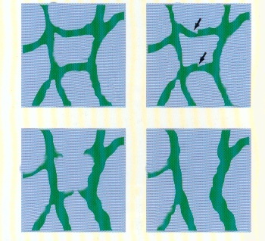
Bone strength = Bone quality + Bone quantity
Micro-architecture increases bone strength
Normal Loss of Loss of
Quantity + Quantity Architecture
Architecture

Slide 9
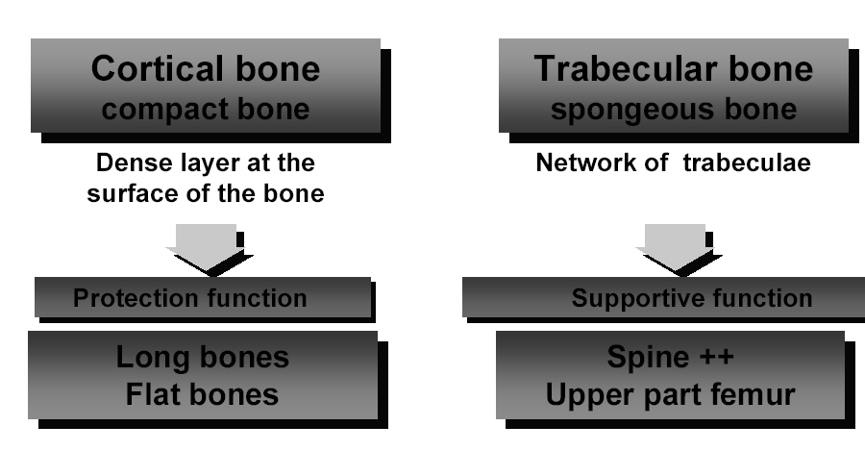

Slide 10
 | Trabecular % | Cortical %
AP spine | 66 | 34
Lateral spine | + + + + | -
Femoral neck | 25 | 75
Ward | + + + + | -
Trochantric | 50 | 50
Mid radial | 1 | 99
Distal | 20 | 80
Ultra | 66 | 34
Total | 20 | 80

Slide 11
Clinical manifestation
Osteoporosis has no clinical manifestation until there is a fracture.
Complication of fractures include:
  Pain, deformity, disability , loss of height
Vertebral fracture: the most common clinical manifestation of osteoporosis:
  Asymptomatic (two-third): incidental finding on CXR or Abdominal X-ray
  Symptomatic( one-third): height loss
Other fractures:
  hip fractures(15% of women and 5% of men by 80years old)
  Colles fracture (distal radius fractures)

Slide 12
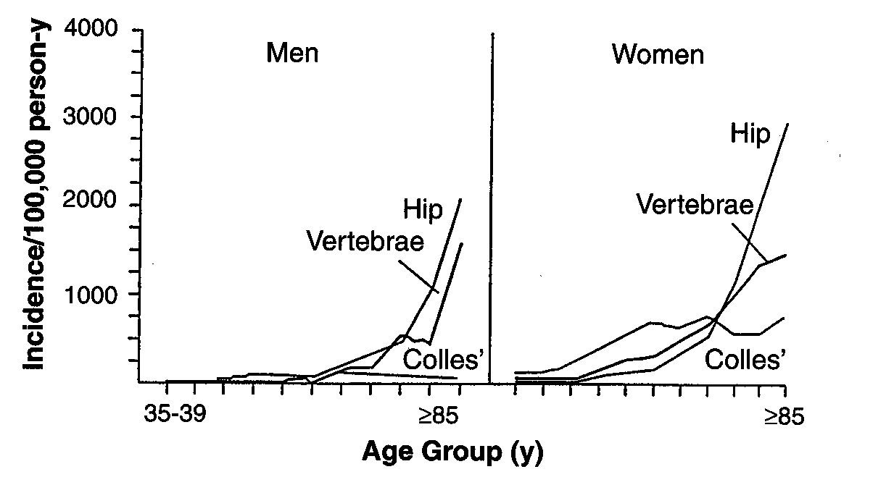
Age-specific incidence rates for Hip , Vertebral
and distal Forearm fractures in men and women

Slide 13
Diagnosis
Assessment of microarchitecture (not routinly used in clinical practice) :
  Bone biopsy
  MicroCT
  Micro MRI
BMD assessment is the gold standard to diagnose osteoporosis
Clinical diagnose of osteoporosis may be made in the presence of a fragility fracture, without BMD

Slide 14
Bone Mass Densitometry
BMD testing is a widely available clinical tool to:
  Diagnose osteoporosis
  Predict fracture risk
  Monitor response to therapy

Slide 15
Osteoporosis Measurement
Plain film, Subjective, Radiogrammetry, Osteogram
SPA
DPA
DXA
QCT
US
MRI

Slide 16
Osteoporosis Measurement
Central Skeleton
Peripheral Skeleton
Dual Energy X-ray absorptiometry (DXA)
Quantitative computed tomography (QCT)
Quantitative ultrasound
Digital X-ray
Radiogrammetry (DXR)
Single X-ray Absorptiometry (SXA)
Peripheral DXA (pDXA)
Peripheral QCT (pQCT)

Slide 17
The WHO criteria for the diagnosis of osteoporosis are based upon BMD measured by DXA, and therefore do not apply to these other technologies.
However, these technologies can be used to predict fracture

Slide 18
Techniques for BMD
Technique | Site | Precision, percent | Accuracy, percent | Examination time, min | Absorbed radiation dose, mrem
Single – photon absorptiometry | Proximal and distal radius, calcaneous | 1-3 | 5 | 15 | 10-20
Dual – energy photon absorptiometry | Spine, hip, total body | 2-4 | 4-10 | 20-40 | 5
DXA | Spine, hip, total, body | 0.5-2 | 3-5 | 3-7 | 1-3
Quantitative CT | Spine | 2-5 | 5-20 | 10-15 | 100-1000

Slide 19
DXA: Why Dual Energy X-rays?
Differential absorption by bone and soft tissue
  Low energy (30-50 keV): Bone mineral attenuation >> Soft tissue
  High energy (>70 keV): Bone mineral attenuation ≈ Soft tissue
  allows to suppress impact of overlying soft tissue
Partially corrects for presence of varying amount of fat

Slide 20
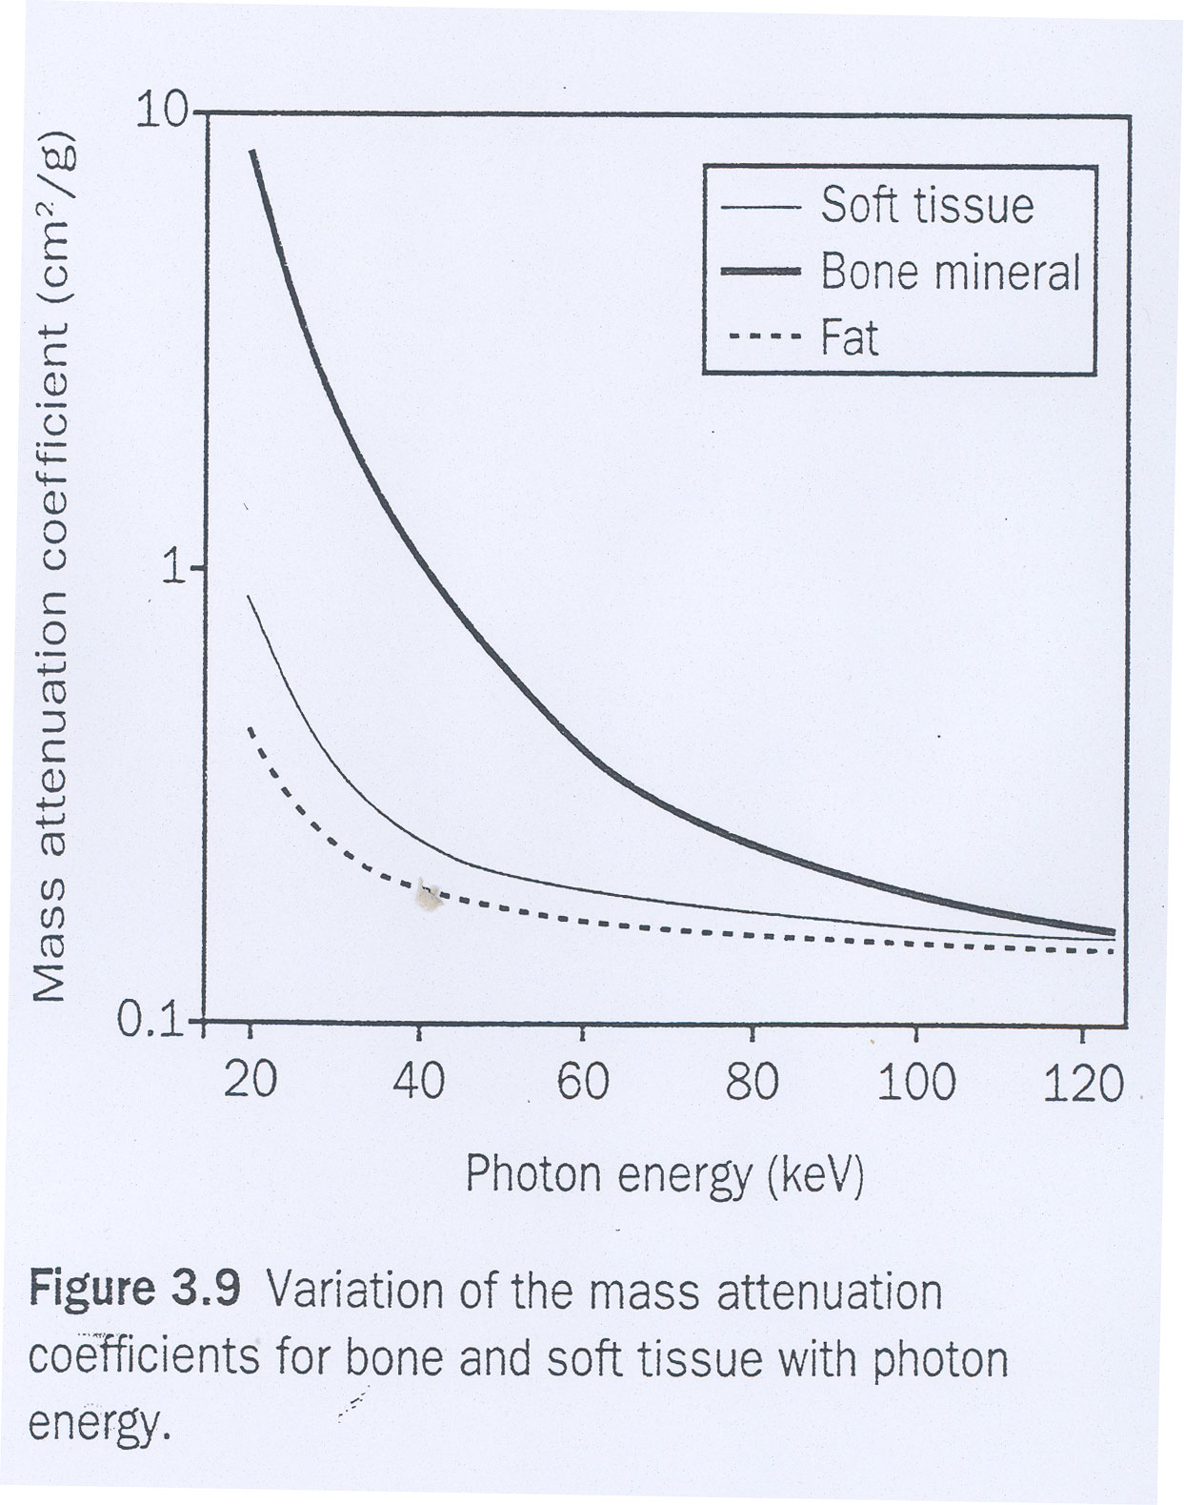

Slide 21
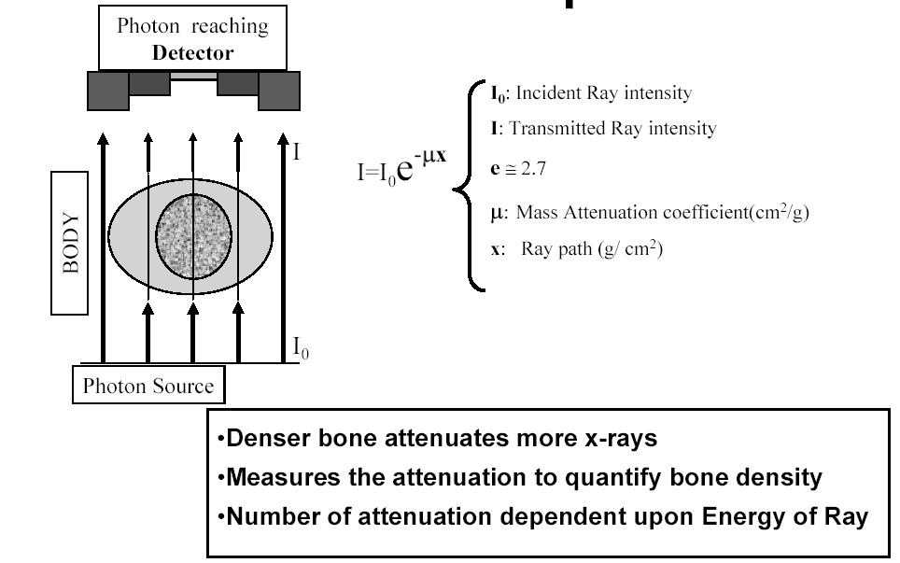

Slide 22
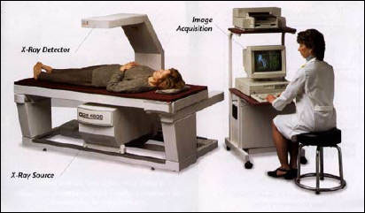

Slide 23
DXA Technology
Detector (detects 2 tissue types - bone and soft tissue)
Very low radiation to patient (similar magnitude to daily background radiation)
Very little scatter radiation to technologist (no shielding of the technologist or the room is necessary)
C-arm
Patient
Photons
Collimator (pinhole for pencil beam, slit for fan beam)
X-ray Source
(produces 2 photon energies with different attenuation profiles)

Slide 24
DXA
Biomechanical studies:
  Strong correlation between mechanical strength and BMD measured by DXA
Prospective cohort studies:
  Strong relationship between fracture risk and BMD measured by DXA
RCTs:
  Relationship between decreased fracture risk with drug therapy and increases in BMD measured by DXA

Slide 25
What DXA Really Measures:
What DXA Really Measures:
DXA measure:
  Bone mineral content (BMC, in grams)
  Bone area (BA, in square centimeters)
Then calculates “areal” BMD in g/cm2
BMD (g/cm2) = BMC (gr) /BA (cm2)

Slide 26
Standard Scores
(1) Z – Score : Checked with Age & Sex Matched
(2) T - Score : Checked with Young Adult

Slide 27
T-score
The value used for diagnosis of osteoporosis
T-Score=
Patient’s BMD – Young-Adult Mean BMD
1 SD of Young-Adult Mean BMD

Slide 28
Z-score
Z-sore=
Patient’s BMD – Age-Matched Mean BMD
1 SD of Age-Matched Mean BMD in g/cm²
Low Z-score (less Low Z-score (less than -2.0) may suggest increased likelihood of secondary osteoporosis,
however . . .
  This is not validated in clinical trials
  High index of suspicion for secondary causes of osteoporosis is suggested in all patients

Slide 29
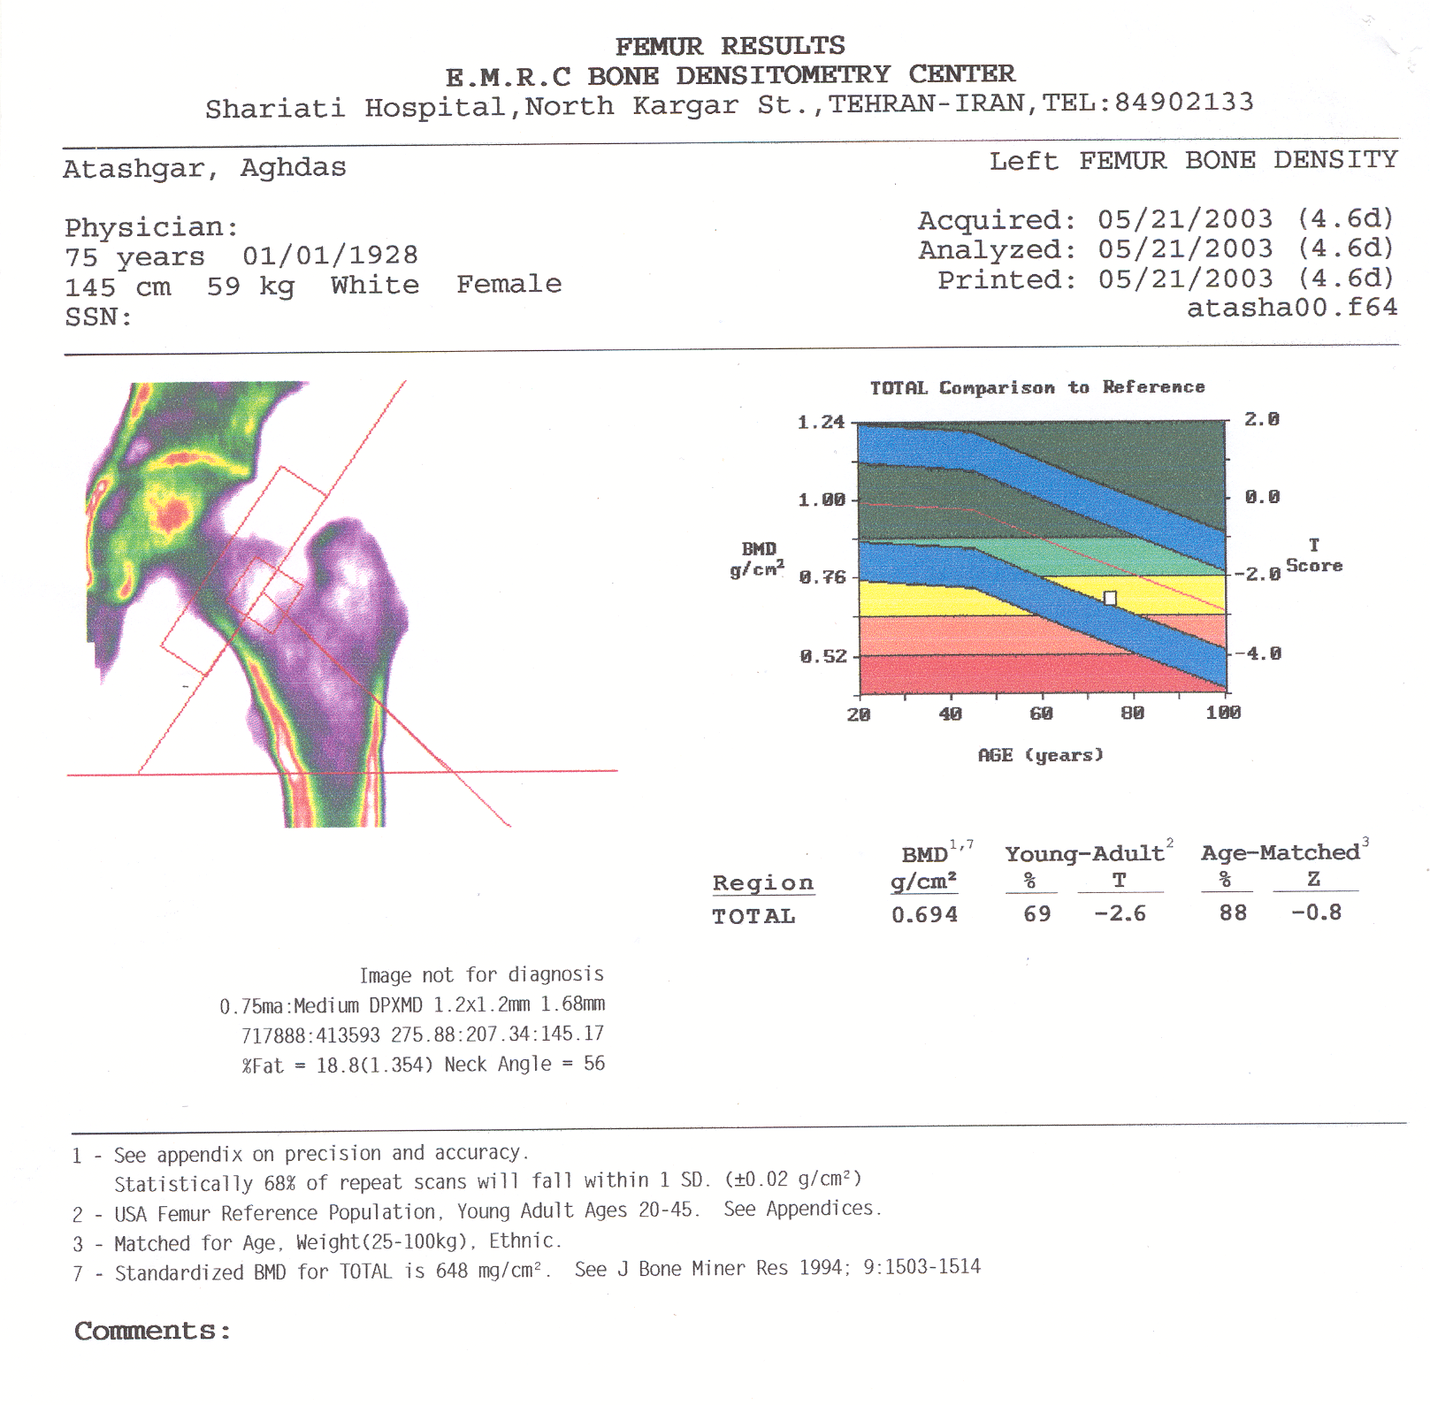

Slide 30
WHO Criteria for Diagnosis of Bone Status
Diagnostic criteria
Classification
T is above or equal to -1
T is between -1 and -2.5
T is -2.5 or lower
T is -2.5 or lower + fragility Fx
Normal
Osteopenia
Osteoporosis
Severe or stablisshed osteoporosis

Slide 31
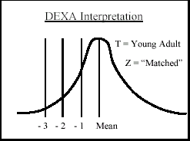
Why

Slide 32
Why are bone mass measurements performed?
Diagnosis of osteopenia or osteoporosis
Fracture risk prediction
Identification of individuals for treatment
Serial assessment of bone mass

Slide 33
Who Should be selected For BMD Measurement ?
Targeted Case Finding
VS
Mass Screening

Slide 34
Indication of bone densitometry
There are several strategies for incorporating BMD measurements into osteoporosis screening program:
  Screening all individuals over a certain age (when fracture risk increases)
  Screening only those women and men over a certain age with clinical risk factors for fracture
  Screening those with clinical risk factors who are close to an intervention threshold and in whom the selective addition of BMD testing may result in intervention

Slide 35
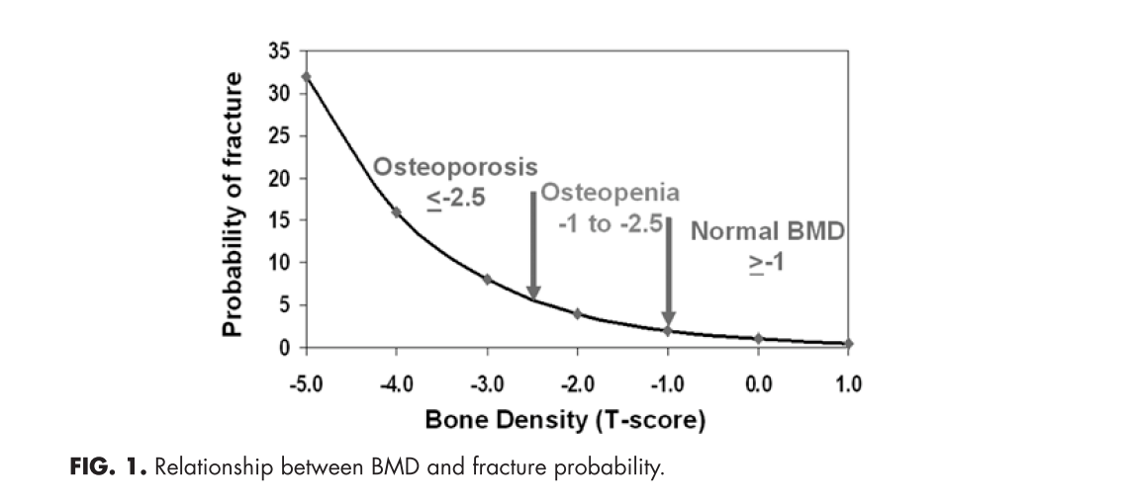

Slide 36
Screening
Individual with T-score below -2.5(osteoporosis) have the highest risk of fracture
There are greater number of individuals with osteopenia than osteoporosis
Absolute number of fractures in subject with osteopenia (according BMD) is greater than subjects with osteoporosis.

Slide 37
Screening (cont’d)
Thus, treatment strategies relying solely on BMD testing will miss many patients at risk for fracture
Therefore, assessment of risk factors that are independent of BMD is important for fracture prediction

Slide 38
Screening (cont’d)
Screening for osteoporosis involves:
  Fracture risk assessment
  Measurement of BMD

Slide 39
Fracture Risk Assessment
Non-BMD factors (clinical risk factors):
  Increased the sensitivity of fracture risk assessment
  Improves treatment intervention strategies
  Including:
    Major risk factors
    Minor risk factors
BMD

Slide 40
Major risk factors
Age > 65 years
• Vertebral compression fracture
Fragility fracture after age 40yrs
Family history of fracture (especially maternal hip fracture > 50yrs)
Systemic glucocorticoid therapy (>3months duration)
Malabsorption syndrome
• Primary hyperparathyroidism
• Propensity to fall
• Osteopenia apparent on x-ray
• Hypogonadism
• Early menopause (before age 45)

Slide 41
Minor risk factors
Rheumatoid arthritis
Past history of clinical hyperthyroidism
Chronic anticonvulsant therapy
Low dietary calcium intake
Excessive alcohol intake
Excessive caffeine intake
Weight < 57 kg
Weight loss > 10% of weight at age 25
Chronic heparin therapy

Slide 42
Identifying those at high risk
The OSC recommends that
  all postmenopausal women and
  men over 50 years of age
be assessed for the presence of risk factors for osteoporosis

Slide 43
Clinical Risk Factors
Validated risk factors that are independent of BMD include the following:
  Advanced age
  Previous fracture
  Long-term glucocorticoid therapy
  Low body weight (less than 58 kg [127 lb])
  Family history of hip fracture
  Cigarette smoking
  Excess alcohol intake

Slide 44
Strongest non-BMD predictors
Age
Prior fragility fracture
Kanis JA; Borgstrom F; De Laet C; Johansson H; Johnell O; Jonsson B; Oden A; Zethraeus N; Pfleger B; Khaltaev N SO - Osteoporos Int 2005 Jun;16(6):581-9

Slide 45
Clinical risk factors
Clinical risk factors are :
  predictive of bone density and fracture risk
  But, may not be as useful for predicting response to antiresorptive therapy

Slide 46
Several osteoporosis risk assessment instruments have been developed to improve the selection of women and men for measurement of BMD
None of the tools was very specific, and most were not validated in other cohorts

Slide 47
Risk Assessment Questionnaires

Slide 48
Risk Assessment Questionnaires

Slide 49
Fracture risk assessment tool(FRAX)
Introduced by WHO in 2008
Estimates the 10-year probability of hip fracture and major osteoporotic fracture for untreated patients between age 40-90 years according:
  Clinical risk factors for fracture
  Femoral neck BMD(g/cm2)
Base upon data from large prospective observational studies of men and women of different ethnicities and different world regions in which clinical risk factors, BMD and fractures were evaluated

Slide 50
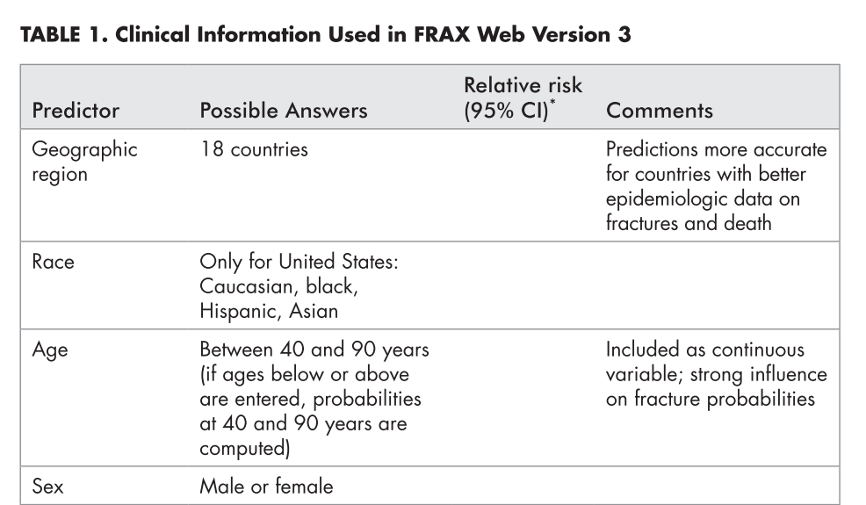

Slide 51
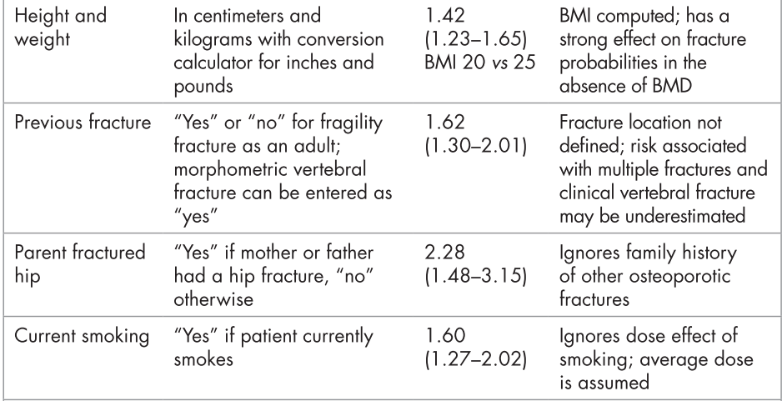

Slide 52
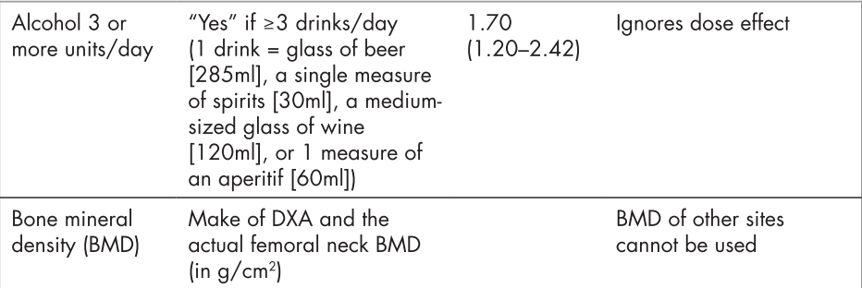

Slide 53
High sensitivity and low specificity
Most of these instruments have high sensitivity and are able to identify patients with low BMD in the osteopenic and osteoporotic ranges.
However, few are able to accurately identify patients with normal BMD who could be spared the expense of DXA testing.

Slide 54
WHO Absolute Fracture Risk
Weighted Probability Calculation
Age
Sex
Height
Weight
Previous
Fractures
Parental
Hip Fracture
Current
Smoking
Glucocorticoid
Use
Rheumatoid
Arthritis
Secondary
Osteoporosis
Alcohol >
3 unit/day
Femoral
Neck BMD
Treat when probability of:
Hip Fracture > 3%
Major Osteoporosis Fracture > 20%
www.shef.ac.uk/FRAX

Slide 55
BMD Measurement
appropriate for:
for all women age 65 and older because of the high risk of osteoporosis and fracture after that age
and
Targeted case-finding among people under age 65
.

Slide 56
Indications For Bone Mineral Density (BMD) Testing
Women aged 65 and older
Postmenopausal women under age 65 with risk factors for fracture.
Women during the menopausal transition with clinical risk factors for fracture, such as low body weight, prior fracture, or high-risk medication use.
Men aged 70 and older
Men under age 70 with clinical risk factors for fracture
Adults with a fragility fracture.

Slide 57
Indications For Bone Mineral Density (BMD) Testing (Cont’d)
Adults with a disease or condition associated with low bone mass or bone loss
Adults taking medications associated with low bone mass or bone loss
Anyone being considered for pharmacologic therapy
Anyone being treated, to monitor treatment effect
Anyone not receiving therapy in whom evidence of bone loss would lead to treatment
Women discontinuing estrogen should be considered for bone density testing according to the indications listed above

Slide 58
Skeletal site to measure
The risk for fracture at a particular skeletal site is best estimated by measuring BMD at that skeletal site
Hip fracture is often associated with significant morbidity and mortality compared with other fractures, DXA of the hip is generally regarded as the best site for diagnosis of osteoporosis.
In contrast, the lumbar spine is often considered the best skeletal site to monitor because:
  Less variability
  Detect responses to therapy earlier than hip BMD

Slide 59
Skeletal site to measure
The best site to measure for osteoporosis screening is controversial.
Measurements from different sites (spine, hip, forearm) are often discordant with regard to the WHO diagnostic classification
When measurements of different skeletal sites are performed, the diagnosis of osteoporosis is based upon the lowest T-score for BMD assessed at one of these sites.
Assessment of multiple sites does not appear to improve fracture prediction
The use of multiple sites for the diagnosis of osteoporosis, osteoporos Int 2006

Slide 60
Skeletal site to measure
Younger postmenopausal women with risk factors for fracture:
  DXA measurements of both the spine and hip because:
    early menopause is associated with greater BMD loss at the spine than the hip
    interference from osteophytes and vascular calcifications on the spine measurement is usually minimal in that age.
Aging women and men (spinal osteophytes are common)
  measurement of hip BMD alone could be sufficient.
If pharmacologic therapy is planned, measurement of spine BMD might be useful for monitoring response to therapy.
In the presence of degenerative changes of the spine, bone mineral density can be monitored at another skeletal site, such as the hip or radius, although the sensitivity for detecting changes at these locations is lower.

Slide 61
Which Skeletal Sites Should Be Measured?
Every patients
Some patients
Spine
  L1-L4
Hip
  Total Proximal Femur
  Femoral Neck
  Trochanter
Forearm (33% Radius)
  If hip or spine cannot be measured
  Hyperparathyroidism
  Very obese
Use lowest T-score of these sites

Slide 62
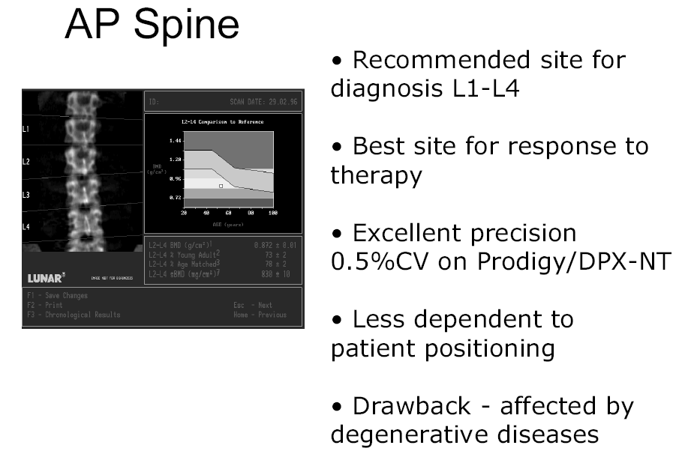

Slide 63
Contraindication of DXA
DXA should not be done in:
  women who are pregnant or may be pregnant (because ionizing radiation, albeit it in very small doses)
  DXA should be postponed until pregnancy is completed.
  Unless the results are likely to play a role in the management of the patient.
It may not be possible to do a DXA of the hip and spine in some patients due to inability to get on the table

Slide 64
Bone mass density
Bone geometry
(size and shape of bone)
Bone Strength
Degree of mineralization
Bone turnover
microarchitecture

Slide 65
Bone Turnover Markers (BTM)
Understanding the mechanism of action of therapeutic agents (in clinical trial)
Role in the care of individual patients is not well established.
Potential roles of BTMs in clinical practice:
  prediction of fracture risk
  monitoring response to therapy
  improving compliance with therapy

Slide 66
Bone turnover markers
Bone formation markers
Bone resorption markers
Octeocalcin
Bone specific alkaline phosphataze
P1NP: N-terminal propeptide of type 1 procollagen
P1CP: C-terminal propeptide of type 1 procollagen
NTX: cross-linked N-telopeptide of type 1 collagen
CTX: cross-linked C- telopeptide of type 1 collagen
D-PYR: Free deoxypyridinoline
PYD: Free pyridinoline
HYP: Hydroxyproline
TRACP5b: isoform 5b of tartrate resistant acid phosphatase.

Slide 67
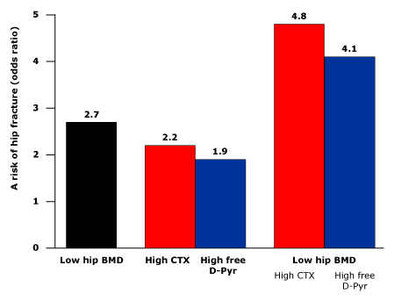
Biochemical markers of bone remodeling
BMD and bone turnover markers are independent predictors of hip fracture risk
urinary C-terminal collagen crosslink excretion (CTX) or free deoxypyridinoline excretion (D/Pyr)

Slide 68
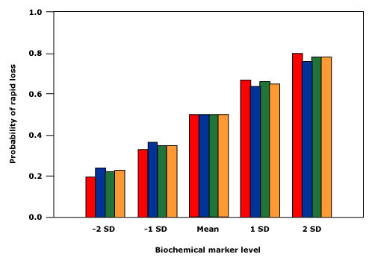
High bone turnover is predictive of rapid bone loss
DPD
OC
PYD
BAP

Slide 69
BTMs
Several studies have demonstrated that markers of bone turnover may be useful in predicting rates of bone loss.
The values in normal subjects and patients with osteoporosis overlap substantially (biochemical markers are not useful in making the diagnosis of osteoporosis)
There is currently no consensus on a role for BTMs in determining candidates for osteoporosis therapy.
The decision to treat such patients should be based upon fracture risk assessment using:
  BMD
  clinical risk factors

Slide 70
Diagnosis of Osteoporosis
Technique
  DXA is the gold standard
Site
  Hip (Neck, Total, or both)
Reference range
  NHANES III data (women 20-29 yrs)

Slide 71
Discrepancies in T score Determination
Different Reference database
Different Site of measurement
Different technologies

Slide 72
Key point
The WHO criteria were never intended to be applied to healthy premenopausal women.

Slide 73
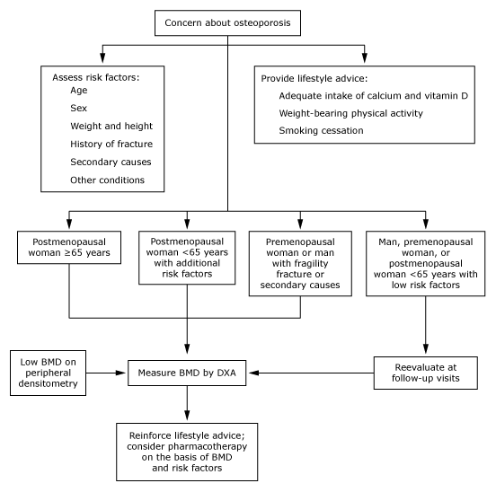
Recommendations regarding selection of patients for DXA

Slide 74


Slide 75
Bone densitometry
Quantitative computerized tomography (qCT) :
  Measures volumetric bone density of the spine and hip
  Analyze cortical and trabecular bone separately
  Useful in clinical research and may be used in individual patients to follow therapeutic responses particularly to intermittent parathyroid hormone (teriparatide) therapy, where large changes may be observed
  it is not recommended for screening, because :
    The application of T-scores to predict the risk of fracture has not been validated with qCT
    This method is more costly
    Results in greater exposure to radiation than DXA

Slide 76
Peripheral measurements:
  Ultrasound, peripheral DXA (pDXA), x-ray absorptiometry, peripheral quantitative computed tomography (pQCT) of the heel, radius, or hand
  The WHO criteria for the diagnosis of osteoporosis are based upon BMD measured by DXA, and therefore do not apply to these other technologies

Slide 77
There is no consensus about which patients to assess who are younger than 65 years

