Slide 1
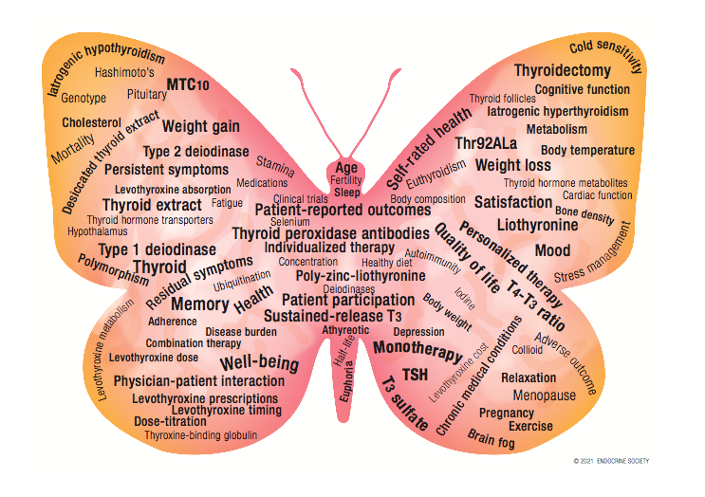
Synthetic Thyroxine Therapy: Formulations, Absorption and Pharmacological Interferences
April 4,2022
Mahsa Abbaszadeh, MD
Research Institute for Endocrine Sciences, Shahid Beheshti University of Medical Sciences

Slide 4
Jonklaas J, et al. Guidelines for the treatment of hypothyroidism: prepared by the American Thyroid Association Task Force on Thyroid Hormone Replacement. Thyroid (2014) 24:1670–751.
Douglas S Ross. Treatment of primary hypothyroidism in adults , 2022 UpToDate
Williams textbook of endocrinology, 14th ed, 2020.

Slide 5
Outline:
Different formulations of levothyroxine
Scheduling of levothyroxine
Absorption of levothyroxine
Foods and Drugs affecting levothyroxine dose
Persistent elevation in TSH:
poor compliance
poor absorption of T4

Slide 6
1) Levothyroxine Formulations:

Slide 7
Levothyroxine Formulations:
LT4 is available as
Tablet preparation,
Liquid preparation in a solution,
Liquid contained within a gel capsule
Parenteral
Endocrine Reviews, 2021, Vol. XX, No. XX

Slide 8
T4 formulations
 | Tablet | Soft gel capsules | Oral solutions | Parenteral
Brand names | Euthyrox, Levo-T, Levoxyl, Synthroid, Unithroid | Tirosint | Tirosint-Sol, Thyquidity
Dosage | 25, 50, 75, 88, 100, 112, 125, 137, 150, 175, 200, 300 mcg | 13, 25, 50, 75, 88, 100, 112, 125, 137, 150, 175, 200 mcg | 13, 25, 50, 75, 88, 100, 112, 125, 137, 150, 175, 200 mcg/ml, 100 mcg/5ml | 20, 40, 100, 200, 500 mcg/ml
Douglas S Ross. Treatment of primary hypothyroidism in adults , 2022 UpToDate

Slide 9
Fine dosage titration
The full range of doses available allows for fine dose titration.
Different formulations are available in color-coded preparations
Endocrine Reviews, 2021, Vol. XX, No. XX

Slide 10
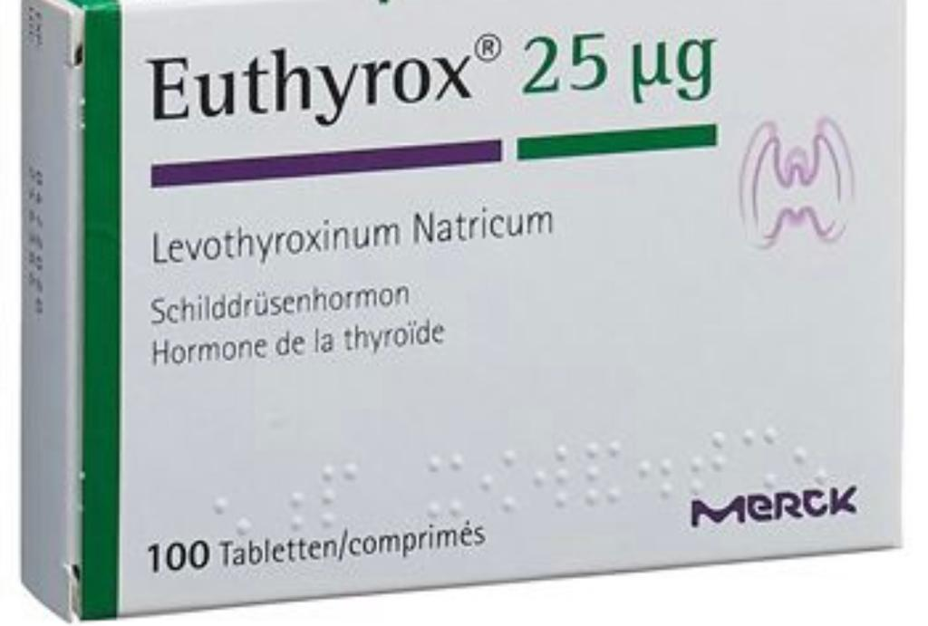
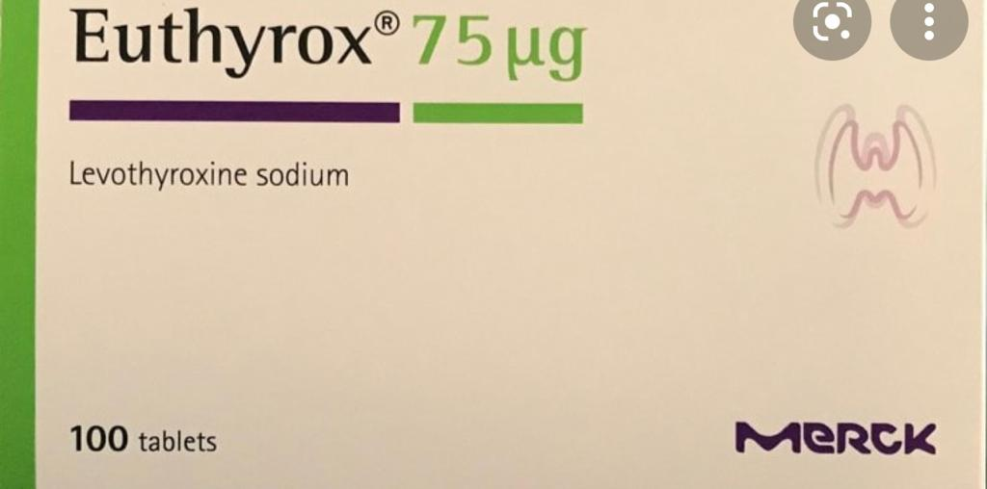
Tablets: 25 to 300 mcg

Slide 11
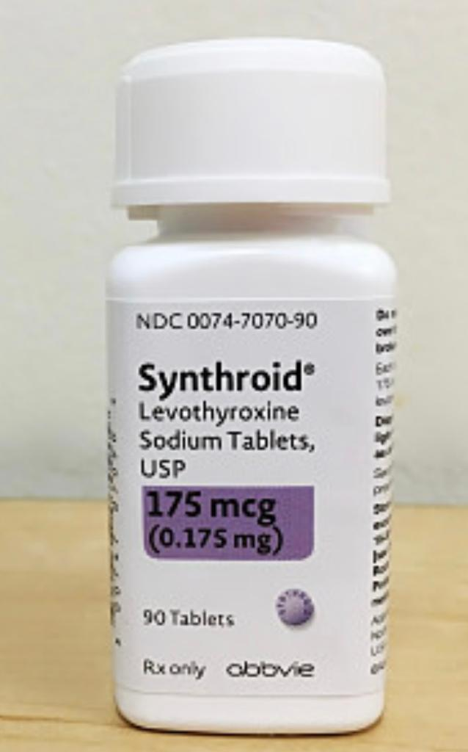
Tablets: 25 to 300 mcg

Slide 12
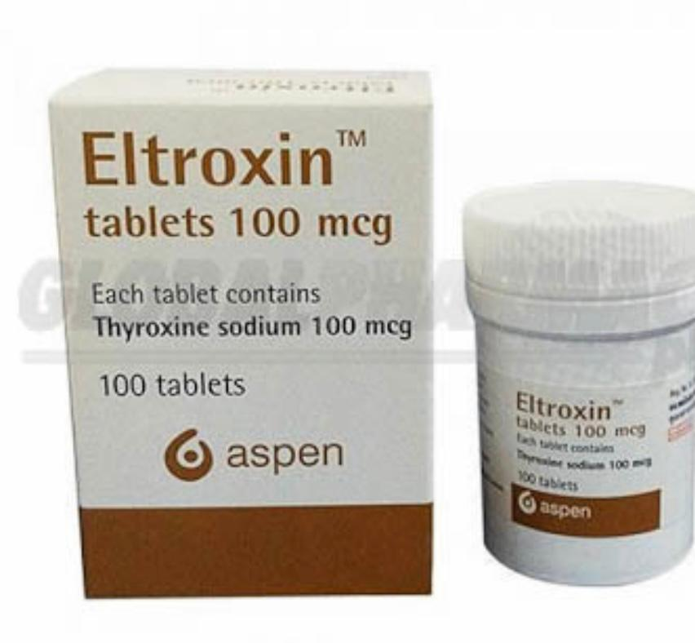
Tablets: 25 to 300 mcg

Slide 13
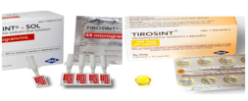
Liquid preparations:
the LT4 is dissolved in glycerol
contained either within a gelatin capsule or in a solution.
Better absorption:
have approximately 100% absorption from the gastrointestinal tract, compared with approximately 75% absorption in the fasting state for other LT4 preparations.
Eur J Pharm Biopharm. 2009;72(1):105-110.

Slide 14
Absorption of levothyroxine
An acidic environment in the stomach seems to promote LT4 absorption, which occurs mostly in the jejunum and ileum.
Absorption of oral LT4 is approximately 75% to 80% in the fasting state, with a decrement in absorption if the LT4 tablet is given in a nonfasting state (59% to 68%).
When giving LT4 intravenously, if this is necessary in a hospitalized patient, approximately 75% of the oral outpatient dose can be used.
Thyroid. 2014;24(12):1670-1751.
Metabolism. 1977;26(1):1-8.

Slide 15
Liquid preparations :
Less affected by the altered pH:
the absorption of the liquid preparations, in theory, might be less affected by the altered pH of the gastric environment associated with food consumption, atrophic gastritis, and use of proton pump inhibitors than other LT4 products.
Allergies:
It is also plausible that gelatin capsules may be better tolerated than tablets in individuals with allergies to the excipients contained within tablet preparations.
J Clin Endocrinol Metab. 2014;99(12):4481-4486.

Slide 16
Tablet versus soft gel capsule or liquid
Guidelines for the treatment of hypothyroidism: prepared by the American Thyroid Association Task Force on Thyroid Hormone Replacement. Thyroid (2014) 24:1670–751.

Slide 17
Liquid preparations:
At the current time, there are no data to show that clinical outcomes are improved by using LT4 liquid compared with LT4 tablets.
Growing evidence that liquid preparations may have better absorption in situations where patients are receiving proton pump inhibitors, tube feeds, or have other causes of malabsorption.
New formulations of levothyroxine in the treatment of hypothyroidism: trick or treat? Thyroid. 2021;31(2):193-201.

Slide 18
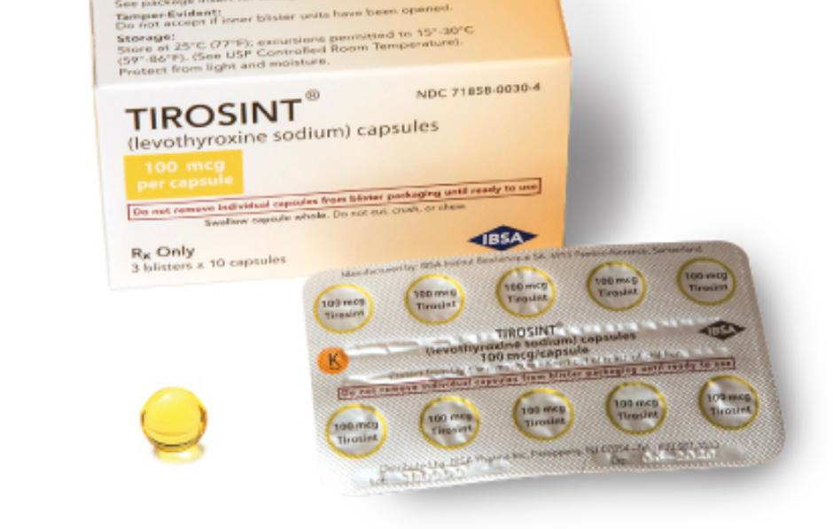
Soft gel capsules: Tirosint (13 to 200 mcg)

Slide 19
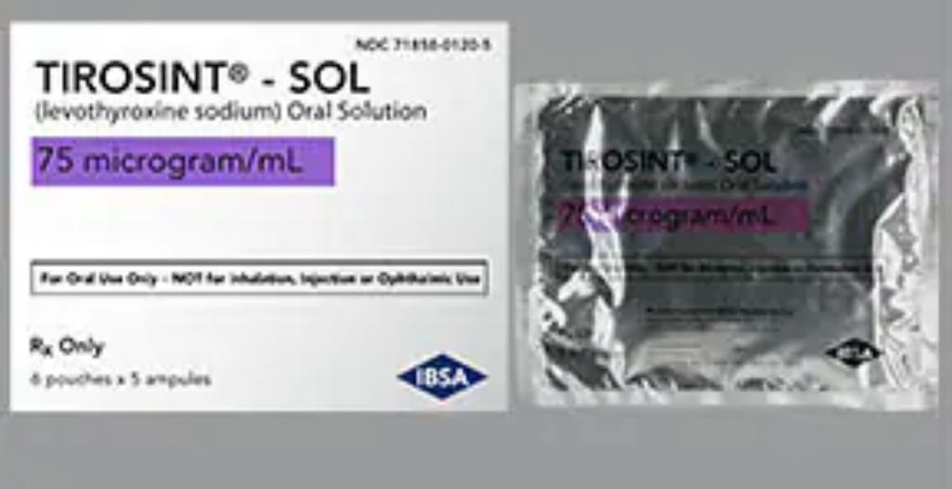
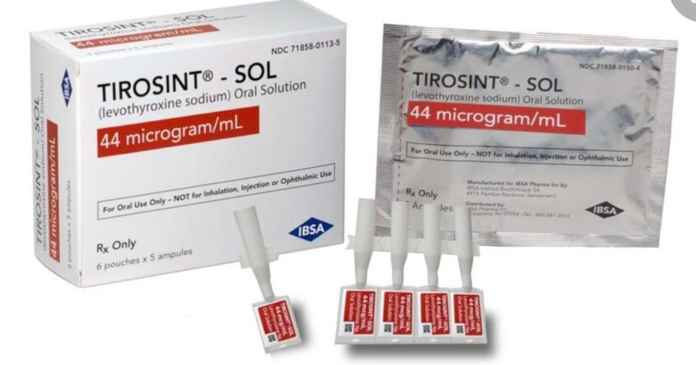
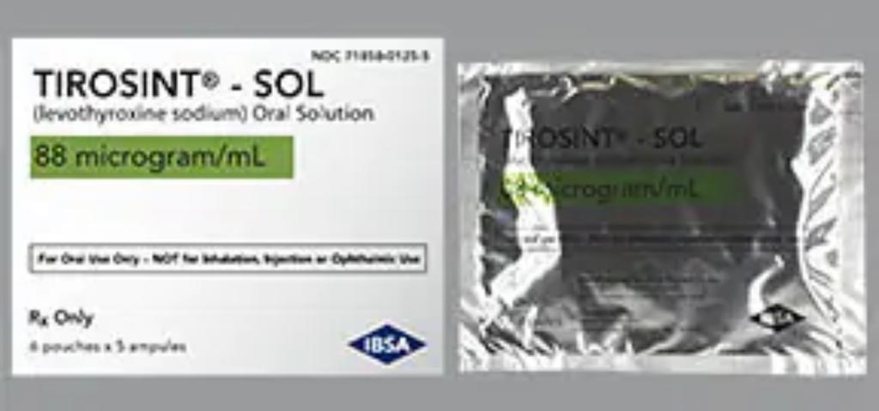
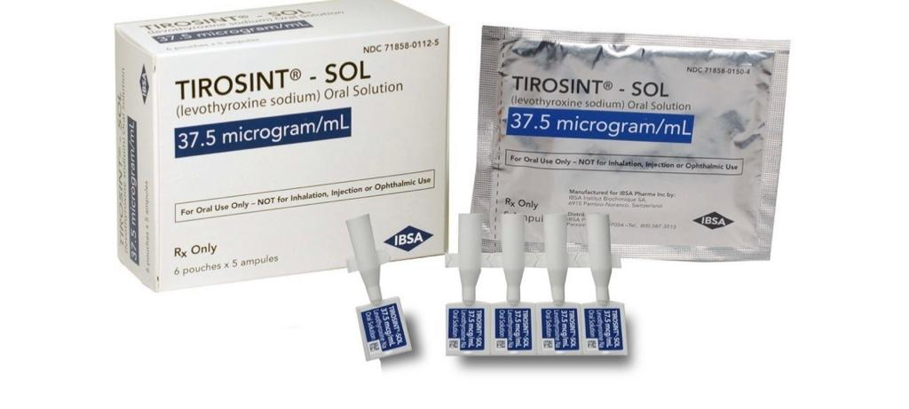
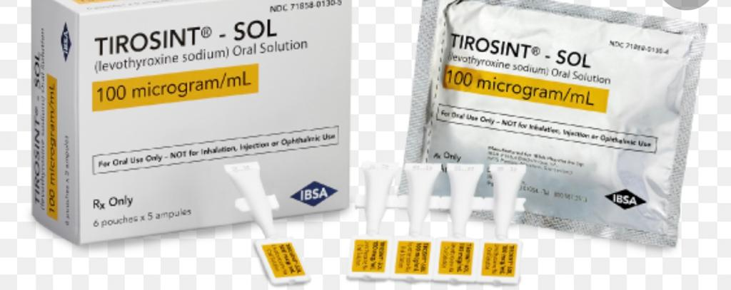
Oral solutions: Tirosint-Sol (13 to 200 mcg/mL) Thyquidity (100 mcg/5 mL oral solution in a 100 mL bottle)

Slide 20
Solution for injection

Slide 21
Generic versus brand name

Slide 22
Guidelines for the treatment of hypothyroidism: prepared by the American Thyroid Association Task Force on Thyroid Hormone Replacement. Thyroid (2014) 24:1670–751.

Slide 23
Guidelines for the treatment of hypothyroidism: prepared by the American Thyroid Association Task Force on Thyroid Hormone Replacement. Thyroid (2014) 24:1670–751.

Slide 24
Generic versus brand product
A recent study of LT4 initiation over a 3-month period in patients treated with brand- name vs generic products:
A similar percentage of out-of-range TSH values.
There also does not seem to be a difference in cardiovascular or skeletal outcomes
JAMA Netw Open. 2020;3(9):e2017645.

Slide 25
Switches between levothyroxine products
There are reports of clinically significant changes in serum TSH associated with a patient’s LT4 preparation being changed either
from one brand name to another,
from a brand-name to a generic product,
from one generic to another.
The change in TSH has been attributed to:
the different excipients
different absorption characteristics
expected to have slightly different bioequivalence.
Thyroid. 2020;30(6):821-828.

Slide 26
Pharmacokinetic parameters:
Bioequivalence:
is a measure of absorption or bioavailability
is used by the FDA to predict the therapeutic efficacy of drugs.
Thyroid. 2004;14(3):191-200.

Slide 27
Pharmacokinetic parameters which are used to compare different products:
maximum serum concentration (Cmax)
time to Cmax,
area under the concentration-time curve (AUC)
If the 90% CIs from the natural logarithms of the AUC at 48 hours and the Cmax are both within the 80% to 125% range, the products are deemed bioequivalent by the FDA, and are permitted to be substituted for each other.
Thyroid. 2004;14(3):191-200.

Slide 28
Such bioequivalence methodology does not detect LT4 doses with approximately12.5% difference from each other (eg, 100 mcg and 112 mcg tablets)
It is always advisable to recheck serum TSH in individuals who have been switched from one preparation to another.
This is the rationale for advising patients to continue taking the same “identifiable” product (either brand or generic).
Thyroid. 2004;14(3):191-200.

Slide 29
Summary:
Either a generic or a brand-name formulation is acceptable.
Patients remain on the same formulation of T4 (Grade 2C).
If a switch from one manufacturer to another is made by the pharmacy, we measure a serum TSH six weeks after changing preparations to document that the serum TSH is still within the therapeutic target.
Thyroid 2020; 30:821.

Slide 30
In a study from the Netherlands during an unexpected shortage of one branded levothyroxine product:
a higher percentage of patients who switched brands had abnormal TSH levels, especially if their dose exceeded 100 mcg/day.
Flinterman LE, Kuiper JG, Korevaar JC, et al. Impact of a Forced Dose-Equivalent Levothyroxine Brand Switch on Plasma Thyrotropin: A Cohort Study. Thyroid 2020; 30:821.

Slide 31
TSH monitoring
Repeat TSH annually
and with any of the following:
New symptoms of hypothyroidism or hyperthyroidism
Pregnancy, menopause or initiation or discontinuation of estrogen replacement
New medication or condition that may alter thyroid hormone absorption or metabolism(eg, amiodarone)
Weight gain or loss of more than 10% of body weight
A switch to a different thyroid hormone manufacturer

Slide 32
2) Ensuring Effective Therapy

Slide 33
Initial dose
The average full replacement dose of T4 in adults is approximately 1.6 mcg/kg body weight per day
But the range of required doses is wide.
Douglas S Ross. Treatment of primary hypothyroidism in adults , 2022 UpToDate

Slide 34
T4 requirements correlate better with lean body mass than total body weight.
BMI | <25 kg/m2 | 25 to 29 kg/m2 | 30 to 34 kg/m2 | 35 to 39 kg/m2 | over 40 kg/m2
the average full replacement dose | 1.76 mcg/kg | 1.47 mcg/kg | 1.42 mcg/kg | 1.27 mcg/kg | 1.28 mcg/kg
Papoian V, Ylli D, Felger EA, et al. Evaluation of Thyroid Hormone Replacement Dosing in Overweight and Obese Patients After a Thyroidectomy. Thyroid 2019; 29:1558.

Slide 35
Simple regimen
As LT4 therapy is generally a lifelong therapy, it is important to ensure that the prescribed regimen is not overly complex and onerous for patients.
As simple a regimen as possible that is linked to a patient’s daily routine is ideal:
Fasting regimens?
other regimens may be acceptable or preferable if they improve adherence.

Slide 36
3) Scheduling of levothyroxine

Slide 37
Scheduling of levothyroxine
Many studies have examined the effect of timing of LT4 ingestion, and its relationship with meals, on the serum TSH.
the general conclusion is that fasting regimens and bedtime regimens may both be acceptable and associated with normal TSH values
Endocrine Reviews, 2021, Vol. XX, No. XX

Slide 38
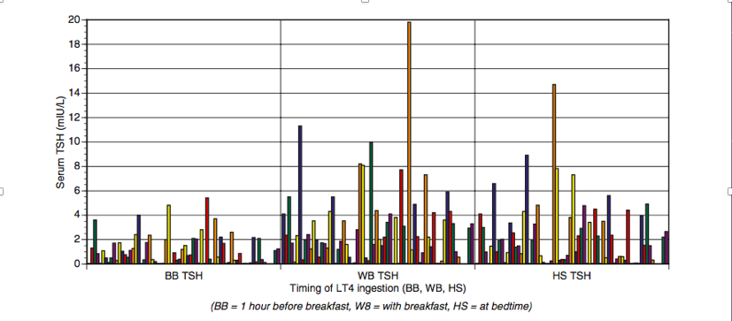
a with-breakfast regimen: the highest and most variable TSH values
a bedtime regimen: lower and less variable TSH values
One hour before breakfast: the lowest and least variable TSH results
Bach-Huynh TG, Nayak B, Loh J, Soldin S, Jonklaas J. Timing of levothyroxine administration affects serum thyrotropin concentration. J Clin Endocrinol Metab. 2009;94(10):3905-3912.

Slide 39
Endocrine Reviews, 2021, Vol. XX, No. XX

Slide 40
Guidelines for the treatment of hypothyroidism: prepared by the American Thyroid Association Task Force on Thyroid Hormone Replacement. Thyroid (2014) 24:1670–751.

Slide 41
4) Absorption of levothyroxine

Slide 42
Absorption of levothyroxine
An acidic environment in the stomach seems to promote LT4 absorption, which occurs mostly in the jejunum and ileum.
Absorption of oral LT4 is approximately 75% to 80% in the fasting state, with a decrement in absorption if the LT4 tablet is given in a nonfasting state (59% to 68%).
When giving LT4 intravenously approximately 75% of the oral outpatient dose can be used.
Thyroid. 2014;24(12):1670-1751.
Metabolism. 1977;26(1):1-8.

Slide 43
5) Levothyroxine Interferents

Slide 44
Foods Affecting Levothyroxine Dose

Slide 45
Foods and levothyroxine dose
Some specific foods or beverages reducing LT4 absorption include: fiber, soybeans, coffee, and grapefruit.
The impaired absorption may be overcome by:
Changing the time of the LT4 administration,
A higher dose of LT4 may be administered
Vitamin C can improve LT4 absorption.
Skelin M, et al. Factors affecting gastrointestinal absorption of levothyroxine: a review. Clin Ther. 2017;39(2):378-403.

Slide 46
Drugs Affecting Levothyroxine Dose

Slide 47
Drugs and levothyroxine dose
Drugs can alter thyroid function in those without preexisting thyroid disease:
Causing overt thyroid dysfunction.
Producing abnormal thyroid biochemical parameters
Altering the LT4 requirement in those already being treated for hypothyroidism
N Engl J Med. 2019;381(8):749-761.

Slide 48
Douglas S Ross. Treatment of primary hypothyroidism in adults , 2022 UpToDate

Slide 49
The effects of drugs:
altered TSH secretion
altered thyroid hormone synthesis or release
altered transport (hepatic synthesis of TBG, binding to carrier proteins)
altered metabolism
altered LT4 absorption.
Endocrine Reviews, 2021, Vol. XX, No. XX
N Engl J Med 2019; 381:749-761

Slide 50
Altered TSH secretion:
bexarotene, which lowers TSH and causes profound central hypothyroidism
Causes CH in almost all patients via TSH suppression
Thyroid Diseases, Endocrinology 3. Cham, Switzerland: Springer (2018). p. 733–61.

Slide 51
Altered thyroid hormone synthesis or release:
methimazole, propylthiouracil
Lithium
Amiodarone
interferon-α,
checkpoint inhibitors (Ipilimumab, Nivolumab,…)
alemtuzumab,
TKI (sunitinib)
N Engl J Med. 2019;381(8):749-761.

Slide 52
Altered transport (hepatic synthesis of TBG, inhibit binding to carrier proteins)
High serum TBG:
Estrogen, Tamoxifen, Raloxifene, Methadone, Heroin, Clofibrate, Mitotane
Low serum TBG:
Androgen, Danazol, Glucocorticoids, Niacin
Inhibit T4 binding to plasma proteins thus increasing serum FT4:
Furosemide
Heparin,
salicylates, and other nonsteroidal anti-inflammatory drugs
Philadelphia: Wolters Kluwer, Lippincott Williams & Wilkins (2013). p. 187–202.

Slide 53
Altered metabolism of thyroid hormone:
i) increased hepatic metabolism via induction of P450,
ii) decreased activation of T4 to T3 via inhibition of DIO2
iii) increased deactivation of T4 and T3 via acceleration of type 3 deiodinase activity.
Need for an increased dose of LT4
Endocrine Reviews, 2021, Vol. XX, No. XX

Slide 54
Endocrine Reviews, 2021, Vol. XX, No. XX

Slide 55
Alteration in LT4 absorption:
Mechanism:
Adsorb to LT4 in the gastrointestinal tract: calcium, iron
Increasing gastric pH: proton pump inhibitors
Medications that interfere with T4 absorption should be taken several hours after the T4 dose.
Thyroid. 2014;24(12):1670-1751.

Slide 56
Frontiers in Endocrinology, December 2020 | Volume 11 | Article 607446

Slide 57
Alteration in LT4 absorption:
Frontiers in Endocrinology, December 2020 | Volume 11 | Article 607446

Slide 58
Frontiers in Endocrinology, December 2020 | Volume 11 | Article 607446

Slide 59
Frontiers in Endocrinology, December 2020 | Volume 11 | Article 607446

Slide 60
Review of American Thyroid Association (ATA) guidelines

Slide 61
Guidelines for the treatment of hypothyroidism: prepared by the American Thyroid Association Task Force on Thyroid Hormone Replacement. Thyroid (2014) 24:1670–751.

Slide 62
Guidelines for the treatment of hypothyroidism: prepared by the American Thyroid Association Task Force on Thyroid Hormone Replacement. Thyroid (2014) 24:1670–751.

Slide 63
TSH changes after IM
A retrospective study
evaluated TSH changes in 10,999 Scottish residents
who were prescribed L-T4 before starting IM.
Iron, calcium, PPI, and estrogens increased TSH significantly, with an increase >5 mU/L in 7.5, 4.4, 5.6, and 4.3% patients, respectively.
changed insignificantly in patients on H2 receptor antagonists or glucocorticoids.
Clin Endocrinol (Oxf) (2015) 82:136–41.

Slide 64
Examples of INTERFERING MEDICATIONS

Slide 65
Immunotherapy (Anti-CTLA-4 Ab and anti-PD-1 Ab):
monoclonal Ab to programmed cell death-1 receptor: (nivolumab and pembrolizumab)
Ab to cytotoxic T lymphocyte-associated antigen-4 (ipilimumab, tremelimumab)
 | hypothyroidism (Autoimmune thyroiditis) | autoimmune hypophysitis
nivolumab | 0–40% | 0–0.9%
pembrolizumab | 0–11.5% | 0–1.2%
ipilimumab | 0–9% | 0–17.4%
tremelimumab | 0–5% | 0–2.6%
González-RodrıǵuezE,Rodrıǵuez-AbreuD.Immunecheckpointinhibitors: review and management of endocrine adverse effects. Oncologist (2016) 21:804–16. doi: 10.1210/jc.2012-4075

Slide 66
Tyrosine kinase inhibitors (TKI)
imatinib, motesanib, sorafenib, sunitinib, and vandetanib:
de novo hyperthyroidism or hypothyroidism,
worsen pre-existing hypothyroidism and increase L-T4 requirements
Nilotinib and dasatanib:
rarely alter L- T4 requirements
Torino F, Barnabei A, Paragliola R, Baldelli R, Appetecchia M, Corsello SM. Thyroid dysfunction as an unintended side effect of anticancer drugs. Thyroid (2013) 23:1345–66. doi: 10.1089/thy.2013.0241

Slide 67
lithium-treated patients
OH or SCH develop in up to 15 or 34%
the annual rate of developing PH being 1.5%,
6.4% in thyroid antibody-positive
0.8% in thyroid antibody- negative
Women <60-year-old are at greatest risk to develop thyroid disease
J Affect Disord (2005) 87:313–7. doi: 10.1016/j.jad.2005.03.010

Slide 68
SSRIs
Affect TFTs variably
Usually with no or downward changes of FT4 and FT3
No or upward change of TSH within the corresponding reference range
McCowen KC, Garber JR, Spark R. Elevated serum thyrotropin in thyroxine- treated patients with hypothyroidism given sertraline. N Engl J Med (1997) 337:1010–1. doi: 10.1056/NEJM199710023371415

Slide 69
antiepileptic drugs (AED)
SCH may occur reversibly:
carbamazepine, phenytoin, valproate, oxcarbazepine,
but not lamotrigine, levitracetam, tiagabine and vigabatrine.
AED administration in L-T4-replaced patients with hypothyroidism requires higher L-T4 doses.
Verrotti A, Scardapane A, Manco R, Chiarelli F. Antiepileptic drugs and thyroid function. J Pediatr Endocrinol Metab (2008) 21:401–8. doi: 10.1515/ jpem.2008.21.5.401

Slide 70
Orlistat
Based on data of the UK Medicines Information pharmacists, only two cases of interaction between orlistat and L-T4 were reported, most likely via T4 malabsorption.
It was recommended that:
L-T4 and orlistat “should be separated by 4 hours,
increased monitoring of thyroid hormone levels may be prudent”
Medicines Q&As. Is there an interaction between orlistat and levothyroxine? Available at: https://www.surreyandsussex.nhs.uk/wp-content/uploads/ 2013/04/UKMi-Interaction-between-Orlistat-Thyroxine.pdf (Accessed June 1, 2020). Unknown author.

Slide 71
Metformin
lowers serum TSH:
in OH and SCH patients,
but not in euthyroid patients
After its chronic administration, FT4 was unchanged and TSH decreased.
Cappelli C, Rotondi M, Pirola I, Agosti A, Gandossi E, Valentini U, et al. TSH-lowering effect of metformin in type 2 diabetic patients: differences between euthyroid, untreated hypothyroid, and euthyroid on L-T4 therapy patients. Diabetes Care (2009) 32:1589–90. doi: 10.2337/dc09- 0273

Slide 72
Medical Conditions Affecting Levothyroxine Dose

Slide 73
Medical conditions and levothyroxine dose
several gastrointestinal conditions may also be associated with a decrement in LT4 absorption:
celiac disease,
atrophic gastritis associated with Helicobacter pylori infection,
Autoimmune chronic gastritis
lactose intolerance,
ulcerative colitis
Front Endocrinol (Lausanne). 2019;10:233.

Slide 74
Medical conditions and levothyroxine dose
Patients with these conditions may require more than the predicted weight-based LT4 dose,
with a trend toward a more typical weight-based requirement if the condition is successfully treated.
For example, reversal of gastritis by treatment of H pylori is associated with improved LT4 absorption.
Front Endocrinol (Lausanne). 2019;10:233.

Slide 75
Treatment:
Celiac disease: a gluten-free diet improves T4 absorption.
Other options for patients with poor T4 absorption include:
increasing the dose of T4 tablets
switching to a soft gel or liquid preparation.
Pulverizing the tablet
adding supplementation with either 1 g/d or 0.5 g/d vitamin C to acidify the intragastric pH.
the development of “formulations that can minimize or mitigate the effects of increased gastric pH on the bioavailability
Yamamoto T. Tablet formulation of levothyroxine is absorbed less well than powdered levothyroxine. Thyroid 2003; 13:1177.
Jubiz W and Ramirez M. Effect of Vitamin C on the absorption of levothyroxine in patients with hypothyroidism and gastritis. J Clin Endocrinol Metab (2014) 99:E1031–4. doi: 10.1210/jc.2013-4360

Slide 76
Guidelines for the treatment of hypothyroidism: prepared by the American Thyroid Association Task Force on Thyroid Hormone Replacement. Thyroid (2014) 24:1670–751.

Slide 77
6) Nonadherent patients

Slide 78
In general, persistently elevated TSH in spite of doses >2 mcg/kg/day suggest:
T4 malabsorption
poor adherence to the medication regimen
Douglas S Ross. Treatment of primary hypothyroidism in adults , 2022 UpToDate

Slide 79
persistently elevated TSH
Malabsorption:
free T4 levels are typically low or low-normal.
poorly compliant patients:
free T4 levels are low, normal, or high
depending on how much T4 they have taken, when they have taken it.
Douglas S Ross. Treatment of primary hypothyroidism in adults , 2022 UpToDate

Slide 80
Approach to patients with elevated TSH:
In patients with persistently elevated TSH despite what appears to be an adequate dose of T4:
1) Assess drug potency
2) check compliance
3) T4 absorption test
4) Management of malabsorption or nonadherent
Douglas S Ross. Treatment of primary hypothyroidism in adults , 2022 UpToDate

Slide 81
1) Loss of potency:
LT4 that is beyond its expiry date
environmental causes such as excessive heat or moisture during transport
Guidelines for the treatment of hypothyroidism: prepared by the American Thyroid Association Task Force on Thyroid Hormone Replacement. Thyroid (2014) 24:1670–751.

Slide 82
2) Check compliance:
Confirming that T4 is taken daily on an empty stomach with water,
ideally an hour before breakfast,
and that medications that interfere with T4 absorption are taken several hours after the T4 dose.
Douglas S Ross. Treatment of primary hypothyroidism in adults , 2022 UpToDate

Slide 83
3) T4 absorption test
Weight-based weekly oral dose of T4 (1.6 mcg/kg body weight times 7): 600- 2000 mcg/kg
Free T4 is measured at baseline and at two hours.
Normal absorption being defined as 60% or greater
Values well below this suggest malabsorption,
values similar to this suggest poor compliance.
Walker JN, Shillo P, Ibbotson V, et al. A thyroxine absorption test followed by weekly thyroxine administration: a method to assess non-adherence to treatment. Eur J Endocrinol 2013; 168:913.

Slide 84
Only 1 of 16 tests done at one institution over a four-year period documented malabsorption
One survey of patients prescribed LT4 found a self-reported nonadherence rate of 22%.
Some data suggest that nonadherence rates of approximately 5% to 27% may be representative.
Gonzales KM, et al. The Levothyroxine Absorption Test: A Four-Year Experience (2015- 2018) at The Mayo Clinic. Thyroid 2019; 29:1734.
Rev Med Chil. 2020;148(6):740-745.

Slide 85
Strategies for Poorly compliant patients
Given their total weekly dose of T4 twice weekly or weekly
not be used in patients with coronary heart disease.
Parenteral administration of LT4
Grebe SK, Cooke RR, Ford HC, et al. Treatment of hypothyroidism with once weekly thyroxine. J Clin Endocrinol Metab 1997; 82:870.

Slide 86
Twice weekly or weekly therapy
A randomized crossover study compared daily vs weekly administration of LT4.
Weekly therapy was associated with:
lower TSH values, although the TSH values were not fully normalized
Supratherapeutic concentrations of FT4 for about 24 hours
FT3 levels remained within the normal range.
Grebe SK, Cooke RR, Ford HC, et al. Treatment of hypothyroidism with once weekly thyroxine. J Clin Endocrinol Metab 1997; 82:870.

Slide 87
No difference in symptoms and well-being
markers of LT4 action such as SHBG, osteocalcin, heart rate, and left ventricular ejection time did not differ between regimens over the 6-week duration of the trial.
Mean serum cholesterol was higher during weekly therapy
Bornschein A, Paz-Filho G, Graf H, Carvalho GA 2012 Treating primary hypothyroidism with weekly doses of levo- thyroxine: a randomized, single-blind, crossover study. Arq Bras Endocrinol Metabol 56:250–258.

Slide 88
A second similar cross-over trial of 6 weeks’ duration
showed greater increases in T4 after the weekly dose compared with the daily dose,
no associated symptoms or echocardiographic manifestations of hyperthyroidism
Bornschein A, Paz-Filho G, Graf H, Carvalho GA 2012 Treating primary hypothyroidism with weekly doses of levo- thyroxine: a randomized, single-blind, crossover study. Arq Bras Endocrinol Metabol 56:250–258.

Slide 89
Guidelines for the treatment of hypothyroidism: prepared by the American Thyroid Association Task Force on Thyroid Hormone Replacement. Thyroid (2014) 24:1670–751.

Slide 90
improving adherence during Ramadan
During Ramadan the best timing of LT4 administration may be unclear.
Twice or 3 times weekly LT4 administration has also been proposed as a means of improving adherence during Ramadan,
Dabbous Z, Alowainati B, Darwish S, et al. A prospective study comparing two-time points of thyroid hormone replace- ment during the holy month of Ramadan. Int J Endocrinol. 2019;2019:9843961.

Slide 91
Parenteral LT4 therapy
No trials of such therapy were identified.
A case report in a patient with uncharacterized malabsorption, rather than noncompliance, has been described
twice weekly or weekly administration of intramuscular LT4 showed some fluctuations of T4 levels, but with these levels remaining in the reference range.
Hays MT 2007 Parenteral thyroxine administration. Thy- roid 17:127–129.

Slide 92
Summary

Slide 93
T4 formulations
 | Tablet | Soft gel capsules | Oral solutions | Parenteral
Brand names | Euthyrox, Levo-T, Levoxyl, Synthroid, Unithroid | Tirosint | Tirosint-Sol, Thyquidity
Dosage | 25, 50, 75, 88, 100, 112, 125, 137, 150, 175, 200, 300 mcg | 13, 25, 50, 75, 88, 100, 112, 125, 137, 150, 175, 200 mcg | 13, 25, 50, 75, 88, 100, 112, 125, 137, 150, 175, 200 mcg/ml, 100 mcg/5ml | 20, 40, 100, 200, 500 mcg/ml
Douglas S Ross. Treatment of primary hypothyroidism in adults , 2022 UpToDate

Slide 94
Summary:
Liquid formulations preference:
Better absorption
Less affected by the altered pH
Either a generic or a brand-name formulation is acceptable.
We suggest that patients remain on the same formulation of T4 (Grade 2C).
Scheduling of levothyroxine: fasting regimens and bedtime regimens may both be acceptable and associated with normal TSH values

Slide 95
The effects of drugs:
altered TSH secretion
altered thyroid hormone synthesis or release
altered transport (hepatic synthesis of TBG, binding to carrier proteins)
altered metabolism
altered LT4 absorption.
Endocrine Reviews, 2021, Vol. XX, No. XX
N Engl J Med 2019; 381:749-761

Slide 96
In general, persistently elevated TSH in spite of doses >2 mcg/kg/day suggest:
T4 malabsorption
poor adherence to the medication regimen

Slide 97
options for patients with poor T4 absorption
increasing the dose of T4 tablets
switching to a soft gel or liquid preparation.
Pulverizing the tablet
adding supplementation with either 1 g/d or 0.5 g/d vitamin C to acidify the intragastric pH.
Yamamoto T. Tablet formulation of levothyroxine is absorbed less well than powdered levothyroxine. Thyroid 2003; 13:1177.
Jubiz W and Ramirez M. Effect of Vitamin C on the absorption of levothyroxine in patients with hypothyroidism and gastritis. J Clin Endocrinol Metab (2014) 99:E1031–4. doi: 10.1210/jc.2013-4360

Slide 98
T4 absorption test
Weight-based weekly oral dose of T4 (1.6 mcg/kg body weight times 7): 600- 2000 mcg/kg
Free T4 is measured at baseline and at two hours.
Normal absorption being defined as 60% or greater
Values well below this suggest malabsorption,
values similar to this suggest poor compliance.
Walker JN, Shillo P, Ibbotson V, et al. A thyroxine absorption test followed by weekly thyroxine administration: a method to assess non-adherence to treatment. Eur J Endocrinol 2013; 168:913.

Slide 99
Strategies for Poorly compliant patients
Given their total weekly dose of T4 twice weekly or weekly
not be used in patients with coronary heart disease.
Parenteral administration of LT4
Grebe SK, Cooke RR, Ford HC, et al. Treatment of hypothyroidism with once weekly thyroxine. J Clin Endocrinol Metab 1997; 82:870.

