Slide 1
IN THE NAME OF GOD Laboratory Analysis in the Diagnosis and Management of Diabetes Mellitus
Nahid Kord, MD
NOV 27,2023

Slide 2
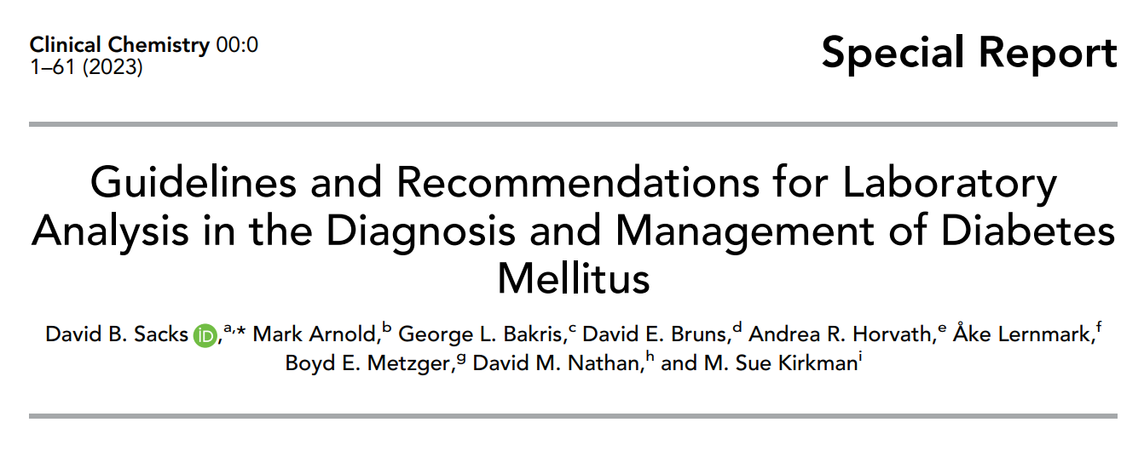

Slide 3
AGENDA
Introduction:
Background, Rating and Grading scale
Glucose:
Use/ Rationale: Diagnosis, Screening, Monitoring/ Prognosis
Analytical Considerations: Preanalytical, Analytical
Interpretation
Hemoglobin A1c:
Description
Use/ Rationale: Diagnosis/ Screening, Monitoring
Target Levels/ Treatment Goals
Analytical Considerations: Preanalytical, Analytical
Interpretation

Slide 4
Introduction

Slide 5
Background
The American Association for Clinical Chemistry (AACC) and American Diabetes Association (ADA) issued this Guideline in 2002 and 2011.
Here we review and update these recommendations, especially in those areas where new evidence has emerged since the 2011 .
The literature was reviewed to the end of 2021.

Slide 6
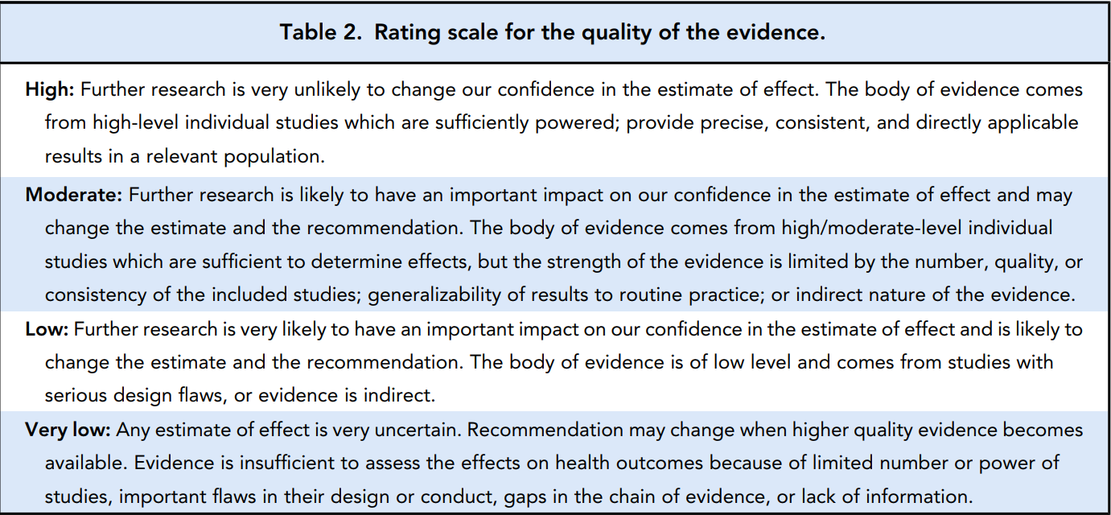

Slide 7
Table 3. Grading the strength of recommendations.
A | STRONGLY RECOMMEND
B | RECOMMEND
C | THERE IS INSUFFICIENT INFORMATION TO MAKE A RECOMMENDATION
GPP | GOOD PRACTICE POINT

Slide 8
Glucose

Slide 9
Diagnosis
Recommendation: Fasting glucose should be measured in venous plasma when used to establish the diagnosis of diabetes, with a value ≥126 mg/dL (≥ 7 mmol/l ) diagnostic of diabetes. A (high)

Slide 10
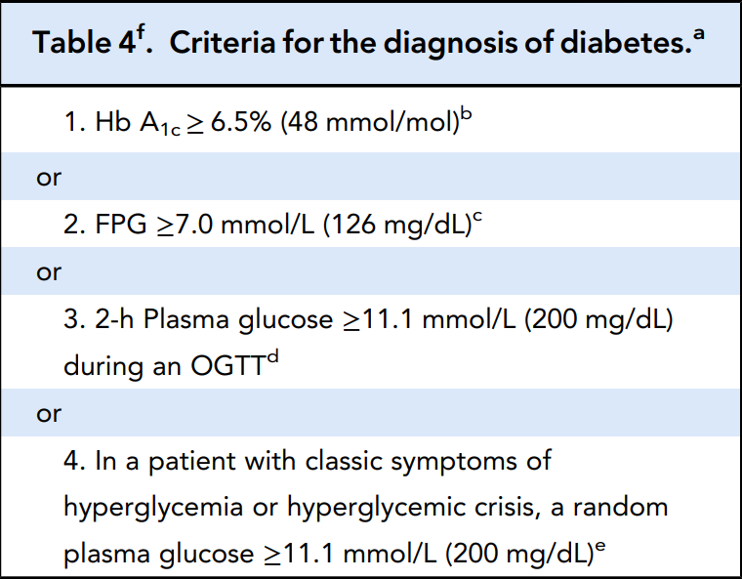
Diagnosis

Slide 11
Diagnosis
If any one of the criteria in Table 4 is met, confirmation is necessary to establish the diagnosis:
Repeating the same assay on a different blood sample drawn on a subsequent day.
Different to the initial assay, in the subsequent sample.
Measure 2 different analytes, namely glucose and Hb A1c, in samples obtained on the same day.
Repeat testing is not required in symptomatic individuals who have unequivocal hyperglycemia.

Slide 12
Diagnosis

Slide 13
Screening
Recommendation: Screening by HbA1c, FPG or 2-h OGTT is recommended for individuals who are at high risk of diabetes.
If Hb A1c is <5.7% , FPG is <100 mg/dL, and/or 2-h plasma glucose is <140 mg/dL), testing should be repeated at 3-year intervals. B (moderate)

Slide 14
Screening
Recommendation: Glucose should be measured in venous plasma when used for screening of high-risk individuals. B (moderate)
Recommendation: Plasma glucose should be measured in an accredited laboratory when used for diagnosis of or screening for diabetes. GPP (good practice point)

Slide 15
Screening
The ADA proposes that all asymptomatic people 35 years of age or more should be screened.
Hb A1c, FPG or 2-h OGTT are appropriate for screening.
If FPG is <100 mg/dL, 2-h plasma glucose is <140 mg/dL, and/or Hb A1c is <5.7% , testing should be repeated at 3-year intervals.

Slide 16
Screening
The ADA suggests that in individuals who are overweight or obese (BMI ≥25 kg/m2) and who have 1 or more other risk factors for diabetes screening be considered at a younger age or be carried out more frequently.
Individuals with prediabetes should be tested annually.

Slide 17
Screening
Because of the increasing prevalence of type 2 diabetes in children, screening of children is now advocated.
Starting at 10 years of age (or at the onset of puberty if puberty occurs at a younger age).
testing should be performed every 3 years in overweight youths (BMI>85th percentile) who have 1 or more risk factors: family history, signs of insulin resistance or conditions associated with insulin resistance, maternal history of diabetes or GDM during the child’s gestation, race/ethnicity

Slide 18
Screening
Despite these recommendations that interventions can delay, and sometimes prevent, the onset of type 2 diabetes in individuals with (IGT) or (IFG), there is yet no published evidence that treatment based on screening influences long-term complications.
There is a lack of consensus in the published literature as to which screening procedure, FPG, OGTT and/or Hb A1c is the most appropriate.

Slide 19
Monitoring/prognosis
Recommendation: Routine measurement of plasma glucose concentrations in a laboratory is not recommended as the primary means of monitoring or evaluating therapy in individuals with diabetes. B (moderate)

Slide 20
Monitoring/prognosis
There is a direct relationship between the degree of glycemia and the risk of renal, retinal, and neurological complications for both type 1 and type 2 diabetes.

Slide 21
Monitoring/prognosis
In the Diabetes Control and Complications Trial (DCCT), adults and adolescents with type 1 diabetes randomized to maintain lower average blood glucose concentrations exhibited a significantly lower incidence of microvascular complications, namely diabetic retinopathy, nephropathy, and neuropathy.

Slide 22
Monitoring/prognosis
The United Kingdom Prospective Diabetes Study (UKPDS) in people with short-duration type 2 diabetes showed that intensive blood glucose control significantly reduced microvascular complications .

Slide 23
Monitoring/prognosis
While meta-analyses suggest that intensive glycemic control in individuals with type 2 diabetes reduces cardiovascular disease, clinical trials have not consistently demonstrated a reduction in macrovascular disease (myocardial infarction or stroke) with intensive therapy.

Slide 24
Monitoring/prognosis
Long-term (10 year) follow-up of the UKPDS population supported a benefit of intensive therapy on macrovascular disease , but 3 other trials failed to demonstrate a significant difference in macrovascular disease outcomes between very intensive treatment strategies achieving Hb A1c concentrations of approximately 6.5% compared with the control groups who had Hb A1c concentrations 0.8% to 1.1% higher.
One study even observed higher cardiovascular mortality in the intensive treatment arm.

Slide 25
Monitoring/prognosis
Laboratory measurements of random or fasting glucose concentrations should not be performed as the primary means of routine outpatient monitoring of people with diabetes.
Laboratory plasma glucose testing can be used to supplement information from other testing or to assess the accuracy of self-monitoring .

Slide 26
Monitoring/prognosis
Monitoring is performed by patients themselves who measure glucose with meters or continuous glucose monitoring (CGM) and by assessment of Hb A1c in an accredited laboratory.
Appropriate intervals between measurements of glucose in acute clinical situations (e.g., hospitalization, DKA, neonatal hypoglycemia) are highly variable and may range from 30 min to 24 h or more.

Slide 27
Preanalytical
Recommendation: Blood for fasting plasma glucose analysis should be drawn in the morning after the subject has fasted overnight (at least 8 h). B (low)

Slide 28
Preanalytical
Recommendation: To minimize glycolysis, a tube containing a rapidly effective glycolytic inhibitor such as granulated citrate buffer should be used for collecting the sample. If this cannot be achieved, the sample tube should immediately be placed in an ice-water slurry and subjected to centrifugation to remove the cells within 15 to 30 min. Tubes with only enolase inhibitors such as sodium fluoride should not be relied on to prevent glycolysis. B (moderate)

Slide 29
Preanalytical
Published evidence reveals a diurnal variation in FPG, with mean FPG higher in the morning than in the afternoon, indicating that many cases of diabetes would be missed in individuals screened with FPG in the afternoon.
Glucose concentrations decrease ex vivo in whole blood due to glucose consumption predominantly by red and white blood cells.

Slide 30
Preanalytical
The rate of glycolysis—reported to average 5% to 7% (approximately 10 mg/dL) per hour —varies with the glucose concentration, temperature, white blood cell count, and other factors.
Such a decrease of glucose will lead to missed diagnoses of diabetes in the large proportion of the population who have glucose concentrations near the cut points for diagnosis of diabetes.

Slide 31
Analytical
Recommendation: Based on biological variation, glucose measurement should have analytical imprecision ≤2.4%, bias ≤2.1% and total error ≤6.1%. To avoid misclassification of individuals, the goal for glucose analysis should be to minimize total analytical error and methods should be without measurable bias. B (moderate)

Slide 32
Analytical
The biological variability within an individual is substantially greater than analytic variability;
analytic imprecision makes a negligible contribution to variation in patient results.

Slide 33
Interpretation
Glucose homeostasis is impaired with aging.
FPG increases with increasing age beginning in the third to fourth decade.
FPG does not increase significantly after age 60, but 2-h glucose concentrations during a 75-g OGTT are considerably higher in older persons.
Many factors participate in the metabolic dysregulation that develops with increasing age, and changes in body composition make an important contribution.

Slide 34
Hemoglobin A1c

Slide 35
Description
Glycation refers to the nonenzymatic attachment of glucose to available amino groups on proteins.
Hemoglobin in the RBC has an average circulating lifespan of approximately 120 days and glycated hemoglobin therefore usually indicates the average glucose concentration over the preceding 60 to 90 days.

Slide 36
Description
Hb A1c is the specific glycated species that is modified by glucose on the N-terminal valine of the hemoglobin beta chain.
Assay methods that measure total glycated hemoglobins (e.g., boronate affinity methods) should be calibrated to report results equivalent to Hb A1c to harmonize results.

Slide 37
Description
In addition to GHb assays, approved and commercially available assays that measure total glycated protein (termed fructosamine) or glycated albumin in the serum or plasma are available.
Concentrations of these glycated proteins also reflect mean glycemia, but over a much shorter time (15 to 30 days, reflecting the turnover of albumin) than GHb (60 to 90 days).

Slide 38
Description
The clinical utility of glycated proteins other than hemoglobin has not been clearly established.
Few published studies have convincingly demonstrated a relationship between glycated protein levels and the chronic complications of diabetes.

Slide 39
Screening/diagnosis
Recommendation: Laboratory-based Hb A1c testing can be used to diagnose (a) diabetes, with a value ≥6.5% (≥48 mmol/mol) diagnostic of diabetes, and (b) prediabetes (or high risk for diabetes) with an Hb A1c level of 5.7% to 6.4% (39 to 46 mmol/mol).
An NGSP-certified method should be performed in an accredited laboratory. A (moderate)

Slide 40
Screening/diagnosis
The role of Hb A1c in the diagnosis of diabetes was first proposed and implemented in 2009, made possible by improved assay standardization through the National Glycohemoglobin Standardization Program (NGSP) and International Federation Of Clinical Chemistry (IFCC), and new data demonstrating the association between Hb A1c concentrations and risk for retinopathy.
Hb A1c assays are not recommended for screening for or diagnosis of gestational diabetes.

Slide 41
Screening/diagnosis
Several technical advantages of Hb A1c testing compared with glucose testing, such as:
Its pre-analytic stability
Decreased biological variability
The clinical convenience of the Hb A1c assay, which requires no fasting or glucose challenge, has led to increasing use of Hb A1c testing for diagnosis.

Slide 42
Screening/diagnosis
Recommendation: Point-of-care Hb A1c testing for diabetes screening and diagnosis should be restricted to FDA-approved devices at CLIA-certified laboratories that perform testing of moderate complexity or higher. B (low)

Slide 43
Screening/diagnosis
Only Hb A1c methods that are NGSP-certified should be used to diagnose (or screen for) diabetes.
The ADA has cautioned that POCT devices for Hb A1c should not be used for diagnosis of or screening for diabetes.
Several published evaluations revealed that few POCT devices for Hb A1c met acceptable analytical performance criteria.

Slide 44
Screening/diagnosis
A meta-analysis published in 2017 revealed continuing problems with the accuracy of POCT devices.
Analysis of 60 studies with 13 devices showed that most devices had negative bias (all the others had positive bias) and large standard deviations.

Slide 45
Screening/diagnosis
Laboratories that measure Hb A1c need to have a CLIA certificate, be inspected, and meet the CLIA quality standards .
These standards include specified personnel requirements (including documented annual competency assessments) and participation 3 times per year in an approved proficiency testing program.

Slide 46
Monitoring
Recommendation: Hb A1c should be measured routinely (usually every 3 months until acceptable, individualized targets are achieved and then no less than every 6 months) in most individuals with diabetes mellitus to document their degree of glycemic control. A (moderate)

Slide 47
Monitoring
The recommended specific treatment goals for Hb A1c are based on the results of prospective randomized clinical trials, most notably the DCCT in type 1 diabetes and the UKPDS in type 2 diabetes.
These trials have documented an association between glycemic control, as quantified by Hb A1c, and risks for the development and progression of chronic complications of diabetes.

Slide 48
Monitoring
The ADA recommends: “The frequency of HbA1c testing should depend on the clinical situation, the treatment regimen used and the clinician’s judgment.”
In the absence of well controlled studies that suggest a definite testing protocol, expert opinion recommends Hb A1c testing “at least two times a year in patients who are meeting treatment goals (and who have stable glycemic control) and at least quarterly and as needed in patients whose therapy has changed and/or who are not meeting glycemic goals”.

Slide 49
Monitoring
People with diabetes who are admitted to hospital should have Hb A1c measured if the result of testing in the previous 3 months is not available.
Studies have established that serial (quarterly for 1 year) measurements of Hb A1c are associated with significant reductions in Hb A1c values in people with type 1 diabetes.

Slide 50
Target levels/treatment goals
Recommendation: Treatment goals should be based on ADA recommendations which include maintaining Hb A1c concentrations <7% for many nonpregnant people with diabetes and more stringent goals in selected individuals if this can be achieved without significant hypoglycemia or other adverse effects of treatment. (Note that these values are applicable only if the assay method is certified by the NGSP as traceable to the DCCT reference.) A (high)

Slide 51
Target levels/treatment goals
Recommendation: Higher target ranges are recommended for children and adolescents, and are appropriate for individuals with limited life expectancy, extensive co-morbid illnesses, a history of severe hypoglycemia, and advanced complications. A (high)

Slide 52
Target levels/treatment goals
In the DCCT, each 10% reduction in Hb A1c (e.g., 12% vs 10.8% or 8% vs 7.2%) was associated with a 44% lower risk for the progression of diabetic retinopathy.
Comparable risk reductions were found in the UKPDS.
It should also be noted that in the DCCT and UKPDS decreased Hb A1c was associated with increased risk for severe hypoglycemia.

Slide 53
Target levels/treatment goals
For selected individuals, more stringent targets than 7% can be pursued, might include those with short duration of diabetes, diet-treated type 2 diabetes, and long life expectancy.
For individuals with a history of severe hypoglycemia, limited life expectancy, advanced microvascular or macrovascular complications or extensive comorbid conditions, higher Hb A1c goals should be chosen.

Slide 54
Target levels/treatment goals
Recommendation: During pregnancy and in preparation for pregnancy, women with diabetes should try to achieve Hb A1c goals that are more stringent than in the nonpregnant state, aiming ideally for <6.0% during pregnancy to protect the fetus from congenital malformations and the baby and mother from perinatal trauma and morbidity owing to large-for-date babies. A (moderate)

Slide 55
Preanalytical: Patient variables—age and race
Hb A1c results are not significantly affected by acute fluctuations in blood glucose concentrations, such as those that occur with illness or after meals.
Age and race are reported to influence Hb A1c.
Population data show age-related increases in mean Hb A1c in people without diabetes of approximately 0.1% per decade after age 30 years .

Slide 56
Preanalytical: Patient variables—age and race
The effects of race on Hb A1c values remain controversial.
Several studies have suggested a relatively higher Hb A1c in Black and Hispanic populations than in White populations at the same level of glycemia.

Slide 57
Other patient-related factors and interfering factors
Recommendation: Laboratories should be aware of potential interferences, including hemoglobin variants that may affect Hb A1c test results depending on the method used. In selecting assay methods, laboratories should consider the potential for interferences in their particular patient population. GPP

Slide 58
Other patient-related factors and interfering factors
Recommendation: Hb A1c measurements in individuals with disorders that affect red blood cell turnover may provide spurious (generally falsely low) results regardless of the method used and glucose testing will be necessary for screening, diagnosis, and management. GPP

Slide 59
Other patient-related factors and interfering factors
Recommendation: Assays of other glycated proteins, such as fructosamine or glycated albumin, may be used in clinical settings where abnormalities in red blood cell turnover, hemoglobin variants, or other interfering factors compromise interpretation of Hb A1c test results, although they reflect a shorter period of average glycemia than Hb A1c. GPP

Slide 60
Other patient-related factors and interfering factors
Recommendation: Hb A1c cannot be measured and should not be reported in individuals who do not have Hb A, e.g., those with homozygous hemoglobin variants, such as Hb SS or Hb EE; glycated proteins, such as fructosamine or glycated albumin, may be used. GPP

Slide 61
Other patient-related factors and interfering factors
Vitamins C and E are reported to lower Hb A1c results falsely, possibly by inhibiting glycation of hemoglobin.
Iron-deficiency anemia is reported to increase test results.
Hypertriglyceridemia, hyperbilirubinemia, uremia, chronic alcoholism, chronic ingestion of salicylates, and opiate addiction are reported to interfere with some assay methods, falsely increasing results.

Slide 62
Other patient-related factors and interfering factors
These studies are old and the findings may not pertain to modern methods. For example, interference by uremia has been eliminated.
Hb A1c cannot be measured in individuals with homozygous hemoglobin variants (e.g., Hb SS, Hb CC, Hb EE) or 2 variant hemoglobins, like Hb SC; they have no Hb A and therefore do not have Hb A1c.

Slide 63
Other patient-related factors and interfering factors
Depending on the particular hemoglobinopathy and assay method, results can be either falsely increased or decreased.
Boronate affinity chromatographic assay methods are generally considered to be less affected by hemoglobin variants than other methods.

Slide 64
Sample collection, handling, and storage
Blood can be obtained by venipuncture or by finger-stick capillary sampling.
Blood tubes should contain anticoagulant as specified by the manufacturer of the Hb A1c assay method (EDTA can be used unless otherwise specified by the manufacturer).

Slide 65
Sample collection, handling, and storage
whole blood samples are stable for up to 1 week at 4 °C.
For most methods, whole blood samples stored at -70 °C or colder are stable longterm (at least 1 year).
Improper handling of specimens, such as storage at high temperatures, can introduce large artifacts that may not be detectable, depending on the assay method.

Slide 66
Analytical: Traceability of Hb A1c methods
Recommendation: Laboratories should use only Hb A1c assay methods that are certified by the NGSP as traceable to the DCCT reference. The manufacturers of Hb A1c assays should also show traceability to the IFCC reference method. GPP

Slide 67
Analytical: Traceability of Hb A1c methods
Recommendation: Laboratories that measure Hb A1c should participate in an accuracy-based proficiency-testing program that uses fresh whole blood samples with targets set by the NGSP Laboratory Network. GPP

Slide 68
Analytical performance goals and quality control
Recommendation: The goals for imprecision for Hb A1c measurement are intra-laboratory CV <1.5% and inter-laboratory CV <2.5% (using at least 2 control samples with different Hb A1c levels), and ideally no measurable bias. B (low)

Slide 69
Analytical performance goals and quality control
The laboratory should include 2 control materials with different mean values (high and low) at the beginning and end of each day’s run. Frozen whole blood controls stored at -70 °C or colder in single-use aliquots are ideal and are stable for months or even years depending on the assay method.

Slide 70
Interpretation: Laboratory—clinician interactions
Laboratory professionals should work closely with clinicians who order Hb A1c testing.
For example, if the assay method is affected by hemoglobin variants, the clinician should be made aware of this.

Slide 71
Interpretation: Laboratory—clinician interactions
An important advantage of using an NGSP-certified assay method is that the laboratory can provide specific information relating Hb A1c test results to both mean glycemia and outcome risks as defined in the DCCT and UKPDS.
For example, each 1% (approximately 11 mmol/mol) change in Hb A1c is related to a change in mean plasma glucose of approximately 1.6 mmol/L (29 mg/dL).

Slide 72
Clinical application: Reporting
Recommendation: Hb A1c should be reported as a percentage of total hemoglobin (glycated hemoglobin as a fraction of total hemoglobin) or as mmol/mol of total hemoglobin (based on the IFCC standardization that uses synthetic glycated hemoglobin fragments ). GPP

Slide 73
Clinical application: Reporting
Recommendation: Hb A1c may also be reported as estimated average glucose (eAG) to facilitate comparison with the home glucose monitoring results and make the interpretation of the Hb A1c more accessible to people with diabetes. GPP

Slide 74
Out-of-range specimens
Recommendation: Laboratories should verify by repeat testing specimens with Hb A1c results below the lower limit of the reference interval or greater than 15% (140 mmol/mol)Hb A1c. GPP

Slide 75
Out-of-range specimens
Sample results less than 4% or greater than 15% Hb A1c should be repeated and, if confirmed, the possibility of a hemoglobin variant should be considered.
Any result that does not correlate with the clinical impression should also be investigated.
Comparison of suspicious Hb A1c results with other glycated protein assays (e.g., fructosamine, glycated albumin) may be informative.

Slide 76
Thank You

