Slide 2
Nutrition and Bone Health
Golaleh Asghari, PhD
Nutrition and Endocrine Research Center

Slide 3
Let’s Discuss
Peak bone mass
Calcium and vitamin D
Other nutrients and dietary factors
Bone loss
Osteoporosis

Slide 4
Peak Bone Mass
Bone strength reflects the integration of bone mineral density (BMD) and other properties of bone that are collectively called "bone quality".
BMD in adults is determined by peak bone mass and subsequent bone loss.
In one analysis, for every one standard deviation decrease in BMD at the hip, there was a 2.6-fold increase in the risk of hip fracture.
Thus, the prevention of low bone mass is directed to maximizing peak bone mass and minimizing the rate of bone loss, with the ultimate goals of maintaining bone strength and preventing fractures.
Osteoporosis prevention, diagnosis, and therapy. JAMA; 2001.
Marshall D et al; BMJ; 1996.

Slide 5
Peak Bone Mass (cont.)
The statement of Professor Charles Dent:
“Osteoporosis is a pediatric disease”
the importance of achieving the maximum potential peak bone mass, thereby attenuating the effects of bone loss later in life.
Dent CE; Proceedings of the International Symposium on Clinical Aspects of Metabolic Bone Disease; 1973.

Slide 6
Peak Bone Mass (cont.)
Peak bone mass:
“the maximum bone mass achieved in life”
Interventions to optimize peak bone mass should be directed toward a healthy lifestyle during the bone-forming years, particularly adolescence.
These can be divided into categories of:
Nutrition
Physical activity
Other lifestyle factors
E Michael Lewiecki; Prevention of osteoporosis; 2019.

Slide 7
Peak Bone Mass (cont.)
All children, and in particular, adolescents, should have
Good nutrition with particular attention to calcium and vitamin D intake
Engage in regular physical activity
Achieve normal body weight
Avoid smoking and alcohol use
E Michael Lewiecki; Prevention of osteoporosis; 2019.

Slide 8
Peak Bone Mass (cont.)
Anorexia nervosa
An increasingly common eating disorder in female adolescents
Is associated with reduced BMD and increased fracture risk
Other nutritional disorders
Inflammatory bowel disease
Celiac disease
Cystic fibrosis

Slide 9
Calcium and vitamin D
Adequate daily intake of calcium and vitamin D, is a key component in the attainment of maximum peak bone mass.
Children 9 to 18 years of age should consume approximately 1300 mg of calcium daily, preferably from calcium-rich or calcium-fortified foods.
Adequate vitamin D (600 IU) is necessary to promote intestinal calcium absorption.
E Michael Lewiecki; Prevention of osteoporosis; 2019.
Esterle L et al; J Bone Miner Res; 2010.

Slide 10
Calcium and vitamin D (cont.)
Routine supplementation of calcium and vitamin D is not necessary for healthy growing children who consume a varied diet.
For those unable to achieve adequate intake from diet, we suggest supplementation with calcium and vitamin D.
Esterle L et al; J Bone Miner Res; 2010.

Slide 12
Calcium and vitamin D (cont.)
However, the skeletal benefits of calcium and vitamin D supplements have been difficult to demonstrate in clinical trials, which may be due, in part, to the design of the trials.
Most trials evaluated short-term supplementation in healthy children who did not have inadequate dietary intake of calcium and vitamin D.
Supplementation is likely to benefit only those children with inadequate intake. In such children, longer-term follow-up is required to show a substantial benefit in bone mineralization and fracture prevention.
Esterle L et al; J Bone Miner Res; 2010.

Slide 13
Calcium and vitamin D (cont.)
In a meta-analysis of 19 randomized trials (2800 healthy children):
A small increase in total body mineral content in children assigned to calcium supplementation (300 to 1200 mg daily for 0.7 to 7 years) rather than placebo (mean difference 0.14, 95% CI: 0.01-0.27)
No differences in BMD at the femoral neck or lumbar spine.
Winzenberg TM et al; Cochrane Database Syst Rev; 2006.

Slide 14
Calcium and vitamin D (cont.)
In observational studies:
Serum vitamin D levels were positively associated with bone density in children and adolescents.
In a meta-analysis of six randomized trials (800 healthy children and adolescents):
No difference in total bone mineral content or hip, forearm, or lumbar spine BMD in children randomly assigned to vitamin D supplementation or placebo.
Winzenberg T et al; Calcif Tissue Int; 2013.
Winzenberg T et al; BMJ; 2011.

Slide 15
Sources of calcium

Slide 16
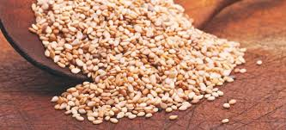
Sesame Seeds
There is a controversy on calcium content of sesame seeds
One tablespoon of hulled sesame seeds contains 88 mg calcium.
One tablespoon of un-hulled sesame seeds contains 37 mg (about 60% less).
Hulled
Un-hulled

Slide 17
Sesame Seeds (cont.)
Nutrient | Unit | 1Value per 100 g | 1 cup = 144.0g | 1 tbsp = 9.0g
Energy | kcal | 573 | 825 | 52
Protein | g | 17.73 | 25.53 | 1.6
Total lipid (fat) | g | 49.67 | 71.52 | 4.47
Carbohydrate | g | 23.45 | 33.77 | 2.11
Fiber, total dietary | g | 11.8 | 17 | 1.1
Sugars, total | g | 0.3 | 0.43 | 0.03
Calcium, Ca | mg | 975 | 1404 | 88
Iron, Fe | mg | 14.55 | 20.95 | 1.31
Magnesium, Mg | mg | 351 | 505 | 32
Phosphorus, P | mg | 629 | 906 | 57
Potassium, K | mg | 468 | 674 | 42
Sodium, Na | mg | 11 | 16 | 1
Zinc, Zn | mg | 7.75 | 11.16 | 0.7
Vitamin D | IU | 0 | 0 | 0
United States Department of Agriculture. Agricultural Research Service National Nutrient Database for Standard Reference Legacy Release

Slide 18
Relationship of calcium absorption fraction to vitamin D nutritional status [as measured by serum 25(OH)D].
Note that efficiency rises up to 25(OH)D levels of approximately 80 nmol/L (32 ng/ml), above which regulation of absorption is no longer limited by vitamin D status.

Slide 19
Vitamin D
Vitamin D guidelines have been issued by major organizations worldwide:
World Health Organization (WHO)
International Osteoporosis Foundation (IOF)
Institute of Medicine (IOM)
Endocrine Society (ES)
American Association of Clinical Endocrinologists (AACE)
European Association of Medical Doctors
The ES and IOM guidelines were formulated after an extensive review of the literature, used similar predefined outcomes of mineral metabolism, yet reached differing conclusions in terms of desirable 25OHD level, set at 30 ng/mL by ES and 20 ng/mL by IOM.
They also differed in recommended doses to reach them, varying between 600 and 800 IU for IOM, and 600 and 2000 IU for ES
Bouillon R, et al; J Clin Endocr Metab.; 2013.

Slide 20
Vitamin D (cont.)
The differences in desirable 25OHD levels derived by the IOM and ES may in part be explained by different target populations they addressed, the general public versus the patient in the clinic.
Furthermore, the defined desirable 25OHD levels, and required vitamin D doses to reach them, do not take into account the wide individual variations around the mean
Race
calcium intake
renal function
body mass index
polymorphisms in key protein/enzymes
Ghada El-Hajj Fuleihan et al; Journal of Bone and Mineral Research; 2015.

Slide 22
Desirable range for serum 25OHD level
Beneficial effects on fall and fracture risk at levels > 20 ng/mL with the upper confidence limits of 40 ng/mL, with no additional benefit for any bone health outcome in serum 25OHD level >40 ng/mL.
Well-documented vitamin D toxicity with serum 25OHD level >100 ng/ mL. Proposed desirable range (20-40 ng/mL), takes into account the currently evidence, put in the context of common sources of variations and uncertainties, and avoids the use of a single cutoff.
Although slightly lower levels (15-20 ng/mL) may be sufficient for some infants and adults, higher levels (40 to 60 ng/mL) may still be safe.
Ghada El-Hajj Fuleihan et al; Journal of Bone and Mineral Research; 2015.

Slide 23
Sources of Vitamin D

Slide 24
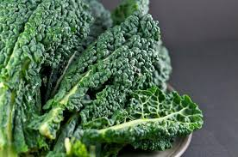
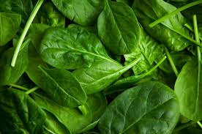
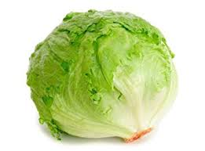
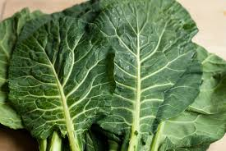
Vitamin K
Recommended intake
120 μg/day for men and 90 µg/day for women
Sources of vitamin K
Synthesized by bacteria in the large intestine
Green leafy vegetables (kale, spinach, collard greens, lettuce)

Slide 25
Sources of vitamin K

Slide 26
Phosphorus
High in protein-containing foods such as
Milk
Meats
Eggs
legumes
In processed foods as a food additive (phosphate salt):
Smoothness
Binding
Moisture retention
In soft drinks as phosphoric acid

Slide 27
Magnesium
Recommended intake
RDA varies based on age and gender
UL (pharmacological): 350 mg/day
Sources of magnesium
Green leafy vegetables, whole grains, seeds, nuts, seafood, beans, some dairy products
Dietary protein enhances absorption and retention

Slide 28
Sources of magnesium

Slide 29
Magnesium (cont.)
What if you consume too much?
Excess supplements cause diarrhea, nausea, cramps, dehydration, acid–base imbalances
Hyper magnesemia occurs in individuals with impaired kidney function (antacid)
What if you don't consume enough?
Hypomagnesemia: results in hypocalcemia; associated with osteoporosis, heart disease, high blood pressure, type 2 diabetes

Slide 30
Other dietary factors and peak bone mass (cont.)
High consumption of carbonated soft drinks may impair bone acquisition and increase fracture risk in girls.
A matter of displacement of more nutritious beverages and that it may be reversed by taking the recommended daily intake of calcium.
High soft drink consumption in the adolescent population contributes to low calcium intake by displacing milk consumption rather than higher phosphate intake.
Whiting SJ et al J Nutr; 2004.
McGartland C et al; J Bone Miner Res; 2003.

Slide 31
Other dietary factors and peak bone mass (cont.)
Another hypothesis: rapid rate of phosphorus absorption and greater phosphorus bioavailability from processed foods such as cola drinks.
Those at high risk and those who have osteoporosis may want to avoid these beverages
Calvo MS et al; Ann NY Acad Sci ; 2013.

Slide 32
Other dietary factors and peak bone mass (cont.)
Excessive caffeine intake may have a deleterious effect on BMD.
Intake of colas also is associated with lower BMD.
Although the primary issue may be displacement of dairy beverages, there is also a potential direct effect.

Slide 33
High acid or alkaline diets
Higher acid diets include those high in protein, dairy, and grains.
It is theorized that these higher acid diets may increase calcium excretion and have a detrimental effect on bone.
The theory also supports a converse beneficial effect of an alkaline diet on bone.
Several meta-analyses, experimental studies, and reviews have not supported either the negative effect of higher acid diets on bone or the positive effects of an alkaline diet on bone.
Hanley DA et al; J Clin Densitom; 2013.

Slide 34
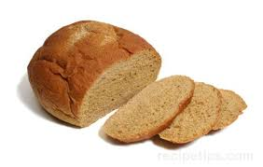
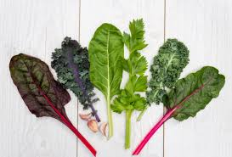
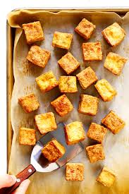
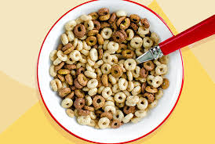
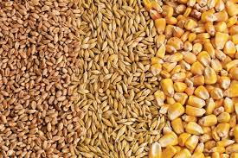
Nutrition and Peak Bone Mass (cont.)
Interventions to promote calcium consumption among youth should be initiated early and focus not only on increasing dairy product intake but also on decreasing intakes of soft drinks and increasing intakes of other calcium-rich foods such as:
fortified orange juice 4. other grains
ready-to-eat cereals 5. dark leafy green vegetables
enriched breads 6. tofu prepared with calcium sulfate
Ranjit et al; 2010.
Hallstrom H et al; Nutr Metab ; 2010.

Slide 35
Bone loss
Stabilizing BMD or reducing the rate of bone loss is the primary objective in the prevention of osteoporosis
a pyramid approach to the prevention and treatment of osteoporosis with a foundation of lifestyle changes that include nutrition, physical activity, and fall prevention
a second tier of addressing drugs and diseases associated with bone loss or osteoporosis
a third tier of pharmacologic therapy
US Department of Health and Human Services, Office of the Surgeon General. Bone Health and Osteoporosis: A Report of the Surgeon General; 2004.

Slide 36
Bone loss (cont.)
Factors influencing rate and magnitude of bone loss:
Concomitant diseases
Hormone concentrations
Age
Body weight
Calcium and vitamin D intake
Physical activity
Family history
Alcohol consumption
Cigarette smoking
E Michael Lewiecki; Prevention of osteoporosis; 2019.

Slide 37
Osteoporosis
In 1997:
The European Foundation for Osteoporosis and Bone Disease published guidelines for the diagnosis and management of osteoporosis
In 2008 and 2013:
Updated by the IOF and European Society for Clinical and Economic Evaluation of Osteoporosis and Osteoarthritis.
Kanis JA et al, The European Foundation for Osteoporosis and Bone Disease, 1997
Kanis JA et al, European guidance for the diagnosis and management of osteoporosis in postmenopausal women, 2008
Kanis JA et al, European guidance for the diagnosis and management of osteoporosis in postmenopausal women, 2013

Slide 38
Osteoporosis (cont.)
Osteoporosis is a systemic skeletal disorder characterized by a decrease in bone mass and micro architectural deterioration of bone tissue.
The World Health Organization has defined osteoporosis as a decrease in bone mass (50%) and bony quality (50%).
J.A. Kanis et al; Bone Miner. Res;1994.

Slide 39
Osteoporosis (cont.)
Idiopathic osteoporosis due to aging and postmenopausal status is the most comment form.
However, the dysregulated bone remodeling and formation due to systemic disease alter the bone turnover and induce secondary osteoporosis
G.R. Emkey et al; Clin. Endocrinol. Metab; 2014.

Slide 40
Lifestyle and osteoporosis
adequate nutrition
regular weight bearing physical activity (30 minutes on most days of the week)
smoking cessation
no or moderate alcohol intake
fall prevention
E Michael Lewiecki; Prevention of osteoporosis; 2019.

Slide 41
Nutrition and Osteoporosis
Calcium & vitamin D are important throughout the life span
Fruit and vegetable consumption associated with improved bone health; good sources of vitamins C and K, magnesium
Protein effect on bone health is controversial
High intake may increase calcium loss
Low protein intake also associated with bone risks
Sodium: high intakes appear to have a negative impact, but studies are inconclusive

Slide 42
Nutrition and Osteoporosis (cont.)
Most randomized controlled trials evidence for the efficacy of interventions based on co-administration of the agent with calcium and vitamin D supplements
Combined calcium (0.5–1.2 g) and vitamin D (400–800 IU) supplements are generally recommended in patients receiving bone protective therapy

Slide 44
Nutrition and Osteoporosis (cont.)
The 2018 US Preventive Services Task Force recommended against supplementation with ≤400 IU vitamin D and ≤1000 mg calcium for the primary prevention of fractures in postmenopausal women
Insufficient evidence to assess the benefits and harms at doses higher than these.
Institute of Medicine; Dietary reference intakes for calcium and vitamin D; 2010.
Grossman DC et al; JAMA; 2018.

Slide 45
Take home messages
Peak bone mass and bone loss are both important for BMD
Calcium and vitamin D intakes based on RDA is necessary for maximizing peak bone mass
Desirable range of 25OHD is 20-40 ng/mL
Other nutrients including vitamin K, phosphorus, magnesium are important for bone health
Combined supplementation of calcium and vitamin D is recommended for osteoporosis treatment
Supplementation of calcium and vitamin D is not necessary for primary prevention of osteoporosis

