Slide 1
Basal bolus versus premixed insulin for intensification
M.Valizadeh
Research Institute for Endocrine Sciences
Shahid Beheshti University of Medical Sciences
August 10,2017
Tehran

Slide 2
Learning objectives:
Select the best insulin regimen for intensification
Different decision in the same situation
Different decisions in different situations

Slide 3
Outline
Case Presentation
Introduction
  Natural course of diabetes
  What do guidelines say about insulin intensification
Insulin initiation & Intensification
  Terminology
Evidences about the best insulin regimen
Conclusion & take home massage

Slide 4
Case 1:
A 56 year-old-man with 10 years history of T2DM come to us for uncontrolled hyperglycemia. He has treated with metformin 2000 mg/d + 10 mg glibenclamide + 20 U Glargine for 2 recent years.
FPG: 135 mg/dl / BS 2hpp: 280 mg/dl /Hb A1c: 8.5%
BMI: 30 Kg/m2 Creatinin: 1.1 mg/dl
What is your next step?
FBS | BS | BS | BS
150 | 220 | 265 | 245
140 | 230 | 300 | 227

Slide 5
Case 2:
A 60 year-old-woman with 14 years history of T2DM come to us for uncontrolled hyperglycemia. she has treated with metformin 1000 mg/d + 160 mg gliclazide + Glutazone 30 mg for 3 recent years.
BMI: 32 Kg/m2 Creatinin: 1.4 mg/dl (GFR: 45)
FPG: 225 mg/dl / BS 2hpp: 280 mg/dl /Hb A1c: 9.5%
What is your next step?
FBS | BS | BS | BS
230 | 320 | 295 | 295
210 | 310 | 320 | 257

Slide 6
Natural course of T2DM
Due to its progressive nature, many patients eventually require and benefit from insulin therapy.
Despite insulin use, however, most patients fail to achieve their glycemic target with simpler insulin regimens, including
  the once daily bedtime basal
  the once/twice-daily premixed regimens.
The majority of patients therefore require more complex management, which may include initiation of an intensive insulin regimen.

Slide 7
Natural History of Type 2 Diabetes
Severity of Glucose Intolerance
NGT
IGT
Frank Diabetes
Insulin Resistance
Worsens with Time
Insulin Secretion
Postprandial Glucose
Fasting Blood Glucose
Normal Blood Glucose
Risk of Microvascular Complications
Risk of Macrovascular Complications
Years to Decades
Typical Diagnosis of Diabetes
Notes:
Explain each component (line) as it is animated.
Type 2 diabetes begins with insulin resistance (impaired glucose tolerance), which is linked to macrovascular disease.
Beta cell function accelerates to compensate, however, it eventually begins to deteriorate, resulting in insulin deficiency and elevated glucose.
In response to deteriorating beta cell function and subsequent loss of first-phase insulin response, postprandial glucose increases, which is associated with the initiation of macrovascular complications.
While fasting glucose levels remain normal during the initial stages of this cycle. They eventually rise, initiating the development of microvascular complications.
Main Message(s)
While physicians often look at fasting glucose as an indication of control, we can see that the postprandial glucose is the initial driver of hyperglycemia and microvascular complications.
Because beta cell deterioration is progressive and persistent, all patients who live long enough will eventually need insulin therapy.
With the increasing prevalence of type 2 diabetes among younger adults, we will see many patients living with diabetes for many years.

Slide 8
Glycemic control:
Due to Nature of T2DM → Many need insulin Therapy beyond basal insulin
  Which Insulin type
  Which Regimen

Slide 9
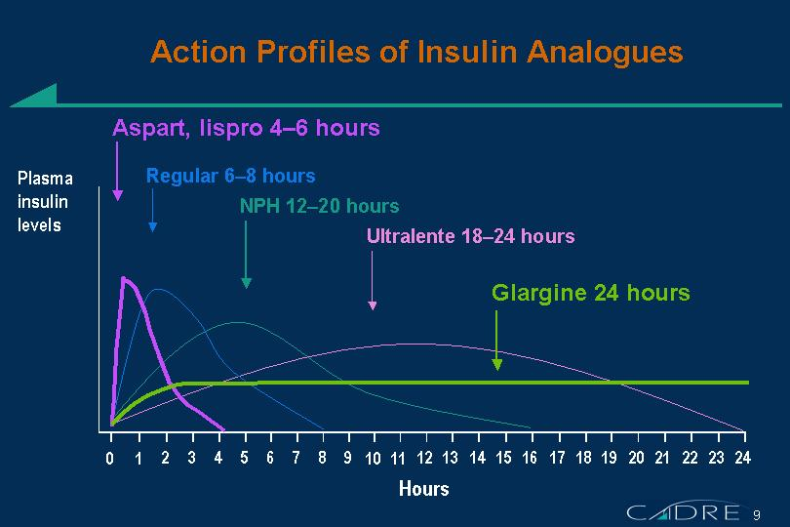

Slide 10
NICE 2015

Slide 11
Insulin Therapy….
Monitor adults with type 2 diabetes who are on a basal insulin regimen (NPH insulin, insulin detemir or insulin glargine) for the need for
  short-acting insulin before meals
  (or a pre-mixed [biphasic] insulin preparation
Monitor adults with type 2 diabetes who are on pre-mixed (biphasic) insulin for the need for a
  further injection of short-acting insulin before meals or
  for a change to a basal bolus regimen if blood glucose control remains inadequate with
    NPH insulin or insulin detemir or insulin glargine,

Slide 12
IDF 2012

Slide 13
Many practitioners often choose premixed insulins for a start of insulin therapy and its intensification .
In a prospective study of 12 countries from three continents, initial insulin therapy with premixed regimens was prescribed in 23 %of people with type 2 diabetes and was still 25 % at 4 years of follow-up , with about one quarter of patients coming from a starting basal insulin regimen.
Premixed insulins are widely used as the starting insulin therapy in clinical practice in China, with prevalence of use ranging from 69 to 74 %, owing to more convenience and fewer injections.
Intensification of insulin therapy with a premixed regimen could be an option for people with type 2 diabetes starting with simpler regimens (once or twice premixed, or once basal).

Slide 14
Which strategies? (Which one is better?)
Two main options for intensification of insulin therapy in patients who are not at HbA1c target with previous treatment:
  basal-bolus
  Premixed insulin regimens.
In patients on basal insulin only, addition of mealtime insulin before the main meal (basal plus) is considered the most logical step with stepwise escalation of additional mealtime insulin doses.
In patients not achieving target glycemic control with one or two injections of premixed insulin, increasing the number of injections and using insulin analog formulations with a higher proportion (e.g., 50 %) of rapid-acting insulin could further improve the glycemic control
What is gold standard regimen?

Slide 15
Glargine at HS + Mealtime Lispro
lispro
Glargine
Insulin Effect
Insulin Effect
B
L
S
HS
B
B
L
S
HS
B
6-56
Notes:
Slide 6-56
INSULIN TACTICS: THE FUTURE
Glargine at HS + Oral Agents or Inhaled Insulin
Based on the advances in insulin therapy, it may be proposed that future regimens for type 2 diabetes patients might include the use of an injectable long-acting basal insulin analogue in combination with oral agents or with inhaled human insulin. The addition of basal insulin glargine to a combination of oral agents can improve glycemic control, reducing glucotoxicity, which may in turn restore endogenous insulin response to sulfonylurea and potentiate the effect of insulin sensitizers. Alternatively, the long-acting insulin glargine can provide a basal insulin profile to be associated in the future with prandial inhaled insulin, which mimics normal insulin effects in response to meals.

Slide 16
But about 50% of T2DM patients are not at the target glycemia by basal bolus regimen!

Slide 17
What are say us evidences??

Slide 18
Terminology that usually used in intensification:
Intensification : more complex regimen beyond basal insulin
  Basal Plus
    Slow intensity Basal bolus: Basal insulin + Prandial Insulin
  Basal bolus
    Full Basal bolus (4 shots/day)
    Variable Basal bolus (basal analog + up to 3 short acting analog)
  Intensification with Premixed (Biphasic insulin regimen)
    2 or 3 shot/d premixed insulin

Slide 19
Terminology:
Insulin naïve
Noninsulin naïve or Background therapy with insulin (already insulin user)
  Alone
  And Oral agents

Slide 20
Main Outcomes:
Glycemic control (efficacy)
Hypoglycemia
Weight gain
Insulin dose (/day or /Kg)
Patient reported outcomes (Convenience / quality of life)
The best regimen is more efficacious with less adverse events and costs

Slide 21
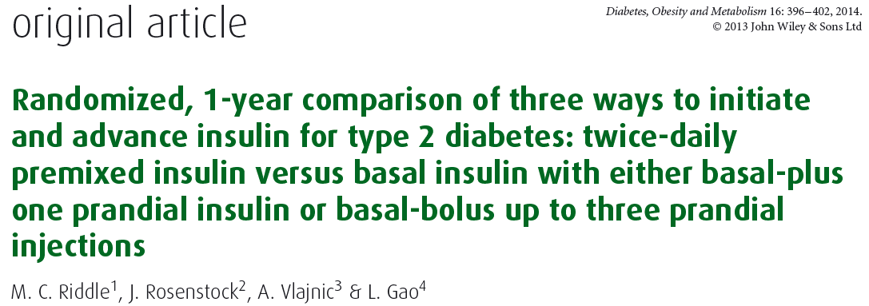
60 weeks randomized, open label Basal plus, vs. Basal stepwise bolus, vs. 2 premixed (BiAsp 30/70)

Slide 22
Study design
This was a three-arm study, conducted at 99 sites in the USA, comparing three current treatment regimens for blood glucose control. After a 4-week run-in phase, eligible participants were randomised 1 : 1 : 1 to receive treatment for 60weeks with one of the following:
Lantus + 1 Apidra(G+1).
Lantus + 3 Apidra(G+3).
Twice daily Novomix 30(PM-2).
3 Arms
Patient-reported outcome questionnaires were administered
at weeks 0, 6, 12, 24, 36, 48 and 60.
Diabetes, Obesity and Metabolism 16: 1121–1127, 2014.

Slide 23
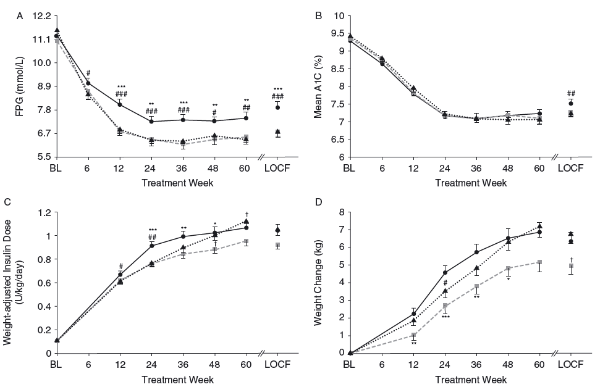

Slide 24
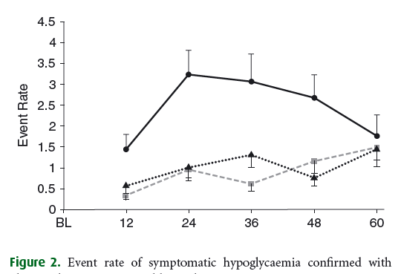

Slide 25
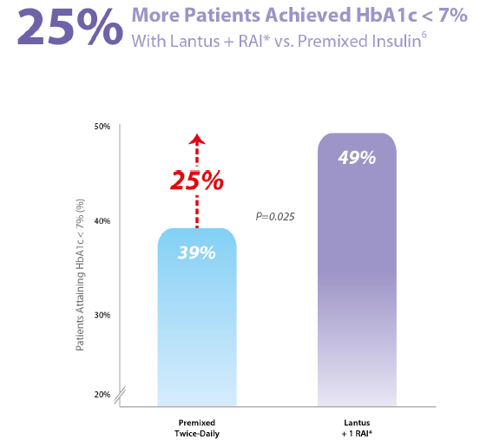
All to Target Study
Riddle M.C, et al, Diabetes, Obesity and Metabolism, 2014

Slide 26
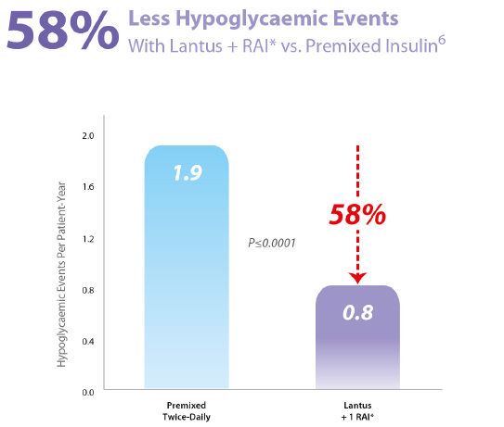
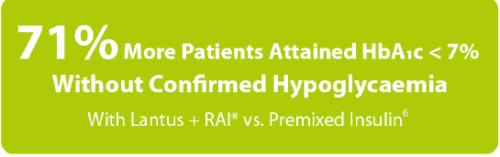
All to Target Study

Slide 27
Key message:
all three insulin regimens improved glycaemic control in T2DM poorly controlled with OAs.
Premixed insulin caused more hypoglycaemia than stepwise insulin glargine based regimens.
Treatment with insulin glargine plus a single prandial injection as needed was as effective as premixed insulin.
Adding further prandial injections provided only a modest improvement in glycaemic control.
Because of its simplicity, efficacy and low hypoglycaemia risk, the basal plus one prandial injection regimen deserves greater consideration in clinical practice.

Slide 28
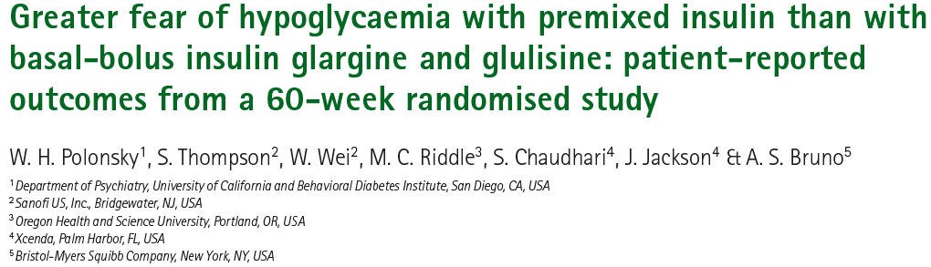
All To Target trial
Diabetes, Obesity and Metabolism 16: 1121–1127, 2014.

Slide 29
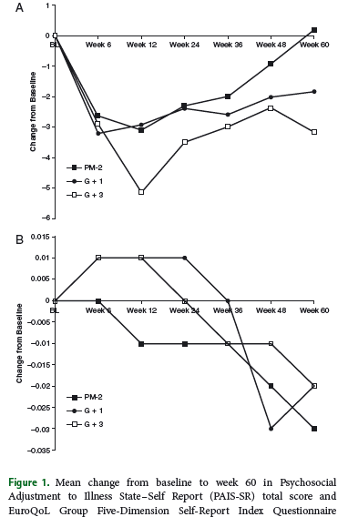

Slide 30
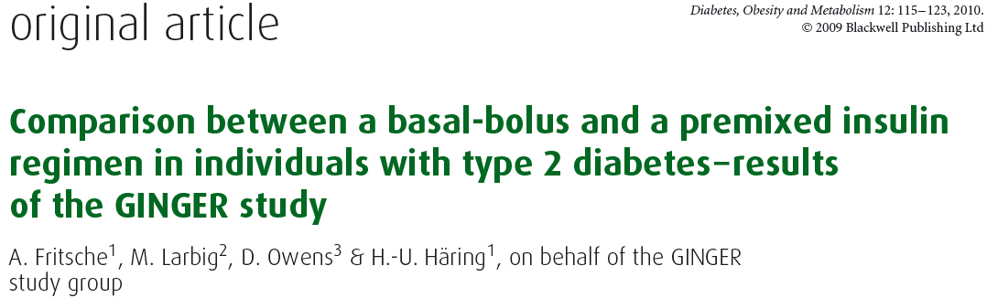
This 52-week, open-label, randomized, multinational, multicentre trial included 310 subjects with type 2 diabetes (T2D) on premix, with or without metformin, who were randomized to a
  basal-bolus regimen with glargine and glulisine (n = 153; mean ± s.d. age 60.2 ± 7.5 years; HbA1c 8.6 ± 0.8%; weight 87.0 ± 15.1 kg; T2D duration 12.8 ± 5.8 years)
  twice-daily premix (n = 157; age 60.9 ± 7.8 years; HbA1c 8.5 ± 0.9%; weight 84.3 ± 15.0 kg; T2D duration 12.5 ± 6.8 years). The primary endpoint was change in HbA1c from baseline to endpoint

Slide 31
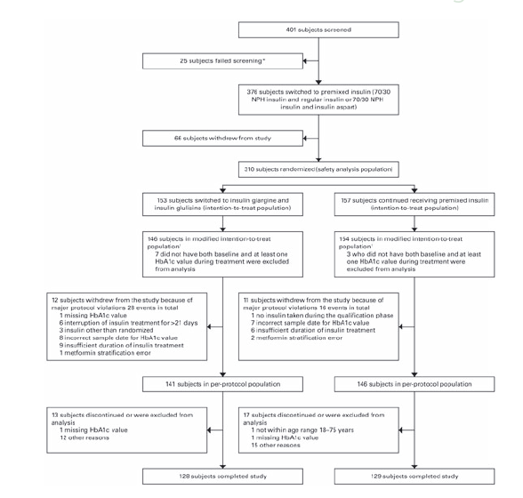

Slide 32
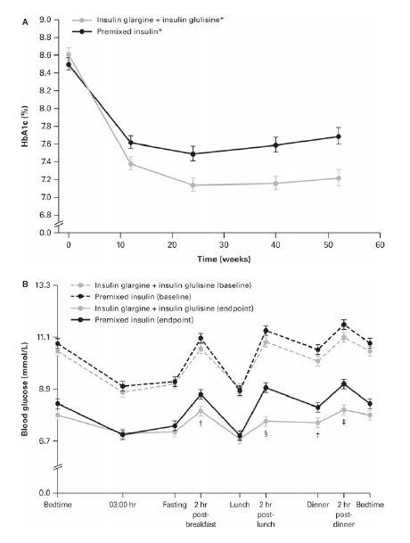

Slide 33
Key message:
Our results suggest that a basal-bolus regimen with glargine–glulisine can provide such an option and not at the expense of an increased risk of hypoglycaemia.
Additional long-term studies are needed to confirm this suggestion and to establish whether a gradual, stepwise increase towards a fully intensified basal-bolus regimen is superior to optimized insulin regimens.

Slide 34
Objective: To compare the efficacy and safety of two insulin intensification strategies in patients with type 2 diabetes inadequately controlled on basal insulin glargine with metformin and/or pioglitazone.
A multinational, randomized, open-label trial that compared insulin lispro low mixture (LM25; n=236) twice daily with a basal–prandial regimen of insulin glargine once daily and insulin lispro once daily (IGL; n=240) over 24weeks in patients with HbA1c 7.5–10.5% and fasting plasma glucose ≤6.7 mmol/l.
Diabetes, Obesity and Metabolism 16: 963–970, 2014.

Slide 35
Estimated change [least squares (LS) mean (95% CI)] in HbA1c after 24 weeks: −1.30 (−1.44, −1.16)% with LM25 and −1.08 (−1.22, −0.94)%with IGL. Non-inferiority was shown [LSmean (95% CI) HbA1c treatment difference−0.21 (−0.38,−0.04) (PP population)]; gated superiority assessment showed a statistically significant advantage for LM25 (p=0.010; ITT population

Slide 37
Key message
In patients with type 2 diabetes inadequately controlled on once-daily basal insulin glargine and metformin and/or pioglitazone, intensification with LM25 was superior to a basal–prandial approach in terms of reduction in HbA1c after 24 weeks and did not increase hypoglycaemia episodes.

Slide 38
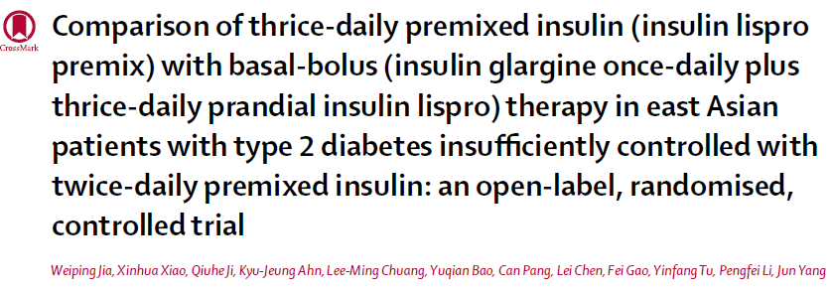
Methods This open-label, randomised, active comparator-controlled, parallel-group trial was done at 24 centres in China, Taiwan, and South Korea.
Patients with type 2 diabetes who were inadequately controlled on twice-daily premixed insulin were randomly assigned (1:1) to receive either insulin lispro mix (mix 50 before breakfast and lunch plus mix 25 before dinner) or basal-bolus therapy (insulin glargine at bedtime plus prandial insulin lispro thrice daily) for 24 weeks.
Randomisation was done by a computer-generated random sequence and was stratifi ed by country or region and baseline HbA1c. Treatment assignments were masked from the study team assessing outcomes but not from investigators and patients.

Slide 39
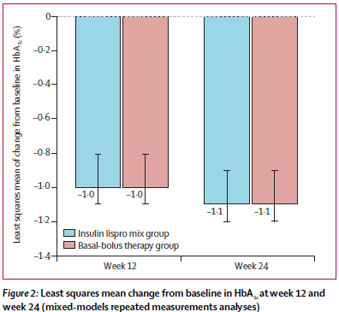
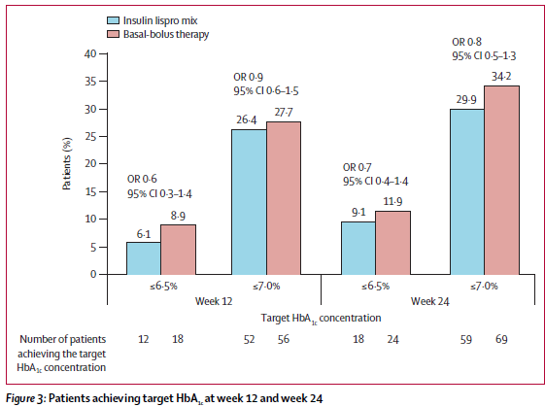

Slide 40
Key message:
A premixed insulin lispro regimen thrice-daily was non-inferior to basal-bolus therapy in terms of overall glycaemic control and thus could be an option for intensifi ed insulin regimen in Asian patients with type 2 diabetes who are inadequately controlled with twice-daily premixed insulin.

Slide 41
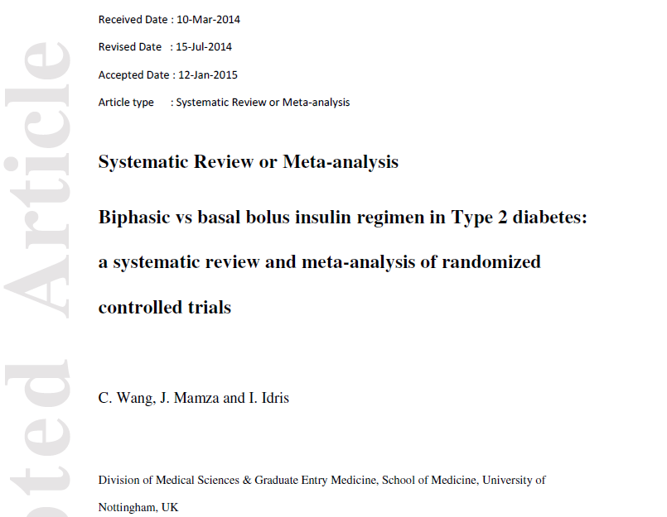
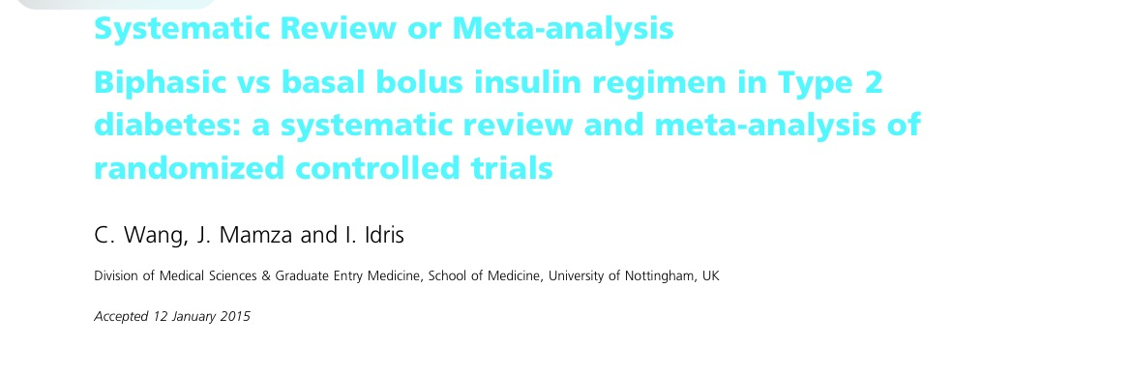
Wang study
Diabetic Medicine (Jan 2015)

Slide 42
Objective
Aim:
evaluate the effects of biphasic insulin compared with a basal bolus insulin regimen on glycaemic control, total daily insulin requirements, risk of hypoglycaemia, weight and quality of life in patients with diabetes mellitus

Slide 43
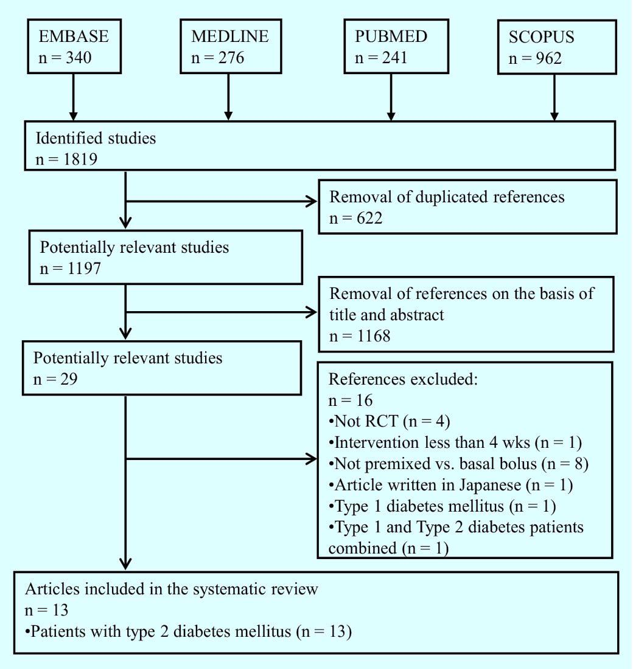
Method
Flow diagram outlining the
systematic literature search
and selection of relevant studies
to include in the systematic review
13 randomized controlled trial studies, involving 4384 patients

Slide 44
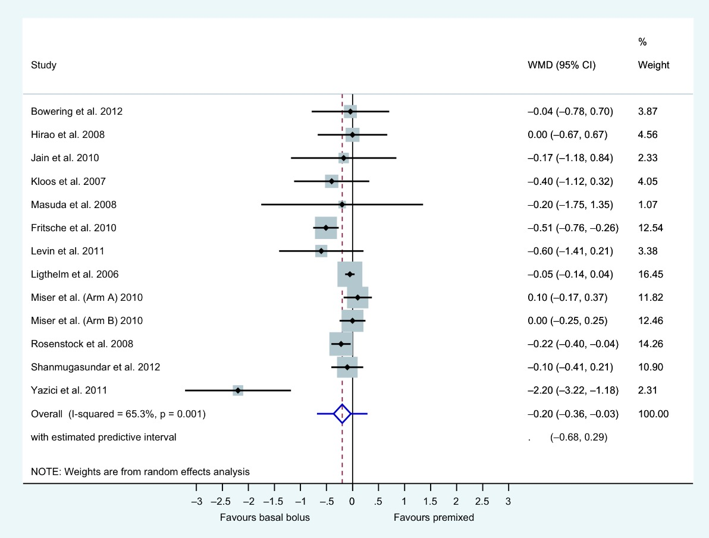
Result
Comparison of the weighted mean difference of baseline to endpoint change in HbA1c levels in the basal bolus vs premixed group in patients with T2DM
2 ≤ injection of any biphasic
vs basal with either basal-plus
one prandial or change to basal plus stepwise prandial

Slide 45
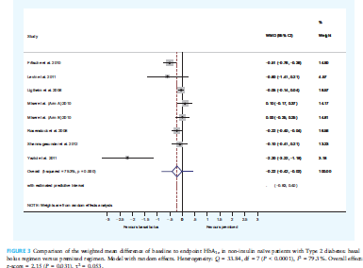

Slide 46
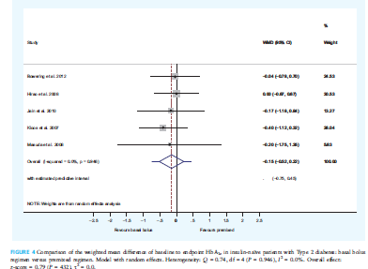

Slide 47
Result
Biphasic and Basal bolus regimens were equally effective in reducing HbA1c in insulin naïve patients with Type 2 diabetes and both regimens are equally effective for initiating insulin in T2DM
Greater HbA1c reductions were seen with basal-bolus compared with biphasic insulin regimens, between-treatment weighted mean difference (WMD) for baseline-to-endpoint changes in HbA1c was -0.2% (95% CI: -0.36 to -0.03) [-2.2 (-3.9, -0.3) mmol/mol].
Total daily insulin requirements and weight were increased with both regimens, whereas hypoglycaemia rates were comparable between the two regimens.
Greater HbA1c reduction was observed in the basal bolus group compared with the biphasic regimen at the expense of higher daily insulin requirements and weight gain, but with no greater risk of hypoglycemia

Slide 48
Key Message:
Current evidence directly comparing the basal bolus and biphasic interventions is limited to RCTs with a duration of no more than 52 weeks, thereby restricting the findings to shorter term outcomes only.
No studies were designed to investigate long-term effects, therefore, it is unclear how metabolic outcomes such as HbA1c, weight and hypoglycaemia rates, as well as QoL markers will be affected by the choice of insulin regimen

Slide 49
The purpose of this study was to conduct a systematic review and meta-analysis of randomized controlled trials (RCTs) comparing the effect of intensified insulin regimens (basal-bolus versus premixed) on glycemic control in patients with type 2 diabetes
Endocrine (2016) 51:417–428

Slide 54
Key messages
Our analyses suggest that there is no clinically relevant difference in the efficacy of basal-bolus versus premixed insulin regimens for HbA1c decrease in type 2 diabetic patients who intensified their insulin therapy.

Slide 55
Intensification in different guidelines:

Slide 56
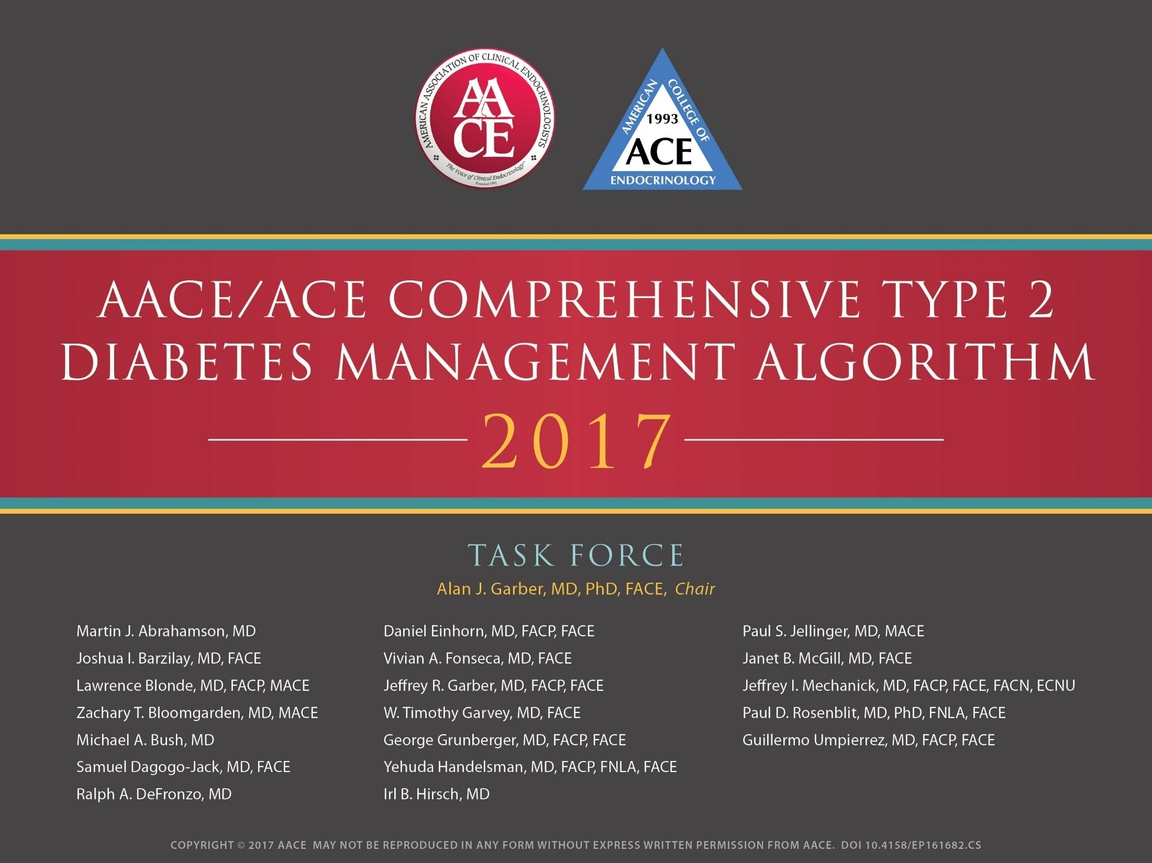

Slide 57
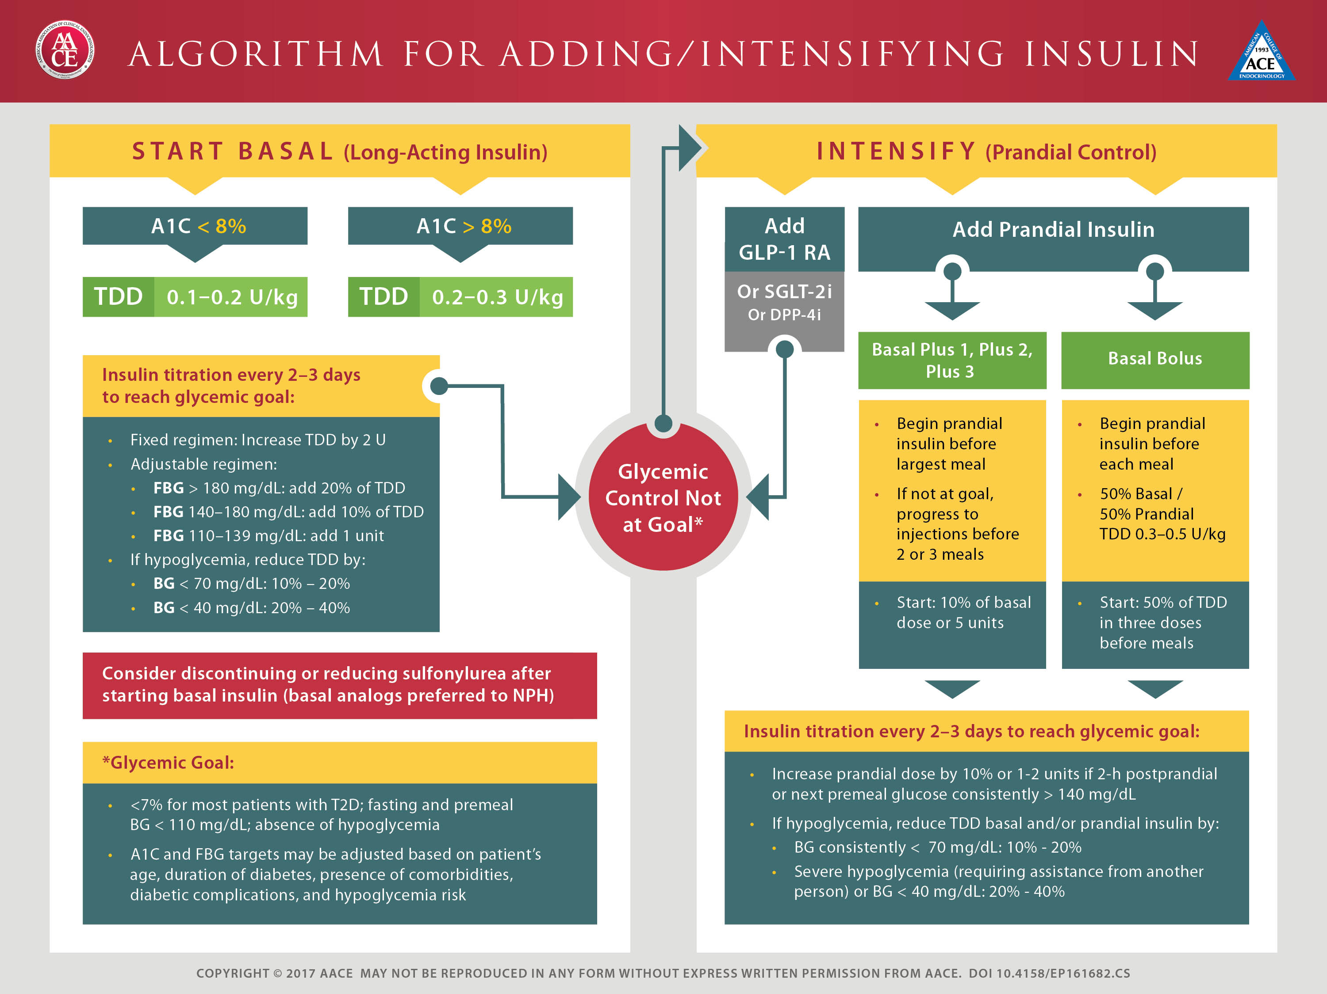

Slide 64
In conclusion:
There is many studies about intensification with premixed and basal bolus for T2DM patients with diverse results
Also there is many review and systematic review in this field
Most of them did not indicate clinically significant difference in primary and secondary outcomes

Slide 65
Take home message
There is no clinically relevant difference in the efficacy of basal-bolus versus premixed insulin regimen for Hb A1c decrease in T2DM.
Intensification is applicable with both basal bolus and premix insulin
Human insulins
Clinician must to adapt treatment to individual patient needs

Slide 66

Thanks for your attention

Slide 67
The Basal/Bolus Insulin Concept
Basal Insulin
  Suppresses glucose production between meals and overnight
  Nearly constant levels
  50% of daily needs
Bolus Insulin (Mealtime or Prandial)
  Limits hyperglycemia after meals
  Immediate rise and sharp peak at 1 hour
  10% to 20% of total daily insulin requirement at each meal
Ideally, for insulin replacement therapy, each component should come from a different insulin with a specific profile
6-20
Notes:
Slide 6-20
MIMICKING NATURE WITH INSULIN THERAPY
The Basal/Bolus Insulin Concept
Insulin is capable of restoring glycemia to nearly normal in most patients with type 2 diabetes. The basal/bolus insulin concept attempts to mimic, with insulin therapy, the patterns that normally control glucose in persons without diabetes. Basal insulin suppresses glucose production so that the levels remain nearly constant between meals and overnight. Basal insulin meets about half of the patient’s daily need for insulin and may be sufficient when considerable endogenous insulin remains. Bolus insulin (10% to 20% of the total daily insulin requirement given at each meal) limits hyperglycemia after meals. This tends to smooth the peaks of glucose that occur in response to these meals. Frequent glucose monitoring aids in determining the candidates for basal or mealtime regimens. Ideally, each component of insulin replacement therapy should come from a different type of insulin with a specific profile to fit the patient’s needs. Practical methods to accomplish this basal/bolus strategy will be illustrated later in this module.
Edelman SV, Henry RR. Insulin therapy for normalizing glycosylated hemoglobin in type II diabetes: applications, benefits, and risks. Diabetes Reviews. 1995;3:308-334; Kelley DB, ed. Medical Management of Type 2 Diabetes. 4th ed. Alexandria, Va: American Diabetes Association; 1998:56-72.

Slide 68
So which method is best?
This is where the “Art of Medicine” comes in:
  If patient has been having difficulty with hypoglycemia, then start any new insulin regimen with conservative doses
  If patient, on the other hand, has been having hyperglycemia, then one can be more aggressive
Remember: every patient is an individual!

Slide 69
Fine Tuning: Meal Bolus Doses
Adjust bolus based on post-meal BGs
Carbohydrate counting or pre-determined meal portion
Individualize insulin to carbohydrate dose or insulin to premeal dose

Slide 70
Advancing Bolus/ Adding Bolus Insulin
Indicated when FBG acceptable but
  HbA_{1c} not at goal and/or
  Postprandial BG not at goal (<140mg/dl)
Insulin options
  To Glargine, add mealtime Regular or Lispro
  To bedtime NPH, add morning NPH and
  mealtime Regular or Lispro
  To suppertime 70/30 or 75/25, add morning 70/30 or 75/25
Oral agent considerations
  Usually stop secretagogue (it is redundant to be on insulin and secretagogue)
  Continue metformin and TZD for additional glycemic and other benefits
6-60
Notes:
Slide 6-60
PRACTICAL GUIDELINES
Advancing Basal/Bolus Insulin
Clinical judgment should prevail when determining whether an advance to a basal/bolus insulin regimen is indicated, especially when the fasting blood glucose is acceptable, but this should be considered when the HbA_{1c} is >7% or >7.5% suggesting postprandial hyperglycemia, and/or the SMBG before dinner is >180 mg/dL. There are three main insulin options. The first option is to add morning NPH and mealtime regular or lispro to the initial regimen of bedtime NPH insulin. The second option is to add morning 70/30 to suppertime 70/30 insulin. The third option is to add mealtime regular or lispro to bedtime insulin glargine. In terms of options for the oral agent, the sulfonylurea may be stopped, but some patients may develop wide fluctuations in blood glucose levels that require resumption of the sulfonylurea. For some patients, metformin can be continued to provide weight control, or glitazone can be continued to achieve glycemic stability.

Slide 71
Changing from Other regimens to Basal/Bolus Insulin
Total Daily Dose
(~70-75% of prior insulin regimen TDD)
~50%
Basal*
~50%
Bolus*
Usually divided into 3 premeal doses
*Range: 40 to 60%

Slide 72
An Example:
Mr. M: 58 yo with history type 2 diabetes for 8 years
  In addition to oral meds, he is on 70/30 insulin: 30 u AM and 15 u PM
  Current Total Daily Dose = 45 u of 70/30
  However, he has been having difficulty with wide glycemic excursions
After discussing his options in detail, he is willing to begin basal/bolus regimen:
New TDD= 45 u x .75 = 33.75 = 34 u
  Basal = 17 u Lantus at bedtime
  Bolus = 17 u total / 3 = 5.6 u = 5 u Humalog with meals

Slide 73
Another method
Same patient: Mr. M on 70/30 insulin: 30 u AM and 15 u PM
  Current Total Daily Dose = 45 u of 70/30
Instead, some clinicians prefer to instead calculate the new basal/bolus doses independently of each other
  Current Basal= 0.70 x 45 u TDD = 31.5 u N
  Current Bolus= 0.30 x 45 u TDD = 13.5 u R
Then, use 70 to 75% of prior NPH, but divide prior short acting into 3 premeal doses
  New Basal= 0.75 x 31.5 u N = 24 u Lantus
  New Bolus= 13.5 u R / 3 = 4.5 u (round up or down) premeal Humalog

Slide 74
Start insulin therapy for adults with type 2 diabetes from a choice of a number of insulin types and regimens:
Offer NPH insulin injected once or twice daily according to need.
Consider starting both NPH and short-acting insulin (particularly if the person's HbA1c is 9.0% or higher), administered either separately or as a pre-mixed (biphasic) human insulin preparation

Slide 75
Consider, as an alternative to NPH insulin, using insulin detemir or insulin Glargine if:
The person needs assistance from a carer or healthcare professional to inject insulin, and use of insulin detemir or insulin Glargine would reduce the frequency of injections from twice to once daily
The person's lifestyle is restricted by recurrent symptomatic hypoglycaemic episodes
The person would otherwise need twice-daily NPH insulin injections in combination with oral glucose-lowering drugs

Slide 76
Consider pre-mixed (biphasic) preparations that include short-acting insulin analogues, rather than pre-mixed (biphasic) preparations that include short-acting human insulin preparations, if:
A person prefers injecting insulin immediately before a meal
Hypoglycaemia is a problem
Blood glucose levels rise markedly after meals

Slide 77
Consider switching to insulin detemir or insulin Glargine from NPH insulin in adults with type 2 diabetes:
Who do not reach their target HbA1c because of significant hypoglycaemia
Who experience significant hypoglycaemia on NPH insulin irrespective of the level of HbA1c reached
Who cannot use the device needed to inject NPH insulin but who could administer their own insulin safely and accurately if a switch to one of the long-acting insulin analogues was made
Who need help from a carer or healthcare professional to administer insulin injections
For whom switching to one of the long-acting insulin analogues would reduce the number of daily injections

Slide 78
Advantages and limitations
Advantages limitations
Standardization of clinical care
Improved quality of care
Dissemination of new evidence
Enhanced efficiency and reduced cost
Influence health policy and planning
Generalizability to individual practitioners
Generalizability to individual patients
Expert opinion vs evidence-based
Authorship bias
Multiple versions/conflicting recommendations

Slide 79
Individualization
Although guidelines may point out the best research evidence to guide the care of average patients, they are not the substitute for clinical judgment, which should be applied to each individual patient
Fletcher RH. Practice guidelines and the practice of medicine: Is it the end of
clinical judgment and expertise? Schweiz Med Wochenschr , 1998; 128:1883–8

