Slide 3
Aquatic Therapy

Slide 4
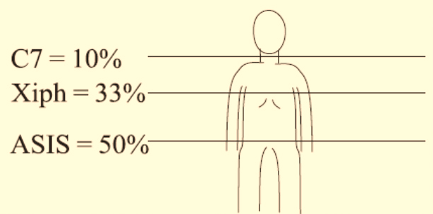
Depth
میزان غوطه وری:
تا ناحیه لگن 60% ( آقا 54 و خانم 47% وزن بدن کاهش وزن دارند)
ناحیه شکم: 50 درصد وزن
میانه دنده ها: 40%
زایفوئید: آقایان 35%، خانم ها 28%

Slide 5
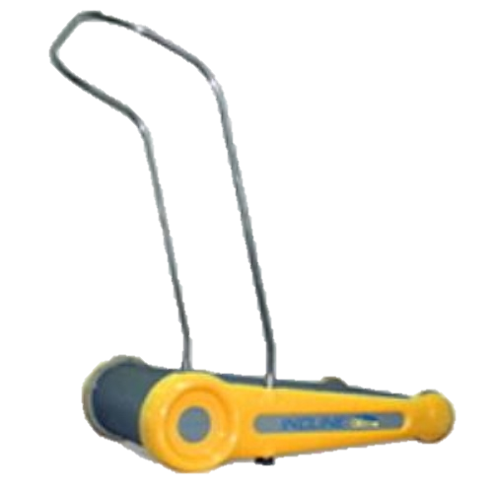
Aquatic treadmill
Purpose
Aerobic exercise

Slide 6
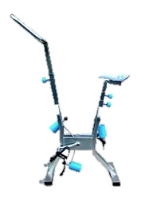
Aquatic Cyclette
Purpose
Aerobic exercise

Slide 7
Aquatic Cyclette
Purpose
Aerobic exercise

Slide 8
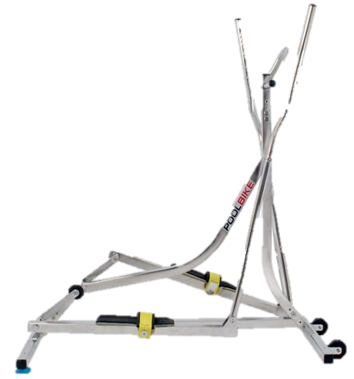
Aquatic Ellipse (Water Elliptical Trainer)
Purpose
Aerobic exercise

Slide 9
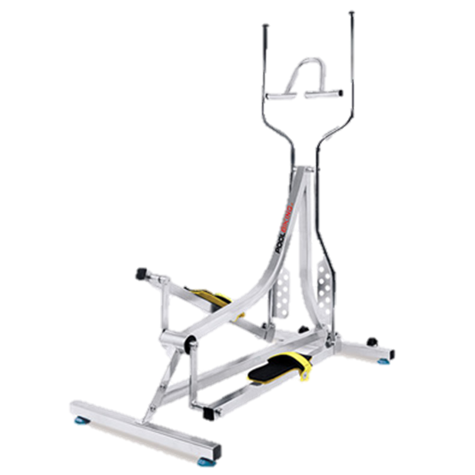
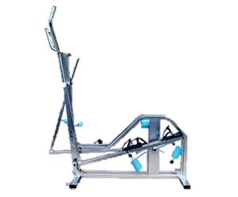
Aquatic Ellipse (Water Elliptical Trainer)
Purpose
Aerobic exercise

Slide 10
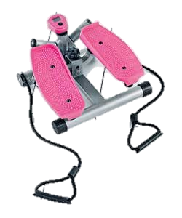
Aquatic Stepper
Purpose
Aerobic exercise

Slide 11
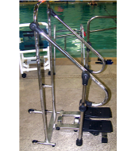
Aquatic Stepper
Purpose
Aerobic exercise

Slide 12
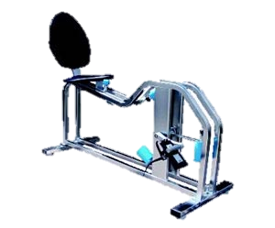
Aquatic Recline - Reclined bike
Purpose
Aerobic exercise

Slide 13
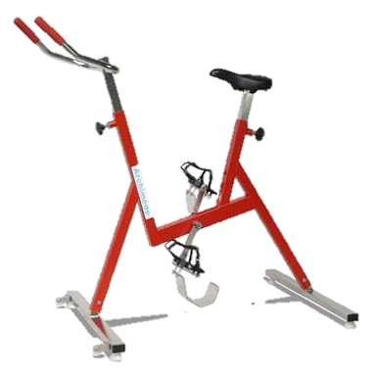
Stationary Aquatic Bicycle
Purpose
Aerobic exercise

Slide 14
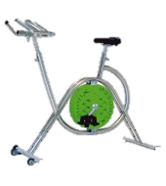
Stationary Aquatic Bicycle
Purpose
Aerobic exercise

Slide 15
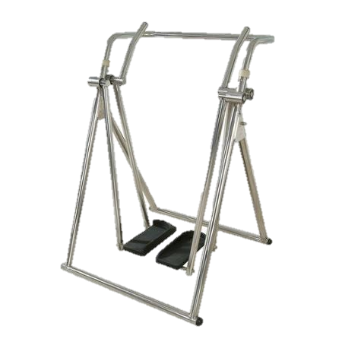
Aquatic Walker
Purpose
Aerobic exercise

Slide 16
Aquatic Exercises
Strengthening
Using hydrostatic pressure, buoyancy & turbulence to increase resistance & thereby increase strength
Stretching
Using hydrostatic pressure & buoyancy to improve static hold stretches with increased temperature for muscle relaxation
Cardiovascular endurance
Using hydrostatic pressure & turbulence to improve diaphragmatic breathing and cardiovascular endurance
Neuromuscular coordination
Using hydrostatic pressure to improve proprioception with dynamic movements, which improves motor planning & output coordination

Slide 17
Weight loss
Recommends to reduce body Fat=
900 Kcal per week
3-5 times per week
60-80% MHR
15-60 min per session
Walking

Slide 18
Weight loss
FITT
900 Kcal per week = Target
3-5 times per week = Frequency
60-80% MHR = Intensity
15-60 min per session =Time
Walking = Type

Slide 19
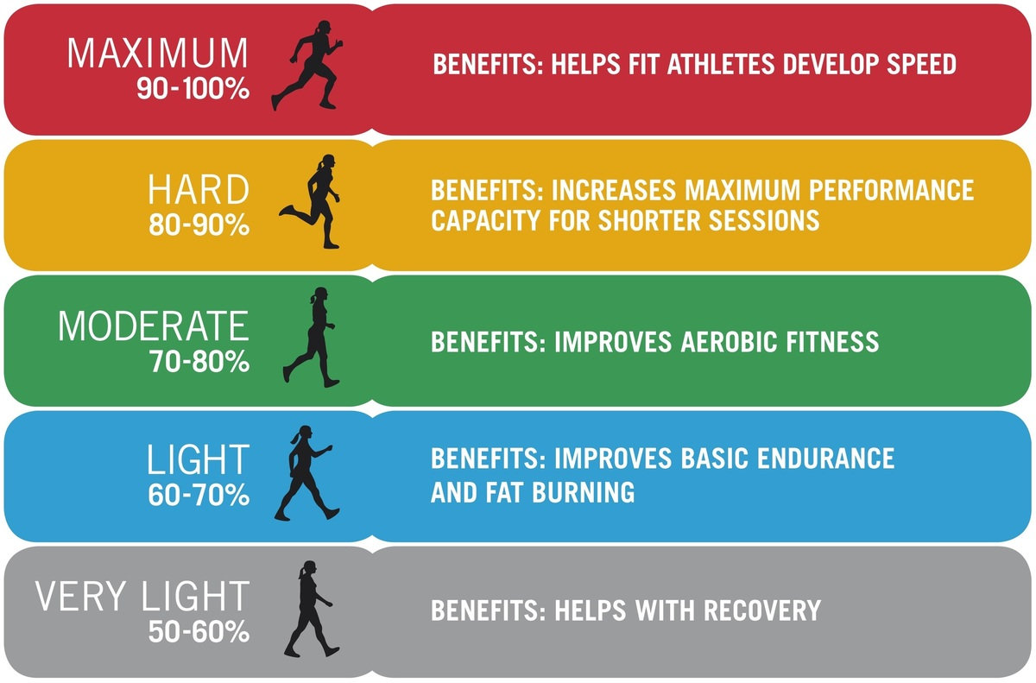

Slide 20
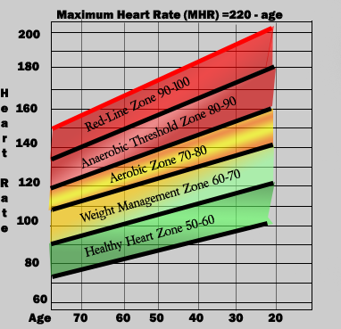

Slide 21
What is MET ? ( metabolic equivalent )
A single met is equivalent to the amount of energy expanded during one minute rest
Energy expenditure during rest = 1 MET
= 3.5 ml of O2 / kg. min
= 1 kcal / kg. hr.

Slide 22
Mets
Kcal/min=3.5*Mets* Weight/200
Calorie(Kcal) ＝ BMR X Mets/24 X hour
Calorie(Kcal) ＝ BMR X Mets/24 X hour

Slide 23
کرال پشت 9.5 مت
کرال سینه 45 متر در دقیقه 7.3
کرال سینه 68 متر در دقیقه 10 مت
پروانه 13.8 مت
قورباغه 10.3 مت
راه رفتن در آب 4.5 مت
پای قورباغه 3.5 مت
شنای تفریحی 6 مت
Sidestroke 7 مت

Slide 24
Monitoring cardiovascular
Talk test
RPE
RPE5

Slide 25
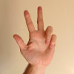
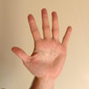
RPE 5 | Scale | Descriptor | Peak HR treadmill | long description
 | 1 | Very light | < 60 | I’m feeling great and could keep up this pace all day long.
 | 2 | Light | 61-70 | I’m still comfortable, but am breathing a little harder.
 | 3 | moderately hard | 71-80 | This is a good workout.
 | 4 | hard | 81-90 | It is getting pretty tough, I could only keep at this pace for a short time period.
 | 5 | Very hard | > 91 | It's too hard, I need to STOP!

Slide 26
RPE | RPE | effort | perceived exertion | Vo2 max | MHR | RHR
6 | 0 | 20%
7 |  | 30% | Very, very light (Rest)
8 | 1 | 40%
9 |  | 50% | Very light, gentle walking | 20> | 35> | 20>
10 | 2 | 55%
11 |  | 60% | Fairly light | 20-39 | 35-54 | 20-39
12 | 3 | 65%
13 |  | 70% | Somewhat hard - steady pace | 40-45 | 55-69 | 40-45
14 | 4 | 75%
15 | 5 | 80% | Hard | 60-84 | 70-89 | 60-84
16 | 6 | 85%
17 | 7 | 90% | Very hard | 85< | 90< | 85<
18 | 8 | 95%
19 | 9 | 100% | Very, very hard
20 | 10 | Exhaustion | Exhaustion

Slide 27
Standard Age-Predicted Maximal HR Formula:
220 – Age = Age-Predicted Maximal HR
Gellish, et al. 2007 Revised Age-Predicted Maximal HR Formula:
(ACSM 2010)
206.9 – (.67 x Age) = Age-Predicted Maximal HR

Slide 28
Karvonen Formula with Traditional Age-Predicted Maximal HR:
(220 – age – RestHR) x Percentage + RHR = Desired Intensity
Karvonen Formula with Gellish Formula for Age-Predicted Maximal HR:
[206.9 – (.67 x Age) – RestHR] x Percentage + RHR = Desired Intensity

Slide 29
Rate Deduction
Individual has a one-minute heart rate taken after standing out of the pool for three minutes and a
one-minute heart rate taken after standing in the water for three minutes at armpit depth. (Remember
Rate Deduction is determined by subtracting the heart rate standing in the water from the heart rate standing out of the water.
Notes:
Individual has a one-minute heart rate taken after standing out of the pool for three minutes and a
one-minute heart rate taken after standing in the water for three minutes at armpit depth. (Remember
that environmental conditions, medication, caffeine and excessive movement when entering the pool
can affect heart rate response. Care should be taken to minimize these factors.) The Aquatic Heart
Rate Deduction is determined by subtracting the heart rate standing in the water from the heart rate
standing out of the water.

Slide 30
Peak HR Formula
Peak HR Formula=
(220 – Age – Aquatic Deduction) x Desired Intensity Percentage
A range within 74-94% is typically prescribed for conditioned individuals

Slide 31
Using the standard peak heart rate formula, a 50-year-old woman who wants to exercise in the water at 82% of her maximum heart rate and who has found her aquatic deduction to be 8, would calculate in the following manner.
(220 – 50 (Age) – 8 (Aquatic Deduction)) x .82 (Intensity) = 133

Slide 32
Kruel Aquatic HR Deduction: Karvonen Formula
[ (220 – Age – RestHR – Aquatic Deduction) x Desired Intensity Percentage ] + RestHR
A range within 55-85% is typically prescribed for conditioned individuals.
Notes:
Kruel Aquatic HR Deduction: Karvonen Formula
Depending on the client or situation, you might prefer to include resting heart rate when making the calculations. Applying the Kruel Aquatic HR Deduction to the HR Reserve formula or the Karvonen Formula, the target aquatic heart rate for an individual is calculated:

Slide 33
Using the Karvonen method, a 50-year-old woman with a resting heart rate of 70, who wants to exercise in the water at 65% of her heart rate reserve and who has found her aquatic deduction to be 8, would calculate in the following manner.

Slide 34
Using the Karvonen method, a 50-year-old woman with a resting heart rate of 70, who wants to exercise in the water at 65% of her heart rate reserve and who has found her aquatic deduction to be 8, would calculate in the following manner.
[ (220 – 50 (Age) – 70 (Resting Heart Rate) – 8 (Aquatic Deduction)) x .65 (Intensity) ] + 70 (RHR) = 130

Slide 35
Using the Gellish formula for the individual’s maximum HR, the calculations above for the 50-year-old
woman with a resting heart rate of 70 and an aquatic deduction of 8 would be:
Peak HR Formula = [206.9 – (0.67 x 50) – 8] x 0.82 = 136
Karvonen Formula = [206.9 – (0.67 x 50) – 70 – 8] x 0.65 + 70 = 132

Slide 36
Heart rate training zones
Maximum HR=220_AGE
Lower=35% * Max HR
upper=70% * Max HR
Aquatic submersion to hip or Xiphoid
Lower HR = lower land HR -17bpm
Upper HR = Upper land hr-17 bpm
Influence of the baroreceptors
Aquatic submersion to neck or chin
Lower HR = lower land HR + 9 bpm
Upper HR = Upper land HR+ 9 bpm
Influence of the atrial receptor
Notes:
The Karvonen method became popular as a closer approximation for an individual’s heart rate and has been used for calculating heart rate range (typically 30-45% for deconditioned individuals and 55-85% for conditioned individuals) for traditional exercise out of the water. (ACSM 2010) The Karvonen method expands on the peak heart rate formula by taking resting heart rate (RHR) into consideration. Resting heart rate is subtracted from the age deduction and the result is multiplied by the desired intensity level; resting heart rate is then added to the resulting number.

Slide 37
Indications
Cerebral palsy
Brain injury and stroke
Multiple sclerosis
Rheumatoid arthritis
Cardiopulmonary disease
Fibromyalgia
Poliomyelitis
Obesity
Osteoarthritis
Injured athletes
Older population

Slide 38
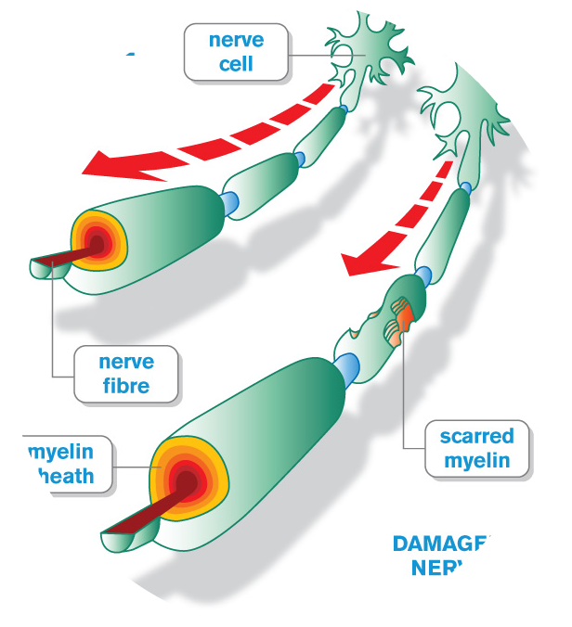
Multiple sclerosis
Fatigue
Musculoskeletal problems
High temperature is contraindicated
50-70% HR max , 3 days in week
1 h, water T= 25 – 27 C
Increased Temperature more than 1.1 C is forbidden

Slide 39
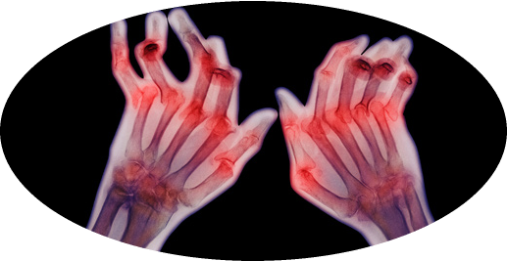
Rheumatoid arthritis
Swollen
Inflammation
Pain
15- 60 min 2 days per week
T=33-34 C
50-65% Max HR

Slide 40
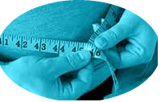
Obesity
90 min 5 days per week
40-75% MHR
T 20 – 28 C
RPE 10-14

Slide 41
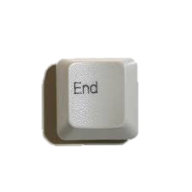
Thank you

