Slide 1
|

Slide 2
BARIATRIC & METABOLIC SURGERY
Alireza Khalaj, MD
|
www.totc.ir
Shahed university
10th international congress of endocrine disorders
22-24 Oct 2014 Tehran-Iran

Slide 3
Epidemiology
Bariatric procedures were first developed more than 50 years ago
In the past 20 years increase 20-fold
Buchwald H, Oien DM. Metabolic/bariatric surgery worldwide 2008. Obes Surg 2009;19:1605-11.

Slide 4
Epidemiology (continue)
The total number of bariatric procedures worldwide was estimated at 340 768 in 2011
The most commonly performed procedures:
Roux-en-Y gastric bypass (46.6%)
vertical sleeve gastrectomy (27.8%)
adjustable gastric banding (17.8%)
biliopancreatic diversion with duodenal switch (2.2%)
Buchwald H, Oien DM. Metabolic/bariatric surgery worldwide 2011. Obes Surg 2013;23:427-36.

Slide 5
Epidemiology (continue)
The largest number of operations were performed in:
the US & Canada together (101 645)
Brazil (65 000)
France (27 648)
Mexico (19 000)
Australia & New Zealand (12 000)
United Kingdom (10 000)
The No other nation performed 10 000 or more operations in 2011

Slide 6
OUTLINES
Which patients should be offered bariatric surgery? (Indications)
Which bariatric surgical procedure should be offered?
What is metabolic surgery?
Effectiveness
Risks & Complications
Conclusion

Slide 7
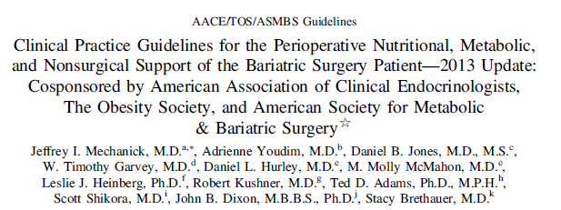
Indications

Slide 8
Which patients should be offered bariatric surgery?
Patients with a BMI ≥40 kg/m2 without co-existing medical problems and for whom bariatric surgery would not be associated with excessive risk should be eligible for 1 of the procedures
Grade A

Slide 9
Which patients should be offered bariatric surgery? (continue)
2. Patients with a BMI ≥35 kg/m2 and 1 or more severe obesity-related co-morbidities:
T2D
Hypertension
Hyperlipidemia
Obstructive sleep apnea (OSA)
obesity-hypo ventilation syndrome(OHS)
wickian syndrome(a combination of OSA and OHS)
Non alcoholic fatty liver disease(NAFLD) or nonalcoholic steatohepatitis (NASH)
Pseudotumor cerebri
GERD
Asthma Grade A

Slide 10
Which patients should be offered bariatric surgery? (continue)
3. Patients with BMI of 30–34.9 kg/m2 with diabetes or metabolic syndrome may also be offered a bariatric procedure although current evidence is limited by the number of subjects studied and lack of long-term data
Grade B

Slide 11
Which patients should be offered bariatric surgery? (continue)
4. BMI ≥30 kg/m2 and therapeutic target of glycemic control in T2D and improved biochemical markers of CVD risk
Grade C

Slide 12
Which patients should be offered bariatric surgery? (continue)
5. There is insufficient evidence for recommending a bariatric surgical procedure specifically for glycemic control alone, lipid lowering alone, or CVD risk reduction alone, independent of BMI criteria
Grade D

Slide 13
Which bariatric surgical procedure should be offered?
Purely gastric restriction
Sleeve gastrectomy
Adjustable gastric band
Gastric Plication
VBG
Gastric restriction with some mal-absorption
RYGB
Mini Bypass
Gastric restriction with significant intestinal mal-absorption
BPD
BPD/DS
AACE/TOS/ASMBS Bariatric Surgery Guidelines, Endocr Pract. 2008;14(Suppl 1

Slide 14
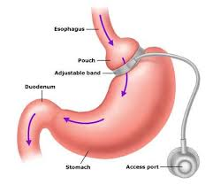
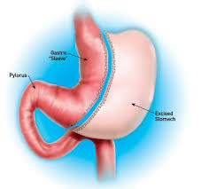
Which bariatric surgical procedure should be offered? (continue)
Sleeve
Adjustable gastric band

Slide 15
پلیسه زدن معده

Slide 16
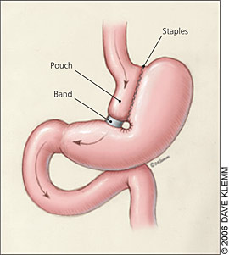
VERTICAL BANDING

Slide 17
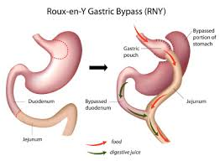
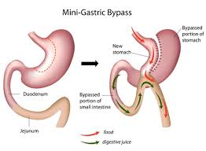
Which bariatric surgical procedure should be offered? (continue)
RYGB
Mini Bypass

Slide 18
Biliopancreatic Divertion

Slide 19
Biliopancreatic Diversion and Duodenal Switch

Slide 20
Ileal Transposition +/- Sleeve Gastrectomy
Physiologic Basis = Enteroinsular Axis
Highlights
Moderate MIS procedure
3 GI anastomosis
Scant worldwide experience

Slide 21
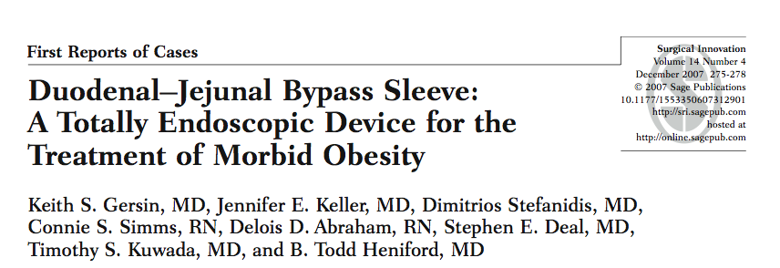
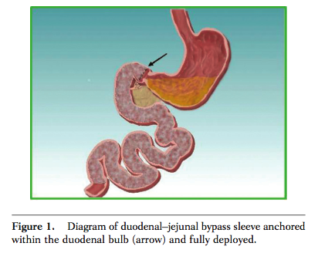
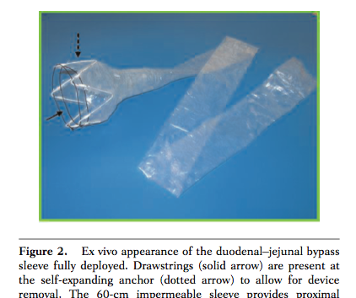
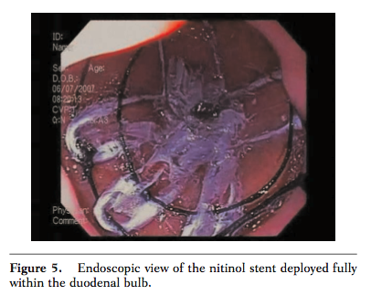

Slide 22
Which bariatric surgical procedure should be offered?
The best choice for any bariatric procedure depends on:
The individualized goals of therapy weight loss and/or metabolic [glycemic] control)
Available local-regional expertise (surgeon and institution)
Patient preferences
Personalized risk stratification

Slide 23
Operation of choice for a patient :
Patients dietary and psychology history
Medical and surgical history
Surgeon experience
Patient comfort and expectation
Ability of medical facility to handle most known complications

Slide 24
Buchwald algorithm for patient selection
There is no gold standard operation .
A surgeon should be able to perform more than one operation.
Patient can be matched to a specific procedure

Slide 25
Which bariatric surgical procedure should be offered?
At this time, there is still insufficient evidence to generalize in favor of one bariatric surgical procedure for these severely obese population
Grade D

Slide 26
Which bariatric surgical procedure should be offered?
In general, laparoscopic bariatric procedures are preferred over open bariatric procedures due to lower early postoperative morbidity & mortality
Grade B

Slide 27
RATIONALE FOR MINIMALLY INVASIVE BARIATRIC SURGERY
Wound infection
Rates of wound infection are significantly greater with open (10 to 15 percent) than laparoscopic (3 to 4 percent) gastric bypass procedures .
SO - Ann Surg 2000 Oct;232(4):515-29
Ventral incisional hernia
Ventral incisional hernias occur with a frequency of 0 to 1.8 percent in laparoscopic series and as high as 24 percent in open series, underscoring a clear advantage of the laparoscopic approach in this regard
SO - Ann Surg 2001 Sep;234(3):279-89; discussion 289-91
Reduction in postoperative pain, shorter length of hospital
stay, and faster recovery

Slide 28
What is metabolic surgery?
We defined metabolic surgery:
“as the operative manipulation of a normal organ or organ system to achieve a biological result for a potential health gain”
Explained by alterations in hormonal or neurogenic pathways.

Slide 29
Metabolic Surgery
Severity of Diabetes
High
Interposition with Gastrectomy
Switch
Roux en Y
Duodenal Exclusion
Mid
Gastrectomy
II or Oment
Banding
Low
BMI
25
30
35
40
45
50
New Market Development
Current Market Development
Notes:
Capture and Create KOL’s performing research to use as subsequent reference and trainers
Use Patient Referrals to Initiate Self Referrals
Gain Acceptance of New Treatment Options using Publication Strategies, PR and DTC

Slide 30
Metabolic Surgery
Medical therapy is always advancing…but will likely continue to underserve considerable numbers of T2DM patients
Current surgical therapy is highly effective…but is more often thought of in terms of its weight loss rather than its metabolic outcomes…and is designed for higher BMI populations
Our current knowledge of these concepts as well the role of gastrointestinal physiology provides rationale for expansion and augmentation of “metabolic” surgical interventions in carefully controlled research trials only

Slide 31
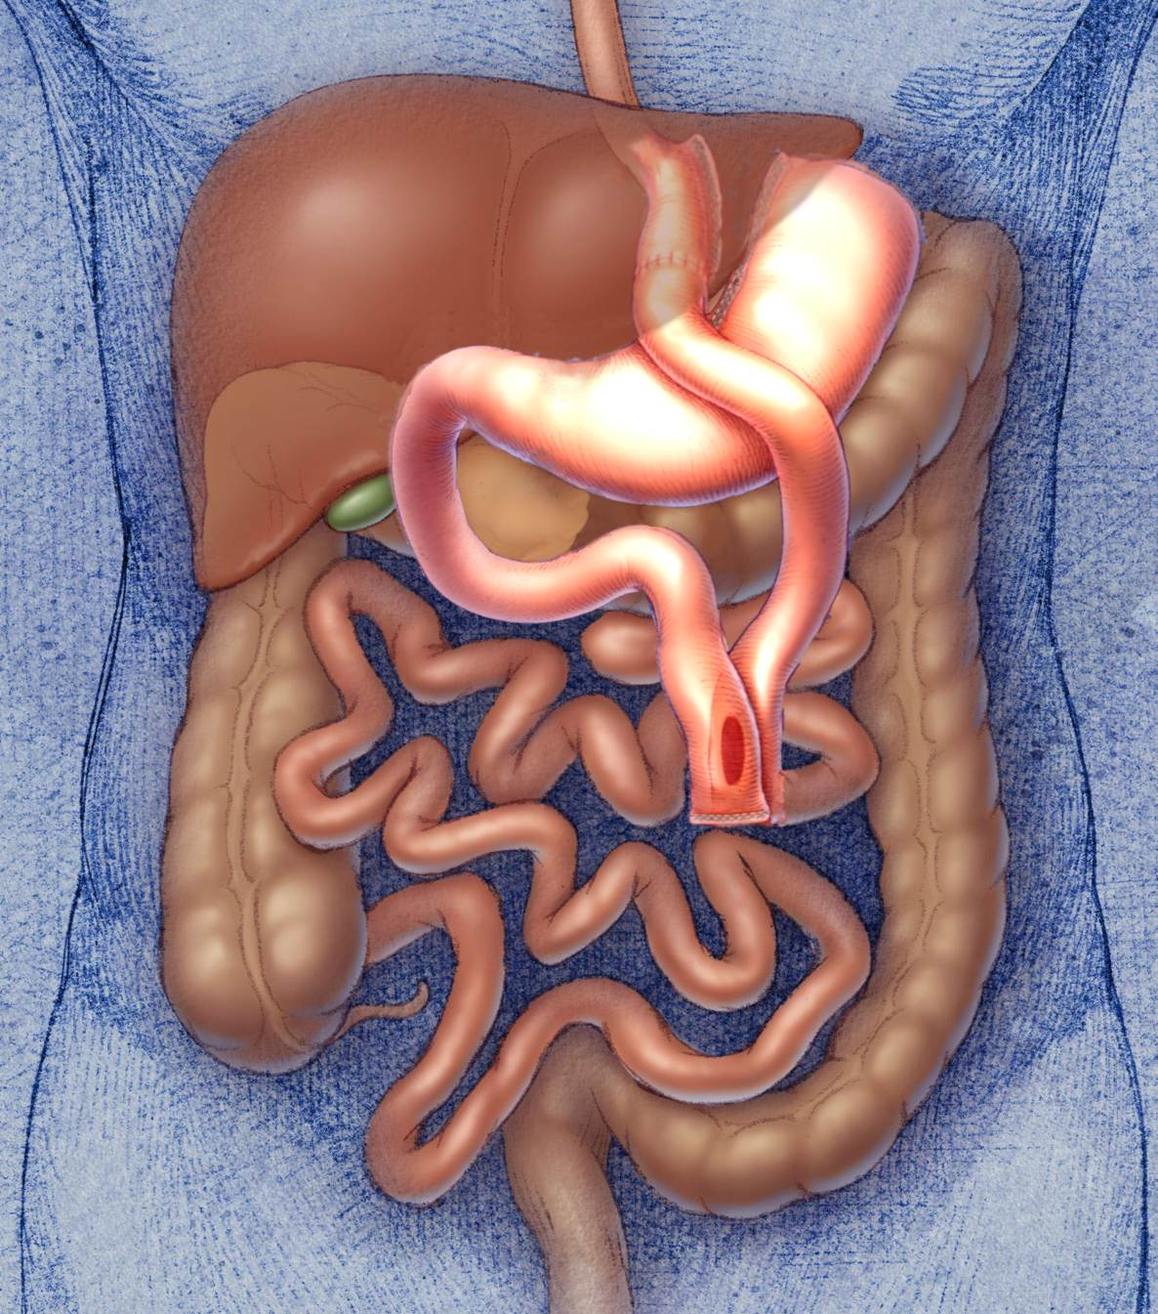
Foregut Theory
Exclusion of the duodenum results in inhibition of a “putative”signal that is responsible for insulin resistance and/or abnormal glycemic control (T2DM)
Rubino et.al, Ann Surg, 2006

Slide 32
The Hindgut Theory
The more rapid delivery of undigested nutrients to the distal bowel upregulates the production of L-cell derivatives like GLP-1
Mason E. Obes Surg 2005 15, 459-461
Rubino et.al, Ann Surg, 2006

Slide 33
EFFECTIVENESS OF BARIATRICSURGERY
Reduction of comorbidities
Reduction in mortality

Slide 34
Reduction of comorbidities
Meta-analysis: surgical treatment of obesity.
Ann Intern Med 2005 Apr 5;142(7):547-59.
Maggard MA; et al
147 studies
Bariatric surgery: a systematic review and meta-analysis.
AU Buchwald H; Avidor Y; Braunwald E; Jensen MD; Pories W; Fahrbach K; Schoelles K
SO JAMA 2004 Oct 13;292(14):1724-37
136 fully extracted studies,

Slide 35
• Diabetes completely resolved in 77 percent and resolved or improved in 86 percent.
• Hyperlipidemia improved in 70 percent or more of patients.
• Hypertension resolved in 62 percent and resolved or improved in 79 percent.

Slide 36
• Obstructive sleep apnea resolved in 86 percent and resolved or improved in 84 percent.
• Gastroesophageal reflux symptoms improve and complete or partial regression of Barrett's esophagus has been demonstrated.

Slide 37
Reduction in mortality
Long-term mortality after gastric bypass surgery.
Adams TD; et al
N Engl J Med. 2007 Aug 23;357(8):753-61.
cohort study
from 1984 to 2002
9949 patients who had undergone gastric bypass surgery
9628 severely obese in control group

Slide 38
Effects of bariatric surgery on mortality in Swedish obese subjects.
AU Sjostrom L; Narbro K; Sjostrom CD; Karason K; Larsson B; Wedel H; Lystig T; Sullivan M; Bouchard C; Carlsson B; Bengtsson C; Dahlgren S; Gummesson A; Jacobson P; Karlsson J; Lindroos AK; Lonroth H; Naslund I; Olbers T; Stenlof K; Torgerson J; Agren G; Carlsson LM
SO N Engl J Med. 2007 Aug 23;357(8):741-52.

Slide 39
Effects of bariatric surgery on mortality in Swedish obese subjects.
AU Sjostrom L; Narbro K; Sjostrom CD; Karason K; Larsson B; Wedel H; Lystig T; Sullivan M; Bouchard C; Carlsson B; Bengtsson C; Dahlgren S; Gummesson A; Jacobson P; Karlsson J; Lindroos AK; Lonroth H; Naslund I; Olbers T; Stenlof K; Torgerson J; Agren G; Carlsson LM
SO N Engl J Med. 2007 Aug 23;357(8):741-52.

Slide 40
. Deaths from all causes were reduced by 40 percent,
from diabetes by 92 percent,
from coronary disease by 56 percent,
and from cancers by 60 percent.
Although the majority of mortality data for bariatric surgery comes from patients under age 65, a retrospective cohort analysis suggests that survival is improved, even in patients over age 65

Slide 41
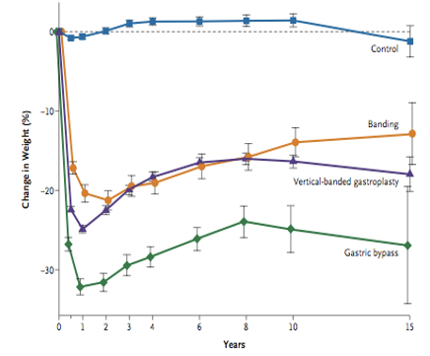
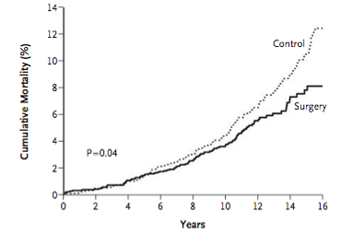
Effects on Weight Loss and Mortality
24%
Sjostrom, L, et.al.; N Engl J Med. 2007;357:741-52

Slide 42
Complications
Bariatric surgery is not without risks
Postoperative mortality (30 days) is low (<0.3%) and declining
The incidence of complications in the first (30-180 days) 4% to 25%

Slide 43
Conclusion
Because of the inability of diet and drug therapy to resolve obesity, the obesity pandemic will long need bariatric surgery
Metabolic surgery will embedded in our discipline in near future in class one obesity & overweight?? Until now there isn’t any evidence to support Metabolic Surgery for normal weight

Slide 44
Any questions?

