Slide 1
What is your first action after see high TSH & T4,T3 in laboratory findings ?
Request imaging
Start treatment
Repeat tests
A.H. Ghanooni M.D
Fellow of endocrinology in SBMU
January 2017

Slide 2
Unsuppressed TSH
TT4 TT3
FT4 FT3
Repeat TSH by another assay or Dilution

Slide 3
Assay interference
High Total t4 → increased protein binding of the hormones
familial dysalbuminemic hyperthyroxinemia
presence of anti-T4 antibodies.
High TSH → presence of heterophilic Ab (in immunometric assays)
These human anti-mouse gamma globulins can bridge the two mouse monoclonal antibodies (solid phase antibody and signal antibody) and cause spuriously elevated readings for TSH [15,20].
Nonlinearity of TSH measurements with serial dilution of the patient’s serum strongly suggests assay interference.
Addition of nonimmune homologous mouse immunoglobulins has reduced this type of assay interference. Commercial assays exist for detecting human anti-mouse antibodies (HAMA).
Patients with substances interfering with TSH measurements are usually euthyroid, not thyrotoxic, and have normal free T4 and T3. Thus, tests for interference with the TSH measurement are rarely required.

Slide 4
Unsuppressed TSH
TT4 TT3
FT4 FT3
Normal
FT4 FT3
measurable TSH
FT4 FT3
Repeat TSH by another assay or Dilution
TBG effect
FDH
Heterophil Ab
Central hyperthyroidism:
RTH
TSHoma

Slide 5
TSH-secreting pituitary adenomas or Resistant to Thyroid Hormone ?????

Slide 6
TSH-secreting pituitary adenomas
0.5 to 3 percent of all functioning pituitary tumors
much less than 1 percent of all cases of hyperthyroidism
the diagnosis should be considered in all hyperthyroid patients, especially those with a diffuse goiter and no extrathyroidal manifestations of Graves' disease.
Eur Thyroid J 2013; 2:76.

Slide 7
TSH-secreting pituitary adenomas (cont.)
TSH concentrations range from normal to markedly elevated (>500 mU/L).
Most TSH-secreting adenomas secrete only TSH.
20 to 25 percent of the adenomas secrete one or more other pituitary hormones, predominantly growth hormone or prolactin.
Adenomas secreting TSH and growth hormone are equally common in men and women,
whereas cosecretion of TSH and prolactin is about five times more common in women than in men.
Hyperprolactinemia is not always due to tumor secretion of prolactin; in some patients, it is caused by compression of the pituitary stalk and interruption of tonic hypothalamic inhibition of prolactin secretion.
Uptodate 2016

Slide 8
CLINICAL PRESENTATION
Symptoms and signs
Mild or typical symptoms and signs of hyperthyroidism (eg, palpitations, tremor, heat intolerance).
expanding tumor mass compression of the normal pituitary gland or the optic chiasm,
co-secretion of growth hormone or prolactin.

Slide 9
In a review of 255 patients with thyroid-stimulating hormone (TSH)-secreting tumors, clinical features other than hyperthyroidism included :
●A diffuse goiter – 93 percent
●Visual field defects – 35 percent
●Menstrual disturbances – 33 percent
●Galactorrhea (women), with or without cosecretion of prolactin – 28 percent
●Headache – 21 percent

Slide 11
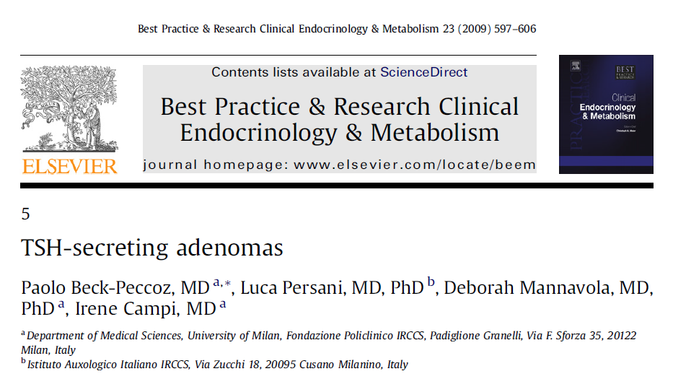

Slide 12
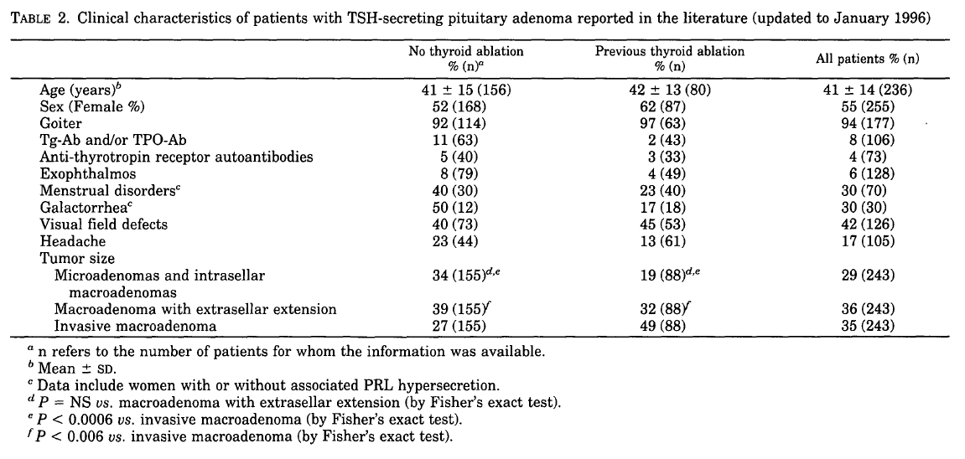

Slide 13
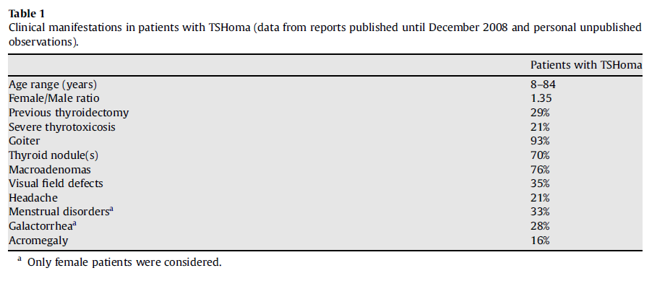

Slide 14
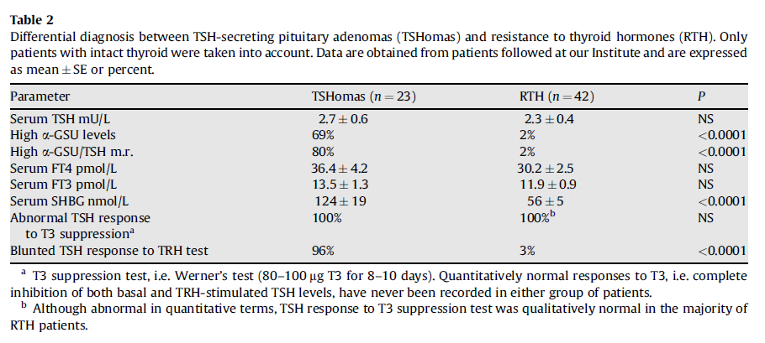

Slide 15
the ranges of hormone values were:
●Serum TSH concentrations – <1.0 to 568 mU/L
●Serum total T4 concentrations – 11.6 to 53 micrograms/dL (150 to 678 nmol/L)
●Serum free T4 concentrations – 1.6 to 7.7 ng/dL (20 to 100 pmol/L)
●Serum total T3 concentrations – 195 to 1300 ng/dL (3.0 to 20 nmol/L)
●Serum free T3 concentrations – 5 to 26 pg/mL (8.0 to 40.2 pmol/L)

Slide 16
Differential diagnosis with TSHoma
Assay interference
Resistance to thyroid hormone

Slide 17
Resistance to thyroid hormone (RTH)
a syndrome of reduced responsiveness of target tissues to thyroid hormone (TH)
TH receptor (TR) Beta gene mutations
reduce the effectiveness of TH through altered cell membrane

Slide 18
Resistance to thyroid hormone (RTH) (cont.)
generalized resistance to TH (GRTH)
majority of patients
near normal serum TSH concentration
eumetabolic
pituitary resistance to TH (PRTH)
high levels of TH
nonsuppressed TSH
hypermetabolic
isolated peripheral tissue resistance to TH (PTRTH)
was reported in a single patient

Slide 19
How we can differentiate TSHoma from RTH?

Slide 20
Differentiation between RTH & TSHoma
TRH stimulation Test
In TSH-secreting tumors, the TSH response elicited by TRH is blunted. In contrast, TSH usually rises in response to TRH in thyroid hormone insensitivity and in normal subjects.
α-subunit measurement
the molar ratio of α-subunit to TRH is high (>1) in almost 85% of patients with TSHsecreting tumors.
T3 suppression test
complete inhibition of TSH does not occur in patients with TSH-secreting tumors.
William 2016

Slide 21
The combination of high T4, T3, and α-subunit; high or inappropriately normal TSH; and a pituitary tumor strongly confirms the diagnosis of a TSH-producing pituitary adenoma.
Williams 2016

Slide 22
elevated free T4, T3, and nonsuppressed TSH and normal serum alpha subunit
In the presence of history or testing suggestive of a pituitary adenoma, or after exclusion of RTH
analysis for mutations in the TR-beta gene
MRI of the pituitary with gadolinium
UpToDate 2017

Slide 23
the presence of a mutation rules out the diagnosis of a TSH-secreting tumor and may prevent the possible confounding discovery of a pituitary incidentaloma.
The presence of a macroadenoma on MRI is strong evidence of a TSH-secreting tumor, particularly in the presence of an elevated alpha subunit.
UpToDate 2017

Slide 24
The presence of a microadenoma on MRI is not specific for a TSH-secreting tumor and can be seen as an incidental finding in 10 percent of normal individuals .
Ann Intern Med 1994; 120:817.

Slide 25
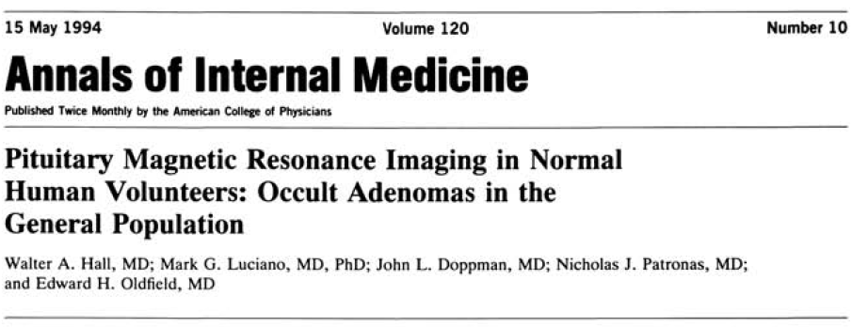

Slide 26
• Design: 100 normal volunteers (70 women, 30 men; age range, 18 to 60 years old) were studied by high resolution magnetic resonance imaging (MRI) of the pituitary gland before and after administration of gadolinium-diethylenetriaminepentaacetic acid (Gd-DTPA).
• Setting: Occult pituitary adenomas are identified at autopsy in 3% to 27% of unselected asymptomatic patients. The frequency of incidental pituitary adenomas detected by MRI in normal persons is unknown.
• Measurements:The MRI scans from volunteers were randomly mixed with scans of 57 patients with Cushing disease and interpreted independently by three blinded Reviewers.
• Results: Seven women (10%) and three men (10%) had focal areas of decreased signal intensity in the pituitary gland after administration of Gd-DTPA. The lesions ranged from 3 to 6 mm in greatest diameter and were diagnosed as pituitary adenomas by at least two of the three reviewers. When similar lesions were detected on MRI scans in patients with Cushing disease,the positive predictive value for identification of an adenoma at that site was 86%.
• Conclusions: About 10% of the normal adult population have pituitary abnormalities on MRI scans that are compatible with the diagnosis of asymptomatic pituitary adenomas.

Slide 27
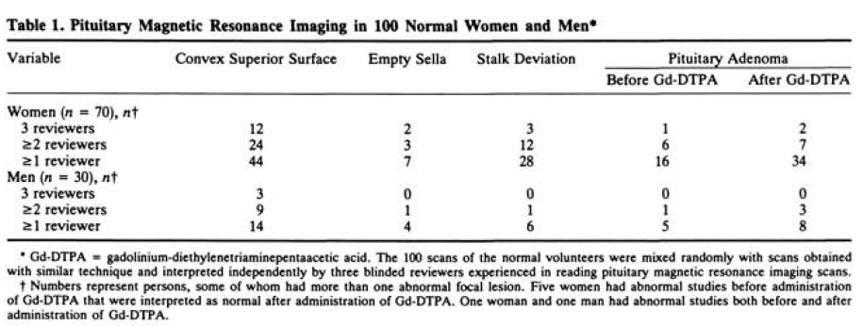

Slide 28
serum alpha subunit levels
The ratio is calculated using the following formula:
[Alpha subunit (in ug/L) ÷ TSH (in mU/L)] x 10
cutoff In postmenopausal women → 29.1
premenopausal women and men → 0.3
[European thyroid association guidelines for the diagnosis and treatment of thyrotropin-secreting pituitary tumors. Eur Thyroid J 2013; 2:76.]
The ratio can be normal in patients with microadenomas [Eur J Endocrinol 2003; 148:433.].

Slide 30
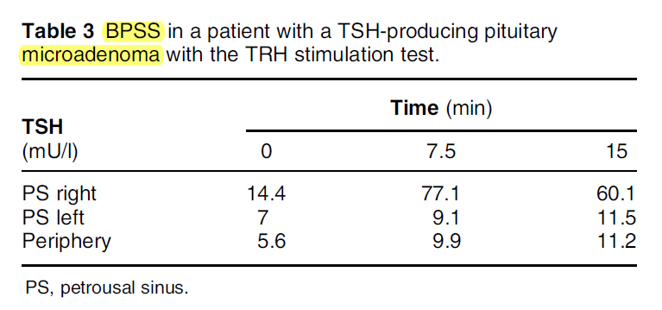

Slide 31
Other tests
Rarely, radiolabeled pentetreotide and
inferior petrosal sinus sampling
may be indicated when MRI of the pituitary shows a microadenoma or is normal.
Endocr Rev 1996; 17:610.

Slide 32
Other tests
The serum sex hormone-binding globulin concentration (SHBG) is high in patients with TSH-secreting pituitary adenomas, whereas the values are normal in RTH.
This difference reflects the expected action of excess T4 and T3 on hepatic SHBG production in hyperthyroidism, and resistance to the hormones' action in RTH.
UpToDate 2017

Slide 33
Other tests
Frequent measurements of serum TSH in four patients demonstrated loss of the normal nocturnal surge in TSH secretion, a finding that is compatible with autonomous TSH secretion.
J Clin Endocrinol Metab 1991; 72:477.

Slide 34
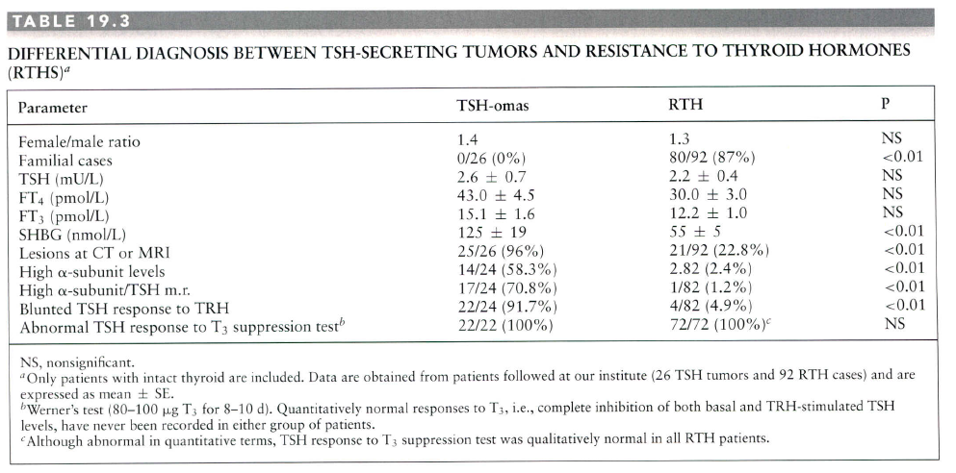
The Thyroid 2013

Slide 35
Other tests
Administration of native somatostatin or its analogs (octreotide and lanreotide) induces a reduction of TSH levels in the majority of cases, and these tests may be predictive of the efficacy of long-term treatment
as well as useful in the differential diagnosis between TSH-secreting tumors and PRTH
The Thyroid 2013

Slide 36
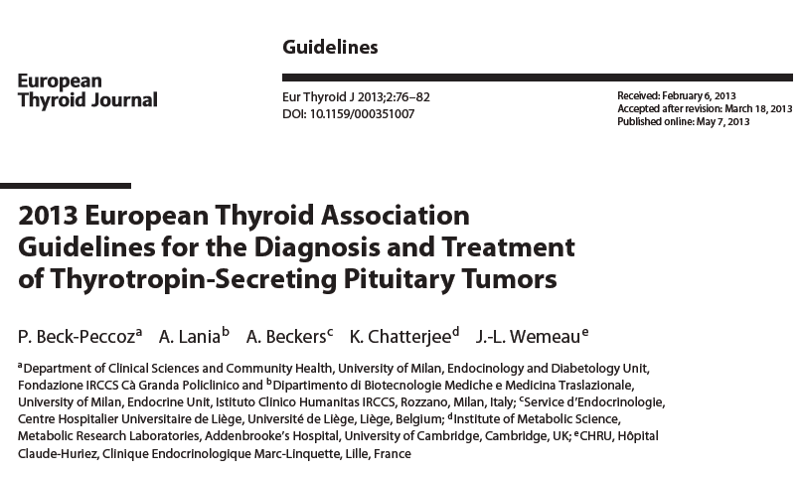

Slide 37
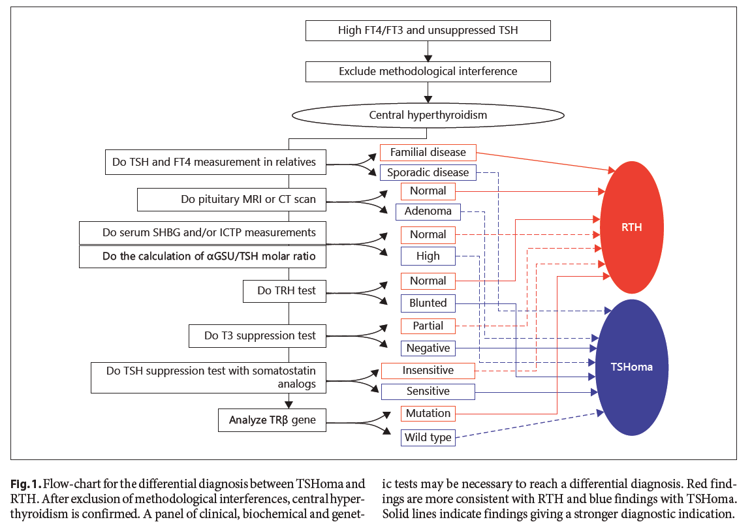
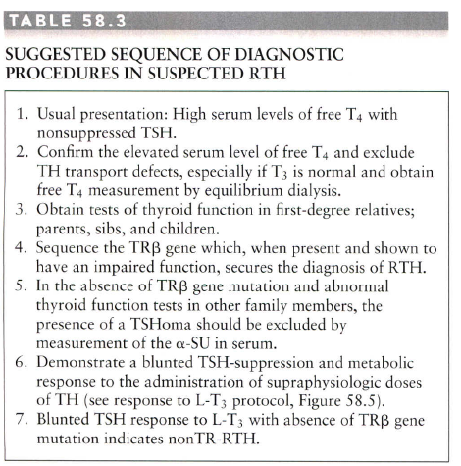
ETA Guidelines 2013

Slide 38
TREATMENT
Surgery
Radiation Therapy
Somatostatin Analogues

Slide 39
TREATMENT (cont.)
Surgery
The European Thyroid Association guidelines suggest surgery as first-line therapy.
Cures are achieved for most patients with microadenomas,
but remission is achieved in less than 60% of patients with macroadenomas.

Slide 40
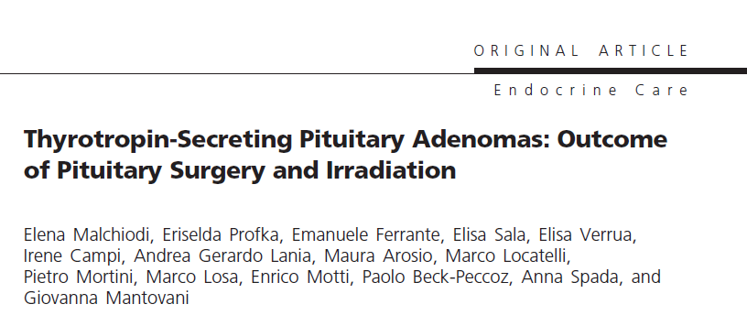

Slide 41
Methods: This was a retrospective multicenter study.
Results: We collected data of 70 TSHomas (70% macroadenomas). The mean follow-up was 64.4 (range 3–324) months.
Overall, 97% of patients were treated with surgery;
in 27% of them radiotherapy was associated.
After surgery, 75% of patients normalized thyroid function,
58% normalized both pituitary imaging and hormonal profile,
9%developed pituitary deficiencies,
3% had tumor or hormonal recurrence, all within the first 2 years after surgery.
Presurgical medical treatment did not significantly improve surgical outcome (63% vs 57%).
Radiotherapy controlled hypersecretion in 37%of patients within 2 years, whereas 32% of patients developed new pituitary deficiencies from 18 to 96 months from treatment.

Slide 42
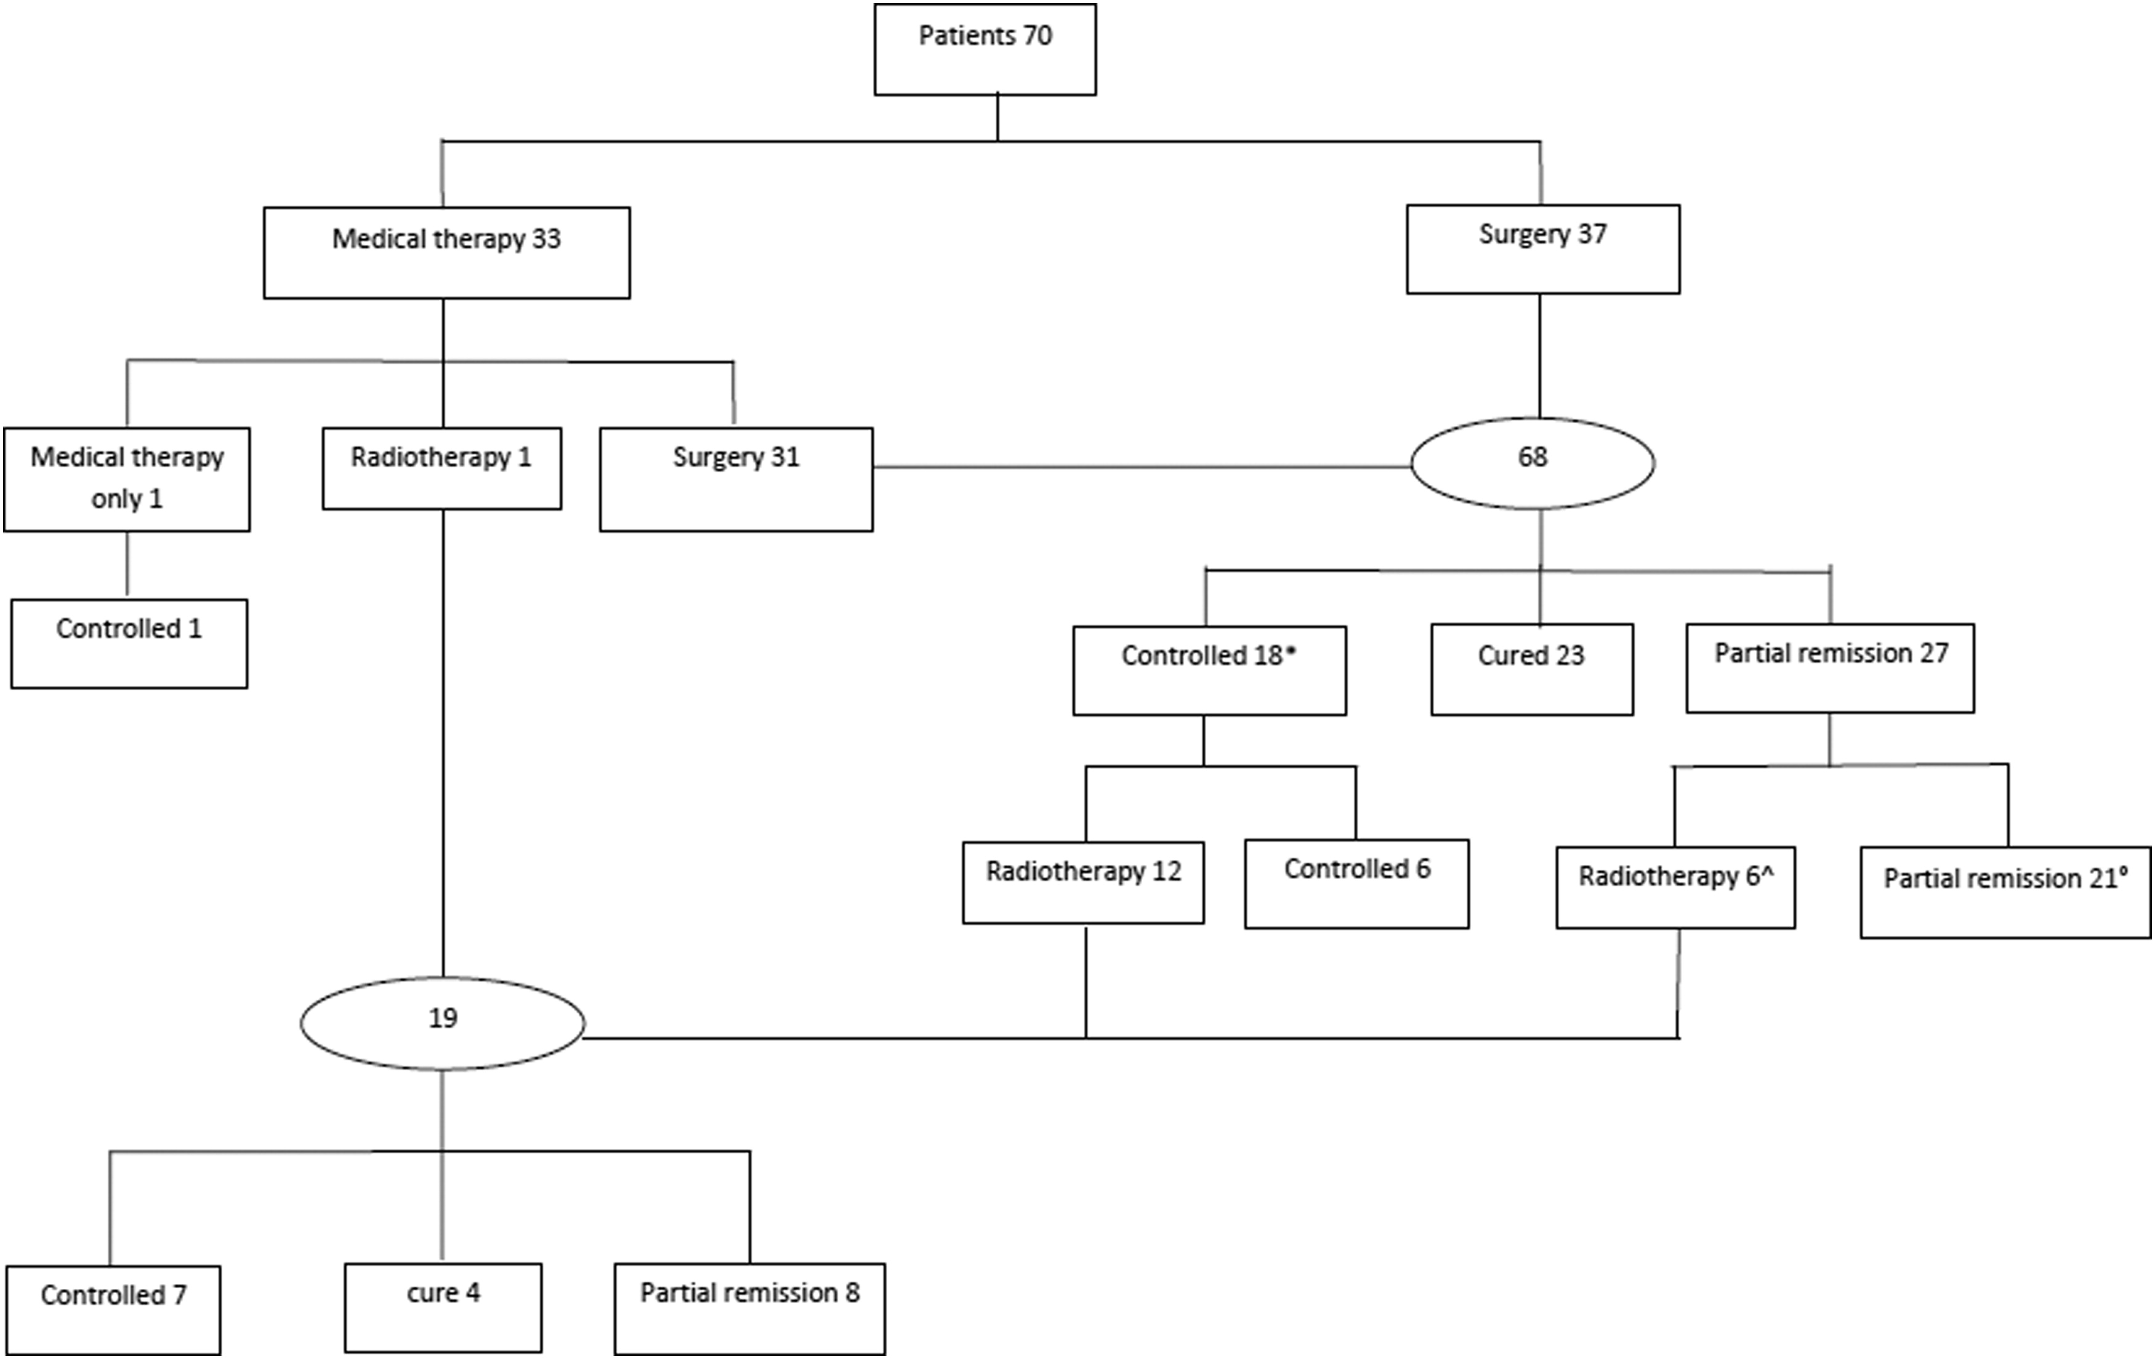
Figure 1. Treatment approaches and outcomes. *, Eleven patients were treated for central hyperthyroidism, 6 patients were treated for both central hyperthyroidism and residual acromegaly, and 1 patient normalized TSH but was treated with dopamine agonist for residual hyperprolactinemia. ^, One patient had relapsing hyperthyroidism on surgical rest after a 2-year period of euthyroidism, 1 patient was irradiated 1 year after surgery for relapsing adenoma with no biochemical evidence of associated hyperthyroidism, and 4 euthyroid patients were irradiated for enlargement of surgical rest. °, Twenty patients maintained an altered response to at least 1 provocative TSH test (either TRH stimulation test and/or T3 suppression test), 1 patient with mixed TSH/GH/FSH adenoma normalized GH and TSH secretion but maintained an incomplete inhibition of FSH after a 1-mg ethinyl estradiol suppression test.

Slide 43
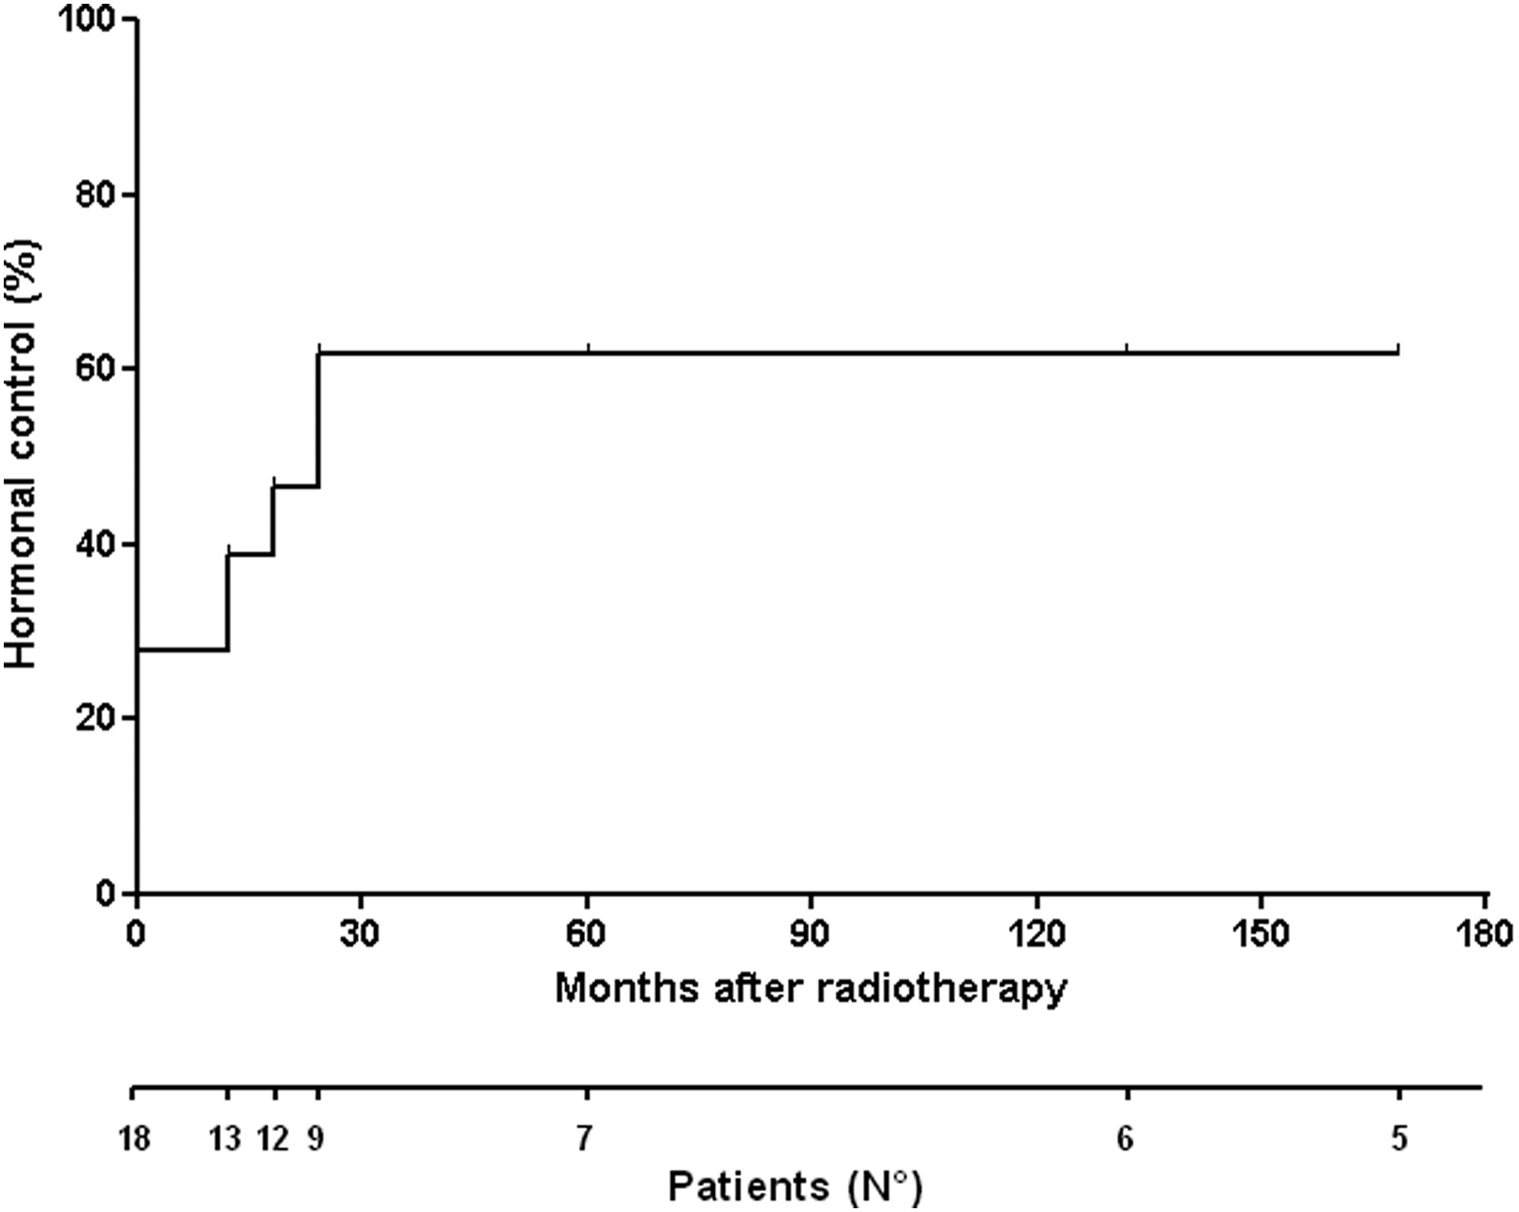
Figure 2. Cumulative incidence patients cured and in partial remission after radiation treatment. On the second x-axis, the number of patients in active follow-up is reported. Nineteen patients were treated with radiation therapy. One patient in partial remission is not shown in the figure because cure time is not known. Five patients were irradiated for increasing residual/recurrent adenoma despite that they were euthyroid. Four patients normalized TSH and free thyroid hormones levels between 12 and 24 months after radiation, and 3 developed hypothyroidism.
Published in: Elena Malchiodi; Eriselda Profka; Emanuele Ferrante; Elisa Sala; Elisa Verrua; Irene Campi; Andrea Gerardo Lania; Maura Arosio; Marco Locatelli; Pietro Mortini; Marco Losa; Enrico Motti; Paolo Beck-Peccoz; Anna Spada; Giovanna Mantovani; The Journal of Clinical Endocrinology & Metabolism 2014, 99, 2069-2076.
DOI: 10.1210/jc.2013-4376
Copyright © 2014

Slide 44
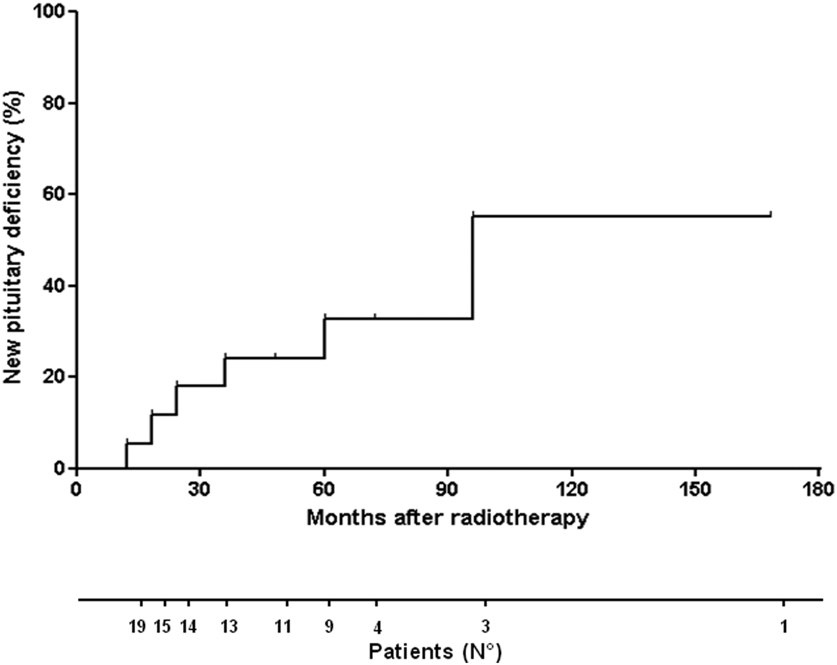
Figure 3. Cumulative incidence of hypopituitarism in patients treated with radiotherapy. On the second x-axis, the number of patients in active follow-up is reported.
Published in: Elena Malchiodi; Eriselda Profka; Emanuele Ferrante; Elisa Sala; Elisa Verrua; Irene Campi; Andrea Gerardo Lania; Maura Arosio; Marco Locatelli; Pietro Mortini; Marco Losa; Enrico Motti; Paolo Beck-Peccoz; Anna Spada; Giovanna Mantovani; The Journal of Clinical Endocrinology & Metabolism 2014, 99, 2069-2076.
DOI: 10.1210/jc.2013-4376
Copyright © 2014

Slide 45
TREATMENT (cont.)
Radiation Therapy
There are no large series reporting treatment of TSHsecreting tumors with radiotherapy alone.
Radiation has mostly been employed as adjunctive therapy to surgery, especially when the latter was not curative.

Slide 46
TREATMENT (cont.)
Somatostatin Analogues
Octreotide
primary or adjunctive treatment,
normalizes T4 and T3 and reduces TSH levels by half
Overall, tumors shrink in about a third of patients.
lanreotide (30 mg every 10 or 14 days)
significantly decreased TSH levels, decreased T4 levels,
but did not shrink tumors.
Octreotide LAR (up to 30 mg monthly)
responsiveness appeared similar to that observed for the subcutaneous preparation in 7 patients.

Slide 47
TREATMENT (cont.)
octreotide
suppressed TSH in 90% of patients with TSH-secreting tumors
reduced tumor size in 50% of these patients.
but tachyphylaxis may occasionally occur.

Slide 48
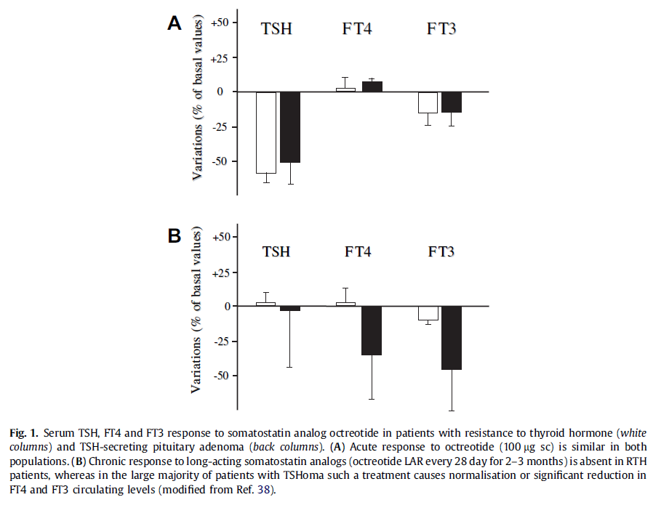

Slide 49
