Slide 1
In The Name Of GOD

Slide 2
Suprasellar mass with morbid obesity and hypernatremia
Soheila sadeghi
Somayeh motazedian

Slide 3
What is the likely diagnosis of suprasellar mass in this patient?
Has bariatric surgery been appropriate for obesity in this patient?
What is the best way to manage hypernatremia?
And about surgery ?
Behavior therapy

Slide 4
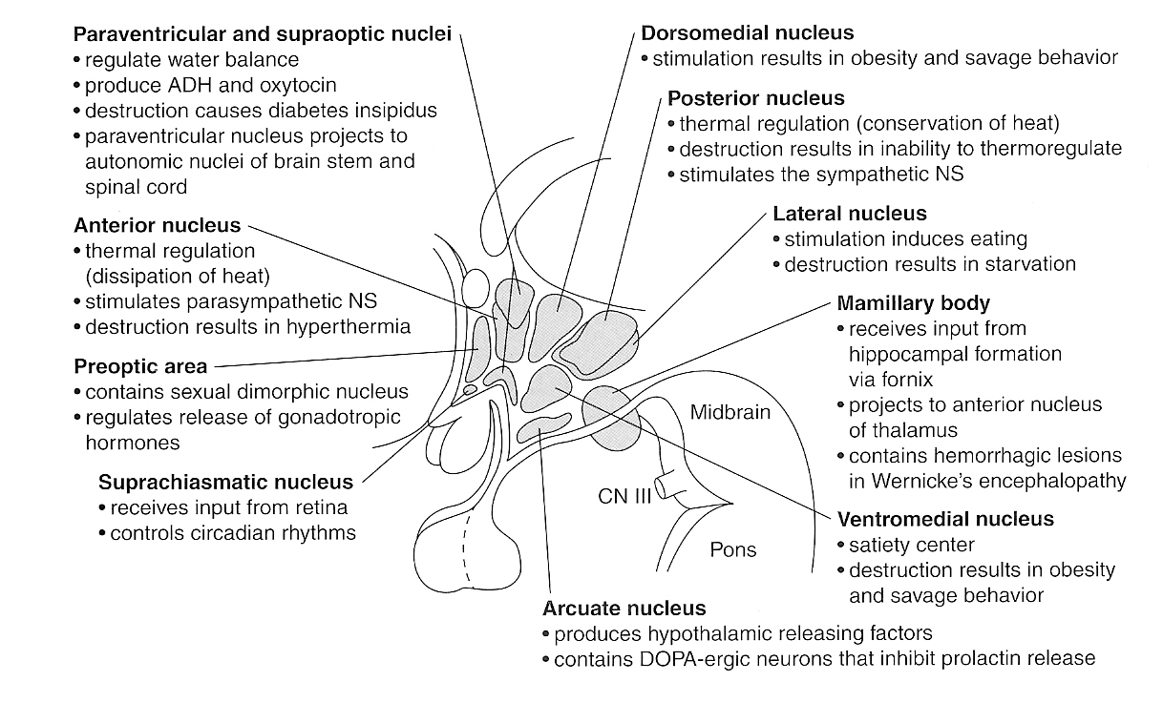

Slide 5
The most frequent pediatric lesions occurring in the suprasellar region:
craniopharyngioma
chiasmatic glioma
germ cell tumor
Rathke cleft
arachnoid cysts
pituitary adenoma
histiocytosis
Due to their shared anatomical location in close proximity to the pituitary gland, hypothalamus, and optic chiasm, many of the suprasellar pediatric lesions have common presenting symptoms
Endocrine dysfunction (particularly short stature, diabetes insipidus, delayed growth, and precocious puberty), visual impairment, and symptoms of raised intracranial pressure are frequent in the initial presentation of suprasellar lesions

Slide 6
These masses also present significant treatment challenges; while many suprasellar lesions are relatively benign in pathology, treatment may be complicated by high surgical morbidity resulting from damage to the hypothalamic-pituitary axis
Damage to these structures has major implications on long term quality of life
As a result, surgical management of these lesions has, in many cases, shifted toward less aggressive resections, followed by adjuvant therapy when needed, with the goal of reducing long-term cognitive, neuropsychiatric, and ophthalmologic morbidity

Slide 7
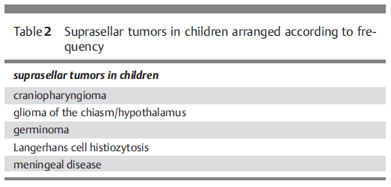

Slide 8
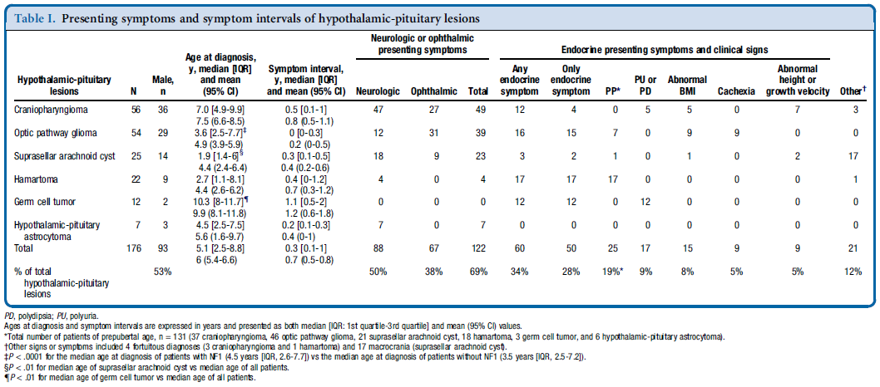
A retrospective, single-center, cohort study of 176 patients (93 boys), range of age , 0.2-18 years, with hypothalamic-pituitary lesions

Slide 9
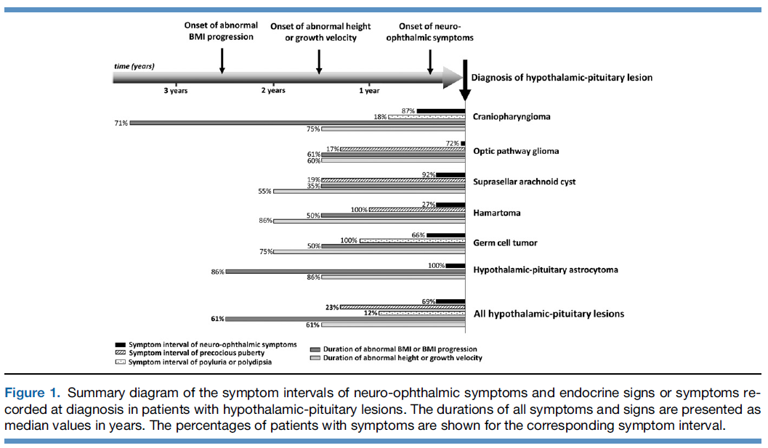

Slide 10
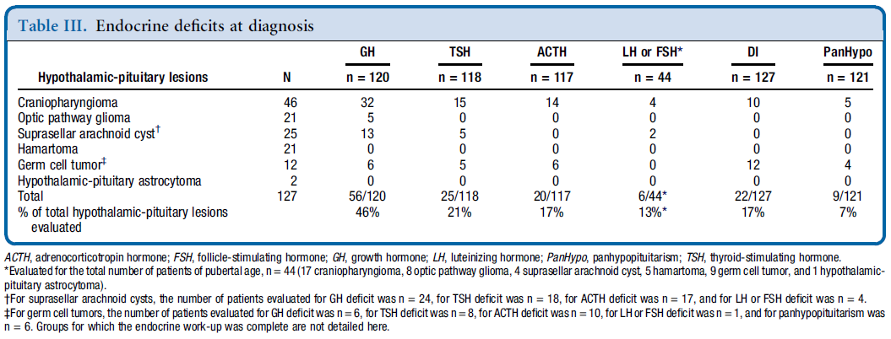

Slide 11
Endocrine disorders occurred in two-thirds of patients prior to the onset of the neuro-ophthalmic presenting symptom but were missed. Identifying them may help to diagnose hypothalamic-pituitary lesions earlier.
patients with abnormal BMI or BMI progression, regardless of height and growth velocity , might require more careful history and clinical evaluation and need timely reevaluation as the occurrence of other neurologic, ophthalmic or endocrine signs and symptoms may suggest the presence of an underlying hypothalamic-pituitary lesion

Slide 12
Hypothalamic obesity (HyOb) is a complex neuroendocrine disorder caused by damage to the hypothalamus, which results in disruption of energy regulation
The key hypothalamic areas of energy regulation are the ARC (arcuate nucleus), the VMH (ventromedial hypothalamus), the PVN (paraventriculer nuclei) and the LHA (lateral hypothalamic area)
Damage- causing disruption of hypothalamic pathways could be physical as seen in hypothalamic tumors, neurosurgery, inflammatory disorders, radiotherapy and trauma or functional as seen in genetic causes, rapid obesity hypoventilation hypothalamic autonomic dysregulation (ROHHAD) syndrome, and Prader-Willi syndrome
The most common cause of HyOb is acquired physical hypothalamic damages and among them, the most known and extensively documented cause is craniopharyngioma

Slide 13
Some predictive factors for the development of HyOb in brain tumors were described such as young age ( < 5–6 years) at diagnosis, histology of tumor (craniopharyngioma, optic glioma, germinoma), hypothalamic tumor involvement, radiotherapy ( > 51 Gy), presence of hypothalamic endocrinopathy, and hydrocephalus requiring ventriculoperitoneal shunt placement
Rapid weight gain and severe obesity are the most striking features of HyOb and caused by hyperphagia, reduced basal metabolic rate (BMR) and decreased physical activity
Recent studies have demonstrated that decreased energy expenditure (BMR and physical activity) has a greater role in the development of obesity
Reduced physical activity is more severe in hypothalamic patients than in simple obese patients and age-matched controls
HyOb is usually unresponsive to diet and exercise

Slide 14
The patients with HyOb have impaired sympathoadrenal activation, so sympathomimetic agents have been suggested to decrease weight gain(dextroamphetamine)
Parasympathetic hyperactivity causes hyperinsulinemia that has a critical role in hyperphagia. inhibition of insulin secretion with somatostatin analogs was attempted for HyOb treatment(octreotide-LAR)
combined diazoxide (as another inhibitor of insulin secretion) and metformine
Sibutramine is a nonspecific neurotransmitter reuptake inhibitor and causes an increase in the levels of serotonin, norepinephrine, and dopamine
Analog of glucagon-like peptide-1 (GLP-1) ; exenatide or liraglutide
Bariatric surgery

Slide 15
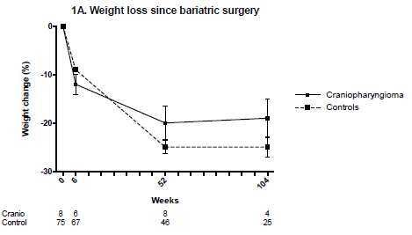
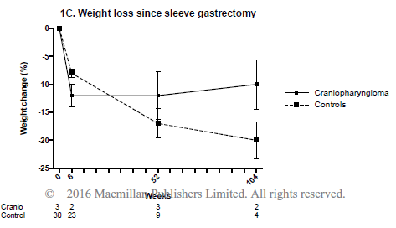
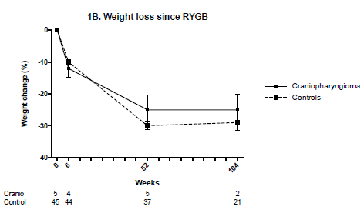
retrospective matched case-control study
compared weight loss after bariatric surgery (i.e. Roux-en-Y gastric bypass and sleeve gastrectomy) between eight patients with craniopharyngioma-related hypothalamic obesity and 75 controls with “common” obesity during two years of follow-up

Slide 16
Mean weight loss after bariatric surgery was 19% vs. 25% at two years of follow-up in patients with craniopharyngioma-relate hypothalamic obesity compared to control subjects with “common” obesity
Mean weight loss was 25% vs. 29% after Roux-en-Y gastric bypass, and 10% vs. 20% after sleeve gastrectomy at two years of follow-up in patients with craniopharyngioma-related hypothalamic obesity vs. control subjects with “common” obesity
Meta-analysis demonstrated significant weight loss one year after Roux-en-Y gastric bypass, but not after sleeve gastrectomy

Slide 17
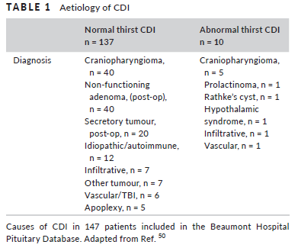
The coexistence of DI with a sellar mass suggests an alternative diagnosis, such as craniopharyngioma, pinealoma or germinoma, or a granulomatous process
Adipsic DI usually occurs in patients who have structural damage to the anterior hypothalamus where the osmoreceptors are situated
Adipsic DI is classically described
- neurosurgical clipping of anterior communicating artery (ACOM)
- extensive surgery for large craniopharyngiomas
- surgery for suprasellar tumours
- neurosarcoidosis

Slide 18
While those individuals with intact thirst will increase water consumption to maintain eunatremia despite relative AVP deficiency, patients with ADI are unable to sense rising osmolality and can quickly develop severe osmolar disturbances leading to marked increases in morbidity and mortality
MORBIDITY :
1) Hypernatremia : Severe hypernatremia is reported quite commonly and is more marked in those with impaired thirst mechanisms
2) Recurrent hospital admissions
3) Sleep Apnea : Obstructive sleep apnea is most commonly seen, but central apnea (likely due to hypothalamic injury) and obesity-related hypoventilation have also been reported
4) Obesity : Many patients with ADI are overweight or obese (20- 46% of patients). Several factors have been implicated etiologically such as Impaired satiety due to injury to the arcuate nucleus; Leptin resistance; Immobility; and Cognitive and Visual impairment
5) Venous Thromboembolism : Deep vein thrombosis and pulmonary embolism have been reported in patients with ADI regardless of etiology

Slide 19
TREATMENT :
maintenance of eunatremia while limiting polyuria and sleep disruption
- Obligate daily water intake 1.5 and 2 L
- The DDAVP doses in individual patients may vary but are reported most commonly as 100 to 250 mcg orally twice daily or 3 to 10 mcg intranasally twice daily
- Fixed DDAVP dosing is intended to achieve a daily urine output between 1.5 and 2 L
- Chlorpropamide (250- 500 mg orally daily) has been reported as an effective treatment modality, independent of renal effects, to restore normal drinking behavior
- For those with impaired memory , behavioral modification with a reward mechanism for compliance may improve control

Slide 20
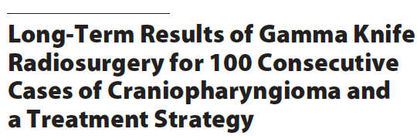
A total of 98 of 107 patients were followed up for a mean of 65.5 months after radiosurgery
The strategy is for a small tumor between the retrochiasm and anterior stalk to be treated by gamma knife radiotherapy with 10–12 Gy, allowing cure without neuroendocrine deficits
Stereotactic gamma knife radiosurgery is safe and effective as adjuvant or boost therapy for residual and/or recurrent craniopharyngiomas after surgical removal, and has acceptable side effects

Slide 21
Life chart
13 Y
14 Y
19 Y
19.5 Y
22 Y
23 Y
24.5 Y
25 Y
25 .5Y (NOW)
BIRTH
DI
HYPOTHYRODISM
BRAIN TUMOR
SLEEVE
GAMMA
ICU
BYPASS
B.EATING
B.EATING
B.EATING
OVER DEPENDENCY
AMNESIA
PSYCHOTHERAPY
DEPRESSION
PSYCHIATRIC DRUGS

Slide 22
Neuropsychiatric symptoms
Cognitive
Memory (episodic)
Affective
Dysphoria
Vegetative
Impaired sleep
Behavioural
Attention
Perceptual-motor
Language
Emotional outburst
Hopelessness
Food seeking behaviour
Dependency
Hyperphagea
Decreased sexual drive
Easy fatigability

