Slide 1
Oral Antidiabetic Agents Workshop
Hengameh Abdi, MD
Endocrine Research Center
Research Institute for Endocrine Sciences
Shahid Beheshti University of Medical Sciences
Tehran
1398.05.15
06 August 2019

Slide 2
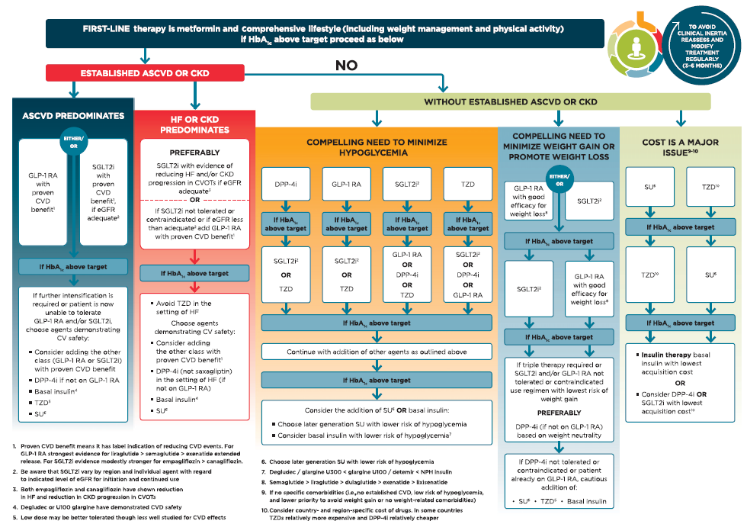
Davies MJ, et al. Diabetes Care 2018;41:2669-2701.

Slide 3
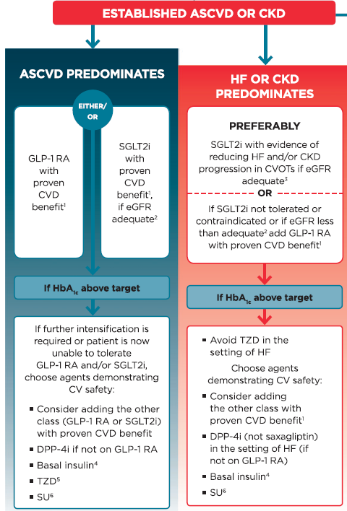

Slide 4
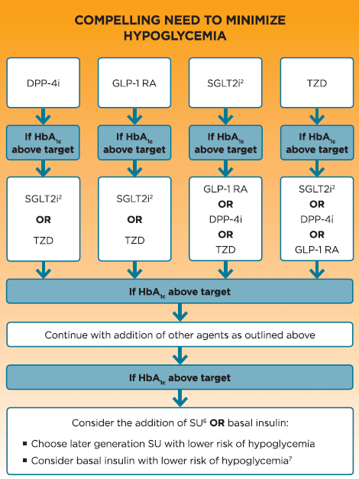

Slide 6
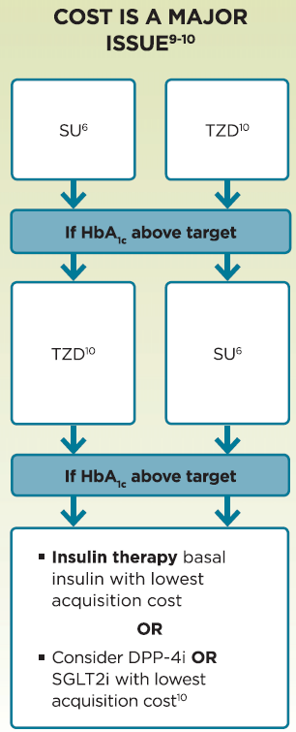

Slide 7
Case presentation (1)
A 38-year-old healthy woman has come to you for consultation about her fasting plasma glucose level of 112 mg/dl detected during a recent screening laboratory study.
She tells about history of gestational DM controlled with diet in her last pregnancy at age of 34. Weight gain attained during the pregnancy has progressively increased over the past 4 years.
Her mother has type 2 DM controlled on metformin and glibenclamide.
She is a company secretary and has a sedentary lifestyle.

Slide 8
Case presentation (1)
BMI: 32 kg/m²
Repeat laboratory tests:
FBS: 108 mg/dl
Cr: 0.72 mg/dl
Lipid profile:
Cholesterol: 160 mg/dl; TG: 275 mg/dl; HDL-C: 28 mg/dl

Slide 9
What is your diagnosis?

Slide 10
Case presentation (1)
What do you recommend to her regarding preventive strategies for development of type 2 DM?
A) Request a glucose tolerance test (GTT)
B) Intensive lifestyle modification
C) Intensive lifestyle modification and pioglitazone
D) Intensive lifestyle modification and metformin
E) Intensive lifestyle modification and low-dose gliclazide

Slide 11
Does she need any other screenings?

Slide 12
Case presentation (2)
A 52-year-old active housewife has come to you. In about 8 months ago, the screening laboratory study documented a fasting plasma glucose value of 156 mg/dl. She tries to attribute this high result to eating so much at the night preceding the laboratory study.
However, she claims that she has omitted simple sugar from her routine diet during the past 8 months. She walks daily for 45 min.
There are no symptoms of hyperglycemia.
Past medical history is unremarkable.

Slide 13
Case presentation (2)
BMI: 30.5 kg/m²
Recent laboratory tests:
FBS: 192 mg/dl
HbA1c: 9.2%
Cr: 0.8 mg/dl (eGFR ~ 80 ml/min)

Slide 14
Case presentation (2)
In addition to lifestyle modification, which therapeutic approach would you recommend to her?
A) Start metformin 500 mg twice daily and if tolerated, increase to 1000 mg twice daily
B) Start metformin 500 mg twice daily and basal insulin 14 units at bedtime
C) Start gliclazide MR 60 mg daily
D) Start metformin 500 mg twice daily (if tolerated, increase to 1000 mg twice daily) and gliclazide MR 30 mg daily concurrently

Slide 15
Case presentation (2)
Three months later:
She has had a weight loss of nearly 6 kg.
Ophthalmologic examination was unremarkable.
FBS: 136 mg/dl
HbA1c: 7.6%
She reports good adherence to her diet, exercise and medications.
She denies hypoglycemic episodes over the period.
She tells about history of hip fracture following a falling in her mother.

Slide 16
Case presentation (2)
At this time, which of the following can be considered for her optimal glycemic control?
A) Increase gliclazide MR to 60 mg daily
B) Switch metformin to sitagliptin/metformin 50/1000 mg twice daily
C) Add pioglitazone 30 mg daily
D) Continue same medications with the same doses

Slide 17
Case presentation (3)
A 68-year-old woman with 12-year history of type 2 DM is referred to you. She takes metformin 2000 mg and gliclazide MR 30 mg daily. She respects the diet recommended by the nutritionist.
She has background retinopathy and peripheral neuropathy.
Cardiovascular history is unremarkable.
She claims that in the past, with increasing gliclazide dose, several hypoglycemic episodes had occurred. She fears hypoglycemia because she lives alone.

Slide 18
Case presentation (3)
BMI: 29.5 kg/m²
Laboratory tests:
FBS: 146 mg/dl
HbA1c: 7.9%
Cr: 1.2 mg/dl (eGFR ~ 50 ml/min)
ALT: 68 U/l
Liver sonography: Fatty liver grade 2

Slide 19
Case presentation (3)
Laboratory tests:
FBS: 146 mg/dl
HbA1c: 7.9%
Cr: 1.2 mg/dl (eGFR ~ 50 ml/min)
Which therapeutic approach would you recommend to her?
A) Add basal insulin
B) Add sitagliptin
C) Add pioglitazone
D) Add premixed insulin
E) Increase gliclazide to 60 mg daily

Slide 21
Case presentation (4)
A 74-year-old man presents for diabetes evaluation. He has had type 2 DM for more than 20 years.
The patient has recently developed congestive heart failure, with an ejection fraction of 35%. He is not apparently symptomatic.
His current antihyperglycemic regimen includes metformin 1500 mg daily and gliclaizide 160 mg twice daily.
He lives with his wife who is affected by Alzheimer’s disease.

Slide 22
Case presentation (4)
The only evidence of heart failure in physical examination is trace peripheral edema.
Blood glucose values by glucometer range from 60 to 160 mg/dl.
Laboratory tests:
Estimated glomerular filtration rate: 45 ml/min
HbA1C: 7.2%

Slide 23
Case presentation (4)
Which of the following would be the most appropriate recommendation regarding his antihyperglycemic medications?
A) Discontinue metformin
B) Discontinue metformin and add sitagliptin 50 mg daily
C) Switch gliclazide 320 mg daily to gliclazide MR 60 mg daily and decrease metformin to 1000 mg daily
D) Switch gliclazide 320 mg daily to repaglinide 1 mg twice daily and decrease metformin to 1000 mg daily
E) Switch gliclazide 320 mg daily to empagliflozin 10 mg daily and decrease metformin to 1000 mg daily
F) Continue same medications with the same doses

Slide 24
Case presentation (5)
A 46-year-old man is seen for follow-up of type 2 DM. He had good glycemic control by full dose of metformin and glibenclamide till 1 year ago. Over the past 1 year, his weight has been increasing and glycemic control has been worsening.
His physical activity is low because of his occupation and also bilateral knee pain. He is an active smoker.
Family history is remarkable with regard to coronary artery disease of his father presented at age of 40.
BMI: 40 kg/m²
BP: 140/85 mmHg

Slide 25
Case presentation (5)
Laboratory tests:
HbA1C: 7.9%
Estimated glomerular filtration rate: 80 mL/min
Which of the following medications is the most appropriate modality to improve his overall status regarding glycemic control, blood pressure and weight?
A) Pioglitazone
B) Acarbose
C) Sitagliptin
D) Empagliflozin
E) Basal insulin

