Slide 1
Weight management
Somayeh Hosseinpour-Niazi, PhD
Nutrition and Endocrine Research Center
Research Institute for Endocrine Sciences
Shahid Beheshti University of Medical Sciences

Slide 2
Weight management
General recommended goals for weight management:
Achieve and maintain body weight goals
FBS <126 mg/dl
Blood pressure <140/80 mmHg
LDL cholesterol <100 mg/dL
Triglycerides <150 mg/dL
HDL cholesterol > 40 mg/dL for men; HDL cholesterol > 50 mg/dL for women
Lifestyle management. Diabetes care 2017; 40: S33-S43

Slide 3
Strategies for weight management
Providers should advise overweight and obese patients:
Higher BMIs increase the risk of cardiovascular disease and all cause mortality
Assess each patient’s readiness to achieve weight loss
Jointly determine weight loss goals and intervention strategies
American Diabetes Association. Diabetes care; 40: S57-S63.

Slide 4
Strategies for weight management
Strategies:
Physical activity
Behavioral therapy
Pharmacological therapy
Metabolic surgery
Diet
American Diabetes Association. Diabetes care; 40: S57-S63.

Slide 5
Strategies for weight management
American Diabetes Association. Diabetes care; 40: S57-S63.

Slide 6
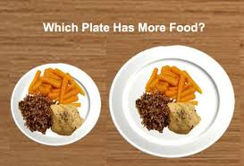
In the Look AHEAD study, weight loss strategies associated with lower BMI in overweight or obese individuals :
Weekly self weighing
Regular consumption of breakfast
Reduced intake of fast foods
Increasing physical activity
Reducing portion sizes
Using meal replacements (as appropriate)
Encouraging individuals to eat those foods with the greatest consensus for improving health
Emphasizing a variety of nutrient dense foods in appropriate portion sizes
American Diabetes Association. Diabetes care 2017; 40: S57-S63.

Slide 7
Eat frequent meals
Strategies for weight management
American Diabetes Association. Diabetes care 2017; 40: S57-S63.

Slide 8
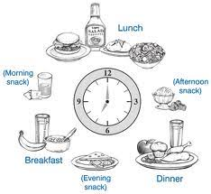
Eat frequent meals
Strategies for weight management
Eating five to six small meals: speed up your metabolism
Eating large meals only once or twice a day: slow down your metabolism.
American Diabetes Association. Diabetes care 2017; 40: S57-S63.

Slide 9
Eat frequent meals
Strategies for weight management
Don’t skip breakfast.
Fasting:
Activates the starvation response
Slowing your metabolism
Increasing the chances that excess fat will be stored to fuel your nutrient-depleted body.
Studies now show that women who eat cereal for breakfast maintained their weight better than those who skipped breakfast.
The plus of whole grain cereal is that it is a low-calorie, fiber-rich food.
American Diabetes Association. Diabetes care 2017; 40: S57-S63.

Slide 10
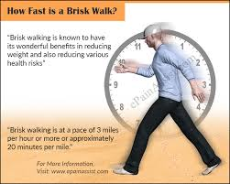
Increasing physical activity
Strategies for weight management

Slide 11
Increasing physical activity
Strategies for weight management
The U.S. Department of Health and Human Services’ physical activity guidelines for Americans:
Adults over age 18 years engage in 150 min/week of moderate-intensity or 75 min/week of vigorous-intensity aerobic physical activity, or an equivalent combination of the two.
Fortunately, studies show that long, brisk walks are very effective in losing weight.
In addition, the guidelines suggest that adults do muscle-strengthening activities that involve all major muscle 2 or more days/week.
Krause food nutrition and diet therapy, 14th Edittion, 2017

Slide 12
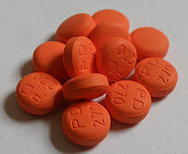
Evaluating pharmacological treatments
Strategies for weight management

Slide 13
Evaluating pharmacological treatments
Strategies for weight management
Weight loss: metformin, a-glucosidase inhibitors, sodium–glucose cotransporter 2 inhibitors, glucagon-like peptide 1 agonists, and amylin mimetics.
Weight neutral: Dipeptidyl peptidase 4 inhibitors appear to be.
Weight gain: insulin secretagogues, thiazolidinediones, and insulin have often been associated
Krause food nutrition and diet therapy, 14th Edittion, 2017

Slide 14
Evaluating pharmacological treatments
Strategies for weight management
Krause food nutrition and diet therapy, 14th Edition, 2017

Slide 15
Evaluating pharmacological treatments
Strategies for weight management
Krause food nutrition and diet therapy, 14th Edition, 2017

Slide 16
Evaluating pharmacological treatments
Strategies for weight management
داروهایی که احتمالا سبب کاهش وزن می شوند
داروهایی که احتمالا سبب افزایش وزن می شوند
جایگزین های داروهای نرولوژیک/ روانپزشکی
داروهای آنتی سایکوتیک
Ziprasidione, risperidone, Quetiapine
داروهای ضد افسردگی
Bupropion, Nefazodone
داروهای ضد صرع
Toprimate, Lamotrigine
داروهای نرولوژیک/روانپزشکی
داروهای آنتی سایکوتیک
Olanzapine, Clozapine, Lithium
داروهای ضد افسردگی
SSRIs, TCAs, MAOIs
داروهای ضد صرع
Gabapentin, Valproate, Carbamazpine
Modern nutrition and diet therapy, 2015

Slide 17
Evaluating pharmacological treatments
Strategies for weight management
داروهایی که احتمالا سبب کاهش وزن می شوند
داروهایی که احتمالا سبب افزایش وزن می شوند
هورمون های استروئیدی
داروهای ضد بارداری
کورتیکوستروئیدها
استروئیدهای پروژسترونی
جایگزین های هورمون های استروئیدی
سایر روشهای پیشگیری از بارداری
NSAIDs
جایگزین های داروهای ضد دیابتی
مت فورمین
آکاربوز
مگلیتول
داروهای ضد دیابتی
انسولین
سولفونیل اوره
تیازولیدین دیونها
Modern nutrition and diet therapy, 2015

Slide 18
Evaluating pharmacological treatments
Strategies for weight management
داروهایی که احتمالا سبب کاهش وزن می شوند
داروهایی که احتمالا سبب افزایش وزن می شوند
دکونژستان های استنشاقی
آنتی هیستامین
داروهای کاهنده فشار خون
بلوکه کننده های آلفا و بتا آدرنرژیک
جایگزین های داروهای کاهنده فشار خون
مهار کننده های ACE، بلوکه کننده کانال های کلسیم
Modern nutrition and diet therapy, 2015

Slide 19
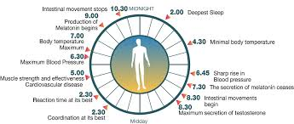
proper sleep and circadian rhythm
Strategies for weight management
Modern nutrition and diet therapy, 2015

Slide 20
Strategies for weight management
Get proper sleep.
Sleep deprivation slows metabolism
If you have trouble falling asleep or staying asleep, try fast-acting melatonin
If sleeping problems are resistant to a quick fix, then see your healthcare professional to rule out any chronic conditions that may be causing insomnia.
Try light therapy.
Circadian Rhythm Disorder can cause hormone imbalances and disrupt your body’s natural hormone production schedule.
This may hinder your ability to control your weight effectively.
Modern nutrition and diet therapy, 2015

Slide 21
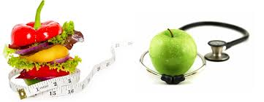
Strategies for weight management
Diet therapy

Slide 22
Diet therapy
Weight management
For overweight or obese adults, reducing energy intake while maintaining a healthful eating pattern is recommended to promote weight loss
Modest weight loss may provide clinical benefits (improved glycemia, blood pressure, and/or lipids) in some individuals.
To achieve modest weight loss, intensive lifestyle interventions (Diet, physical activity, and behavioral therapy ) with ongoing support are recommended.
American Diabetes Association. Diabetes care; 40: S57-S63.

Slide 23
Weight management
Diet therapy
Diet, physical activity, and behavioral therapy designed to achieve 5% weight loss should be prescribed for overweight and obese patients ready to achieve weight loss.
Such interventions should be high intensity (>16 sessions in 6 months) and focus on diet, physical activity, and behavioral strategies to achieve a 500–750 kcal/day energy deficit
Diets should be individualized, as those that provide the same caloric restriction but differ in protein, carbohydrate, and fat content are equally effective in achieving weight loss.
American Diabetes Association. Diabetes care; 40: S57-S63.

Slide 24
Weight management
Diet therapy
For patients who achieve short-term (3-month), weight loss goals (5%), long-term (>1-year) comprehensive weight maintenance programs should be prescribed.
Such programs should provide at least monthly contact and encourage ongoing:
Monitoring of body weight (weekly or more frequently)
Continued consumption of a reduced calorie diet
Participation in high levels of physical activity (200– 300 min/week)
American Diabetes Association. Diabetes care; 40: S57-S63.

Slide 25
Weight management
Diet therapy
Weight loss can be attained with lifestyle programs that achieve a 500–750 kcal/day energy deficit or provide approximately:
1,200–1,500 kcal/day for women
1,500–1,800 kcal/day for men
Although benefits may be seen with as little as 5% weight loss, sustained weight loss of >7% is optimal.
American Diabetes Association. Diabetes care; 40: S57-S63.

Slide 26
Weight management
Diet therapy
For overweight or obese adults, reducing energy intake while maintaining a healthful eating pattern is recommended to promote weight loss.
Modest weight loss may provide clinical benefits (improved glycaemia, blood pressure, and/or lipids)
To achieve modest weight loss, intensive lifestyle interventions (counseling about nutrition therapy, physical activity, and behavior change) with ongoing support are recommended.
American Diabetes Association. Diabetes care 2017; 40: S57-S63.

Slide 27
Weight management
Diet therapy
Optimal mix of macronutrients
Evidence suggests that there is not an ideal percentage of calories from carbohydrate, protein, and fat for all people
Macronutrient distribution should be based on individualized assessment of current eating patterns, preferences, and metabolic goals
American Diabetes Association. Diabetes care; 40: S57-S63.

Slide 28
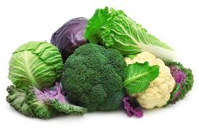
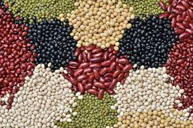
Weight management
Diet therapy
Carbohydrate
For good health, carbohydrate intake from vegetables, fruits, whole grains, legumes, and dairy products should be advised over intake from other carbohydrate sources, especially those that contain added fats, sugars, or sodium.
American Diabetes Association. Diabetes care; 40: S57-S63.

Slide 29
Weight management
Diet therapy
Glycemic index and glycemic load, dietary fiber and whole grains
Substituting low-glycemic load foods for higher-glycemic load foods may modestly improve glycemic control
Obese and overweight people should consume at least the amount of fiber and whole grains recommended for the general public
American Diabetes Association. Diabetes care; 40: S57-S63.

Slide 30
Weight management
Diet therapy
Glycemic index and glycemic load, dietary fiber and whole grains
Dietary guideline for American 2011

Slide 31
Weight management
Diet therapy
Total fat, MUFAs/PUFAs
Evidence is inconclusive for an ideal amount of total fat intake
Fat quality appears to be far more important than quantity
A Mediterranean-style, MUFA-rich eating pattern and DASH diet may benefit glycemic control and CVD risk factors and can therefore be recommended as an effective alternative to a lower-fat, higher-carbohydrate eating pattern
American Diabetes Association. Diabetes care 2017; 40: S57-S63.

Slide 32
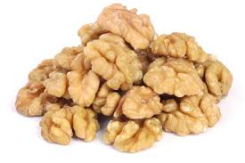
Weight management
Diet therapy
Omega-3 fatty acids
Evidence does not support recommending omega-3 (EPA and DHA) supplements for the prevention or treatment of cardiovascular events
As recommended for the general public, an increase in foods containing long-chain omega-3 fatty acids (EPA and DHA) (from fatty fish) and omega-3 linolenic acid (ALA) is recommended because of their beneficial effects on lipoproteins, prevention of heart disease, and associations with positive health outcomes
The recommendation for the general public to eat fish (particularly fatty fish) at least two times (two servings) per week is also appropriate
American Diabetes Association. Diabetes care 2017; 40: S57-S63.

Slide 33
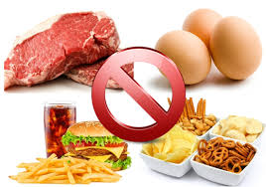
Weight management
Diet therapy
Saturated fat, dietary cholesterol, and trans fat
Reduction of the amount of dietary saturated fat, cholesterol, and trans fat
SFA (< 7% total calorires )
Cholesterol (< 200 mg/d)
Trans fat (0%)
American Diabetes Association. Diabetes care 2017; 40: S57-S63.

Slide 34
Weight management
Diet therapy
Sodium
The recommendation for the general population to reduce sodium to less than 2,300 mg/day is also appropriate for people with diabetes.
For individuals with both diabetes and hypertension, further reduction in sodium intake should be individualized.
American Diabetes Association. Diabetes care 2017; 40: S57-S63.

Slide 35
Foods to AVOID when treating obesity
Weight management

Slide 36
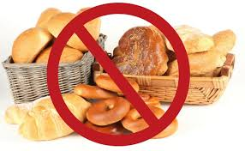
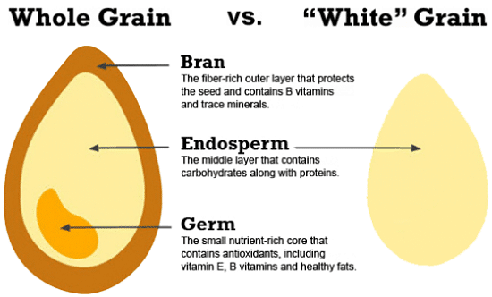
Foods to AVOID when treating obesity:
Weight management
All simple or refined carbohydrates (white flour, white rice, white bread, pasta, cookies, cakes, crackers, processed snack foods, etc.).

Slide 37
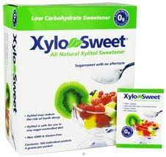
Foods to AVOID when treating obesity:
Weight management
All foods containing refined sugar or synthetic sugar-substitutes such as aspartame, Splenda®, etc.
These may actually contribute to weight gain, rather than aid in weight loss.
Studies now show that artificial sweeteners trick the body into associating sweetness with zero calories.
As a result, there’s a tendency to splurge on the “real thing,” because the body loses its ability to associate sweetness with a sense of fullness.
Choose a natural sweetener like Xylosweet instead.

Slide 38
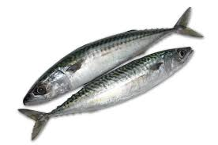
Foods to AVOID when treating obesity:
Weight management
Carbonated soft drinks that cause blood pH levels to become acidic
Deep-sea fish that may contain toxic levels of mercury. Choose minimal-mercury tuna instead.
Farm-raised fish that contain PCBs and not enough omega-3 essential fatty acids, due to their land-based diets. Choose wild-caught salmon instead.

Slide 39
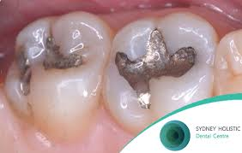
Foods to AVOID when treating obesity:
Weight management
Consider removing mercury dental fillings.
If you have silver fillings, get an evaluation from a mercury-free dentist who specializes in the safe removal of mercury amalgam fillings.
Mercury in the body damages immune cells, which can be a contributing factor for weight gain and obesity-related chronic conditions.
Find a mercury-free dentist in your area now!

Slide 40
Foods to AVOID when treating obesity:
Weight management
Sodium nitrite found in processed foods such as hot dogs, lunch meats, and bacon
Monosodium glutamate (MSG) found in many foods as a flavor enhancer
Hydrogenated or partially hydrogenated oils (trans fats) found in many processed foods, deep-fried foods, fast foods, and junk food.
Excessive caffeine intake. While moderate amounts of caffeine may be beneficial in boosting metabolism, excessive caffeine consumption can disrupt the body’s systems, causing insomnia and digestive irregularity (constipation or diarrhea).

Slide 41
Dietary tips for combating obesity

Slide 42
Dietary tips for combating obesity:
Eat more fiber
Fiber gives you a satiated feeling, helping you to curb food cravings.
It also keeps your colon healthy, and aids in proper digestion.
Research has shown that obesity puts you at higher risk for colorectal cancer, primarily due to a low-fiber, high-calorie, processed food diet.

Slide 43
Dietary tips for combating obesity:
Skip the low-fat food products
Most of the low-fat, processed foods in grocery stores: Typically high-carb foods that are loaded with sugar, salt, artificial sweeteners, and synthetic fat substitutes.
Many of these ingredients cause weight gain, rather than reduce it.

Slide 44
Dietary tips for combating obesity:
Watch out for fruit juices
They often contain added sugars that can increase your calorie intake dramatically.
Opt for water, or diluted fruit juice (three quarters water and one quarter juice).

Slide 45
از توجه شما سپاسگزارم

