Slide 1
Special Case Control Designs
S.S Hashemi
MD, MPH, PhD Assistant professor of Epidemiology

Slide 2
matched case– control studies with
1 : 1 matching,
1 : k2i matching, or
k1i: k2i
matching, where i denotes the ith matched group for i = 1, 2, . . . , n, where n is the total number of groups.

Slide 3
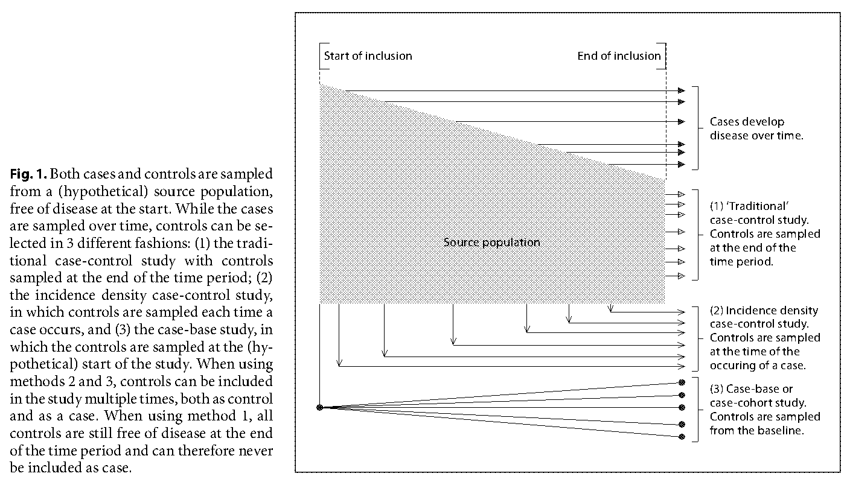
Timing of Control Selection

Slide 4
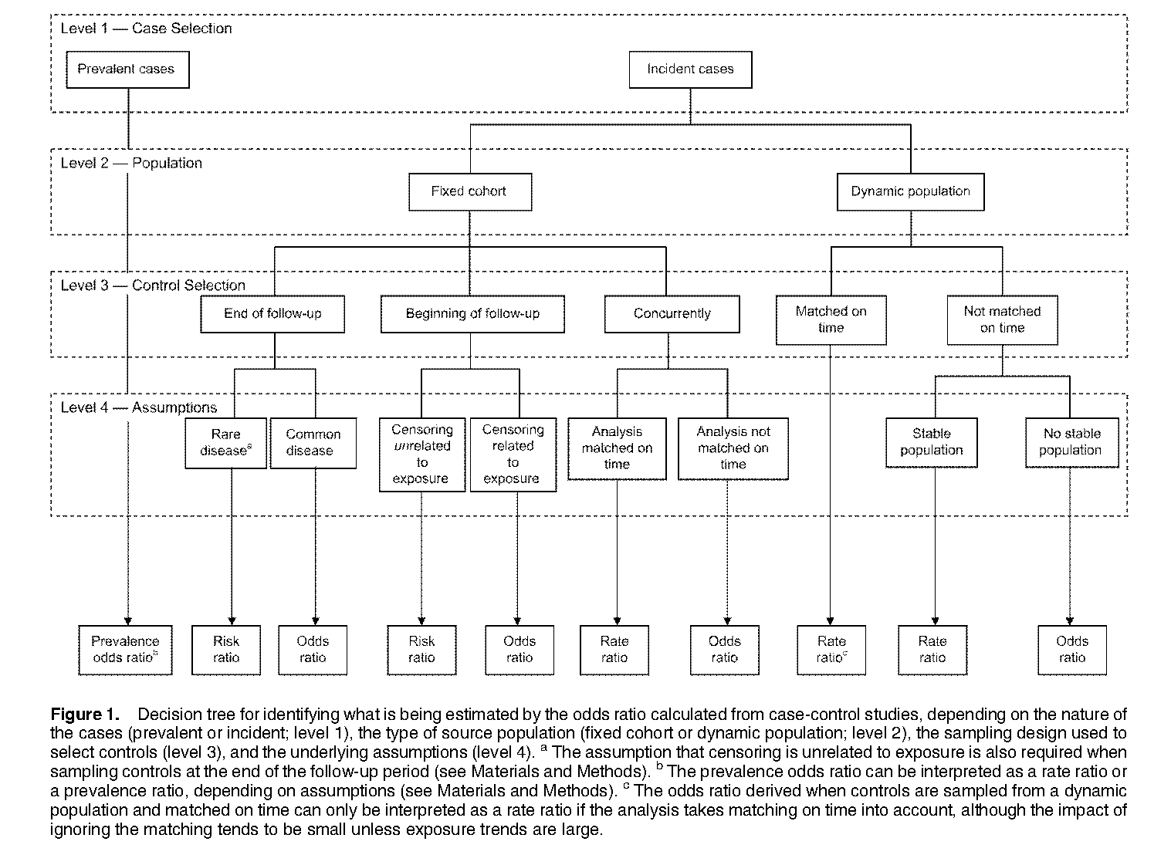

Slide 5
Variants of the Case-Control Design
Nested Case-Control Studies
Case- cohort studies

Slide 6
Case-Cohort Studies
The case-cohort study is a case-control study in which the source population is a cohort
and (within sampling or matching strata) every person in this cohort has an equal chance of being included in the study as a control, regardless of how much time that person has contributed to the person-time experience of the cohort or whether the person developed the study disease.
This design is a logical way to conduct a case-control study when the effect measure of interest is the ratio of incidence proportions rather than a rate ratio

Slide 7
An advantage of the case-cohort design is that it facilitates conduct of a set of case-control studies from a single cohort, all of which use the same control group
Disadvantage:
More control to reach the same precision
statistical precision of a study is strongly determined by the numbers of distinct cases and noncases. Thus, if 20% of the source cohort members will become cases, and all cases will be included in the study, one will have to select 1.25 times as many controls as cases in a case-cohort study to ensure that there will be as many controls who never become cases in the study. 1/(1-0.2)

Slide 8
Density Case-Control Studies
to estimate rate ratios, controls should be selected so that the exposure distribution among them is, apart from random error, the same as it is among the person-time in the source population or within strata of the source population.
Such control selection is called density sampling because it provides for estimation of relations among incidence rates, which have been called incidence densities.

Slide 9
One way to implement this rule is to choose controls from the set of people in the source population who are at risk of becoming a case at the time that the case is diagnosed. This set is sometimes referred to as the risk set for the case, and this type of control sampling is sometimes called risk-set sampling. Controls sampled in this manner are matched to the case with respect to sampling time; thus, if time is related to exposure, the resulting data should be analyzed as matched data (Greenland and Thomas, 1982).
It is also possible to conduct unmatched density sampling using probability sampling methods if one knows the time interval at risk for each population member. One then selects a control by sampling members with probability proportional to time at risk and then randomly samples a time to measure exposure within the interval at risk

Slide 10
Cumulative (“Epidemic”) Case-Control Studies
a case-control study of an epidemic of diarrheal illness after a social gathering may begin after all the potential cases have occurred (because the maximum induction time has elapsed).
In such a situation, an investigator might select controls from that portion of the population that remains after eliminating the accumulated cases; that is, one selects controls from among noncases (those who remain noncases at the end of the epidemic follow-up).
incidence odds ratio

Slide 11
Case-Only, Case-Specular, and Case-Crossover
There are a number of situations in which cases are the only subjects used to estimate or test hypotheses about effects.
it is sometimes possible to employ theoretical considerations to construct a prior distribution of exposure in the source population and use this distribution in place of an observed control series.
Such situations arise naturally in genetic studies, in which basic laws of inheritance may be combined with certain assumptions to derive a population or parental-specific distribution of genotypes

Slide 12
Case-Specular Studies
When the exposure under study is defined by proximity to an environmental source (e.g., a power line), it may be possible to construct a specular (hypothetical) control for each case by conducting a “thought experiment.”
Either the case or the exposure source is imaginarily moved to another location that would be equally likely were there no exposure effect;
the case exposure level under this hypothetical configuration is then treated as the (matched) “control” exposure for the case.

Slide 13
A simple way to describe the case-specular design is to say: Suppose you did a case-control study with 1:1 matching in which you "interviewed" houses, rather than people.
A case-house is one with a childhood cancer; the matching ·control is the house across the street from the case.
Of course, you can only "interview“ the control-house if it actually exists.

Slide 14
In other words, "case-counterfactual" (that is, case control) studies ask the -question: what is the ratio between the observed exposure odds and the expected exposure odds that would have been observed among cases if the effect(s) of exposure had been prevented?

Slide 15
Sometimes, an actual control group is not needed to answer this question; for example, among cases of schizophrenia, males substantially outnumber females. We do not need a control group to know that, in the absence of a gender effect (or serious confounding), the sex ratio should be about 1
Likewise, the case-specular design does not need an actual control group if power lines are allocated randomly to this or that side of the street: case-houses' exposure odds (where "exposed" means the power line was on the near side of the street, and "unexposed" means it was on the far side) can be compared with the exposure odds of 1, which is the expected odds if allocation were balanced

