Slide 1
Antihyperglycemic Therapy in DM(guidelines recommendations)
MS,HOSSEINI,ASSOCIATE PROFFESOR OF ENDOCRINOLOGY,BAQIATALLAH UNIVERSITY OF MEDICAL SCIENCE

Slide 2
Agenda
Introduction
ADA recommendation
AACE/ACE recommendation
IDF recommendation
NICE recommendation
Conclusion

Slide 3
Introduction
There is now extensive evidence on the optimal management of diabetes, offering the opportunity of improving the immediate and long-term quality of life of those with diabetes
Unfortunately such optimal management is not reaching many, perhaps the majority, of the people who could benefit
Guidelines are one part of a process which seeks to address those problems
Currently,there are many clinical practice guidelines around the world to manage diabetes at the local,regional and international level
Most are evidence based,albeit often developed using quite different processes
They all concur in the basic recommendations ,however ,the are significant differences in some topics that may confuse primary care physicians when they want to take the best decision regarding the management of their patients
INTERNATIONAL DIABETES FEDERATION,2017, Clinical Guidelines Task Force

Slide 4
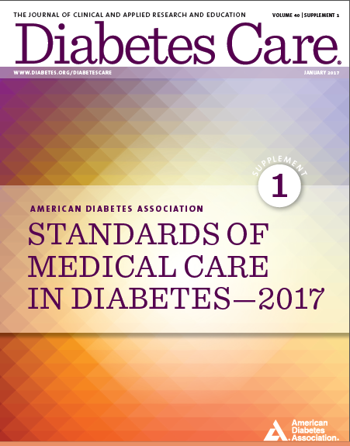

Slide 5
Approach to management of hyperglycemia

Slide 6
ADA recommendation
American Diabetes Association Standards of Medical Care in Diabetes. Approaches to glycemic treatment. Diabetes Care 2017; 40 (Suppl. 1): S64-S74
Notes:
[note to speaker – use either this slide or the next slide depending on the audience and format of your talk]
Here is an overview of the ADA’s treatment algorithm for type 2 diabetes, moving from monotherapy, to duel therapy, to triple therapy, and then to combination injectable therapy. Lifestyle management is emphasized throughout the progression of care, and individualization based on efficacy, hypoglycemia risk, weight, side effects, and costs is recommended.
It is important to note that the ADA’s full Standards of Care provides tables on the properties of these agents, as well as the costs associated with them. Please visit professional-dot-diabetes-org-slash-S-O-C for more information.
The order in the chart was determined by historical availability and the route of administration, with injectables to the right; it is not meant to denote any specific preference. Potential sequences of antihyperglycemic therapy for patients with type 2 diabetes are displayed, with the usual transition moving vertically from top to bottom (although horizontal movement within therapy stages is also possible, depending on the circumstances). DPP-4-i, DPP-4 inhibitor; fxs, fractures; GI, gastrointestinal; GLP-1 RA, GLP-1 receptor agonist; GU, genitourinary; HF, heart failure; Hypo, hypoglycemia; SGLT2-i, SGLT2 inhibitor; SU, sulfonylurea; TZD, thiazolidinedione.
[SLIDE]
6

Slide 7
Notes:
[note to speaker – use either this slide or the previous slide depending on the audience and format of your talk]
Here is an overview of the ADA’s treatment algorithm for type 2 diabetes, moving from monotherapy, to duel therapy, to triple therapy, and then to combination injectable therapy. Lifestyle management is emphasized throughout the progression of care, and individualization based on efficacy, hypoglycemia risk, weight, side effects, and costs is recommended.
It is important to note that the ADA’s full Standards of Care provides tables on the properties of these agents, as well as the costs associated with them. Please visit professional-dot-diabetes-org-slash-S-O-C for more information.
The order in the chart was determined by historical availability and the route of administration, with injectables to the right; it is not meant to denote any specific preference. Potential sequences of antihyperglycemic therapy for patients with type 2 diabetes are displayed, with the usual transition moving vertically from top to bottom (although horizontal movement within therapy stages is also possible, depending on the circumstances). DPP-4-i, DPP-4 inhibitor; fxs, fractures; GI, gastrointestinal; GLP-1 RA, GLP-1 receptor agonist; GU, genitourinary; HF, heart failure; Hypo, hypoglycemia; SGLT2-i, SGLT2 inhibitor; SU, sulfonylurea; TZD, thiazolidinedione.
[SLIDE]
7

Slide 8
Insulin Therapy in T2DM
The progressive nature of T2DM should be regularly & objectively explained to T2DM patients.
Avoid using insulin as a threat, describing it as a failure or punishment.
American Diabetes Association Standards of Medical Care in Diabetes. Approaches to glycemic treatment. Diabetes Care 2017; 40 (Suppl. 1): S64-S74
Notes:
The progressive nature of T2DM should be regularly & objectively explained to T2DM patients.
Along those lines, for your patients who are not achieving glycemic goals, promptly initiate insulin therapy
Avoid using insulin as a threat, describing it as a failure or punishment
And do give patients a self-titration algorithm
[SLIDE]
8

Slide 9
Combination Injectable Therapy in T2DM
American Diabetes Association Standards of Medical Care in Diabetes. Approaches to glycemic treatment. Diabetes Care 2017; 40 (Suppl. 1): S64-S74
Notes:
[note to speaker – use either this slide or the next slide depending on the audience and format of your talk]
The algorithm for combination injectable therapy in type 2 diabetes starts with basal insulin, with or without other agents, and offers three equivalent strategies for intensification if goals are not met, with ample room for individualization.
Again, it is important to note that the ADA’s full Standards of Care provides tables on the properties of these agents, as well as the costs associated with them. Please visit professional-dot-diabetes-org-slash-S-O-C for more information.
FBG, fasting blood glucose; GLP-1 RA, GLP-1 receptor agonist; hypo, hypoglycemia.
[SLIDE]
9

Slide 10
Notes:
[note to speaker – use either this slide or the previous slide depending on the audience and format of your talk]
The algorithm for combination injectable therapy in type 2 diabetes starts with basal insulin, with or without other agents, and offers three equivalent strategies for intensification if goals are not met, with ample room for individualization.
Again, it is important to note that the ADA’s full Standards of Care provides tables on the properties of these agents, as well as the costs associated with them. Please visit professional-dot-diabetes-org-slash-S-O-C for more information.
FBG, fasting blood glucose; GLP-1 RA, GLP-1 receptor agonist; hypo, hypoglycemia.
[SLIDE]
10

Slide 11
Properties of available glucose-lowering agents in the U.S. that may guide individualized treatment choices in patients with type 2 diabetes

Slide 12
Continued

Slide 13
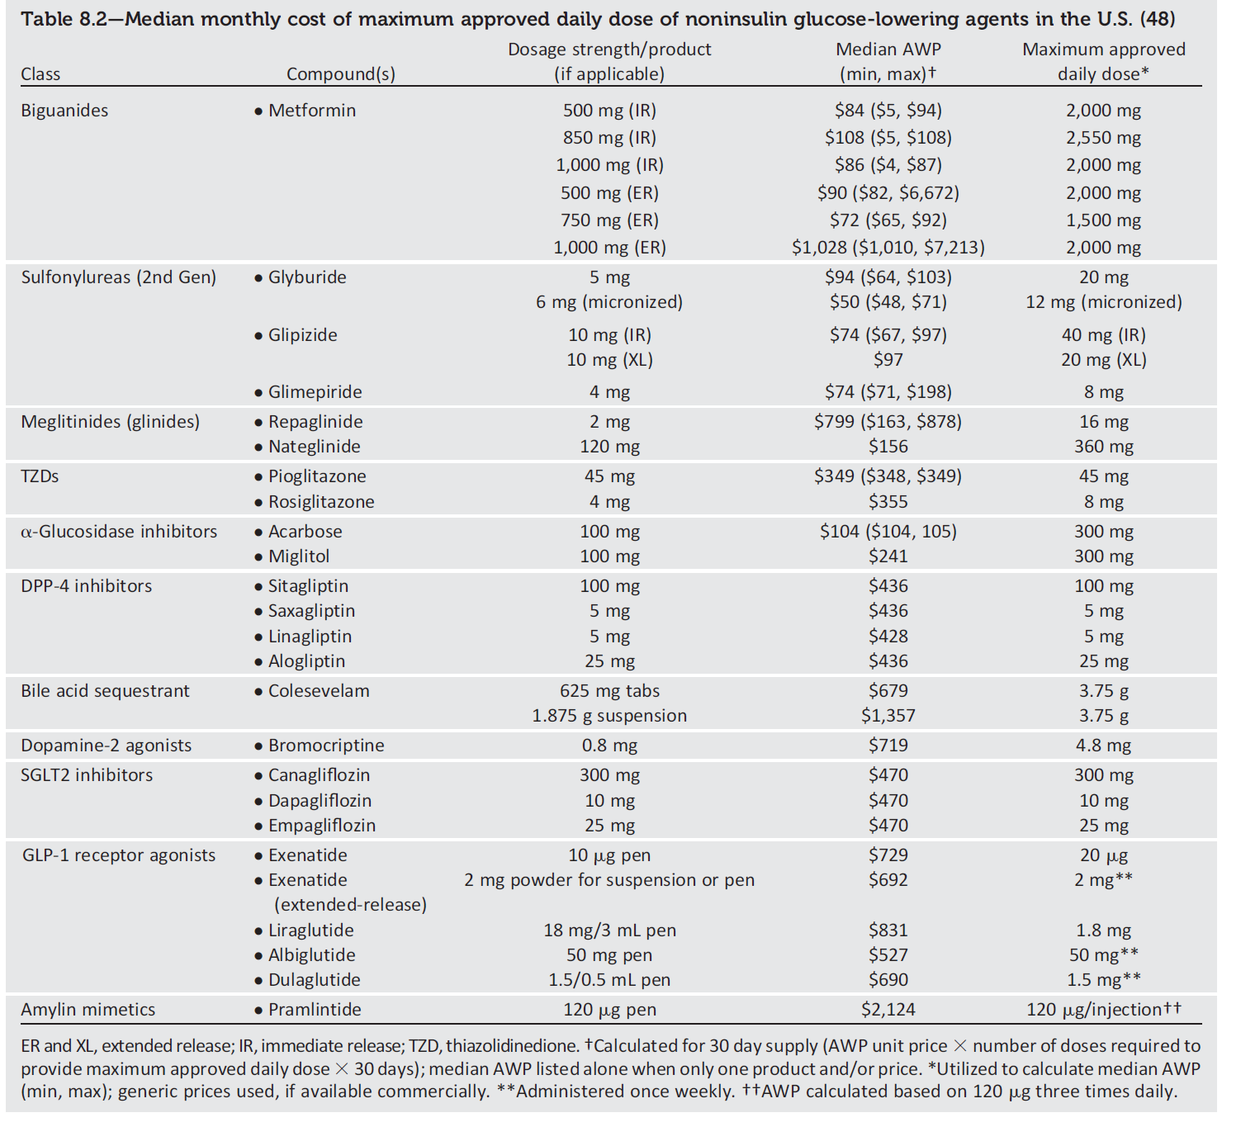
Average wholesale price (AWP) does not necessarily reflect discounts, rebates, or other price adjustments that may affect the actual cost incurred by the patient but highlights the importance of cost considerations.
Notes:
This table provides cost information for currently approved noninsulin therapies. Of note, prices listed are average wholesale prices (AWP) and do not account for discounts, rebates, or other price adjustments often
involved in prescription sales that affect the actual cost incurred by the patient. While there are alternative means to estimate medication prices, AWP was utilized to provide a comparison of list prices with the primary goal of highlighting the importance of cost considerations when prescribing antihyperglycemic treatments.

Slide 14
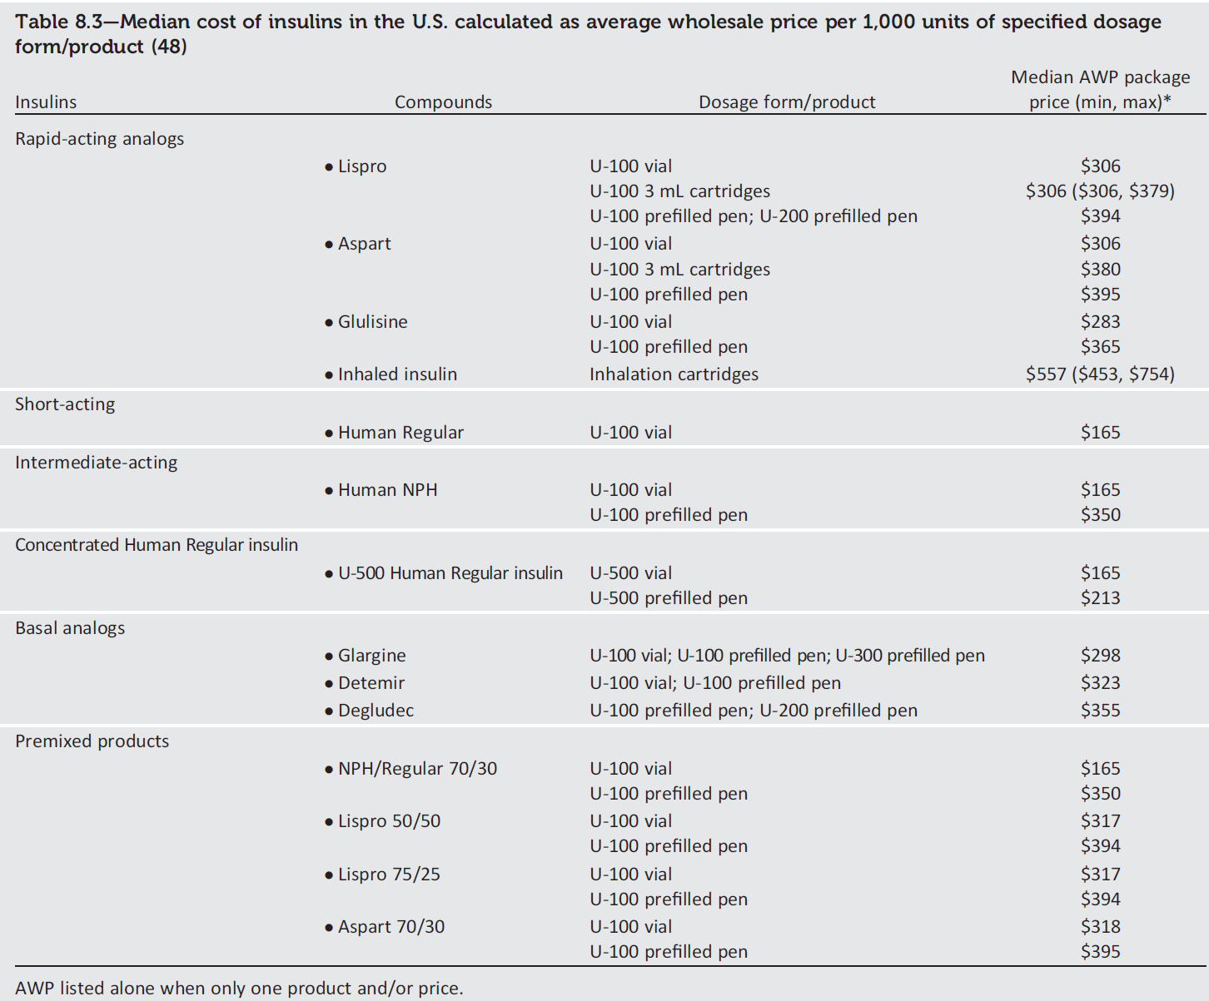
There have been substantial increases in the price of insulin in the past decade, and cost-effectiveness is an important consideration.
Notes:
This table provides average wholesale price information (cost per 1,000 units) for currently available insulin
products in the U.S. There have been substantial increases in the price of insulin over the past decade and the cost-effectiveness of different antihyperglycemic agents is an important consideration when selecting therapies.

Slide 18
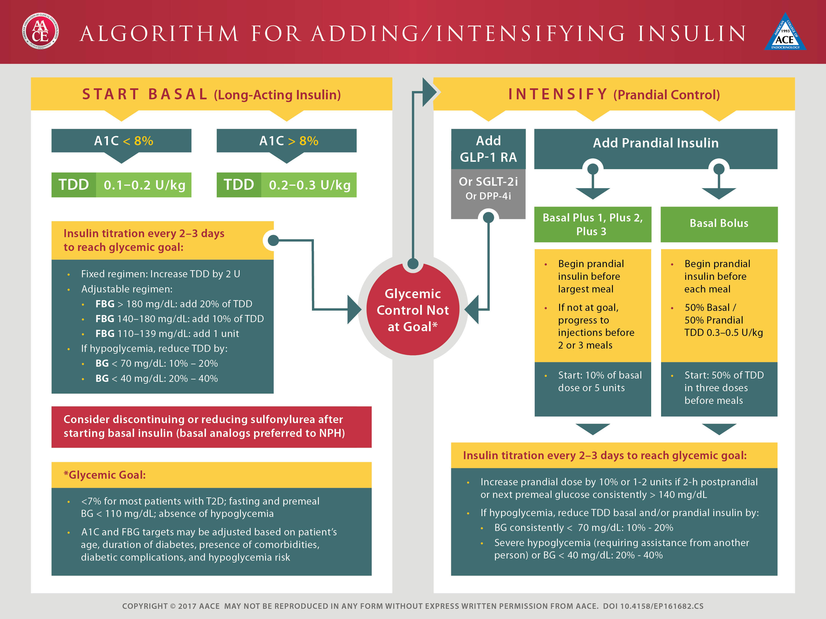

Slide 19
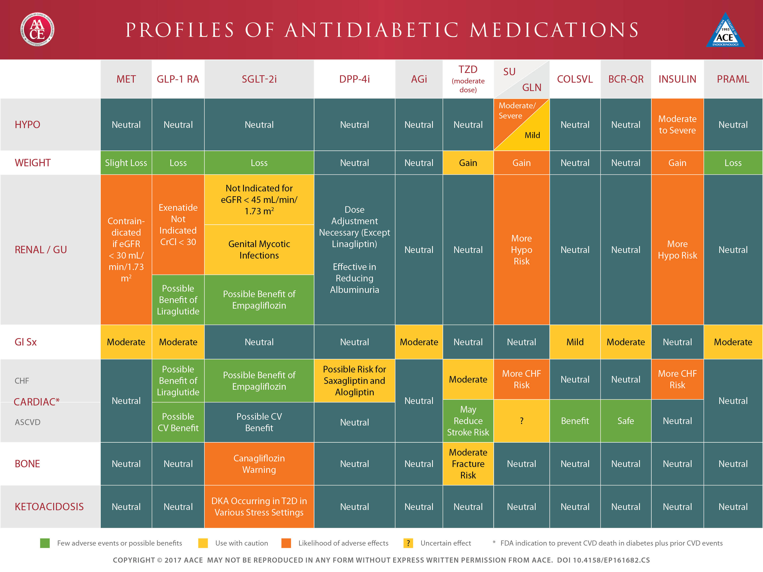

Slide 21
IDF recommendation

Slide 22
IDF recommendation

Slide 23
IDF recommendation

Slide 24
IDF recommendation

Slide 25
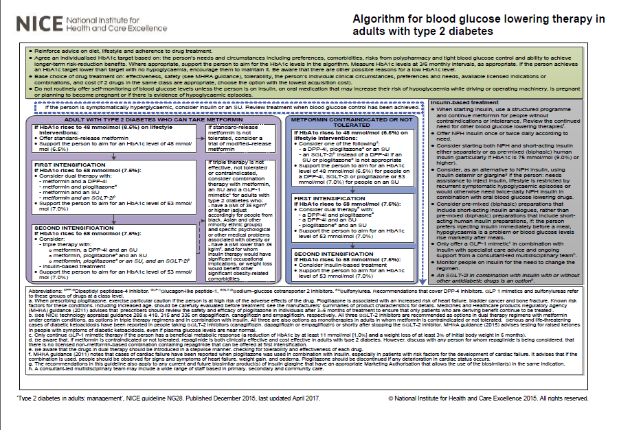

Slide 26
NICE Recommendations
Reinforce advice on diet, lifestyle and adherence to drug treatment.
Agree an individualised HbA1c target based on: the person’s needs and circumstances including preferences, comorbidities, risks from polypharmacy and tight blood glucose control and ability to achieve longer-term risk-reduction benefits.
If the person achieves an HbA1c target lower than target with no hypoglycaemia, encourage them to maintain it.
Base choice of drug treatment on: effectiveness, safety ,tolerability, the person’s individual clinical circumstances, preferences and needs, available licensed indications or combinations, and cost (if 2 drugs in the same class are appropriate, choose the option with the lowest acquisition cost).

Slide 29
Conclusion
Lifestyle management is a fundamental aspect of diabetes care
Individualised HbA1c should be considered based on: the person’s needs and circumstances including preferences, comorbidities, risks from polypharmacy and tight blood glucose control and ability to achieve longer-term risk-reduction benefits.
Choice of drug treatment according to: effectiveness, safety ,tolerability, the person’s individual clinical circumstances, preferences and needs, available licensed indications or combinations, and cost

