Slide 1
In the name of god
Mona talaschian
Research Institute for Endocrine sciences
Shahid Beheshti University of Medical Sciences
16 January ,2023

Slide 2
Patient History
A 53-year old woman.
Born ardebil & lives in Tehran.
Source of history : patient, reliable.
Chief complaint : refer to endocrinologist because of HTN and hypokalemia.

Slide 3
Present illness
A 53-old woman known case HTN since 8 years ago.
HTN has been diagnosed incidentally(160/100).
No paroxysmal HTN & hypotension episodes.
BP not good controlled with antihypertensive drugs.(Valsartan 80 daily controlled since 4 years ago).

Slide 4
Present illness
No spell symptoms.
Episodic cramp and fatigue since 8 years ago(twice falling due to muscle weakness)
Hypokalemia (it has been since HTN diagnosis)
Use of drug/Substance Induced of Hypertension: Neg

Slide 5
RA diagnosis since 4 years ago and treatment with 2.5 mg prednisolone.
Panic disorder diagnosis for 2 years.
Spinal canal stenosis for 15 years old and surgery done.

Slide 6
Family History
She has 4 children(3 normal pregnancy)
All of them have similar symptoms but were not checked
One of the children had high blood pressure in childhood(it is not documented)
13 years old grandchild had had hypokalemia since childhood.
Her mother had HTN and hyperkalemia.
No history of early-onset MI or CVA in family.

Slide 7
Drug History
Valsartan 80mg/daily
Propranolol 20mg/daily
Citalopram,Alperazolam
Prednisolone 2.5mg/daily
MTX weekly

Slide 8
Pmh:
HTN
RA
Spinal canal stenosis
Hysterectomy(6 years ago)

Slide 9
ROS
Cardiovascular & Respiratory :
No chest pain
No Palpitation
No dyspnea

Slide 10
ROS
Genitourinary:
No polyuria
No nocturia
Extremity :
No edema
Integumentary:
No Paleness
No diaphoresis

Slide 11
ROS
Musculoskeletal :
weakness & cramp
Neurological:
Headache
No dizziness

Slide 12
Physical Exam
General appearance:
A 53y/o female, Awake & alert
Vital sign
Supine BP: 120/100, PR: 60
T: 36.8
RR: 16

Slide 13
Physical Exam
Skin: NL
Head and neck: No moon face, No buffalo hump
Thyroid: NL size & firm , No palpable nodule.
Thorax (heart& lung): NL
Abdomen:NL
Upper & lower limbs: No ecchymosis, Force 5/5 in upper limbs
Pulses: symmetric in both upper extremity & no diminished or delayed pulse in lower extremity.

Slide 14
Lab test
 | PH | HCO3 | PCO2 | Na | K | Ca (Ionized) | Mg
1401.9.29 | 7.52 | 24 | 29 | 143 | 1.9 | 3.6
1401.9.29 | 7.48 | 20 | 27 | 141 | 2.1 | 3.8
1401.10.1 | 7.53 | 39 | 47 | 138 | 2.9 |  | 0.9
1401.10.3 | 7.48 | 32 | 43 | 134 | 3.7 |  | 2.8
1401.10.5 |  |  |  | 136 | 4.3

Slide 15
1401.9.30
potassium random urine 27 meq/l
Sodium random urine 204 meq/l
NA=138
K=2.9
Mg=0.9

Slide 16
Tsh =0.17
T4 =7.8
Anti tpo =1.2
Cortisol =1.74 micg/dl
Acth =5 pg/ml

Slide 19
u/a 24h: Free cortisol=12.9 mcg/24h Cr=988 mg/24h | Ald=3.7ng/dl Ald=6 ng/dl Renin direct=12.9mIu/ml

Slide 20
Drug in hospital
Spironolacton 50mg/TDS
Propranolol 20
Kcl 15% 10 cc/TDS
Prednisolon 2.5mg

Slide 21
Problem list
HTN since 8 years ago
HTN controlled with antihypertensive drugs.
Hypokalemia in lab test
Aldosterone & PRC , PRA in lab test ?
Family history of HTN ?

Slide 22
AGENDA
Secondary HTN causes
When suspicious to PA?
Screening test for PA
Drug effect on lab test in PA
Low renin,high renin ,low aldosterone HTN
Finally ,what is good approach for this patient?

Slide 24
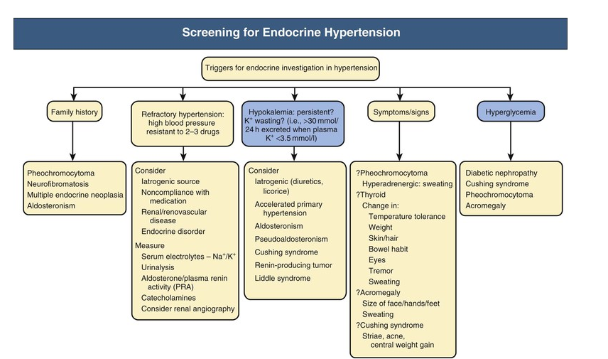

Slide 25
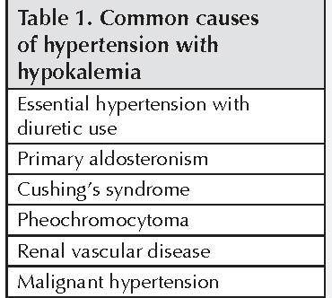
Secondary Hypertension
A specific cause of secondary hypertension can be identified in 5%–10% of hypertensive patients.
The most common types of secondary hypertension:
Renal parenchymal disease
Renovascular hypertension
Primary aldosteronism
Chronic sleep apnea
Substance/drug-induced.

Slide 26
Investigations for HTN
Blood tests:
Na, k
Cr (eGFR)
Lipid profile & FBS.
Urine test: Dipstick urine test.
12-lead ECG(AF, LVH, IHD).

Slide 27
Additional lab data
Urinary albumin/creatinine ratio
Serum uric acid levels
Liver function tests
TSH

Slide 28
Additional Diagnostic Tests
Echocardiography (LVH, systolic/diastolic dysfunction, atrial dilation, aortic coarctation).
Kidneys/renal artery and adrenal imaging: Ultrasound/renal artery Duplex; CT-/MR-angiography (renal parenchymal disease, renal artery stenosis, adrenal lesions, other abdominal pathology).
Fundoscopy: Retinal changes, hemorrhages, papilledema.
Further testing for secondary hypertension if suspected: ARR, plasma free metanephrines, late-night salivary cortisol or other screening tests for cortisol excess.

Slide 31
Preparation before screening
All the other guidelines specifically listed MRA, BB, & potassium-wasting diuretics, with the withdrawal time varying from 2 to 6 weeks.
ACE i, ARB and CCB(DHP) were recommended to be withdrawn for at least 2 weeks by most of the guidelines.

Slide 32
Preparation before screening
Williams textbook
There are exceptions to this rule. For example, if the patient is hypokalemic despite treatment with spironolactone or eplerenone, then the mineralocorticoid receptors are not full blocked, and PRA or PRC should be suppressed in such a patient with PA.
Thus if renin is suppressed, the evaluation for PA(case-detection testing, confirmatory testing, and AVS) can proceed despite treatment with MRAs.

Slide 33
Preparation before screening
Williams textbook
A PRA level less than 1 ng/mL per hour or PRC below the reference range in a patient taking an ACE inhibitor or ARB makes primary aldosteronism likely.

Slide 34
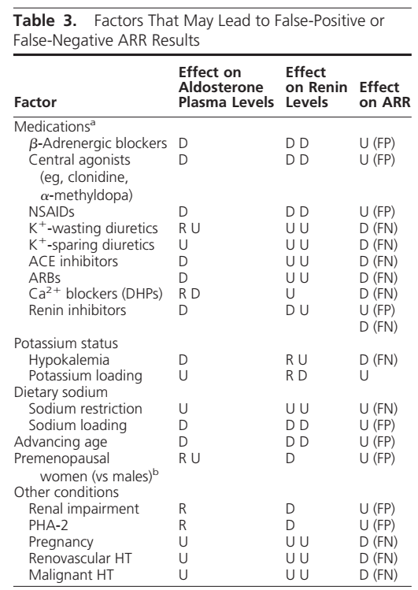
Endocrine Society Clinical Practice Guideline,2016
The Management of Primary Aldosteronism: Case Detection, Diagnosis, and Treatment: An Endocrine Society Clinical Practice Guideline,2016

Slide 37
LOW-RENIN HYPERTENSION
Low-renin hypertension accounts for about 30% of hypertensive patients and entails a wide spectrum of disorders, including monogenic, secondary and essential forms, the most common of which are low-renin essential hypertension and primary aldosteronism.

Slide 38
A proper differential diagnosis, primarily based on an accurate family history and the concomitant evaluation of serum aldosterone and plasma K+, is important, as each form requires a different and targeted therapy.

Slide 39
Bartter syndrome
Bartter syndrome is an inherited renal tubular disorder caused by a defective salt reabsorption in the thick ascending limb of loop of Henle, resulting in salt wasting, hypokalemia, and metabolic alkalosis. Mutations of several genes encoding the transporters and channels involved in salt reabsorption in the thick ascending limb cause different types of Bartter syndrome.
Int J Nephrol Renovasc Dis v.11; 2018

Slide 40
These patients were different from the typical patients with hyperaldosteronism because they were younger, had normal blood pressure, and also had growth retardation.
In addition, patients with BS present hyperreninemic hyperaldosteronism with normal/low blood pressure, reduced peripheral resistance, and hyporesponsiveness to antihypertensives.

Slide 41
How can we suspect BS?
In adults, the presence of BS or GS can be suspected after more common causes such as diuretic abuse and surreptitious vomiting have been excluded.

