Slide 1
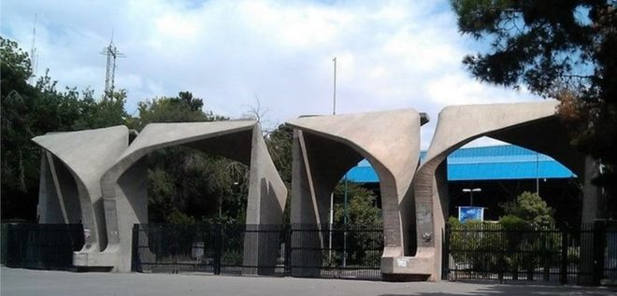



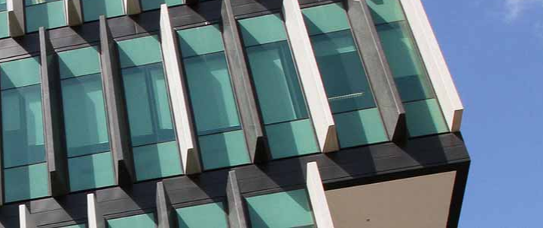

The application of Finite Element Analysis in
Skeletal Biomechanics
The University of
TEHRAN
Mehdi Hassanzadeh
2019

Slide 2


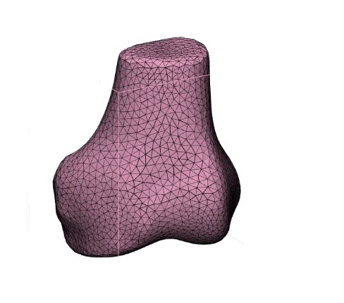
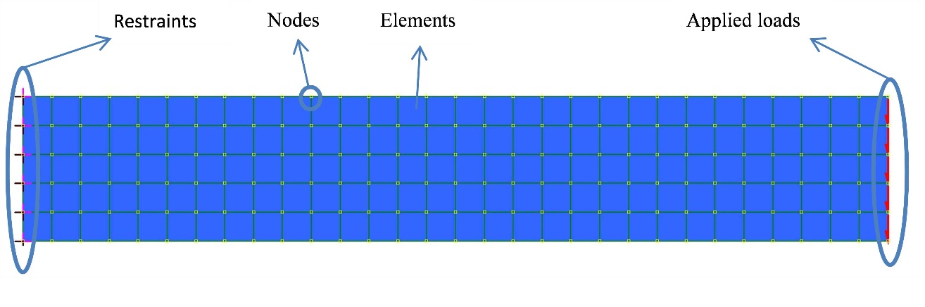
What is the application of Finite Element Analysis in Skeletal Biomechanics?
How accurate are the results?
How reproducible are the results?
A simple cantilever beam under shear force is discretized into a set of finite elements.
1/28

Slide 3
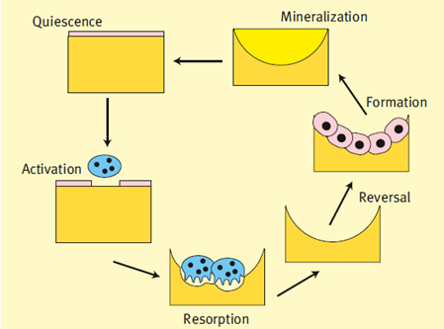
Bone adaptation
Smart structure:
Stimulus
Sensor
operator
Optimal remodeling is responsible for bone health and strength throughout life.
Mechanical forces have a major contribution on the bone formation in both cortical and trabecular bone.
Imbalanced bone remodeling may cause bone mass reduction or osteoporosis.
2/28
Ref: Galea J.C. Analysing the microarchitecture of cribra orbitalia via... Diss. Master thesis, University of Bristol, 2013.

Slide 4
Bone Strength
Bone strength determined by:
The ability of bone against deformation (elastic modulus or stiffness)
Absorbing applied force/ energy (toughness)
Accommodating repetitive loading (fatigue strength)
Inhibition of progress of a crack (fracture toughness)
Combination of:
Amount of bone present
The spatial distribution of the bone mass
The intrinsic properties of each of the bone components
3/28
Ref: Brandi, Maria Luisa. "Microarchitecture, the key to bone quality." Rheumatology 48.suppl_4 (2009).

Slide 5
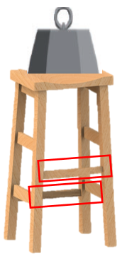
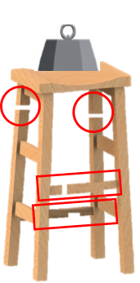
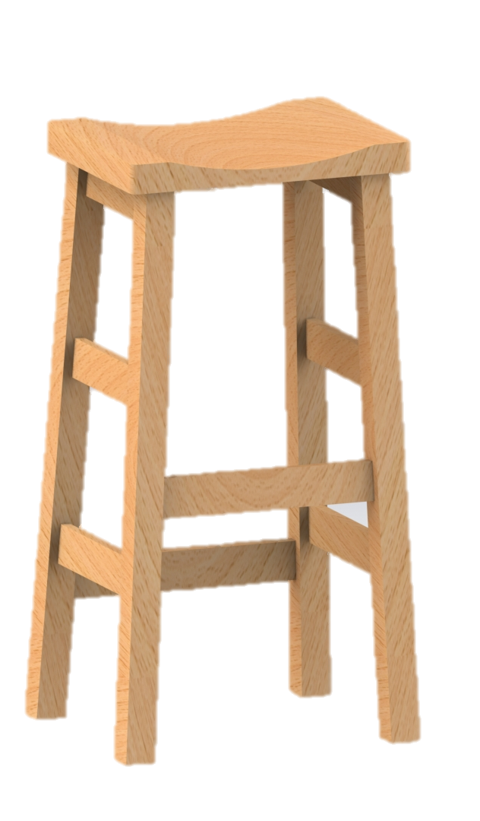
Amount of bone present
The spatial distribution of the bone mass
The intrinsic properties of each of the bone components
Bone Strength
Normal mass and architecture
Loss of mass
deteriorated architecture
4/28

Slide 6
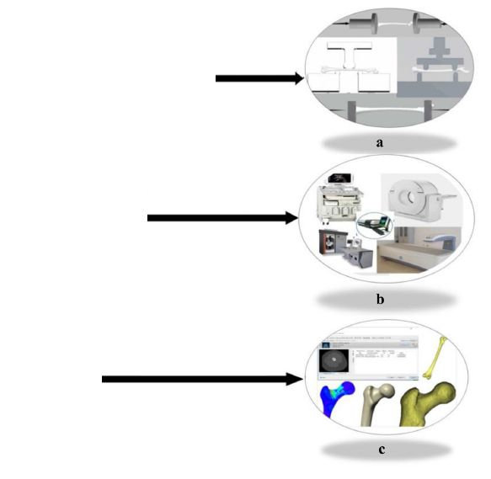
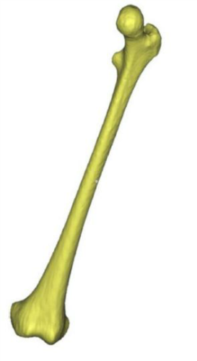
Imaging modalities
Mechanical test
FE Analysis
5/28
Ref: Kong,Deyin, et al. "Recent Advance in Evaluation Methods for Characterizing … (2019).

Slide 7
Imaging modalities/DXA
Fragility is not confined to women with osteoporosis
BMD
Fx/1000 p-yrs
0
5
10
15
20
25
30
35
40
45
50
1
0.5 0
Women
with Fxs
18%
-0.5
75%
- 1.0 SD
-1
-1.5
57%
-2
- 2.5 SD
-2.5
-3
25%
-3.5
0
100
200
300
400
Women with Fxs
50
60
70
80
age
Number (000)
6/28
Ref: Siris et al Arch Intern Med. 2004;164(10):1108–12

Slide 8
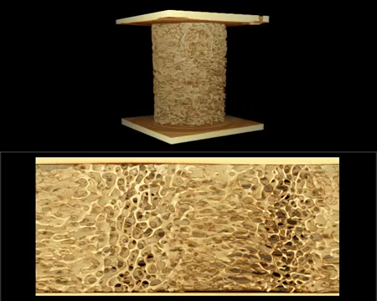
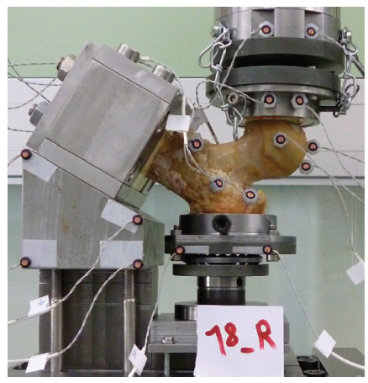
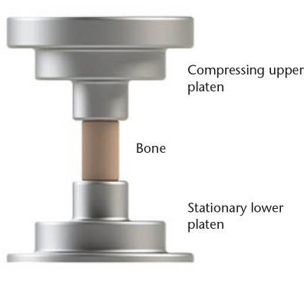
Mechanical test
Obtaining the mechanical indices including; maximum load, ultimate strength, and maximum strain
Calculating the mechanical properties, such as the elastic modulus, energy absorption, and structural rigidity.
7/28
Ref: Zhao S, Arnold M, Ma S, et al. Standardizing compression testing for measuring…. Bone Joint Res. 2018
Philippe k Zysset et al. "Finite element analysis for prediction of bone strength." BoneKEy reports 2 (2013). //Video is created by researchers in ANU

Slide 9
Finite element analysis
Finite Element Analysis (FEA) is a numerical and computerized method for predicting how a product reacts to real-world forces .
Application of finite element (FE) analysis to determine stresses in human bones was initiated in the early 1970s in the field of orthopedic biomechanics.
In the 1990s, the availability of computed tomography (CT) provided feasibility of anatomical-specified FE modelling for selected parts or whole bones.
The development of computer hardware and software tools allowed substantial progress in the area of FE modelling validation and began the era of patient-specific FE modeling.
8/28
Philippe k Zysset et al. "Finite element analysis for prediction of bone strength." BoneKEy reports 2 (2013).

Slide 10
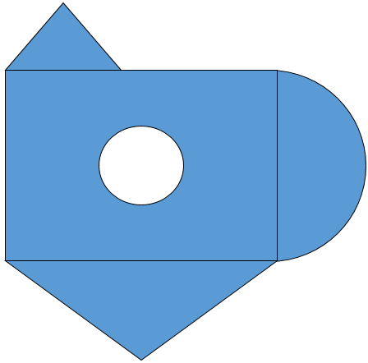

FEA / Main concept
Area?
1
FEM, Useful for problems with complicated geometries, loadings, and material properties where analytical solutions can not be obtained.
2
3
4
Discretizing
Solving the problem for each parts
Assembling the results
5
Area=A1+A2-A3+A4+A5
9/28

Slide 11
FEA / Main concept
Many phenomena can be expressed by “governing equations” and “boundary conditions”
It is very difficult (maybe impossible) to solve these equations for the entire structure
Divide the domain into a number of small, simple elements
10/28

Slide 12
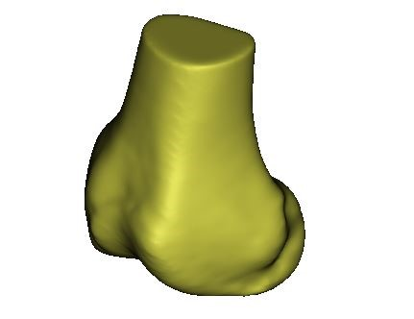
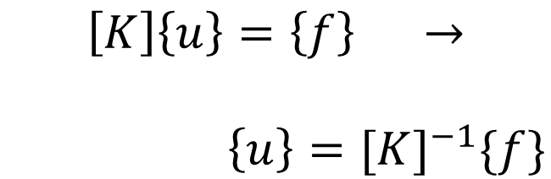
FEA / Main concept
Governing Equation
(Differential equation)
L(φ ) + f = 0
FE
$$\left[K\right]\left\{u\right\}=\left\{f\right\} →$$
$\left\{u\right\}={[K]}^{−1}\{f\}$
Boundary Conditions
B(φ ) + g = 0
You know all the equations, but
you cannot solve these eq. for the whole structure
11/28

Slide 13
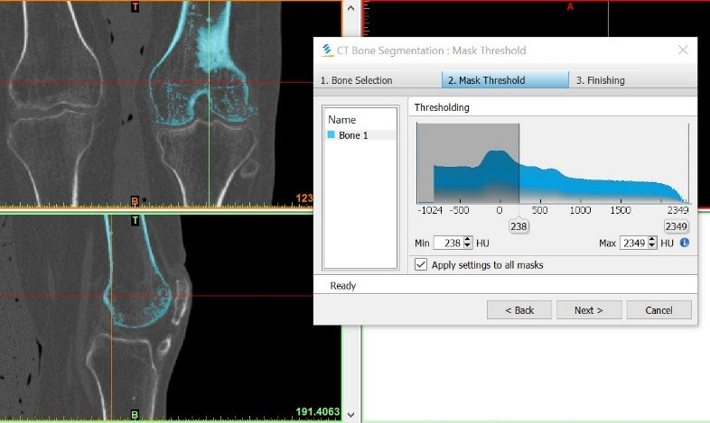
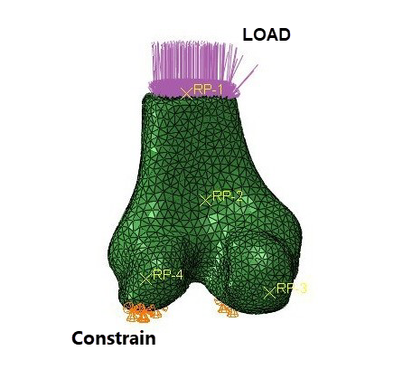
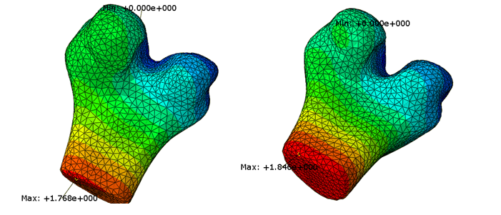
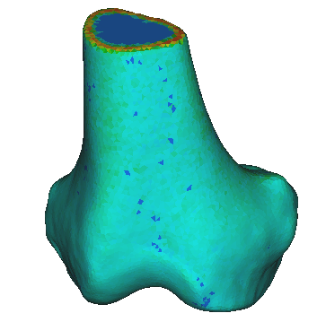
1
2
3
5
5
4
12/28

Slide 14
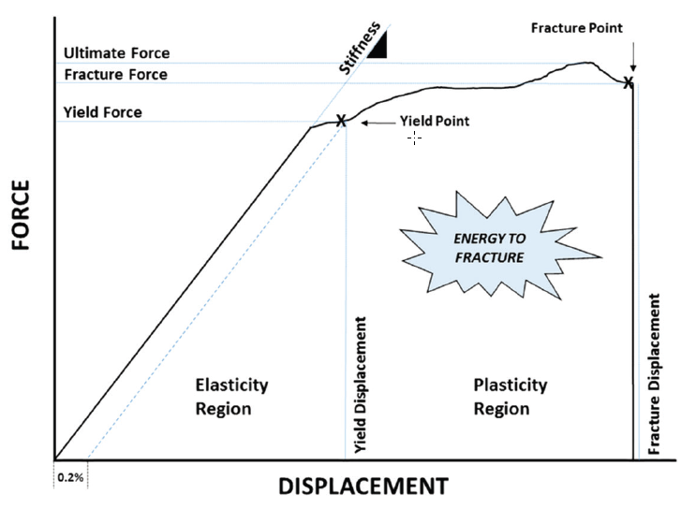
FEA / Outputs
There are two behavioural characteristics either side of their yield point that are called as elastic and plastic regions.
The load-displacement curve can be achieved with FEA.
The linear part of the curve, i.e., stiffness, can be obtained with linear FEA, while the simulation of the yielding of the curve, the maximal force and the energy to failure requires nonlinear FEA.
13/28
Hart, Nicolas H., et al. "Mechanical basis of bone strength: influence of bone material..." Journal of musculoskeletal & neuronal interactions 17.3 (2017)

Slide 15
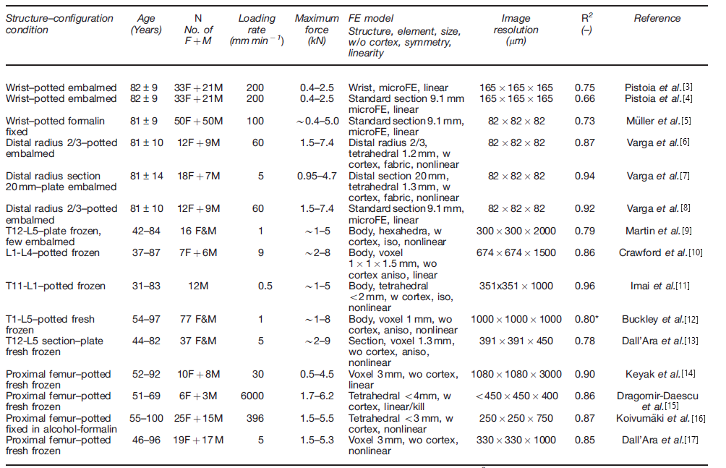
FEA / Accuracy
correlation coefficient
14/28
Ref: Zysset, Philippe K., et al. "Finite element analysis for prediction of bone strength." BoneKEy reports 2 (2013)

Slide 16
FEA / Reproducibility
Reproducibility of the FEA results primarily depends on the reproducibility of the CT or other images on which the models are based.
Conditions | N | Reproducibility error | Reference
Short-term (1 week) Long-term (4 months) | 30 | Radius < 2.4 % Tibia < 3.6 % | MacNeil and Boyd (2008)
Short term Scanned three times | 15 | Radius < 2.3 % Tibia < 3.6 % | Ellouz et al. (2014)
The short-term and long-term reproducibility for multicenter studies using a radius phantom. | 14 (cadaveric distal radius bone) | Radius (multi-center )< 2.5 % | Burghardt et al. (2013)
15/28

Slide 17
FEA / DXA
Group | N | micro-FE | DXA | Ref.
 | Fx Cases / Control | Δ strength % (control –Fx case) | UD radius aBMD % (control – Fx case)
Postmenopausal women | 33/33 | 15.3 | 13.9 | Boutroy et al. (2008)
Postmenopausal women | 100/105 | 20.2 | 11.9 | Christen et al.
Postmenopausal women | 14/28 | 46 | 12 | Nishiyama et al. (2013)
Postmenopausal women | 101/101 | 11.2 | 9.5 | Vilayphiou et al. (2010)
Postmenopausal women | 44/88 | 22 | 4 | Nishiyama et al. (2013)
Premenopausal women | 66/100 | 2.6 | 2.6 | Chevalley et al. (2013)
Men | 185/185 | 9 | 6.2 | Vilayphiou et al. (2011)
16/28
Van Rietbergen, B., and K. Ito. "A survey of micro-finite element analysis for clinical assessment of bone strength: the first decade." Journal of biomechanics 48.5 (2015).

Slide 18
study
A novel pixel based image quantification analysis method
Numerical modeling of bone apparent density adaptation of the lower limbs in patients suffering from spinal cord injury
17/28

Slide 19
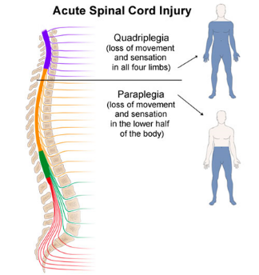
study
An abrupt disruption to the bone metabolic process
Reduction of loads in lower limbs
Several mechanisms are responsible for this bone loss, but the removal of mechanical stimuli resulting from the loss of motor function and habitual ambulation is believed to be an important factor
18/28

Slide 20
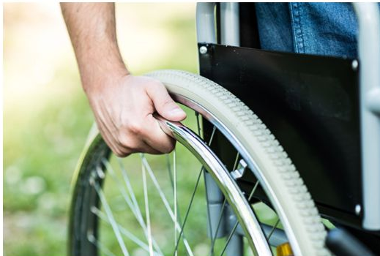
study
Bone loss process in SCI population
Regional bone loss may occur at rates approaching 1% of bone mineral density (BMD) per week at specific regional sites for the first several months after injury
Microgravity ( 0.25 % per week)
Bed rest ( 0.1 % per week)
Postmenopausal women are not taking anti-resorptive medications (3-5 % per year)
The Wolf’s law asserted that the bone structure would be adapted with the loading cycle which the bone experience
19/28

Slide 21
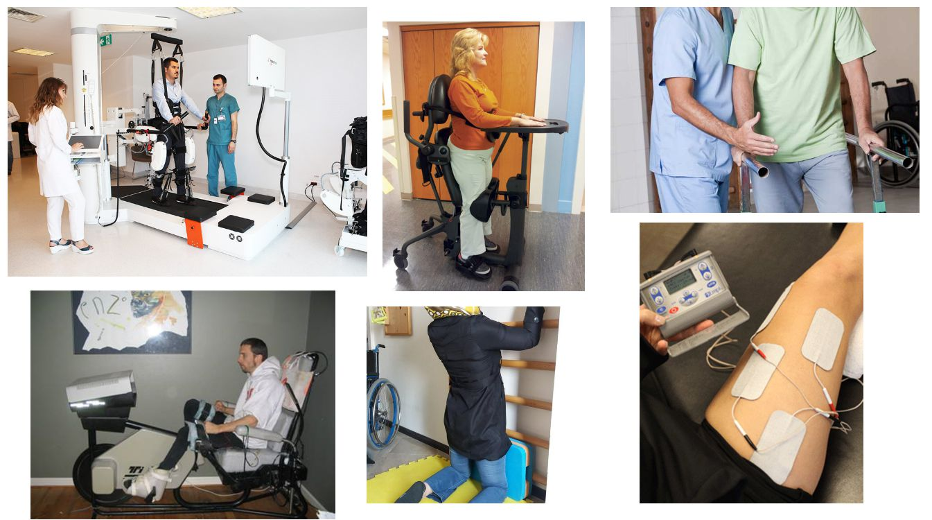
study
Rehabilitation activities
Which kinds of rehabilitation activities?
How can we choose the effective rehabilitation method?
Are the effective rehabilitation methods different between each SCI patients?
20/28

Slide 22
Clinical research in Rehabilitation Activities
Clinical researches are costly and time-consuming
Existence of different environmental variables which affect the final result especially for long term researches
The limitation at the length of the research
The limitation of data accusing from the volunteers due to the destructive effects of scanning methods
The Results aren’t patient specific
Using a FEM in order to reach a numerical model which can predict the bone structure, can provide the ability that different rehabilitation methods can be investigated for different time periods
21/28

Slide 23
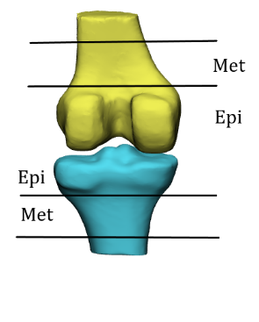
study
A novel pixel based image quantification analysis method
This procedure has been done by using the Mimics and Matlab software
Alignment and registration were performed separately for femur and tibia bones by creating four image stacks per scan
1. A primary registration was done by using MIMICS registration function. This function allows registering two datasets by doing a landmark point-based registration.
2. A final registration was performed by using ICP FINITE registration program, an iterative closest point registration algorithm which is available in Matlab Central File Exchange.
ROIs: epiphyseal (0–10 %) and metaphyseal (10–20 %) regions
22/28

Slide 24
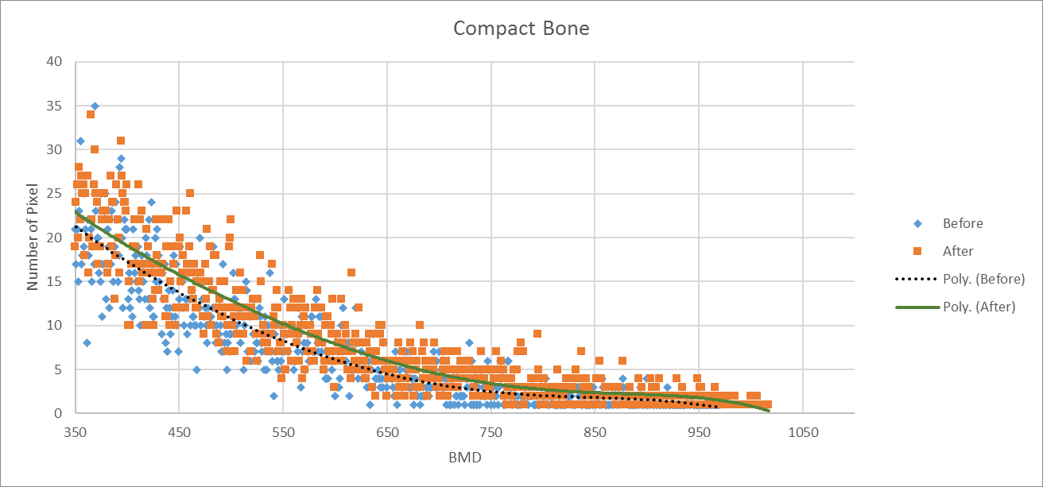
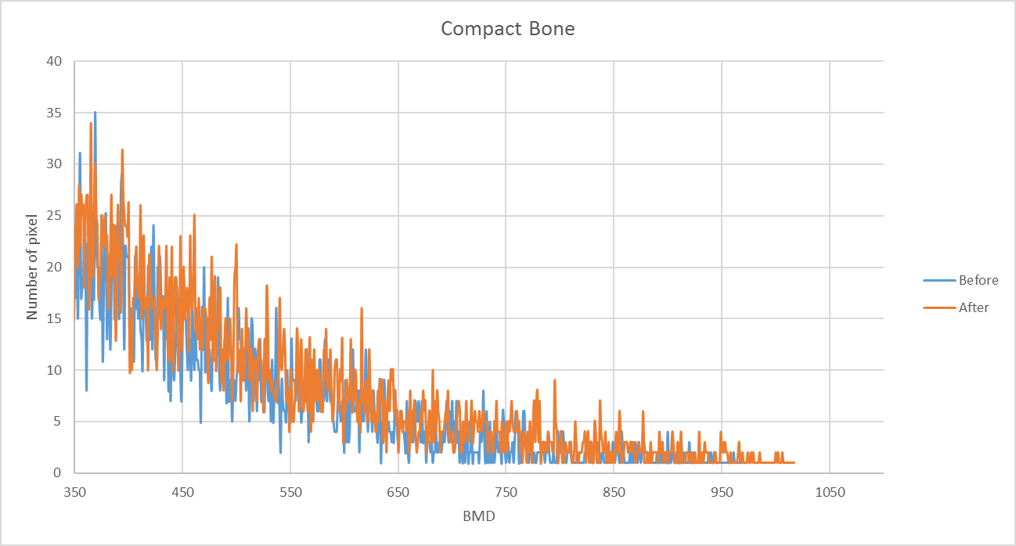
study
 |  |  | vBMD | Result %
Compact Bone
 |  |  |  | 1.812009383
BMC | Result %
 | 4.96425588
BV | Result %
 | 3.096144076
23/28

Slide 25
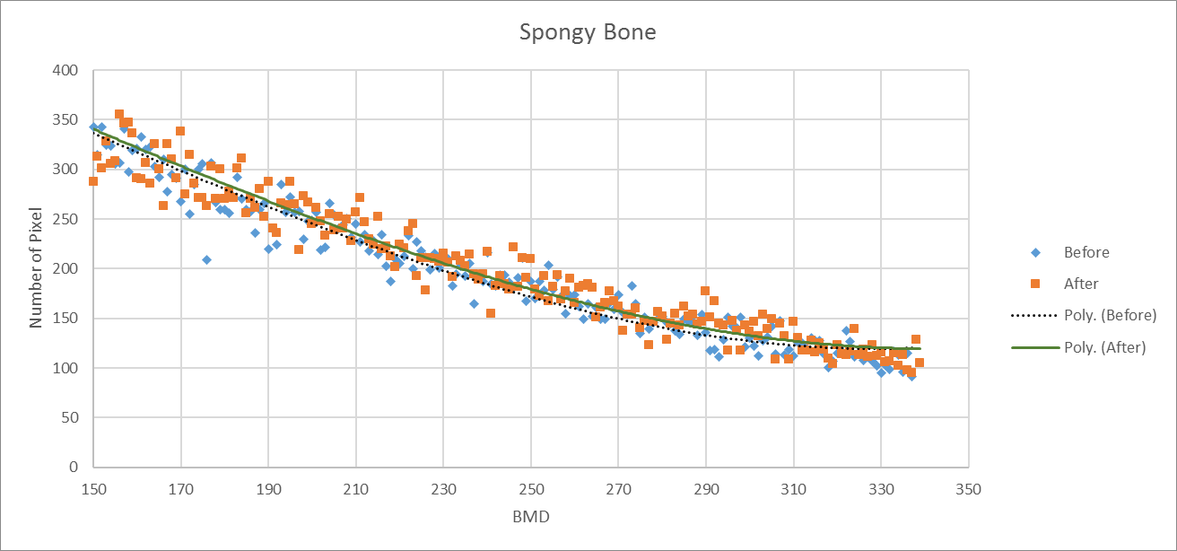
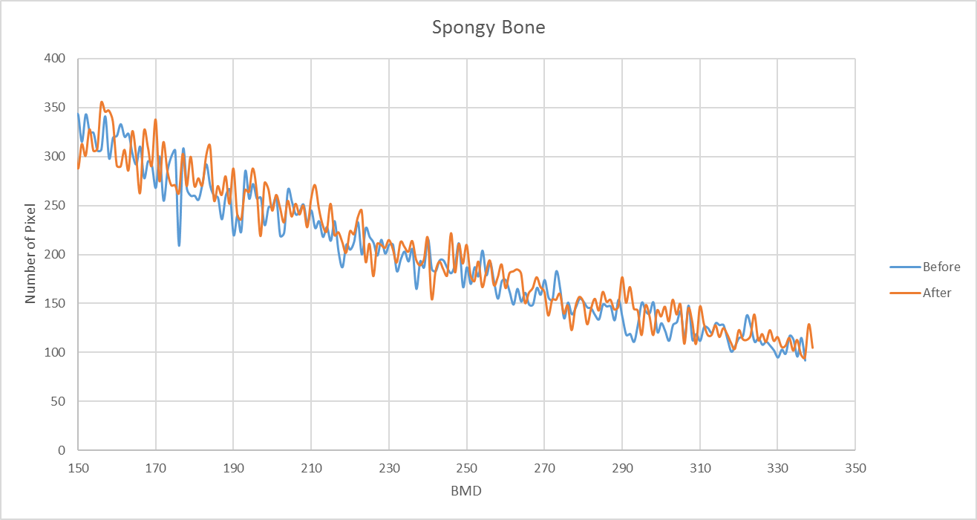
study
 |  | vBMD | Result %
Spongy Bone
 |  |  | 0.097747122
BMC | Result %
 | 2.848288312
BV | Result %
 | 2.948917916
23/28
24/28

Slide 26
study
Strain distribution
After the exercise
Before the exercise
Max=1.846 mm
Max=1.768 mm
25/28

Slide 27
study
Numerical modeling of bone apparent density adaptation of the lower limbs in patients suffering from spinal cord injury
What's the main purpose of this project?
The main goal of this project is achieving an analytical and 3D model for prediction of bone loss in SCI patients (using FEA)
What's the application of the predictive model for SCI patients ?
26/28

Slide 28
study
What's the application of the predictive model for SCI patients ?
With this model, we can investigate all available rehabilitation methods to select more effective one based on patients’ level of injury
patient specific rehabilitation
27/28

Slide 29
Thanks for your attention
Mojtaba Haghighi-Yazdi
Morad Karimpour
Ali Ghasem-Zadeh
Gustavo Duque
Acknowledgments
Mehdi Hassanzadeh

