Slide 1
Nonalcoholic Fatty Liver Disease Case Discussion
Majid Valizadeh, MD
Obesity Research Center
Research Institute for Endocrine Sciences
Shahid Beheshti University of Medical Sciences
21 July 2016

Slide 2
Case 1

Slide 3
Case 1
A generally healthy 42 y/o lady came to you for evaluation of fatty liver (grade I) discovered during a routine abdominal ultrasound.
She reports no risk factors or symptoms of chronic liver disease.
PMH and family history: Unremarkable
She takes no medications.

Slide 4
Case 1
Physical examinations:
BMI: 28 kg/m²
BP: 120/80 mm Hg
Others: Unremarkable

Slide 5
Case 1
Which of the following laboratory assessments are necessary?
AST, ALT
FBS
Lipid profile
All above

Slide 6
Case 2

Slide 7
Case 2
A generally healthy 56 y/o active man has been referred to you due to increased serum transaminase levels.
(AST: 45 IU/L; ALT: 56 IU/L)
He reports no risk factors or symptoms of chronic liver disease.
PMH and family history: Unremarkable.
He is smoker (20 pack-years).
He takes no medications.

Slide 8
Case 2
Physical examinations:
BMI: 32 kg/m²
Waist circumference: 105 cm
BP: 120/80 mmHg
Others: Unremarkable

Slide 9
Case 2
Laboratory:
FBS: 91 mg/dL
Creatinine: 0.8 mg/dL
Total cholesterol: 250 mg/dL
(LDL-C:160 mg/dL, HDL-C: 52 mg/dL)
Triglyceride: 190 mg/dL
Normal CBC

Slide 10
Case 2
Which of the following diagnostic work-ups do you suggest?
Liver US
Repeat AST, ALT in 3 months
HBsAg, HCV Ab
Autoimmune markers

Slide 11
Case 3

Slide 12
Case 3
A generally healthy 60 y/o married salesman.
Intermittent mild transaminase abnormalities since 11 years ago that have become more consistent since 6 years ago.
ALT: 40-50 (most values); highest level: 72 U/L
AST: highest level: 47 U/L
No symptoms of chronic liver disease.

Slide 13
Case 3
PMH: HTN, obesity, dyslipidemia, a benign thyroid nodule, hypogonadism.
FH: His father died at age 37 years of cirrhosis (he was not a heavy drinker and the cause of the cirrhosis was not known).
He has 1 to 2 alcoholic drinks per month.
No history of smoking or drug use.
He exercises for 45 minutes to 1 hour on a daily basis.

Slide 14
Case 3
Medications:
Aspirin
Fenofibrate
Omega-3
Irbesartan
Hydrochlorothiazide
Omeprazole
Testosterone

Slide 15
Case 3
Physical examinations:
Wt: 94 kg
Ht: 160 cm
BMI: 37 kg/m²
PR: 84/min
BP: 122/70 mm Hg
Regular, unlabored respirations
Normal heart, lungs and abdomen
No stigmata of chronic liver disease

Slide 16
Case 3
Laboratory:
FBS: 94 mg/dL
Creatinine: 1.1 mg/dL
ALT: 49 U/L
AST: 39 U/L
Creatine phosphokinase: 420 ng/mL
Total cholesterol: 208 mg/dL (LDL-C:118 mg/dL)
Triglyceride: 288 mg/dL
Normal CBC, thyrotropin, testosterone, prostate-specific antigen levels.
Normal iron studies and ceruloplasmin level.
Negative viral markers.

Slide 17
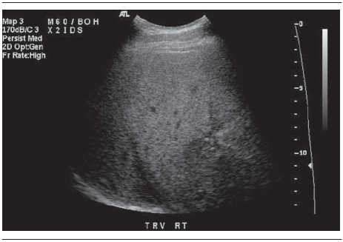
Case 3
Abdominal ultrasound:
Diffuse increased echogenicity with scattered granulomas

Slide 18
Case 3
Which of the following items do you suggest to this patient?
Liver biopsy
Lifestyle modification
Fibroscan
A and B

Slide 19
Case 4

Slide 20
Case 4
A 44 y/o generally healthy woman.
Has been referred for management of fatty liver found on abdominal ultrasound survey due to a mild RUQ discomfort.
No history of smoking or alcohol use.

Slide 21
Case 4
Physical examinations:
BMI: 24.2 kg/m²
Waist circumference: 92 cm
PR: 65/min
BP: 125/70 mm Hg
Normal heart, lungs and abdomen
No stigmata of chronic liver disease

Slide 22
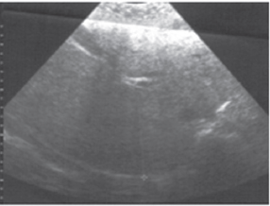
Case 4
Hepatic US report:
Fatty liver (Grade III)

Slide 23
Case 4
Laboratory:
FBS: 91 mg/dL
ALT: 49 U/L (two times, 6 months apart)
AST: 50 U/L (two times, 6 months apart)
Total bilirubin: 0.6 mg/dL
Alkaline phosphatase: 88 IU/L (RR: 60-300 IU/L)
Serum albumin: 3.9 g/dL
Total cholesterol: 276 mg/dL (LDL-C:193 mg/dL; HDL-C: 61 mg/dL)
Triglyceride: 109 mg/dL
Negative viral markers.
Normal CBC, thyrotropin and iron studies.

Slide 24
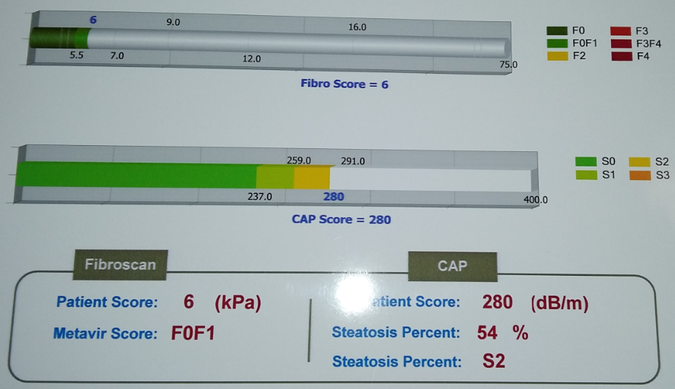
Fibroscan Report

Slide 25
Case 4
Which of the following items do you suggest?
Lifestyle modification
Liver biopsy
Atorvastatin
A and C

