Slide 2
پیشگیری از بیماری های تیروئید
دکتر فریدون عزیزی
پژوهشکده علوم غدد درون ریز و متابولیسم
دانشگاه علوم پزشکی شهید بهشتی
روز تیروئید، 8 خرداد 1393

Slide 3
ابلاغ شده توسط مقام معظم رهبری سیاست های کلی سلامت (ماده 2 )
2- تحقق رویکرد سلامت همه جانبه و انسان سالم در همه قوانین، سیاست های اجرایی و مقررات با رعایت:
1-2 اولویت پیشگیری بر درمان.
2-2 روزآمد نمودن برنامه های بهداشتی و درمانی.
3-2 کاهش مخاطرات و آلودگی های تهدید کننده سلامت مبتنی بر شواهد معتبر علمی.
4-2 ....

Slide 4
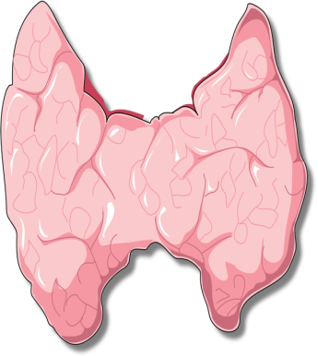

Slide 5
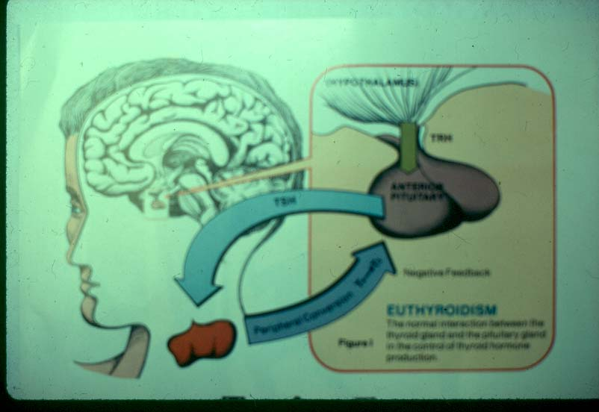

Slide 6
Definitions
Primordial prevention is the prevention of occurrence of risk factors in healthy individuals
Primary prevention is the prevention of new disease in previously healthy individuals, Achieved by decreasing risk factors for disease.
Secondary prevention is the prevention of progression of mild or latent disease to more severe disease, Typically involves screening for occult disease.
Tertiary prevention is the term used by some to describe medical care intended to improve already established disease.

Slide 7
موضوعات مطرح شده در رابطه با پیشگیری از بیماری‌های تیروئید
پیشگیری ابتدایی و اولیه
1. اصلاح کمبود ید
2. قطع مصرف دخانیات
3. ارتباط مصرف الکل و پرکاری تیروئید
پیشگیری ثانویه
1. کم‌کاری مادرزادی تیروئید
2. اختلالات زیربالینی تیروئید
3. تشخیص سرطان تیروئید با اولتراسونوگرافی
4. غربالگری تیروئید گره‌دار با کالسی‌تونین
5. غربالگری با RET
6. غربالگری تیروئید در حاملگی
7. افتالموپاتی گریوز
پیشگیری ثالثیه
8. بیماری‌های یاتروژنیک
9. حاملگی و اختلالات تیروئید
10. توقف بیماری با مراقبت‌های مطلوب

Slide 8
Primordial and primary preventions of thyroid disease
Correction of iodine deficiency
Whole population in iodine deficient regions
Pregnant and lactating women in iodine sufficient areas?
Tobacco smoking sessation
Graves, Graves’ eye disease and ATD (?)
Thyroid nodules?
Alcohol and Graves
Cooper DS & Ridgway EC. Thyroid 2002; 12: 925.

Slide 9
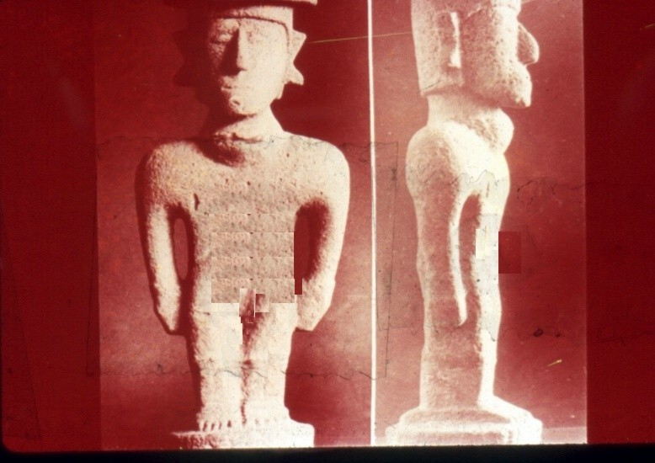
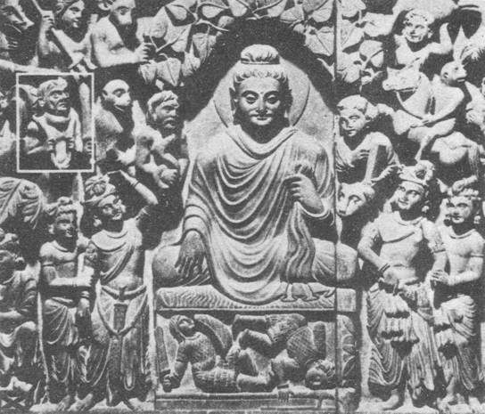
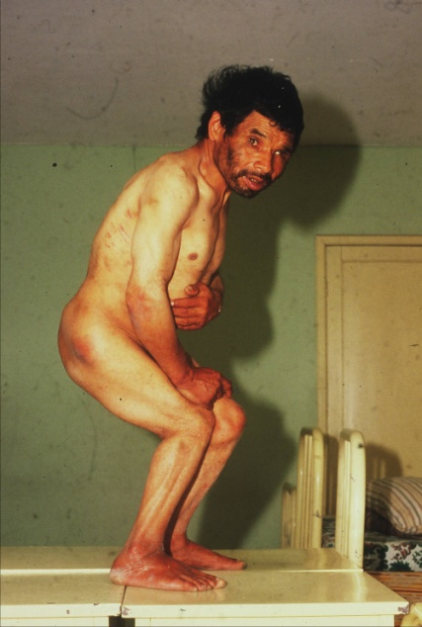
Goiter has been known since the days of Lord Buddha and before
Earliest evidence of goiter: 3000 BC
Cretinism, Tip of the Iceberg
World wide prevalence of goiter

Slide 11
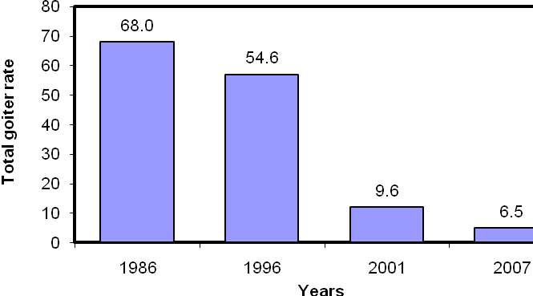
Median urinary iodine excretion in 4 national surveys in the I.R.Iran
Total goiter rate in 4 national surveys in the I.R. Iran
Azizi F. Thyroid International 2009;4:1

Slide 12
تاثير حذف كمبود يد در سلامت جامعه ايراني
پيشگيري از بروز گواتر در بيش از 25 ميليون متولدين 23 سال اخير
افزايش 66،000،000 ضريب هوشي در كودكان و نوجوانان
صرفه جويي 17،500،000،000،000ريال
(12،000،000،000 يورو) در هزينه هاي بهداشتي درماني

Slide 13
وضعیت ید ادرار بزرگسالان (تهران، 88-1387)
Nazeri P, Mirmiran P, Mehrabi Y, et al. Thyroid 2010; 20: 1399-1406.

Slide 14
کاستی های میانه ید ادرار دانش آموزان در استان های مختلف کشور (1388)
میانه ید ادرار کمتر از 100 میکروگرم در لیتر:
آذربایجان غربی (72)، خوزستان (86)، لرستان (91)، تهران (97)
ید ادرار بیشتر از 50 میکروگرم در لیتر در بیش از 20 درصد نمونه ها
آذربایجان غربی، خوزستان، لرستان، تهران
زنجان، سیستان و بلوچستان، قم، همدان
سئوال: وضعیت تغذیه در مادران باردار چگونه است؟
جناب آقای دکتر دلشاد

Slide 15
Tobacco Smoking and Thyroid
Worsens ID: Competitive inhibitory effect of thiocyanate on NIS
Increases risk of Graves: Affects autoimmunity
Role in orbitopathy
Conflicting results on hypothyroidism
Lower prevalence of circulating thyroid antibodies
Smoking cessation
Appearance of serum thyroid antibodies
Transient rise of overt hypothyroidism
Prumme L & Wiersing. JAMA 1939; 269: 479.
Carle A et al. Clin Endocrinol 2012; 77: 764.
Effarimidis G et al. JCEM 2009; 94: 1324.

Slide 16
Moderate alcohol consumption and Graves disease
Authors, year | Graves/control (n) | ODD ratio
Yoshiushi et al, 1998 | 228/228 | 0.3 Women NS Men
Winsa et al, 1991 | 208/372 | 0.4 All
Carle et al, 2013 | 272/1088 | 1.73-0.56
Holm et al (NHS), 2005 | 543 | NS
Jankovic et al, 2005 | ? | NS
Li et al, 2000 | ? | NS
Carle A, et al. Clin Endocrinol 2012

Slide 17
Outline
Primary prevention
IDD, Tobacco smoking, Alcohol
Secondary prevention
CH, Subclinical disease, DTC, Pregnancy, Orbitopathy
Tertiary prevention
Iatrogenic, Pregnancy, Progression

Slide 18
Screening can be defined as “the application of a test to detect a potential disease or condition in a person who has no known signs or symptoms of that condition at the time the test is done.” Screening with thyroid function tests may identify asymptomatic individuals as well as patients who have mild, nonspecific symptoms such as cold intolerance or feeling “a little tired.”

Slide 19
شاخص‌های غربالگری
1. بیماری یا وضعیت مورد نظر یک مشکل مهم سلامت جامعه باشد.
2. تسهیلات برای اثبات تشخیص در دسترس و مهیا باشد.
3. درمان موثری برای آن وجود داشته باشد.
4. تشخیص و درمان زودهنگام سبب کاهش موربیدیتی و مرگ و میر (مورتالیتی) شود.
5. فواید تشخیص زودهنگام بیشتر از خطرات غربالگری و هزینه آن باشد.
6. آزمون یا ابزاری وجود داشته باشد که بتواند بیماری را قبل از شروع شکایات و علایم تشخیص دهد.

Slide 20
Secondary prevention of thyroid disease
Congenital hypothyroidism
Subclinical hypothyroidism
Subclinical hyperthyroidism
Ultrasonographic detection of thyroid cancer
Nodules
Lymph nodes
Siblings
Calcitonin screening in NTD for MTC
RET analysis
Screening in pregnancy
Graves’ orbitopathy

Slide 21
Health burden of congenital hypothyroidism
The findings of Le´ger et al. highlight the continuing health burden of CH in the screening era. Although having to take a tablet of T4 daily and lifelong to ensure normal development, growth, and metabolism may seem a minor hassle to physicians, it may not be so for all parents and children. A recent study in the United States found evidence suggesting that many parents discontinue treatment without following a testing protocol
Van Vliet & Grosse. JCEM 2011; 96: 1671

Slide 22
Secondary prevention of thyroid disease
Screening of individuals for subclinical hyperthyroidism or hypothyroidism with thyrotropin (TSH) testing.
Treatment with antithyroid drugs/radioiodine or thyroxine to prevent sequelae or progression to a more advanced degree of thyrotoxicosis or thyroid failure, respectively.
سرکار خانم دکتر رزاقی آذر

Slide 23
شیوع اختلالات تیروئید در غربالگری بالغین در کلورادو
تحت درمان لووتیروکسین | بدون دیافت لووتیروکسین
(15252 نفر) | (24337 نفر) | تشحیص
درصد | درصد
60/1 | 90/1 | درستکاری تیروئید
0/7 | 0/4 | کم‌کاری آشکار
17/6 | 8/5 | کم‌کاری زیربالینی
0/9 | 0/1 | پرکاری آشکار
20/7 | 0/9 | پرکاری زیربالینی

Slide 24
Recommendations for screening for thyroid disease of various professional societies
جناب آقای دکتر حسین پناه

Slide 25
Secondary prevention of thyroid disease
Congenital hypothyroidism
Subclinical hypothyroidism
Subclinical hyperthyroidism
Ultrasonographic detection of thyroid cancer
Nodules
Lymph nodes
Siblings
Calcitonin screening in NTD for MTC
RET analysis
Screening in pregnancy
Graves’ orbitopathy

Slide 26
Incidence of thyroid cancer by ultrasonographic screening
Yuen, et al. HEAD & NECK—DOI 2011; 453

Slide 27
Cervical nodes: ATA Recommendations
Recommendations 21 and 27 on the ‘‘preoperative evaluation and treatment of lateral cervical nodes’’ and Recommendations 49 and 50 on the ‘‘evaluation and treatment of lateral cervical nodes after initial therapy has been completed’’ assume that there is a benefit to identify and treat clinically occult lateral nodal metastases.

Slide 28
PTC: Screening of relatives
Ultrasonographic screening of first-degree relatives (siblings) of patients with apparently sporadic multicentric PTC
The age for first ultrasound and the follow-up of subjects with an initially negative examination remain undefined.
The criteria for indication of FNAC and surgery (in cases of nondiagnostic cytology) need to be better defined
Rosario PW. Thyroid 2012; 22: 805.

Slide 29
Calcitonin Screening
Highly sensitive tool for the presurgical diagnosis of MTC , far more sensitive than cytology.
Allows earlier diagnosis of MTC than the classical approach
Two recent independent reports—one from Europe and the other from the U.S.— suggested that CT screening is actually cost-effective
Costante & Filetti. Occologist 2011; 16: 49.

Slide 30
Question?
Is there a value in identifying early cancers in certain populations?
جناب آقای دکتر نخجوانی

Slide 31
Secondary prevention of thyroid disease
Congenital hypothyroidism
Subclinical hypothyroidism
Subclinical hyperthyroidism
Ultrasonographic detection of thyroid cancer
Nodules
Lymph nodes
Siblings
Calcitonin screening in NTD for MTC
RET analysis
Screening in pregnancy
Graves’ orbitopathy

Slide 32
A 30 year-old woman seeks pre-conception thyroid counseling. There is no personal or familial history of thyroid disease. She has a palpable thyroid of aprox. 20 gm in weight and is euthyroid.
Which one of the following would be your advise before pregnancy?
Thyroid screening is not indicated
Measure both TSH and TPOAb

Slide 33
The rates of missed diagnoses if screening were to be performed only in the high-risk population
Wang W, Euro J Endocrinol 2010; 164: 263

Slide 34
Antenatal thyroid screening and childhood cognitive function
John H. Lazarus, M.D., Jonathan P. Bestwick, M.Sc., Sue Channon, D.Clin.Psych., Ruth Paradice, Ph.D., Aldo Maina, M.D., Rhian Rees, M.Sc., Elisabetta Chiusano, M.Psy., Rhys John, Ph.D., Varvara Guaraldo, M.S.Chem., Lynne M. George, H.N.C., Marco Perona, M.S.Chem., Daniela Dall'Amico, M.D., Arthur B. Parkes, Ph.D., Mohammed Joomun, M.Sc., and Nicholas J. Wald, F.R.S.
N Engl J Med 2012; 366:493-501

Slide 35
21,846 pregnant women at 11-14 weeks
Control
Screen
TSH >97.5th% FT4 <2.5th%
Follow
T4Rx
IQ test in all children at age 3 were similar
Lazarus et al: N Engl J Med 2012;366:493-501

Slide 36
Standardized Full-Scale Child IQ and Scores on the Child Behavior Checklist (CBCL) and the Behavior Rating Inventory of Executive Function, Preschool Version (Brief-P), According to Study Group*
Test | Screening Group (N = 390 | Control Group (N = 404) | Difference (95% CI) (Control Group − Screening Group)† | P Value
IQ
Mean | 99.2±13.3 | 100.0±13.3 | 0.8 (−1.1 to 2.6) | 0.40
<85 (% of children) | 12.1 | 14.1 | 2.1 (−2.6 to 6.7) | 0.39
CBCL T score‡
Mean | 44.4±12.4 | 45.1±13.6 | 0.7 (−1.2 to 2.5) | 0.49
Brief-P T score§
Median | 40 | 40 | 0 | 0.59
Interquartile range | 47–55 | 47-55
* Plus–minus values are means ±SD. The full-scale child IQ test was standardized so that for each psychologist, the
mean score among the children in the control group whom they tested was 100. In the screening group, the women
were assigned to treatment with levothyroxine.
† For percentages of children with an IQ below 85, the absolute (percentage-point) differences are shown.
‡ For the CBCL, a T score above the 98th percentile is indicative of a clinically significant problem.
§ For the Brief-P, a T score above 65 is indicative of a clinically significant problem.
N Engl J Med 2012; 366:493-501

Slide 37
Screening for Thyroid Disease in Pregnancy
Although the benefits of universal screening for thyroid dysfunction may not be justified at this time, selected screening for the following should be done:
Positive FHx thyroid disease
Goiter
TPOAb+
Symptoms
Type 1 DM
Miscarriage
Other autoimmune disease
Infertility
Morbid obesity
>30 years
Stagnaro-Green, Abalovich, Alexander, Azizi, et al. Thyroid 2011; 21: 1081-1125.

Slide 38
Outline
Primary prevention
IDD, Tobacco smoking, Alcohol
Secondary prevention
CH, Subclinical disease, DTC, Pregnancy, Orbitopathy
Tertiary prevention
Iatrogenic, Pregnancy, Progression

Slide 39
Tertiary prevention of thyroid disease
Avoidance of iatrogenic disease
Thyroid hormone overdose
Pregnancy and thyroid dysfunction
Care of present disease to detect progression

Slide 40
Illustration of impact of thyroxine usage and drugrelated subclinical hyperthyroidism on the development of atrial fibrillation in individuals over age 60

Slide 41
Tertiary prevention
Avoiding iatrogenic disease, such as thyroid hormone overdose.
From epidemiologic data it can be calculated that approximately 100,00 elderly individuals in Iran have iatrogenic hyperthyroidism from thyroid hormone overdose, putting them at risk for atrial fibrillation and osteoporosis.

Slide 42
Conclusion
The ultimate goal of those who practice medicine is to improve the physical, mental, spritual and social well-being of fellow human beings.
In this regard, medicine is a public service profession; thus, social accountability is an integral feature of medical education and practice.

