Slide 1
A 32-year-old woman with recurrence of Cushing’s symptoms
May 16,2022
Mahsa Abbaszadeh, MD
Research Institute for Endocrine Sciences, Shahid Beheshti University of Medical Sciences

Slide 2
Patient ID:
32 y/o woman
Born in Shabestar, live in Pakdasht
Housewife
History of multiple hospital admissions (3 childbirth, 3 surgery)
Source of history: patient, reliable

Slide 3
Chief Complaint:
Striae and Obesity

Slide 4
Present Illness:
A 32-year-old woman
History of Cushing’s syndrome and Adrenal adenoma (1386-1388)
Laparoscopic right adrenalectomy (1388)
Headache, dizziness and progressive obesity since 2 years ago
Striae, hypertension and proximal muscle weakness since 6 month ago

Slide 5
Past Medical History:
Cushing’s syndrome (1386-1388):
Significant Weight gain in 1month
Striae
Edema
Round face, Plethora
Dorsal fat pad
Lethargy
Evaluation of infertility in Shariati Hospital

Slide 6
Paraclinic evaluation:
Test | Result | Reference Range
24hr UFC | >1250 mcg/24 hr. | 1.5 - 63
ACTH | 2.4 pg/ ml | 7.2 – 63.3
Abdominopelvic sonography: A 20 *24 cm lesion, at the site of the right adrenal.
Abdominopelvic CT Scan: A 25 *10 mm, partially enhanced, well defined lesion in favor of adrenal adenoma.
Pituitary MRI: Nl

Slide 7
Test | Result | Reference Range
Urine Metanephrine | 148 μg/ 24hr. | 140- 785
Urine Normetanephrine | 136 μg/ 24hr. | 75- 375
Urine VMA | 5.4 μmol/24 | 4- 35
DHEAS | 21 μg/dl | 65- 380

Slide 8


Slide 9
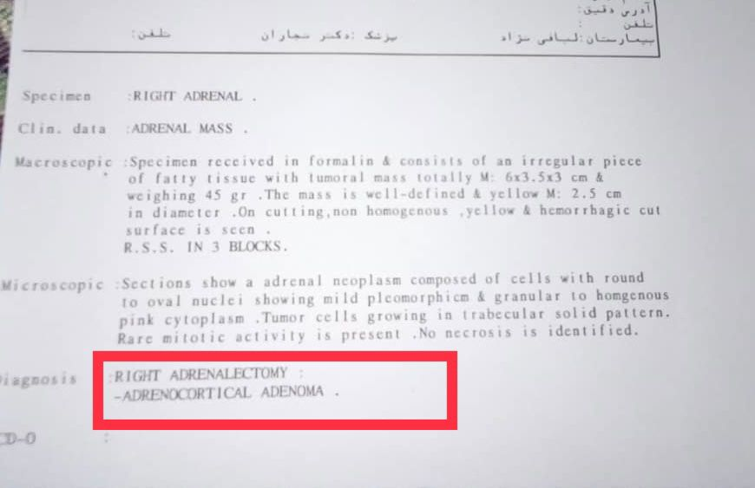

Slide 10
Past Medical History:
Cushing’s syndrome, Adrenal adenoma, Laparoscopic right adrenalectomy (1388)
Childbirth (1389, 1391, 1394)
Cholecystectomy (1400)
COVID-19 (1400)
HTN: from 6 months ago
Abnormal glucose tolerance: from 6 months ago

Slide 11
Past Medical History:
Weight gain, Headache, dizziness from 1398
Recurrence of symptoms of Cushing’s syndrome from 6 month ago:
Striae, Round face, Dorsal fat pad
Proximal muscle weakness
Ecchymosis, easy bruising
Hypertension (SBP: 190 mmHg), Abnormal glucose tolerance (FBS: 125 mg/dl)
Depression, mood change

Slide 12
Drug History:
Tab Metformin 500 mg daily
Tab Losartan 25 mg Daily
Tab acetaminophen Codeine PRN

Slide 13
Habitual and Social History:
HH:
Neg
Social History :
Married at the age of 17.
living with her husband and two daughters (aged 7 and 12)
History of death of one of the Childs
Education: Primary
Occupation: Housewife

Slide 14
Review of Systems:
Constitutional symptoms: weight gain (+)
Head and neck: Round face (+)
Cardiovascular: Hypertension (+)
Respiratory: Nl
Gastrointestinal: Constipation (+)
Genitourinary: Menstrual changes (+)
Musculoskeletal: Fracture (-)
Skin: plethora (+), Ecchymosis (+), Easy bruising (+), Purplish stretch marks on the abdomen (+), Swelling (+),
Neurological: proximal weakness(+), Headache (+), dizziness (+)
Psychiatric: depression(+), anxiety(-), irritability (+)
Endocrine: weight change(+), impaired glucose test (+)

Slide 15
Physical Examination:
GENERAL APPEARANCE:
32 y/o women, awake and alert
Vital Sing:
BP: 130/75 mmHg, PR: 76/min, RR: 16/min, OT: 36.8, SO₂: 96%
BMI:
Weight: 97 Kg Height: 1.65cm BMI: 35.6
Waist Circumference: 99 cm

Slide 16
Physical Examination:
Head and NECK : Round face, Facial plethora, normal thyroid size, without nodule
Thorax and Back: Acne, Dorsal fat pad
Lungs : Clear
Heart : Normal
Abdomen : Striae (red purple, >1cm wide), no organomegaly
Extremities :
Upper : Normal (range of motion , muscle tone , pulses )
Lower : Force of muscles : 4/5

Slide 17
1400.11.2
 | Result | Normal Range
WBC (× 10⁹/L) | 9.4 | 4-11
Hb (g/dL) | 13 | 12-15
MCV (fL) | 86.5 | 80-100
Platelets (× 10⁹/L) | 251 | 150-400
BUN (mg/dl) | 15 | 9-21
Cr (mg/dl) | 1 | 0.6-1.3
FBS (mg/dl) | 94 | <100
HBA1C (%) | 5.9 | <5.6
Electrolytes (Na, K) | Normal
 | Result | Normal Range
AST (U/L) | 11 | Up to 41
ALT (U/L) | 25 | Up to 41
ALP (U/L) | 190 | 64-306
T. Bilirubin (mg/dl) | 0.7 | Up to 1.5
D. Bilirubin (mg/dl) | 0.2 | Up to 0.7
PT, PTT, INR | Normal

Slide 18
Laboratory tests:
Date | Test | Result | Reference Range
1400.11.27 | 24 hr. U. free cortisol | 803 mcg/ 24 h | 1.5 - 63
1400.12.1 | 24 hr. U. free cortisol | 547 mcg/ 24 h | 1.5 - 63
1400.12.8 | ACTH | 84.35 pg/ ml | 7.2 – 63.3 (7 am – 10 am)
1400.12.14 | ACTH | 101.1 pg/ ml | 7.2 – 63.3 (7 am – 10 am)
1400.12.21 | 24 hr. U. free cortisol (HIGH-DOSE DST) | 6.4 mcg/ 24 h | 1.5 - 63
1400.12.19 | Morning Cortisol | 20.4 mcg/ dl | 3.7- 19.4 (6 am – 10 am)
1400.12.21 | Morning (Dexamethasone) | 9.3 mcg/ dl | DST<5
MRI هیپوفیز: نرمال

Slide 19
1400.11.2
 | Result | Reference Range
Prolactin (mIU/ml) | 320 | 106 - 850
LH (mIU/ml) | 0.57 | 1.8 – 11.8
FSH (mIU/ml) | 0.5 | 1.2 - 21
T4 (μg/dl) | 4.7 | 4.65 – 9.31
TSH | 0.8 mu/l | 0.4- 4.5
DHEAS (μg/dl) | 178.6 | 99- 340

Slide 20
1400.12.21

Slide 21
PROBLEM LIST
A 32-year-old woman
History of Cushing’s syndrome, adrenal adenoma and Laparoscopic right adrenalectomy (1388)
Striae, progressive obesity, proximal muscle weakness, HTN and abnormal glucose tolerance: since 6 months ago
Increased UFC, Increased ACTH, >90% Cortisol suppression following High-dose DSTs
Pituitary micro adenoma: 4.5 mm

Slide 22
Differential Diagnosis:
Cushing’s disease
Ectopic ACTH syndrome
Ectopic CRH syndrome

Slide 23
Desmopressin stimulation test, 1401.1.23
 | Test : Cortisol |  | Test: ACTH
 | Result | Reference Range (6.2 – 20 mcg/ dl) | Result | Reference Range ( 7.2 – 64 pg/ ml)
-15 min | 16.02 mcg/ dl |  | 52.68 pg/ ml
0 min | 15.01 mcg/ dl |  | 129.5 pg/ ml?
+15 min | 18.75 mcg/ dl |  | 98.46 pg/ ml
+30 min | 21.20 mcg/ dl |  | 58.42 pg/ ml
+ 45 min | 23.55 mcg/ dl |  | 99.14 pg/ ml

Slide 24
IPSS, 1401.1.27
ACTH
 | Right | Left | Peripheral
-5 min | 143.1 | 54.91 | 56
0 min | 169 | 41.2 | 49.54
+3 min | 291.3 | 87.51 | 83.75
+5 min | 265.3 | 128.4 | 135.6
+ 10 min | 319.3 | 13.83 | 172.9
ACTH Reference Range(7.2 – 64 pg/ml)

Slide 25
Pituitary mass resection, 1401.2.1

Slide 26
1400.2.4
1400.2.8

Slide 27
AGENDA:
Interpretation of laboratory tests
ACTH rise after IV catheterization and injection
Coexistence of ACTH- Dependent and ACTH- independent Cushing Syndrome
Genetic Background of simultaneous ACTH- Dependent and ACTH- independent Cushing Syndrome
Persistent Cushing’s disease

Slide 28
Interpretation of laboratory tests:
HIGH-DOSE DSTs
desmopressin stimulation test
Inferior Petrosal venous sinus catheterization

Slide 29
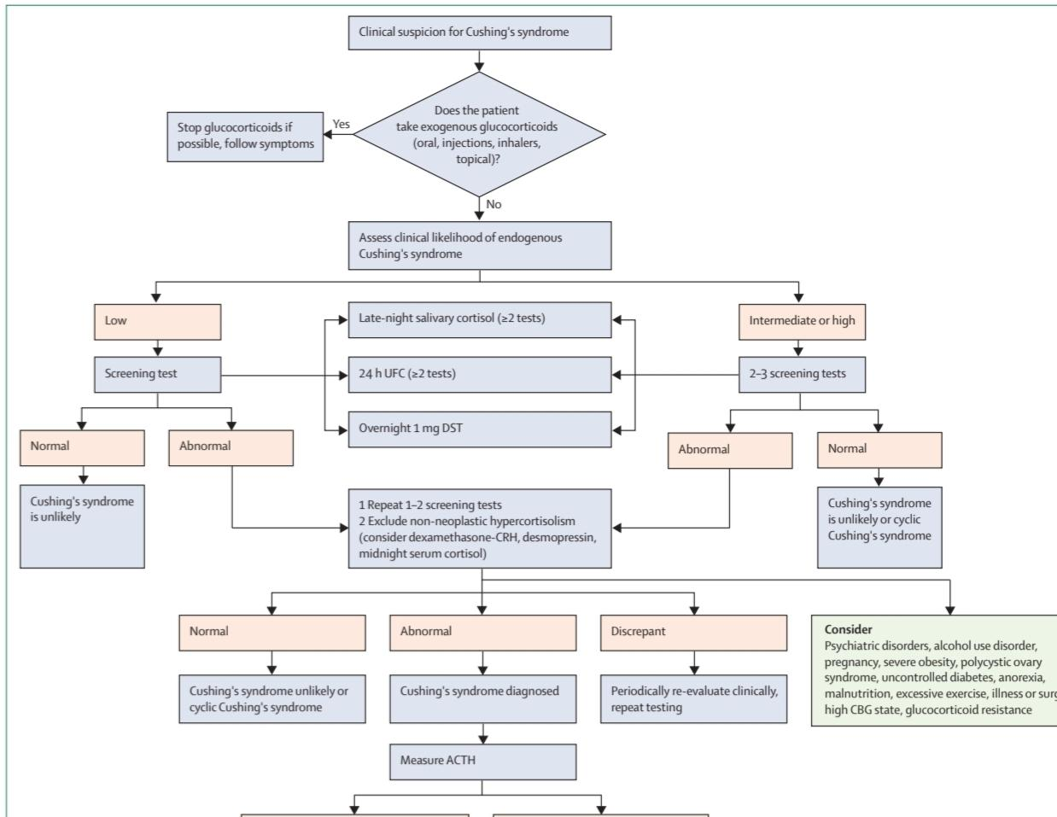
Test | Result | Reference Range
24 hr. U.F.C | 803 mcg/ 24 h | 1.5 - 63
24 hr. U.F.C | 547 mcg/ 24 h | 1.5 - 63
ACTH | 84.35 pg/ ml | 7.2 – 63.3
ACTH | 101.1 pg/ ml | 7.2 – 63.3
diabetes-endocrinology October 2021, Consensus on diagnosis and management of Cushing’s disease: a guideline update

Slide 30
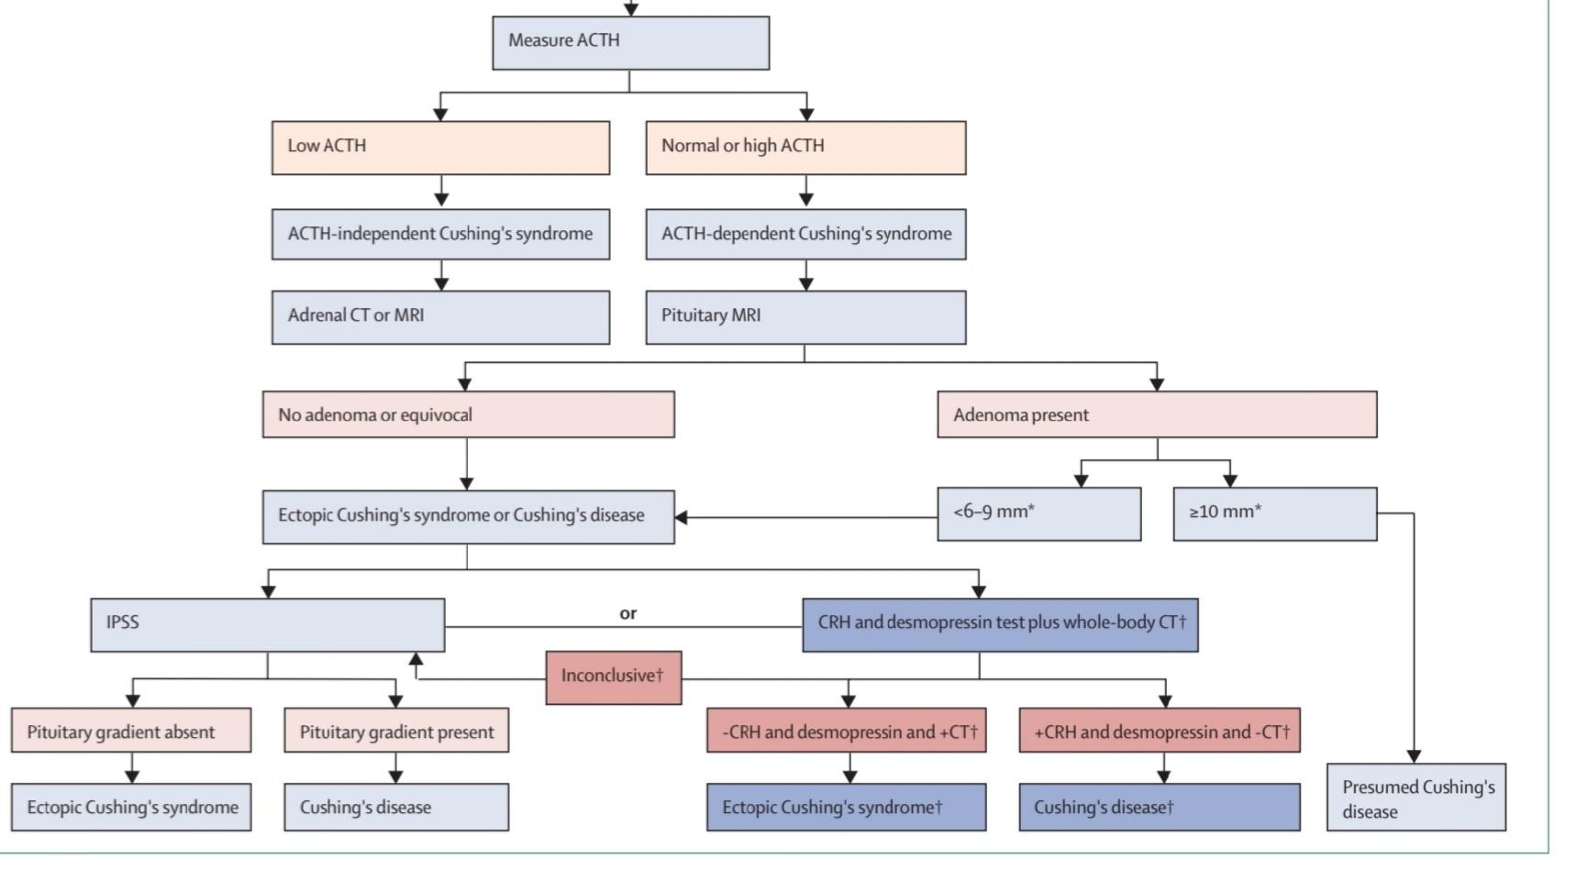
Test | Result | Reference Range
U.F.C | 803 mcg/ 24 h | 1.5 - 63
U.F.C | 547 mcg/ 24 h | 1.5 - 63
ACTH | 84.35 pg/ ml | 7.2 – 63.3
ACTH | 101.1 pg/ ml | 7.2 – 63.3
U.F.C (DST) | 6.4 mcg/ 24 h | 1.5 - 63
diabetes-endocrinology October 2021
Consensus on diagnosis and management of Cushing’s disease: a guideline update

Slide 31
HIGH-DOSE DSTs:
Date | Test | Result | Reference Range
1400.11.27 | 24 hr. U. free cortisol | 803 mcg/ 24 h | 1.5 - 63
1400.12.1 | 24 hr. U. free cortisol | 547 mcg/ 24 h | 1.5 - 63
1400.12.21 | 24 hr. U. free cortisol (HIGH-DOSE DST) | 6.4 mcg/ 24 h | 1.5 - 63

Slide 32
HIGH-DOSE DSTs
Test | Result
UFC | 803 mcg/ 24 h
UFC | 547 mcg/ 24 h
DST | 6.4 mcg/ 24 h
More than 50 percent suppression:
81 to 88 percent of patients with Cushing's disease showed suppression,
31 to 57 percent of patients with ectopic ACTH secretion failed to suppress, yielding a high number of false-positive results.
80 or 90 percent suppression:
improve specificity to 100 percent
found a sensitivity of 47 to 83 percent.
J Clin Endocrinol Metab 1994; 78:418

Slide 33
Desmopressin stimulation test, 1401.1.23
 | Test : Cortisol |  | Test: ACTH
 | Result | Reference Range (6.2 – 20 mcg/ dl) | Result | Reference Range ( 7.2 – 64 pg/ ml)
-15 min | 16.02 mcg/ dl |  | 52.68 pg/ ml
0 min | 15.01 mcg/ dl |  | 129.5 pg/ ml
+15 min | 18.75 mcg/ dl |  | 98.46 pg/ ml
+30 min | 21.20 mcg/ dl |  | 58.42 pg/ ml
+ 45 min | 23.55 mcg/ dl |  | 99.14 pg/ ml

Slide 34
CRH
 | Test : Cortisol | Test: ACTH
 | Result | Result
-15 min | 16.02 mcg/ dl | 52.68 pg/ ml
0 min | 15.01 mcg/ dl | 129.5 pg/ ml
+15 min | 18.75 mcg/ dl | 98.46 pg/ ml
+30 min | 21.20 mcg/ dl | 58.42 pg/ ml
+ 45 min | 23.55 mcg/ dl | 99.14 pg/ ml
Serum cortisol concentrations:
increase 20 to 600 percent (mean 250 percent)
to 13 to 36 mcg/dL (mean 25 mcg/dL),
reaching a peak 30 to 60 minutes after CRH injection.
Plasma ACTH concentrations:
increase 35 to 900 percent (mean 400 percent)
reach a peak of around 20 to 120 pg/mL 30 minutes after CRH injection.
Ann Intern Med 1990; 112:434

Slide 35
DESMOPRESSIN STIMULATION TEST
 | Cortisol | ACTH
-15 min | 16.02 mcg/ dl | 52.68 pg/ ml
0 min | 15.01 mcg/ dl | 129.5 pg/ ml
+15 min | 18.75 mcg/ dl | 98.46 pg/ ml
+30 min | 21.20 mcg/ dl | 58.42 pg/ ml
+ 45 min | 23.55 mcg/ dl | 99.14 pg/ ml
serum cortisol:
using the criterion of a greater than 20 percent increase in serum cortisol, 80 to 85 percent of patients respond.
However, in some reports, 8 of 25 (32 percent) of patients with ectopic ACTH syndrome, mostly benign carcinoid tumors, also responded.
plasma ACTH:
using criteria of a 30 or 50 percent increase 95 and 81 percent of patients respond, respectively.
Endocr J 1997; 44:687

Slide 36
IPSS, 1401.1.27
ACTH
 | Right | Left | Peripheral
-5 min | 143.1 | 54.91 | 56
0 min | 169 | 41.2 | 49.54
+3 min | 291.3 | 87.51 | 83.75
+5 min | 265.3 | 128.4 | 135.6
+ 10 min | 319.3 | 13.83 | 172.9
ACTH Reference Range(7.2 – 64 pg/ml)

Slide 37
Interpretation
Pituitary source of ACTH
A central-to-peripheral plasma corticotropin (ACTH) gradient of:
≥2 before CRH administration,
or ≥3 after CRH administration.
N Engl J Med 1991; 325:897

Slide 38
Petrosal venous sinus catheterization
Some studies have shown that a gradient of ≥1.4 between the ACTH concentrations in the two sinuses predicted the side of the tumor with up to 71 percent accuracy if catheters were appropriately placed.
2022 uptodate, Establishing The cause of Cushing syndrome

Slide 39
Measurement of serum DHEAS is useful.
it is generally decreased in adrenal causes of Cushing's syndrome
normal or increased in ACTH-dependent causes
Date | Test | Result | Reference Range
1388 | DHEAS (μg/dl) | 21 | 65- 380
1400 | DHEAS (μg/dl) | 178.6 | 99- 340
2022 uptodate, Establishing The cause of Cushing syndrome

Slide 40
ACTH rise after catheterization and injection

Slide 41
Desmopressin stimulation test, 1401.1.23
 | Test : Cortisol |  | Test: ACTH
 | Result | Reference Range (6.2 – 20 mcg/ dl) | Result | Reference Range ( 7.2 – 64 pg/ ml)
-15 min | 16.02 mcg/ dl |  | 52.68 pg/ ml
0 min | 15.01 mcg/ dl |  | 129.5 pg/ ml?
+15 min | 18.75 mcg/ dl |  | 98.46 pg/ ml
+30 min | 21.20 mcg/ dl |  | 58.42 pg/ ml
+ 45 min | 23.55 mcg/ dl |  | 99.14 pg/ ml

Slide 42
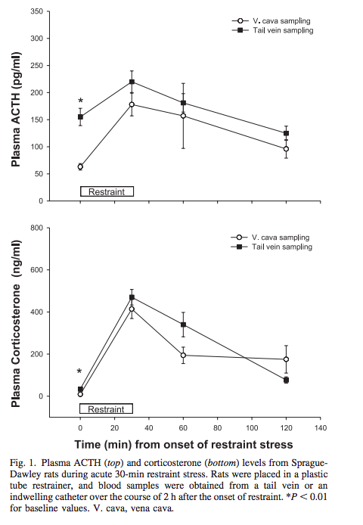
compared plasma ACTH and corticosterone concentrations in pre- and post stress rat blood samples
obtained via previously implanted vena cava catheters, tail vein nicks, or clipping the tip off the tail
obtained by decapitation with and without anesthesia.
Am J Physiol Endocrinol Metab 289: E823–E828, 2005.

Slide 44
Coexistence of
ACTH- Dependent
and
ACTH- independent
Cushing Syndrome

Slide 45
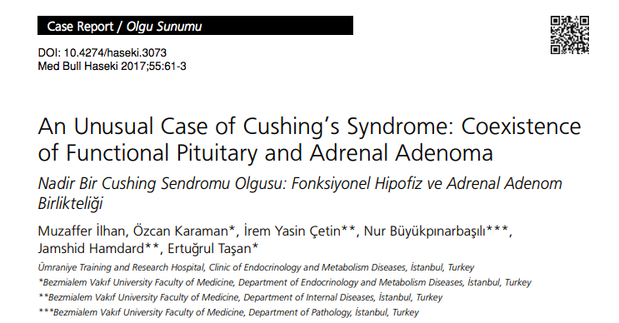
To our knowledge, this is the first case of coexistence of functional pituitary and adrenal adenoma.

Slide 46
A 47-year-old woman with a past history of surgery and gamma knife radiosurgery because of Cushing’s disease
Was admitted with weight gain and unregulated blood glucose levels. diagnostic work-up indicated ACTH-independent Cushing’s syndrome.

Slide 47
Coincidence of nonfunctioning tumors in adrenal or pituitary is a common finding in diagnostic steps of CS.
Coexistence of both functional pituitary and adrenal lesions in same patient has been reported in only a few cases.

Slide 48
Along with the rare possibility of this coexistence, longstanding ACTH hypersecretion can play a role in functional transition of adrenal adenomas.
Despite bilateral adrenocortical hyperplasia in CD is a well-defined entity and can be found in 70-80% of patients with CD, autonomic transformation of adrenal glands due to longstanding ACTH hypersecretion is still a matter of debate.

Slide 49
A case of CD which reoccurred after ten months of TSS because of autonomous cortisol secretion of adrenal macronodule.
In that case, coexistent macro and microhyperplasia in the resected adrenal gland suggested that macronodular hyperplasia could be the later stage of micronodular hyperplasia and indicated the possible transition of pituitary-dependent to adrenal-dependent CS.
Timmers HJ, et al. A patient with recurrent hypercortisolism after removal of an ACTH-secreting pituitary adenoma due to an adrenal macronodule. J Endocrinol Invest 2006;29:934-9.

Slide 50
removal of ACTH stain-positive pituitary adenoma and subsequent resection of the left adrenal gland with 3.5 cm adrenal nodule which was surrounded by an atrophic cortex did not cure hypercortisolism in a patient with CS.
Contralateral adrenalectomy which histologically showed micronodular hyperplasia suggested that ACTH dependent CS might lead to adrenal-dependent CS
Hermus AR, Pieters GF, Smals AG, et al. Transition from pituitary-dependent to adrenal-dependent Cushing’s syndrome. N Engl J Med 1988;318:966-70.

Slide 51
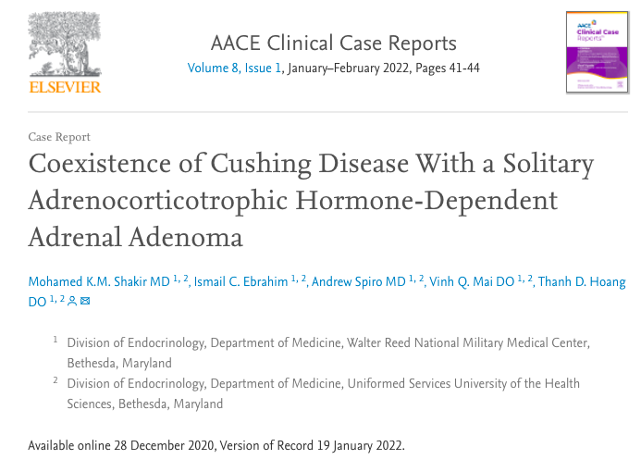

Slide 52
A 49-year-old woman was admitted for urosepsis.
An abdominal CT scan showed a 2.7-cm right adrenal adenoma.
She denied any abdominal striae or other symptoms.
24-hour-urine cortisol 294 μg,
midnight serum cortisol 23.0 μg/dL (reference < 7.5),
plasma ACTH level 39 pg/mL (reference 5-27).
A CRH stimulation test showed >20% rise in serum cortisol and >35% rise in ACTH levels.
A pituitary MRI showed a 5 mm pituitary lesion.
The patient underwent transsphenoidal pituitary surgery, which confirmed an ACTH-secreting lesion. A follow-up adrenal CT performed 6 months later showed a decrease in the size of the adrenal adenoma (1.8 cm).

Slide 53
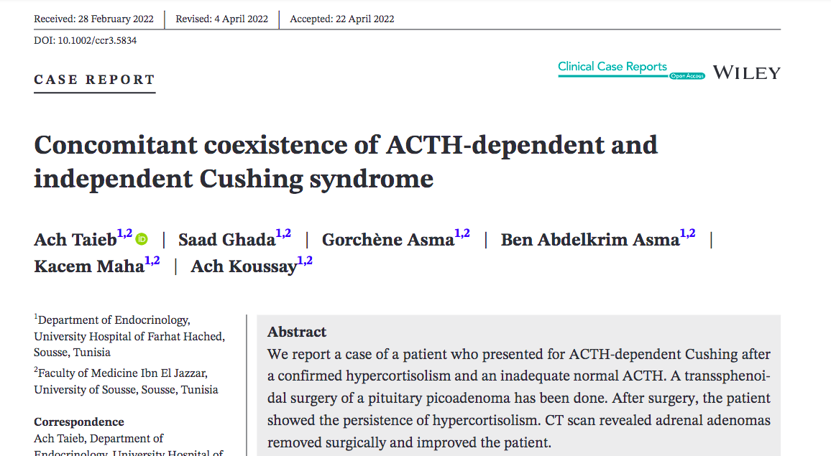

Slide 54
Abs et al reported a case series of 3 patients with Cushing disease with bilateral macronodular adrenal hyperplasia, presenting initially as an adrenal macronodule.
Scintigraphy was consistent with diffuse hyperplasia of both adrenal glands with formation of a single dominant macronodule.
Interestingly, 2 of the nodules developed shrinkage after removal of the pituitary adenoma.
Acta Endocrinol (Copenh), 129 (4) (1993), pp. 284-290

Slide 55
These investigators suggested that:
the macronodule may possibly represent an evolutionary stage of diffuse adrenal hyperplasia to the autonomous adrenal nodule after prolonged ACTH stimulation.
Acta Endocrinol (Copenh), 129 (4) (1993), pp. 284-290

Slide 56
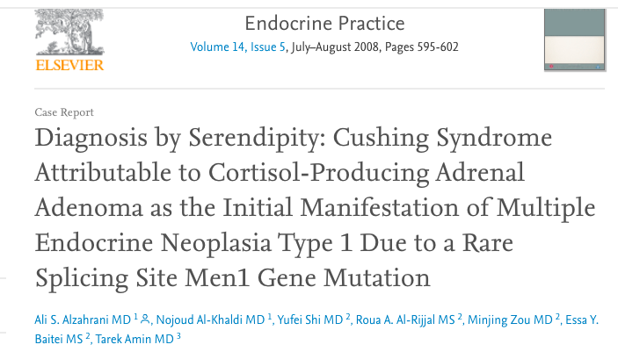

Slide 57
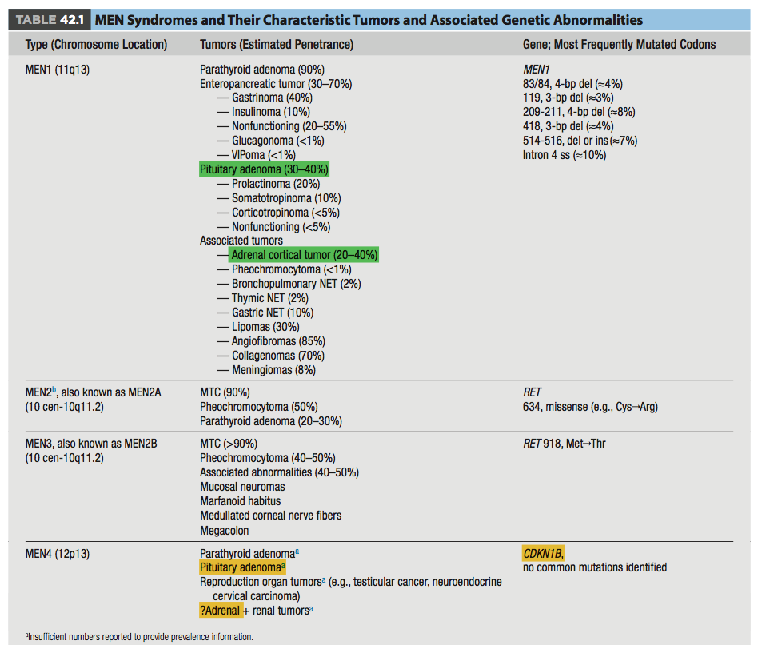

Slide 58
A 16-year-old girl
who was not known to have any medical illness
had no known family history of MEN 1 syndrome
presented with Cushing syndrome attributable to a cortisol-producing adrenal adenoma.
During her evaluation, she was found to have primary hyperparathyroidism and a pituitary microprolactinoma.
These findings raised the possibility of MEN 1 syndrome.

Slide 59
Family screening showed that her father had evidence of primary hyperparathyroidism, mild hyperprolactinemia, normal findings on magnetic resonance imaging of the pituitary, and a 1.2- cm nodule in the tail of the pancreas in conjunction with slight elevation of serum insulin and normal gastrin levels.
The patient’s 5 siblings had evidence of primary hyperparathyroidism, and 2 of them also had mild hyperprolactinemia.
Genetic screening confirmed the presence of a MEN1 gene missense G to A mutation in the patient, her father, and her siblings at the splicing site of intron 6 (IVS6 + 1G > A).
This mutation leads to frameshift and truncation of the MEN1 gene.

Slide 60
This case highlights:
the potential for Cushing syndrome to be the first manifestation of MEN 1 syndrome
describe the rare underlying genetic mutation
the heterogeneous manifestations of the syndrome within the same family, even having the same genetic mutation.

Slide 62
A total of twenty-five cases describing the coexistence of a pituitary adenoma and pheochromocytoma have been reported in the literature over the past 40 years.
Among pituitary tumors, acromegaly has been the most common.

Slide 63
In an effort to identify the relationship between the two tumors, multiple theories have been suggested including:
fortuitous association,
overlap or variants of MEN syndromes,

Slide 64
Genetic Background of
simultaneous ACTH- Dependent
and ACTH- independent
Cushing Syndrome

Slide 65
2022 uptodate, Establishing The cause of Cushing syndrome

Slide 66
Genetics of Cushing’s disease
Corticotroph adenomas are predominantly of sporadic origin, based on a monoclonal expansion of a singular mutated cell.
These adenomas abundantly express EGFR, which signals to induce ACTH production.
Somatic activating driver mutations in USP8 are present in 36–60% of corticotroph adenomas.
Rarely, muta­tions in the glucocorticoid receptor NR3C1, the BRAF oncogene, the deubiquitinase USP48, and TP53 are encountered.
Patients with familial tumour syndromes, such as MEN1, FIPA, and DICER1, rarely develop corticotroph adenomas.
As USP8 mutational status might predict recurrence after transsphenoidal surgery, such genomic classifications could open new avenues for more targeted, personalised treatment modalities in the future.

Slide 68
Who should be tested for MEN 1?
an index case with two or more MEN1-associated endocrine tumors (i.e. parathyroid, pancreatic, or pituitary tumors)
2) in patients with suspicious or atypical MEN1: parathyroid adenomas occurring before the age of 30 yr multigland parathyroid disease Gastrinoma multiple pancreatic NET at any age individuals who have two or more MEN1-associated tumors that are not part of the classical triad of parathyroid, pancreatic islet, and anterior pituitary tumors (e.g. parathyroid tumor plus adrenal tumor)
asymptomatic first-degree relatives of a known MEN1 mutation carrier
a first-degree relative of an MEN1 mutation carrier expressing familial MEN1 (i.e. having symptoms, signs, biochemical or radiological evidence for one or more MEN1-associated tumors)
Front. Endocrinol., 11 June 2019

Slide 69
Most previously reported cases of pituitary adenomas coexisting with adrenal adenoma are seen in patients with multiple endocrine neoplasia syndrome
Endocr Pract, 14 (5) (2008), pp. 595-602

Slide 70
Persistent Cushing’s disease

Slide 71
Remission
The best criteria of cure are:
●An undetectable serum cortisol concentration
●An undetectable plasma ACTH concentration
An extremely low serum cortisol concentration (<1.8 mcg/dL, 50 nmol/L) is the best predictor of cure,
some patients with low but detectable serum cortisol concentrations (2 to 4 mcg/dL) that suppress with low-dose dexamethasone may remain in remission, as may those with cortisol values <5 mcg/dL.
Esposito F, Dusick JR, Cohan P, et al. Clinical review: Early morning cortisol levels as a predictor of remission after transsphenoidal surgery for Cushing's disease. J Clin Endocrinol Metab 2006; 91:7

Slide 72
Remission
typically defined as postoperative serum cortisol concen­trations lower than 55 nmol/L (<2 μg/dL),
is seen in approximately 80% of patients with microadenomas
60% with macroadenomas
if the procedure is performed by an experienced surgeon.
Pituitary 2020; 23: 595–609.

Slide 73
Late remission
Some patients appear to have a late remission, and early postoperative assessment of serum cortisol concentration is not sufficient to predict outcome.
Some patients show a gradual decline in cortisol during the first three months after surgery, possibly indicating progressive necrosis of remaining tumor cells.
Valassi E, Biller BM, Swearingen B, et al. Delayed remission after transsphenoidal surgery in patients with Cushing's disease. J Clin Endocrinol Metab 2010; 95:601

Slide 74
Late remission
In a study of 17 patients whose serum cortisol remained higher than 50 nmol/L (1.8 mcg/dL) within the first 14 days after surgery.
Serum cortisols had decreased to <50 nmol/L (1.8 mcg/dL) by three months after surgery, and all remained in remission during one to eight years of follow-up.
In a second study, 5.6 percent of 620 patients had late remission occurring at 38±50 days,
suggesting that decisions about additional therapy should await additional testing in patients with persistent hypercortisolism after transsphenoidal surgery.
Valassi E, Biller BM, Swearingen B, et al. Delayed remission after transsphenoidal surgery in patients with Cushing's disease. J Clin Endocrinol Metab 2010; 95:601

Slide 75
Treatment if surgery fails
Five therapeutic options :
●Repeat resection of residual corticotroph adenoma, particularly if residual tumor is visible on MRI.
●Irradiation of the pituitary gland.
●Medical therapy.
●Medical adrenalectomy with mitotane, for example, may be used in conjunction with pituitary irradiation
•Surgical adrenalectomy
J Clin Endocrinol Metab 2005; 90:5478

Slide 76
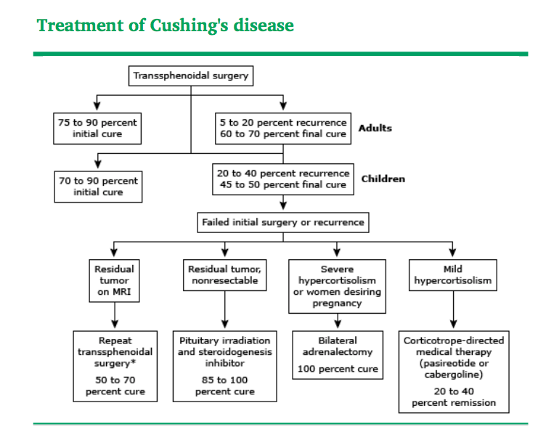
2022 uptodate, Primary therapy of Cushing's disease: Transsphenoidal surgery and pituitary irradiation

Slide 77
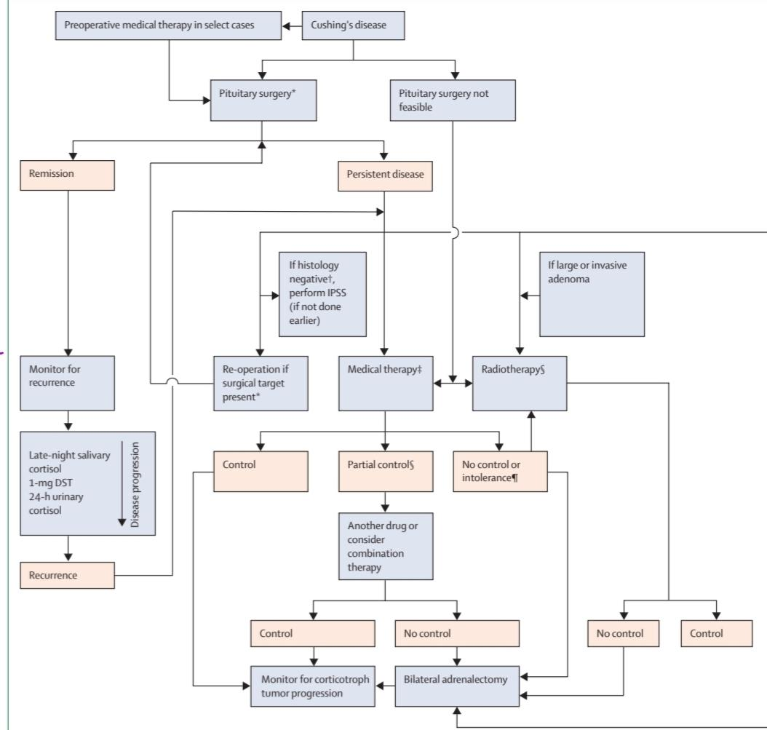
diabetes-endocrinology October 2021, Consensus on diagnosis and management of Cushing’s disease: a guideline update

Slide 78
Repeat pituitary surgery
If there are no contraindications for surgery, we suggest repeat trans sphenoidal surgery in patients with biochemical evidence of recurrent Cushing's disease
if tumour is evident on MRI,
especially if the first surgery was not done in a pituitary tumour centre of excellence
(low quality, discretionary recommendation).
diabetes-endocrinology October 2021
Consensus on diagnosis and management of Cushing’s disease: a guideline update

Slide 79
Repeat pituitary surgery
If MRI does not show tumour presence:
reoperation might be appropriate if an experienced surgeon at a high­ volume centre considers it feasible
and positive pathology or a central gradient on IPSS was seen before the initial operation
(low quality, discretionary recommendation).
Reoperation has a lower success rate than initial surgery.
57 to 71 percent cure
many of them developed other pituitary hormone deficiencies as a result of the second procedure.
diabetes-endocrinology October 2021
Consensus on diagnosis and management of Cushing’s disease: a guideline update

Slide 80
Radiotherapy
Radiotherapy is most commonly used in cases of
persistent hypercortisolism after incomplete corticotroph tumour resection,
particularly if the tumour is aggressive or invasive or is considered unresectable
(high quality, strong recommendation).
Stereotactic radiosurgery is probably more convenient as few treatment sessions are required, but avoiding optic chiasm exposure is crucial (high quality, strong recommendation).
diabetes-endocrinology October 2021
Consensus on diagnosis and management of Cushing’s disease: a guideline update

Slide 81
Radiotherapy
Lifelong monitoring for pituitary hormone deficiencies and recurrence is required in all patients undergoing radiotherapy (high quality, strong recommendation).
Imaging for secondary neoplasia in the radiation field should also be considered (high quality, strong recommendation).
diabetes-endocrinology October 2021
Consensus on diagnosis and management of Cushing’s disease: a guideline update

Slide 82
PITUITARY IRRADIATION
It may be considered as the initial therapy in children because it is as successful as transsphenoidal surgery.
Patients with hypercortisolism should receive adrenal enzyme inhibitors (such as mitotane, metyrapone, or ketoconazole) to achieve eucortisolism until the radiation therapy is successful.
2022 uptodate, Primary therapy of Cushing's disease: Transsphenoidal surgery and pituitary irradiation

Slide 83
PITUITARY IRRADIATION
●Efficacy
Reduction of cortisol to normal occurs in 50 to 80 percent of subjects.
Addition of pharmacologic therapy increases the remission rates to 85 to 100 percent.
2022 uptodate, Primary therapy of Cushing's disease: Transsphenoidal surgery and pituitary irradiation

Slide 84
Medical therapy for Cushing’s disease
Drugs can be used to:
treat hypercortisolism in patients with persistent or recurrent Cushing’s disease
those who are not candidates or refuse surgery,
to control cortisol concentrations in patients undergoing radiotherapy.
diabetes-endocrinology October 2021
Consensus on diagnosis and management of Cushing’s disease: a guideline update

Slide 85
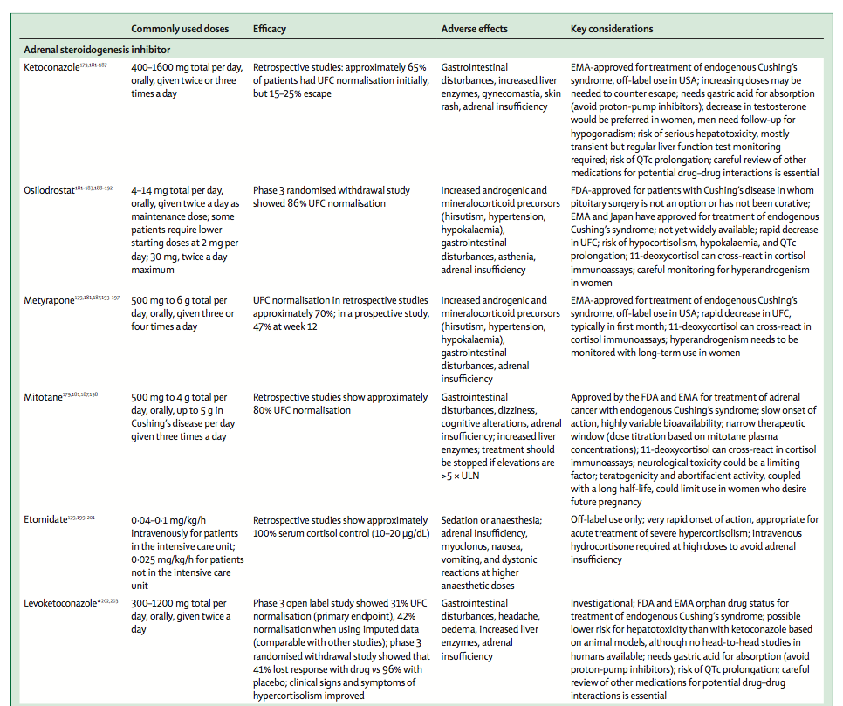
diabetes-endocrinology October 2021
Consensus on diagnosis and management of Cushing’s disease: a guideline update

Slide 86
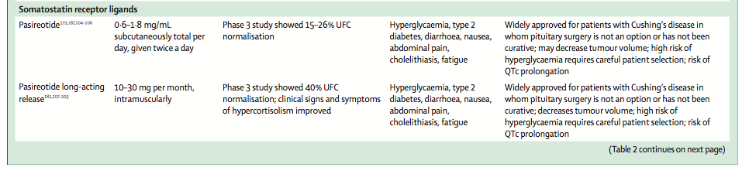
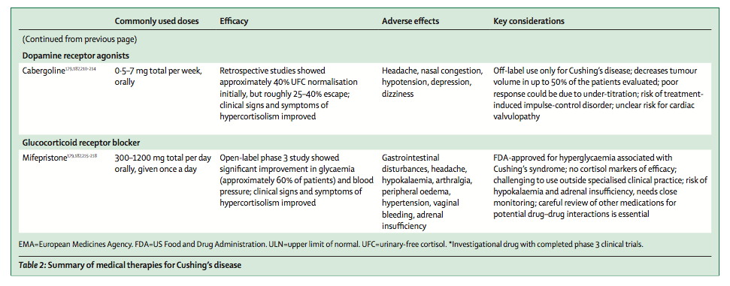
diabetes-endocrinology October 2021
Consensus on diagnosis and management of Cushing’s disease: a guideline update

Slide 87
Treatment Plan:
Persistent Cushing's disease confirmation
Pituitary MRI (visible tumor) / UFC
Resurgery?
Ketoconazole and radiotherapy?
Evaluation of MEN 1 mutation / Ca, P
Control of BP , FBS and other complications of CD

Slide 88


Slide 89
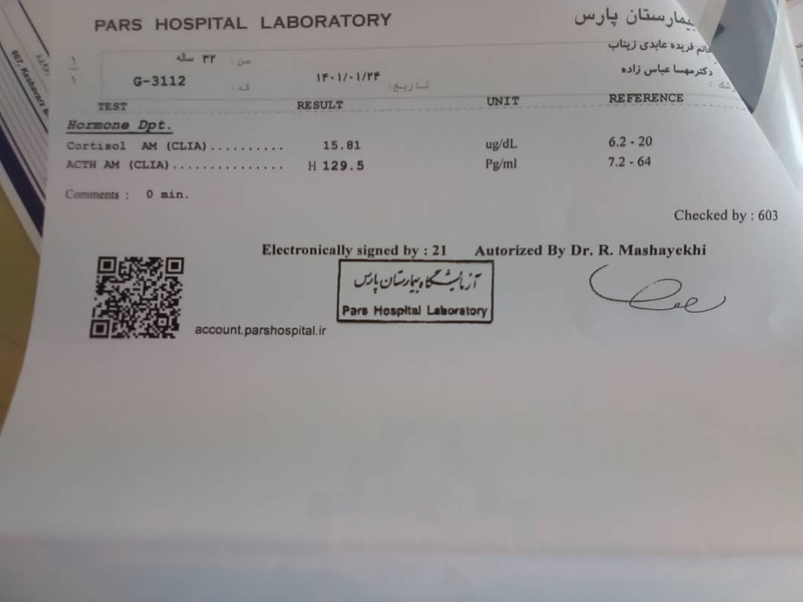
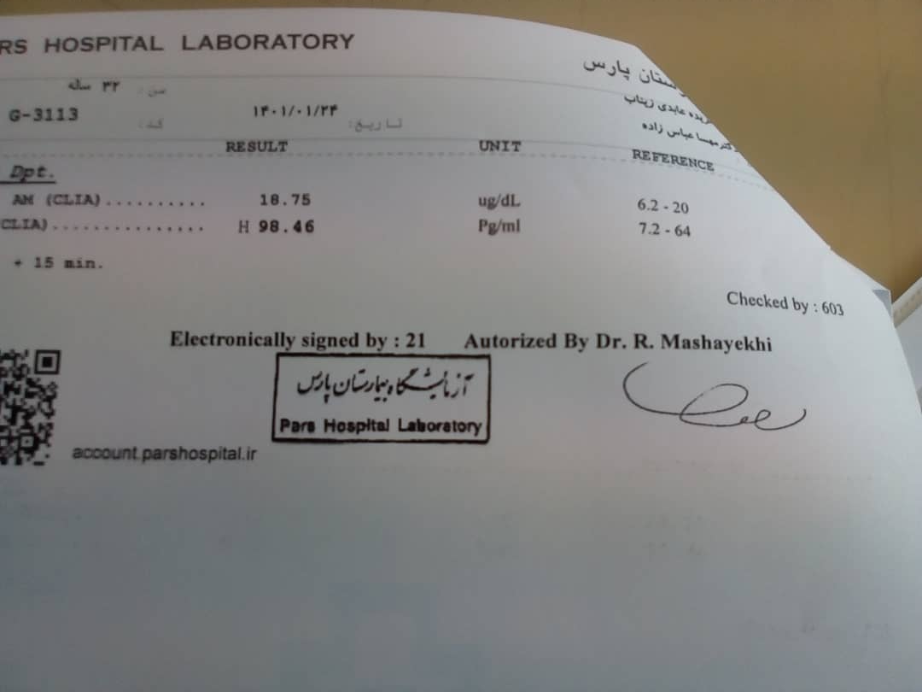


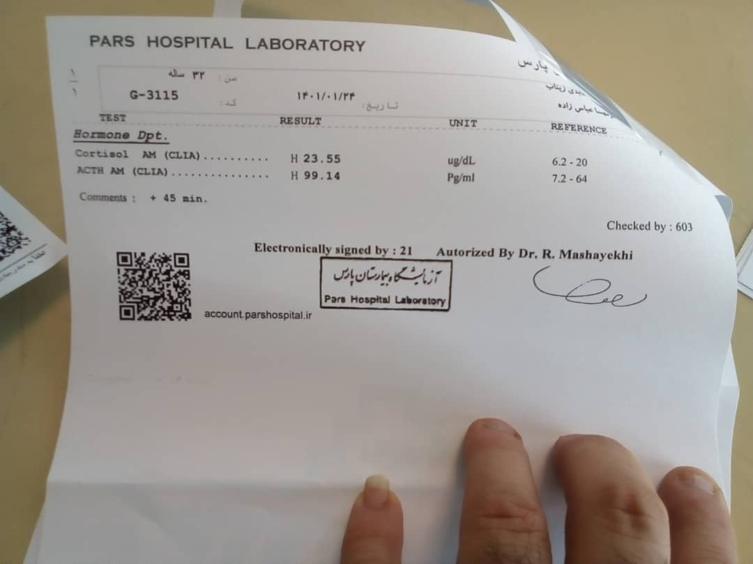

Slide 90




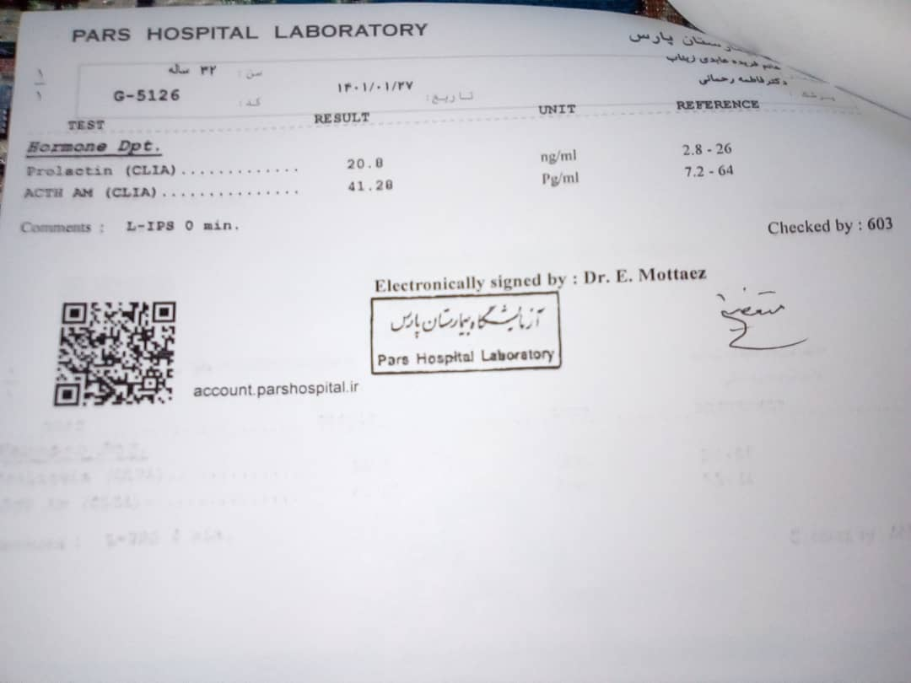
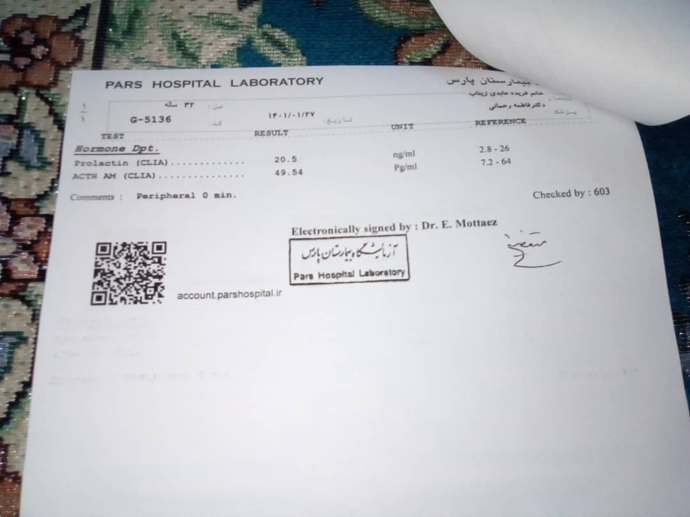

Slide 91





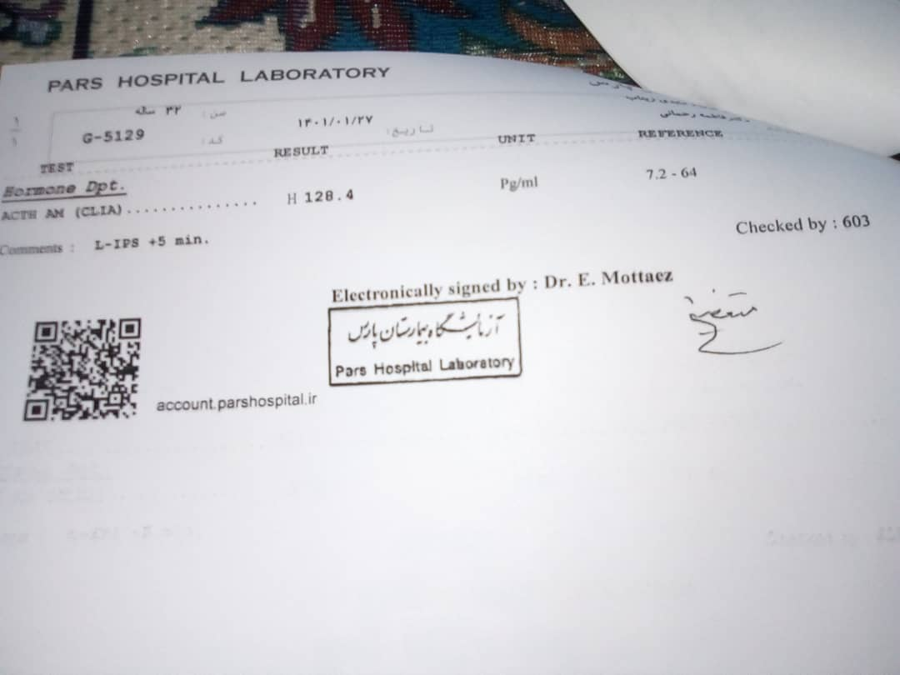

Slide 92
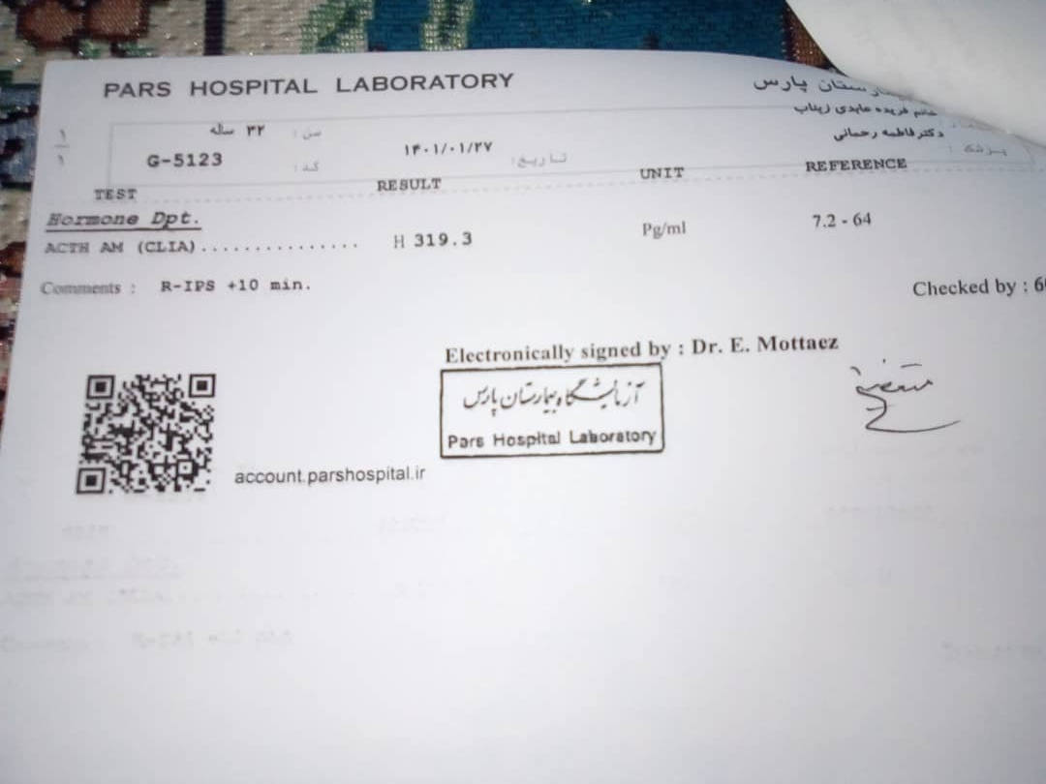

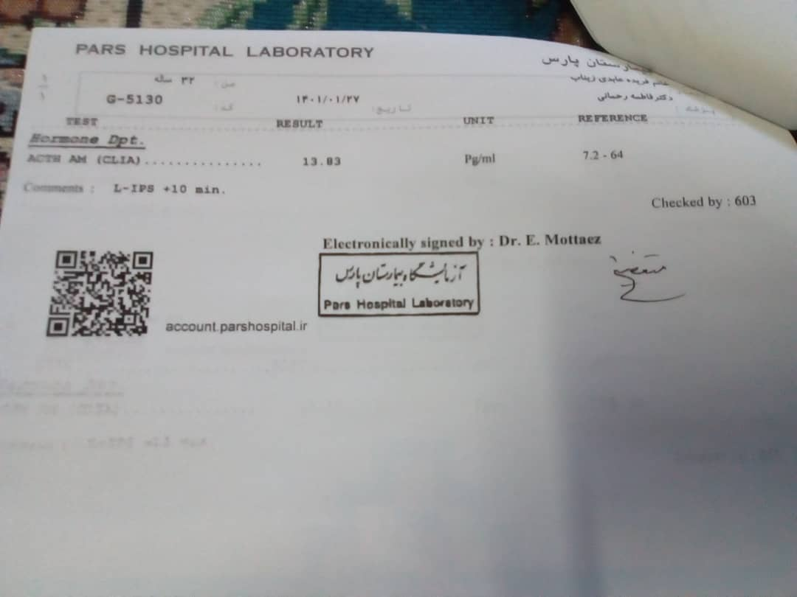

Slide 93



Slide 94
IPSS, 1401.1.27
Prolactin Reference Range: (2.8 – 26 ng/ml)
Prolactin (0 min)
Right | Left | Peripheral
144.2 ng/ml | 20.8 ng/ml | 20.5 ng/ml

Slide 97
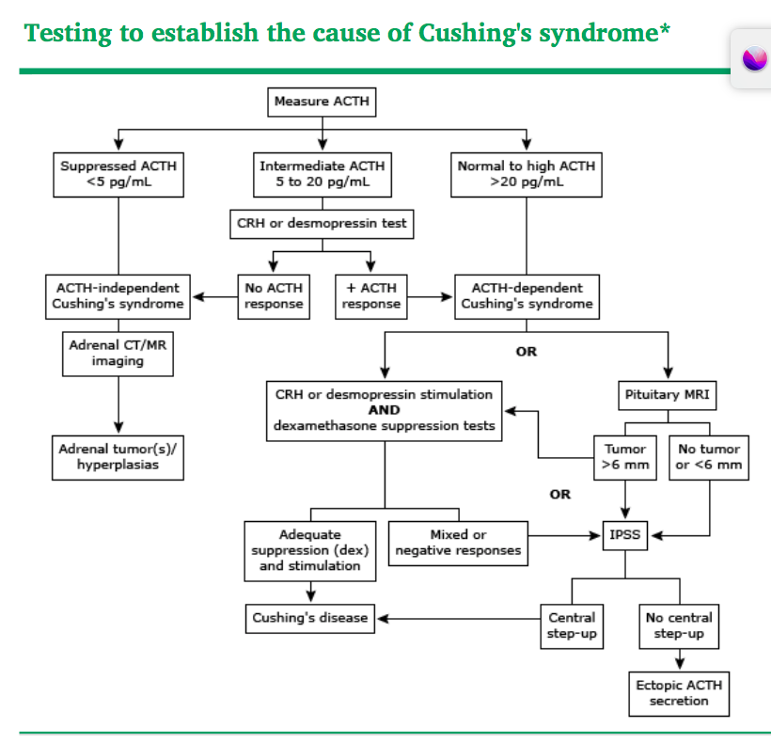
2022 Uptodate, Establishing The cause of Cushing syndrome

Slide 98
Test strategy
The choice of tests: vary depending on availability, diagnostic accuracy, technical expertise, and risk.
There are three approaches that have been advocated for distinguishing between pituitary and ectopic sources of ACTH:
●Perform noninvasive biochemical testing with CRH and/or desmopressin (DDAVP) and dexamethasone suppression. When at least one of these tests suggests Cushing's disease, perform pituitary magnetic resonance imaging (MRI) and possible petrosal sinus sampling.
●Perform biochemical tests and pituitary MRI, and if Cushing's disease is not diagnosed, perform imaging to identify an ectopic source of ACTH. If such a source is not found, proceed to petrosal sinus sampling
●Perform pituitary MRI and then petrosal sinus sampling if no mass >6 mm is identified
2022 Uptodate, Establishing The cause of Cushing syndrome

Slide 99
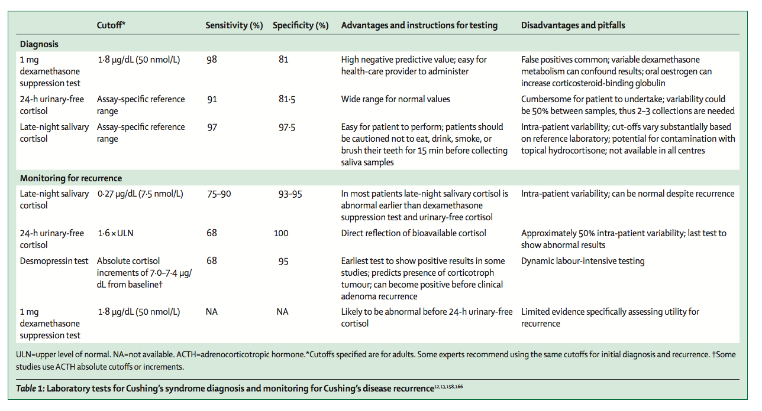
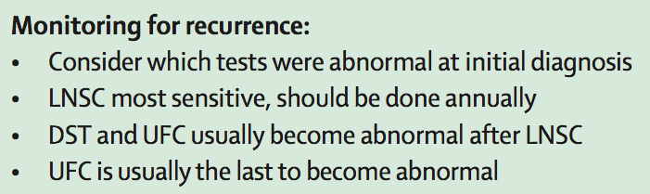
diabetes-endocrinology October 2021
Consensus on diagnosis and management of Cushing’s disease: a guideline update

Slide 100
Measurement of 24-hour urinary cortisol excretion may be useful since it confirms the serum cortisol concentration. The urine collection should begin at least 24 hours after the last small dose (10 mg or less) of hydrocortisone; a small maintenance dose (0.25 to 0.5 mg) of dexamethasone may be substituted before and during the collection. Excretion of less than <10 mcg/day (28 nmol/day) is consistent with cure.Management of patients with intermediate postoperative values of serum or plasma cortisol should be individualized. If there is a reason to suspect that tumor tissue was left behind and that the normal values reflect tumor ACTH secretion, measurement of salivary cortisol at midnight can be helpful as it is likely to be abnormal with persistent disease. Lack of cortisol suppression to the overnight 1 mg dexamethasone suppression test may help confirm the suspicion of persistent disease. In these cases, additional therapy may be recommended. Patients with normal cortisol dynamics, in whom the normal corticotropes may not be suppressed, may be followed.ACTH, CRH, or metyrapone stimulation tests are not helpful in these patients, because it is not clear how to interpret the results in this setting. A persistent response of cortisol and ACTH to the administration of intravenous desmopressin (10 mcg) may suggest a higher risk of recurrence
Romanholi DJ, Machado MC, Pereira CC, et al. Role for postoperative cortisol response to desmopressin in predicting the risk for recurrent Cushing's disease. Clin Endocrinol (Oxf) 2008; 69:117

Slide 101
diabetes-endocrinology October 2021
Consensus on diagnosis and management of Cushing’s disease: a guideline update

