Slide 1
In the name of God
Case presentation
1401/3/30
Prepared by : Dr Atoosa Larijani

Slide 2
Patient history
A 46-year-old woman
Born & live in Kerman
Source of history : Patient, reliable
Patient job : Housewife

Slide 3
Chief Complaint
Referrals due to laboratory disorders for further investigation

Slide 4
Past history
Hypertension : From 10 years ago
Diabetes mellitus:From 3 years ago
Hypothyroidism : From 6 months ago
RA : From 5 years old
ILD in the field of RA: from 4 years ago
History of heart disease : Negative
Smoking: Negative
Alcohol consumption : Negative

Slide 5
Family history
The patient had 2 brothers
1 brother with RA and ILD who died at the age of 35, 1 year ago due to complications from ILD
History of diabetes : Negative
History of HTN : Negative

Slide 6
Drug History
Glucophage 1000 : BD
Levothyroxine 100 : Daily
Concor 5 : Daily
Sulfasalazine 500 : BD
Hydroxychloroquine 200: BD
Prednisolone 5 mg: Daily up to 1 month ago
Valsartan 80 : BD
Lantus : 24 units daily (From 6 months ago)
Novorpid : 12 units before each meal (from 6months ago)
Potassium citrate 5 mEq : BD (from 6months ago)

Slide 7
Present Illness
A 46-year-old woman with problems starting 2 years ago with progressive muscle weakness and muscle wasting Preferably in the lower limbs
Inability to go up and down stairs and do daily chores that have gradually increased
Bedridden : from 2 months ago

Slide 8
Present Illness
Arthritis of the left ankle from 1 month ago ( Anti CCP>150 ,RF 3+ , Joint effusion in ultrasound)
Exacerbation of hypertension and diabetes from 6 months ago
5 times, falling due to muscle weakness
Recurrent urinary tract infections and oral candidiasis

Slide 9
Present Illness
Blurred vision : Positive
Mood disorder : Positive
Weight Loss: Positive 20 kg in 2 years
Hair loss : Positive
Amenorrhea : Positive From 6 months ago
Muscle weakness : Positive
Easy bruising : Positive
Oily skin,hyperhidrosis : Negative
Fracture : Negative
Acne, hirsutism : Negative
Headache : Negative

Slide 10
Physical examination
A 46-year-old woman
Lethargic
BP: 150/90 PR: 85
BMI: 17 Height :173 Weight : 53 kg
Round face
Force of muscles: Lower limbs : 3/5 Upper limbs : 3/5
Multiple bruises on the lower and upper limbs and buttocks
Pigmentation on the arm and back of the neck
Dorsal fat pad
Stria : Negative
Skin thinning : Positive
Thigh muscle circumference: 33 cm
Loss of upper and lower limb muscles

Slide 11
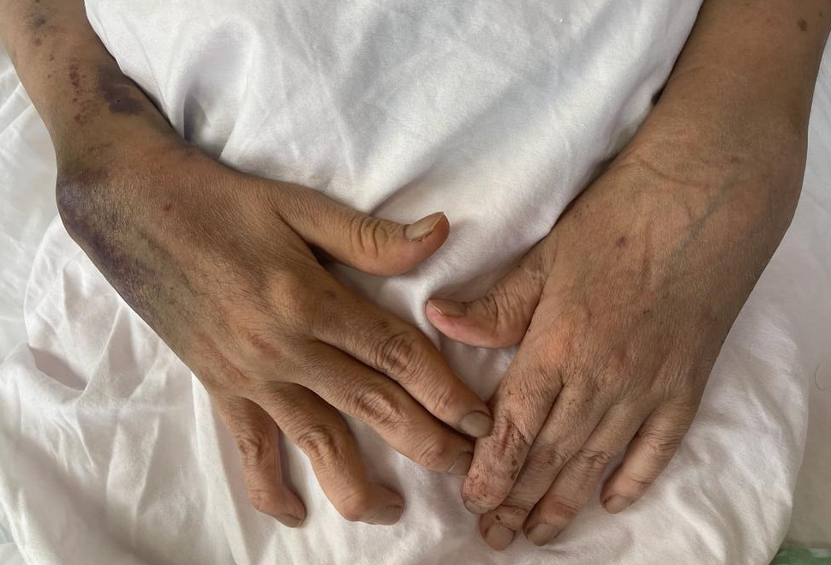

Slide 12
ODST 1400/12/2

Slide 13
UFC 1401/2/8

Slide 14
ACTH 1401/2/12

Slide 15
High-dose dexamethasone suppression tests 1401/2/12

Slide 16
TFT 1400/12/2

Slide 17
K 1400/12/2

Slide 18
VBG 1401/2/28

Slide 19
Source of excess ACTH: Pituitary or ectopic?

Slide 20
Consensus on diagnosis and management of Cushing’s disease: a guideline update 2021

Slide 21
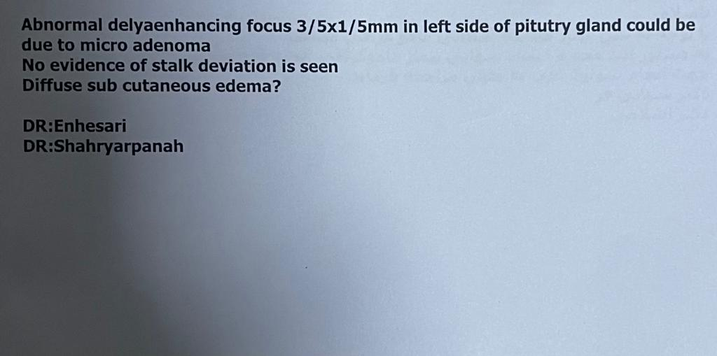
Pituitary MRI

Slide 24
Consensus on diagnosis and management of Cushing’s disease: a guideline update 2021

Slide 25
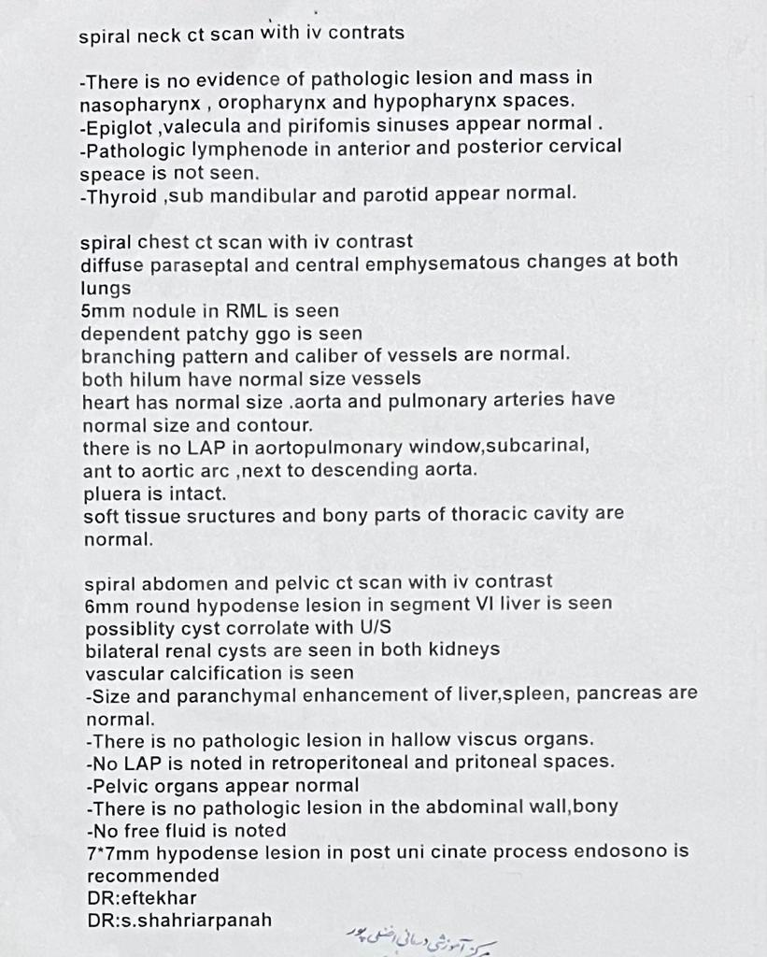
CT of the chest, abdomen, pelvis and neck with contrast

Slide 26
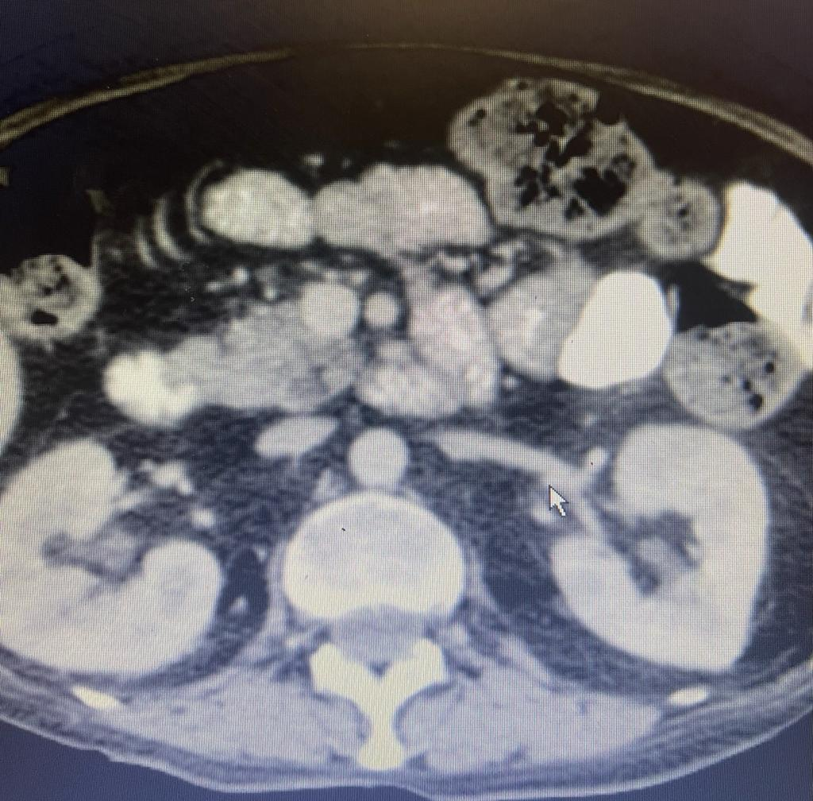

Slide 27
EUS
Multicystic pancreatic uncinate lesion consistant with BD-IPMN (Branch duct IPMN)

Slide 28
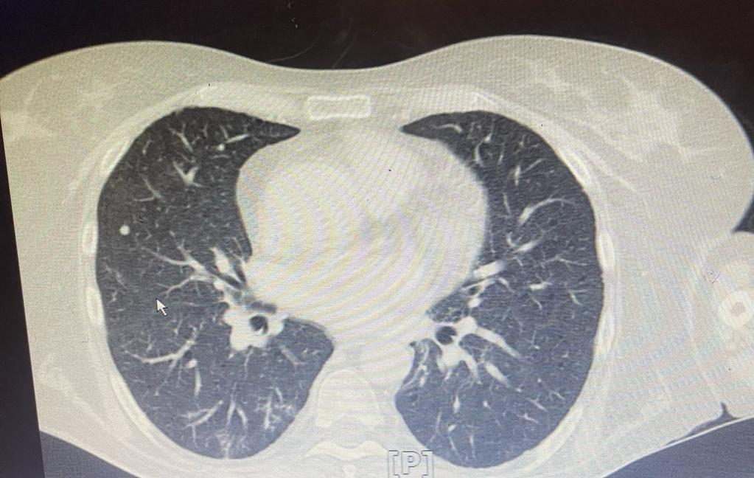

Slide 29
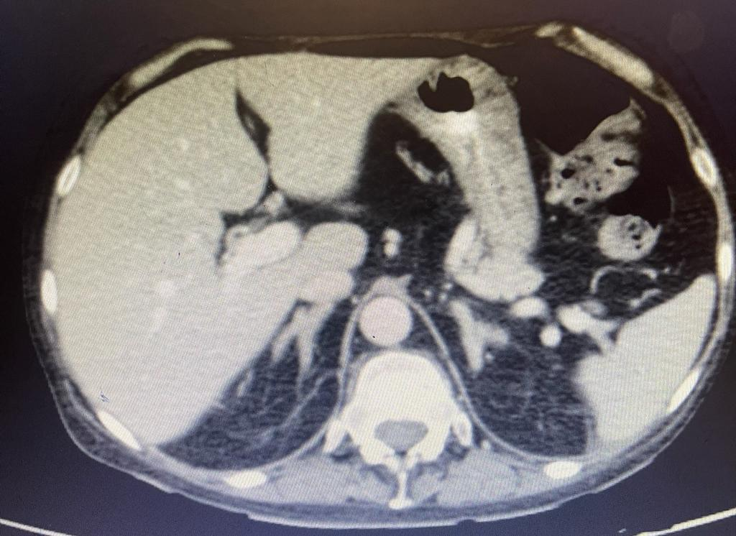

Slide 30
0.8%
0.8
17%
81.25
Nonsignificant

Slide 31
Consensus on diagnosis and management of Cushing’s disease: a guideline update 2021

Slide 32
1.17
1.2
No central gradient

Slide 33
Noninvasive biochemical testing :
CRH stimulation test:
up to 15% misdiagnosed by the test
High-dose dexamethasone suppression tests :
up to 50 % of patients with Cushing's disease may fail to respond
Desmopressin stimulation test:
up to 20 % of those with Cushing's disease do not respond
Petrosal venous sinus catheterization :
accuracy approximately 95 %
MANAGEMENT OF ENDOCRINE DISEASE: Cushing’s syndrome due to ectopic ACTH secretion: an expert operational opinion 2020

Slide 34
Consensus on diagnosis and management of Cushing’s disease: a guideline update 2021

Slide 35
What is the next step to finding Ectopic Cushing ?

Slide 36
Functional imaging
octreotide scintigraphy
The sensitivity from 30 to 53 percent
Failure to detect these tumors may be related to their small size or inadequate expression of somatostatin receptors
68-Ga DOTATATE PET/CT
better sensitivity in diagnosis of bronchial carcinoids
Low sensitivity in lesions < 1 cm
FDG PET
small-cell lung cancers
MANAGEMENT OF ENDOCRINE DISEASE: Cushing’s syndrome due to ectopic ACTH secretion: an expert operational opinion
2020

Slide 37
Other functional imaging
MIBG scintigraphy and FDOPA PET:
after a negative CT, octreoscan or ⁶⁸Ga- SSTR PET/CT and ¹⁸FDG-PET-CT,
pheochromocytoma/paraganglioma or a specific mid-gut EAT.
MANAGEMENT OF ENDOCRINE DISEASE: Cushing’s syndrome due to ectopic ACTH secretion: an expert operational opinion
2020

Slide 38
octreotide scintigraphy

Slide 41
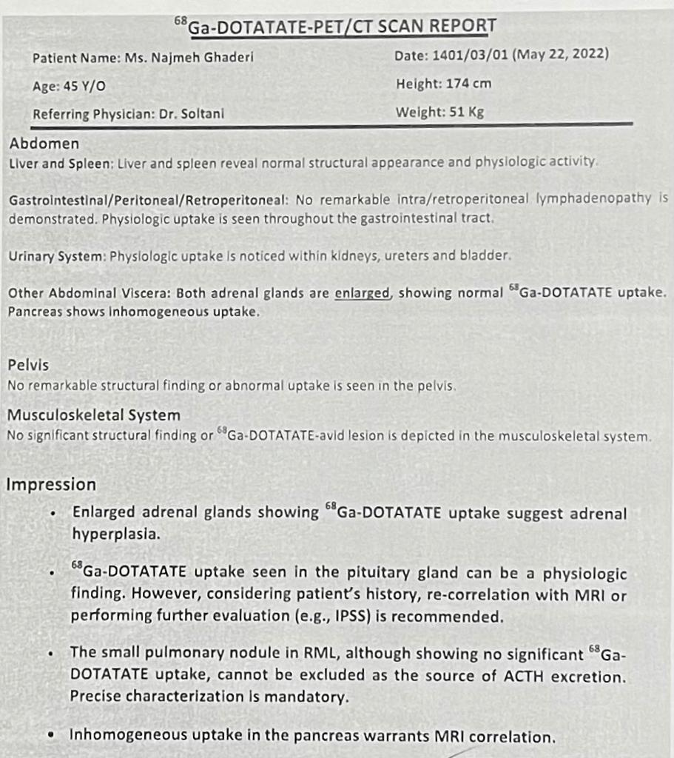

Slide 42
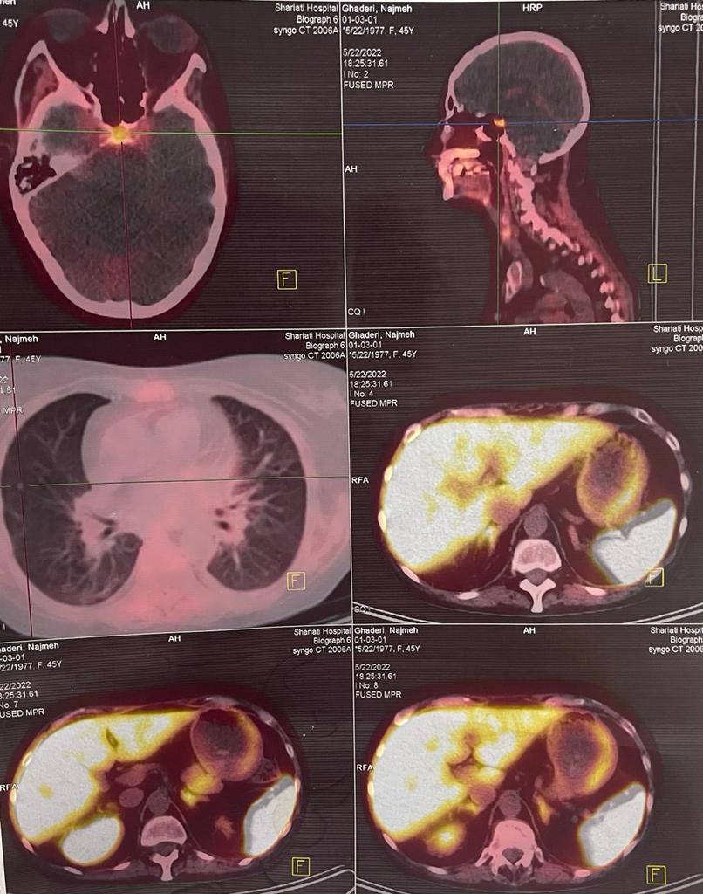

Slide 43
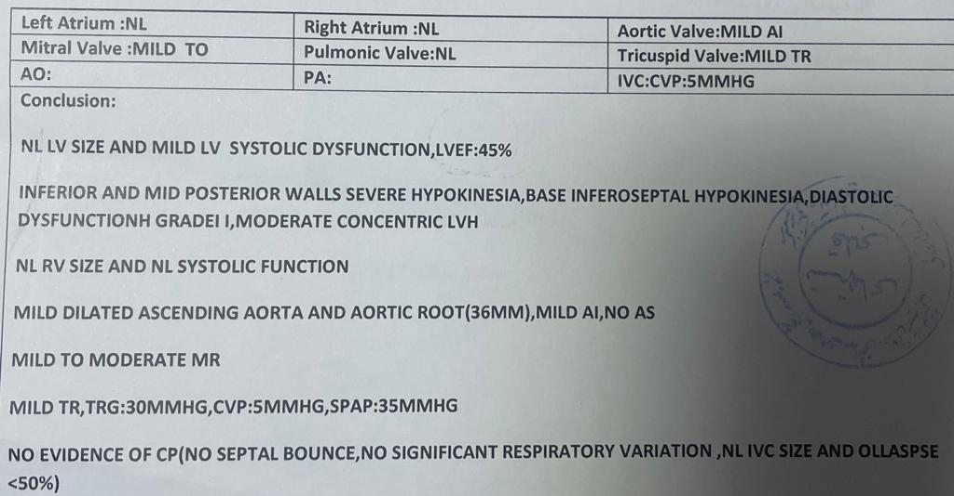
Ecocardiography

Slide 44
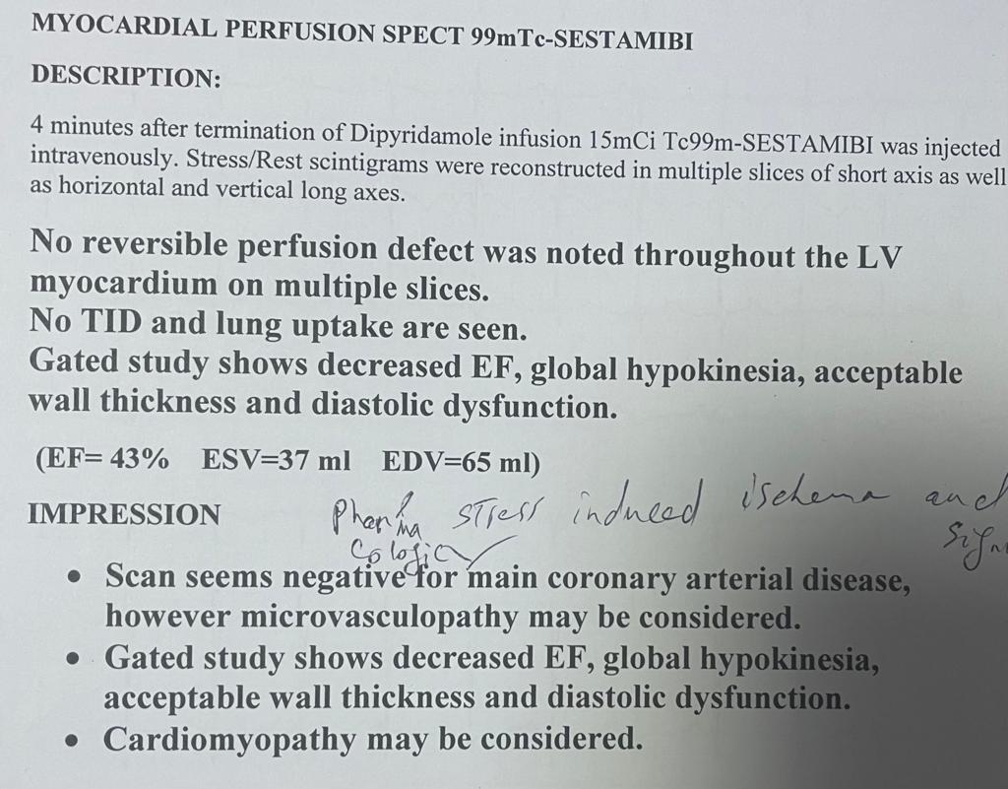

Slide 45
Sonography thyroid

Slide 46
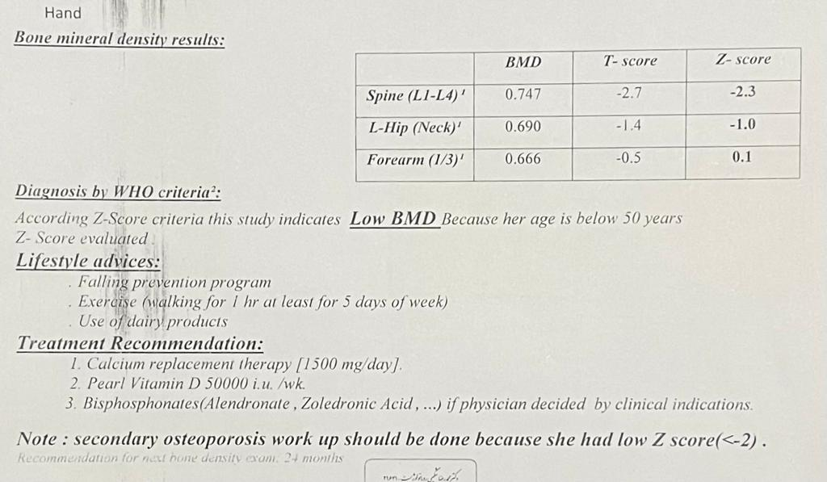
BMD

Slide 47
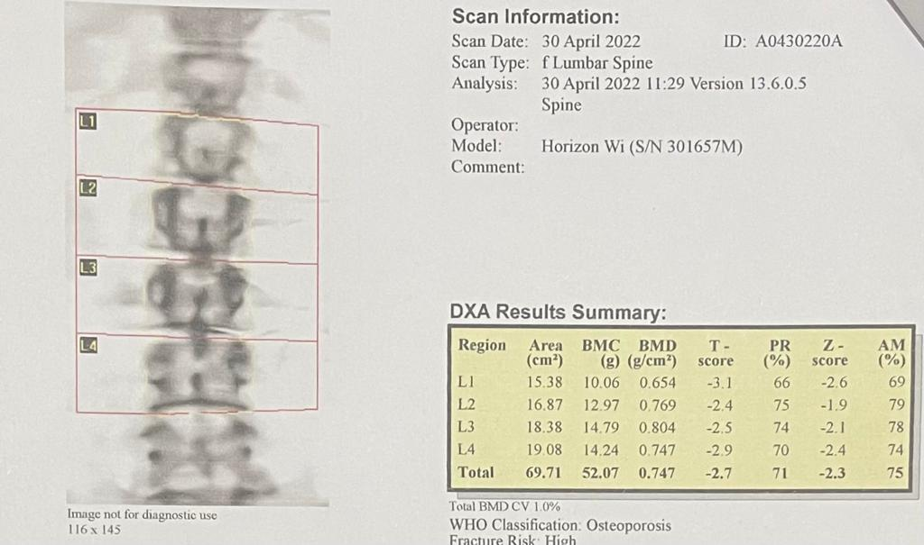

Slide 48
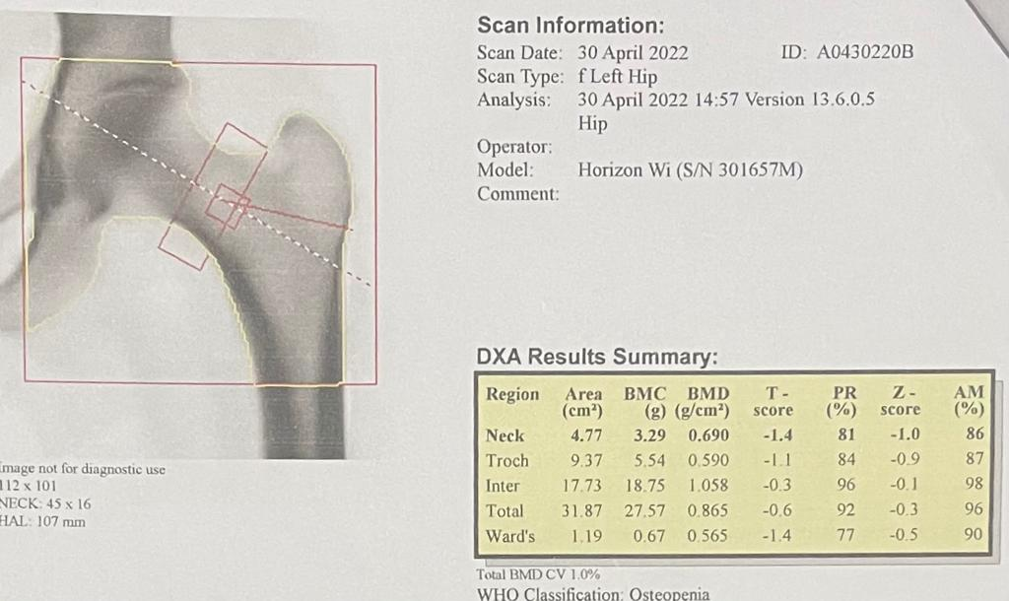

Slide 49
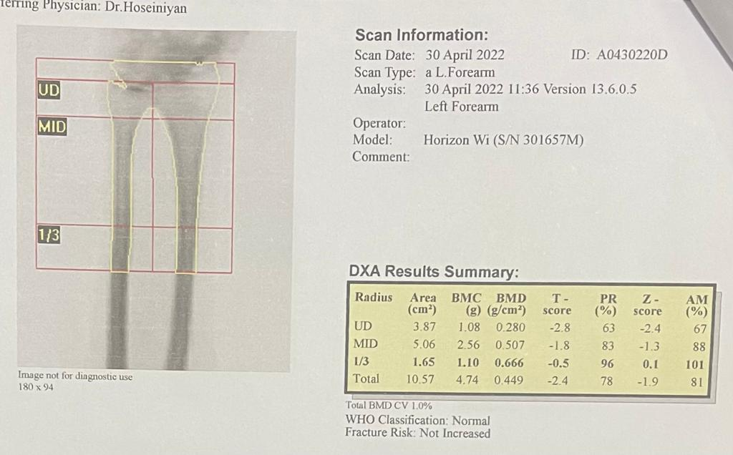

Slide 50
Problems List
A 46-year-old woman
Progressive muscle weakness
Hypokalemia and metabolic alkalosis
HDDST : Non-suppressed
Desmopressin test : No increased
Pituitary microadenoma
68-Ga DOTATATE PET/CT : Negative
Octreotide scintigraphy: NL
CT of the chest ,abdomen: 5 mm nodule in RML

Slide 51
Diagnosis
Ectopic Cushing’s syndrome

Slide 52
Uptodate2022

Slide 53
Uptodate2022

Slide 54
Conventional and Nuclear Medicine Imaging in Ectopic Cushing's Syndrome?

Slide 58
Diagnostic accuracy of combined HDDST and Desmopressin Stimulation test to differentiate Cushing's disease from ectopic Cushing ?

Slide 63
Does negative IPSS rule out Cushing's disease?

Slide 65
1.29
0.9

Slide 68
Case Presentation 3
A 30-year-old woman
with progressive weight gain, fatigue, muscle weakness, and skin changes suggestive of hypercortisolism.
UFCs : 824 and 3515 µg (0-50)
ACTHs : 80 and 102 pg/mL
cortisol of 44.8 µg/dL after 1 mg DST
MRI: NL
whole-body imaging: NL

Slide 69
Is this IPSS result consistent with ectopic ACTH syndrome?

Slide 70
No; the presence of a pituitary adenoma on the contralateral side cannot be excluded when there is only unilateral successful IPS catheterization.
She had transsphenoidal exploration, which revealed a right-sided adenoma. The tumor stained positive for ACTH on surgical pathology.

Slide 72
Is the diagnostic accuracy of desmopressin different from CRH in IPSS?

Slide 75
Could this patient's lung nodule be the source of ectopic Cushing?

Slide 76
Ectopic Cushing’s Syndrome Secondary to Pulmonary Carcinoid Tumor
The patient was a 28-year-old woman
with clinical features starting about 6 months previously
Full-body CT : a single 4 mm nodule in the inferior lobe of the right lung.
Octreotide scintigraphy with 99-m Tc : NL
PET Scan : NL
Tabriz, Iran 2012

Slide 80
Pulmonary lesions ranged in diameter from 1.1 to 4 cm

Slide 81
Can MTC cause ectopic Cushing in this patient?

Slide 83
Ectopic Cushing's syndrome (ECS) induced by medullary thyroid cancer (MTC) is rare
The development of Cushing’s syndrome (CS) in MTC patients is generally associated with advanced disease and poor prognosis.
96 cases of ECS due to MTC reported in literature
Most patients (51%) presented with metastatic disease at diagnosis and showed severe hypercortisolism.
Medullary thyroid cancer with ectopic Cushing’s syndrome: a case report and systematic review of detailed cases from the literature 2015

Slide 84
Most likely location for ectopic cushioning?

Slide 85
Thoracic , which is the main source of occult EATs
Due to lung nodules and the progression of the disease bronchial carcinoid is the most likely patient's ectopic focus.
68-Ga DOTATATE PET/CT :
better sensitivity in diagnosis of bronchial carcinoids
Low sensitivity in lesions < 1 cm
Due to a 5 mm nodule in RML : Negative imaging does not rule out bronchial carcinoid

Slide 86
What is the patient's treatment?

Slide 87
Treatment of hypercortisolism

Slide 88
Bilateral adrenalectomy :
Progressive course of the disease
Not finding the location of ectopic cushing

Slide 89
Treatment Plan
Check 8 cortisol 8 AM to check the success of the total adrenalectomy ( < 1 Mg/dl)
Treatment of osteoporosis with calcium, Alendronate and vitamin D.
Repeat Chest CT scan to check for increased lung nodule size 3-6 months later
Control of patient's glucose, Blood pressure and K (Spironolactone 100–300 mg/d).
Repeat the patient's pituitary MRI 3-6 months later to evaluate the increase in microadenoma
Physiotherapy for patient muscle weakness
Fludrocortisone 0.1 mg daily and Dexamethasone 0.5 mg daily and evaluation of the adequacy of treatment

Slide 90
Cortisol after bilateral adrenalectomy

Slide 91
Course after effective therapy
Physical symptoms and signs of Cushing's syndrome :
2 to 12 months.
Hypertension, and glucose intolerance:
Improve but may not disappear.
Osteoporosis:
6 months to 2 years but may not normalize

Slide 93
Thank you for your attention

Slide 96
The Prolactin normalized ACTH IPS/ Peripheral ratios were all >08 in patients with proven Cushing’s disease, whereas they were all <0.6 in proven ectopic ACTH syndrome
0.90
0.99
0.97
0.95
0.93
proven Cushing’s disease

Slide 97
Clinical presentation

Slide 98
Ectopic ACTH secretion :
Depends on the characteristics of the tumor (differentiation and spread , age of the patient and intensity and duration of hypercortisolism
Extremely elevated UFC and plasma ACTH concentrations
Hypokalemia and Metabolic alkalosis
Rapid onset of hypercortisolism
Frank melanodermia at presentation is rare (<20% of patients with EAS) due to the rapidity of the onset of the disease
Absence of weight gain or even loss of weight

Slide 99
Complications of Cushing’s disease
Hypercoagulability
Cardiovascular disease : left ventricular hypertrophy, concentric remodeling, dilated cardio myopathy, increased intermedia thickness
Bone disease
Growth hormone deficiency : Myopathy might be partially related to growth hormone deficiency
HTN
DM
Increased risk of infection
Dysfunction of one or more pituitary axes such as central hypothyroidism,
Gonadal function impairment
Physical and psychological morbidity commonly affects quality of life
Proximal myopathy
Hypercoagulability

Slide 102
Anatomic imaging:
Chest imaging
Abdominal imaging
Neck and pelvic imaging
MANAGEMENT OF ENDOCRINE DISEASE: Cushing’s syndrome due to ectopic ACTH secretion: an expert operational opinion
2020

