Slide 1



Slide 2

Insulin Therapy in Guidelines
An Overview
F. Hadaegh
Prevention of Metabolic Disorders Research Center,
Research Institute for Endocrine Sciences,
Shahid Beheshti University of Medical Sciences
August 2017
Tehran

Slide 3
Glycemic Control for Patients With Type 2 Diabetes Mellitus Our Evolving Faith in the Face of Evidence
(Circ Cardiovasc Qual Outcomes. 2016;9:504-512) René Rodríguez-Gutiérrez et al

Slide 4
Glycemic Control for Patients With Type 2 Diabetes Mellitus Our Evolving Faith in the Face of Evidence
(Circ Cardiovasc Qual Outcomes. 2016;9:504-512) René Rodríguez-Gutiérrez et al

Slide 5
Glycemic Control for Patients With Type 2 Diabetes Mellitus Our Evolving Faith in the Face of Evidence
(Circ Cardiovasc Qual Outcomes. 2016;9:504-512) René Rodríguez-Gutiérrez et al
cardiovascular
disease-specific mortality (RR, 1.11; 95% [CI], 0.86–1.43)
or all-cause mortality (RR, 1.04;
95% CI, 0.91–1.19), calling into question the reliability
and significance of the reduced risk in nonfatal MIs.3

Slide 6
Kasia J. Lipska, MD, MHS
JAMA Published online January 26, 2017
the improvement in cardiovascular mortality
in both of these trials emerged far earlier than expected
(within the first 3 months for empagliflozin and 6 months
for liraglutide) given the natural history of the progression
of atherosclerosis attributable to hyperglycemia
there was
only a modest reduction in HbA1c of 0.4

Slide 7
Kasia J. Lipska, MD, MHS
JAMA Published online January 26, 2017

Slide 8

Implications for Design of Trials
The FDA does not require post marketing studies to ensure that drugs used for the treatment of T2D do not increase (and instead hopefully reduce) microvascular events.
In fact, the FDA advises that drugs that lower HbA1c levels can be “reasonably expected to reduce the long-term risk of microvascular complications” and, therefore, “reliance on HbA1c remains an acceptable primary efficacy endpoint for approval of drugs seeking an indication to treat hyperglycemia secondary to T2D.
Kasia J. Lipska, MD, MHS
JAMA Published online January 26, 2017

Slide 9
Any drug that lowers glucose levels may not predictably reduce the risk of microvascularcomplications
Empagliflozin reduced the risk of several kidney outcomes despite minimal differences in glycemic control between study groups.
Semaglutide also improved nephropathy end points, but increased the risk of retinopathy
In the ongoing Canagliflozin CardiovascularAssessment Study(CANVAS) clinical trial the independent data monitoring committee identified an increased risk of leg and foot amputations associated with canagliflozin use, which is currently under investigation.
Kasia J. Lipska, MD, MHS
JAMA Published online January 26, 2017

Slide 10
Kasia J. Lipska, MD, MHS
JAMA Published online January 26, 2017

Slide 11
Makam AN, Nguyen OK
Circulation. 2017 Jan 10;135(2):180-195.

Slide 12
1.Absolute estimates of benefit: What are the absolute (and not relative) benefits of a particular therapy for patient-centered outcomes?
2. Time horizon to benefit: How long must a patient be on a particular therapy to reap the potential benefit in comparison with their current life expectancy?
3. Balance of benefits versus harms: Do the potential absolute benefits outweigh the potential harms of therapy for the specific patient under consideration?
4. Shared decision making: Is the decision to treat consistent with the patient’s values and preferences?
Makam AN, Nguyen OK
Circulation. 2017 Jan 10;135(2):180-195.

Slide 13
if the risk of myocardial infarction for those prescribed drug X is only 1% and the risk in the placebo group is only 1.5%, the RR remains a deceptively impressive impressive 0.67 (1/1.5) ;
But the ARR is now only 0.5%, and the NNT is 200 (1/0.5), indicating a minimally effective therapy.
Thus, reports of the RR or RRR do not provide physicians any information on the magnitude of treatment benefit.
ARR and NNT provide limited information to guide treatment decisions beyond the duration reported in clinical studies.
Makam AN, Nguyen OK
Circulation. 2017 Jan 10;135(2):180-195.

Slide 14
What Are the Estimated Benefits of Intensive
Glycemic Control in Type 2 Diabetes?
Large Relative Benefits in Preventing (Mostly Surrogate) Outcomes
Makam AN, Nguyen OK
Circulation. 2017 Jan 10;135(2):180-195.

Slide 15
HbA1C :(6.4% -7.0 ) VS. (7.9% and 8.4%)
In the landmark UKPDS trial, the relative benefits of 10 years of intensive glycemic control for individuals with newly diagnosed diabetes were only demonstrated for intermediate markers of microvascular complications ;
but not for actual meaningful clinical manifestations of microvascular
disease (ie, vision loss, symptomatic neuropathy, amputation,
or end-stage renal disease requiring dialysis).
Other trials have similarly failed to show improvement in these more clinically meaningful end points.
Makam AN, Nguyen OK
Circulation. 2017 Jan 10;135(2):180-195.

Slide 16
Makam AN, Nguyen OK
Circulation. 2017 Jan 10;135(2):180-195.

Slide 17
The potential for intensive glycemic control to prevent more meaningful microvascular
outcomes (ie, vision loss or ESRD requiring dialysis) is estimated to take ≥2 decades to manifest.
Even with an additional 10 years of follow-up in the UKPDS trial (for a total of 25 years), improvements in these end points have not yet been reported.
Consequently, a pragmatic approach to avoiding
the harms of overtreatment would be to defer intensive glycemic control in individuals with a life expectancy that is clearly <9 years.
Makam AN, Nguyen OK
Circulation. 2017 Jan 10;135(2):180-195.

Slide 18
Makam AN, Nguyen OK
Circulation. 2017 Jan 10;135(2):180-195.

Slide 19
Makam AN, Nguyen OK
Circulation. 2017 Jan 10;
135(2):180-195.

Slide 20
We should abandon the notion that HbA1c levels ≤7% are well controlled and levels > 7% are uncontrolled.
This arbitrary dichotomy does not adequately portray whether we are optimizing the benefits of treatment, quality of life, and value for individuals, because most people with diabetes in the uncontrolled range (ie, HbA1c >7%) are nonetheless asymptomatic
Achieving tight glycemic control does not meaningfully reduce cardiovascular complications.
An EBM approach would consist of treating to achieve adequate glycemic control to prevent symptomatic disease (eg,polyuria, polydipsia), followed by further consideration of more intensive treatment if a clinical assessment suggests that the potential absolute benefits outweigh the harms, as with any other cardiovascular risk factor
Makam AN, Nguyen OK
Circulation. 2017 Jan 10;135(2):180-195.

Slide 21
This assessment would encompass a thorough understanding of the patient’s risks, prognosis (ie, age, comorbidities, and functional status), and socio-personal context (eg, lifestyle, social support, workload capacity), as well as engaging with the patient to elicit perceived or experienced treatment burden, and values and preferences for care.
it is imperative for physicians to remember that the fundamental goal is to help individuals who have diabetes make the best therapeutic decision to improve their overall health and quality of life, not to prevent diabetes-related complications by any means possible.
Makam AN, Nguyen OK
Circulation. 2017 Jan 10;135(2):180-195.

Slide 22
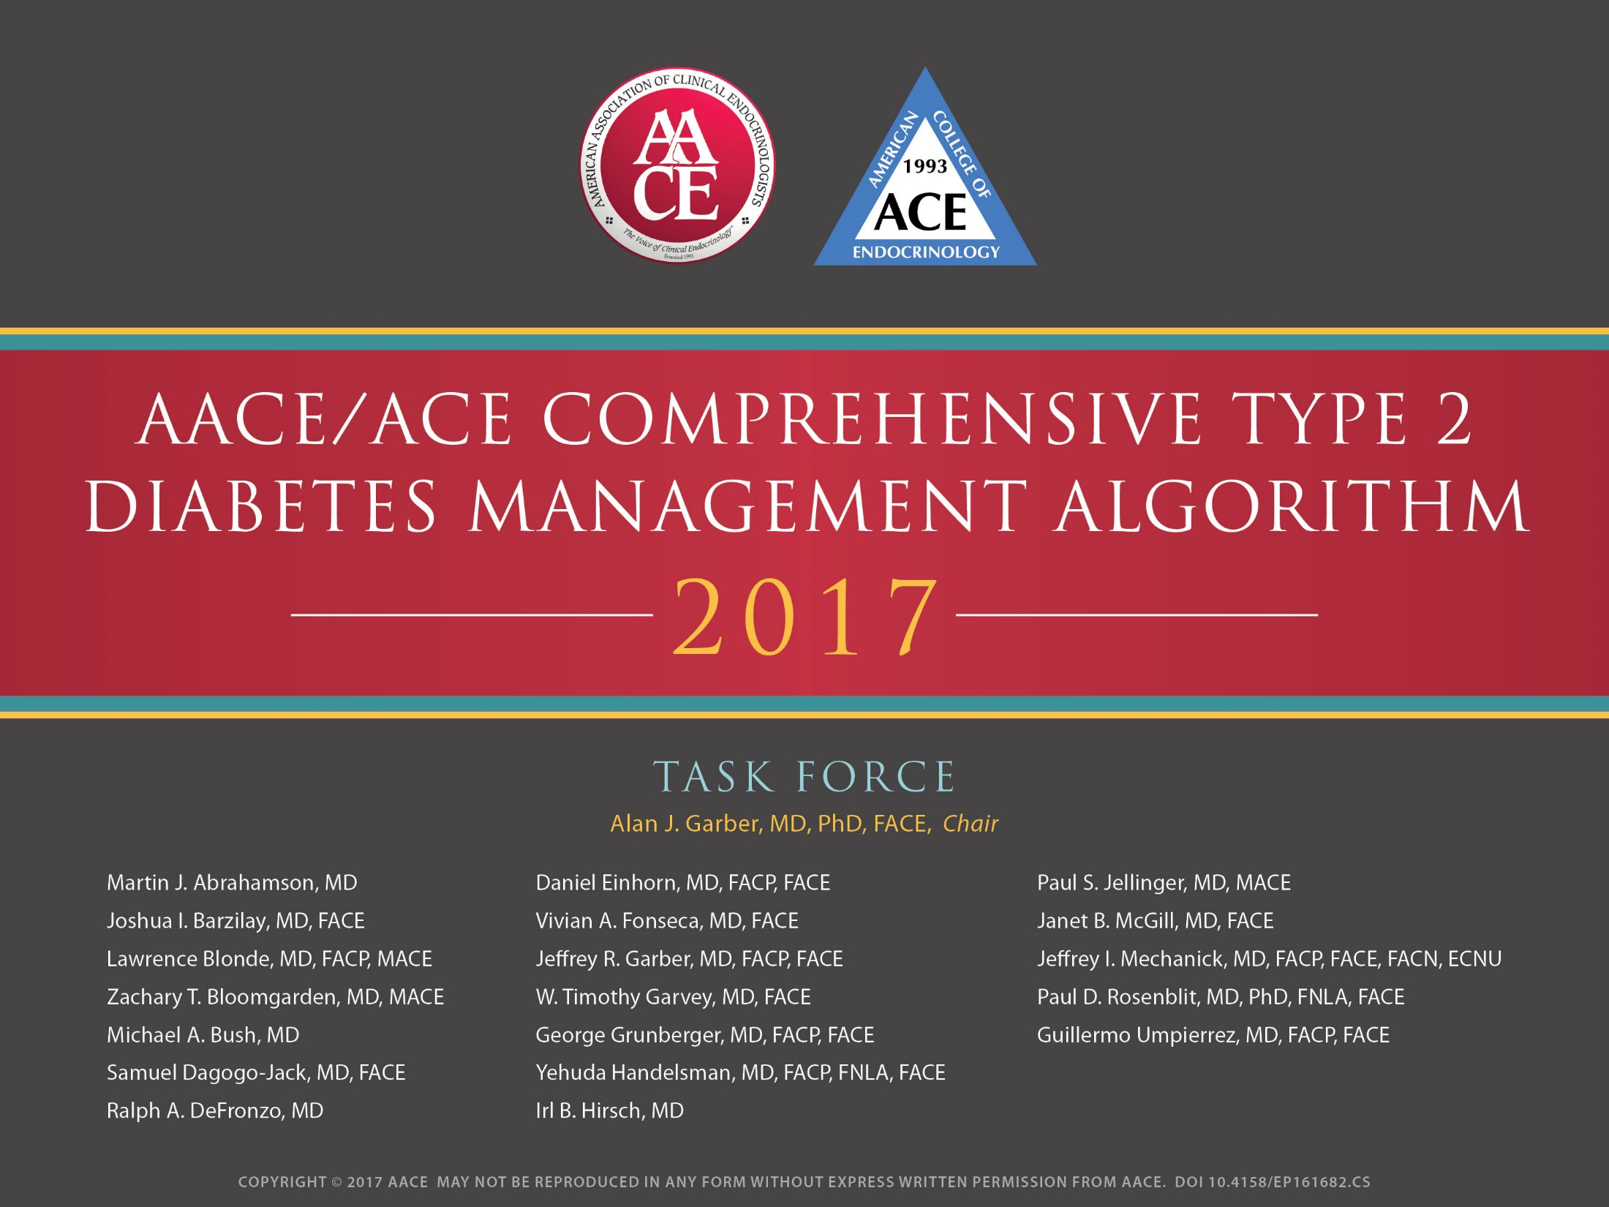

Slide 23
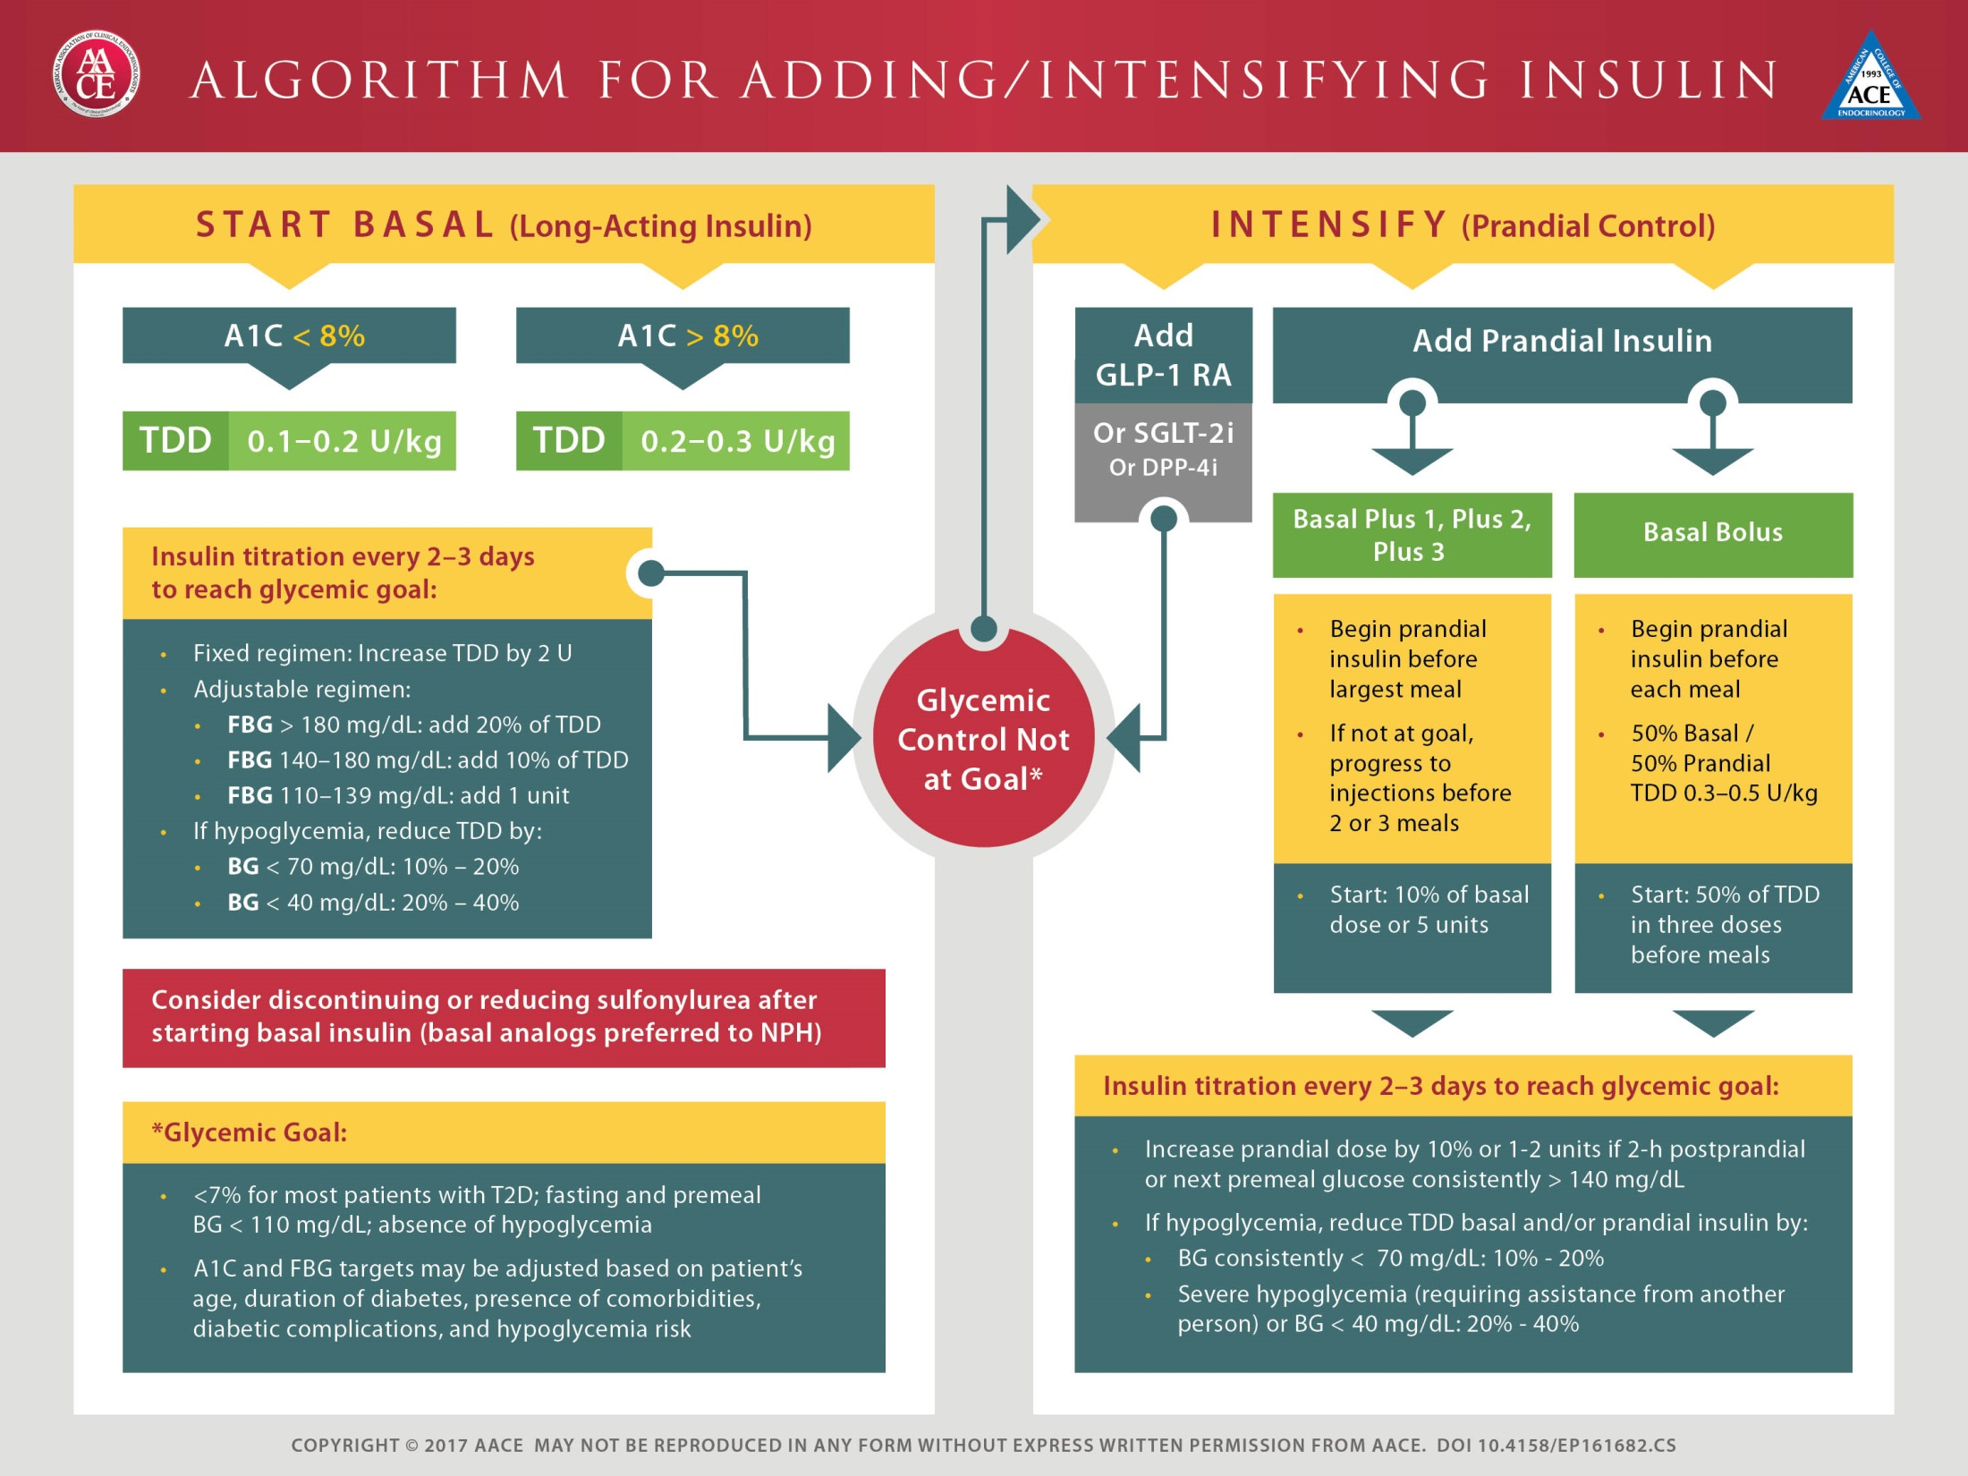

Slide 25
Max:0.5 IU/kg

Slide 27
At the end of 24 weeks, the two approaches
were shown to be clinically equivalent.
Over 32 weeks, participants initiated with the stepwise plan had a similar A1C with significantly lower
hypoglycemia and better patient satisfaction compared to the group who initiated three bolus injections per day.

Slide 29
Over-basalization occurs when the basal dose is increased, but glycemic targets are not achieved

Slide 31
Key Message
Our analyses suggest that there is no clinically relevant difference in the efficacy of basal-bolus versus premixed insulin regimens for HbA1c decrease in type 2 diabetic patients who intensified their insulin therapy.

Slide 32
ADA 2017

Slide 33
ADA 2017

Slide 34
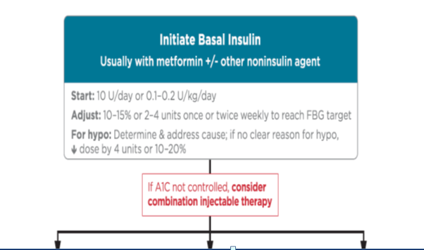

Slide 35
Consider different proportions in Mixed Insulin (75/25, 50/50)
Changing to Human Insulin ???

Slide 36
Fixed combinations of GLP-1 receptor agonists with long-acting insulin,
Compared with insulin alone, these products such as insulin Degludec +Liraglutide (Xultophy )or insulin Glargine +lixisenatide (Soliqua 100/33 )are associated with less hypoglycaemia and weight gain, as well as reduced insulin doses.
Findings from head-to-head studies of basal insulin and GLP-1 receptor agonist combinations indicated that the drugs are as effective as basal bolus insulin regimens, possibly because GLP-1 receptor agonists reduce postprandial glucose excursions.
Type 2 Diabetes
Sudensa Chat terjee, Kamlesh Khunti, Melanie J Davies
www.thelancet Vol389 June3, 3017

Slide 37
J Diabetes Investig. 2017 May
we analyzed data of a cohort of Japanese patients with diabetes from a large-scale single-center registry to investigate the association between different methods of insulin therapy in real-life clinical settings and subsequent changes in glycemic control in patients with type 2 diabetes.

Slide 41
Challenges in optimisation and maintenance of glycaemic control
Major difficulties in optimising glucose-lowering therapies are clinical inertia and treatment non-adherence.
Clinical inertia is the reluctance of health-care professionals to initiate and titrate therapy appropriately to reach glycaemic targets and is associated with :
1-lack of knowledge,
2- Fear of adverse effects such as hypoglycaemia,
3-and a perception that patients will not accept treatment intensification,

Slide 42
Challenges in optimisation and maintenance of glycaemic control
Treatment non-adherence places considerable financial burden on health-care economies with billions of US$ wasted on medication that is prescribed but not consumed.
Patients can get help to adhere to treatment through structured education and self-management programmes, which have been shown to improve personal responsibility and should be emphasised for all medications, including anti-hypertensive and lipid-lowering therapies

Slide 44
Take Home Message
Different recommendations in different guidelines, in part, can be explained by various contextual variables
In our country with limited resources, we need to develop a new national evidence based guideline
Considering difficulties in guideline development, and as an easier task, customizing existing guidelines seems to be more practical

Slide 45
Take Home Message
Clinicians should discuss treatment options with patients using a shared decision-making approach that considers
individual health status,
Resources,
Life context;
Tools are available to support this process
evidence-based medicine approach can be used to individualize glycemic goals and prevent OVERTREATMENT,

Slide 46

Thanks for your patience,
dear colleagues!

Slide 47
Case Studies

Slide 48
Mrs. M. 52 year old housewife with T2DM from 10 years ago,
admitted for control of diabetes.
She has inactive life but obey diet under observation of a dietician.
Clinical history:
PMH:
HTN form 5 years ago
FH:DM +
DH :
Tab. Metformin 2000 mg /D
Tab. Gliclazide 80 mg/BD
GI intolerance to Liraglutide
Tab. ASA 80 mg /D
Tab. Atorvastatin 10 mg /D
Tab. Valsartan 80 mg/ BD

Slide 49
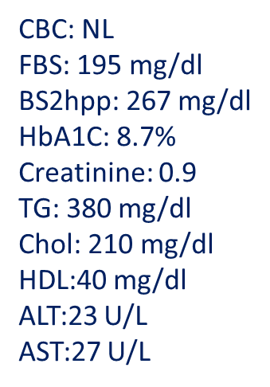
Ph/Ex: no End organ damage
BMI: 26 kg/m2
SMBG
SBP:130
DBP:75mmHg
FBS | BS2hB | BS2hL | BS2hD
190 | 248 | 260 | 248
213 | 247 | 257 | 269
Lab data:

Slide 50
Recommendation
↑ Metformin 3000 mg/D & Gliclazide 320 mg/D
Adding Sitagliptin 100 mg/D
Adding Pioglitazone 30 mg/D
Adding basal Insulin 12 U/D
5) Starting basal/prandial Insulin Analogues

Slide 51
Which of the following insulins has the longest duration of action?
1- Insulin degludec
2- insulin detemir
3- Insulin glargine 100
4- Insulin premix

Slide 52
Which of the following insulins has the longest duration of action?
1- Insulin degludec
2- insulin detemir
3- Insulin glargine 100
4- Insulin premix

Slide 53
Precipitation after injection is specific for which of the following insulins ?
1- Insulin degludec
2- insulin detemir
3- Insulin glargine
4- Insulin NPH

Slide 54
Precipitation after injection is specific for which of the following insulins ?
1- Insulin degludec
2- insulin detemir
3- Insulin glargine
4- Insulin NPH

Slide 55


در مطالعه UKPDS چند درصد افراد بعد از 6 سال از شروع تشخیص دیابت به درمان با انسولین نیاز داشتند ؟
1) 30
2) 40
3) 50
4) 60
در مطالعه A 1 chieve میزان Hb A1c در هنگام شروع انسولین در بیماران ایرانی چه میزانی بود ؟
1) 7/6
2) 8/6
3) 9/6
4) 10/6

Slide 56
Case Discussion
A 64-year-old man with 12-year history of T2DM is referred to you. He is taking metformin 2000 mg and injects glargine insulin 32 U at 9 pm daily. In the past few months, his fasting glucose levels have ranged from 110-140 mg/dl. He suffers from a mild background retinopathy. He fears from hypoglycemia and doesn’t follow a regular dietary pattern. He has no financial problems.
BMI: 35 kg/m², HbA1c: 8.2%, Cr: 0.8 mg/dl.
  In addition to lifestyle modification, which therapeutic approach would you recommend to him?
  Add one rapid acting insulin before the largest meal
  Titrate insulin glargine
  a glucagon like peptide 1 agonist (Victoza)
  ChaAdd nge glargine insulin to twice daily premixed insulin

Slide 57
Case Discussion
A 57-year-old woman with 10-year history of T2DM is referred to you. She is taking metformin 2000 mg and gliclazide MR 160 mg daily. She complains of increased hypoglycemic episodes over 3 past months. She has history of coronary artery disease.
BMI: 32 kg/m², HbA1c: 9.1 %, Cr: 0.7 mg/dl, no albuminuria.
  In addition to lifestyle modification, which therapeutic approach would you recommend to her?
  Discontinue gliclazide and change metformin to sitagliptin/metformin 50/1000 mg daily
  Discontinue gliclazide, initiate basal insulin and change metformin to sitagliptin/metformin 50/1000 mg daily
  Add a glucagon like peptide 1 agonist (Victoza)
  Add pioglitazone 30 mg daily

Slide 58
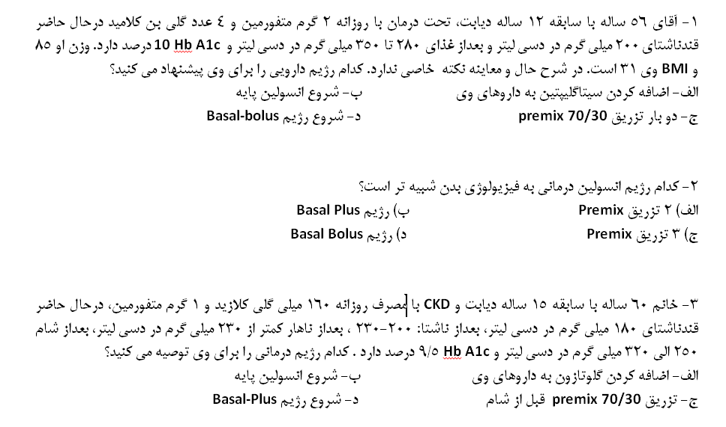




Slide 59
Case Discussion (1)

Slide 60

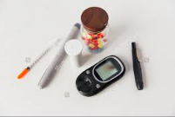
CASE 1
1st visit: 95/11/23
Mr. M. Ch., a 70-year-old man with T2DM for 20 years came to my office.
He complained of fluctuation in blood sugars and repeated hypoglycemic episode and inability to lose weight. He admitted to a few dietary indiscretions, such as having multiple servings of dessert when going out with retired friends. For exercise, he has been walking only 10 minutes a day.
Social History:
The patient had worked as a successful traditional dealer till 5 years ago, now has very little activity in that field and rather retired. He is married and lives with his wife and one son, an engineer.
He does not smoke, no drink.
Clinical history:
T2DM: 20 years duration
IHD (Stent): 7 years ago
Thyroid surgery (Goiter)
Kidney surgery
HTN
Retinopathy: Bilateral NPDR

Slide 61

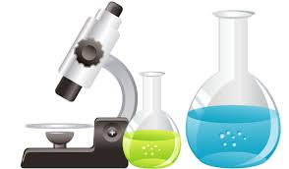


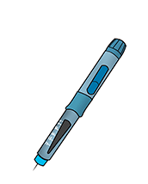
CASE 1: 1st visit (23/11/95)
Physical Examination
Lab Data
A1C = 6.7%
Creatinine = 1.2 mg/dL
eGFR= 61 mL/min/1.73 m²
FPG= 125 mg/dL
2hpp= 197 mg/dL
Total Chol= 128 mg/dL
HDL= 27 mg/dL
LDL= 75 mg/dL
TG= 115 mg/dL
ALT= 16 U/L
Alk Ph= 152
Hb= 13.2
Plt= 280000
WBC=5100
BMI:30.7 kg/m²
Weight: 92 kg
Height: 173 cm
SBP: 140 mmHg
DBP: 70 mmHg
PR: 68/min
On exam, the lungs are clear to auscultation, the heart has a regular rate and rhythm without murmurs, and the abdomen is non-tender.
Peripheral pulses are normal, and there is no lower extremity edema. The foot exam shows normal mono-filament test and no skin or toe nail lesions
Medication
Novomix 20-10-20 (TID)
Metformin 500 (TDS)
Atorvastatin 20 mg/d
Losartan 50 mg BID
Atenolol 50 mg/d
ASA 80 mg/HS
LT4 400 µg/w

Slide 62
CASE 1: SMBG chart, 1st visit (23/11/95)
رژیم درمانی | غیره | 3 نیمه شب | 2 ساعت پس از شام | قبل از شام | 2 ساعت پس از ناهار | قبل از ناهلر | 2 ساعت پس از صبحانه | ناشتا
Metformin 500 (TDS) Novomix 20-10-20 (TID) |  |  |  |  |  | 92 |  | 120 | شنبه
 |  |  |  |  | 240 |  |  | 68 | یکشنبه
 |  |  |  |  |  |  | 54 |  | دوشنبه
 |  |  |  |  |  |  |  | 144 | سه شنبه
 |  |  |  |  |  |  |  |  | چهارشنبه
 |  |  | 61 |  |  |  |  |  | پنجشنبه
 |  |  |  |  |  | 256 |  | 200 | جمعه

Slide 63
Case1:
Which of the following is the most appropriate next step in management?
Switch to basal plus/bolus regimen
Switch to basal + GLP1-RA regimen
Adjustment of current Novomix doses
Using Novomix twice daily (BID) with adjusted doses
Others

Slide 64
Final decision (23/11/95)
After complete discussion on all available options to treating him better, we agreed on the followings:
Novomix was stopped
Lantus started, 27 IU, HS
Victoza started, 0.6 mg/d
Metformin up titrated to 1000 mg BID
Atorvastatin up titrated to 40 mg
He accepted to take part in diabetes educational class and make me regularly informed about his SMBG chart by fax.

Slide 65
CASE 1: SMBG chart, 1st fax (2/12/95)
رژیم درمانی | غیره | 3 نیمه شب | 2 ساعت پس از شام | قبل از شام | 2 ساعت پس از ناهار | قبل از ناهلر | 2 ساعت پس از صبحانه | ناشتا
Metformin 1000 (BID) Latus 27 IU, HS Victoza 0.6 mg |  |  |  |  |  | 92 |  | 100 | شنبه
 |  |  |  |  | 171 |  |  | 128 | یکشنبه
 |  |  | 230 |  |  |  | 160 |  | دوشنبه
 |  |  |  | 128 |  |  |  | 96 | سه شنبه
 |  |  |  |  |  |  |  |  | چهارشنبه
 |  |  | 195 |  |  |  |  |  | پنجشنبه
 |  |  |  |  | 228 | 25 |  | 143 | جمعه

Slide 66
Plan after 1st fax
  Lantus down titrated (27 to 23 IU, HS)
  Victoza up titrated (0.6 to 1.2 mg/d)

Slide 67
CASE 1: SMBG chart, 2nd fax (11/12/95)
رژیم درمانی | غیره | 3 نیمه شب | 2 ساعت پس از شام | قبل از شام | 2 ساعت پس از ناهار | قبل از ناهلر | 2 ساعت پس از صبحانه | ناشتا
Metformin 1000 (BID) Latus 23 IU, HS Victoza 1.2 mg |  |  |  | 163 |  |  |  | 150 | شنبه
 |  |  |  |  |  |  |  | 114 | یکشنبه
 |  |  | 240 |  |  |  | 166 |  | دوشنبه
 |  |  |  |  | 196 |  |  |  | سه شنبه
 |  |  |  |  |  |  |  | 156 | چهارشنبه
 |  |  | 195 |  |  |  |  | 148 | پنجشنبه
 |  |  |  |  | 240 | 250 |  |  | جمعه

Slide 68
Plan after 2nd fax (11/12/95)
  Lantus up titrated (23 to 24 IU, HS)
  Victoza up titrated (1.2 to 1.8 mg/d)

Slide 69
CASE 1: 2nd visit (20/2/96)
Physical Examination
Lab Data
A1C = 7.2%
Creatinine = 1.2 mg/dL
eGFR= 61 mL/min/1.73 m²
FPG= 134mg/dL
Total Chol= 127mg/dL
HDL= 36mg/dL
LDL= 53mg/dL
TG= 188mg/dL
Urine Microalbumin= 17 mg/24hrs
TSH= 2.7
ALT= 28 IU/L
Alk Ph= 152
Hb= 13.2
Plt= 280000
WBC=5100
BMI:29.9 kg/m²
Weight: 89.5 kg
Height: 173 cm
SBP: 125 mmHg
DBP: 70 mmHg
PR: 72/min
Medication
Lantus 26 IU/HS
Victoza 1.8 mg/d
Metformin 500 (BID)
Atorvastatin 40 mg/d
Losartan 50 mg BID
Atenolol 50 mg/d
ASA 80 mg/HS
LT4 400 µg/w
He was quite satisfied with treatment, no hypo, no GI side effect.
had decreased MFN dose due to fear about its renal side effects.
Had appropriately increased Lantus dose to 26 IU.

Slide 70
CASE 1: SMBG chart, 2nd visit (20/2/96)
رژیم درمانی | غیره | 3 نیمه شب | 2 ساعت پس از شام | قبل از شام | 2 ساعت پس از ناهار | قبل از ناهلر | 2 ساعت پس از صبحانه | ناشتا
Metformin 500 (BID) Latus 26 IU, HS Victoza 1.8 mg |  |  |  |  | 194 |  |  | 110 | شنبه
 |  |  |  | 120 |  |  |  | 122 | یکشنبه
 |  |  | 195 |  |  |  | 160 |  | دوشنبه
 |  |  |  |  | 205 |  |  | 106 | سه شنبه
 |  |  |  |  |  |  |  |  | چهارشنبه
 |  |  |  | 134 |  |  |  |  | پنجشنبه
 |  |  |  |  |  | 140 |  | 130 | جمعه

Slide 71
Plan after 2nd visit (20/2/96)
  Metformin up titrated to 1000 mg BID
  Lantus (26 IU, HS) & Victoza (1.8 mg/d) were continued as before.
  Advised not to change the dosages by himself alone.
  More exercise was recommended.

Slide 72
CASE 1: 3rd visit (20/3/96)
Physical Examination
No new data
Lab Data
BMI:28.9 kg/m²
Weight: 86.6 kg
Height: 173 cm
SBP: 120 mmHg
DBP: 72 mmHg
PR: 70/min
He came to me earlier than planned before because was worried about possible harms induced by Victoza on his prostate and kidneys. Has stopped Victoza since 2 days ago.
Medication
Lantus 26 IU/HS
Victoza 1.8 mg/d
Metformin 1000 (BID)
Atorvastatin 40 mg/d
Losartan 50 mg BID
Atenolol 50 mg/d
ASA 80 mg/HS
LT4 400 µg/w

Slide 73
CASE 1: SMBG chart, 3rd visit (20/3/96)
رژیم درمانی | غیره | 3 نیمه شب | 2 ساعت پس از شام | قبل از شام | 2 ساعت پس از ناهار | قبل از ناهلر | 2 ساعت پس از صبحانه | ناشتا
Metformin 1000 (BID) Latus 26 IU, HS Victoza 1.8 mg |  |  |  |  | 155 |  |  | 100 | شنبه
 |  |  |  | 98 |  |  | 153 |  | یکشنبه
 |  |  |  |  |  |  |  |  | دوشنبه
 |  |  |  |  | 131 |  |  | 88 | سه شنبه
 |  |  | 149 |  |  |  |  |  | چهارشنبه
 |  |  |  |  |  | 117 |  |  | پنجشنبه
 |  |  |  |  | 194 |  |  | 92 | جمعه

Slide 74
Plan after 3rd visit (20/3/96)
  Reassurance on medication side effects
  Lantus down titrated (26 to 24 IU, HS)
  Victoza (1.8 mg/d) was started again.
  Metformin continued by 1000 mg BID

Slide 75
Summary of case 1
Novomix TID to “Lantus+ Victoza” in an old IHD case
After four months, changing the diabetes treatment from Novomix TID to Lantus+Victoza in an old patient with documented IHD, considering LEADER trial, resulted in:
  Disappearance of hypoglycemia
  No fluctuation in BGs
  Weight loss (5.5 kg)
  Less injections per day
  Patient satisfaction
  No important loss of control (HbA1c 6.7% to 7.2%)

Slide 76
Case Discussion (2)

Slide 77

CASE 2: 1st visit (2/5/92)
Medication
Novomix 24 IU (morning), 34 IU (night) [0.66 IU/kg]
Metformin 500 TDS
Atorvastatin 20 mg/d
ASA 80 mg/HS
Losartan 25 mg BID
Enalapril 5 mg BID
Mrs. M. F., A 52-year-old obese woman, with T2DM from 20 years ago, came to my office for severe paresthesia in feet. She also complained of 10 kg weight gain & some non-severe but annoying hypoglycemia episodes since she had been on insulin 4 years ago. She thought hypoglycemic episode has made her eat more than needed resulting in progressive weight gain and variation in BGs, in spite of her really eagerness to care of herself and have better control.
Social History:
She was a house wife from a rather low income family; married and had 3 children. She had planned to have walking bi-weekly, but actually that was not done regularly. No smoke, no drink.
Her family history is positive for obesity, CAD and T2DM in several relatives.

Slide 78

CASE 2: 1st visit (2/5/92)
Height= 155 cm
Weight=88 Kg
BMI=36.7
SBP: 140 mmHg
DBP: 85 mmHg
PR: 68/m
Lab data:16/04/92
A1C = 7.9 %
Creatinine = 0.9 mg/dL
eGFR= 74 mL/min/1.73 m²
FPG= 150 mg/dL
Total Chol= 145 mg/dL
HDL= 41 mg/dL
LDL= 73 mg/dL
TG= 155 mg/dL
ALT= 31 U/L
Hb= 10.8
Plt= 285000
WBC=5600
Ferritin= 5
Physical exam was unremarkable except for obesity, moderate acanthosis nigricans and loss of sensation in mono-filament test. Peripheral pulses were normal.

Slide 79
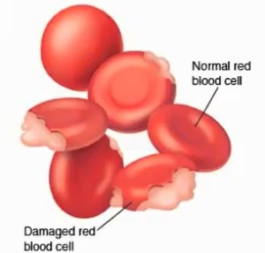
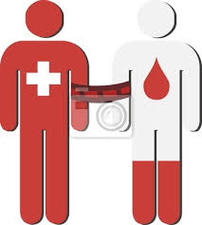
Factors that affect interpretation of HbA1C
Any condition that shorten RBC survival
- recovery from acute blood loss
- hemolytic anemia
- poorly controlled diabetes
Blood transfusion
Falsely low HbA1C regardless of assay method
M.Tohidi

Slide 80
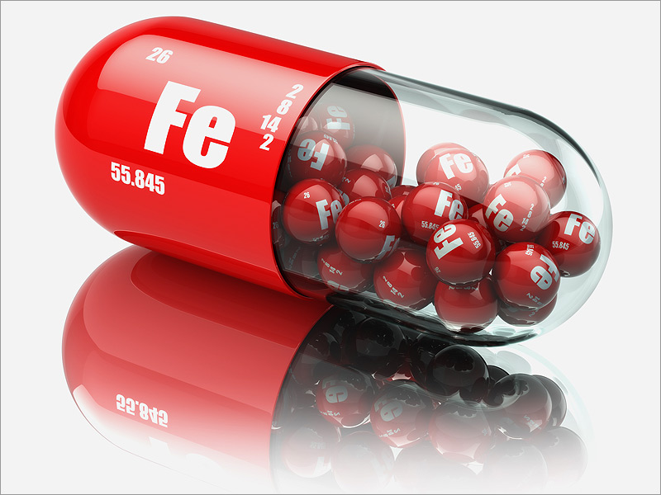
Factors that affect interpretation of HbA1C
Iron deficiency anemia
Malondialdehyde, which is increased in patients with iron deficiency anemia enhances the glycation of hemoglobin.
Elevated HbA1C but not glycated albumin in late pregnancy in non-diabetic women is related to iron deficiency.
Hashimoto K, et al.: A1C but not serum glycated albumin is elevated in late pregnancy owing to iron deficiency. Diabetes Care 2008;31:1945-8.
Higher HbA1C
M.Tohidi

Slide 81
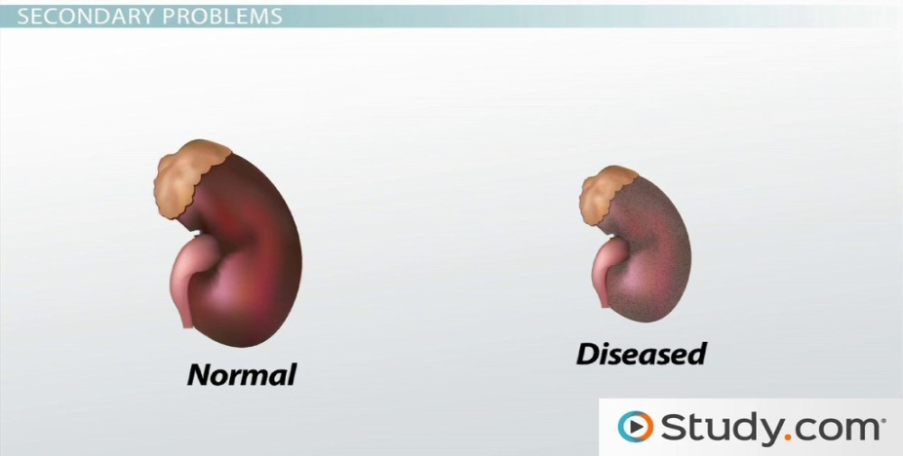
Factors that affect interpretation of HbA1C
Chronic renal failure
Interference from carbamylated Hb
Renal anemia
Erythropoetin intake
These factors make it difficult to interpret the HbA1C results in diabetic patients with chronic renal failure.
M.Tohidi

Slide 82
Case 2:
Considering the presented data, what is the proper therapeutic advise for her?
Using Novomix three times daily (TDS) with adjusted doses
Adjustment (increase) of current Novomix doses
Switch to 2-3 OADs + basal insulin regimen
Switch to basal + GLP1-RA regimen
Switch to basal plus/bolus regimen
Others

Slide 83
How we proceeded?
  We completely discussed on different options for better management & emphasized & agreed on the need for losing weight. She participated in educational classes of diabetes & really tried to follow the instruction learned there as much as she could.
  Oral Iron therapy made her feel better and she could have more physical activity.
  Metformin was up titrated to 1000 mg BID and maintained constantly after that. Gabapentin was effectively used from the first visit and she responded well.
  With full w/u, no micro or macrovascular complications of diabetes were revealed.
  Metabolic surgery was explained for her but still she has not accepted it due to different matters, mainly economic issues.
    She could not afford use of GLP-I RA.

Slide 84
Case 2: 4-years follow up chart
 |  | 1392-04-16 | 1392-08-26 | 1392-12-05 | 1393-03-25 | 1393-07-20 | 1393-11-20 | 1394-03-18 | 1394-07-12 | 1394-11-04 | 1395-02-19 | 1395-06-13 | 1395-10-23 | 1396-02-07
Novomix | morning | 20 | 18 | 14 | 15 | 10 | 9 | 7 | 3 | - | -
 | night | 30 | 28 | 24 | 25 | 22 | 20 | 20 | 16 | - | -
Lantus (IU) |  |  |  |  |  | - | - | - | - | 12 | 20 | 18 | 20 | 20
Sitagliptin (mg) |  |  |  |  |  |  |  |  |  | 100 | 50 | - | 100 | 100
HbA1c % |  | 7.9 | 6.6 | 4.6 | 5.3 | 6 | 7.5 | 6.3 | 6.2 | 6 | 5.9 | 7.4 | 6.7 | 6.4
Weight (kg) |  | 88.1 | 86.5 | 86.3 | 85.2 | 82.8 | 81.4 | 84 | 83 | 82 | 81.8 | 81.2 | 82.7 | 83

Slide 85
Summary of case 2
Four years follow up in an obese middle-aged diabetic housewife on Novomix
Gradual dose adjustment (decrement) of Novomix BID and finally switching it to “Lantus+Sitagliptin” resulted in:
  Disappearance of hypoglycemia
  Less fluctuation in BGs
  Weight loss (5 kg)
  Less injections per day (2 to 1)
  Patient satisfaction
  Stable good diabetes control (HbA1c <7% in rather all times)

Slide 86
Case Discussion (3)

Slide 87

CASE 3: 1st visit (3/2/91)
Mr. H.Z., 58-year-old, with 18 years history of T2DM came to me for the first time on 91/2/3. He said he had not been so complaint with diabetes recommendations but had decided to take care of himself better and request me to settle the treatment from the first step again. adherent quite good.
Social History:
He was a retired businessman but was active as a land developer just for satisfaction of himself and his self-confidence. Although had no economic barrier for treatment but did not prefer to pay a lot in that field!
He was married and lives with his wife. No smoke, no drink.
Medical History:
T2M: for 18 years
HLP: for > 10 years duration
Medication
Metformin 500 BID
Glibenclamide 2.5 mg, morning
Atorvastatin 10 mg/d
ASA 80 mg, PRN

Slide 88
CASE 3: 1st visit (3/2/91)
Lab data: 29/10/91
A1C = 9.4 %
Creatinine = 1.3 mg/dL
eGFR= 60 mL/min/1.73 m²
FPG= 179 mg/dL
Total Chol= 143 mg/dL
HDL= 45 mg/dL
LDL= 70 mg/dL
TG= 142 mg/dL
ALT= 17 IU/L
Hb= 14.3
Plt= 202000
WBC=6600
Infrequent SMBG showed FBSs around 180.
Height=174 cm
Weight=82.3 Kg
BMI=27.3 kg/m2
SBP:120 mmHg
DBP:80 mmHg
Heart rate:68/m
Physical exam was unremarkable except for excess weight, and dry skin with fissuring in his feet. He felt mono-filament normally and peripheral pulses were normal.

Slide 89
Case 3:
Considering the presented data, what is the proper therapeutic advise for him?
Adjustment of current therapy with 2 OADs
Adding 3rd OAD to the current therapy
Adding basal insulin to current regimen
Adding GLP1-RA to current regimen
Switch to Premix insulin regimens
Switch to basal plus/bolus regimen
Others

Slide 90
How we proceeded?
  We completely discussed on different options for better management & emphasized & agreed on the need for losing weight. He actively participated in diabetes educational classes & acceptably tried to follow the instruction learned there.
  Metformin was up titrated to 1000 mg BID and maintained constantly after that.
  He responded very well initially to sub-maximal doses of 2OADs after losing 6 kg in 3 months.
  Secondary failure to 2OADs were found after 2.5 years concurrent with gaining weight, Sitagliptin was added and worked well for a year. Due to persistent problem in controlling FPGs, Glargine was finally added to 3OADs regimen and is still working well with dose adjustment.
  During close follow up, no microvascular complications were revealed. Due to positive ETT test, he will undergo a coronary CT-angiography.

Slide 91
Case 3: five years follow up chart
Date | 1390-10-29 | 1391-2-3 | 1391-3-18 | 1391-5-15 | 1391-8-28 | 1391-11-21 | 1392-3-8 | 1392-8-4 | 1393-7-26 | 1393-10-30 | 1394-02-15 | 1394-12-08 | 1395-03-27 | 1395-08-27
MFN | 500 mg BD | 1000 mg BD | 1000 mg BD | 1000 mg BD | 1000 mg BD | 1000 mg BD | 1000 mg BD | 1000 mg BD | 1000 mg BD | 1000 mg BD | 1000 mg BD | 1000 mg BD | 1000 mg BD | 1000 mg BD
GLC | GLB ½, morning | 40 mg BID | 40 mg BID | 40 mg BID | 40 m, 80 n | 40 m, 120 n | 40 m, 120 n | 40 m, 120 n | 40 m, 120 n | 40 m, 120 n | 40 m, 120 n | 40 mg BID | MR 30 mg | MR 30 mg
Ziptin | - | - | - | - | - | - | - | - | - | 100 mg | 100 mg | 100 mg | 100 mg | 100 mg
Lantus | - | - | - | - | - | - | - | - | - | - | -- | 12 | 20 | 25
HbA1c |  | 9.4 | 7.3 | 6.8 | 7.5 |  | 6.8 | 6.6 | 7.4 |  | 6.8 | 7 | 6.8 | 7.4
Weight |  | 82.3 | 76 | 76 | 73.7 | 71.6 | 75 | 78 |  | 83 | 80.5 | 81 | 82.6 | 83.5

Slide 92
Summary of case 3
Stepwise intensification with OADs, then “basal insulin” was added
    The presented case is a real usual case of T2DM. It shows the effect of weight loss and education together with changes in life style.
    We may follow him in a 5 years journey to see the usual natural history of diabetes treatment, from gradual increase in OADs use, facing secondary failure to each steps, then adding basal insulin to OADs as a simple outpatient measure.

