Slide 1
Dr.khyamzadeh

Slide 2
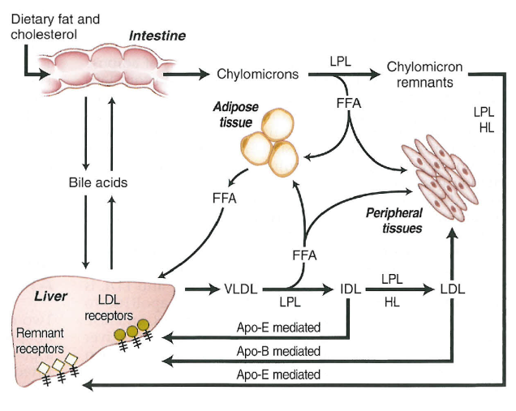

Slide 3
In fasting conditions, TG is predominantly carried in VLDL particles and their remnants, with chylomicrons absent from the plasma of a normolipidemic individual after a 14hour fast. In the postprandial state, TG is additionally carried in chylomicrons and their remnants.

Slide 4
At a certain point that varies from individual to individual (when plasma TG rises to> 500 to 1000 mg/dL) chylomicrons will also begin to accumulate in fasting plasma.
HTG has generally been classified as ‘primary’ when a definite familial or inherited basis is suspected, while ‘secondary’ HTG refers to cases where there coexist one or more identifiable secondary conditions such as metabolic syndrome, T2D, alcohol consumption, various medications, renal insufficiency and pregnancy,etc.

Slide 5
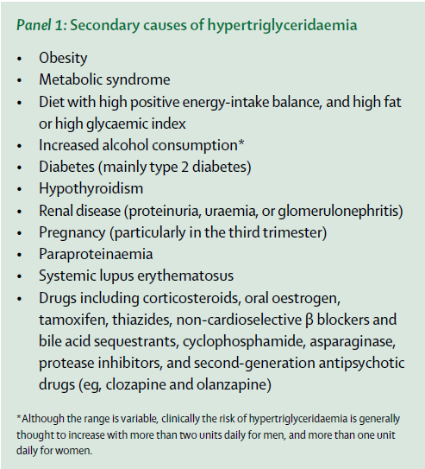

Slide 6
monogenic HTG is caused by mutations in genes that encode proteins needed for the efficient metabolism of TRL, including
LPL
APOC2
APOA5
LMF1
GPIHBP1

Slide 8
familial chylomicronemia syndrome
Patients with this syndrome have plasma triglyceride levels ranging from 10 to 100 times the normal value (1500 to 15,000 mg per deciliter [17 to 170 mmol per liter]), the plasma to have a milky ("lactescent" or "lipemic") appearance.
eruptive xanthomas
Arthralgias
neurologic symptoms
lipemia retinalis
hepatosplenomegaly

Slide 9
Plasma lipid concentrations become altered within the hormonal milieu of pregnancy, but these rarely have clinical consequences . A rare exception is pregnancy related
hypertriglyceridemia (HTG), whose complications,namely acute pancreatitis, hyperviscosity syndrome,and possibly preeclampsia,are life threatening
but likely preventable with timely intervention.

Slide 10
Plasma triglyceride (TG) concentration normally increases 2- to 4-fold in uncomplicated late gestation,but for most women with normal baseline TG levels and no compromise in metabolic pathways, such increases are well tolerated.
However, in rare instances, sometimes associated with genomic alterations that affect key metabolic entities,pregnant women can develop HTG, defined as plasmaTG above the 95th percentile for age.

Slide 11
In particular, the very rare subgroup of pregnant women that develops severe HTG, defined as plasma TG greater than 11.4 mmol/liter(1000 mg/dl), show an increased risk of acute complications and are at risk of expressing hyperlipidemia in the future.

Slide 12
Given that anecdotal observational data are the only source for recommendations of rare conditions such as gestational HTG, we must rely on case reports and experience to recommend management principles.

Slide 13
Low-fat diet
Dietary counseling remains the foundation of the multidisciplinary approach. A very low-fat diet, defined by dietary fat below 20% of caloric intake, is the current mainstay of clinical management of severe hypertriglyceridemia in both the pregnant and nonpregnant states.

Slide 14
Hospital admission may be required for initiation and/or maintenance of the stringent diet.Aconsequence of adherence to such dietary restrictions can be weight loss, which has known associated risks such as low birth weight, prematurity, and maternal complications.

Slide 15
Intravenous dextrose (iv administration of 5% dextrose in 0.45% sodium chloride solution was initiated and continued for 2 to 4 d, until plasma TG levels fell by at least half) or total parenteral nutrition (TPN) has been used to maintain caloric balance in a controlled manner, and these interventions have been associated with reductions in plasma TG concentration in the context of severe gestational HTG.

Slide 16
Nutritional fat supplements
oral administration of medium chain TG (MCT) or omega-3-acid ethyl esters has become an integral part of management. MCT, unlike long chain TG, are transported via the portal circulation directly to the liver for rapid oxidation,avoiding incorporation into chylomicrons and uptake into adipose tissue.

Slide 17
omega-3-acid ethyl esters may directly stimulate LPL, enhancing removal of TG-rich
lipoproteins.Clinically, omega-3 fatty acids have been reported to reduce serum TG by 25 to 30% .
Adverse pregnancy outcome from exposure to both MCT and omega-3 ethyl esters appears unlikely.

Slide 18
Fibrat
fibrates appear to effectively reduce plasma TG concentrations, but their efficacy can be modulated by particular genotypes; for instance, carriers of apoE2 may have a better than predicted response, whereas individuals with complete LPL deficiency may have an attenuated response

Slide 19
Niacin-based preparations
pharmacological doses of niacin are required (2 to 3 g/d), and the effects of such high pharmacological doses of niacin on pregnancy have not been studied.one of the cases received niacin 500 mg four times daily in addition to fenofibrate, with no reported adverse effects. However, despite aggressive pharmaceutical management, this patient did progress to developing pancreatitis and required a cesarean section at 29.

Slide 20
Heparin
Heparin was used as part of the management plan in one case in the absence of thromboembolic disease. In that case, heparin may have contributed to the subsequent elevation in TG concentrations at 37 wk gestation. Although there are theoretical reasons to consider parenteral heparin—for instance, its ability to liberate LPL from the endothelium —the effects are transient, with depletion of LPL with chronic use.

Slide 21
There is also evidence of the development of secondary paradoxical HTG.When iv unfractionated heparin was used to manage a pulmonary embolism in a patient with pregnancy-associated HTG, plasmaTG concentration dropped initially but returned to previous levels after a few days of continuous heparin infusion.Given the questionable efficacy, and its associated risks, heparin cannot be recommended as part of the treatment of severe HTG in pregnancy.

Slide 22
Insulin
Insulin is required for proper functioning of LPL in lipolysis of TG-rich lipoproteins.Dramatic and immediate reduction of TG in patients with risk of HTG induced pancreatitis has been shown using a single dose of sc regular insulin (0.1 U/kg) in the context of associated poorly controlled hyperglycemia.However, in the
absence of hyperglycemia, we cannot recommend insulin to correct severe pregnancy-associated HTG.

Slide 23
Therapeutic plasma exchange
TPE has been described in case reports as a treatment of gestational HTG-induced pancreatitis,but safety and utility have not been thoroughly assessed.in one of the cases TPE used in the prevention of pancreatitis in gestational HTG, suggesting that aggressive TPE can be used safely to prevent pancreatitis and achieve a full-term birth.However, experience with nonpregnant patients with severe HTG suggests that the effects of TPE are very transient in the absence of efforts to control other aspects of pathophysiology, including fat restriction.

Slide 24
A newer development is targeted gene therapy, using alipogene tiparvovec, which is an adenoviral-mediated gene therapy that contains thehumanLPLp.S447X “gainof-
function” variant and is administered im, provides hope for future therapeutic options for this rare, but serious genetic condition.

