Slide 2
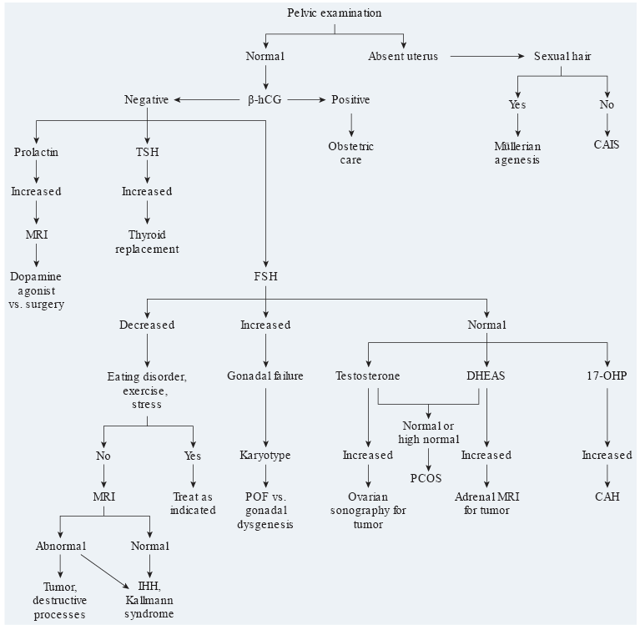
Williams GYNECOLOGY 3 EDITION 2016

Slide 3
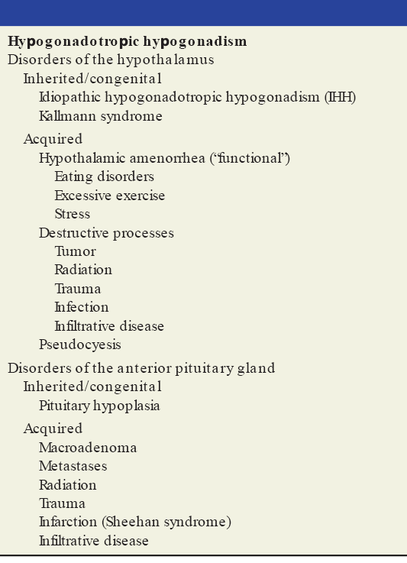

Slide 4
DDx of Sellar Lesions:
Congenital
Neoplastic
Vascular
Inflammatory/Infectious

Slide 5
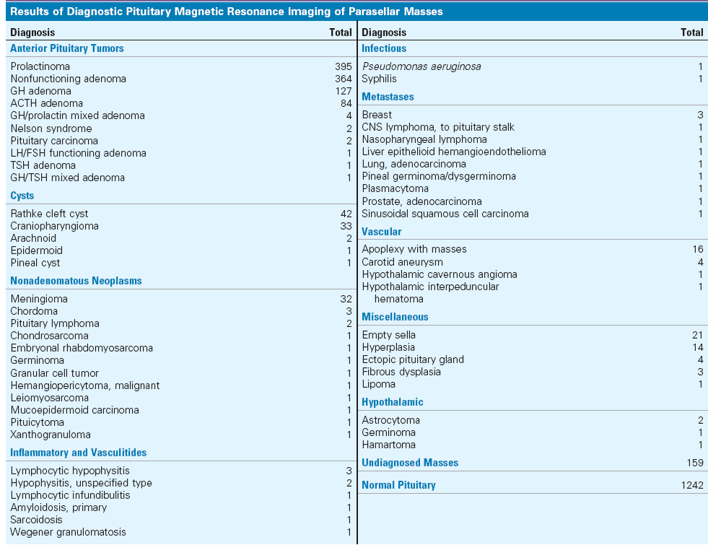

Slide 6
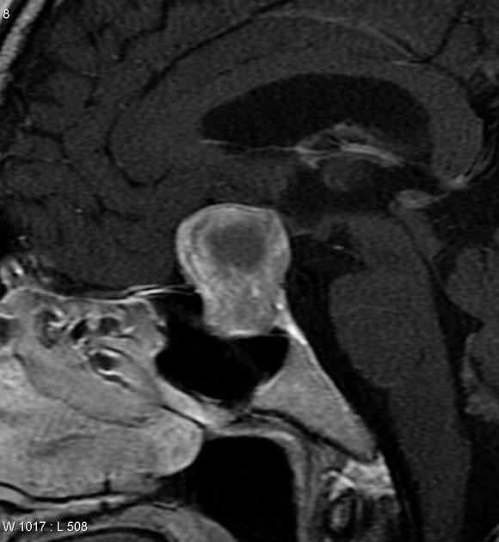
Nonfunctional pituitary macroadenoma with cystic change
>> Population prevalence is approximately 0.1%
>> They account for approximately 30-50% of all pituitary region masses
>> On MRI, they are isointense to the grey matter both on T1 and T2-weighted images. However attenuation and signal characteristics can significantly vary depending on tumor components such as hemorrhage, cystic transformation or necrosis
>> usually present as a solid tumor with an attenuation similar to brain and demonstrates moderate contrast enhancement
A large mostly solid enhancing mass enlarging the pituitary fossa and extending into the suprasellar cistern, elevating and compressing the optic chiasm. Central areas demonstrate cystic change
Pisaneschi M, Kapoor G. Imaging the sella and parasellar region. Neuroimaging Clin. N. Am. 2005;15 (1): 203-19.

Slide 7
Nonfunctional pituitary macroadenoma with cystic change
>> Usually extending superiorly. Indentation at the diaphragma sellae can give a snowman or figure eight configuration
MRI
MRI is the preferred imaging modality
T1
typically isointense to grey matter
larger lesions are often heterogeneous and vary in signal due to areas of cystic change/necrosis/ hemorrhage
T1 C+ (Gd)
solid components demonstrate moderate to bright enhancement
T2
typically isointense to grey matter
larger lesions are often heterogeneous and vary in signal due to areas of cystic change/necrosis/ hemorrhage
T2* gradient echo
most sensitive for detecting any hemorrhagic components, which appear as areas of signal loss
calcification is rare, but should be excluded by reviewing CT scans
Pisaneschi M, Kapoor G. Imaging the sella and parasellar region. Neuroimaging Clin. N. Am. 2005;15 (1): 203-19.

Slide 8
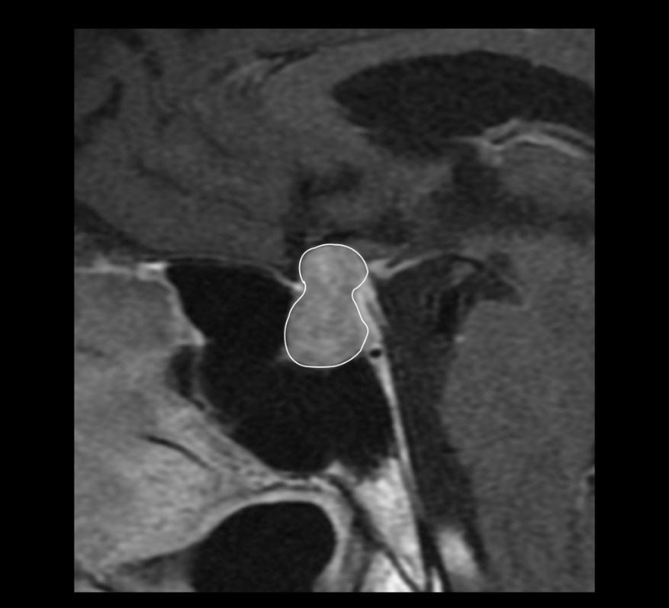
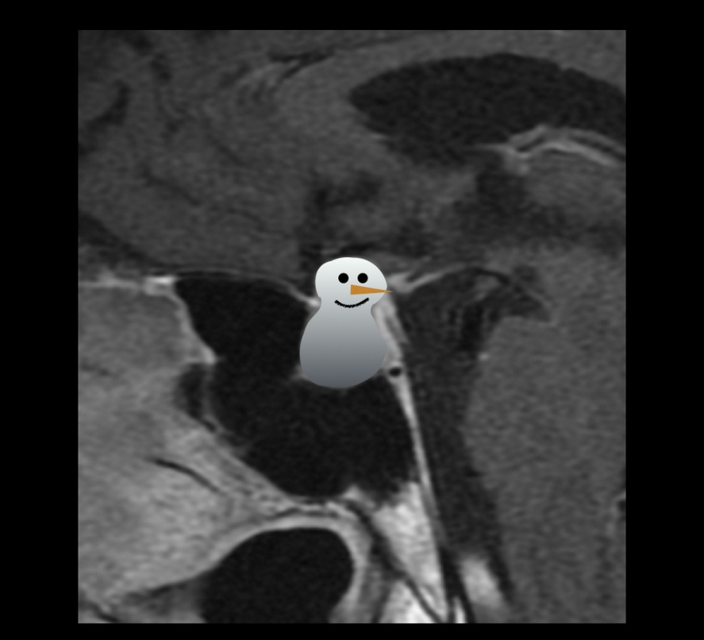
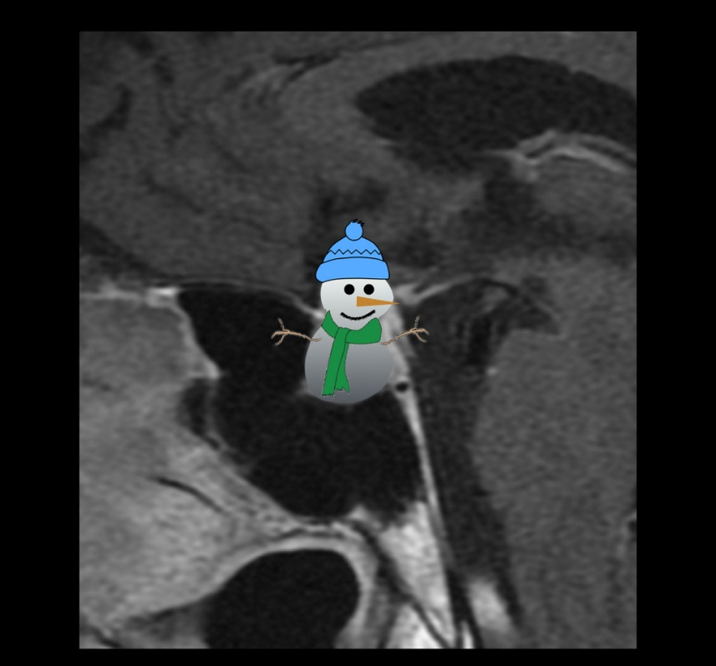
Nonfunctional pituitary macroadenoma with cystic change
Snowman appearance
>> Necrotic macroadenoma usually lead to Sellar enlargement and the walls of the tumor show distinct contrast uptake . A fluid level may be present in some cases.

Slide 9
Rathke's cleft cyst
pars intermedia cysts
>> Nonneoplastic, sellar or suprasellar epithelium-lined cysts arising from the embryologic remnants of Rathke's pouch
>> RCCs are common and are found in ~15% (range 11-22%) of autopsies.
>> Although the underlying substrate is congenital, they appear to enlarge during life, as they are rare in childhood
>> Female to male ratio of approximately 2:1
Clinical presentation
The vast majority of RCCs are asymptomatic and are incidentally found when the pituitary is imaged for other reasons.
If large, they may cause:
visual disturbances: due to compression of the optic chiasm
pituitary dysfunction
headaches
Sumida M, Uozumi T, Mukada K et-al. Rathke cleft cysts: correlation of enhanced MR and surgical findings. AJNR Am J Neuroradiol. 1994;15 (3): 525-32
Swearingen B, Biller BM. Diagnosis and management of pituitary disorders. Humana Pr Inc. (2008) ISBN:1588299228

Slide 10
Rathke's cleft cyst
MRI
The signal characteristics vary according to the cyst composition, which may be mucoid or serous.
T1
50% are hyperintense (high protein content)
50% are hypointense
T2
70% are hyperintense
30% are iso or hypointense
T1 C+ (Gd)
no contrast enhancement of the cyst is seen; however, a thin enhancing rim of surrounding compressed pituitary tissue may be apparent ⁹⁻¹⁰
>> In ~75% of cases, a small non-enhancing intracystic nodule can be identified which is virtually pathognomonic of a Rathke's cleft cyst. When seen, it is hyperintense to surrounding fluid on T1 and hypointense on T2. Depending on the signal of the surrounding fluid, it may be inapparent on one sequence or the other.

Slide 11
Rathke's cleft cyst
Differential diagnosis
The main differential diagnoses are:
craniopharyngioma
no gender difference
similar age group
usually suprasellar or have a suprasellar component
tend to calcify
cystic pituitary adenoma
arachnoid cyst
older patients
no gender difference
epidermoid cyst
usually suprasellar
restriction on DWI
teratoma
usually has solid components
often fatty signal

Slide 12
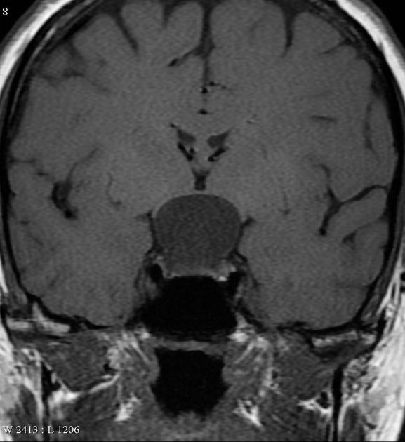
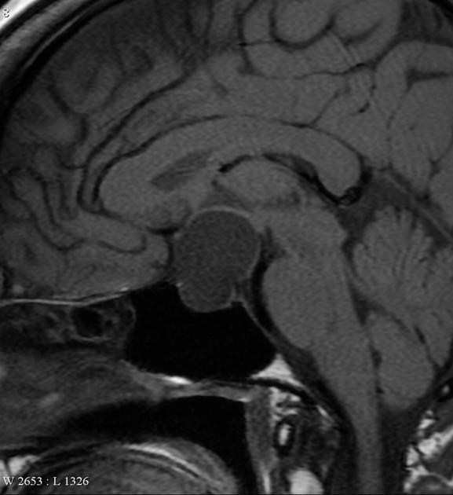
Rathke's cleft cyst
There is a large sellar and predominantly suprasellar cyst characterized by thin walls and homogeneous
content similar to the CSF signal

Slide 13
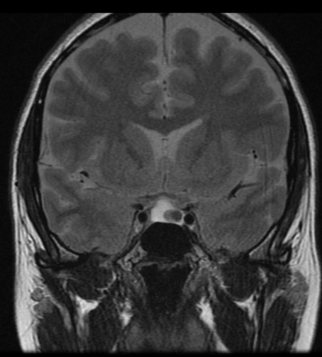
Rathke's cleft cyst
A well-defined T2 hyperintense intra and suprasellar cystic mass is identified.
On T2 coronal imaging this demonstrates a 7 mm hypointense intracystic nodule which is mildly T1 hyperintense. Normally enhancing pituitary gland is draped over the anterior right aspect of the cyst with mild elevation and deviation of the infundibulum to the right of midline.
The apex of the cyst contacts without displacing the optic chiasm and proximal aspects of the pre-chiasmatic optic nerves. There is no extension into the cavernous sinuses and the cavernous carotid flow voids are maintained.
Conclusion
The imaging features are essentially pathognomonic of a Rathke's cleft cyst.

Slide 14
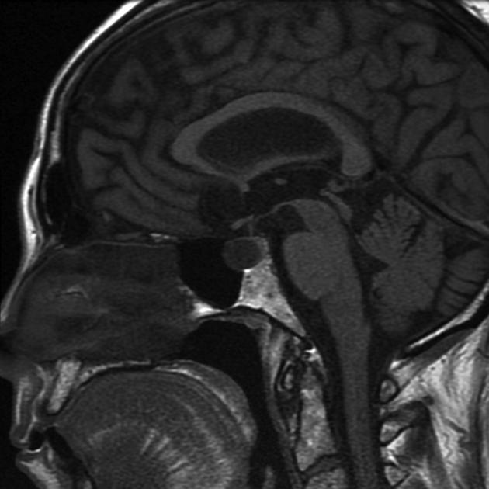
Rathke's cleft cyst
A 1.5cm lesion within the mid and anterior portion of sella displaces otherwise normal appearing pituitary tissue posteriorly.
The infundibulum lies in the midline.
The mass does not extend beyond the diaphragma, and causes no optic chiasm or optic nerve compression.

Slide 15
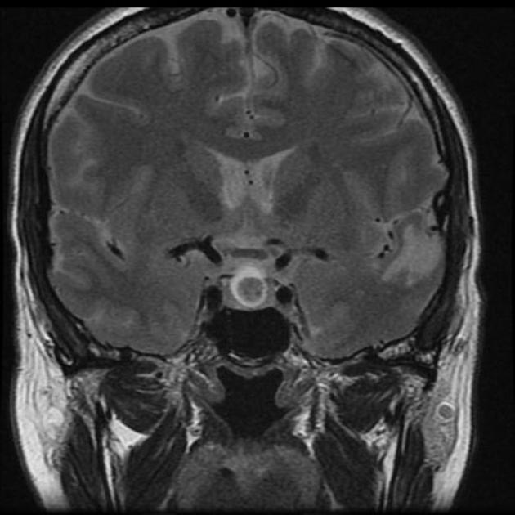
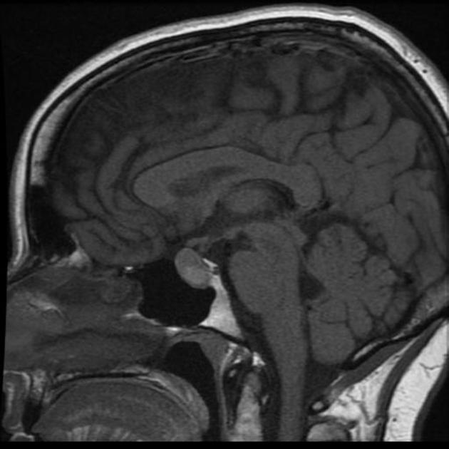
Rathke's cleft cyst
AGE: 55
GENDER: Female
Stable over 5 years
A cystic lesion mostly fills the pituitary fossa and bulges into the suprasellar cistern and not compressing or distorting the optic chiasm.
A nodule posteroinferiorly within the cyst, which does not enhance.

Slide 16
Craniopharyngioma
>> Craniopharyngiomas are relatively benign neoplasms that typically arise in the sellar/suprasellar region.
>> They account for ~1-5% of primary brain tumors, and can occur anywhere along the infundibulum (from the floor of the third ventricle, to the pituitary gland).
>> Two pathological types (difference in appearances, prognosis and epidemiology)
adamantinomatous (pediatric): ~90 %
papillary (adult): ~10 %
Adamantinomatous
There may be single or multiple cysts filled with thick oily fluid high in protein, blood products, and/or cholesterol,
Papillary
The papillary subtype is seen almost exclusively in adults and is formed of masses of metaplastic squamous cells and the tumor is more solid. Calcification is uncommon or even rare
Bernstein M. Neuro-oncology, the essentials. Thieme. (2007) ISBN:1588904970

Slide 17
Craniopharyngioma
Location
suprasellar (95%)
both the suprasellar and intrasellar spaces (75%)
purely suprasellar (20%)
purely intrasellar location is quite uncommon (<5%)
Clinical presentation
headaches and raised ICP
visual symptoms
20% of children
80% adults
hormonal imbalances
short stature and delayed puberty in children
decreased libido
amenorrhea
diabetes insipidus
behavioral change due to frontal or temporal extension

Slide 18
Craniopharyngioma
Adamantinomatous
Typically have a lobulated contour as a result of usually multiple cystic lesions. Solid components are present, but often form a relatively minor part of the mass, and enhance vividly on both CT and MRI. Overall, calcification is very common.
MRI
cysts
T1: iso- to hyperintense to brain (due to high protein content "machinery oil cysts")
T2: variable but ~80% are mostly or partly T2 hyperintense
solid component
T1 C+ (Gd): vivid enhancement
T2: variable or mixed
calcification
difficult to appreciate on conventional imaging
susceptible sequences may better demonstrate calcification

Slide 19
Craniopharyngioma
Papillary
>> Papillary craniopharyngiomas tend to be more spherical in outline and usually lack the prominent cystic component
>> Most are either solid or contain a few smaller cysts. Calcification is uncommon
>> These tumors tend to displace adjacent structures.
MRI
cysts
when present they are variable in signal
T1: 85% T1 hypointense ⁴
solid component
T1: iso- to slightly hypointense to brain
T1 C+: vivid enhancement
T2: variable/mixed

Slide 20
Craniopharyngioma
Differential diagnosis
Rathke cleft cyst
no solid or enhancing component
calcification is rare
unilobular
the majority are completely or mostly intrasellar
pituitary macroadenoma (with cystic degeneration or necrosis)
can look very similar
usually has intrasellar epicentre with pituitary fossa enlargement rather than suprasellar epicentre
despite occasional presence of T1 bright cystic regions, calcification in these cases is often absent (whereas most adamantinomatous craniopharyngiomas are calcified)
intracranial teratoma
presence of fat is helpful, but requires fat saturated sequences or CT to confirm

Slide 21
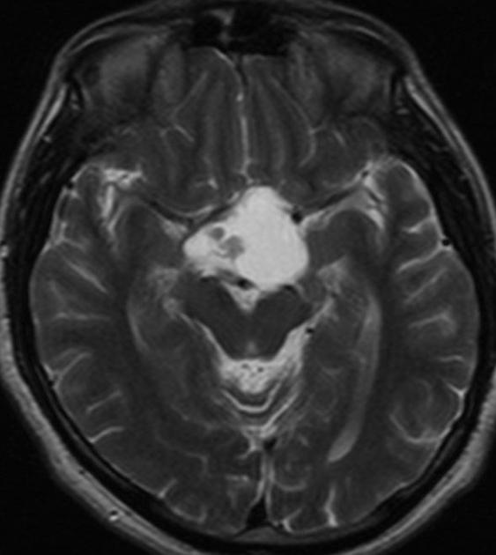
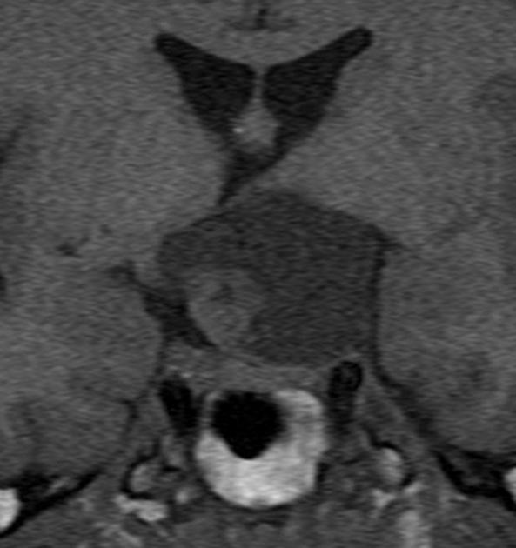
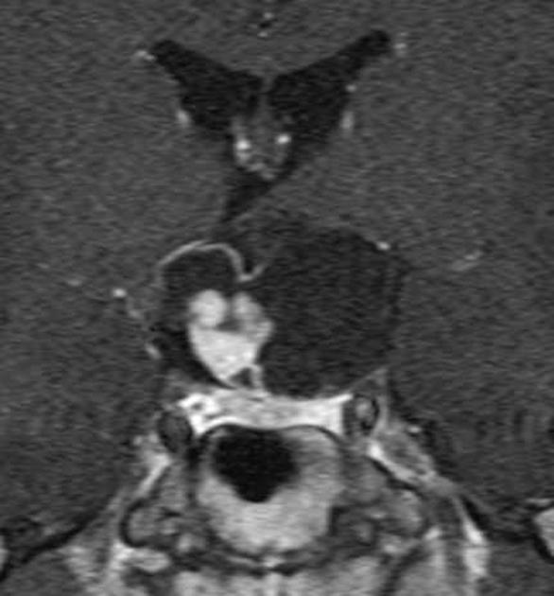
Craniopharyngioma
Adamantinomatous
MRI demonstrates a large, predominantly cystic, suprasellar mass with enhancing nodules and rim enhancement.

Slide 22
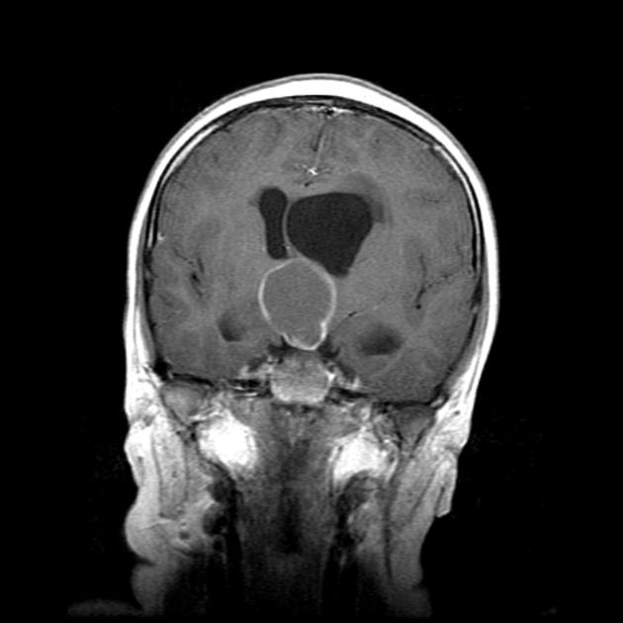
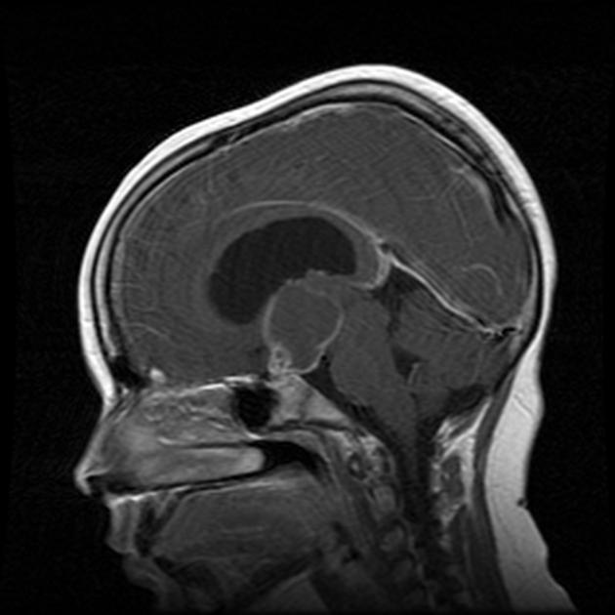
Craniopharyngioma
Craniopharyngioma (adamantinomatous)
Headaches since 4 wks mainly in the evenings and during the night, no visual disturbances.
AGE: 11 years
GENDER: Female
Brain cor T1 contrast In the suprasellar region a nodular mass is seen with ring enhancement. At the lower pole of the tumour a complex enhancing solid component is demonstrated, located straight above the pituitary gland
Brain sagittal T1 with contrast In the suprasellar area a nodular mass is seen with ring enhancement. At the lower pole of the tumour a complex enhancing solid component is demonstrated, located straight above the pituitary gland

Slide 23
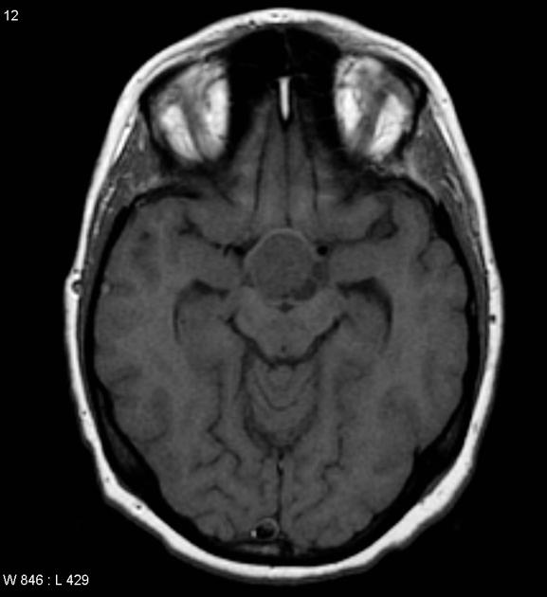
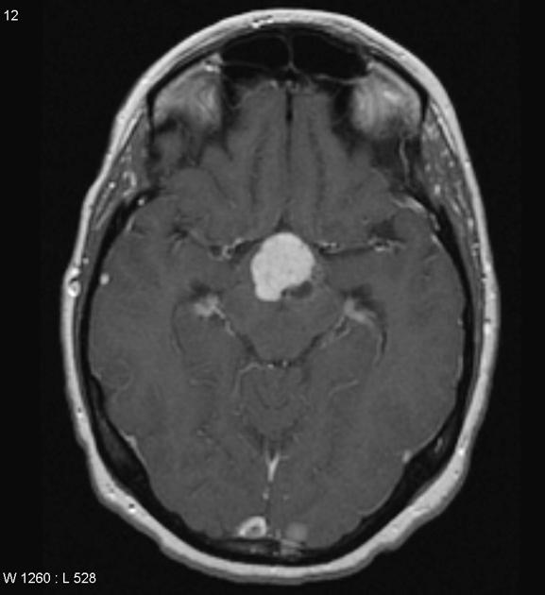
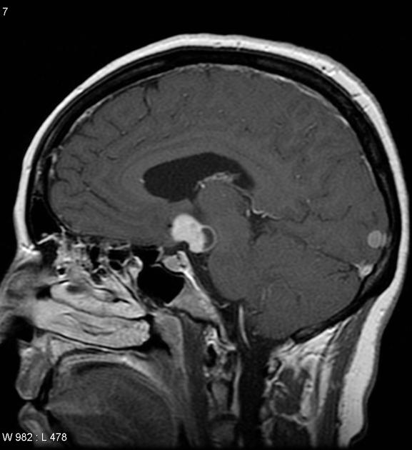
Craniopharyngioma
Craniopharyngioma (papillary)
MRI of the brain demonstrates a predominantly solid enhancing suprasellar mass with a small cystic component posteriorly, towards the left, which demonstrates no T1 hyperintensity.

Slide 24
Arachnoid cyst
>> Arachnoid cysts are relatively common benign and asymptomatic lesions occurring in association with the central nervous system, both within the intracranial compartment (most common) as well as within the spinal canal.
>> On imaging, they are characterized as well circumscribed cysts, with an imperceptible wall, displacing adjacent structures, and following the CSF pattern (hypodense on CT and hyperintense on T2 with FLAIR suppression on MRI).
>> They can also have a remodeling effect on the adjacent bone.
Clinical presentation
The majority of arachnoid cysts are small and asymptomatic.
When symptoms occur, they are usually the result of gradual enlargement resulting in mass effect.
Location
most frequently (50-60%) located in the middle cranial fossa
suprasellar cistern (suprasellar arachnoid cyst)
within the ventricles

Slide 25
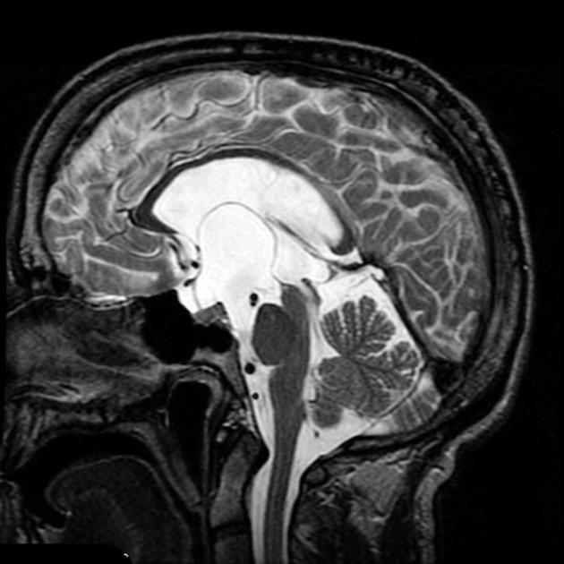
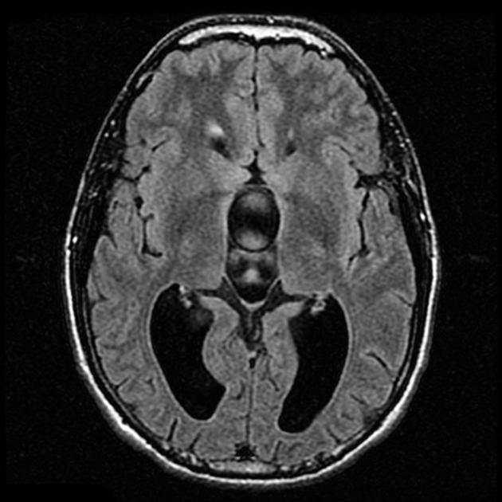
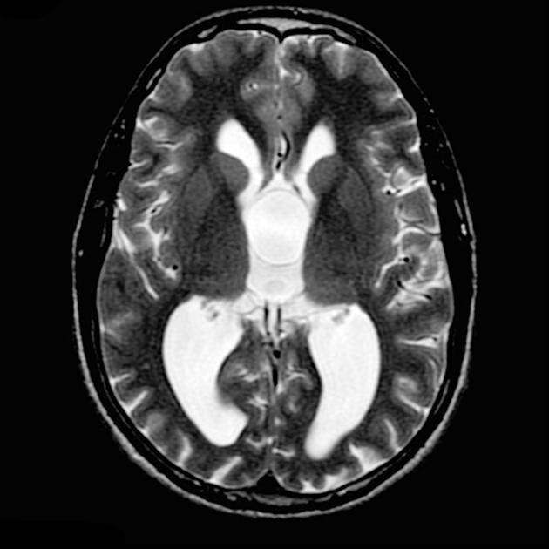
Arachnoid cyst
MRI
As they are filled with CSF it is not surprising that they follow CSF on all sequences, including FLAIR and DWI.
As their wall is very thin it only occasionally can be seen, and displacement of surrounding structures implies their presence. As there is no solid component, no enhancement can be identified.
MRI demonstrates a CSF intensity space distorting the optic chiasm and pituitary infundibulum (pushing them forwards and upwards). A thin membrane can be seen (best of sagittal and axial T2 weighted images) invaginating upwards into the third ventricle, splaying the septum pellucidum and even bulging into the left foramen of Munro. The lateral ventricles are dilated, in keeping with obstructive hydrocephalus, clearly long standing (note large size and lack of transependymal oedema).

Slide 26
Empty sella
An empty sella, also known as an empty pituitary fossa, a pituitary fossa which is largely empty of tissue, replaced by CSF. Although some authors use the term for normal sized fossae with little pituitary tissue, most would reserve the term for cases where the fossa is at least a little enlarged
Historically (and still today) empty sella patients were divided into those with:
primary empty sella (i.e. those without antecedent causes)
secondary empty sella (i.e. those with an identifiable cause)
Epidemiology
Most publications report a strong female predilection, with obesity also frequently reported.
Clinical presentation
Although many patients with so-called primary empty sella, are entirely asymptomatic and endocrinologically normal,

Slide 27
Empty sella
MRI
MRI is the modality of choice for confirming the diagnosis.
It will demonstrate the sella to be filled with CSF and the infundibulum can be seen to traverse the space, thereby excluding a cystic mass. This is known as the infundibulum sign .
Differential diagnosis
arachnoid cyst
very similar in appearance, plus mass effect on the infundibulum
on high-resolution imaging, the margins of the cyst may be visible superiorly
Rathke's cleft cyst
usually do not exactly follow CSF signal
may contain a small T2-hypointense dot (cyst with dot sign)
craniopharyngioma
usually do not exactly follow CSF signal
usually have visible solid components
often calcified
cystic pituitary macroadenoma
usually do not exactly follow CSF signal
usually have visible solid components
epidermoid
usually do not exactly follow CSF signal
demonstrate restricted diffusion

Slide 28
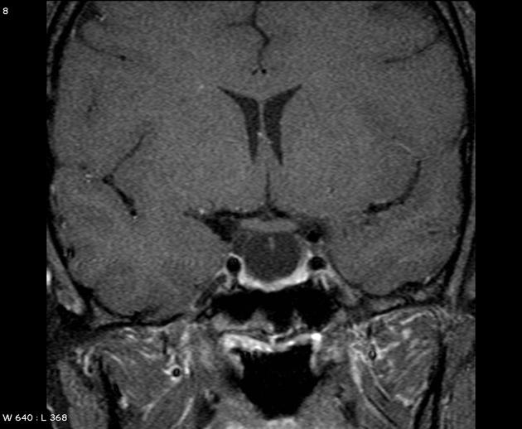
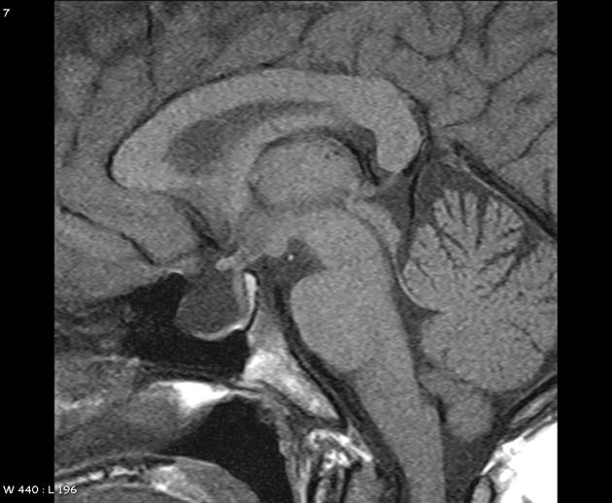
Empty sella
T1 Sag and post contrast T1 coronal images demonstrate CSF signal intensity in the sella.
Note normal gland being pushed to the bottom of the sella.

Slide 29
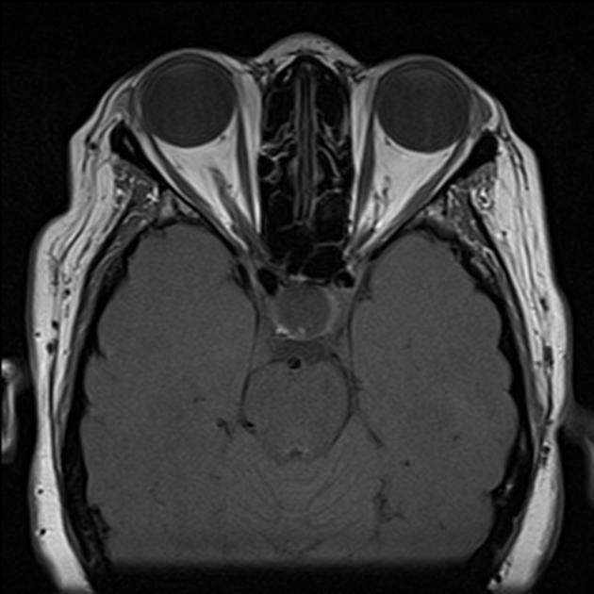
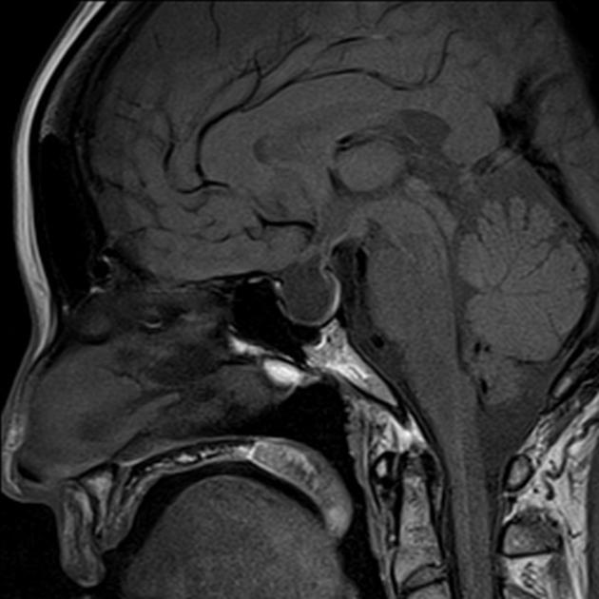
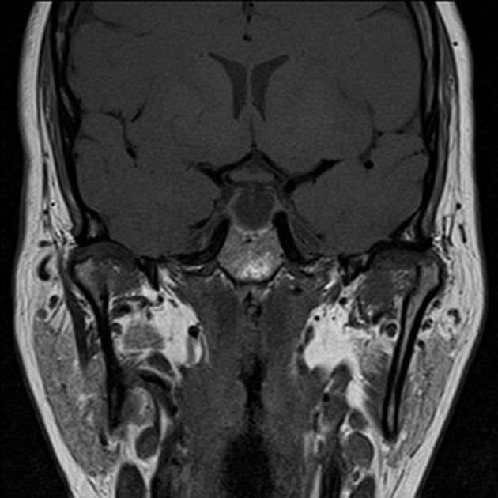
Empty sella
The sella contains fluid of CSF signal. The infundibulum traverses the sella, without displacement.

Slide 30
Intracranial dermoid cyst
Intracranial dermoid cysts are uncommon lesions with characteristic imaging appearances. They can be thought of as along the spectrum: from epidermoid cysts at one end (containing only desquamated squamous epithelium) and teratomas at the other (containing essentially any kind of tissue from all three embryonic tissue layers).
On imaging, they are usually well-defined lobulated midline masses that have low attenuation (fat density) on CT and high signal intensity on T1-weighted MR images. Typically they do not enhance after contrast administration.
Dermoid cysts account for ~0.5% of all primary intracranial tumours and are slightly more common in females ⁶. Typically, dermoid cysts present in the first three decades of life ⁶.

Slide 31
Intracranial dermoid cyst
MRI
Unlike intracranial lipomas that follow fat density on all sequences, intracranial dermoids have more variable signal characteristics ¹⁻⁴:
T1
typically hyperintense (due to cholesterol components)
hyperintense droplets in the subarachnoid space may be visible if rupture has occurred
T1 C+ (Gd): generally do not enhance
extensive pial enhancement may be present in chemical meningitis caused by ruptured cysts
T2: variable signal ranging from hypo- to hyperintense

Slide 32
Intracranial dermoid cyst
Clinical presentation
Many intracranial dermoid cysts are asymptomatic and are only found incidentally. Often there is a long history of vague symptoms, with headache being a prominent feature ⁴. Symptomatic clinical presentation usually occurs in one of two ways:
mass effect
compression of adjacent structures, e.g. optic chiasm
rupture (spontaneous, traumatic, or iatrogenic (at resection))
leakage of sebum into the subarachnoid space results in aseptic chemical meningitis
the presentation is variable, ranging from a headache to seizures, vasospasm, and even death ⁴
Intracranial dermoid cysts are typically located in the midline, although they can grow towards one side or the other. Locations include:
posterior fossa / vermis
suprasellar/subfrontal

Slide 33
Intracranial dermoid cyst
Differential diagnosis
The differential is limited to pituitary region lesions with intrinsic high T1 signal or to an even smaller list (as CT and fat-suppressed sequences are often available) of lesions that contain fat:
intracranial lipoma
homogeneous fat attenuation/signal intensity
chemical shift artefact
intracranial epidermoid cyst
attenuation similar to CSF
restricted diffusion on DWI
intracranial teratoma: immature
usually occur in the pineal region
craniopharyngioma
most are strikingly hyperintense on T2
most enhance strongly

Slide 34
Intracranial teratoma
Intracranial teratomas are uncommon intracranial neoplasms, which can have a bewildering variety of components and thus a wide range of appearances. They can be divided into two broad categories, intra- and extra-axial, which differ in epidemiology and clinical presentation. Another method of classifying an intracranial teratoma is as mature, immature and mature with malignant transformation.
Epidemiology
Although uncommon in the general population, they account for the largest proportion of fetal intracranial neoplasms (26-50% of fetal brain tumours ^{3,6}).
Clinical presentation
Clinical presentation varies according to whether they are intra- or extra-axial.
Markers
Sometimes may be associated with elevated levels of:
serum alpha fetoprotein (AFP)
serum carcinoembryonic antigen (CEA)

Slide 35
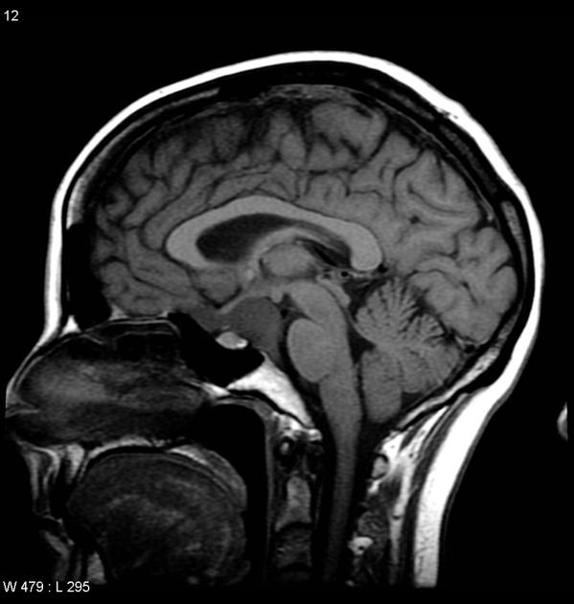
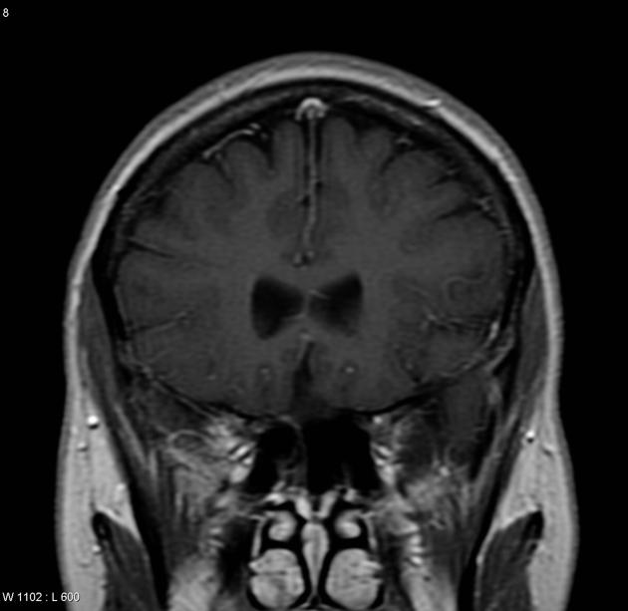
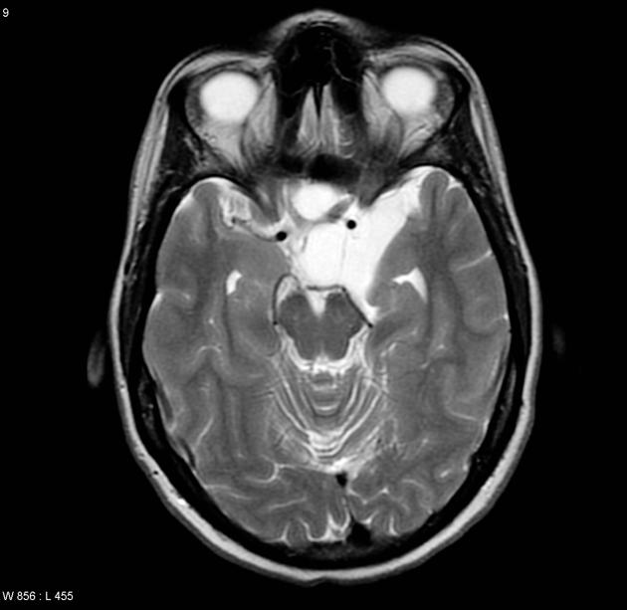
Intracranial teratoma
MRI
T1
hyperintense components due to fat and proteinaceous/lipid-rich fluid
intermediate components of soft tissue
hypointense components due to calcification and blood products
T1 C+ (Gd): solid soft tissue components show enhancement
T2: again mixed signal from differing components
Teratoma: suprasellar

Slide 36
Intracranial epidermoid cyst
Intracranial epidermoid cysts are relatively common congenital lesions which account for about 1% of all intracranial tumors.
They result from inclusion of ectodermal elements during neural tube closure, and typically present in middle age due to mass effect on adjacent structures. Their content, derived from desquamated epithelial cells, mimics CSF on CT and MRI, with the exception of DWI which demonstrates restricted diffusion.
Epidemiology
Although predominantly congenital, epidermoid cysts are usually very slow growing and as such take many years to present.
Typically patients are between 20 and 40 years of age.
Epidermoid cysts account for approximately 1% of all intracranial tumours.

Slide 37
Intracranial epidermoid cyst
Clinical presentation
Signs and symptoms of epidermoid cysts are due to gradual mass effect, with presentation including ⁴:
headaches: most common
cranial nerve deficits
cerebellar symptoms
seizures
raised intracranial pressure
Location
intradural: 90%
cerebellopontine angle: 40-50% ^{2,8}
suprasellar cistern: 10-15% ⁸
fourth ventricle: ~17% ⁸
middle cranial fossa
interhemispheric: < 5% ^{9,10}
spinal (rare)
extradural: 10% ⁸
most within skull

Slide 38
Intracranial epidermoid cyst
MRI
T1
usually isointense to CSF
higher signal compared to CSF around the periphery of the lesion is frequently seen
rarely they can be of high signal and are known as white epidermoids
rare intralesional haemorrhage can also result in intrinsic high signal
T1 C+ (Gd)
thin enhancement around the periphery may sometimes be seen
in the rare cases of malignant degeneration, enhancement becomes more pronounced
T2
usually isointense to CSF (65%)
slightly hyperintense (35%)
rarely hypointense, usually in the setting of the so-called white epidermoid (the term refers to the T1 appearance) ²
FLAIR
often heterogeneous/dirty signal; higher than CSF
beware of flow artefact from CSF pulsation which can mimic this appearance
DWI: useful for differentiation from arachnoid cysts due to increased signal (due to a combination of true restricted diffusion and T2 shine through) which is not seen with arachnoid cysts

Slide 39
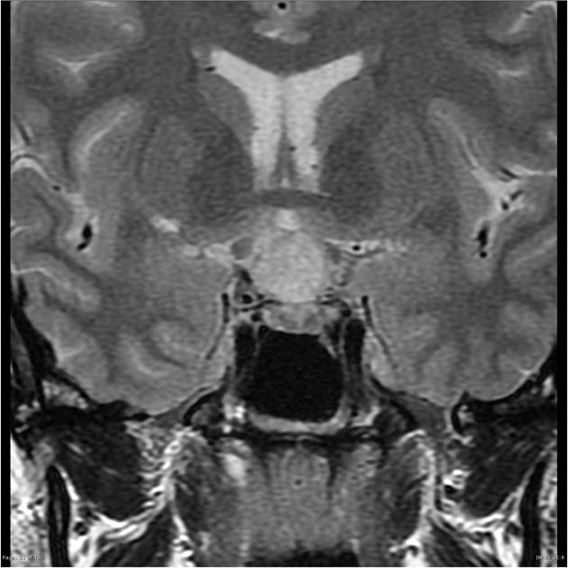
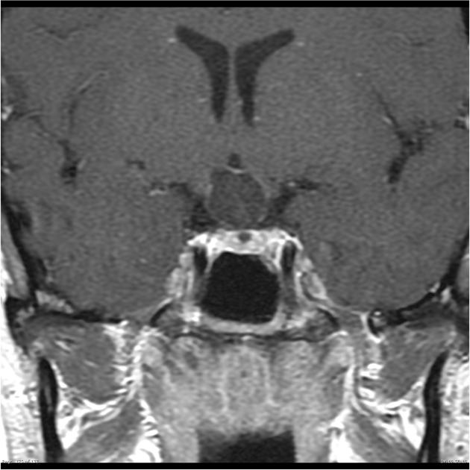
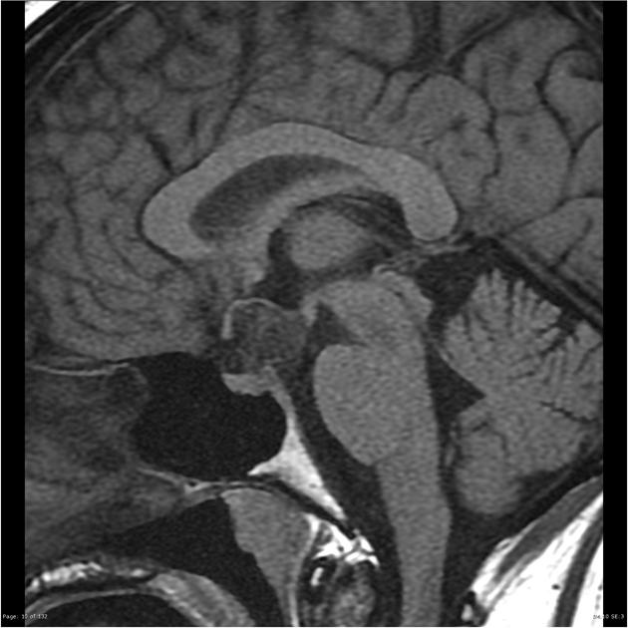
Patient Data
AGE: 35 years
GENDER: Female
Galactorrhea and decreased vision.
Intracranial epidermoid cyst
Pre and post contrast scans were performed including dynamic imaging through the pituitary fossa. A complex cystic lesion is seen in the suprasellar. Internal septation and wall thickening is seen superiorly and as thin rim enhancement post administration of contrast. The lesion markedly compresses the optic chiasm which is bowed superiorly around the lesion..

Slide 40
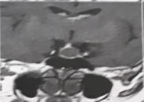
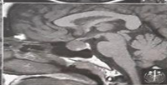
Our Patient
Cystic appearance
No calcification
No Lobulation
No enhancement
No snowman appearance
Size, shape, intensity, location,complexcity,…
Rathke's cleft cyst

Slide 41
Between 2005 and 2013, 1107 patients were evaluated for clinically manifesting SM, of which 1005 were alive and residing within the province by December 1, 2013.
Nova Scotia is a major province in Atlantic Canada. The population of the province has remained relatively stable between 2000 and 2013 (932,491 to 945,061).

Slide 42
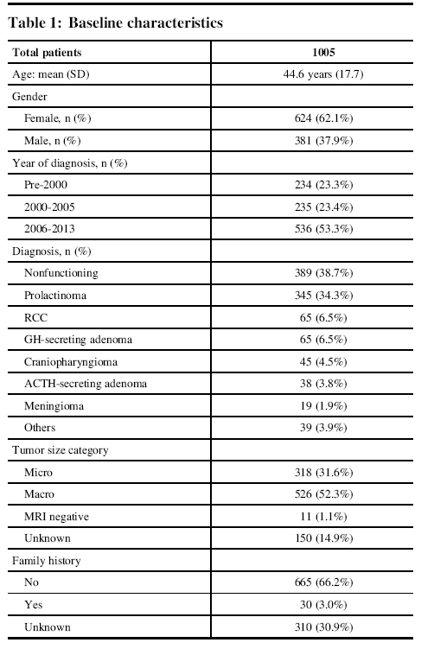
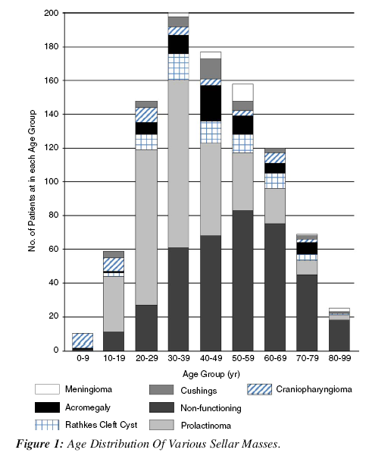

Slide 43
RCC was the most common nonpituitary SM (65/167), constituting 39% of all nonpituitary SMs and 6.5% of all SMs with a SIR of 0.5 and prevalence of 6.90/100,000.There were more females 39 (61%), and the mean age at diagnosis was 46.0±15.3 years. The most common modes of presentation were incidental finding (71%), headache (28%), and vision abnormalities (12%). One-third (32%) of patients with RCC required surgery, whereas others are being followed conservatively.

Slide 44
A systematic review of the published English literature was performed focusing on large modern case series of RCCs to describe their natural history, clinicopathologic features, radiographic features, and surgical outcomes, including rates of recurrence
A PubMed search of the keywords ‘‘Rathke’s cleft cyst’’, ‘‘outcomes’’, ‘‘surgery’’, and ‘‘endoscopic’’ alone and in combination was performed. The query yielded 280 total citations, and the articles that were selected for review of surgical outcomes included those (1) with a large number of patients ([50 patients) (2) who were treated with surgery, and (3) included clinical outcome data, including endocrinologic outcomes and ecurrence rates.

Slide 45
The main differential diagnosis of RCCs includes pituitary adenoma, pituitary cyst and intrasellar craniopharyngioma.
>> The key feature distinguishing RCCs from an adenoma is the midline location of RCCs without stalk deviation, as well as the position of the cyst between the anterior and posterior glands when viewed from sagittal cuts.
>> The fluid inside an RCC can vary. It can be clear, similar to CSF with low protein content, in which case the cyst will rarely cause symptoms.
>> Or it can be filled with mucinous fluid with high protein content, which is more frequently seen in symptomatic patients.

Slide 46
>> Headache was described in 44–81 % of symptomatic cases
>> visual loss in 11–67 % of symptomatic cases
>> endocrinologic dysfunction in 30–60 % of symptomatic cases
>> In as many as 16 % of patients, sudden onset severe headaches have been described
>> Diabetes insipidus is also a relatively common presenting finding in patients with RCCs, when compared to pituitary adenomas, with reported rates for RCC patients ranging from 2.3 % to 37 % of patients

Slide 47
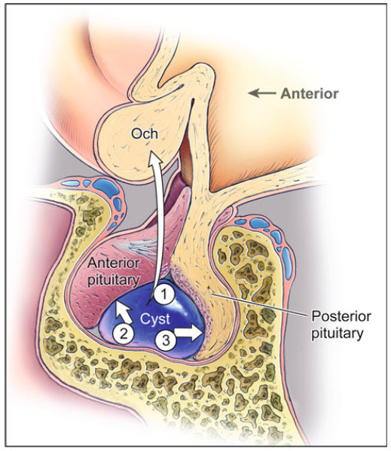
On MRI, RCCs will typically appear hyperintense on T2.
However, their appearance on
T1-weighted imaging can be either
>> hyperintense, consistent with proteinaceous mucinous cyst contents that often represent presence of inflammation,
>> or hypointense, consistent with clear, low-protein cyst contents
An intracystic nodule having high signal intensity on T1-weighted images and low signal intensity on T2-weighted images has been reported in over 75 % of RCCs

Slide 48
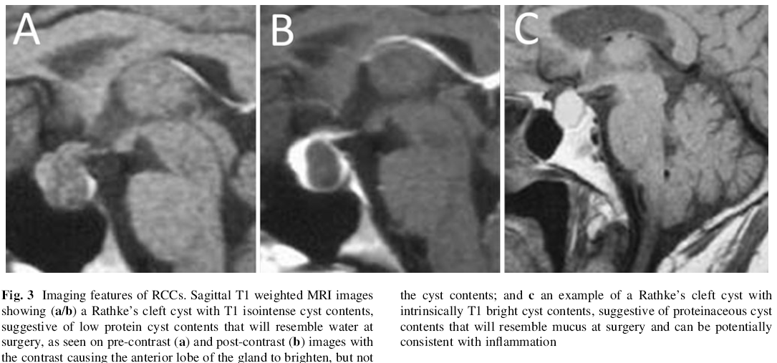

Slide 49
Natural history of untreated RCCs
Size change
>> Of a series of 61 incidentally discovered RCC cases reported by Aho and colleagues , 42 cases
(69 %) did not show any growth over a 9 year follow-up period.
>> In another series of 139 incidentally discovered RCCs reported by Sanno and colleagues , only 5.3 % of these cases were found to have any documented growth, while 76.5 % of cysts remained unchanged in size.
>> In 15.9 % of cases, the cysts actually decreased in size.
Within the series published by Aho and colleagues , development of new visual loss, endocrinopathy,
or significant cyst growth ([1.5 cm) occurred in 31 % of patients observed through serial imaging over a 9-year period.

Slide 50
Surgical management
Surgical drainage is the mainstay for symptomatic RCCs, and it is typically achieved via a transsphenoidal exposure.
Historically, RCCs were treated with cyst wall fenestration for decompression along with biopsy sampling of the cyst wall to confirm the diagnosis.
More recently, some authors have advocated for the need for removal of the entire cyst wall, quoting lower rates of cyst recurrence with this more aggressive approach.
Unfortunately, similarly to craniopharyngiomas, complete cyst removal has been found to be associated with higher rates of postoperative endocrine complicatins
The morbidity of surgical treatment of RCCs must include considerations of those involved with the transsphenoidal approach, including
cerebrospinal fluid leaks
surgical site infections
injury to the carotid artery or the optic apparatus. Among the three large clinical

Slide 51
Recurrence rates after surgical treatment
Some studies report very low rates, as low as 0 % , and some reports describe high rates, up to 42 %
>> Aho and colleagues : 18 % recurrence at 5 years
>> Benveniste and colleagues : 16 % recurrence at 2 years
Factors associated with higher rates of recurrence in case series include
purely suprasellar location (3-year recurrence rates of 29 % vs. 0 % in purely sellar lesions in same series)
inflammation and reactive squamous metaplasia in the cyst wall (odds ratio 2.6–3.7)
superinfection of the cyst (13–31 % recurrence rates)
repair strategy using a fat graft in the cyst cavity, (odds ratio, 17.3)

Slide 52
Conclusion
While surgery is associated with minimal morbidity, the natural history of asymptomatic
RCCs is one of slow growth, suggesting that observation through serial magnetic resonance imaging is appropriate for smaller, asymptomatic RCCs.
For symptomatic RCCs, surgical resection provides good symptomatic relief of headaches and visual disturbance, and can even improve endocrine dysfunction.

Slide 53
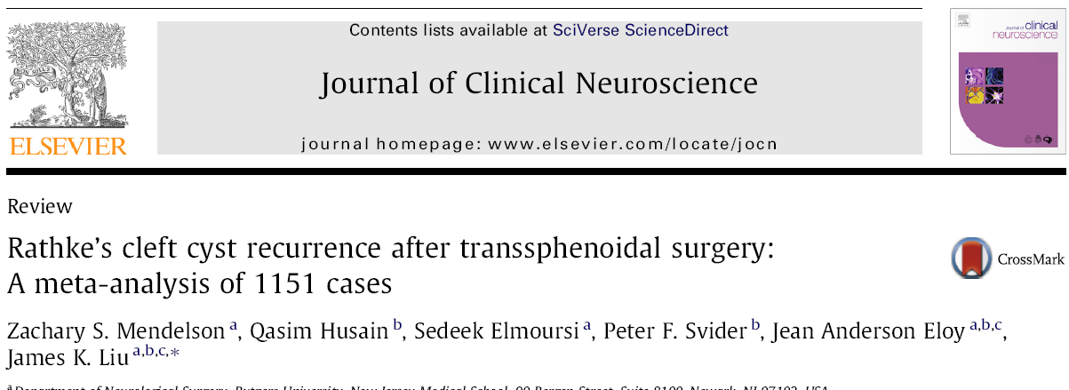
Meta-analysis (1990 – 2012 )
The weighted estimate of recurrence was 12.5% (95% CI 0.095–0.158) using the random effects model
There are a variety of situations which appear to promote the recurrence of RCC, including the presence of squamous metaplasia, enhancement of the cyst wall on MRI.

Slide 54
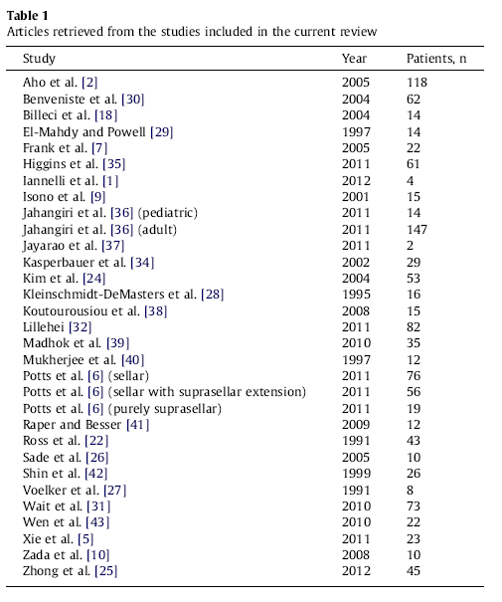
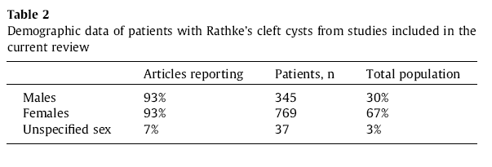
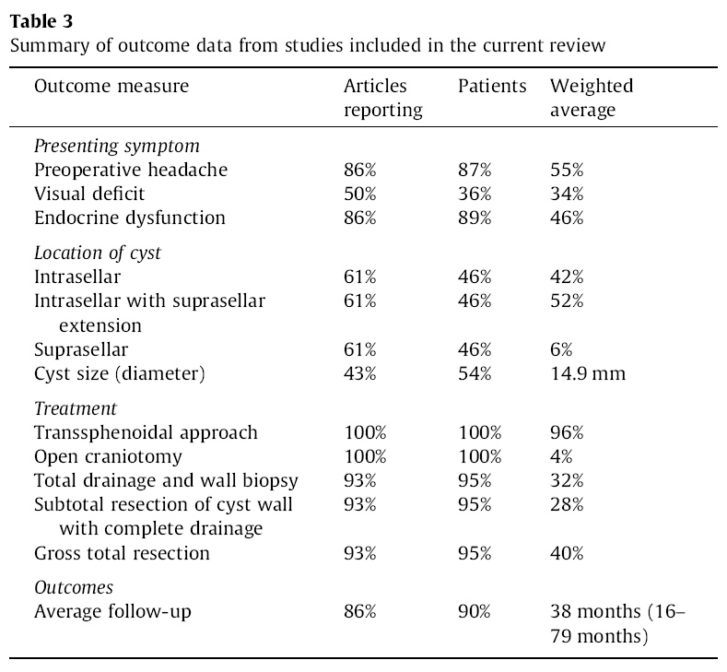

Slide 55
retrospective review of the medical records 2002 – 2012
87 patients with symptomatic RCCs who had undergone resection
Follow-up is scheduled at 3 and 9 months after surgery and annually thereafter. Magnetic resonance imaging is performed at each follow-up visit. Pituitary function is
monitored by hormone level assessment at 1, 3, 6, and 12 months after surgery

Slide 56
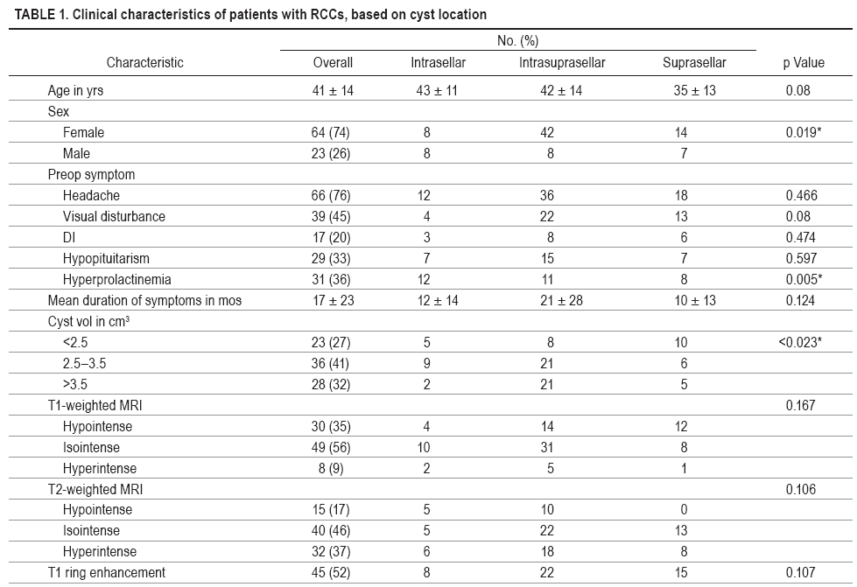

Slide 58
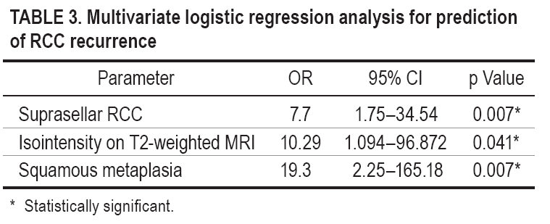
Conclusions
A suprasellar cyst location, ring enhancement , hypointensity on T1-weighted MRI, and cyst volume were the independent predictors of squamous metaplasia.
A suprasellar cyst location, the occurrence of squamous metaplasia, and isointensity on T2-weighted MRI were the independent predictors of RCC recurrence

Slide 59
In a retrospective review of 2598 subjects undergoing at least one pituitary MRI scan from 1999 to 2009 in a tertiary pituitary centre, nonadenomatous sellar masses accounted for 18% of visible lesions, of which the most frequent were RCCs (19%).
Famini, P., Maya, M.M. & Melmed, S. (2011) Pituitary magnetic resonance imaging for sellar and parasellar masses: ten-year experience in 2598 patients. Journal of Clinical Endocrinology and Metabolism, 96, 1633–1641

Slide 60
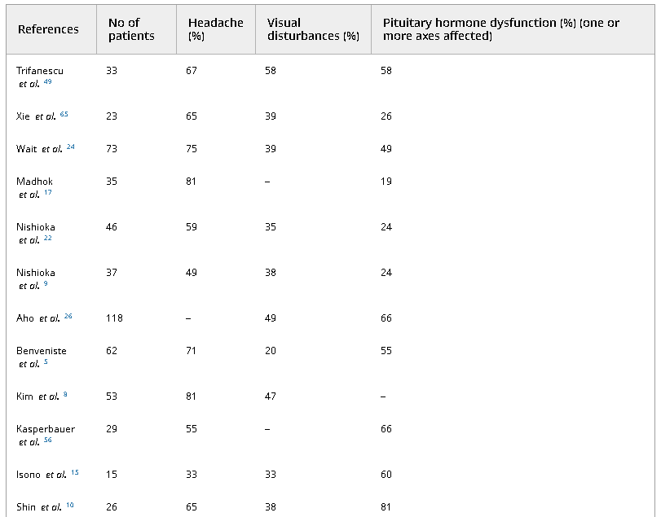
Table 1. Manifestations at presentation in patients with Rathke’s cleft cysts
Headache is the most prevalent manifestation
33% and 81%
Frontal, episodic, nonpulsating, bilateral headache or deep retroorbital pain are the most common, but pain may also affect the occipital or temporal region or involve the whole head
Headaches do not usually correlate with the cyst size, location or the presence of pituitary dysfunction
it has been suggested that episodic frontal headaches may indicate an intermittent inflammatory reaction, and surgical treatment is required to prevent further irreversible endocrine dysfunction
The duration of headaches varies from hours to months, with most patients describing it for 1–2 weeks

Slide 61
Imaging properties
An ovoid shape, small tumor volume, cystic characteristics and little or no cyst wall enhancement suggest an RCC.
A ‘snowman’ shape, solid characteristics and homogeneous enhancement of the solid portion suggest a pituitary adenoma
A superiorly lobulated shape, third ventricle compression, mixed solid and cystic characteristics and reticular enhancement of the solid portion suggest a craniopharyngioma
Particularly in comparison with craniopharyngiomas, RCCs are smaller and rarely show calcification (up to 13% of cases)

Slide 62
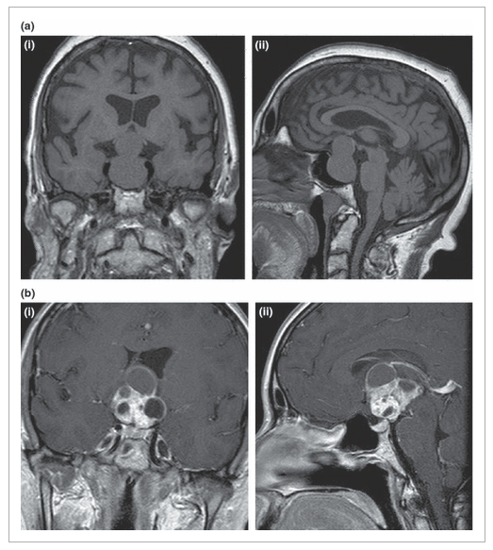
Coronal (i) and sagittal (ii) T1-weighted images of pituitary adenoma arising out of the pituitary fossa and compressing the optic chiasm showing ‘snowman’ shape and uniform signal.
Coronal (i) and sagittal (ii) T1-weighted postgadolinium images of a craniopharygioma with superiorly lobulated shape and mixed solid and cystic characteristics.

Slide 63
Natural history
In series of nonoperated presumed RCCs, 26–94% of them did not progress (based on imaging studies or on the clinical picture) during follow-up periods up to 9 years
Conclusions/Management algorithm
The limited number of series of asymptomatic Rathke’s cleft cysts suggests that yearly clinical surveillance (with imaging at 1, 3 and 5 years for the first 5 years) is a reasonable option, but its duration, at present, is not clear. Symptomatic patients require surgical intervention aiming to drain the cyst content and possibly safely remove the capsule
Series with long observation periods show that the relapse rates are higher than previously thought necessitating close follow-up with 12-monthly scans for at least 5 years after surgery

Slide 64
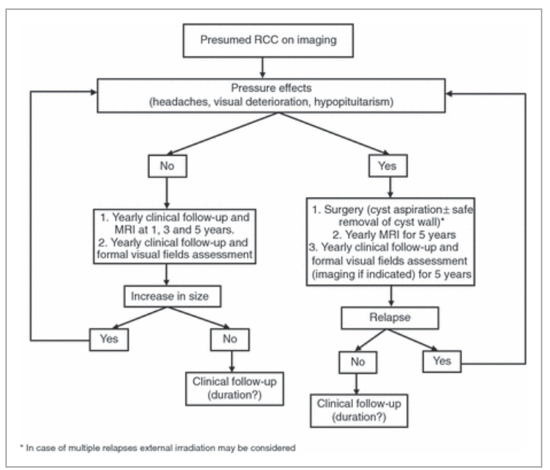

Slide 66
506 with pituitary incidentalomas were obtained by questionnaire from March 1999 to May 2000 under the in Japan. 258 patients underwent surgery (surgical group), while 248 patients were followed up conservatively for a mean period of 26.9 months (range 6–173 months)
(non-surgical group).
Clinical and biochemical assessment, CT or MRI of the pituitary, and visual field testing by Goldman perimetry were assessed at baseline and 6 months and yearly thereafter.

Slide 69
in a cohort of 29 patients with symptomatic cystic sellar lesions and imaging characteristics consistent with RCC managed with surveillance, spontaneous involution was described in nine cases (31%) that had a further follow-up of 9–46 months after the regression. Furthemore, headaches spontaneously resolved in five of seven patients presenting with this symptom

Slide 71
Conclusions
Although headache is often an accepted indication for surgery, we advocate a more conservative approach in patients presenting solely with headache since spontaneous regression is possible
In patients presenting with visual or endocrine dysfunction due to persistent mass effect from RCC, surgery is still recommended because of the unpredictable clinical course and the potential risk of irreversible damage from mass effect.

Slide 72
All brain magnetic resonance imaging (MRI) scans performed at the University of Virginia from 2006 through 2013 were searched for the words “Rathke cleft cyst,” and pituitary clinic notes from 2007 to 2012 were reviewed for patients identified as probably having an RCC. Images for all patients were reviewed by the interpreting neuroradiologist, and those patients with at least 2 MRI scans were included. The dimensions of each cyst were assessed by the same neuroradiologist, and the volume of each cyst was analyzed as a function of the time from the first image obtained.

Slide 73
A total of 75 patients (4–76 years old) met our inclusion criteria. The length of follow-up was 1 to 126 months (median 24 months). In 43 patients (57%) no detectable change in the size of their cysts was seen, in 21 patients (28%) cysts increased in size, and in 11 patients (15%) cysts decreased in size.
Nineteen patients (25%) ultimately underwent surgery, whereas 56 (75%) did not receive operative management

Slide 74
Random coefficient regression predicted cyst size (cubic centimeters) as a linear function of surveillance time (months).The solid line identifies the predicted marginal (ie, average) cyst size, and the dashed lines denote the lower and upper limits of the simultaneous 95% CI. The slope of the regression (0.0010 cm³/mo; 95% CI, −0.0015 to 0.0035 cm³/mo; P = .427),

Slide 75
Conclusion
Our study demonstrates that the majority of radiologically diagnosed RCCs remain unchanged or decrease in size over time. These results suggest that, in the absence of pressure symptoms, it is reasonable to manage patients with RCCs conservatively

Slide 76
A total of 14 patients with spontaneous regression of cystic sellar masses in our hospital were included. The median age was 35 years (range, 5–67), and 8 patients were male. Clinical symptoms, hormone study and MRI were evaluated for all patients. The initial MRI showed all 14 patients with RCCs. Eight patients were presented with sudden onset of headache, and 1 patient with dizziness. Another patient, a 5-year-old child, was presented with delayed growth. Three patients had no symptoms via regular medical work up. All 14 patients had no visual symptoms. The follow-up period ranged from 5.7 to 42.8 months, with the mean of 17.3 months.

Slide 77
The mean initial tumor size was 1.29 cm³ (range, 0.05 to 3.23). After involution, the tumor size decreased to 0.23 cm³ (range, 0 to 0.68) without any treatments. Repeated MRI showed a spontaneous decrease in tumor volume by 78% (range, 34 to 99). The initial MRI showed that the tumor was in contact with the optic chiasm in 7 patients, while compressing on the optic chiasm in 3 patients. Five patients were initially treated with hormone replacement therapy due to hormone abnormality. After the follow-up period, only 2 patients needed a long-term hormone replacement therapy.

Slide 80
Conclusion
The spontaneous involution of RCCs is not well quantified before. Their incidence has not been well demonstrated, but this phenomenon might be underreported. Conservative management can be a treatment option in some RCCs without visual symptoms, even in those that are large in size and in contact with the optic nerve via imaging study

Slide 81
Our Patient
MRI
29 year-old female
Symptom : amenorrhea
headache
DI
Height Growth ( ? )
Lab. Data
Non secretory mass
Hypogonadotropic hypogonadism
Low IGF1

Slide 82
Summary
DDx
Rathke's cleft cyst
Craniopharyngioma
Non functioning macroadenoma with cystic change
Treatment
Conservative follow up vs surgery
Follow up
Hormone replacement therapy
Consider BMD
Calcium & Vitamin D supplementation
6 month Or Annual Perimetry and MRI

Slide 84
Pituicytoma
Female 80 year-old
MRI of the brain and pituitary demonstrates a sizeable mass centered in the suprasellar and interpeduncular sellar, continuous with the infundibulum of the pituitary gland. It is isointense on T1 and iso- to perhaps slightly hyperintense on T2 weighted images. It enhances vividly. Normal pituitary tissue is seen in the bass of the fossa.
This case demonstrates appearances of a rare pituitary / infundibular tumour, a pituicytoma. This patient has been followed up for many years with little growth

Slide 85
Pituicytoma
In the current (2016) WHO classification of CNS tumours, the term pituicytoma is restricted to a distinct group of low-grade glial tumours found in the posterior pituitary and infundibulum, presumably arising from pituicytes
Louis DN, Ohgaki H, Wiestler OD, Cavenee WK "WHO Classification of Tumours of the Central Nervous System. 4th Edition Revised"
Differential diagnosis
When small, and clearly localised to the infundibulum the main differential includes:
granular cell tumours of the pituitary region
pilocytic astrocytoma of the neurohypophysis
craniopharyngioma
When larger, then it is difficult to anticipate the diagnosis with other diagnoses being far more common, including:
pituitary macroadenoma
meningioma
pituitary metastasis
pituitary infiltration
lymphocytic hypophysitis
neurosarcoidosis
optic pathway glioma

Slide 86
Pituicytoma
MRI
T1: isointense solid mass; posterior pituitary bright spot often absent
T1 C+ (Gd): bright contrast enhancement
T2: heterogeneous, hypointense to isointense
Clinical presentation
Clinical presentation is either from endocrine dysfunction (amenorrhea, galactorrhea, infertility, diabetes insipidus, panhypopituitarism) or from compression of adjacent structures, typically the optic chiasm. Many are asymptomatic, with the lesion only found incidentally

Slide 87
CNS germinoma
Clinical presentation
Presentation depends on location, with compression of the tectal plate leading to obstructive hydrocephalus and Parinaud syndrome, whereas involvement on the pituitary infundibulum leads to diabetes insipidus (most common), hypopituitarism (common) or optic chiasm compression or signs of intracranial hypertension ¹¹. When the thalami and basal ganglia are involved, the presentation is often delayed with a larger tumour at diagnosis.
MRI
MRI demonstrates a soft tissue mass, typically ovoid or lobulated in contour, engulfing the calcified pineal gland with the following signal characteristics ¹²:
T1: isointense or slightly hyperintense to adjacent brain
T2
isointense or slightly hyperintense to adjacent brain
may have areas of cyst formation
may have areas of haemorrhage (low signal)
have a predilection for invading adjacent brain (oedema)
central calcification appears low signal (engulfed pineal gland)
T1 C+ (Gd): vivid and homogeneous

Slide 88
CNS germinoma (suprasellar)
AGE: 15 years
GENDER: Female
Decreased vision
MRI of the brain demonstrates a T1 isointense to brain, T2 hyperintense mass filling the inferior recesses of the third ventricle and extending down along the infundibulum into the pituitary fossa. It demonstrates intermediate relatively homogeneous contrast enhancement. The pineal gland, is a little bulky and demonstrates similar signal intensity and enhancement.
The mass elevates and compresses the optic chiasm and results in increased signal in the optic tracts bilaterally.

Slide 89
CNS germinoma
Intracranial germinomas, also known as dysgerminomas or extra-gonadal seminomas, are a type of germ cell tumour and are predominantly seen in paediatric populations. They tend to occur in the midline, either at the pineal region (majority) or along the floor of the third ventricle/suprasellar region
Germinomas are tumours of young patients with a peak incidence of 10-12 years of age (90% of patients being younger than 20 at the time of diagnosis). They account for 3-5% of paediatric intracranial tumours but only 0.4-1% of intracranial tumours in adults.
They are the most common tumour of the pineal region accounting for approximately 50% of all tumours, and the majority (73-86%) ¹⁰ of intracranial germ cell tumour.
Gender ratios are interestingly different depending on location. In the pineal region there is a marked male preponderance with a male to female ratio of 5-22:1 whereas in the suprasellar region, they are slightly more frequent in females with a male to female ratio of 1:1.3. Overall, due to the pineal region being most common, germinomas are seen more frequently in males
Villano JL, Propp JM, Porter KR et-al. Malignant pineal germ-cell tumors: an analysis of cases from three tumor registries. Neuro-oncology. 2008;10 (2): 121-30.

Slide 90
Pituitary metastases
The demographic of affected patients reflects that of underlying primary tumours, which are most frequently breast cancer in women and lung cancer in men
Clinical presentation
Clinical presentation is variable but includes ¹:
hormonal dysfunction
diabetes insipidus
common: 29-71% ³
presumably due to the predilection for posterior pituitary involvement (see below)
panhypopituitarism
hyperprolactinaemia: disruption of the normal inhibition of prolactin release by dopamine
mass effect
optic chiasm compression
extension into cavernous sinuses

Slide 91
Pituitary metastases
MRI
Although all metastases to the pituitary (as is the case everywhere) start as microscopic deposits, they are usually encountered in two patterns:
a mass arising from the pituitary fossa (similar to a macroadenoma)
infundibular lesion
Small intrasellar masses are generally not identified, mainly because they are presumably asymptomatic and require targeted sequences that are not performed without indication.
Sizeable mass
These masses typically involve both the intra and suprasellar compartments. As they are usually rapidly growing they have some features that are helpful in distinguishing them from pituitary macroadenomas:
relatively normal size fossa (growth in a short period)
bony destruction rather than remodelling
dural thickening
dumb-bell shape as the diaphragma sella has not had time to be stretched
irregular edges

Slide 92
Pituitary metastases
The tumour has squeezed through the diaphragma sella (red arrows) with only some widening, as this has occurred over a short time. There also appears to be dural enhancement anteriorly (blue arrow).

Slide 93
Pituitary metastases
Primary : Lung
MRI demonstrates an enhancing, diffusion restricting bilobed pituitary mass with extension into the suprasellar compartment. Compression of the optic chiasm by the suprasellar component with increased FLAIR signal in the bilateral optic nerves and bilateral optic tracts

Slide 94
Lymphocytic hypophysitis
Lymphocytic hypophysitis is seen most frequently in women (strong female predilection with a F:M of ~ 9:1), and often in the postpartum period or the third trimester of pregnancy.
Clinical presentation
Clinical presentation is varied depends on the part of the pituitary affected and the size of the lesion. Lymphocytic hypophysitis can thus be classified as:
anterior pituitary: lymphocytic adenohypophysitis (LAH)
most common
mimics a pituitary adenoma
endocrine hormone deficits are common, including hypopituitarism
mass effects on adjacent structures (e.g. optic chiasm)
posterior pituitary: lymphocytic infundibular neurohypophysitis (LINH)
rare
diabetes insipidus
both anterior and posterior pituitary: lymphocytic infudibular panhypophysitis (LIPH)
Associations
auto-immune conditions such as
autoimmune thyroiditis
pernicious anaemia

Slide 95
Lymphocytic hypophysitis
MRI
T1
affected area is isointense with slight signal heterogeneity
normal posterior pituitary bright spot may be absent ⁸
T1 C+ (Gd)
can variably enhance, usually homogeneously ⁷
dural enhancement may be present ⁸
infundibulum may be thickened ⁸
T2
hypointensity in parasellar region can be present and may be useful in differentiating from a pituitary adenoma ⁴

Slide 96
Lymphocytic hypophysitis
There is a 13 x 24 x 18 mm (AP x trans x CC) sellar and suprasellar mass. It is intermediate in signal intensity pre-contrast. There is avid post-contrast enhancement except for its a few small nonenhancing foci.
The floor of the sella flattened and remodelled.

Slide 97
Lymphocytic hypophysitis
MRI of the pituitary region demonstrates enhancing soft tissue mass involving the anterior and posterior pituitary as well as the infundibulum which is markedly expanded. The superior component severely compresses and elevates the optic chiasm.

Slide 98
Meningioma
Meningiomas are more common in women, with a ratio of 2:1 intracranially
They are uncommon in patients before the age of 40 and should raise suspicion of neurofibromatosis type 2 (NF2) when found in young patients.
Imaging
MRI is the investigation of choice for the diagnosis and characterisation of meningiomas. When appearance and location are typical, the diagnosis can be made with a very high degree of certainty. In some instances, however, the appearances are atypical and careful interpretation is needed to make a correct preoperative diagnosis.
Meningiomas typically appear as extra-axial masses with a broad dural base. They are usually homogeneous and well circumscribed, although many variants are encountered.

Slide 99
Meningioma
MRI Signal characteristics
Signal characteristics of typical meningiomas include:
T1
usually isointense to grey matter (60-90%) ^{3,8, 13}
hypointense to grey matter (10-40%): particularly fibrous, psammomatous variants
T1 C+ (Gd): usually intense and homogeneous enhancement
T2
usually isointense to grey matter (~50%) ^{3,8,13}
hyperintense to grey matter (35-40%)
usually correlates with a soft texture and hypervascular tumours ¹³
seen in microcystic, secretory, cartilaginous (metaplastic) chordoid and angiomatousvariants ¹²
hypointense to grey matter (10-15%): compared to grey matter and usually correlates with harder texture and more fibrous and calcified contents

Slide 100
Meningioma
Suprasellar meningioma
A fairly defined globular supra-sellar mass lesion is seen showing to be hypointense on T1 and hyperintense on T2, with some small peripheral cysts, and intense rather homogenous post-contrast enhancementThe lesion is seen widening and splaying the arteries of circle of willis with indentation and widening of the cerebral peduncles. That lesion is seen abutting the optic chiasma.

Slide 101
Suprasellar cistern lipoma
Suprasellar cistern lipomas are uncommon, usually incidental findings, with characteristic imaging features and a very limited differential diagnosis
suprasellar lipomas are usually asymptomatic and are only found incidentally either at autopsy or when the brain is imaged for other reasons.
MRI
MRI is the modality of choice for assessing these lesions as not only does it have exquisite sensitivity and specificity for the detection and characterisation of fatty lesions (provided fat saturated sequences are performed), but it is also able to demonstrate local anatomy.
The sine qua non of intracranial lipomas is a nodule tissue which follows fat on all sequences including fat suppressed sequences, and does not demonstrate solid enhancing components

Slide 102
Suprasellar cistern lipoma

