Slide 2
Self Monitoring of Blood Glucose
Seyed Adel Jahed, M.D., Endocrinologist
Gabric Diabetes Education Association
RIES 4 Jan 2017 Tehran, Iran

Slide 3
Agenda
1
Introduction
2
Frequency and Timing of SMBG
3
SMBG Education Checklist
4
Interpreting SMBG
5
Conceptual Framework for SMBG Use
6
Dilemma

Slide 4
Agenda
1
Introduction
2
Frequency and Timing of SMBG
3
SMBG Education Checklist
4
Interpreting SMBG
5
Conceptual Framework for SMBG Use
6
Dilemma

Slide 5
Importance
SMBG is an outcome measurement component of “monitoring,” which is included in the AADE7 (American Association of Diabetes Educators) Self-Care Behavior among the other six diabetes self-care behaviors:
being active
following a healthy eating plan
taking medications
practicing healthy coping strategies
reducing risks
problem solving
SMBG allows patients to evaluate their individual response to therapy and assess whether glycemic targets are being achieved.
SMBG is an integral component of effective therapy.
Notes:
Diabetes Care 2016 Jan; 39(Supplement 1): S1-S2.
Austin, M. M. (2013). The two skill sets of self-monitoring of blood glucose education: the operational and the interpretive. Diabetes Spectrum, 26(2), 83-90.

Slide 6
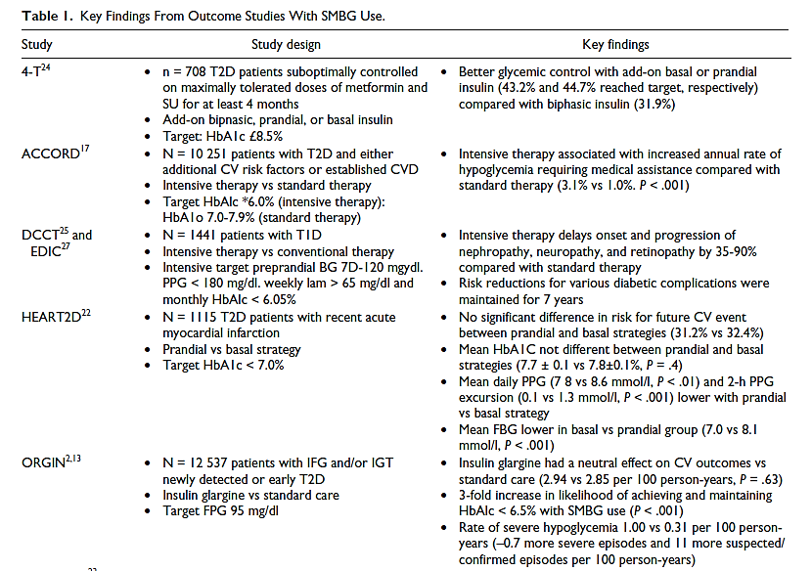
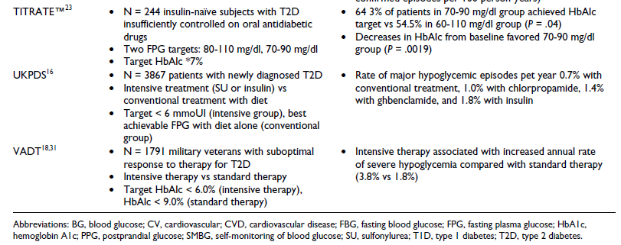
Major clinical trials of insulin-treated patients have included SMBG as part of the multifactorial interventions to demonstrate the benefit of intensive glycemic control on diabetes complications.
Notes:
Schnell, O., Hanefeld, M., & Monnier, L. (2014). Self-Monitoring of Blood Glucose A Prerequisite for Diabetes Management in Outcome Trials. Journal of diabetes science and technology, 8(3), 609-614.

Slide 7
In T₁DM, there is a correlation between greater SMBG frequency and lower A1C.
11.0
10.5
10.0
9.5
9.0
Mean A1C
13-26 years
8.5
8.0
1-13 years
7.5
26-50 years
7.0
50+ years
6.5
0-2
3-4
5-6
7-8
9-10
11-12
≥13
SMBG per day
Miller KM, et al. Diabetes Care. 2013;36:2009-2014.
Notes:
Miller, K. M., Beck, R. W., Bergenstal, R. M., Goland, R. S., Haller, M. J., McGill, J. B., ... & T1D Exchange Clinic Network. (2013). Evidence of a strong association between frequency of self-monitoring of blood glucose and hemoglobin A1c levels in T1D Exchange clinic registry participants. Diabetes Care, 36(7), 2009-2014.
Chicago

Slide 8
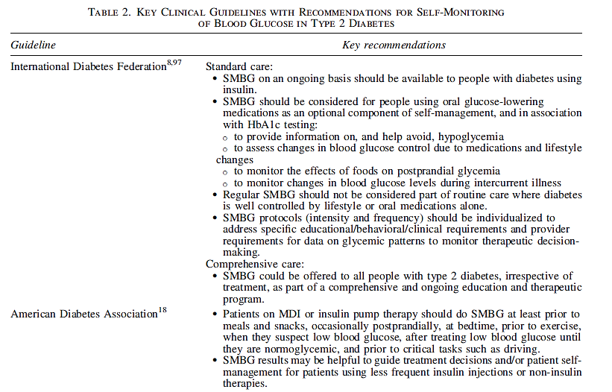
Key Clinical Guidelines with Recommendations for SMBG in T₂DM
Notes:
Czupryniak, L., Barkai, L., Bolgarska, S., Bronisz, A., Broz, J., Cypryk, K., ... & Martinka, E. (2014). Self-monitoring of blood glucose in diabetes: from evidence to clinical reality in central and eastern europe—recommendations from the international central-eastern european expert group. Diabetes technology & therapeutics, 16(7), 460-475.

Slide 9
Agenda
1
Introduction
2
Frequency and Timing of SMBG
3
SMBG Education Checklist
4
Interpreting SMBG
5
Conceptual Framework for SMBG Use
6
Dilemma

Slide 10
Appropriate frequency and timing of SMBG
No universally accepted standards for frequency and timing
Many factors must be considered:
Type of diabetes
Willingness to perform SMBG
Level of diabetes control
Medication regimen
Lifestyle and daily schedule with regard to activity, food, and work
Physical ability to check blood glucose
Ability to problem-solve and take action
Financial limitations
Comorbid conditions

Slide 11
SMBG for people with T₁DM or T₂DM on MDI regimen
Before meals and snacks
Post-prandials (occasionally)
At bedtime
Before exercise
When hypoglycemia is suspected
After hypoglycemia treatment (until normoglycemia is attained)
Before crucial tasks such as driving

Slide 12
T₂DM: Structured testing
For people with non-insulin treated T₂DM the 2009 IDF SMBG guidelines suggest:
“Focused” SMBG regimens based on the specific glucose data required (i.e., fasting vs. postprandial)

Slide 13
Possible testing regimens
Meal-based testing schemes:
The 3-point regimen
The 5-point regimen
The 7-point regimen
The staggered-frequency regimen
Goal:
the effect of food consumed on the rise in blood glucose after specific mealtimes
Notes:
Austin, M. M. (2013). The two skill sets of self-monitoring of blood glucose education: the operational and the interpretive. Diabetes Spectrum, 26(2), 83-90.

Slide 14
Three-point SMBG profile to check FPG and the effect of the largest meal
 | Pre-Breakfast | Post-Breakfast | Pre-Lunch | Post-Lunch | Pre-Supper | Post-Supper | Bedtime
Saturday | × |  |  |  | × | ×
Sunday | × |  |  |  | × | ×
Monday | × |  |  |  | × | ×
Tuesday | × |  |  |  | × | ×
Wednesday | × |  |  |  | × | ×
Thursday | × |  |  |  | × | ×
Friday | × |  |  |  | × | ×
Notes:
Austin, M. M. (2013). The two skill sets of self-monitoring of blood glucose education: the operational and the interpretive. Diabetes Spectrum, 26(2), 83-90.

Slide 15
Five-point SMBG profile to check FPG and the effect of the two large meal
 | Pre-Breakfast | Post-Breakfast | Pre-Lunch | Post-Lunch | Pre-Supper | Post-Supper | Bedtime
Saturday
Sunday | × | × |  |  | × | × | ×
Monday | × | × |  |  | × | × | ×
Tuesday | × | × |  |  | × | × | ×
Wednesday
Thursday
Friday

Slide 16
Seven-point SMBG profile to check FPG and the effect of all meals
 | Pre-Breakfast | Post-Breakfast | Pre-Lunch | Post-Lunch | Pre-Supper | Post-Supper | Bedtime
Saturday | × | × | × | × | × | × | ×
Sunday | × | × | × | × | × | × | ×
Monday | × | × | × | × | × | × | ×
Tuesday
Wednesday
Thursday
Friday

Slide 17
Paired meal-based SMBG profile (less intensive)
 | Pre-Breakfast | Post-Breakfast | Pre-Lunch | Post-Lunch | Pre-Supper | Post-Supper | Bedtime
Saturday | × | ×
Sunday
Monday |  |  | × | ×
Tuesday
Wednesday |  |  |  |  |  | × | ×
Thursday
Friday | × | ×

Slide 18
Paired testing
Paired testing, before and 1–2 hours after a meal, has gained attention in recent years.
Research by Monnier et al. concluded that, as A_{1C} approaches a target of 7%, postprandial blood glucose contributes more to the A_{1C} result than does FPG.
In such situations, diabetes educators should encourage individuals to focus their efforts on reaching their postprandial blood glucose targets.

Slide 19
Difficulty in coping?
Patients who resist performing SMBG 7-times/day for several days
could instead
Perform fewer tests over several days at a specific mealtime and then rotate testing every several days until all mealtimes can be assessed.
Notes:
Austin, M. M. (2013). The two skill sets of self-monitoring of blood glucose education: the operational and the interpretive. Diabetes Spectrum, 26(2), 83-90.

Slide 20
Paired meal-specific SMBG profile- 1st week
 | Pre-Breakfast | Post-Breakfast | Pre-Lunch | Post-Lunch | Pre-Supper | Post-Supper | Bedtime
Saturday | × | ×
Sunday
Monday | × | ×
Tuesday | × | ×
Wednesday
Thursday | × | ×
Friday | × | ×

Slide 21
Paired meal-specific SMBG profile- 2nd week
 | Pre-Breakfast | Post-Breakfast | Pre-Lunch | Post-Lunch | Pre-Supper | Post-Supper | Bedtime
Saturday |  |  | × | ×
Sunday |  |  | × | ×
Monday
Tuesday |  |  | × | ×
Wednesday
Thursday |  |  | × | ×
Friday |  |  | × | ×

Slide 22
Paired meal-specific SMBG profile- 3rd week
 | Pre-Breakfast | Post-Breakfast | Pre-Lunch | Post-Lunch | Pre-Supper | Post-Supper | Bedtime
Saturday
Sunday |  |  |  |  | × | ×
Monday |  |  |  |  | × | ×
Tuesday |  |  |  |  | × | ×
Wednesday |  |  |  |  | × | ×
Thursday
Friday |  |  |  |  | × | ×

Slide 23
SMBG profile to assess fasting hyperglycemia
 | Pre-Breakfast | Post-Breakfast | Pre-Lunch | Post-Lunch | Pre-Supper | Post-Supper | Bedtime
Saturday |  |  |  |  |  |  | ×
Sunday | ×
Monday |  |  |  |  |  |  | ×
Tuesday | ×
Wednesday |  |  |  |  |  |  | ×
Thursday | ×
Friday

Slide 24
Targeted SMBG profile weeks 1-2
 | Pre-Breakfast | Post-Breakfast | Pre-Lunch | Post-Lunch | Pre-Supper | Post-Supper | Bedtime
Saturday | ×
Sunday | ×
Monday | ×
Tuesday | ×
Wednesday | ×
Thursday | ×
Friday | ×

Slide 25
Targeted SMBG profile weeks 3-4
 | Pre-Breakfast | Post-Breakfast | Pre-Lunch | Post-Lunch | Pre-Supper | Post-Supper | Bedtime
Saturday | × | ×
Sunday | × |  |  | ×
Monday | × |  |  |  |  | ×
Tuesday | × | ×
Wednesday | × |  |  | ×
Thursday | × |  |  |  |  | ×
Friday | × | ×

Slide 26
Targeted SMBG profile weeks 5-6
 | Pre-Breakfast | Post-Breakfast | Pre-Lunch | Post-Lunch | Pre-Supper | Post-Supper | Bedtime
Saturday | × |  | ×
Sunday | × |  |  |  | ×
Monday | × |  |  |  |  |  | ×
Tuesday | × |  | ×
Wednesday | × |  |  |  | ×
Thursday | × |  |  |  |  |  | ×
Friday | × |  | ×

Slide 27
Staggered SMBG profile In following controlled busy cases
 | Pre-Breakfast | Post-Breakfast | Pre-Lunch | Post-Lunch | Pre-Supper | Post-Supper | Bedtime
Saturday | × |  | ×
Sunday |  | × |  |  |  | ×
Monday |  |  |  | ×
Tuesday | × |  |  |  | ×
Wednesday |  |  | × |  |  | ×
Thursday |  | × |  |  | ×
Friday | × | ×

Slide 28
More on the frequency and method of BS monitoring
Analyses of data from the T₁D Exchange database support a strong association between both higher SMBG frequency or CGM use and lower HbA_{1c} levels.
Use of CGM was also significantly associated with lower HbA_{1c} levels, particularly if CGM was used ≥6 days/week.
The most common reasons for discontinuation of CGM were concerns about accuracy and cost.
Parkin CG., et al. Diabetes Technology & Therapeutics. 2016, 18(11), 727-47.
Notes:
Parkin, C. G., Homberg, A., & Hinzmann, R. (2016). 9th Annual Symposium on Self-Monitoring of Blood Glucose, April 28–30, 2016, Madrid, Spain. Diabetes Technology & Therapeutics, 18(11), 727-747.

Slide 29
Agenda
1
Introduction
2
Frequency and Timing of SMBG
3
SMBG Education Checklist
4
Interpreting SMBG
5
Conceptual Framework for SMBG Use
6
Dilemma

Slide 30
SMBG Education Checklist
Operational Skills: Using the Meter
Selecting a meter
Ensuring meter accuracy
Documenting SMBG data
Addressing individual needs
Interpretation Skills: Using SMBG Data
Knowing blood glucose targets
Knowing the appropriate frequency and timing of glucose tests
Using pattern management in decision-making

Slide 31
Factors that Can Affect Glucose Meter Results
Notes:
Tonyushkina, K., & Nichols, J. H. (2009). Glucose meters: a review of technical challenges to obtaining accurate results. Journal of diabetes science and technology, 3(4), 971-980.

Slide 32
ISO 15197:2013 Standard require tighter BGMS accuracy

Slide 33
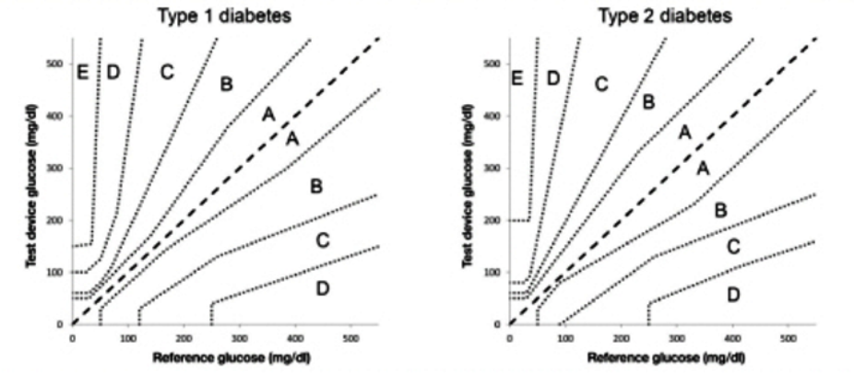
Parkes Consensus Error Grid For Patients With Diabetes
The version for type 1 diabetes is used for regulatory purposes
Parkes JL, et al. A new consensus error grid to evaluate the clinical significance of inaccuracies in the measurement of blood glucose. Diabetes Care. 2000; 23(8):1143-8.

Slide 34
Parkes Consensus Error Grid
Parkes JL, et al. A new consensus error grid to evaluate the clinical significance of inaccuracies in the measurement of blood glucose. Diabetes Care. 2000; 23(8):1143-8.

Slide 35
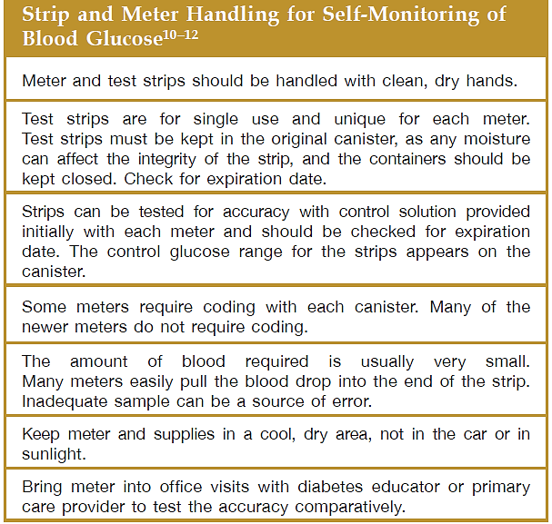
Practical aspects of the procedure is imperative
Notes:
Kirk, J. K., & Stegner, J. (2010). Self-monitoring of blood glucose: practical aspects. Journal of diabetes science and technology, 4(2), 435-439.

Slide 36
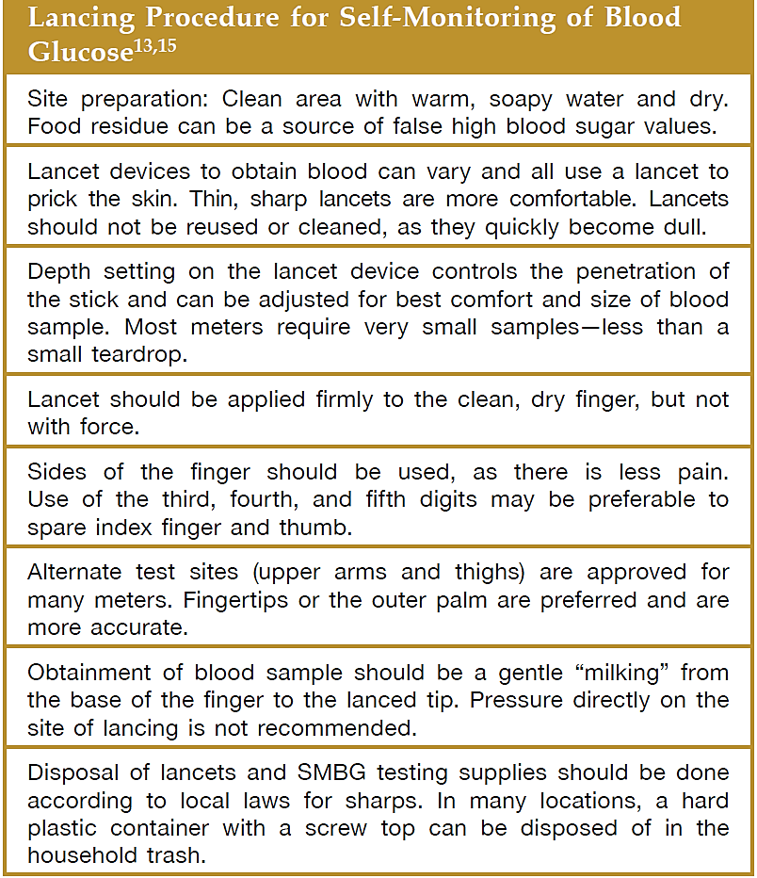
Appropriate steps for successful blood obtainment
Notes:
Kirk, J. K., & Stegner, J. (2010). Self-monitoring of blood glucose: practical aspects. Journal of diabetes science and technology, 4(2), 435-439.

Slide 37
Alternate Site Testing (AST)
Meters are available that allow SMBG using blood samples from sites other than the fingertip (forearm, palm of the hand, thigh).
Accuracy of results over a wide range of BG levels and during periods of rapid change in BG levels is variable across sites.
During periods of rapid change in BG levels (e.g. after meals, after exercise and during hypoglycemia), fingertip testing has been shown to more accurately reflect glycemic status than forearm or thigh testing.
In comparison, blood samples taken from the palm near the base of the thumb (the thenar area) demonstrate a closer correlation to fingertip samples at all times of day and during periods of rapid change in BG levels.
Notes:
Berard, L. D. (2013). Clinical Practice Guidelines Monitoring Glycemic Control Canadian Diabetes Association Clinical Practice Guidelines Expert Committee. Can. J. Diabetes, (37).

Slide 38
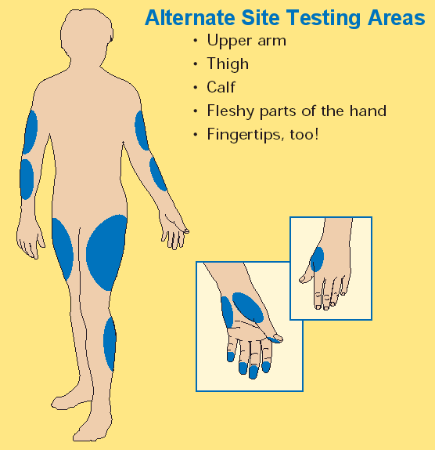
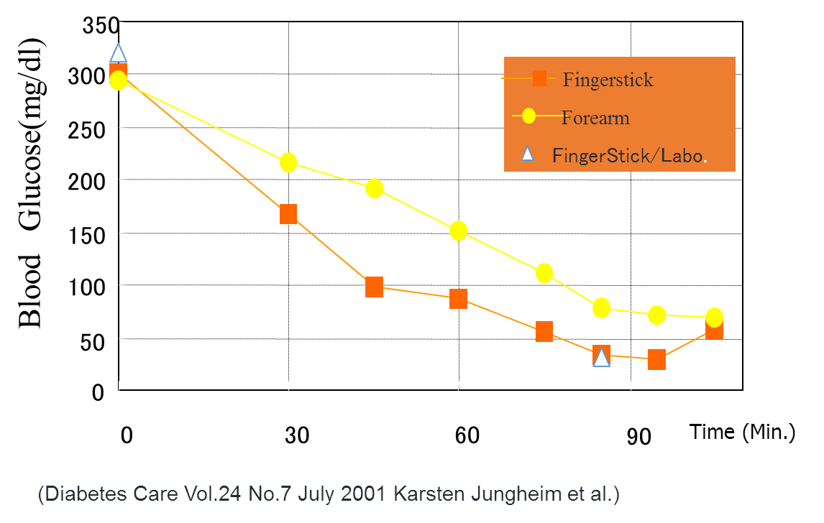
Alternate Site Testing (AST)

Slide 39
Agenda
1
Introduction
2
Frequency and Timing of SMBG
3
SMBG Education Checklist
4
Interpreting SMBG
5
Conceptual Framework for SMBG Use
6
Dilemma

Slide 40
Interpreting SMBG
Interpreting SMBG: problem-solving self-care behavior
If patients’ healthcare team does not use the SMBG data in clinical decision-making, then SMBG is of no value and a waste of resources!
Notes:
Interpreting SMBG results is considered a problem-solving self-care behavior. It is not uncommon for people who are testing their blood glucose, especially people with type 2 diabetes, to be proficient at and feel confident in their ability to perform tests, but to not use their SMBG data in lifestyle decision-making. Additionally, if patients’ HCPs do not use the SMBG data in clinical decision-making, then SMBG is of no value and a waste of resources.

Slide 41
Using pattern management in decision-making
Pattern management: systematic review and analysis of the patients’ recorded blood glucose levels
Goal: behavior changes in lifestyle or the therapeutic regimen to resolve consistent patterns of high or low blood glucose and attain blood glucose targets
Some available meters and software programs provide automated pattern detection.
Notes:
Some decisions such as treating hypoglycemia do not require multiple SMBG results to justify taking action. However, most clinical and lifestyle decisions, such as adjusting medication doses, changing food intake, or understanding the effects of exercise, will require three to four blood glucose results taken at the same time of day before taking action.
Pattern management involves both patients and providers performing a systematic review and analysis of the patients’ recorded blood glucose levels.
Some available meters and software programs provide automated pattern detection. Regardless of how patterns are detected, the goal is to proactively make changes in lifestyle or the therapeutic regimen to resolve consistent patterns of high or low blood glucose and attain blood glucose targets.

Slide 42
Problem-solving skills: The way to behavior change
Teaching patients problem-solving skills to act on SMBG results is crucial to improve outcomes.
Testing blood glucose alone, without taking action based on the results, will not necessarily lead to improved clinical outcomes.

Slide 43
Problem-solving skills: The way to behavior change
Diabetes educators: key role in teaching problem-solving skills
Encouraging individuals to write their blood glucose values
Logbook: linear and vertical manner to review results

Slide 44
Agenda
1
Introduction
2
Frequency and Timing of SMBG
3
SMBG Education Checklist
4
Interpreting SMBG
5
Conceptual Framework for SMBG Use
6
Dilemma

Slide 45
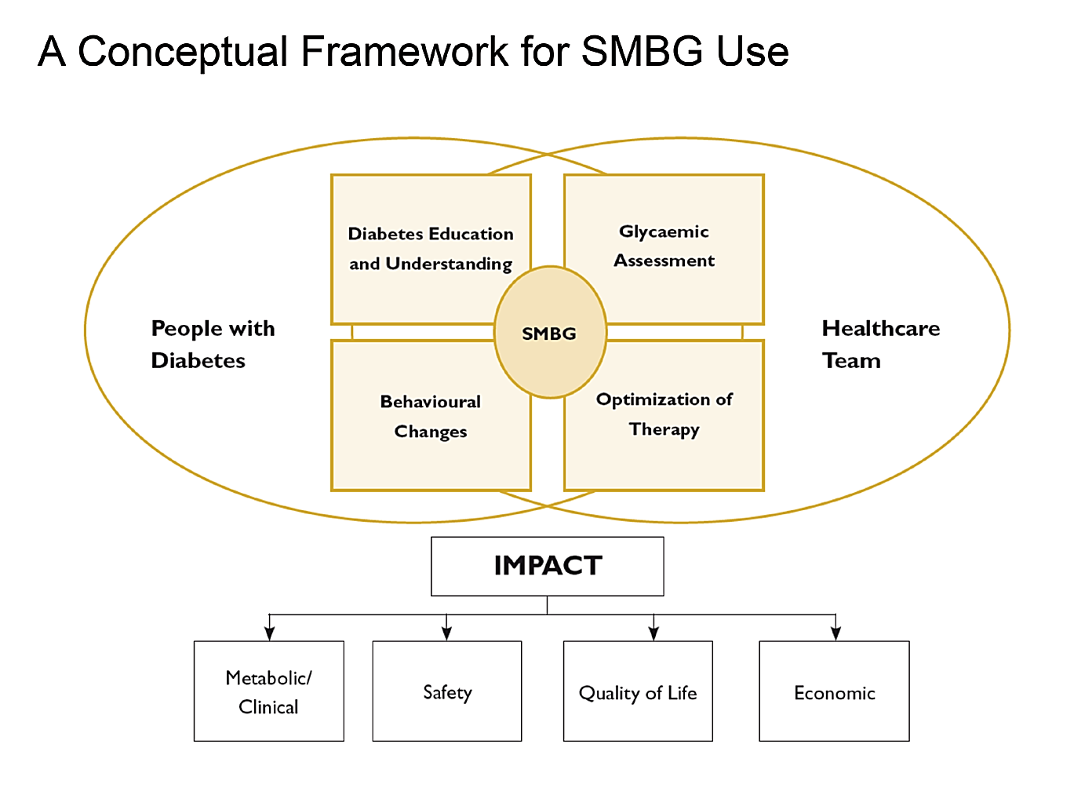
Conceptual Framework for SMBG Use
Notes:
International Diabetes Federation: Guideline: self-monitoring of blood glucose in non-insulin-treated type 2 diabetes. Brussels, Belgium, International Diabetes Federation, 2009. Available from www.idf.org/webdata/ docs/SMBG_EN2.pdf

Slide 46
Agenda
1
Introduction
2
Frequency and Timing of SMBG
3
SMBG Education Checklist
4
Interpreting SMBG
5
Conceptual Framework for SMBG Use
6
Dilemma

Slide 47
Dilemma
Few experts doubt the value of SMBG for patients using a MDI insulin regimen or insulin pump therapy:
Its utility in detecting hypoglycemia and dosing insulin
No universal standard for testing frequency for T₂DM

Slide 48
Dilemma
Data from the T₁D Exchange registry show that only ~33% of adults and 20% of children/adolescents are at the ADA treatment goals and <25% of diabetes patients utilized SMBG.
Individuals with T₁DM continue to experience prolonged episodes of hypoglycemia (<60 mg/dL) despite intensive management with insulin pumps, CGM, and frequent SMBG.
Notes:
Parkin, C. G., Homberg, A., & Hinzmann, R. (2016). 9th Annual Symposium on Self-Monitoring of Blood Glucose, April 28–30, 2016, Madrid, Spain. Diabetes Technology & Therapeutics, 18(11), 727-747.

Slide 49
Dilemma
Although new technologies have the potential to help patients achieve optimal glycemic control, one must also consider the trade-offs of adherence.
Essentially, it comes down to a ‘‘value proposition’’ the value of strict adherence to self-management compared with the impact on quality of life.
The use of current technologies clearly facilitates ‘‘diabetes health’’ but at the expense of ‘‘diabetes happiness.’’
This is likely a key factor that has limited widespread adoption of these technologies.

Slide 50
Thanks for your attention

