Slide 1
Congenital adrenal hyperplasia case report

Slide 2
Present illness
We report a case of 20 years virgine old female in mashhad had ambiggous genitalia since birth.
After 2 w nausea ,vomiting,two times seizure and hypotention was begin.the child was born out of non consangious marriage,the mother had never been treated with any drug during pregnancy.
The patient has been on fludrocortison & hydrocortison since 2 weeks after birth.

Slide 3
Present illness
At the age of 6months chromosomal analysis revealed an XX Karyotype Study .
Patient had clitoromegally,fusion of minor labia,single urovaginal opening (urogenital sinus anomaly) that at the age of 1years she has done genital surgery(genitoplasty).

Slide 4
Present illness
The patient underwent fludrocortison,Hydrocortison and then dexamethason treatment but she acknowledged poor adherence to treatment and irregular medical assistance.
Patient didn’t use her drug at 4years ago because of complication of drug i,e obesity.
Then after 3 months she had refered to endocrinologist with cutaneous and gingival ,lip,around areol hyperpigmentation,weakness,hypotention,loss of wieght.

Slide 5
Present illness
After this accident(in 93/5/4) because of left adrenal mass(adrenal cortical adenoma) she had underwent on adrenalectomy surgery.
Recently she had symptoms suggestive of virilization.there was history of deepening of voice,temporal buldging.
In 97/1/29 recurrently she had underwent on clitroplasty & uretroplasty &labioplasty surgery.

Slide 6
Past medical& surgical history
In 1394 she had numbness and tingling sensation in right hand with diagnosis of unilateral CTS he underwent surgery.
Hypothyroidism(from 1395)
Her menstural cycles had not started(primary amenorrhea)

Slide 7
Drug history
Tab hydrocortison 10mg/3 tab/daily
Tab fludrocortison 0.1mg/2tab/daily
Tab dexamethason 0.5mg/1tab/daily

Slide 8
Family history
She was the first sibling of her family and had a younger brother 14 years age(Height:170cm)
& another brother 19 years age(Height:184)
Her mother& father Height is more than 160cm.
Her mother attained menarch at the age of 13 years and have regular cycles and had no symptoms suggestive of virilization.

Slide 9
ROS
Excessive hair growth over on androgen dependent(hirsutism) from 9years of old
Deepening voice and virilization
Spotting
Reduced appetitis
Acne
strriae
No easy bruising

Slide 10
Puberty period:
Growth spurt:her peak height velocity was untill 10 years of age then was stopped.
Thelarc(apearence of breast tissue) was at 13 years of age
Menarche:amenorrhea
Pubarch:11 years

Slide 11
Upper lip

Slide 12
chin

Slide 13
Lateral arms

Slide 14
Mid sternum

Slide 15
Upper Abdomen

Slide 16
Lower abdomen

Slide 17
back

Slide 19
Ph/e
GA: The patient was conscious and oriented. Height : 146cm , BW:55 Kg BMI:25.8
Upper trunk/lower trunk:1.08 hirsutism score:26-27
V/S: BP: 95/65(no orthostatic chang) ,
PR: 75/min reg , OT: 37.0 C
On clinical examination the patient had hirsutism and had amusculine look.
Cutaneous examination of the patient showed long multipele non prulant striae (<1cm) over the arms,abdomen, and legs

Slide 20
Thyroid was in normal size of 20g, no nodule is detected
Breast:tuner 3
Cardiac and pulmonary ascultation was normal
Muscel force and tone was normal and no myopathy
Labia major and minor and uretheral orifice were normal.

Slide 21
97/5/28 | 96/6/6 | 95/11/6 | 94/8/4 | 93/11/1 | 89/5/6
0.025ng/ml (0.06-0.82) | 3.9ng/ml |  | 0.3ng/ml | 0.1 ng/ml | 8.5ng/ml | testeron
6.73ng/dl (65-368) | 6.9ng/ml |  | 0.2ng/ml | 0.2ng/ml | 3.1ng/ml | DHEA
0.01 ng/ml (0.39-3.6) | 69ng/ml | >20ng/ml | 13.4ng/ml | 0.8ng/ml | 7ng/ml | 17(OH) Progestron
9.2pg/ml(7.2-63.3) | >1250pg/ml |  | 16.3 pg/ml |  |  | ACTH
0.01ng/ml | 37ng/ml | 30ng/ml |  |  |  | PRA
135 | 136 | 133 | 133 |  |  | Na
4 | 5.2 | 4.5 | 5.7 |  |  | K

Slide 22
97/5/28 | 96/12/14 | 96/10/11 | 96/6/6 | 95/11/4 | 93/11/19
1.07mIU/l | 0.3mIU/l | 1.8mIU/l | 6.9mIU/l | 26.9mIU/l | 3.91mIU/l | TSH
 | 97/5/28 | 96/12/19 | 96/10/11 | 94/11/29 | 94/8/4
 | 9.2pg/ml | >2000pg/ml | >1250pg/ml | 5.4pg/ml | 16.3pg/ml | ACTH

Slide 23
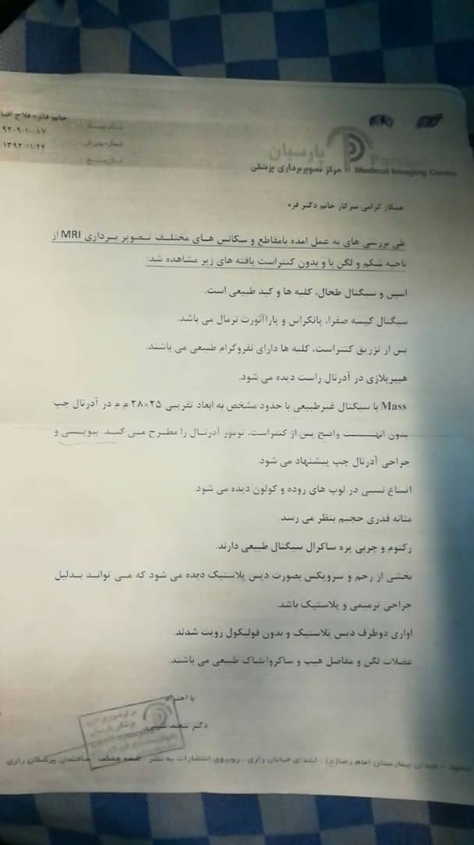

Slide 24
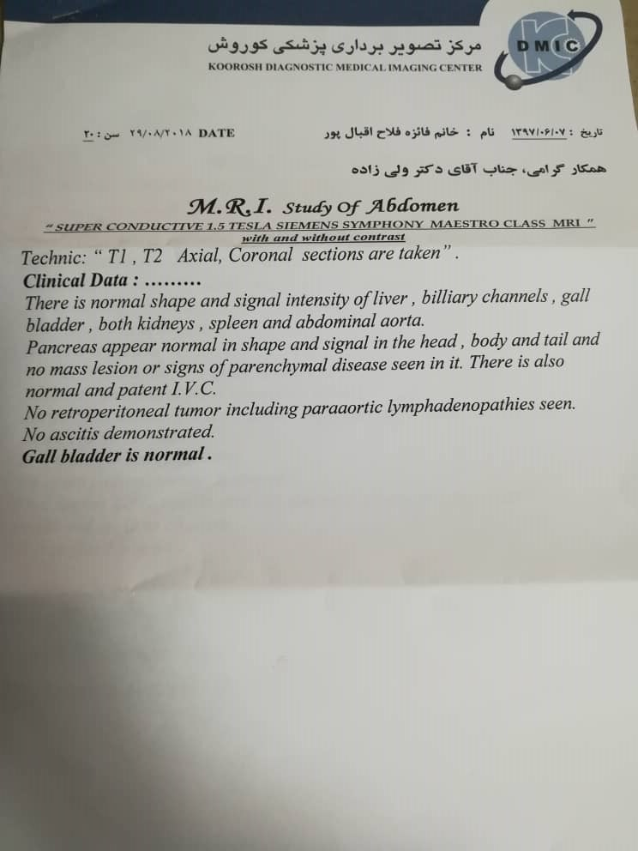

Slide 25
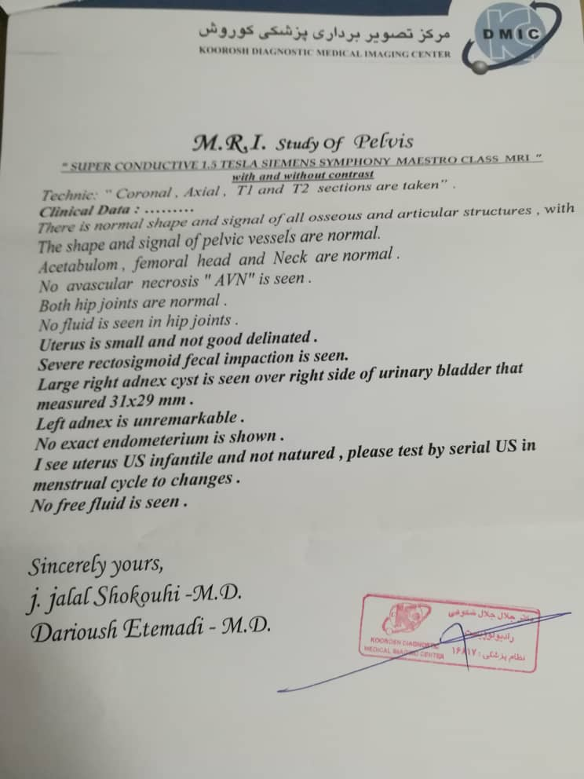

Slide 26
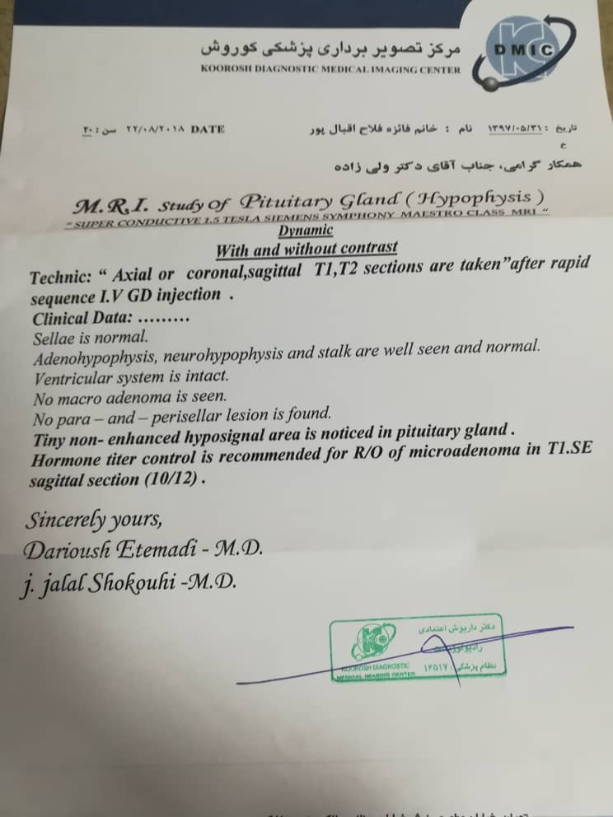

Slide 28
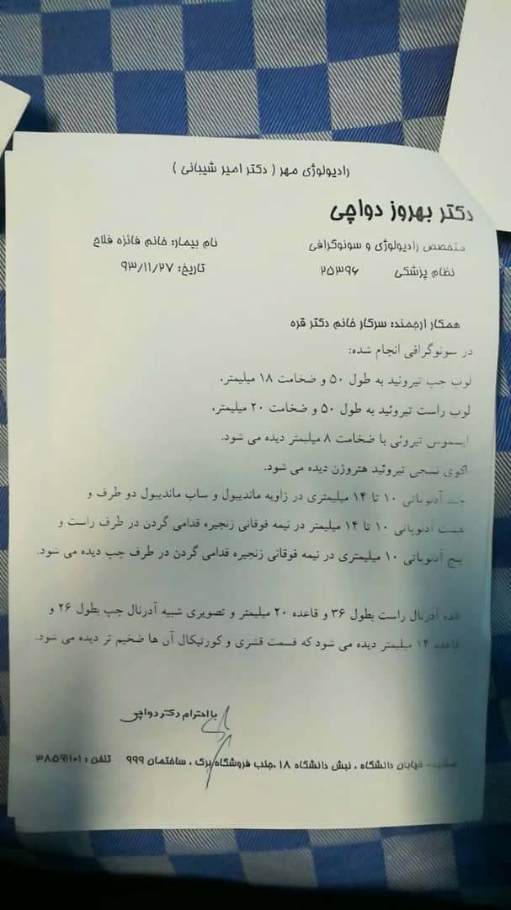

Slide 30
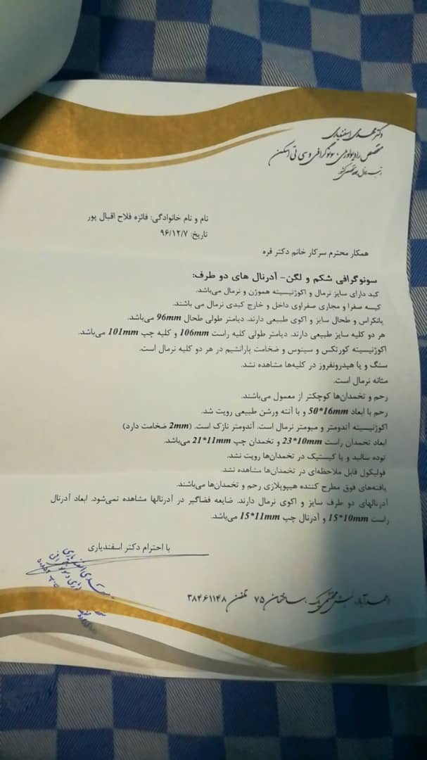

Slide 31
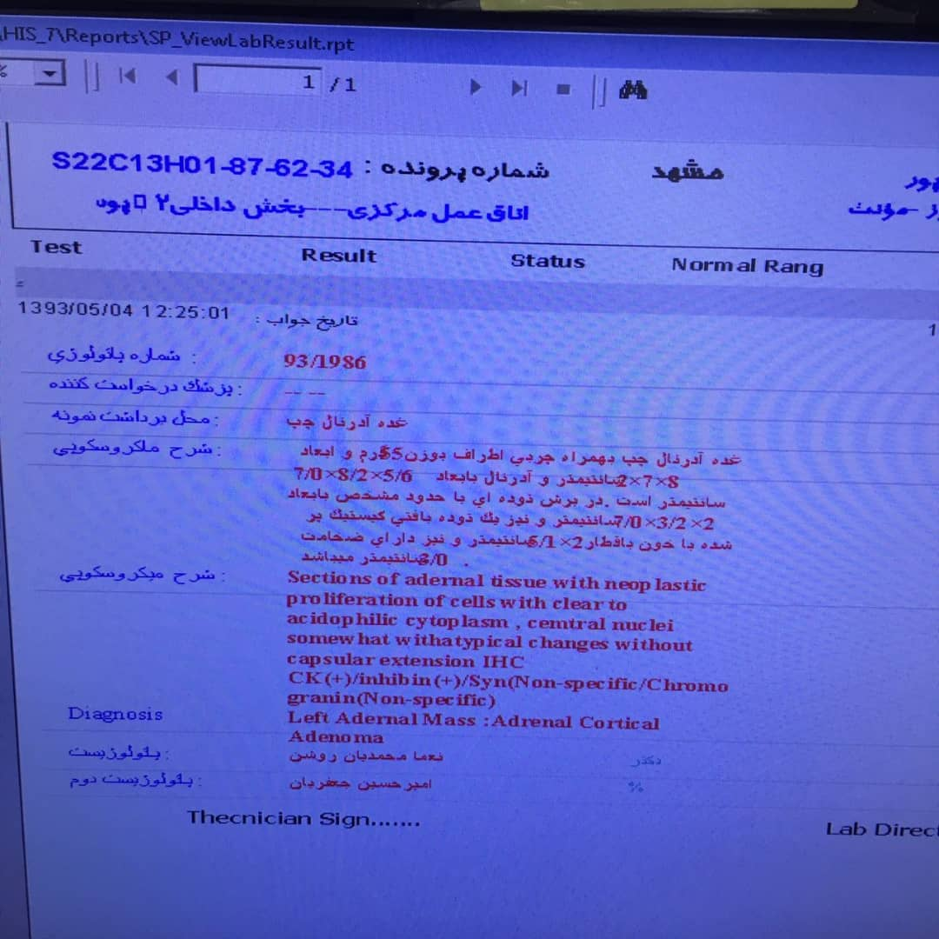

Slide 32
Thank you

