Slide 1
Pituitary Stalk Lesions
Omid Gharooei Ahangar

Slide 2
Problem list
Young healthy woman
Prolactinemia with micro adenoma
Mass of stalk
Ca in ULN
PTH high
Vitamin D low
IGF 1 HIGH

Slide 3
AGENDA
DDX of pituitary stalk lesion
Kinds of stalk lesion shape in MRI
DDX of any shape
What DX close to our patient
What the next plan

Slide 4
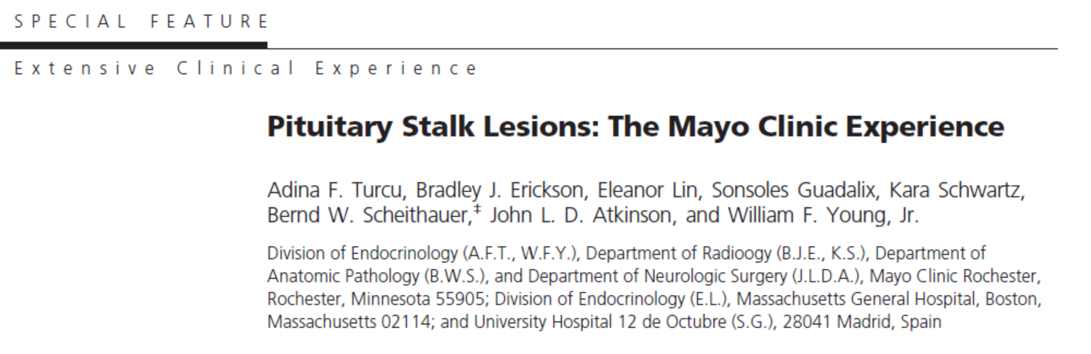

Slide 5
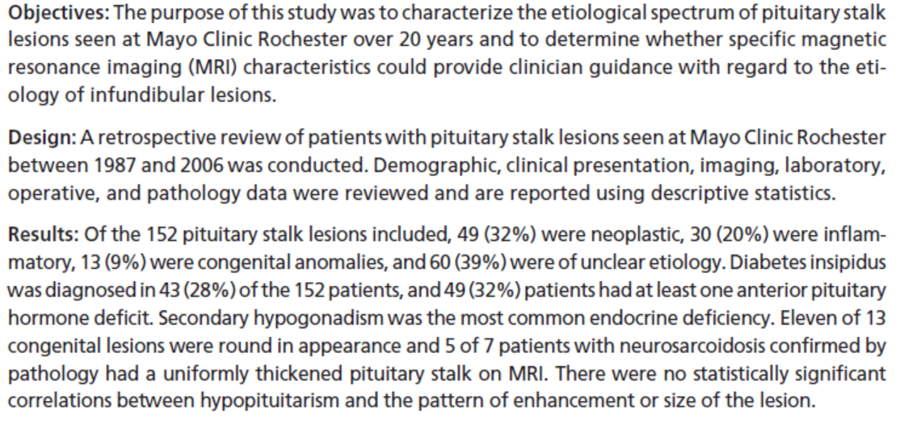

Slide 6
The etiological spectrum of these lesions is broad and can be divided in 3 categories:
neoplastic
inflammatory/infectious
Congenital.

Slide 7
In our patient
Because of chronicity it is unlikely to be malignant cause so I can not consider it.
Also the lesion was not cystic so DDX of cystic can not be consider.
So DX limited to some congenital or inflammatory cases.

Slide 8
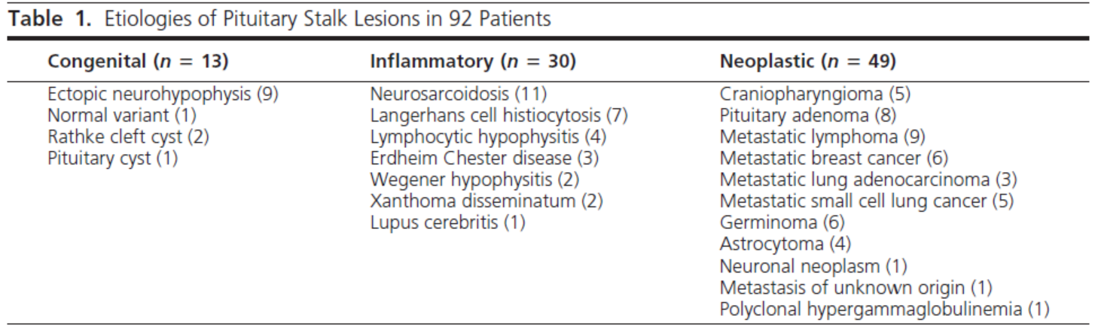

Slide 9
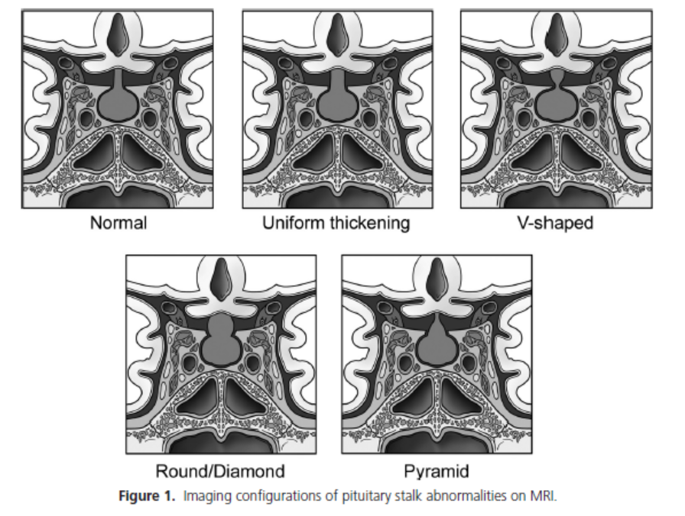

Slide 10
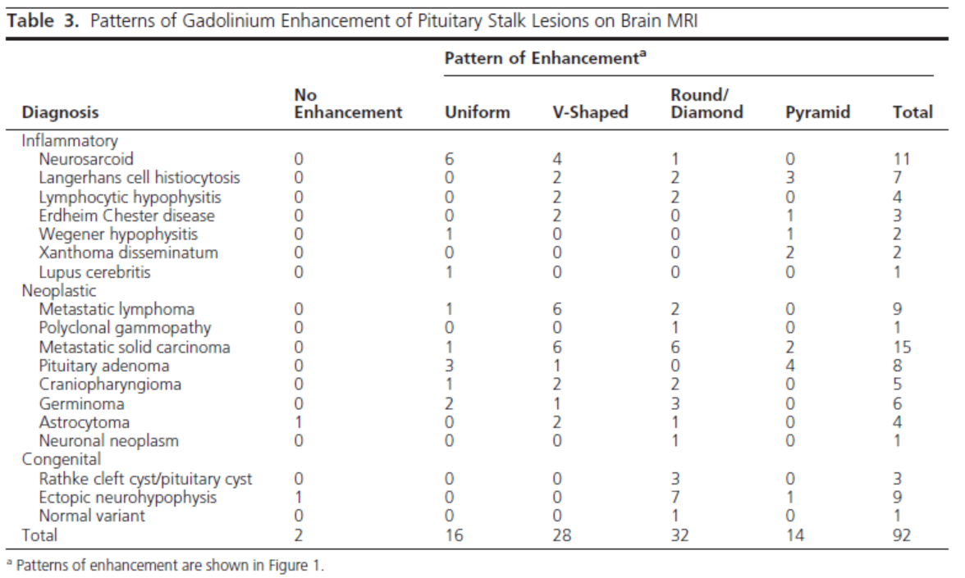

Slide 11
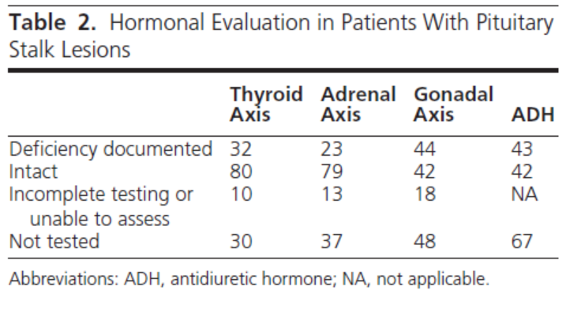

Slide 12
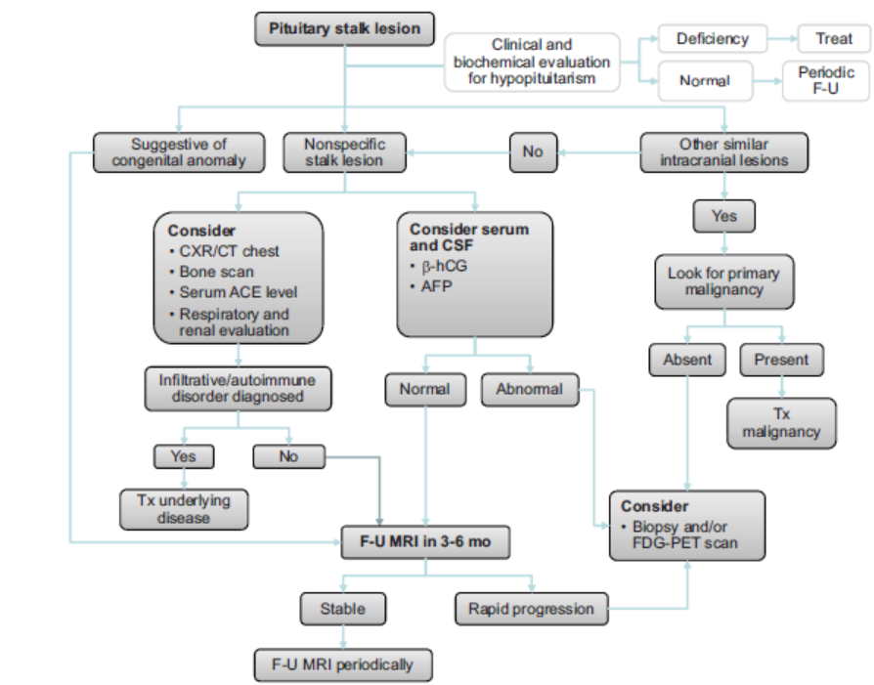

Slide 13
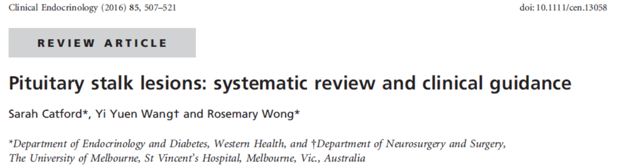

Slide 14
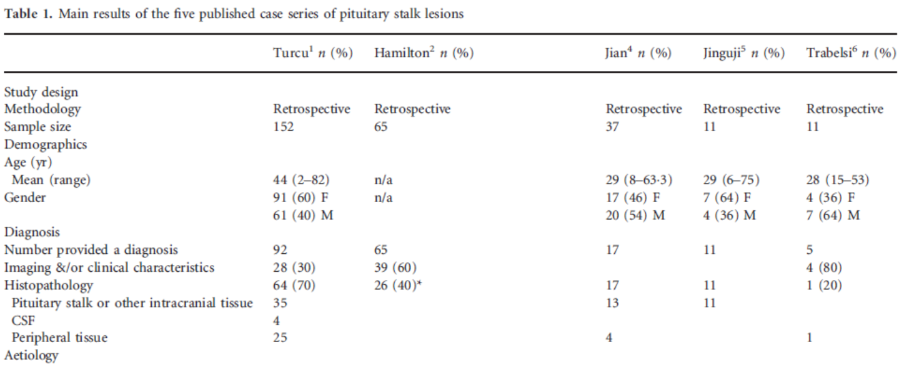

Slide 15
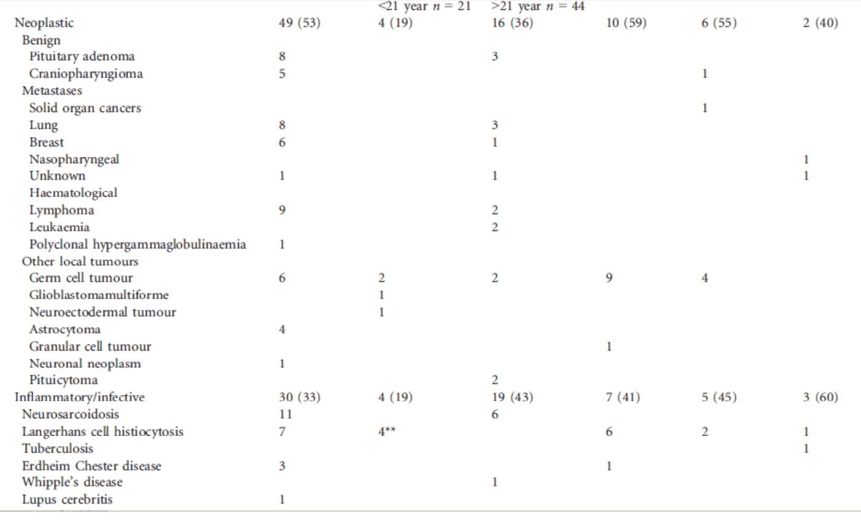

Slide 16
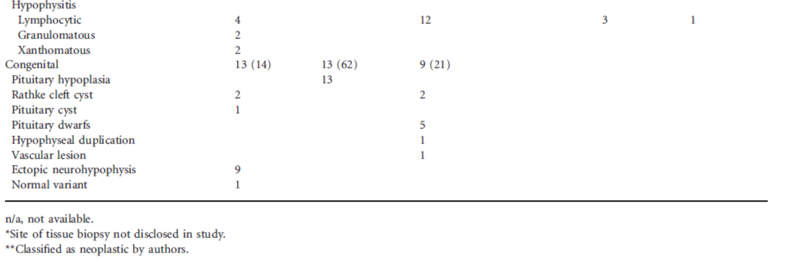

Slide 17
Investigating a pituitary stalk lesion
All patients discovered to have a PS lesion, including incidental cases should undergo the following noninvasive preliminary investigations.
• Anterior pituitary hormones (FSH , LH, testosterone (men), estradiol (women), ACTH, cortisol, TSH, fT4, prolactin, GH, IGF-1)
• Full blood examination, blood film, biochemistry, calcium and phosphate, renal and liver function
• Markers of cell turnover (LDH, B2M) and inflammation CRP (C-reactive protein), ESR (erythrocyte sedimentation rate)
• Serum ACE, 1,25 dihydroxyvitamin D
• Serum AFP (alpha-fetoprotein) and hCG (human chorionic gonadotropin)
• c-ANCA (cytoplasmic antineutrophil cytoplasmic antibody)
• Quantiferon Gold in the presence of risk factors for tuberculosis.
Urinalysis
• CT neck, chest, abdomen and pelvis with contrast

Slide 18
Incidental pituitary stalk lesion
We suggest clinical review and repeat pituitary hormone testing in 3 months, and MRI pituitary in 6 months, and thereafter every 6–12 months during the first 2– 3 years.
If the PS lesion increases significantly in size (>65 mm in width) or new lesions develop, or if pituitary hormone deficiency arises or the patient’s clinical status changes, then we suggest proceeding to more invasive investigations including consideration of PS biopsy.

Slide 19
BX
We suggest PS biopsy when all the following criteria are met:
Isolated PS lesion (especially if width >65 mm) with or without associated pituitary pathology on imaging. (Normal measuring 3.25±0.56 mm in transverse diameter at the optic chiasm and 1.91±0.40 mm at its pituitary insertion)
CDI and/or hypopituitarism, or progressive disease on imaging.
Diagnosis unclear from extensive investigations.
Alternate tissue sites for biopsy not available or accessible.
Pituitary neurosurgical expertise available.

Slide 20
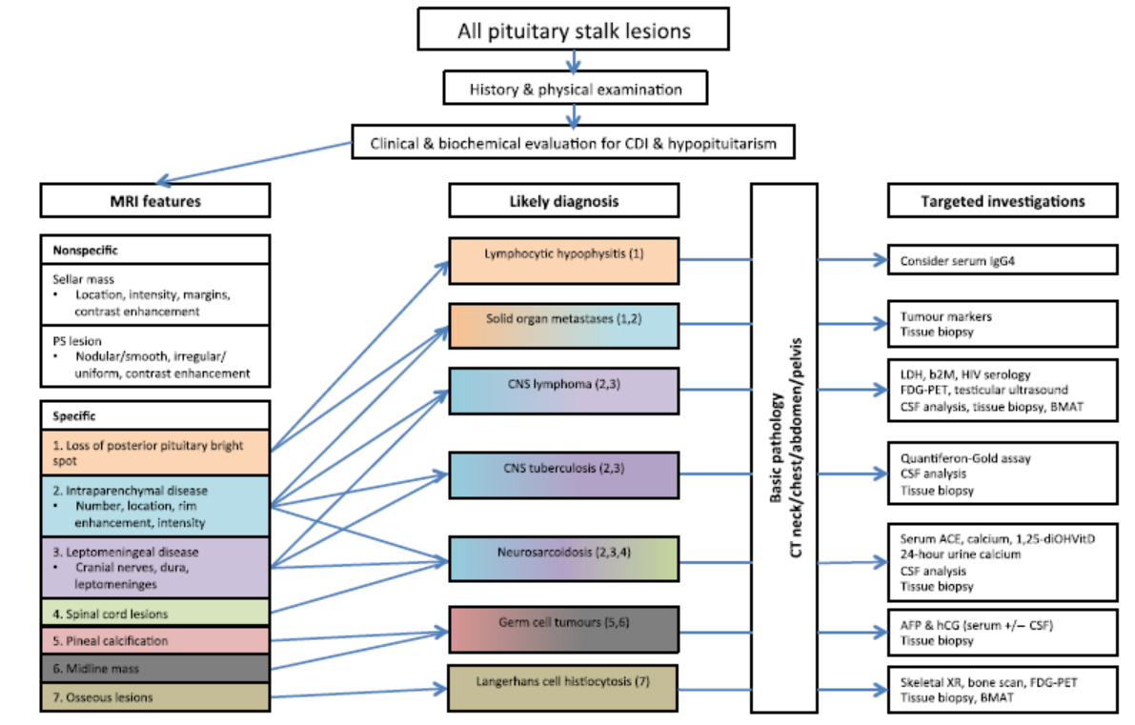

Slide 21


Slide 22
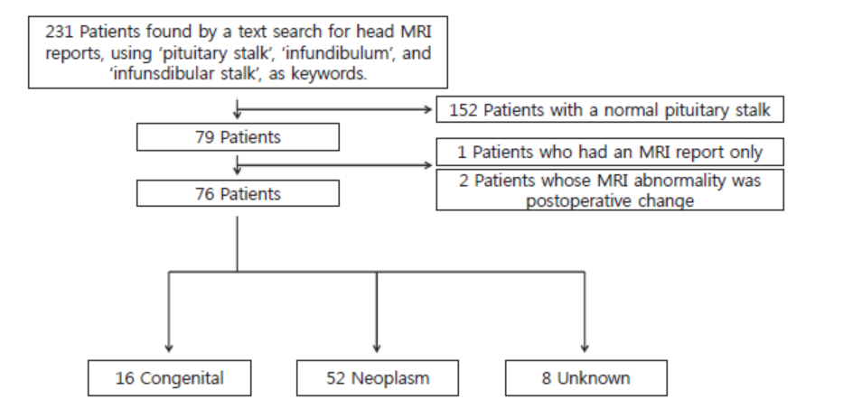

Slide 23
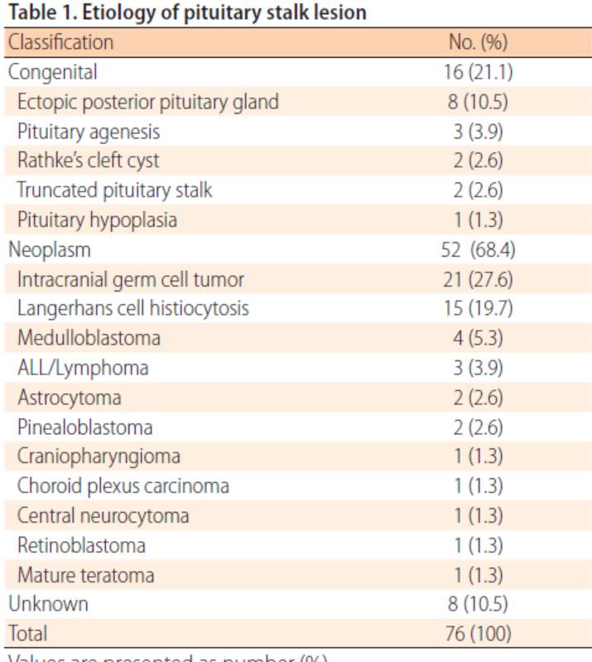

Slide 24
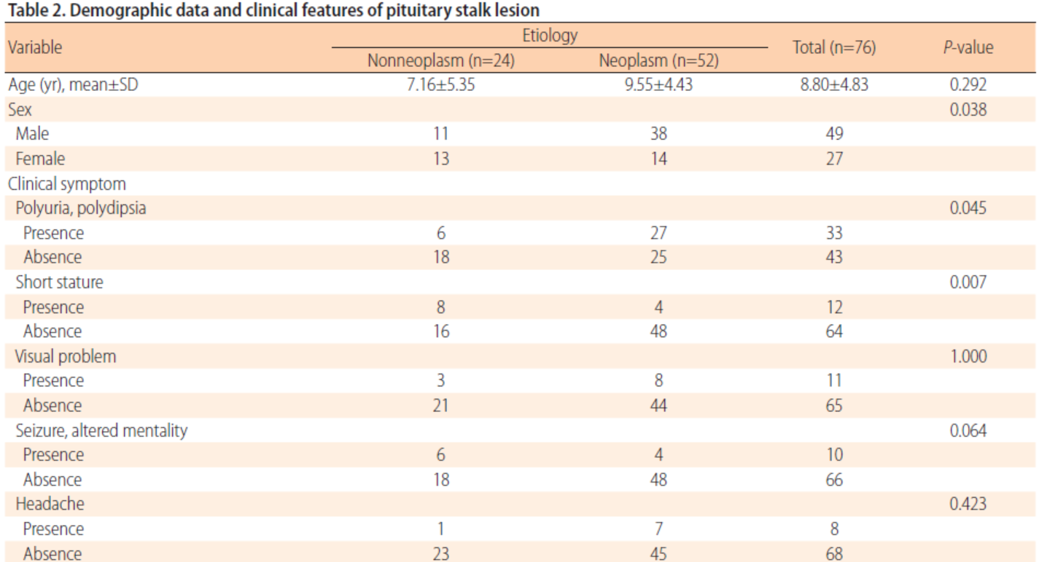

Slide 25
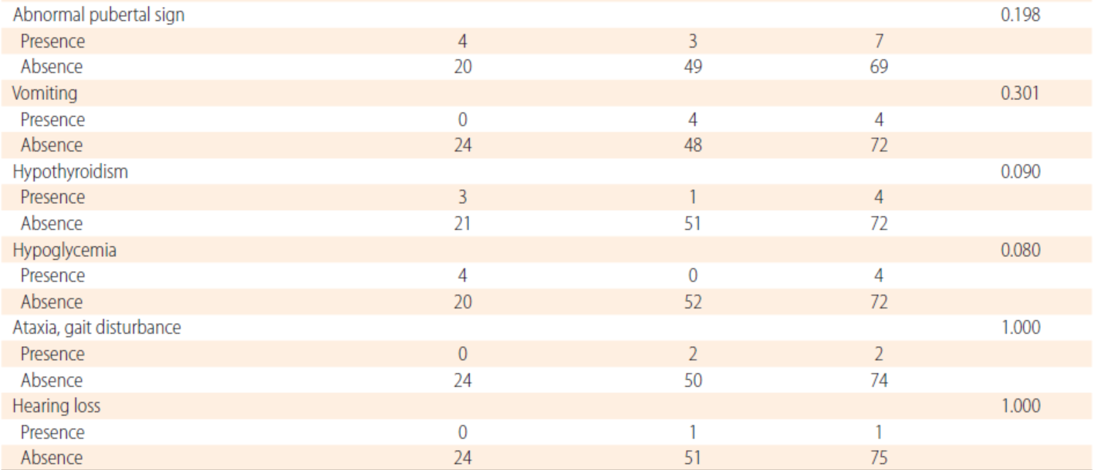

Slide 26
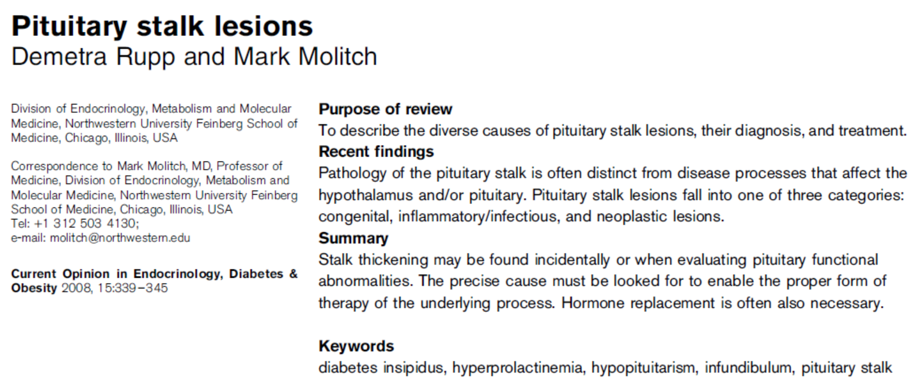

Slide 27
Congenital lesions
Pituitary stalk interruption syndrome is characterized by the following: an ectopic posterior pituitary, a hypoplastic anterior pituitary, and lack of or significant thinning of the pituitary stalk. On MRI, the ectopic posterior pituitary appears as a high-signal nodule in the area of the infundibular recess of the third ventricle. GH deficiency is a common feature.
septooptic dysplasia, is characterized by midline forebrain abnormalities, optic nerve hypoplasia, and hypopituitarism.
Duplication of the pituitary, including the stalk has been reported. These cases are often associated with midline facial abnormalities and many of these patients die in infancy.

Slide 28
What about calcium?

Slide 29
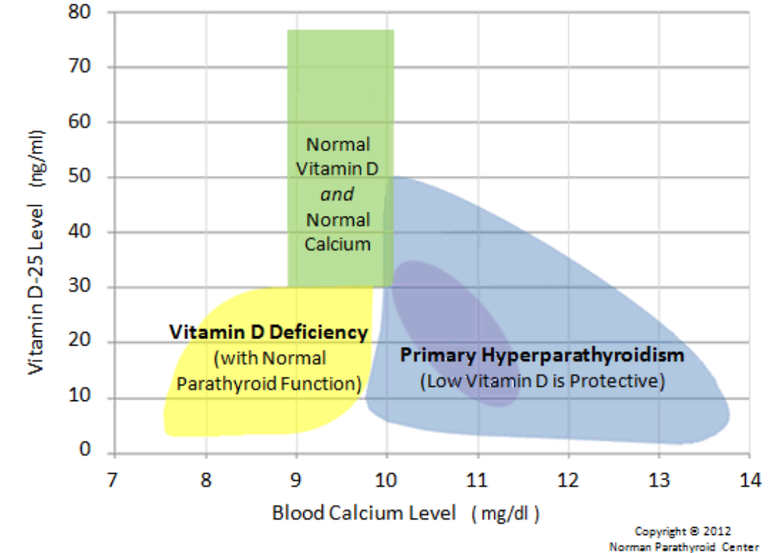

Slide 30
Here is the most important fact on this page:
since vitamin D is required for humans to absorb calcium in their intestines, a low vitamin D cannot ever be the cause of high blood calcium. This fact is not debatable.
Thus, if you have a low vitamin D and your calcium is above 10.0, then the high calcium in your blood must have come from somewhere else other than your diet (it came from your bones). Thus, if you have a low vitamin D, and a calcium level above 10.1, then you are almost guaranteed to have primary hyperparathyroidism

Slide 31
What is next step?
I am suggested BX of lesion Because of size and progression
Correction of vitamin D
Repeated IPTH after correction
Urine 24 hours for hypercalciuria
GTT for elevated IGF-1
Consider MEN_1

Slide 32
Lymphocytic hypophysitis
Although it most commonly affects the anterior pituitary, and rarely involves the posterior pituitary and PS.
A probable diagnosis of lymphocytic hypophysitis can be made on the basis of clinical, laboratory and imaging findings, however histopathology is required for a definitive diagnosis.
Current literature supports the use of supraphysiological doses of glucocorticoids when there is significant enlargement of the pituitary or PS, CDI or hypopituitarism.

Slide 33
Neurosarcoidosis
neurosarcoidosis occurs in 5–15% of cases and usually in the context of widespread disease.
The pituitary, PS or hypothalamus are affected in 18% of patients with neurosarcoidosis.
Neurosarcoidosis requires a tissue sample for diagnosis. Serum ACE is a useful preliminary investigation (specificity 95%, sensitivity 24–76%).
Chest imaging is useful as it is abnormal in up to 90% of patients with systemic sarcoidosis.
The presence of ACE in the CSF is highly specific (94– 95%), but lacks sensitivity (24–55%) and therefore is not recommended as a first-line investigation.

