Slide 1
Gastrointestinal Manifestations of MEN2B
Dr. Abolfazl Heidari

Slide 2
PREVALENCE AND EPIDEMIOLOGY
MTC accounts for only 5% to 10% of all thyroid cancers.
Although 25% of patients with MTC occur in well defned familial endocrine syndromes with autosomal dominant inheritance, 75% of MTC cases are sporadic.
Endocrinology Adult and Pediatric, De Groot 7th ed 2016, Volume II

Slide 3
PREVALENCE AND EPIDEMIOLOGY
MEN 2A refers to the occurrence of MTC in association with pheochromocytoma in 50% of cases, and in association with hyperparathyroidism in 20% to 30% of cases.
MEN 2B consists of MTC in conjunction with pheochromocytoma and several additional features, including mucosal neuromas, ganglioneuromatoses of the gastrointestinal tract, and a marfanoid habitus.
Familial medullary thyroid carcinoma (FMTC) describes the autosomal dominant inheritance of MTC alone. Most authors regard FMTC as a low-risk variant of MEN 2.
Endocrinology Adult and Pediatric, De Groot 7th ed 2016, Volume II

Slide 4
PREVALENCE AND EPIDEMIOLOGY
The overall prevalence of MEN 2 is approximately 1:25,000.
The penetrance is approximately 70% at 70 years of age. It has been reported that 90% of MEN 2 carriers will eventually show evidence of MTC.
This contrasts with MEN 1, in which penetrance is 94% by 50 years of age.
Endocrinology Adult and Pediatric, De Groot 7th ed 2016, Volume II

Slide 5
MOLECULAR PATHOGENESIS:
RET PROTO-ONCOGENE
The the RET (REarranged during Transfection) proto-oncogene gene is located on chromosome 10q11.2.
The RET proto-oncogene encodes a tyrosine kinase cell surface receptor.
RET mutations have been characterized in approximately 98% of MEN 2 families overall.
In MEN 2A and FMTC, approximately 97% of families will have an identifable RET germ line mutation, and in MEN 2B, approximately 98% of families are mutation positive.
Endocrinology Adult and Pediatric, De Groot 7th ed 2016, Volume II

Slide 6
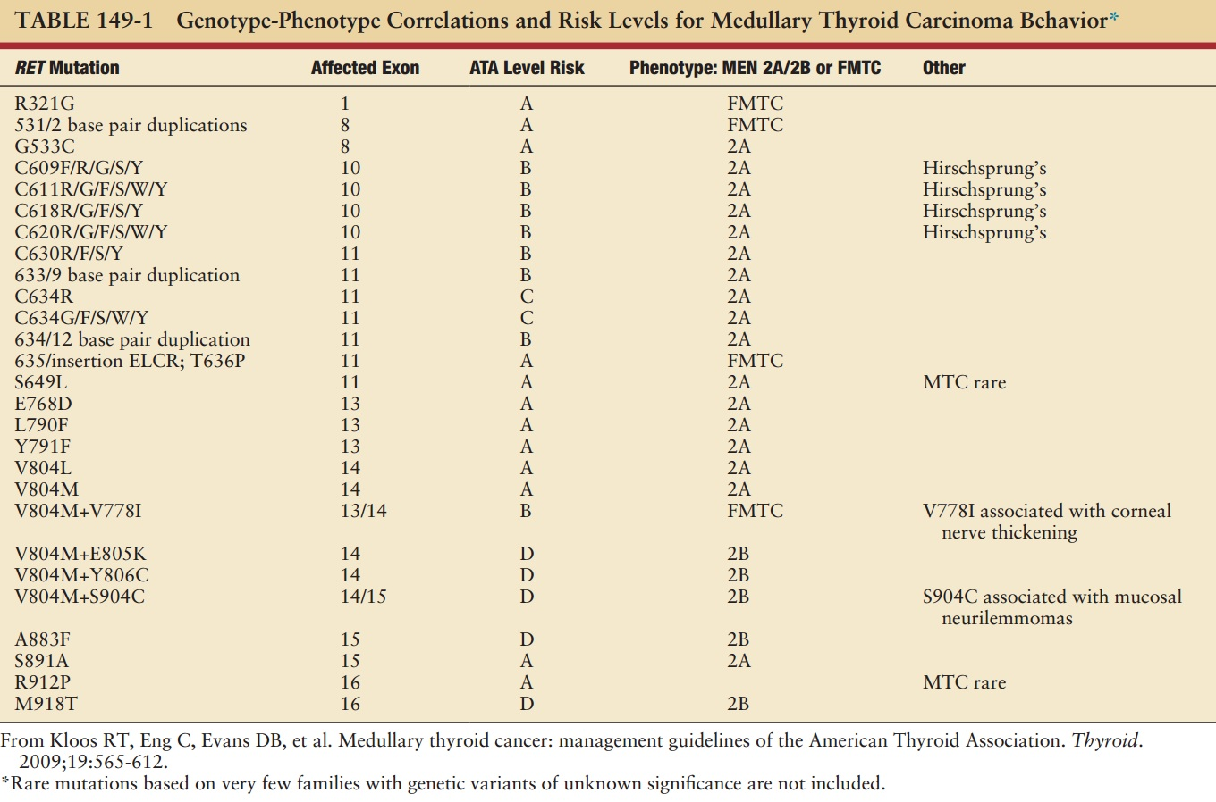
Endocrinology Adult and Pediatric, De Groot 7th ed 2016, Volume II

Slide 7
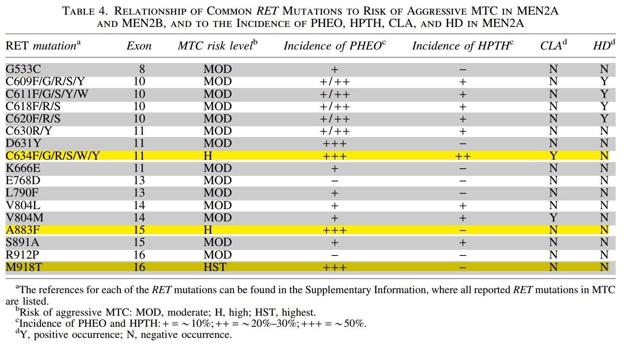
Revised ATA Guidelines for the Management of MTC 2014

Slide 8
MEN 2B
In 95% of MEN 2B families, the germ line RET mutation at codon 918 in exon 16 occurs, causing a mutation of methionine to threonine (M918T). This mutation is in the tyrosine kinase domain and is specifc to MEN 2B.
This codon 918 RET mutation is also found somatically in the tumor tissue in some sporadic MTCs.
A germ line RET codon 918 mutation can also occur de novo, where MEN 2B patients have no family history of the disease. However, they still have a 50% chance of passing this mutation on to their offspring.
Endocrinology Adult and Pediatric, De Groot 7th ed 2016, Volume II

Slide 9
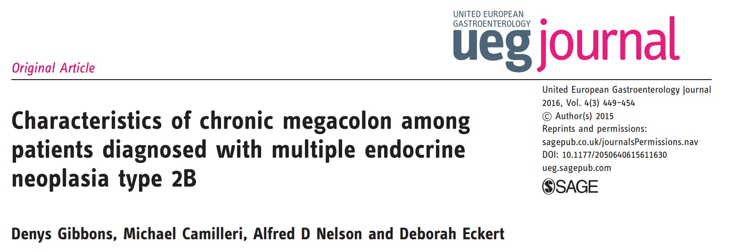

Slide 10
Our aim was to review the clinical features of patients with MEN 2B and megacolon by analysis of electronic medical records (EMRs) of patients diagnosed at Mayo Clinic between 1995 and 2015. From review of these EMRs, we identified three more patients with megacolon and MEN 2B evaluated before 1995, and retrieved their records, which were in paper form.

Slide 11
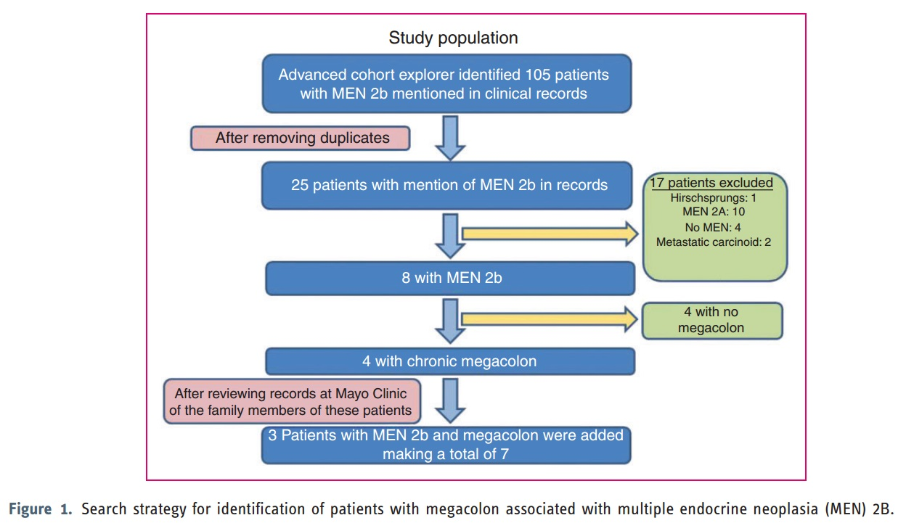

Slide 12
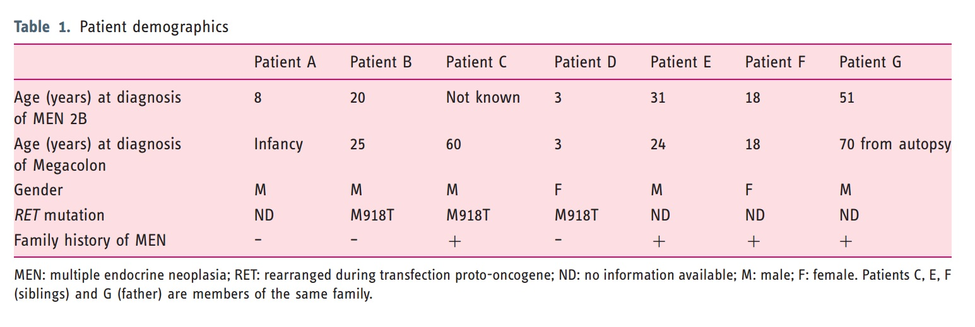

Slide 13
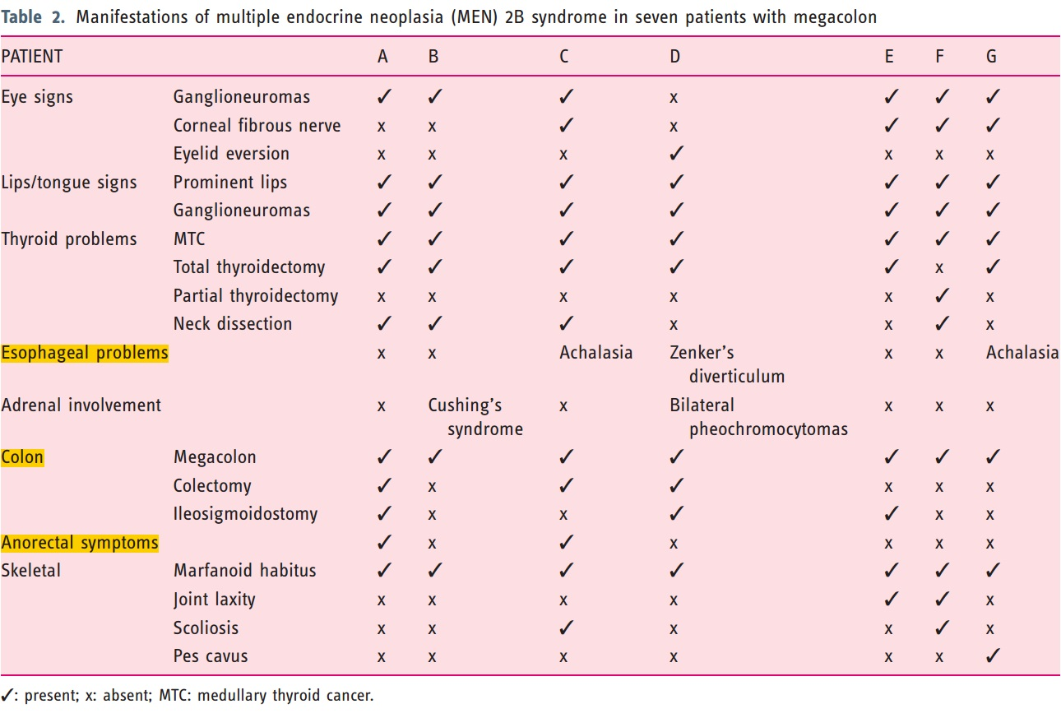

Slide 14
Megacolon
Seven of 11 (63%) patients with MEN 2B had megacolon (Table 2); four underwent colectomy with ileosigmoidostomy, one had total colectomy with ileorectal anastomosis.
The colon in one patient was recorded as 20 cm in diameter, including the cecum (20 cm). On histopathology, the commonly encountered changes were hypertrophy, hyperplasia and dysplasia of ganglion cells, and enteric or subserosal nerve hypertrophy.
Megacolon is caused by loss of normal bowel tone, leading to segmental distension and dilation.

Slide 15
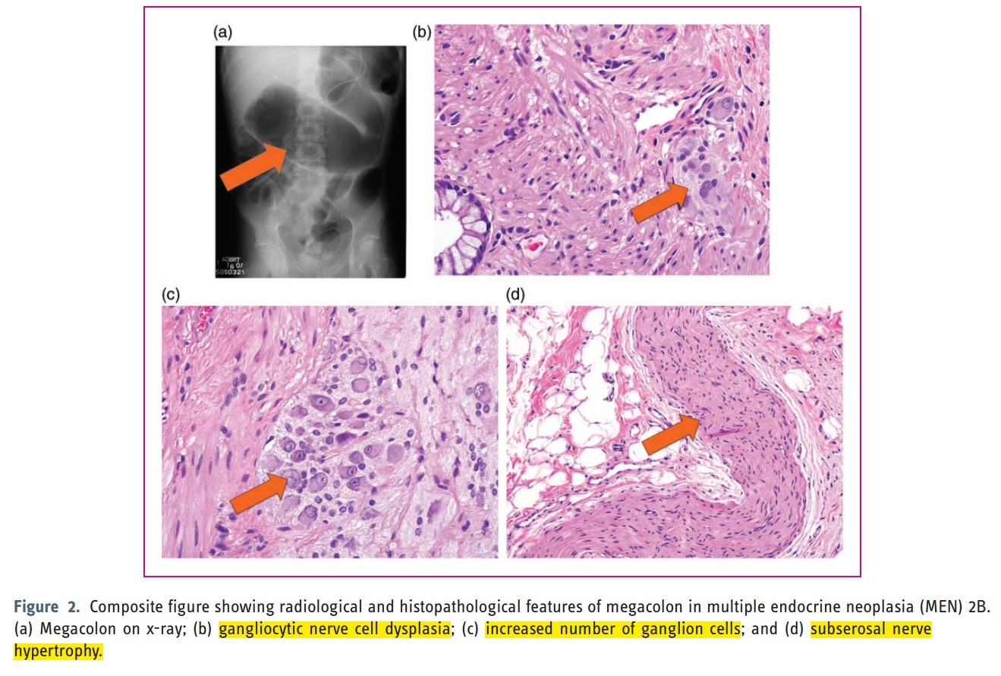

Slide 16
This study found that of the 11 patients who were diagnosed with MEN 2B, seven (63%) had megacolon.
This study documented that there was a relatively high prevalence of esophageal dysfunctions (42%, three of seven patients) in MEN 2B, suggesting neuromuscular dysfunction in MEN 2B.

Slide 17
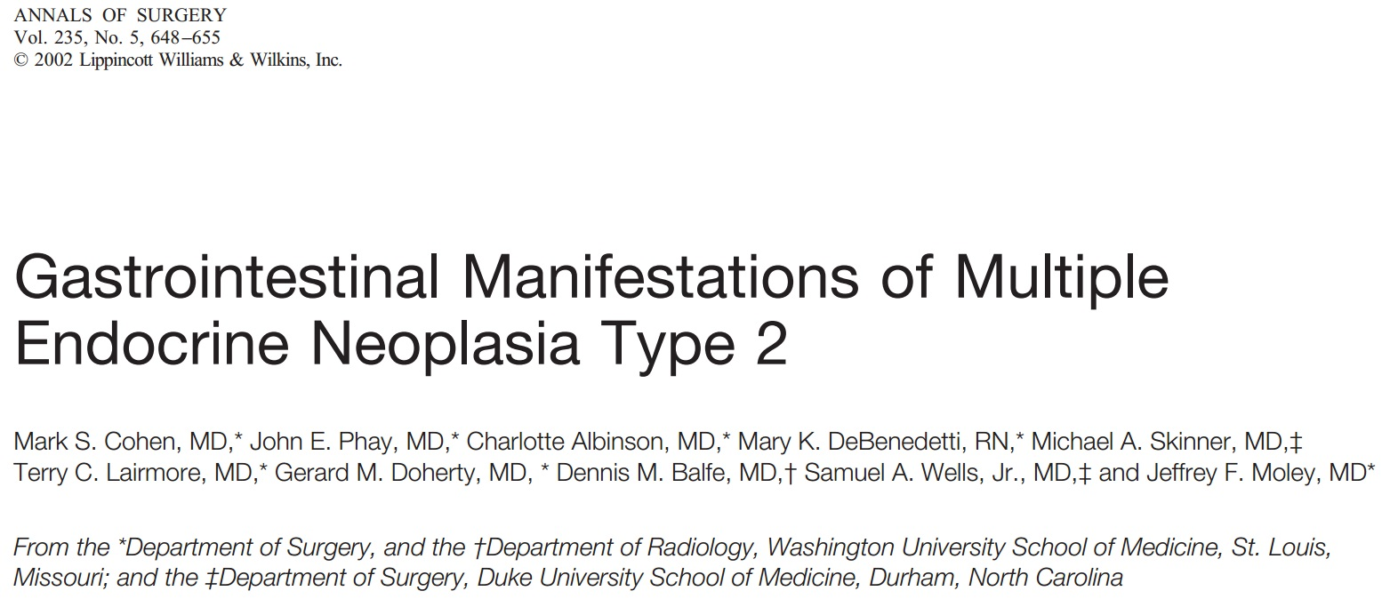

Slide 18
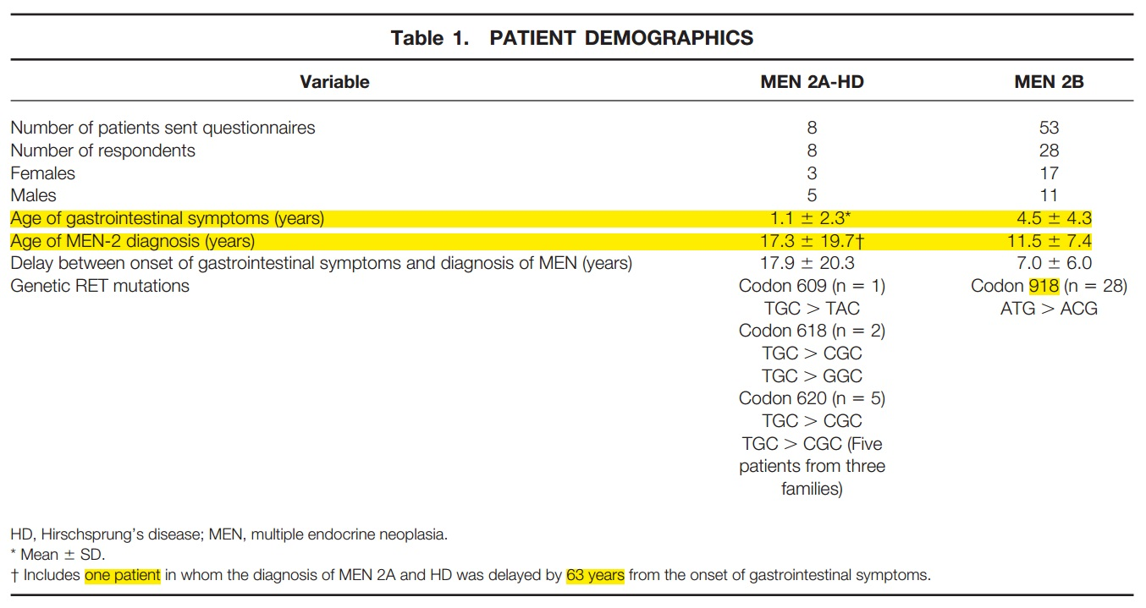

Slide 19
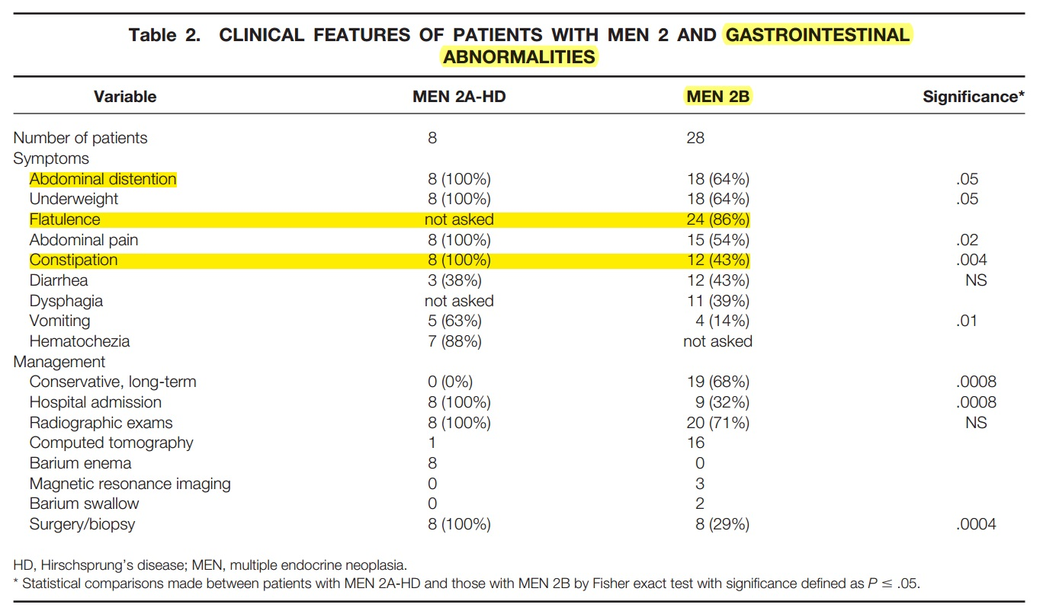

Slide 20
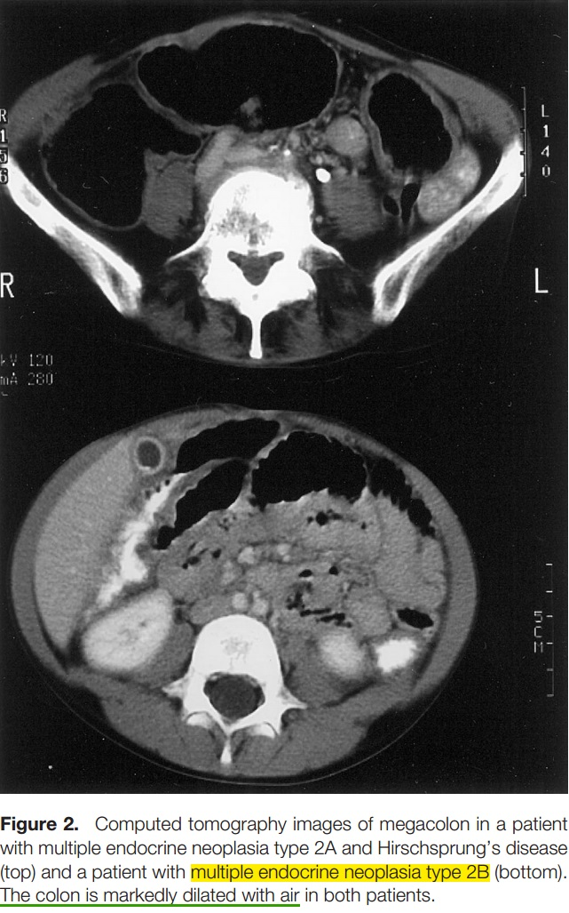

Slide 21
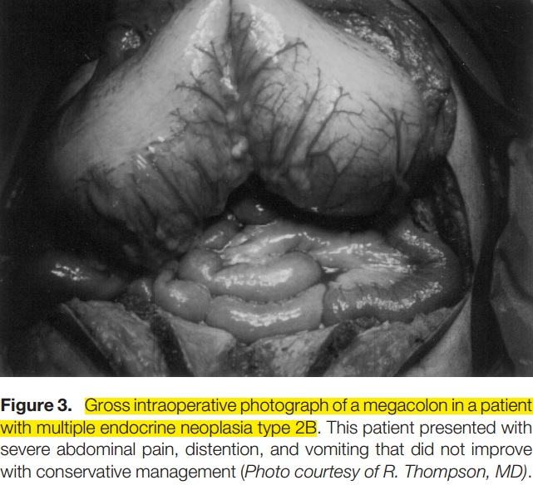

Slide 22
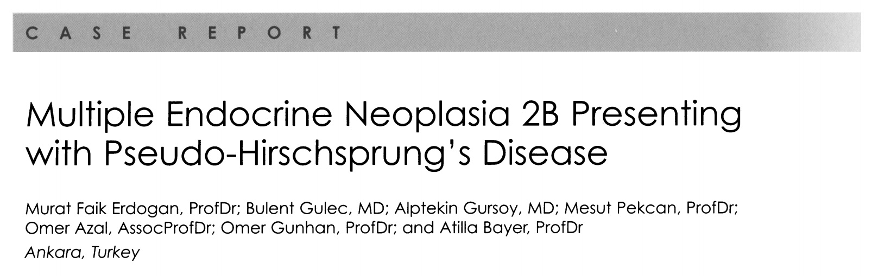

Slide 23
A 21-year-old male was admitted to our hospital mainly with the complaints of constipation since early childhood.
Patient's past medical history revealed a long-lasting chronic constipation and several operations due to intestinal obstructions.
He had subtotal thyroidectomy in his local hospital with a diagnosis of euthyroid multinodular goiter three years ago. Thyroid histopathological specimens obtained from his local hospital showed multicentric microscopic lesions of MTC in both thyroid lobes.

Slide 24
Gastrointestinal radiological examination with barium and computed tomography has shown severely dilated intestinal segments at the level of both small and large intestines at the follow-up (Figure 1).
Emergent laparotomy was performed when he presented with abdominal pain, fever, chills, nausea, vomiting and constipation, because of the patient's intestinal dysmotility and marked colon dilatation caused by acute bowel obstruction.
During laparotomy, diffusely enlarged and thickened distal transverse and proximal descending colon was observed.

Slide 25
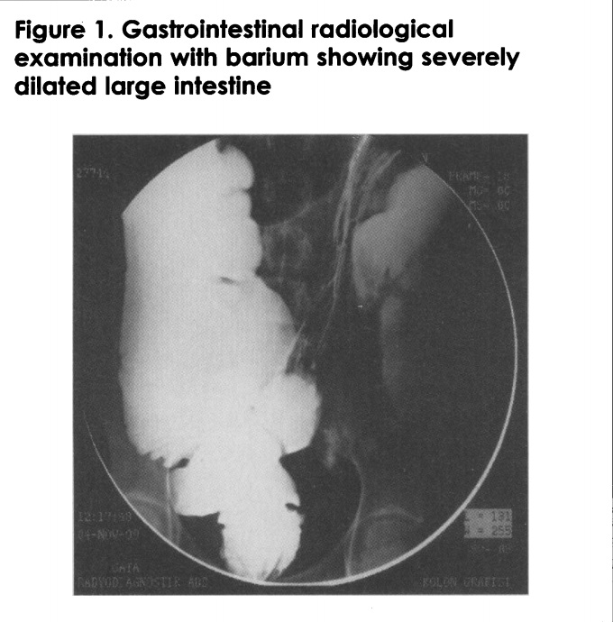

Slide 26
Histopathological examination showed diffuse intestinal ganglioneuromatosis with abundant neural tissue in both the myenteric and submucosal nerve plexus involving the resected colon segment and biopsies from the remaining colon and small intestine.
There were diffuse hyperplasic and disorganized mature ganglion cells and nerve fibers.
Aganglionosis was not detected.

Slide 27
On admission, the 24-hour excretion levels of urinary catecholamine metabolites were normal with VMA of 4.9 mg/24 hr (normal range, 1.9-9.8 mg/24 hr) and metanephrine of 0.76 mg/24 hr (normal range, 0.01-1 mg/24 hr).
However, screening for pheochromocytoma with magnetic resonance imaging detected a mass lesion of 4 cm in the left adrenal gland. The patient underwent unilateral open transabdominal adrenalectomy and the histopathological examination confirmed the presence of a pheochromocytoma.

Slide 28
The family history was unremarkable. The parents of the patient and four brothers were reported to be in good states of health.
Genetic testing revealed a germline mutation of the ret proto-oncogene in codon 918 in exon 16.
A further genetic analysis of the first-degree relatives revealed no affected family members. Therefore, it was concluded that the patient had a de novo MEN 2B mutation.

Slide 29
Thank you

