Slide 2
اپیدمیولوژی دیابت در جهان و ایران

Slide 3
Overview of the talk

Slide 4
The History of Diabetes

Slide 5
Avicenna (980-1037) (Princeps Doctorum)

Slide 6
The Road to Insulin

Slide 7
Classification of diabetes (WHO, ADA etc.)

Slide 9
Natural history of type 2 diabetes

Slide 10
Diabetes: A significant threat to public health

Slide 11
Worldwide, 1 in 11 adults has diabetes

Slide 12
Prevalence of diabetes and impaired fasting glucose in the adult (20-64 years) urban population of Iran

Slide 13
High prevalence of diabetes and abnormal glucose tolerance in adult population (≥20 years) of Tehran

Slide 14
Incidence rates of type 2 diabetes in the adult population (≥20 years) of Tehran (1999-2011)

Slide 15
Estimation of the Prevalence of glucose intolerance in Iran

Slide 17
TLGS Cohort: follow-up phases and Response Rates

Slide 21
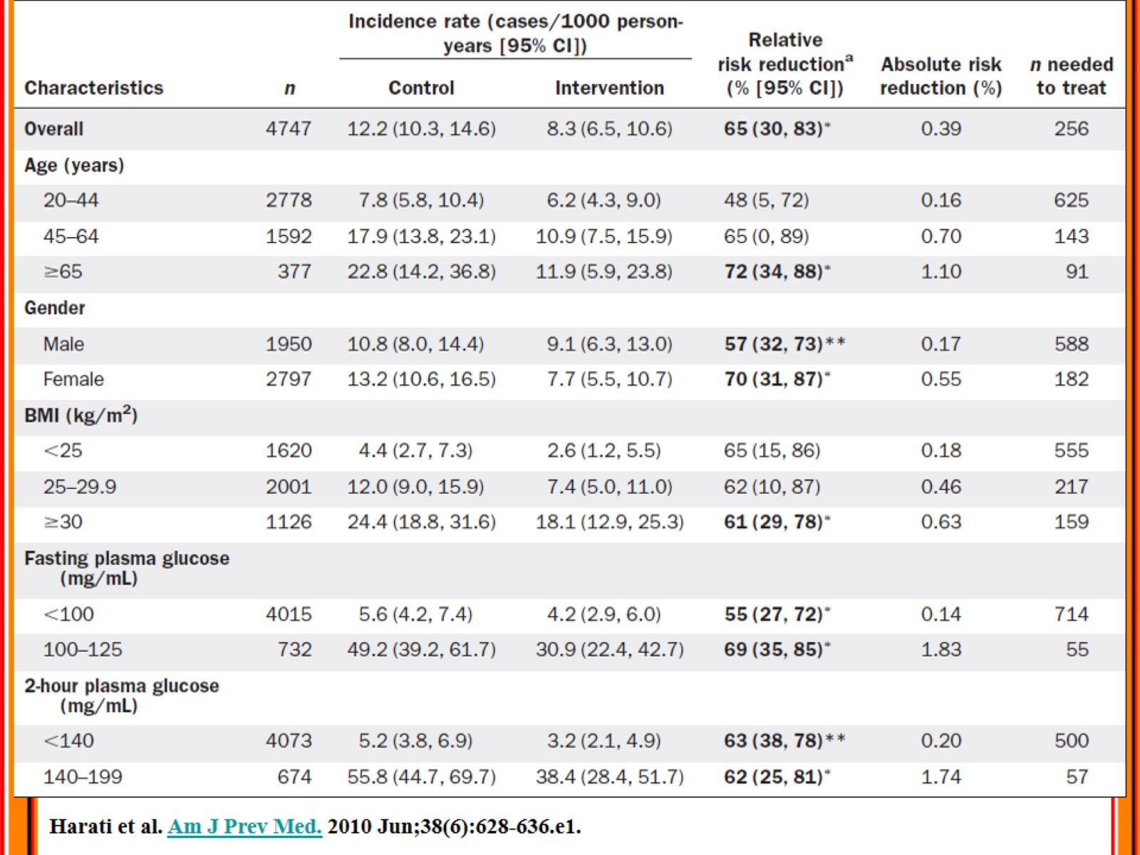

Slide 27
Diabetes Mellitus Ranks in Burden of Diseases in Iran (1990-2010)

Slide 28
Durden of Disease from Diabetes Mellitus in Iran (1990-2010)

Slide 29
The way forward

