Slide 2
Fertility in patients with congenital adrenal hyperplasia
Mohajeri Tehrani M.D.
Professor of Endocrinology & Metabolism
Tehran University of Medical Sciences

Slide 3
Topics
CAH management before pregnancy
CAH management during pregnancy
CAH management in male

Slide 4
Vignette Case
A 30 years old woman with salt wasting classic CAH who presented at birth with ambiguous genitalia now presents requesting fertility support.
She use prednisolone Tab7.5 mg/d & fludrocortisone Tab 0.1/d

Slide 5
Continue the same dose of prednisolone & fludrocortisone
Change to Dexamethasone &fludrocortisone
Change to Hydrocortisone without fludrocortisone
Continue the same dose of prednisolone without fludrocortisone

Slide 6
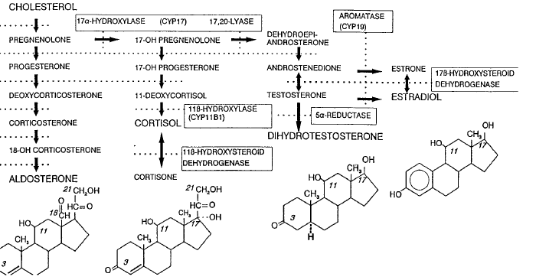
Adrenal steroidogenesis Pathway

Slide 7
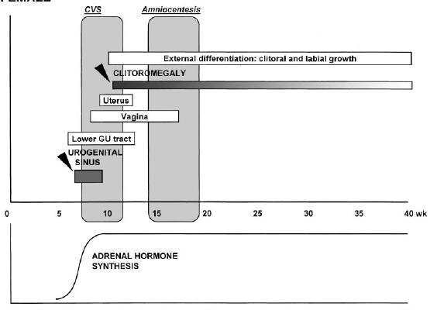
Female sexual Differentiation

Slide 8
Prevalence of CAH
1 in 16,000 individuals has classic CAH.
approximately 1 in 600 is affected with nonclassic disease.

Slide 9
Infertility
Salt Wasting CAH or 11 Beta Hydroxylase Deficiency
Simple Virilizing CAH
NC CAH
Notes:
Infertility is least likely
to occur in nonclassic adrenal hyperplasia, is more frequent
with simple virilizing CAH, and is most likely in patients
with either salt-wasting CAH or 11b-hydroxylase deficiency
(although practitioners will be most likely to encounter an
infertile patient with nonclassic disease, given its increased
frequency in the population).

Slide 10
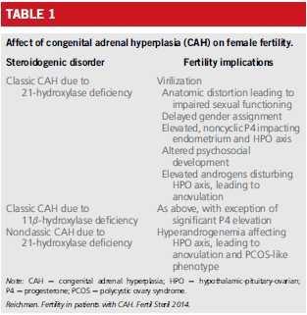

Slide 11
Subfertility in classical form of CAH is related to several causes:
Morphological anomalies of genitalia due to precocious and severe virilization
Disturbed personal body image leading to psychological difficulties in social and sexual relationships
Androgen oversecretion
Notes:
Ithasbeensuggestedthatthetonicoversecretionofandrogensthatmay be aromatized to estrogens results in continuous steroid feedback and thus loss of gonadotropin cyclicity, leading to anovulation or dysovulation

Slide 12
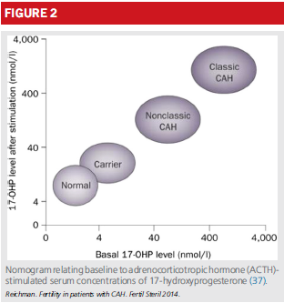
Diagnosis of CAH
Notes:
A morning 17-
OHP value of >200 ng/dL in the follicular phase strongly suggests
the diagnosis. Confirmation testing is performed via a
corticotropin stimulation test using 250 mg of cosyntropin,
with measurement of 17-OHP performed at baseline and 60
minutes after infusion

Slide 13
Diagnosis of CAH

Slide 14
Treatment of CAH
Nonsurgical treatment
Surgical correction thus involves three steps:
Clitoroplasty
Labioplasty
Vaginoplasty
Notes:
Before surgery, the anatomy
of the urogenital sinus must be carefully defined, either radiographically
or via endoscopy, and metabolic dysfunction
must be meticulously corrected.

Slide 15
Non surgical
pregnancy in mothers with salt-wasting CAH:
A Mineralocorticoid
A Glucocorticoid
If androgen do not suppress then may be need for adenalectomy
Ovulation can be induced with either clomiphene or injectable gonadotropins

Slide 16
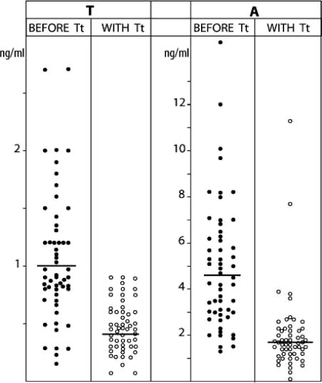
Plasma T and A before and with hydrocortisone treatment

Slide 17
PRENATAL TREATMENT FOR AT-RISK PREGNANCIES
When a couple in whom both partners are heterozygotes for 21-hydroxylase deficiency conceives, there is a 1 in 8 chance of affected female fetus
Thus, in 7 cases out of 8, prenatal treatment with glucocorticoids has no direct benefit for the fetus.

Slide 18
Steroid Side effect During Pregnancy
Maternal weight gain
Hyperglycemia,
Negative effects for the fetus
abnormal growth
adrenal insufficiency

Slide 19
Accurate prenatal diagnosis thus becomes critical to avoid needless exposure
The prenatal treatment of CAH remains controversial and poses unresolved ethical questions
Merce Fernandez-Balsells M, Muthusamy K, Smushkin G, Lampropulos JF,
Elamin MB, Abu Elnour NO, et al. Prenatal dexamethasone use for the prevention
of virilization in pregnancies at risk for classical congenital adrenal
hyperplasia because of 21-hydroxylase (CYP21A2) deficiency: a

Slide 20
Prenatal diagnosis
Prenatal diagnosis, has required invasive fetal testing to detect affected female offspring either by :
chorionic villus sampling (10-12w)
Amniocentesis
Circulating cell-free fetal DNA (6w)
Notes:
However, with technical advances in isolation
and analysis of circulating cell-free fetal DNA from the maternal circulation, there now exists a modality whereby
prenatal diagnosis can be made as early as 6 weeks' gestation, obviating treatment with empiric steroids.

Slide 21
Treatment During Pregnancy in CAH Patients
Hydrocortisone TDS is the preferred glucocorticoid
Prednisolone BD is alternative
Dexamethasone cross the placenta and cause fetal adrenal suppression
Notes:
Stress dose during labor

Slide 23
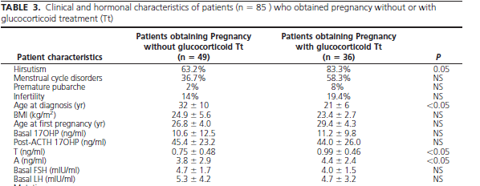
Effect of glucocorticoid on Clinical & Hormonal Characteristic

Slide 24
Adrenal suppression for NC CAH YES or NO
Initiation of glucocorticoids might be justified in hyper androgenic non classic CAH patients, given that elevated serum androgens have been implicated as a potential risk factor for early pregnancy loss
Arlt W, Willis DS, Wild SH, Krone N, Doherty EJ, Hahner S, et al. Health status
of adults with congenital adrenal hyperplasia: a cohort study of 203 patients.
J Clin Endocrinol Metab 2010;95:5110–21.
Notes:
In contrast with patients with more severe disease,
women with nonclassic CAH who conceive without steroidal
treatment typically do not need adrenal suppression with the
onset of pregnancy. It could be argued, however, that initiation
of glucocorticoids might be justified in hyperandrogenic
nonclassic CAH patients, given that elevated serum androgens
have been implicated as a potential risk factor for early
pregnancy loss in some studies (62, 63). This risk remains
hypothetical, and such interventions have not been
substantiated by experimental data.

Slide 25
NC CAH Treatment
Hydrocortisone is considered to be an appropriate treatment and a twice-a-day hydrocortisone dose schedule seems to be a reasonable compromise between effectiveness and simplicity.
It reduces the incidence of miscarriages.
Winterer J, Chrousos GP, Loriaux DL, Cutler Jr GB 1985 Effect of
hydrocortisone dose schedule on adrenal steroid secretion in congenital
adrenal hyperplasia. J Pediatr 106:137–142

Slide 26
Factors should be considered in evaluating prenatal treatment of CAH:
Fetal GC physiology
Safety to the fetus
Safety to the mother
Efficacy

Slide 27
Fetal GC physiology
Fetal cortisol levels are low in very early gestation,
Rise during wk 8–12 while the external genitalia are differentiating
Fetal cortisol are only about 10% of maternal levels.
Kari MA, Raivio KO, Stenman UH, Voutilainen R 1996 Serum
cortisol, dehydroepiandrosterone sulfate, and steroid-binding
globulins in preterm neonates: effect of gestational age and dexamethasone
therapy. Pediatr Res 40:319–324

Slide 28
Thus, the constant dexamethasone dose currently used may result in GC levels that exceed typical physiological fetal GC levels by about 60 fold.
White PC 2006 Ontogeny of adrenal steroid biosynthesis: why
girls will be girls. J Clin Invest 116:872–874

Slide 29
Fetal safety
Dexamethson is classified as category B drug
. Teratogenic effects, especially orofacial clefts,
Animal studies :
(low birth weight , reduced brain weight )

Slide 30
Fetal safety
The Journal of Clinical Endocrinology & Metabolism 86(12):5651–5657

Slide 31
Maternal safety
The Journal of Clinical Endocrinology & Metabolism 86(12):5651–5657

Slide 32
Prader stages

Slide 33
Prader stages of affected female infants (with or without DEXA)
Notes:
Diagram depicting Prader stages of affected female infants in
monitored, dexamethasone prenatally treated pregnancies in relation
to gestational age when dexamethasone was started. Affected untreated
siblings are shown attached by a dotted line.

Slide 34
Endocrine Society Clinical Practice Guideline
Task Force placed a higher value on
preventing unnecessary prenatal exposure of
mother and fetus to dexamethasone and avoiding potential harms associated with this exposure.

Slide 35
Endocrine Society Clinical Practice Guideline
We recommend that prenatal therapy continue to be regarded as experimental.
Thus, we do not recommend specific treatment protocols.

Slide 36
Endocrine Society Clinical Practice Guideline 2018
In women with CAH who become pregnant we recommend continued prepregnancy doses of hydrocortisone/ prednisolone and fludrocortisone therapy, With dosage adjustments if symptoms and signs of glucocorticoid insufficiency occur. (1|ss)

Slide 37
Endocrine Society Clinical Practice Guideline 2018
In women with congenital adrenal hyperplasia who are pregnant, or trying to become pregnant, we recommend against using glucocorticoid that traverse the placenta, such as dexamethasone. (1|ss)

Slide 38
Endocrine Society Clinical Practice Guideline 2018
In women with nonclassic CAHwho are infertile
or have a history of prior miscarriage,
we recommend treatment with a glucocorticoid that does not traverse the placenta. (1|ss)

Slide 39
FERTILITY IN MALES
Testicular adrenal rest tumors are found in 27% to
47% of males with classic CAH lead to obstruction.
Measurement of 17-OHP should be assessed
in men who have unexplained abnormal semen analyses associated with hypogonadism.

Slide 40
FERTILITY IN MALES
Adrenal Androgen
estrogens
suppress gonadotropin secretion
Treatment with glucocorticoids alone
can be effective in restoring normal spermatogenesis
impair Leydig
cell function
Notes:
Markedly elevated
adrenal androgens are peripherally aromatized to estrogens,
which can suppress gonadotropin secretion and impair Leydig
cell function
Treatment with glucocorticoids alone can
be effective in restoring normal spermatogenesis

Slide 41
Endocrine Society Clinical Practice Guideline 2018
In males with classic congenital adrenal hyperplasia, we recommend periodic testicular ultrasound to assess for the development of testicular adrenal rest tumors. (1|ss)

Slide 42
Conclusion:
CAH can have a profound impact on the ability of affected individuals to reproduce.
However, the rate of miscarriages is lower in pregnancies occurring with glucocorticoid treatment .
The prenatal treatment of CAH is against dexamethasone that traverse placenta.

