Slide 1


Liquid Biopsy Methylation and Mutation
in papillary thyroid cancer
Members of the Research Committee
Dr. Seyed Mohammad Tavangar
Dr. Ramin Heshmat
Dr. Bagher Larijani
Presented by: Fatemeh Khatami
Endocrinology and Metabolism Clinical Sciences Institute, Tehran University of Medical Sciences
Email : f-khatami@farabi.tums.ac.ir

Slide 2
Liquid Biopsy A test done on a sample of blood to look for cancer cells from a tumor that are circulating in the blood or for pieces of DNA from tumor cells that are in the blood.
A liquid biopsy is a simple and non-invasive alternative to surgical biopsies which enables doctors to discover a range of information about a tumor through a simple blood sample. Traces of the cancer's DNA in the blood can give clues about which treatments are most likely to work for that patient.
A liquid biopsy may be used to help find cancer at an early stage. It may also be used to help treatment plan or to find out how well treatment is working for cancer recurrence.

Slide 3
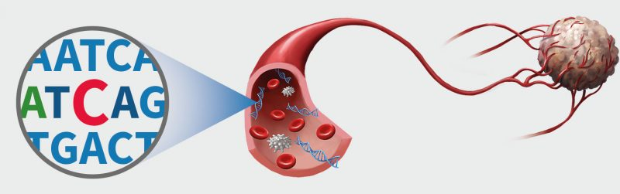
Reliable, noninvasive methods of cancer detection.
Being able to take multiple samples of blood over time may also help doctors understand what kind of molecular changes are taking place in a tumor.
Signatures of patients’ tumors can be characterized molecularly; aids in understanding tumor biology and may be the best tool for monitoring , therapeutic response and perhaps, early detection and personalized cancer management.
Real time representative of tumors

Slide 4
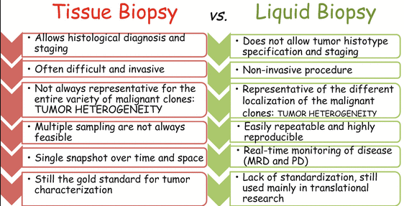

Slide 5
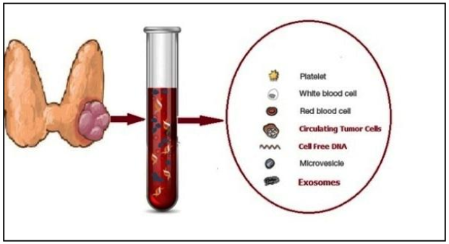
Papillary Thyroid Carcinoma (PTC) is the most common thyroid cancer ( 80% of all thyroid cancers cases)
The diagnostic procedures of thyroid nodules include ultrasound examination of the neck and cytological analysis of Fine Needle Aspiration (FNA).
90% of the nodules are classified as benign, and 3.5% – 5% as malignant, 15% of nodules are diagnosed as undetermined by cytological examination of FNA
80% of the thyroid FNA samples that were classified as indeterminate by cytology will undergo
an unnecessary diagnostic
thyroidectomy, which has its
own risk of complications

Slide 6
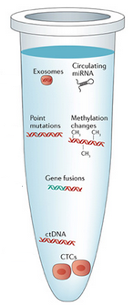
We are planning to track both Genetic and Epigenetic alterations trough liquid biopsy so we should:
1- Select the most important candidate genes of PTC
2- cfDNA isolation optimization
3- Detect methylation in cfDNA of candidate genes
4- Detect the most important mutations in cfDNA
5- Detect methylation and mutation in genomic
DNA (gDNA) isolated from fresh frozen tissue
6- Compare the result to:
Find most important gene as the epigenetic hallmark
Detect Core promoter region of each candidate
gene as the gene expression regulator element
The comparison of cfDNA and gDNA
Correlation of methylation of several promoter
genes in each candidate
Correlation of cfDNA mutation and methylation

Slide 7

MS-HRM for methylation quantification
High resolution melting analysis (HRM) is a sensitive and specific method for the detection of methylation.
Methylated DNA and unmethylated DNA acquire different sequences after bisulphite treatment resulting in PCR products with markedly different melting profiles.
MS-HRM allows for estimation of the methylation level by comparing the melting profiles of unknown PCR products to the melting profiles of PCR products derived from standards with a known unmethylated to methylated template
ratio. The simplicity and high reproducibility of the MS-HRM protocol makes MS-HRM the method of
choice for methylation assessment in many
diagnostic and research applications

Slide 8
Steps To Aim Our Goals
Literature review (meta analysis)
Training Courses
Grant Receiving (NIMAD)
Plasma Sample Collection
Fresh Frozen Tissue Collections
cfDNA extraction of Plasma
gDNA extraction of Fresh Frozen Tissue
Primer designing for MS-HRM
Running the MS-HRM test in cfDNA
Running The MS-HRM test in gDNA
Mutation detection in both cfDNA and gDNA
Analyzing The Results
Publishing Articles

Slide 9
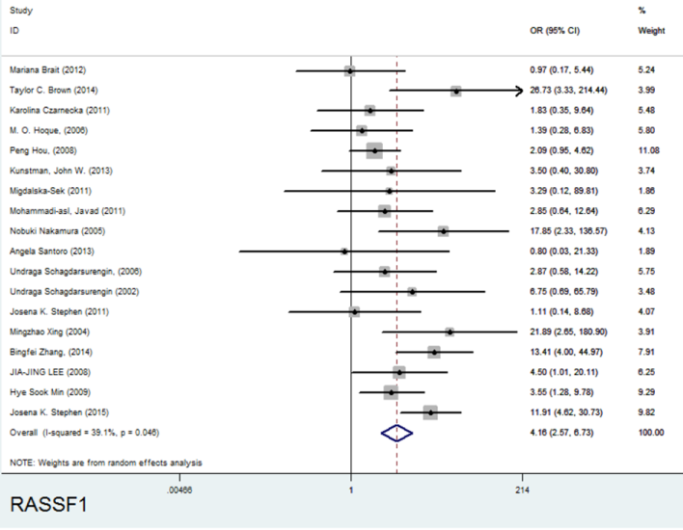
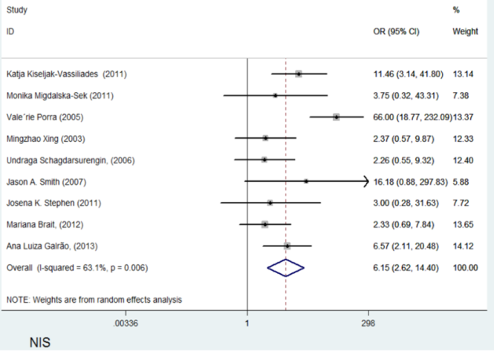
Literature review
A systematic review and meta-analysis article entitle” Meta-analysis of promoter methylation in eight tumor-suppressor genes and its association with the risk of thyroid cancer”
A total of 8549 articles were retrieved According to our result of meta-analysis from 125 candidate genes the most important 8 were selected and NIS gene was added to our project

Slide 10
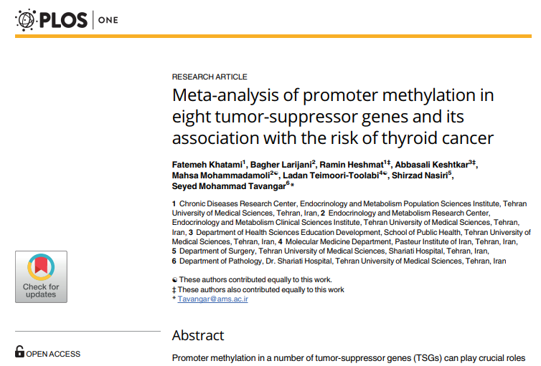

Slide 11
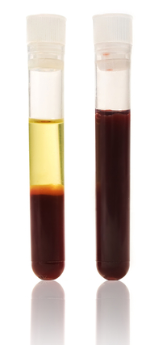
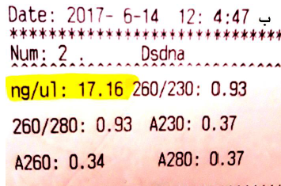
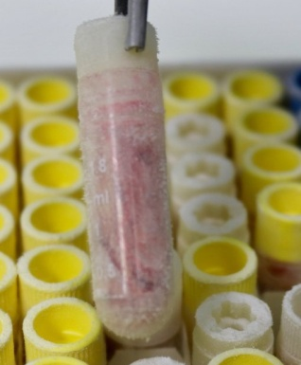
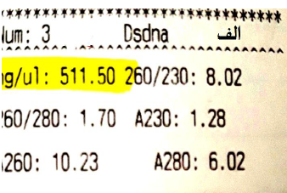
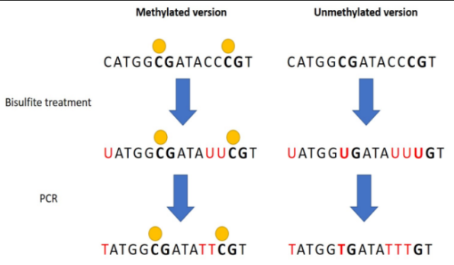
Methods
cfDNA
Blood collection before surgery
cfDNA isolation and store at -80
gDNA
Fresh Frozen tissue collection after surgery in nitrogen Tank
Transferring the tank to Cell Therapy Research Center
Transferring to cell therapy research center ASAP
gDNA extraction done and stored at -80◦C
C/T conversion
Both cfDNA and gDNA undergone on bisulfate treatment to convert unmethylated Cytosines to Thymin and then transferred to molecular medicine department of Pasture Institute
Select 57 PTC cases and 45Goiter samples

Slide 12
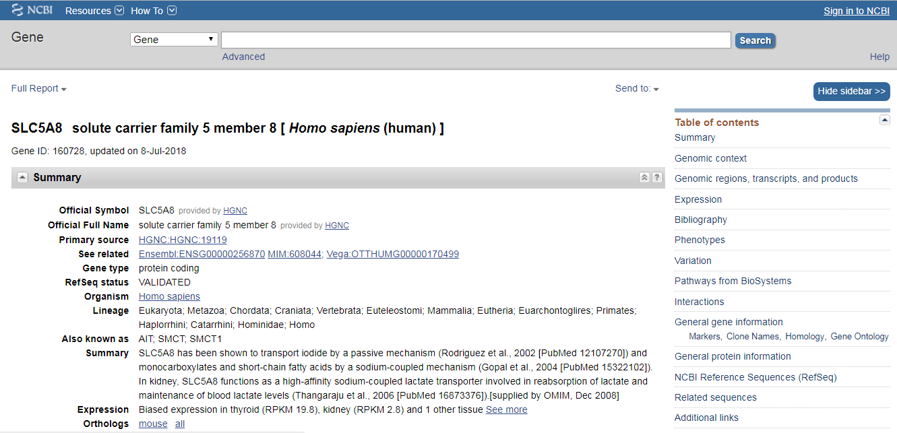
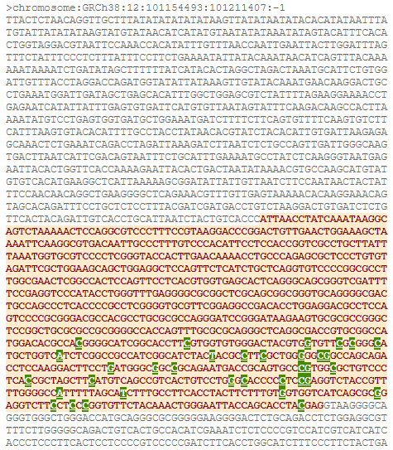
Methods
Finding the Promoter regions
Finding the promoter regions of DNMT1,MGMT, NIS and RASSF1 genes

Slide 13
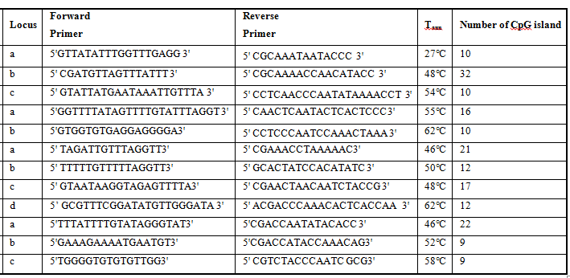
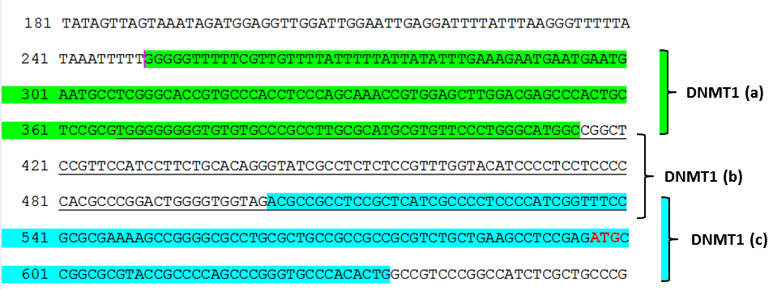
Methods
Targeting the selected region by HRM specific 24 Primers
Specific Primers were designed for 12 targeted region of four tumor suppressor genes for MS-HRM
Specific primers and probe designed for mutation detection in cfDNA and gDNA
In Molecular Medicine Departments, Pasteur Institute of Iran

Slide 14
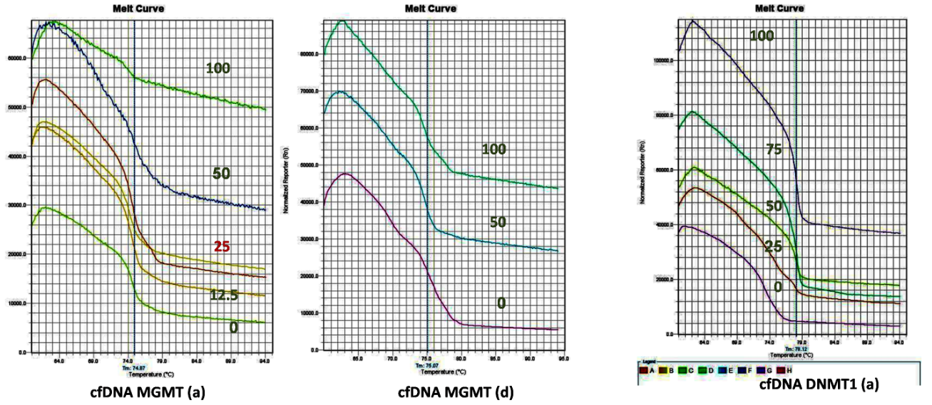
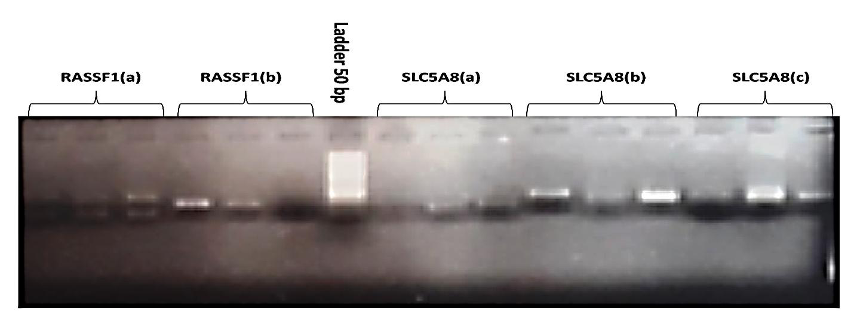
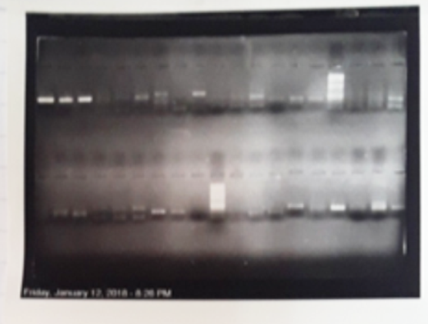
In Molecular Medicine Departments, Pasteur Institute of Iran
MS-HRM Optimization
For each targeted region of four selected tumor suppressor genes the MS-HRM were optimized

Slide 15
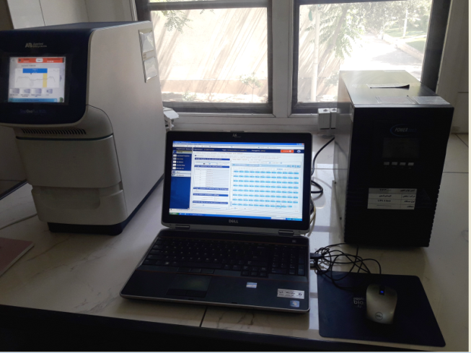
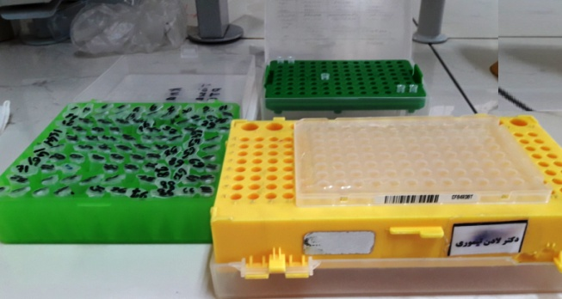
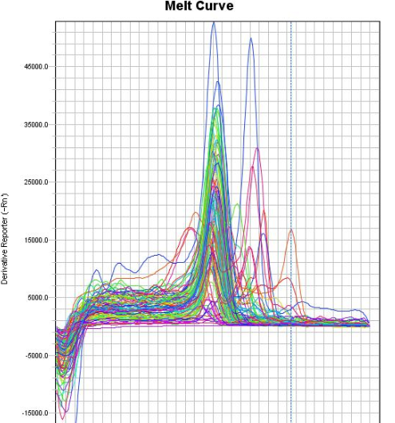
In Molecular Medicine Departments, Pasteur Institute of Iran
Promoter methylation quantification
Running the MS-HRM for 57 PTC / 45 Goiter controls in both cfDNA and gDNA for targeted 12 promoter regions of four targeted genes
1224 Run of MS-HRM for cfDNA
1224 Run of MS-HRM for gDNA
>2448 graphs
For each sample the resulting graphs should be analyzed to determine the methylation quantification
Resulting
Graphs Interpretation
BRAFV600E Mutation detection in both cfDNA and gDNA in 57 PTC cases and 45 Goiter samples
Mutation detection

Slide 16
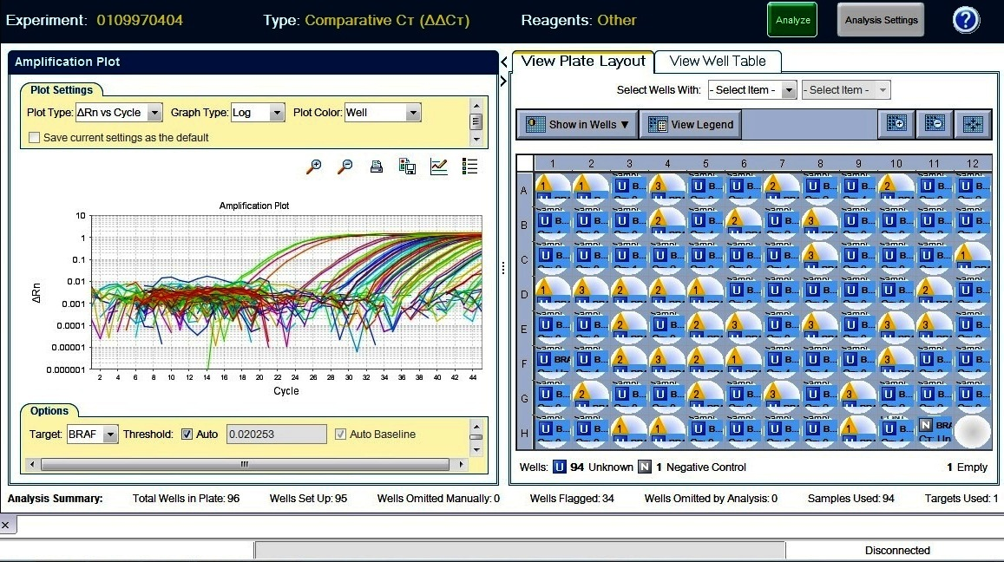
Results

Slide 17
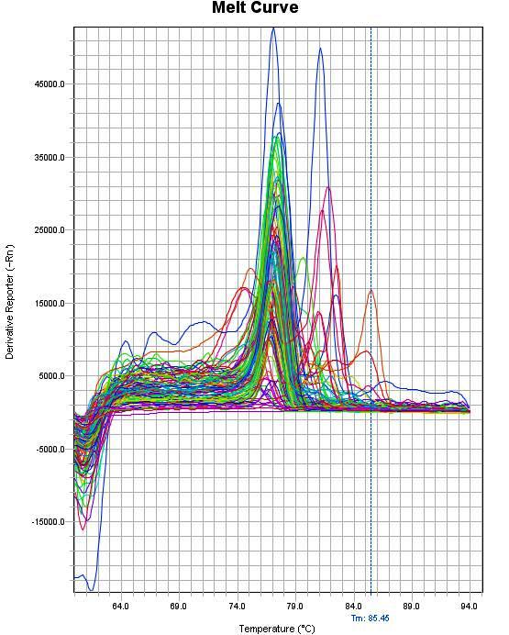

Slide 18
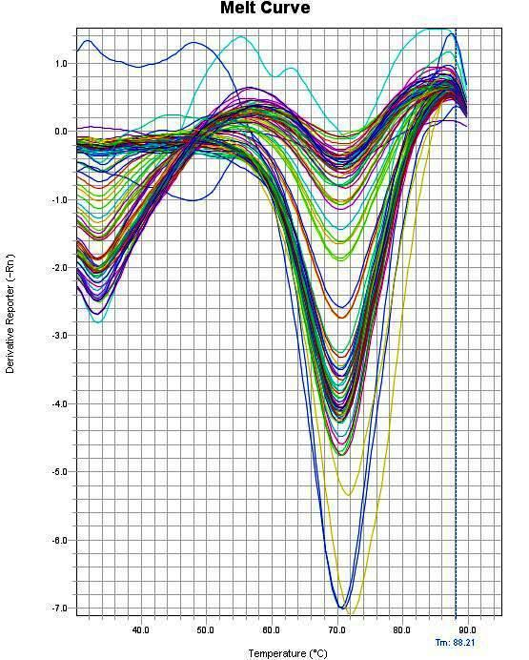

Slide 19
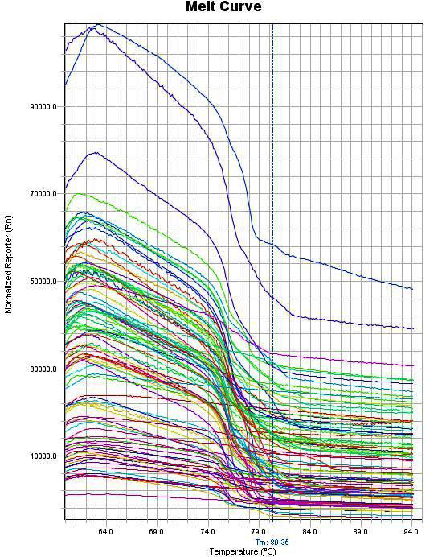
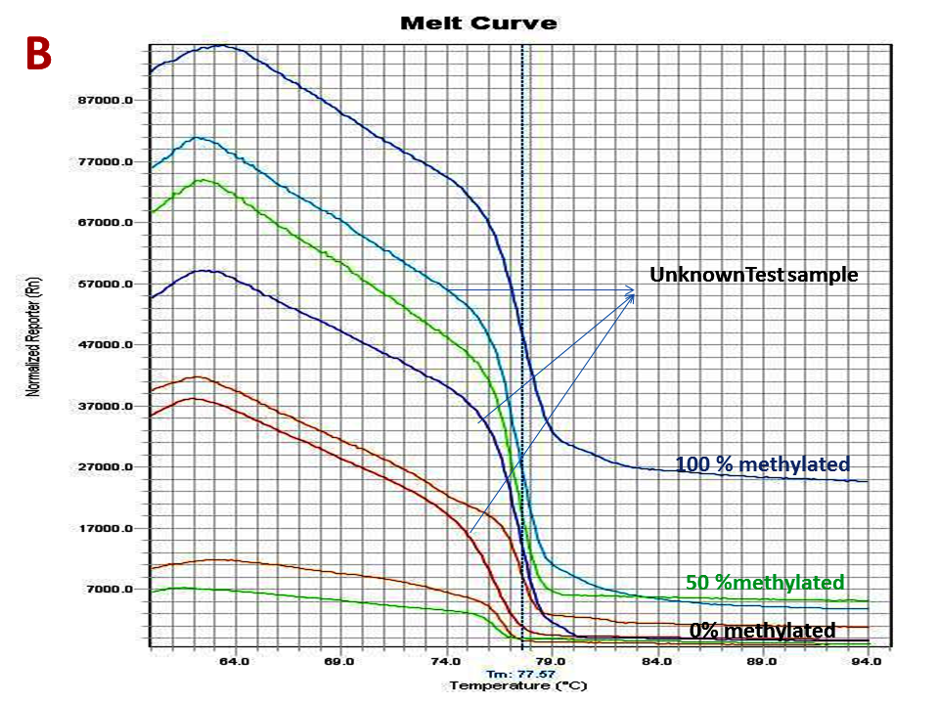

Slide 20
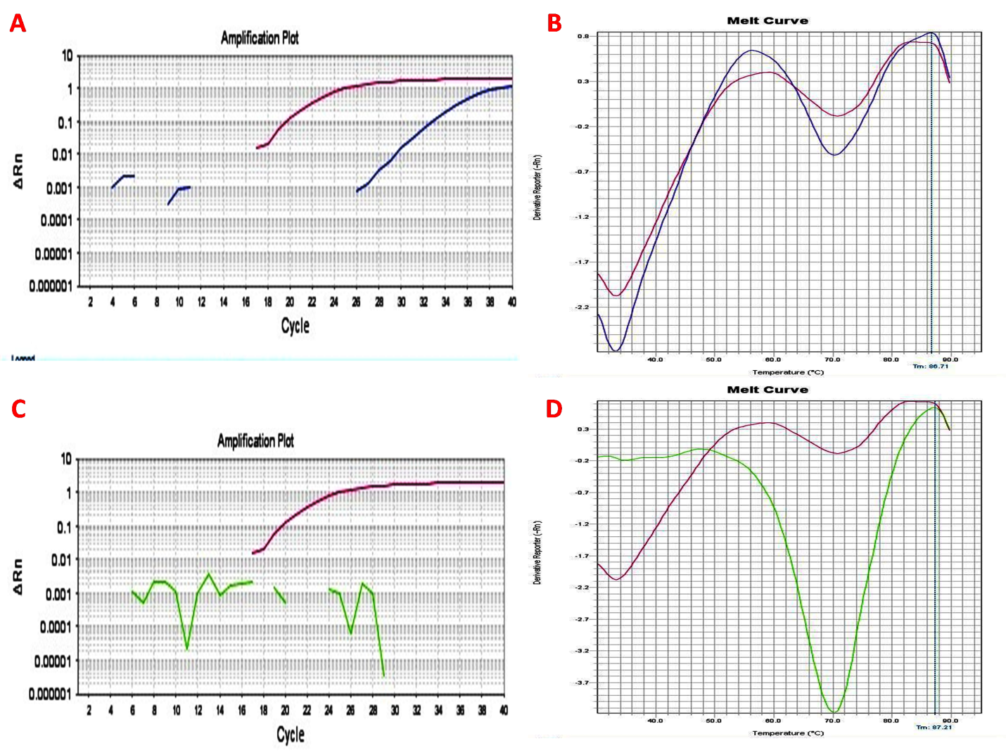
BRAF mutation detected in cfDNA of 72 % PTC patients and 3% of Goiter
The Real time result for BRAF^{V600E}. Amplification plot (A) and melt curve plot (B) of positivePTC sample BRAF^{V600E} mutation (blue line) in comparison with positive control (red line). Amplification plots (C) and melts curve plots (D) of negative goiter BRAF^{V600E} mutation (green line) in comparison with positive control (red line).

Slide 21
Correlation between the status of circulating cfDNA BRAF^{V600E} mutation and clinic pathologic features of PTC .
 | BRAF-positive n = 33 | BRAF-negative n = 24 | P- value
Mean Age (year) ± SD | 40.0 ± 2.58 | 44.9 ± 3.57 | 0.228
Tumor size, average ± SD (cm) | 3.1 ± 1.6 | 3.7 ± 2.3 | 0.147
Extra thyroidal extension (ETE) | 12 (21 %) | 9 (15.7 %) | 0.222
Lymph node metastases | 22 (38.5%) | 5 (8.7 %) | *0.001
Tumor stage
I | 3 (5.2 %) | 6 (10.5%) | 0.068
II | 16 (28.0%) | 13 (22.8%)
III | 10 (17.5%) | 5 (8.7%)
IV | 1 (1.7%) | 0 (0.0%)

Slide 22
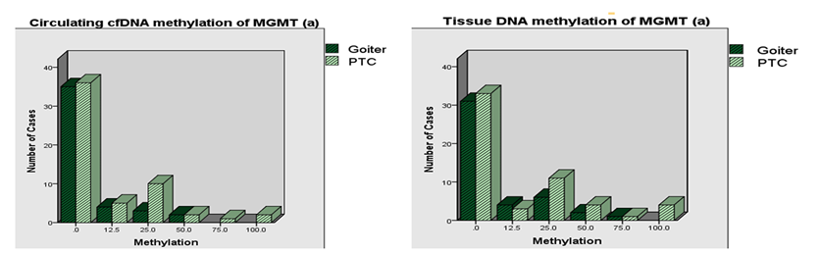
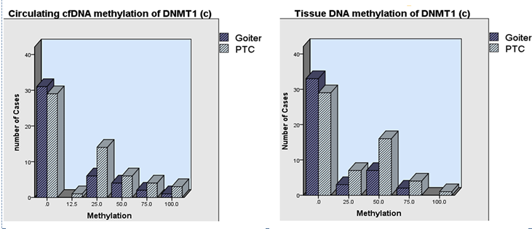
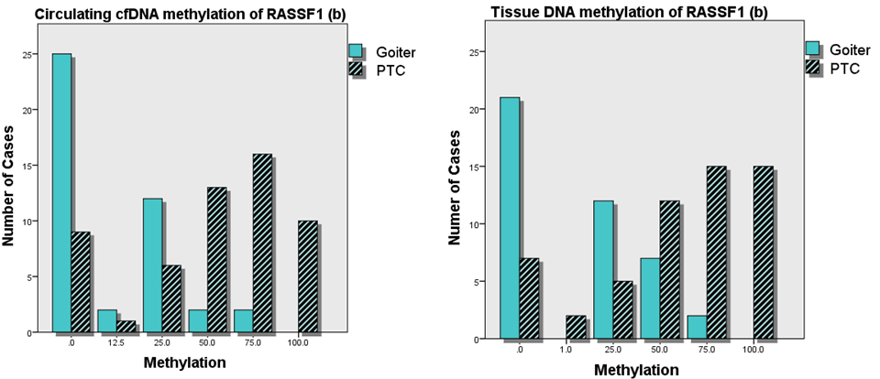
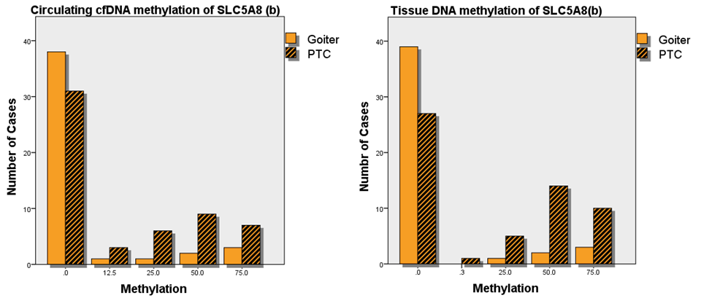
1- The same methylation pattern were detected for both cfDNA and gDNA in all targeted 12 promoter regions cfDNA fragments are originated from PTC solid tumors

Slide 23
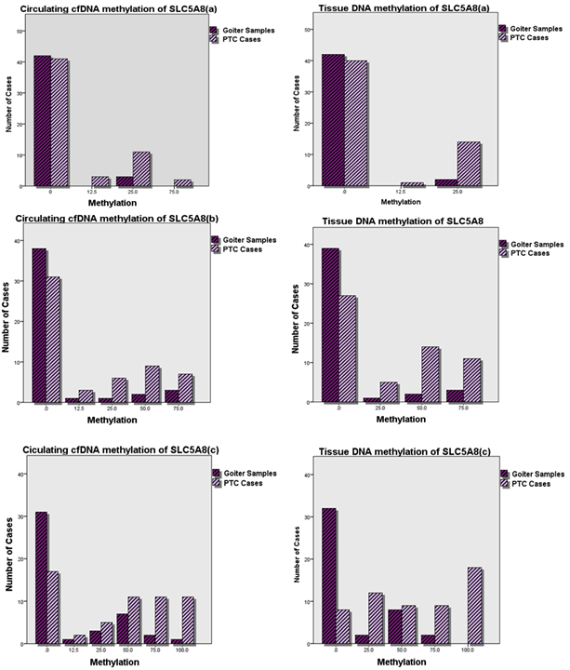

Slide 24
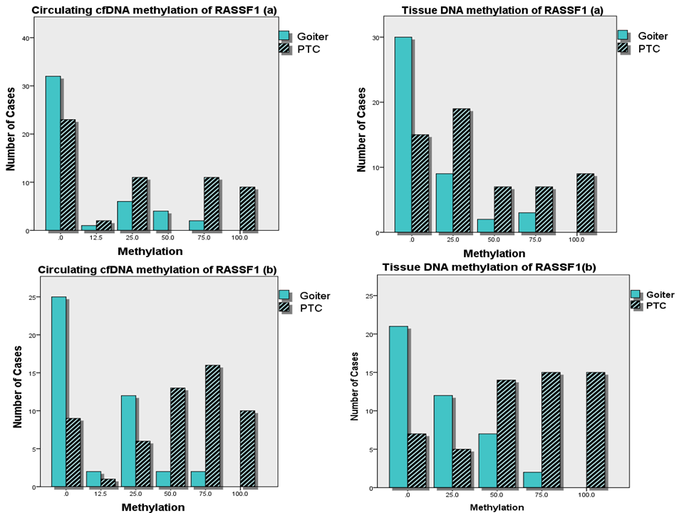

Slide 25
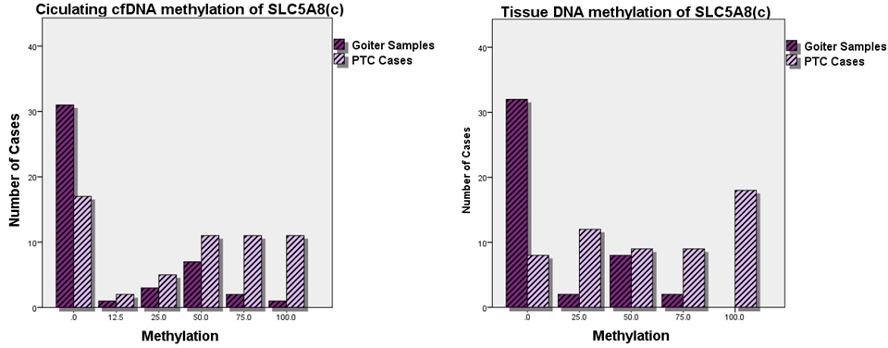

Slide 26
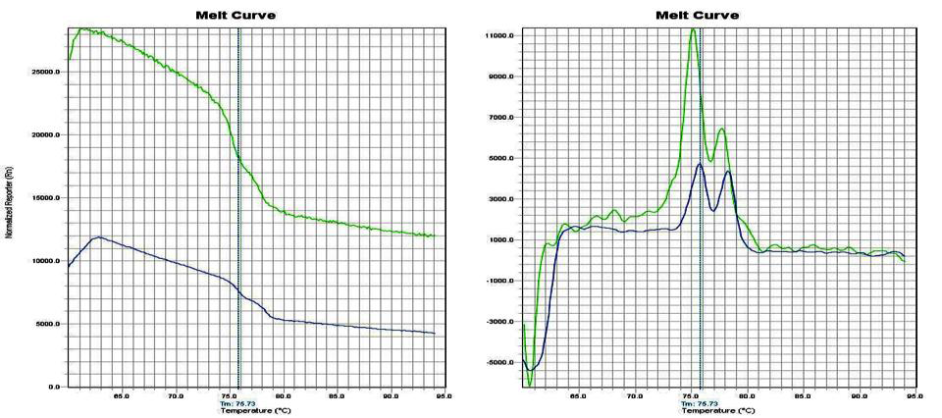
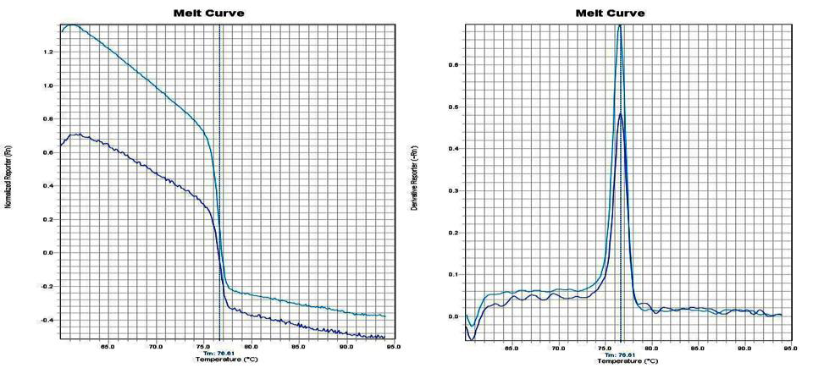
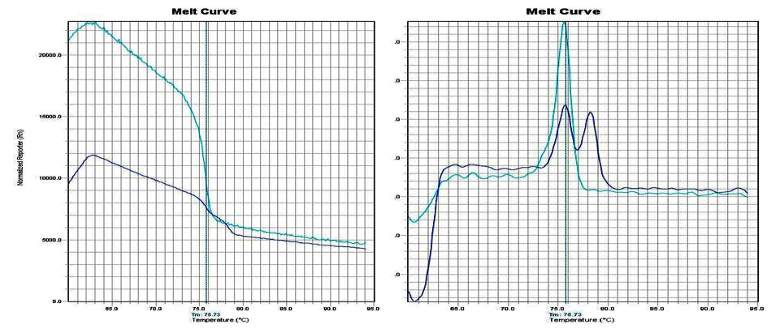
DNMT1

Slide 27
The methylation quantification of three cfDNA promoter
regions belonging to DNMT1 .
Target Promoter Region | Methylation* | PTC Cases (percentage) | Goiter Cases (percentage) | P-value
DNMT1 (a) | 0 | 41 (73.2 %) | 34 ( 77.3 % ) | 0.584
 | 1 | 9 ( 16.1 % ) | 4 ( 9.1 % )
 | 2 | 4 ( 7.1 % ) | 2 ( 4.5 % )
 | 3 | 1 ( 1.8 % ) | 3 ( 6.8 % )
 | 4 | 1 ( 1.8 % ) | 1 ( 2.3 % )
DNMT1 (b) | 0 | 36 ( 63.2 % ) | 38 (84.4 % ) | 0.045**
 | 1 | 10 (17.5 % ) | 1 ( 2.2 % )
 | 2 | 4 ( 7.0 % ) | 2 (4.4 % )
 | 3 | 4( 7.0 % ) | 4 (8.9 % )
 | 4 | 3 ( 5.3 % ) | 0 (0.0 % )
DNMT1 (c) | 0 | 29 ( 50.9 % ) | 31 ( 70.5 % ) | 0.356
 | 1 | 15 ( 26.3 % ) | 6 ( 13.6 % )
 | 2 | 6 ( 10.5 % ) | 4 ( 9.1 % )
 | 3 | 4 ( 7.0 % ) | 2 ( 4.5 % )
 | 4 | 3 ( 5.3 % ) | 1 ( 2.3 % )

Slide 28
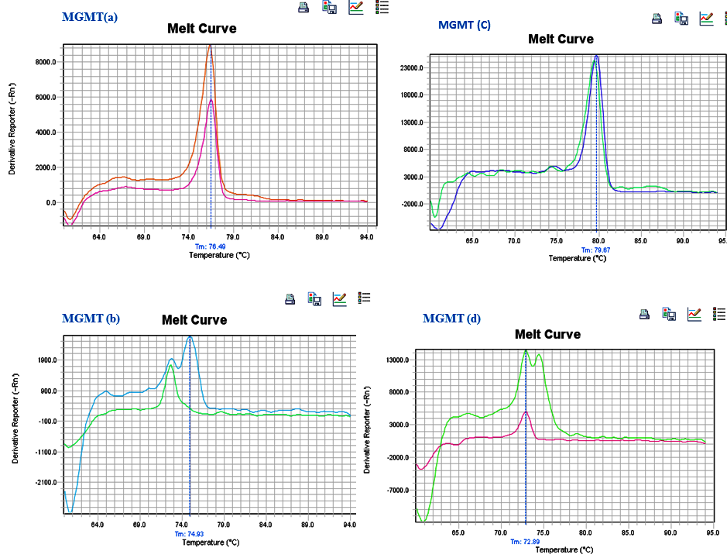
MGMT

Slide 29
Methylation of four regions of MGMT in cfDNA of PTC and goiter cases.
Target Promoter Region | Methylation* | PTC Cases (percentage) | Goiter Cases (percentage) | P-value
MGMT (a) | 0 | 37 (64.9 % ) | 36 ( 80.0 % ) | 0.086
 | 1 | 16 ( 28.1% ) | 7 ( 15.6 % )
 | 2 | 1 ( 1.8 % ) | 2 ( 4.4 % )
 | 3 | 1 ( 1.8 % ) | 0 ( 1.8 % )
 | 4 | 2 ( 0.0 % ) | 0 ( 0.0 % )
MGMT (b) | 0 | 20( 35.1%) | 30 (66.7 % ) | 0.001**
 | 1 | 15( 26.3%) | 13 ( 28.9 % )
 | 2 | 13( 22.8%) | 2 ( 4.4 % )
 | 3 | 7( 12.3%) | 0( 0.0 % )
 | 4 | 2( 3.5%) | 0( 0.0 % )
MGMT (c) | 0 | 16 (28.1 %) | 21 ( 46.7 % ) | <0.001**
 | 1 | 4 (7.0 %) | 7 ( 15.6 % )
 | 2 | 4 (7.0 %) | 11 ( 24.4 % )
 | 3 | 8 (14.0%) | 4 ( 8.9 % )
 | 4 | 25 (43.9 %) | 2 (4. 4 % )
MGMT (d) | 0 | 12 ( 21.4 % ) | 32 ( 72.7 % ) | <0.001**
 | 1 | 6 ( 10.7 % ) | 6 ( 13.6 % )
 | 2 | 7 ( 12.5 % ) | 2 ( 4.5 % )
 | 3 | 20 ( 25.7 % ) | 2 ( 4.5 % )
 | 4 | 11 ( 19.6 % ) | 2 ( 4.5 % )

Slide 30
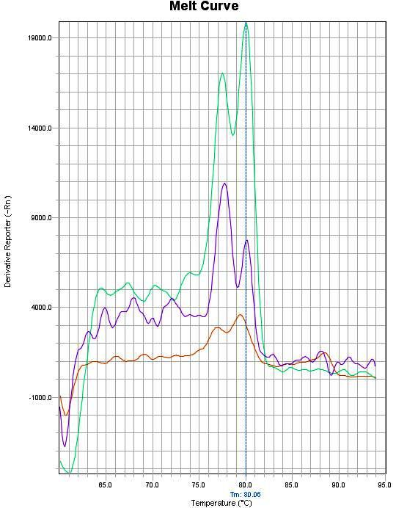
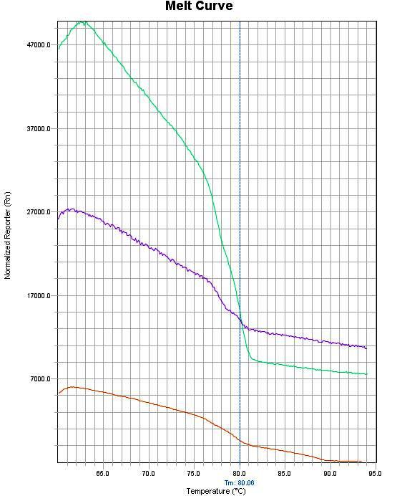
RASSF1

Slide 31
The difference of methylation quantification of two cfDNA
promoter regions belonging to RASSF1 gene.
Promoter Region | Methylation* | PTC Cases Number (percent) | Goiter Cases Number (percent) | P-value
RASSF1 (a) | 1 | 19 (33.3%) | 35 (79.5%) | 0.103
 | 2 | 23 (40.4%) | 7 (15.9%)
 | 3 | 8 (14.0%) | 2 (4.5%)
 | 4 | 7 (12.3%) | 0 (0.0%)
 | 5 | 0 (0.0%) | 0 (0.0%)
RASSF1 (b) | 1 | 11 (19.6%) | 21(48.8%) | <0.001
 | 2 | 7 (12.5%) | 13 (30.2%)
 | 3 | 11(19.6%) | 7 (16.3%)
 | 4 | 16 (28.6%) | 2 (4.7%)
 | 5 | 11(19.6%) | 0 (0.0%)

Slide 32
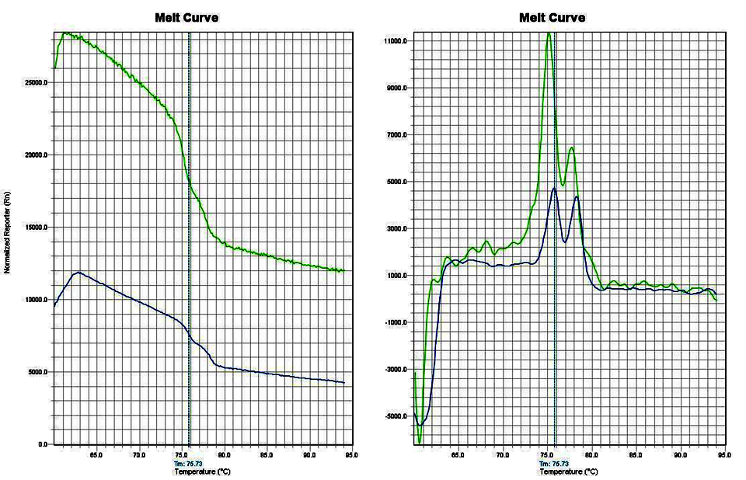
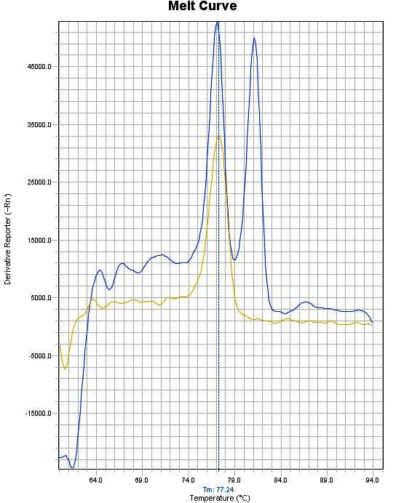
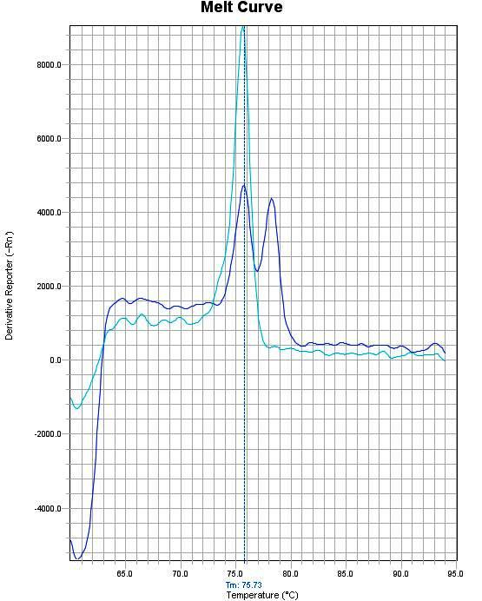
NIS

Slide 33
The difference of methylation quantification of three cfDNA promoter
regions belonging to NIS gene.
Promoter Region | Methylation* | PTC Cases Number (percent) | Goiter Cases Number (percent) | P-value
SLC5A8(a) | 1 | 48 (87.3%) | 44 (100%) | 0.049
 | 2 | 6 (10.9%) | 0(0.0%)
 | 3 | 1 (1.8%) | 0(0.0%)
 | 4 | 0 (0.0%) | 0(0.0%)
 | 5 | 0 (0.0%) | 0(0.0%)
SLC5A8(b) | 1 | 23 (40.4%) | 43 (95.6%) | 0.004
 | 2 | 7(12.2%) | 0 (0.0%)
 | 3 | 5 (8.8%) | 1 (2.2%)
 | 4 | 21(36.8%) | 2 (2.2%)
 | 5 | 0(0.0%) | 0(0.0%)
SLC5A8(c) | 1 | 9 (15.1%) | 34 (77.3%) | 0.005
 | 2 | 12 (21.4%) | 2 (4.5%)
 | 3 | 10 (17.9%) | 4 (9.1%)
 | 4 | 9 (16.1%) | 4 (9.1%)
 | 5 | 16 (28.6%) | 0 (0.0%)

Slide 34
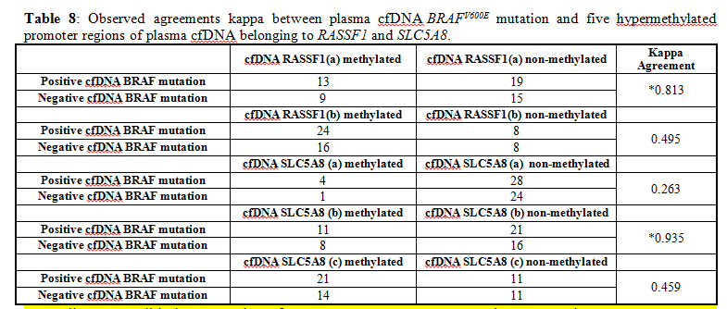

Slide 35
1- BRAF mutation of cfDNA is the same as gDNA and is detectable in cfDNA with 67 % of PTC
2- The pattern of methylation were mostly similar (kappa agreement more than 0.8) and
3- SLC5A8(b) and SLC5A8(c) : core promoter regions of NIS
4- (b) : core promoter regions of RASSF1
5- MGMT (b) : core promoter regions of MGMT
6- DNMT1(a): core promoter regions of DNMT1
7- RASSF1 (a) and SLC5A8 (b) are mostly Co occurrent with BRAF mutation

Slide 36
Conclusion
First time of Liquid biopsy optimization for epigenetic change detection in thyroid cancer diagnosis
Same methylation pattern of cfDNA and gDNA show the origin of cfDNA is Tumor tissue
First panel of Liquid methylation based test considering SLC5A8 (c) and RASSF1 (b) for discrimination between PTC and Goiter
Liquid biopsy with tracking methylation of SLC5A8 (b), SLC5A8 (c), RASSF1 (b), MGMT(b), (c),(d) , and possibly DNMT1 (b) is recommended
Liquid biopsy BRAF mutation detected in cfDNA of 60 % PTC patients
The most correlated core promoter region with BRAF mutation is SLC5A8 (b) which can be used for Lymph node metastasis of PTC through liquid biopsy

Slide 37
ctDNA methylation can be taken in to the account of PTC diagnosis and managements as the Novel Liquid Biopsy Test

Slide 38
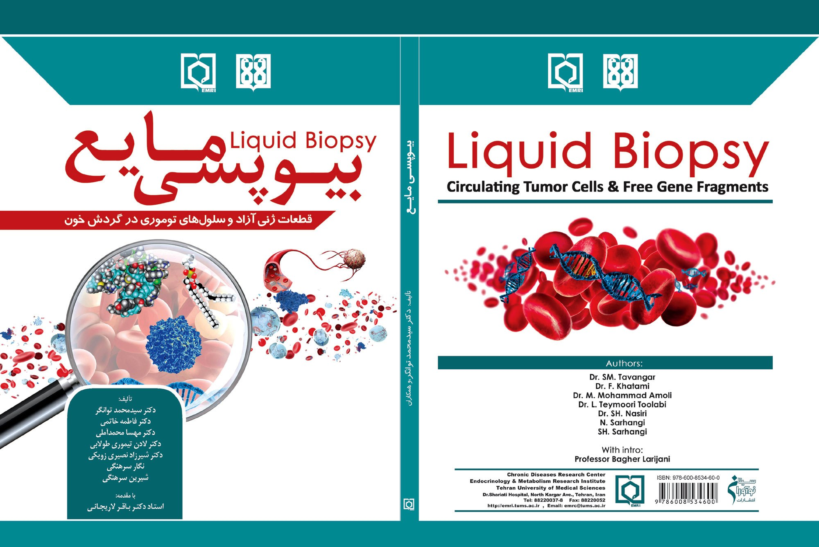

Slide 39
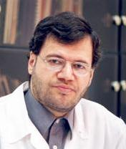
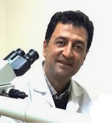
Special Thanks to
Professor Bagher Larijani
Professor Seyed Mohammad Tavangar

Slide 40


