Slide 1

به نام يگانه پروردگار

Slide 2
Research Methodology
Measurement Errors
Davood Khalili, MD, MPH, PhD
Department of Biostatistics & Epidemiology
Research Institute for Endocrine Sciences
Shahid Beheshti University of Medical Sciences

Slide 3
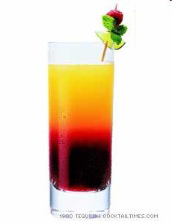
Measurement Error

Slide 4
Errors in Research
Systematic
Cause in: Invalidity & Spurious association
Random
Cause in: unreliability & Diluted association
Confounding
Cause in: a relationship but not causal association

Slide 5
Random Error
Deviations from the true value that
occur in a random chance pattern
frequency
the distribution of X with no random error
X

Slide 6
Random Error
Deviations from the true value that
occur in a random chance pattern
the distribution of X with random error
frequency
the distribution of X with no random error
X

Slide 7
Random Error
Deviations from the true value that
occur in a random chance pattern
the distribution of X with random error
frequency
the distribution of X with no random error
X
Notice that random error doesn’t
affect the average, only the
variability around the average

Slide 8
Systematic Error
Any process at any stage of inference which tends to produce results or conclusions that differ systematically from the truth
frequency
the distribution of X with no systematic error
X

Slide 9
Systematic Error
Any process at any stage of inference which tends to produce results or conclusions that differ systematically from the truth
the distribution of X with systematic error
frequency
the distribution of X with no systematic error
X

Slide 10
Systematic Error
Any process at any stage of inference which tends to produce results or conclusions that differ systematically from the truth
the distribution of X with systematic error
frequency
the distribution of X with no systematic error
X
Notice that systematic error does
affect the average -- we call this a bias

Slide 11
The Error Component
X
T
+
e
Two Components:
e_{r} (Random Error)
e_{s} (Systematic Error)

Slide 12
RELIABILITY AND VALIDITY
Not reliable
Biased (Not valid)
Reliable
Biased (Not valid)
Not reliable
Somehow valid
Reliable
Valid
In Random error measurement is not reliable.
In Systematic error measurement is biased (not valid).

Slide 13
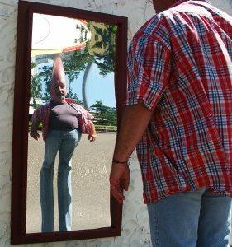

Slide 14
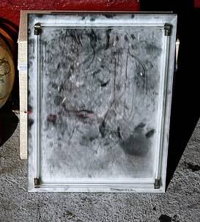

Slide 15
Errors in Research
Systematic
Cause in: Invalidity & Spurious association
Random
Cause in: unreliability & Diluted association
Confounding
Cause in: a relationship but not causal association

Slide 16
Selection Bias
the way in which cases and controls, or exposed and nonexposed individuals, are selected such that an apparent association is observed
Reference Population
Disease –
Exposure –
Disease +
Exposure -
Disease –
Exposure +
Disdease +
Exposure +
Study Sample

Slide 17
Selection Bias
Non-response Bias
Exclusion Bias
Berksonian Bias
Healthy worker effect
Differential losses to follow-up

Slide 18
Information Bias
a systematic tendency for individuals selected for inclusion in the study to be erroneously placed in different exposure/outcome categories, thus leading to misclassification.
Reference Population
Disease –
Exposure –
Disease +
Exposure -
Disease –
Exposure +
Disdease +
Exposure +
Study Sample

Slide 19
Information Bias
Exposure Identification Bias:
- Recall Bias
- Interviewer Bias
Outcome Identification Bias:.
  - Observer Bias
  - Respondent Bias

Slide 20
Systematic errors nearly always cannot be corrected.
Sometimes they can be estimated using some advanced epidemiological methods.

Slide 21
Errors in Research
Systematic
Cause in: Invalidity & Spurious association
Random
Cause in: unreliability & Diluted association
Confounding
Cause in: a relationship but not causal association

Slide 22
Random errors almost always cannot be corrected.
Routinely, they are estimated using statistical methods (i.e. Confidence Interval and p-value)

Slide 23
(Background)
Errors in Research
Systematic
Cause in: Invalidity & Spurious association
Random
Cause in: unreliability & Diluted association
Confounding
Cause in: a relationship but not causal association

Slide 24
Considering
3rd Factor(S) in Causality
3rd variable(s)
Exposure
1st var
Outcome
2nd var

Slide 25
Kinds of RELATIONSHIPS OF
3rd VARIABLE(S)
IN RESEARCH
CONFOUNDING
MEDIATION
COLLINEARITY
EFFECT MODIFICATION
(INTERACTION OR MODERATION)

Slide 26
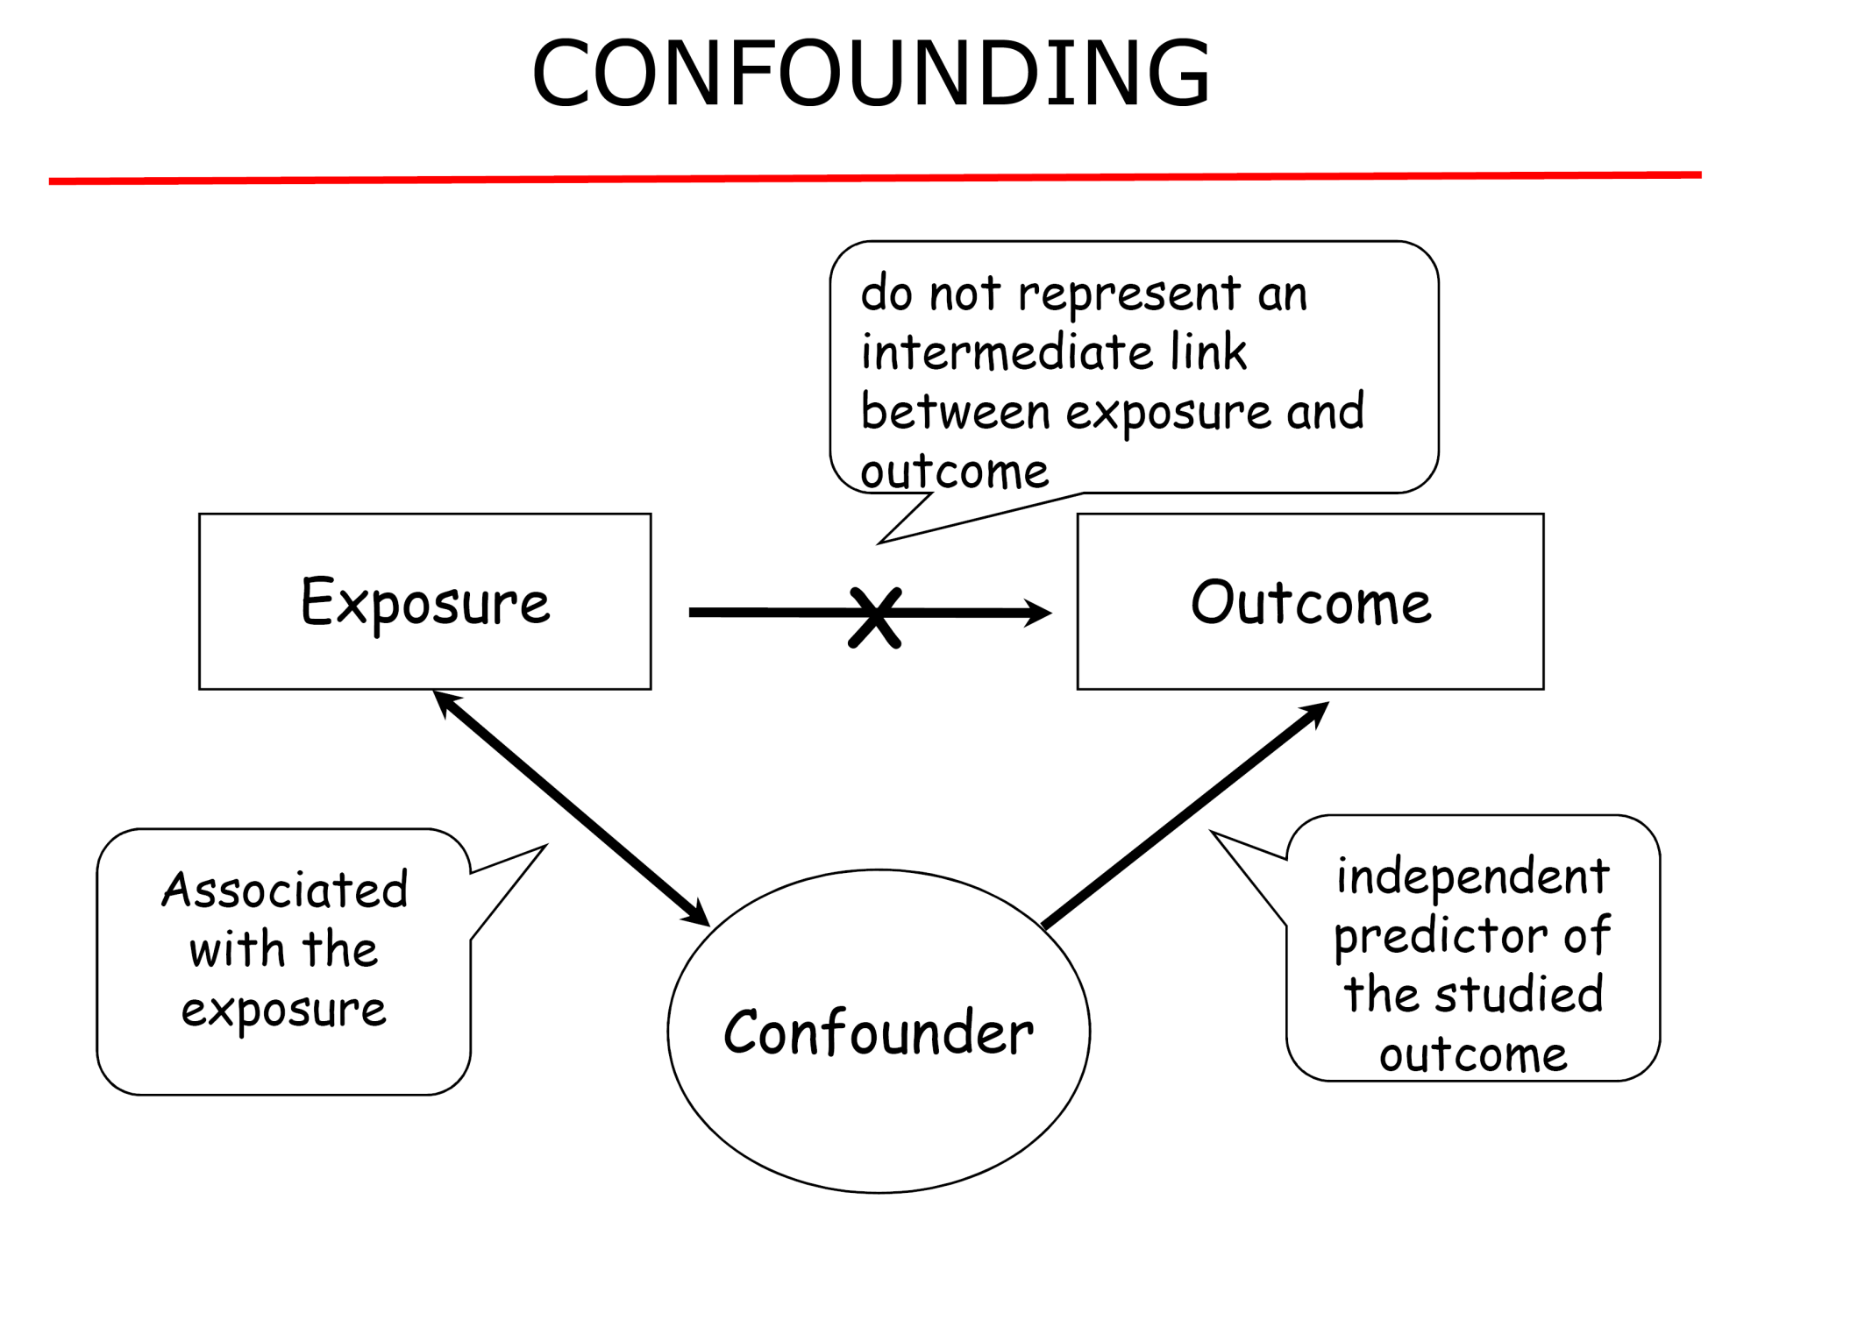
A confusion of effect

Slide 27
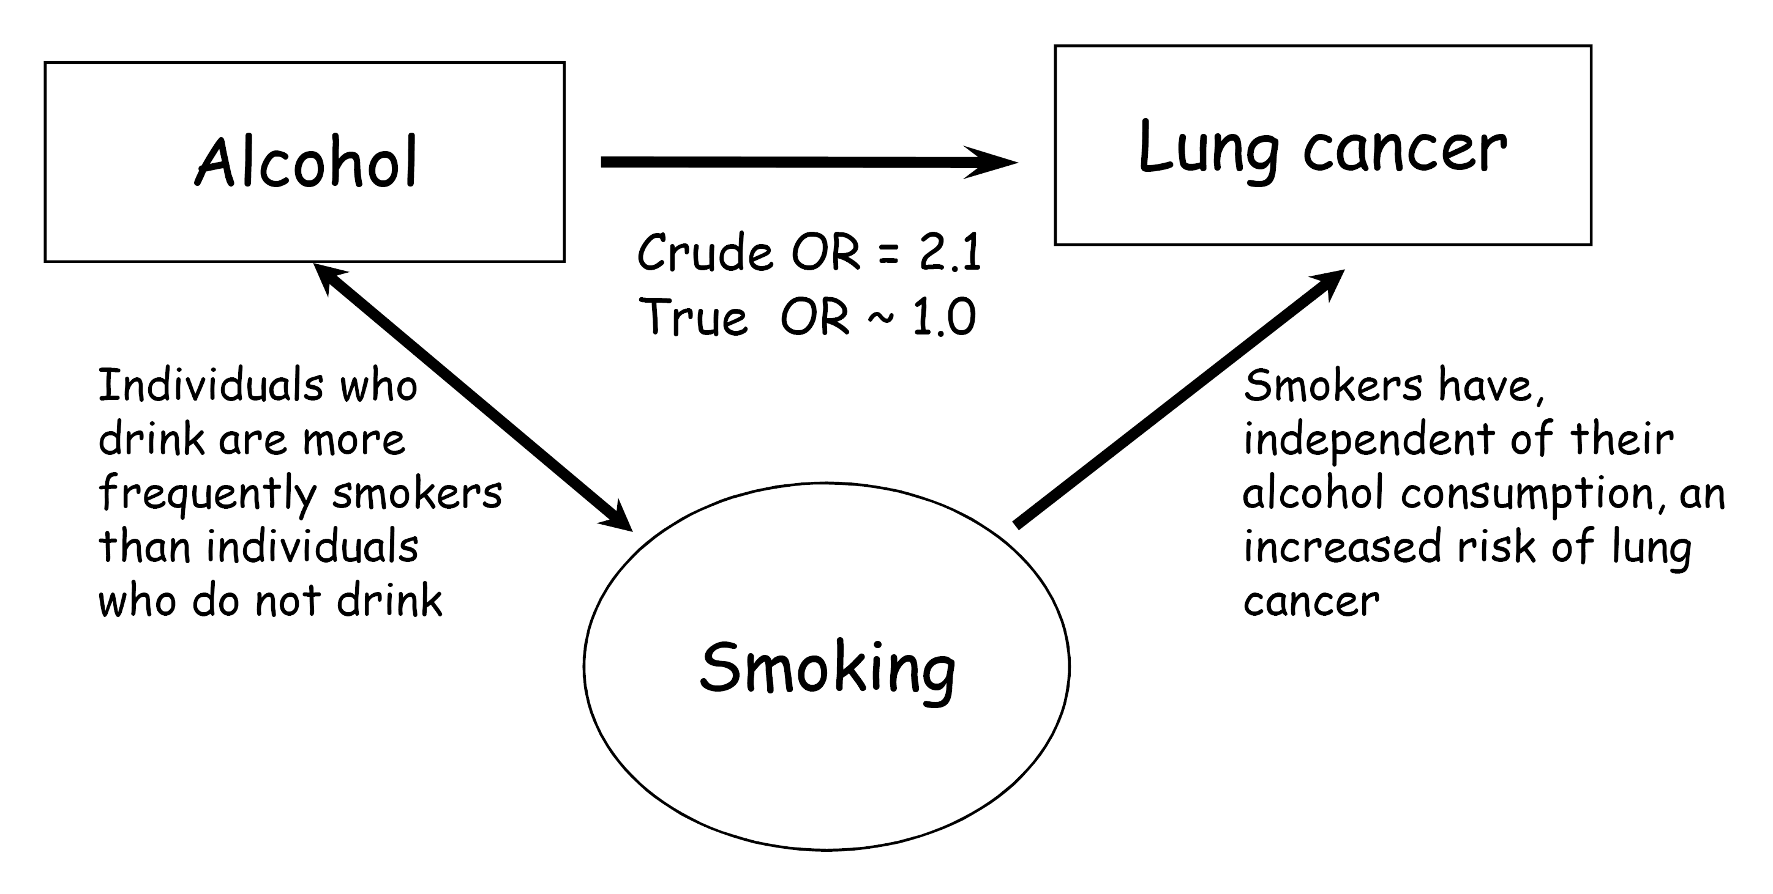

Slide 28
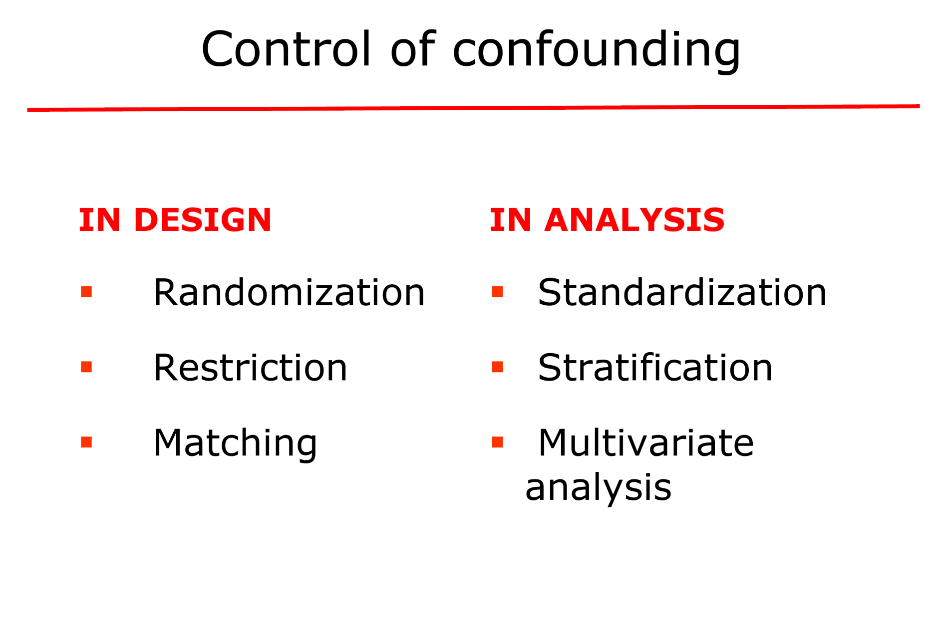
The most applicable method

