Slide 1
atypical TED & refractory GD
Omid gharooei Ahangar

Slide 3
Mechanical contributions to GO pathogenesis
Individuals younger than 40 yr of age are considerably more likely to exhibit orbital fat expansion in the absence of muscle enlargement, whereas patients over 70 yr are more prone to severe, fusiform muscle enlargement without significant changes in orbital adipose tissue volume.
Proptosis, stems from this increase in orbital tissue volume within the unyielding confines of the bony orbit. Extraocular muscle dysfunction is caused, early in the disease, by swelling of the muscle bodies.
In later stages the extraocular muscles may become fibrotic and atrophic as a result of chronic inflammation and compression of the muscle fibers.
Chemosis and periorbital edema appear to be caused primarily by decreased venous and lymphatic drainage from the orbit secondary to compression of these channels.

Slide 4
Histological examination of orbital adipose and extraocular muscle tissues in GO reveals an excess of complex carbohydrates called glycosaminoglycans (GAG), in which hyaluronan predominates.
Gross enlargement of the muscle bodies in GO is caused primarily by accumulation of GAG and edema within the connective tissues investing and separating the muscle fibers.

Slide 5
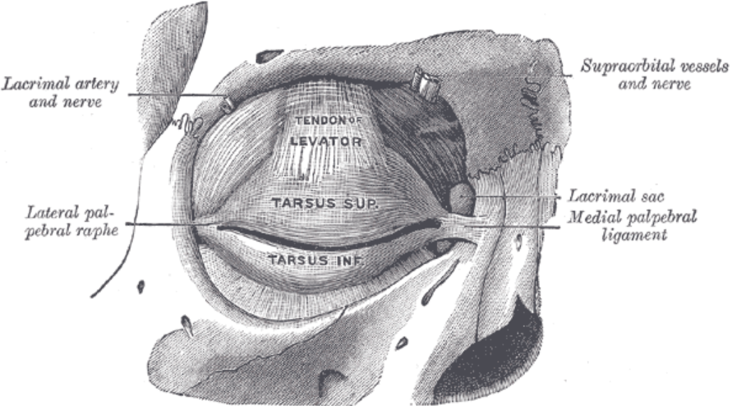
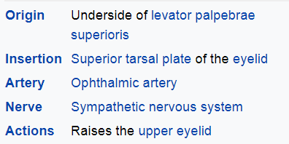
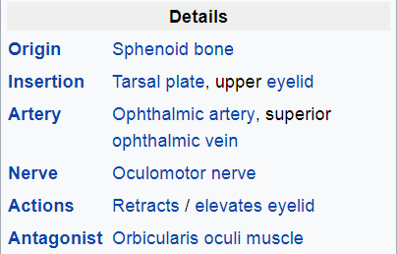

Slide 7
Thyroid eye disease (TED)
commonly occurs in 25% to 50% of patients with Graves disease.
Patients frequently present with eyelid retraction, extraocular muscle enlargement, and proptosis.
Pathologic and radiographic studies revealed that although the inferior rectus is most commonly involved, every extraocular muscle, including the levator palpebrae, can be affected.
Previous articles have investigated levator involvement and have identified it as a possible explanation for eyelid retraction.
Ohnishi et al. reported that 83% of patients with TED had enlargement of the levator palpebrae on MRI.
Small also showed that pathologically there was enlargement of levator muscle fibers in patients with TED.

Slide 8
DDx
Although TED can significantly involve all extraocular muscles, it is important to consider other causes of extraocular muscle enlargement and orbital signs.
There have been several case reports of lymphoma masquerading in patients with known TED. Given that lymphoma and other lesions commonly affect the superior orbit, it is important to consider these possibilities and biopsy them appropriately.

Slide 9
Idiopathic orbital inflammation (IOI) can also present similarly to TED and occur concurrently with TED. It is an important consideration when managing patients with atypical presentations of TED or IOI.
Bijlsma and Kalmann reported a series of 4 patients diagnosed with TED and IOI at different times.
Although it is possible that the levator involvement in the present case is due to IOI, the lack of tendon involvement seen on MRI would suggest that it is due to TED.
In addition, all the cases in their study developed orbital masses and/or dacryoadenitis rather than myositis. It is however likely that patients with Graves disease who develop myositis secondary to IOI are misdiagnosed as having TED.

Slide 10
Others forms of myopathy have also been reported to occur concurrently with TED.
Mensink et al. reported 4 cases with TED and myopathies, including myotonic dystrophy, chronic progressive external ophthalmoplegia, and facioscapulohumeral muscular dystrophy. A concurrent myopathy could explain the ptosis in the patient; however, she did not have other systemic associations at the time of evaluation and it cannot account for the enlargement of the levator palpebrae seen on MRI.
Another potential mechanism for ptosis in patients with TED is compromise of the oculomotor nerve.
Naseem et al. reported a patient with severe TED with optic nerve compression and sudden-onset unilateral ptosis. After undergoing orbital decompression, the ptosis resolved. The patient did have limitation in upgaze but did not have other signs of oculomotor involvement. They hypothesized that the ptosis was due to compression and ischemia of a branch of the oculomotor nerve innervating the levator palpebrae.

Slide 12
The ptosis is a result of myositis of the extraocular muscles with adhesions, lymphocytic infiltration, and proliferation of the retro-orbital adipose and conjunctival tissue.
The palpebral retraction is due to tonic contracture of the levator palpebrae.
There is also a loss of synergy between the latter and the rectus inferior muscle. While lowering the eyeball, the eyelid remains retracted and the portion of the sclera above the limbus can be seen.

Slide 14
Thyroid eye disease in Asians
Asian patients often have a delayed and atypical presentation of TED compared with Caucasians.
With darker complexion, thicker skin and conjunctival tissues and possibly higher pain threshold, clinical activity score often underestimates or fails to determine deeper orbital involvement.
More Asian patients with Dysthyroid optic neuropathy are ‘cold-presenters’. Advanced radiological investigation may identify ‘subclinical’, localized inflammation and justify medical treatment for progressive deformity (e.g. proptosis and diplopia) before rehabilitative surgery.
In a Singaporean cohort of 174 patients, corneal erosion secondary to acquired epiblepharon was a common sign in East Asian patients. Mean exophthalmometry values and prevalence of upper eyelid retraction and edema are comparatively lower in East Asian patients.

Slide 15
Management of thyroid eye disease
The management of TED can be summarized as 7S:
(1)Stabilization of thyroid function
(2) advice to avoid active and passive Smoking
(3) Staging of disease activity and severity
(4) Symptomatic treatment for dry eye and raised intraocular pressure
(5) Suppression of inflammation during active disease with steroids, radiotherapy, immunosuppressants, and biologics
(6) Staged Surgeries during the inactive phase (orbital decompression, strabismus correction, and eyelid operations)
(7) Surveillance for vision-threatening complications such as DON, severe exposure keratopathy, uncontrolled raised intraocular pressure, and globe subluxation.

Slide 16
Although thyroid status does not always correlate with the presence, severity, or activity of TED, early stabilisation of thyroid function is always recommended.
RAI is contraindicated in patients with active TED (clinical activity score ≥3/10).
Standard dose oral prednisolone prophylaxis (0.4-0.5 mg/kg for 3 months) can be precribed in patients with mild to moderate TED and a high risk of progression, whereas a lower dose (0.2- 0.3 mg/kg for 4-6 weeks) is preferred for patients with mild TED or without preexisting TED but with risk factors.
Patients without preexisting TED and risk factors do not require glucocorticoid prophylaxis.

Slide 17
Immunosuppressants
Immunosuppressants are indicated for patients with inflammatory orbitopathy with active TED (clinical activity score ≥3/7) and can be considered for those with DON or recent-onset, progressive myopathy. Intravenous PMP has replaced oral prednisolone as the first-line treatment due to fewer side effects and higher effectiveness.
The European Group on Graves’ Orbitopathy (EUGOGO) recommends intravenous 500mg PMP weekly for 6 weeks and then 250 mg for another 6 weeks in patients with moderate-to severe and active TED.
Periocular steroid injections, e.g. triamcinolone acetonide (40mg/ ml), are useful for asymmetric orbitopathy, mild relapses during tapering, or when the patient is reluctant or systemic steroids are contraindicated.
In patients with persistent active disease despite a full cycle of PMP, steroid-sparing agents (e.g. methotrexate, azathioprine, rapamycin, cyclosporine, cyclophosphamide) or newer biologics (e.g. rituximab,28 adalimumab) may be considered, although high-level evidence is lacking.

Slide 18
Orbital radiotherapy
Orbital radiotherapy is a useful adjuvant for patients with steroid-dependent, intolerant or resistant inflammatory orbitopathy, recent-onset progressive myopathy or DON.
Orbital radiotherapy is most useful when administered during the course of PMP but is relatively contraindicated in younger (age <30 years) patients or those with diabetic retinopathy.

Slide 19
Selenium supplementation
Selenium supplementation of 100 μg twice daily for 6 months has been shown to improve soft tissue signs and quality of life and prevent progression in patients with recent-onset mild TED.
Nonetheless, the study was conducted in selenium-deficient regions and supplementation is beneficial only if serum selenium level is insufficient.

Slide 20
Surgical intervention
Except for patients with vision-threatening complications (DON, globe-subluxation, refractory exposure keratopathy), elective surgery is recommended at least 6 to 9 months after stabilization of endocrine and orbital status.

Slide 21
Prognosis of thyroid eye disease
After achieving euthyroidism, up to 90% of lid retraction and 30% of restrictive myopathy improve, but proptosis rarely improves.
For patients with clinically evident TED (NOSPECS class 3 or above), the typical disease course continues for 18 to 36 months before it stabilizes.

Slide 22
Resistant Thyrotoxicosis in a Patient with Graves Disease
Definition?
Prevalence?
Dose?
Methimazole
Adult-The initial daily dosage is 15 mg for mild hyperthyroidism, 30 to 40 mg for moderately severe hyperthyroidism, and 60 mg for severe hyperthyroidism, divided into 3 doses at 8-hour intervals. The maintenance dosage is 5 to 15 mg daily

Slide 24
Mechanisms of Resistance
Possible mechanisms mediating resistance in cases refractory to conventional treatment may range from drug malabsorption, rapid drug metabolism, antidrug antibodies, impairment of intrathyroidal drug accumulation or action, and predominant elevation of T3 rather than T4 levels.

Slide 25
Workup of Patients with Resistant Thyrotoxicosis
Evaluation of resistant cases should always start with the evaluation of patient compliance.
Malabsorption should also be ruled out in these patients through careful history taking and physical examination.
The measurement of drug levels or anti-drug antibodies may then be undertaken. However, these tests are usually not available for routine clinical use. Alternatively, resistance to drugs can be tested by performing a perchlorate discharge test four hours after drug intake under medical supervision.
iodine measurement of urinary iodine excretion may be additionally undertaken to evaluate iodine contamination

Slide 26
Management of Resistant Thyrotoxicosis
Although corticosteroids have traditionally been used in the management of thyroid crisis, some authors have also reported their use in the management of resistant thyrotoxicosis. Dexamethasone, in conjunction with iopanoic acid, has been used for the rapid preoperative preparation of uncontrolled, resistant thyrotoxicosis.
prednisolone (20 mg/day), added to antithyroid drugs, has been successfully used to achieve euthyroid state in patients with resistant thyrotoxicosis before administration of radioiodine.
Cholestyramine, a bile acid sequestrant, has been shown to cause a dramatic decline in serum thyroid hormone levels in Graves associated thyrotoxicosis resistant to conventional treatment.
Lithium has shown favorable response in resistant cases of thyrotoxicosis.

Slide 29
How should overt hyperthyroidism due to GD be managed?
Patients with overt Graves’ hyperthyroidism should be treated with any of the following modalities: RAI therapy, ATDs, or thyroidectomy.
Strong recommendation, moderate-quality evidence
RAI therapy: Women planning a pregnancy in the future (in more than 6 months following RAI administration, provided thyroid hormone levels are normal), individuals with comorbidities increasing surgical risk, and patients with previously operated or externally irradiated necks, or lack of access to a high-volume thyroid surgeon, and patients with contraindications to ATD use or failure to achieve euthyroidism during treatment with ATDs. Patients with periodic thyrotoxic hypokalemic paralysis, right heart failure pulmonary hypertension, or congestive heart failure should also be considered good candidates for RAI therapy.

Slide 30
ATDs: Patients with high likelihood of remission (patients, especially women, with mild disease, small goiters, and negative or low-titer TRAb); pregnancy; the elderly or others with comorbidities increasing surgical risk or with limited life expectancy; individuals in nursing homes or other care facilities who may have limited longevity and are unable to follow radiation safety regulations; patients with previously operated or irradiated necks; patients with lack of access to a high-volume thyroid surgeon; patients with moderate to severe active GO; and patients who need more rapid biochemical disease control.
Surgery: Women planning a pregnancy in <6 months provided thyroid hormone levels are normal (i.e., possibly before thyroid hormone levels would be normal if RAI were chosen as therapy); symptomatic compression or large goiters (‡80 g); relatively low uptake of RAI; when thyroid malignancy is documented or suspected (e.g., suspicious or indeterminate cytology); large thyroid nodules especially if greater than 4 cm or if nonfunctioning, or hypofunctioning on 123I or 99mTc pertechnetate scanning; coexisting hyperparathyroidism requiring surgery; especially if TRAb levels are particularly high; and patients with moderate to severe active GO.

Slide 31
Contraindications
RAI therapy: Definite contraindications include pregnancy, lactation, coexisting thyroid cancer, or suspicion of thyroid cancer, individuals unable to comply with radiation safety guidelines and used with informed caution in women planning a pregnancy within 4–6 months.
ATDs: Definite contraindications to ATD therapy include previous known major adverse reactions to ATDs.
Surgery: Factors that may mitigate against the choice of surgery include substantial comorbidity such as cardiopulmonary disease, end-stage cancer, or other debilitating disorders, or lack of access to a high-volume thyroid surgeon. Pregnancy is a relative contraindication, and surgery should only be used in the circumstance when rapid control of hyperthyroidism is required and antithyroid medications cannot be used. Optimally, thyroidectomy is performed in the second trimester.

Slide 33
Initiation of ATD therapy for the treatment of GD
MMI should be used in virtually every patient who chooses ATD therapy for GD, except during the first trimester of pregnancy when PTU is preferred, in the treatment of thyroid storm, and in patients with minor reactions to MMI who refuse RAI therapy or surgery.
Strong recommendation, moderate-quality evidence
a rough guide to initial MMI daily dosing: 5–10 mg if free T4 is 1–1.5 times the upper limit of normal; 10–20 mg for free T4 1.5–2 times the upper limit of normal; and 30–40 mg for free T4 2–3 times the upper limit of normal.
Serum T3 levels are important to monitor initially because some patients normalize their free T4 levels with MMI but have persistently elevated serum T3, indicating continuing thyrotoxicosis.
When more rapid biochemical control is needed in patients with severe thyrotoxicosis, an initial split dose of MMI (e.g., 15 or 20 mg twice a day) may be more effective than a single daily dose because the duration of action of MMI may be less than 24 hours.

Slide 34
If thyroidectomy is chosen for treatment of GD, how should it be accomplished?
If surgery is chosen as treatment for GD, patients should be rendered euthyroid prior to the procedure with ATD pretreatment, with or without b-adrenergic blockade. A Ki containing preparation should be given in the immediate preoperative period.
Strong recommendation, low-quality evidence.
Calcium and 25-hydroxy vitamin D should be assessed preoperatively and repleted if necessary, or given prophylactically. Calcitriol supplementation should be considered preoperatively in patients at increased risk for transient or permanent hypoparathyroidism.
Strong recommendation, low-quality evidence

Slide 35
Continue…….
In exceptional circumstances, when it is not possible to render a patient with GD euthyroid prior to thyroidectomy, the need for thyroidectomy is urgent, or when the patient is allergic to ATDs, the patient should be adequately treated with b-adrenergic blockade, KI, glucocorticoids, and potentially cholestyramine in the immediate preoperative period. The surgeon and anesthesiologist should have experience in this situation.
Strong recommendation, low-quality evidence.

Slide 36
The surgical procedure and choice of surgeon
If surgery is chosen as the primary therapy for GD, neartotal or total thyroidectomy is the procedure of choice.
Strong recommendation, moderate-quality evidence
If surgery is chosen as the primary therapy for GD, the patient should be referred to a high-volume thyroid surgeon.
Strong recommendation, moderate-quality evidence

Slide 39
Cholestyramine is an anionic exchange resin which has been shown to bind to iodothyronines in the gastrointestinal tract, lowering serum thyroid hormone concentrations when used in combination with thionamides and a β-adrenergic blocker.
Thanks to its safety and efficacy, cholestyramine is a useful adjunctive therapy for preoperative preparation especially in patients with severe Graves’ disease that is resistant to conventional therapy.
High-dose cholestyramine treatment (up to 12 g divided three times daily) has been also reported

