Slide 1
In The Name of God

Slide 2
Continuing Bisphosphonate Treatment for Osteoporosis
By F.Zameni
Fellow of Endocrinology and Metabolism
March 2016

Slide 3
Agenda
Introduction
FLEX Trial
HORIZON Trial
Osteonecrosis of the jaw (ONJ)
Atypical femur fractures (AFFs)
Long-Term Osteoporosis Management With BPs
Conclusion

Slide 4
Introduction
A fracture owing to osteoporosis occurs every 3 seconds around the world.
One in three older women and one in five older men will experience a fragility fracture after age 50 years.
Less than a decade after the publication of the first pivotal clinical trial with ALN in 1995, reports regarding serious complications such as osteonecrosis of the jaw (ONJ) and atypical femoral fractures (AFFs),potentially associated with Bisphosphonates(BPs).
In September 2011, the FDA recommended that physicians reassess the indication for continued BP therapy beyond 3 to 5 years.

Slide 5
Agenda
Introduction
FLEX Trial
HORIZON Trial
Osteonecrosis of the jaw (ONJ)
Atypical femur fractures (AFFs)
Long-Term Osteoporosis Management With BPs
Conclusion

Slide 6
The Fracture Intervention Trial (FIT) have found that therapy with alendronate increases BMD and decreases fracture risk for up to 4 years in postmenopausal women with low BMD.
However, whether patients should continue treatment beyond 4 years is uncertain.
The FIT Long Term Extension (FLEX) Trial compared the effects of continuing and discontinuing ALN after 5 years.

Slide 7
Methods: Randomized, placebo-controlled ,double-blind trial, extension trial to FIT.
Participants : 1099 women 60–86 year of age who had been randomized to ALN in FIT.
Intervention : Randomization to ALN , 5 mg/d (n=329) or 10 mg/d (n=333), or placebo (n=437) for 5 years (1998-2003).
primary outcome : measure was total hip bone mineral density (BMD)
secondary outcome : measures were BMD at other sites and biochemical markers of bone remodeling. An exploratory outcome measure was fracture incidence.

Slide 8
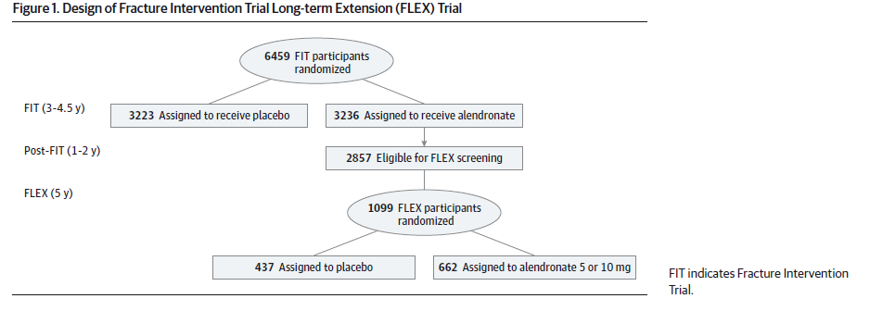

Slide 10
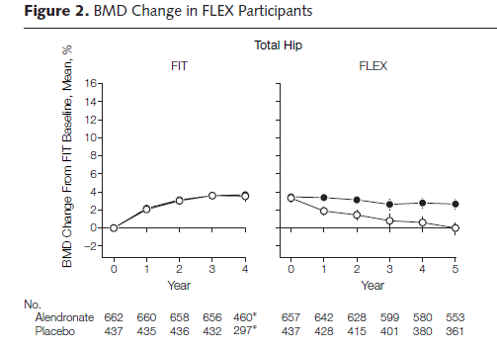

Slide 11
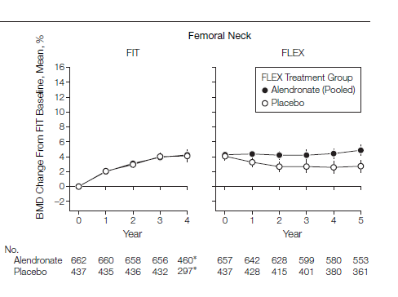

Slide 12
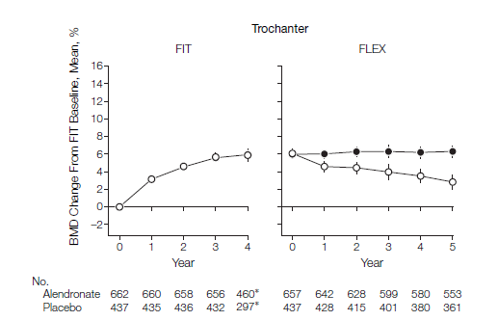

Slide 13
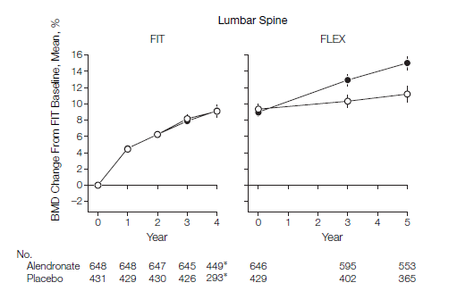

Slide 14
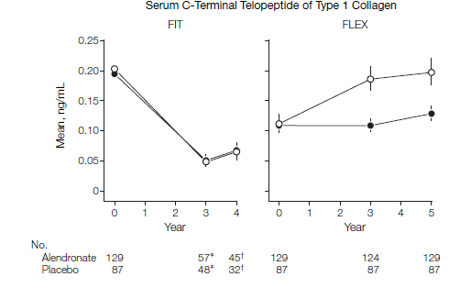

Slide 15
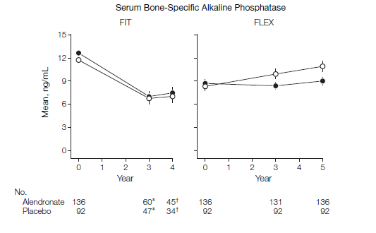

Slide 16
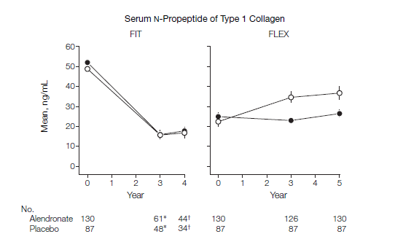

Slide 17
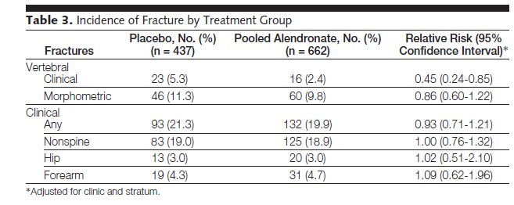

Slide 18
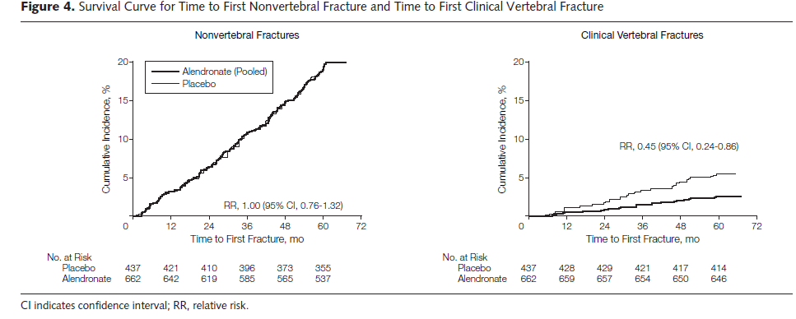

Slide 19
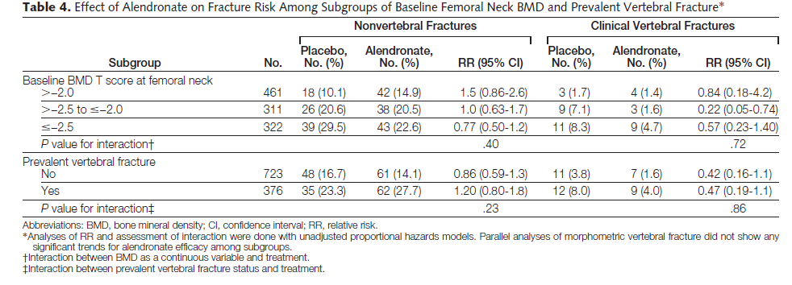

Slide 20
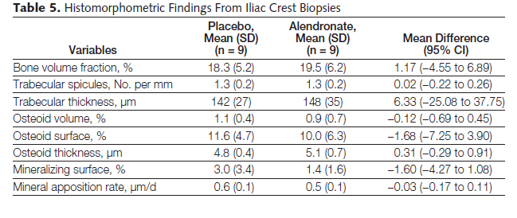

Slide 21
Conclusions
Women who discontinued alendronate after 5 years showed a moderate decline in BMD and a gradual rise in biochemical markers but no higher fracture risk other than for clinical vertebral fractures compared with those who continued alendronate.
These results suggest that for many women, discontinuation of alendronate for up to 5 years does not appear to significantly increase fracture risk. However, women at very high risk of clinical vertebral fractures may benefit by continuing beyond 5 years.

Slide 22
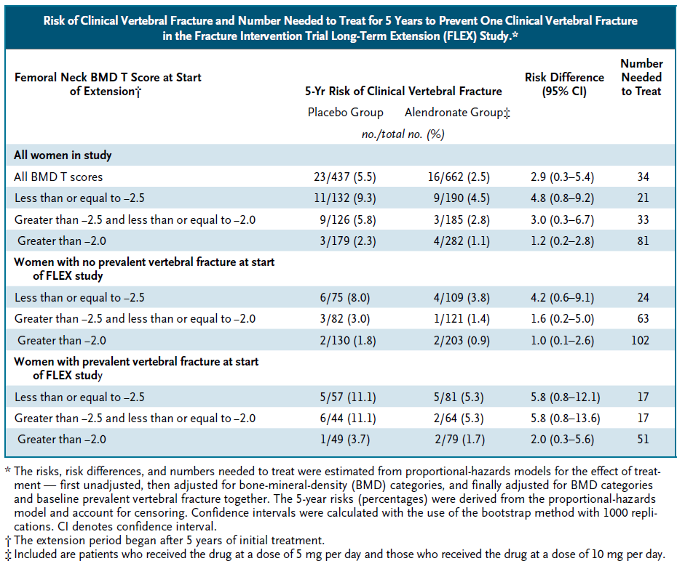

Slide 23
Agenda
Introduction
FLEX Trial
HORIZON Trial
Osteonecrosis of the jaw (ONJ)
Atypical femur fractures (AFFs)
Long-Term Osteoporosis Management With BPs
Conclusion

Slide 24
Methods: multicenter, double-blind, placebo controlled , extension trial.
participants: 1233 postmenopausal women who received ZOL for 3 years in the core study were randomized to 3 additional years of ZOL (Z6, n=616) or placebo (Z3P3, n=617).
primary outcome: femoral neck (FN) BMD percentage change.
Secondary outcome: other BMD sites, fractures, biochemical bone turnover markers and safety.

Slide 25
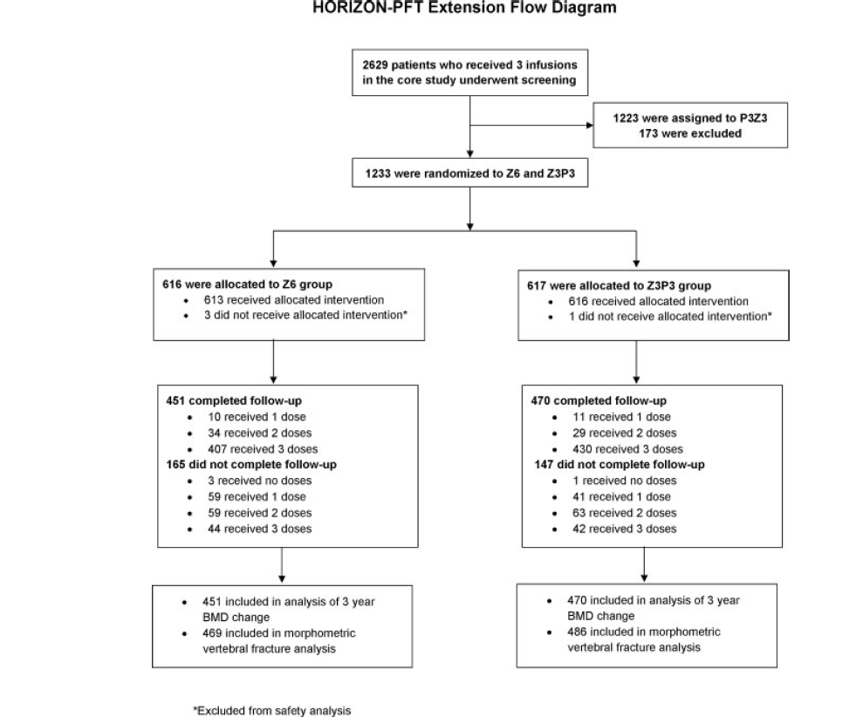

Slide 26
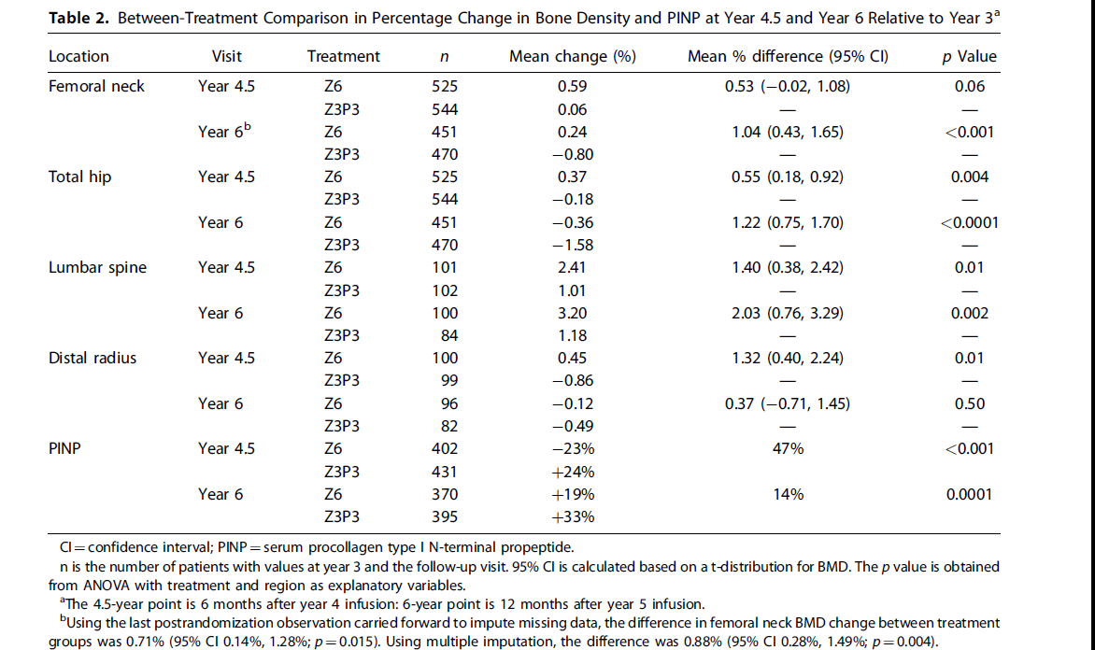

Slide 27
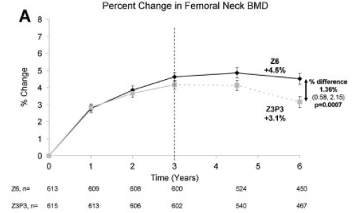
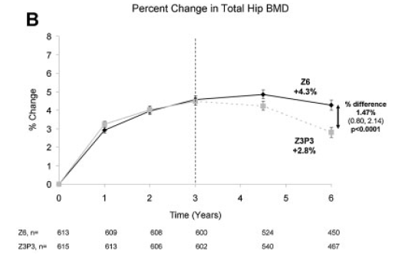

Slide 28
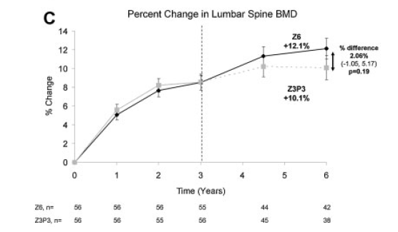

Slide 29
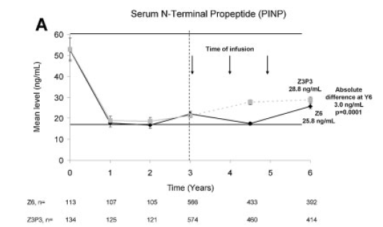
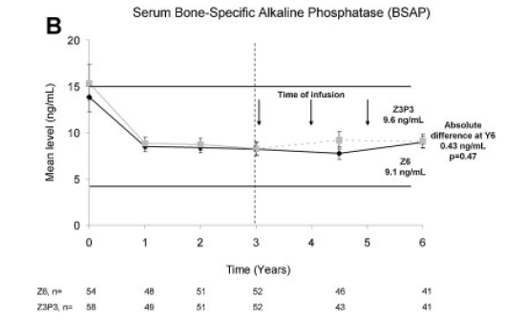

Slide 30
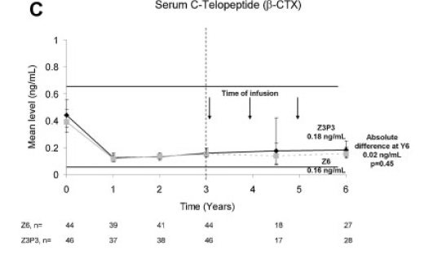

Slide 31
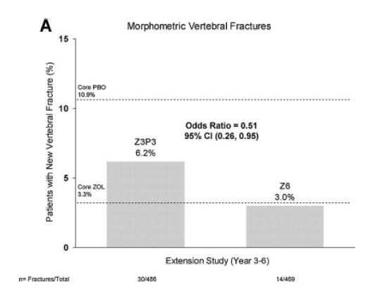

Slide 32
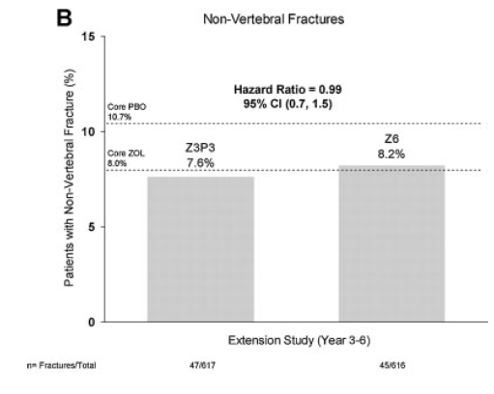

Slide 33
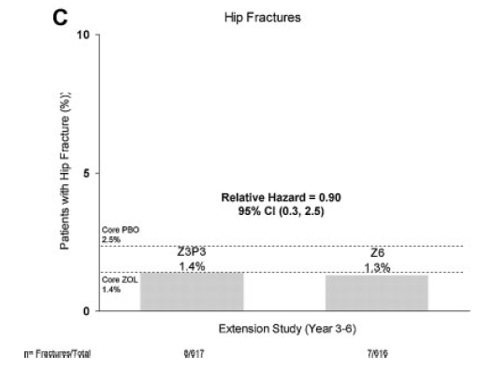

Slide 34
Conclusions
Small differences in BMD in those who continued versus those who stopped treatment suggest after 3 years of annual ZOL, many patients may discontinue therapy up to 3 years.
However, vertebral fracture reductions suggest that those at high fracture risk, particularly vertebral fracture, may benefit by continued treatment.

Slide 35
Agenda
Introduction
FLEX Trial
HORIZON Trial
Osteonecrosis of the jaw (ONJ)
Atypical femur fractures (AFFs)
Long-Term Osteoporosis Management With BPs
Conclusion

Slide 36
Osteonecrosis of the jaw (ONJ)
ONJ was first associated with BP therapy in a report in 2003, in patients with metastatic cancer receiving highdose intravenous BP therapy.
ONJ is characterized by
exposed necrotic bone in the maxillofacial region that has been present for at least 8 weeks of appropriate therapy
exposure to potent antiresorptive agents (BPs or denosumab) or anti-angiogenic agents
no history of radiation therapy to the jaw.
The pathogenesis of ONJ remains unclear,but several potential mechanisms have been proposed. These include oversuppression of bone remodeling, infection, inhibition of angiogenesis, soft tissue toxicity, and immune dysfunction.
In patients receiving BP therapy for osteoporosis, current estimates
of the incidence of ONJ range from approximately 1/10,000 to
1/100,000 patient treatment years.

Slide 37
Potential factors increasing the risk for BP-treated patients to develop ONJ include poor oral hygiene, smoking, diabetes mellitus, concomitant glucocorticoid and/or chemotherapy use, and invasive dental procedures, such as dental extractions or implants.
The incidence may be higher in Asian populations.
Preventive practices that may reduce the incidence of ONJ include prophylactic dental care and avoidance of invasive dental procedures.

Slide 38
Agenda
Introduction
FLEX Trial
HORIZON Trial
Osteonecrosis of the jaw (ONJ)
Atypical femur fractures (AFFs)
Long-Term Osteoporosis Management With BPs
Conclusion

Slide 39
Atypical femur fractures (AFFs)
The relationship between AFFs and BPs was first reported in 2005 in patients receiving oral BPs for osteoporosis.
Incidence rates from 1.8/100,000 per year with a 2- year exposure to 113/100,000 per year with exposure from 8 to 9.9 years.

Slide 42
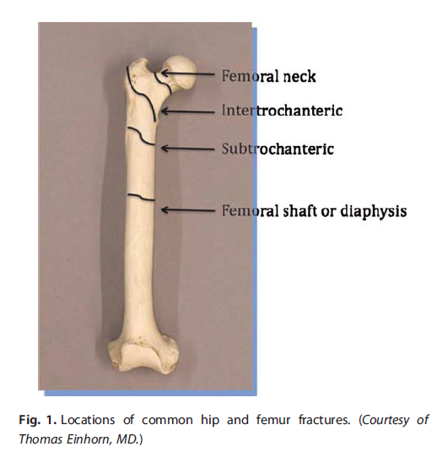

Slide 43
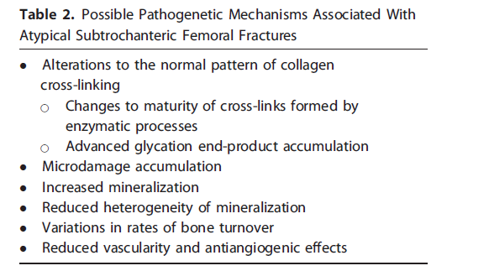

Slide 44
Diagnosis of AFFs : exclude fractures of the femoral neck, intertrochanteric fractures, pathologic fractures associated with local primary or metastatic bone tumors, and periprosthetic fractures.

Slide 45
The radiologic presentation of AFF : bears strikin(similarities to that of stress fractures and may resemble that of pseudofractures).
About 70% of patients with a confirmed stress fracture of the femur report prodromal pain for a period of weeks before the diagnosis.
Radiographic features of stress fractures typically include a periosteal callus that appears hazy and indistinct initially and later solidifies. The periosteal callus is clear evidence of an attempt at repair prior to overt fracture and also occurs in AFFs adjacent to the evolving fracture on the lateral cortex .

Slide 46
AFF in patients on BPs have occurred in the setting of comorbid conditions with known adverse effects on bone quality (eg, DM).
In DM, high glucose levels cause the accumulation of advanced glycation end products (AGEs) that have been associated with an increased risk of fracture. In vitro and in vivo studies demonstrate that AGE accumulation increases the brittleness of bone.
A large proportion of patients also has taken GCs in addition to BPs. GCs reduce osteoblast activity, increase osteoblast apoptosis, and are also associated with osteonecrosis of the femoral head.

Slide 47
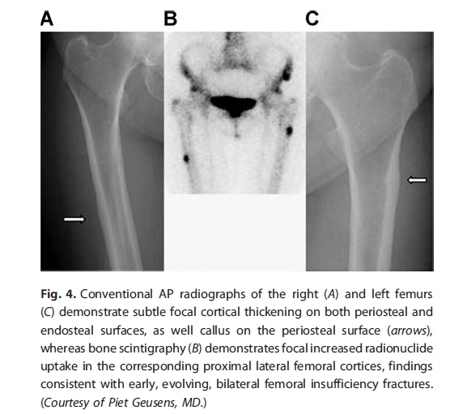

Slide 48
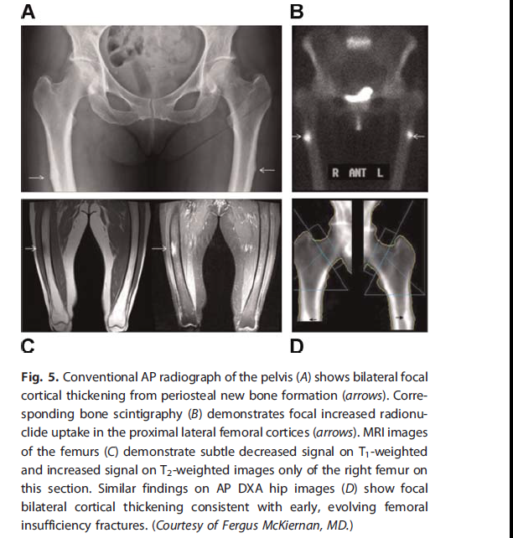

Slide 49
Case Presentation
A 58 year old female with a history of osteopenia found after ankle fracture 10 years ago. She was placed on alendronate at that time.
She presents with complaints of left thigh pain and no recent trauma.
Imaging shows no abnormalities and she is treated conservatively.
One month later while walking down stairs, she feels a crack in her thigh and is unable to bear weight without severe pain.

Slide 50
Agenda
Introduction
FLEX Trial
HORIZON Trial
Osteonecrosis of the jaw (ONJ)
Atypical femur fractures (AFFs)
Long-Term Osteoporosis Management With BPs
Conclusion

Slide 52
Risk Stratification From the Alendronate and Zoledronic Acid Extension Studies
In summary, the extension studies reveal that 10 years of therapy with ALN and 6 years with ZOL prevented bone loss at multiple skeletal sites and a reduction in VF compared with stopping ALN after 5 years or ZOL after 3 years.
Subjects who seemed to benefit most from long-term ALN or ZOL therapy are those categorized as high risk, best captured by a persistent low T-score at hip (–2.5 in HORIZON for total hip or femoral neck T-score and above –2.5 but–2 for femoral neck in FLEX), or incident fracture during the core study in HORIZON.

Slide 53
Continued ALN resulted in a lower risk of clinical vertebral fractures, whereas ZOL resulted in a lower risk of morphometric vertebral fractures.

Slide 54
Potential risk stratification by bone turnover markers
At this time, based on the limited evidence from FLEX and HORIZON extension studies,there is no evidence to support the measurement of BTMs to assess fracture risk after long-term BP use or in offset periods.

Slide 55
Potential risk stratification by fracture risk calculators, age, and weight (FRAX scores)
For untreated patients, fracture risk calculators have been developed to identify individuals who may not have osteoporosis by DXA but are at high fracture risk nonetheless.
In one study using the Manitoba database,Leslie and colleagues demonstrated FRAX scores slowly increased over time. This increase was attenuated but not prevented by treatment, and a change in FRAX score on therapy did not independently predict incident fracture.

Slide 56
Stopping Bisphoshonates and Restarting Therapy
The persistent effect of BPs on bone , coupled with concerns regarding perceived harms from such therapy, led to the concept of a drug holiday.
The drug holiday is designed to minimize side effects and maximize benefits.
After 3 years of intravenous ZOL and 5 years of oral ALN treatment, high-risk postmenopausal white women, such as those with recent incident fracture in the HORIZON extension, or with low hip T-scores in both studies appeared to benefit the most from continued BP treatment.
The evidence for this benefit is limited to reducing the risk of vertebral fractures.

Slide 57
History and physical examination can provide information about additional clinical risk factors that may further increase fracture risk, such as older age, low BMI, weight loss, fall history, or the intake of drugs that have adverse effects on bone.
Attention to causes of secondary osteoporosis, calcium intake, and vitamin D levels may also affect response to therapy.
Two observational studies suggest that the serum 25-hydroxyvitamin D level should be 30 ng/mL or more to ensure an adequate response to BPs.(67–69) However, vitamin D status did not affect the bone density response to ALN in FIT.

Slide 58
After treatment for 5 years with ALN and 3 years with ZOL, in PMW who have a low fracture risk with a hip T-score higher than –2.5, discontinuation of BP therapy may be considered with reassessment at 2 to 3 years after discontinuation to determine risk.
Repeat DXA or BTM measurements may be considered during this “holiday,” but there are no data to guide the clinician regarding reinstitution of therapy because neither 1-year change in BMD nor 1 year change in BTMs predicted fractures post-BP discontinuation.
It would be reasonable to consider withholding therapy as long as BMD is stable and to restart BP therapy (or an alternate osteoporosis medication) if the BMD T-score is –2.5, or if other new/additional risk factors for fractures emerge. However, this approach is based on expert opinion.

Slide 59
Side-Effect Risks after Stopping Bisphosphonate Treatment

Slide 60
Effect of bisphosphonate discontinuation (holiday) on AFF risk
The risk of AFF after stopping treatment fell by 70%/year since last BP use (odds ratio [OR]=0.28, 95% CI 0.21–0.38), and the most dramatic reduction in risk occurred after the first year of discontinuation.

Slide 61
Effect of bisphosphonate discontinuation on ONJ risk
Because of the long-terminal half-life of BPs, the American Dental Association and the American Association of Oral and Maxillofacial Surgeons do not recommend routine discontinuation of BP treatment for osteoporosis in most patients about to undergo invasive dental procedures.

Slide 62
Potential use of BTMs to determine safety risks
Markedly suppressed bone turnover leading to an inability to repair skeletal microfractures, followed by propagation of these small fractures, has been proposed as the mechanism underlying AFFs.
The value of BTMs to predict which patients on long-term BPs are at risk for AFFs is unclear.
American Dental Association recommendations and the American Association of Oral and Maxillofacial Surgeons conclude that measurement of BTMs does not help in the assessment of risk of ONJ in patients on BPs for osteoporosis.

Slide 63
Management of AFF and ONJ related to bisphosphonates
When ONJ or an AFF occurs in a patient on chronic BPs for osteoporosis :
discontinuation of the BP is recommended.
antibacterial mouth rinse, oral antibiotics, and surgical debridement.
In addition, a few reports have demonstrated a beneficial effect of strontium ranelate in AFF.
Based on available reports, a limited course of teriparatide may be considered to accelerate healing of BP-related AFFs or ONJ.

Slide 64
Long-Term Osteoporosis Management With BPs

Slide 65
For PMW who have been on oral BP therapy for 5 years or intravenous ZOL for 3 years, the patient option of continuing oral BP therapy for up to a total of 10 years :
had experienced a hip, spine fractures (including asymptomatic vertebral compression fractures)
multiple other osteoporotic fractures before therapy
experienced a major osteoporotic fracture (spine, hip, humerus, or forearm) while on therapy
because such fractures, especially when recent (ie, experienced within 3 to 5 years), increase future fracture risk

Slide 66
Patients who sustain a major osteoporotic fracture while on therapy should also undergo evaluation for causes of secondary osteoporosis, new risk factors, inadequate vitamin D status, high fall risk and assessment of poor compliance or adherence to therapy.
In addition, switching to alternative therapies may be considered, although there have not been adequate studies to evaluate the efficacy of such an approach.
The optimal length of therapy for the patient who suffers a fracture while on treatment has not been established, and clinical judgment will be needed to determine each patient’s specific fracture risk.

Slide 67
Factors increased fracture risk and used for the decision on whether to continue therapy:
older age (for example, >70 to 75 years)
medication use (eg, aromatase inhibitors, glucocorticoid therapy)
new diagnosis of a disorder associated with secondary osteoporosis.

Slide 68
The Task Force suggests that the patient remains at elevated fracture risk the provider discuss with the patient the option of continuing BP treatment for another 2 to 3 years with reassessment at that time.
For those women who are not considered to be at high fracture risk, a drug holiday may be considered with reassessment at 2 to 3 years.

Slide 69
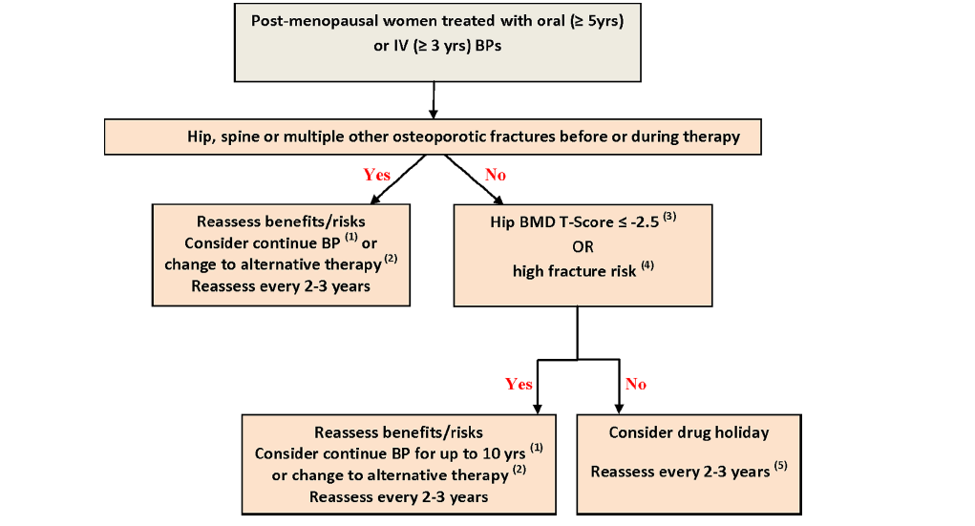

Slide 70
Subjects who seemed to benefit most from long-term ALN or ZOL therapy are those categorized as high risk, best captured by a persistent low T-score at hip (–2.5 in HORIZON for total hip or femoral neck T-score and above –2.5 but–2 for femoral neck in FLEX), or incident fracture during the core study in HORIZON.

Slide 71
Agenda
Introduction
FLEX Trial
HORIZON Trial
Osteonecrosis of the jaw (ONJ)
Atypical femur fractures (AFFs)
Long-Term Osteoporosis Management With BPs
Conclusion

Slide 72
Conclusion
To optimize the efficacy of bisphosphonates in reducing fracture risk, decisions to continue treatment must be based on individual assessment of risks and benefits and on patient preference.
In this regard, patients at low risk for fracture (e.g., younger patients without a fracture history and with a BMD approaching normal) may prove to be good candidates for discontinuation of bisphosphonate therapy after 3 to 5 years, whereas patients at increased risk for fracture (e.g., older patients with a history of fracture and a BMD remaining in the osteoporotic range) may benefit further from continued bisphosphonate therapy.

Slide 73
Thank you

Slide 74
