Slide 1
Glucose variability

Slide 2
Agenda
Definition and importance
Tools for measuerment
Glucose variability and diabetic complication
Postprandial excursion
How to minimize Glucose variability
conclusions

Slide 3
What is meant by “glucose variability”?
Within-day variation (glucose excursions)
Glucose excursions (from average or basal) in an individual over 24 hours
includes: postprandial excursions, hypoglycaemic excursions, diurnal variations
Within-patient day-to-day variation
Variance of glucose between days in an individual at the same time of day
Between-patient variation
Difference in response of individuals given the same therapeutic or lifestyle challenge

Slide 4
Glucose variability

Slide 5
Whole story is not limited to HbA1c
HbA1c is not the most complete expression of the degree of hyperglycemia
Other factors independent of HbA1c levels may add further metabolic burden and increase the risk of diabetic complications

Slide 6
HbA_{1c} = 7% BAD
Blood Glucose
HbA_{1c} = 7% GOOD
Time
.
Notes:
Excessive daily glycemic fluctuations contribute to diabetic complications and impair Quality of life
Perhaps the most compelling reason to target PPH is to achieve around-the-clock blood glucose control.
It is noteworthy that PPH, similar to HbA1C, has been correlated with the presence of diabetic complications, notably retinopathy and nephropathy, in various epidemiological studies
PPH, even in the absence of marked fasting hyperglycaemia, is a recognised risk factor for coronary artery disease. CHD mortality was doubled in individuals with 2-hour post-50g oral glucose load levels of 5.3 to 10.9 mmol/L (96 to 196 mg/dl) compared with individuals with 2-hour post-glucose load levels of <96mg/dl. (Whitehall Study)
PPHG, but not fasting hyperglycaemia, was an independent risk factor for myocardial infarction and total mortality. (Diabetes Intervention Study)

Slide 7
Agenda
Definition and importance
Tools for measuerment
Glucose variability and diabetic complication
Postprandial excursion
How to minimize Glucose variability
conclusions

Slide 8
Different methods for Glucose variability
Continuous glucose monitoring:
Mean (average)±standard deviation (SD)
J index
Coefficient of variance (CV)
Low blood glucose index, high blood glucose index(LBG,HBG)
Average daily risk range (ADRR)
Mean amplitude of glucose excursion (MAGE)
Mean of daily differences (MODD)
Continuous overall net glycemic action(CONGA)
Serum :
Glycated albumin
1,5-anhydroglucitol
Glycated albumin/glycosylated hemoglobin ratio

Slide 9
Mean amplitude of glucose excursion MAGE
Average of all blood glucose excursions or swings (peak to trough) that are greater than 1 SD of all measures for a given glucose profile
Most common measure of glucose spikes, swings, or excursions as opposed to glucose dispersion, Used for many years; can be applied to SMBG or CGM data
41 and 48 mg/dL# (results from day 1 and 2 for one normal individual using CGM for 48 h)

Slide 10
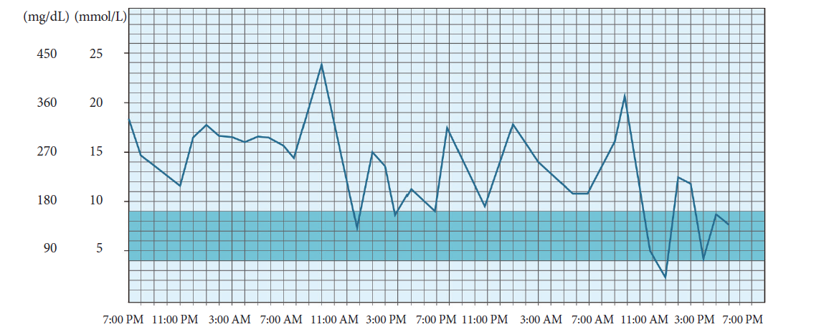
Definition and importance
Definition and importance

Slide 11
Agenda
Definition and importance
Tools for measuerment
Glucose variability and diabetic complication
Postprandial excursion
How to minimize Glucose variability
conclusions

Slide 12
To assess whether the coefficient of variation (CV) of fasting plasma glucose (FPG) over a 3-year period was a significant predictor of mortality in type 2 diabetic patients
All type 2 diabetic patients (n = 1,409) aged 56–74 years attending the Verona Diabetes Clinic and having at least two FPG determinations in each of the years 1984–1986 were followed for 10 years (1987–1996) to assess total and cause-specific mortality.
Diabetes Care 2 3 :4 5–50, 2000

Slide 13
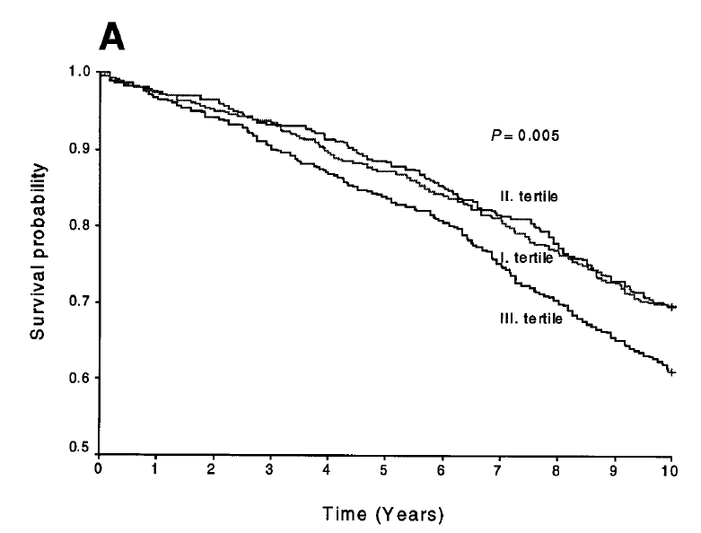
The log-rank test revealed significant differences in survival among tertiles of mean FPG (P<0.005)

Slide 14
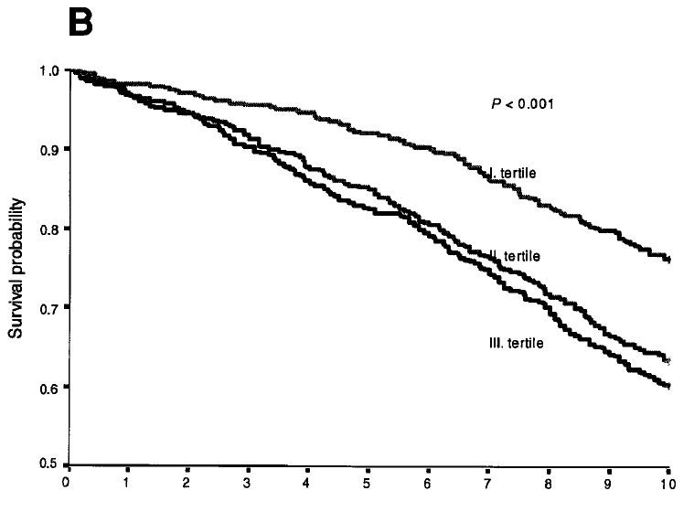
The log-rank test revealed significant differences in survival among tertiles of the CV of FPG (P<0.001)

Slide 15
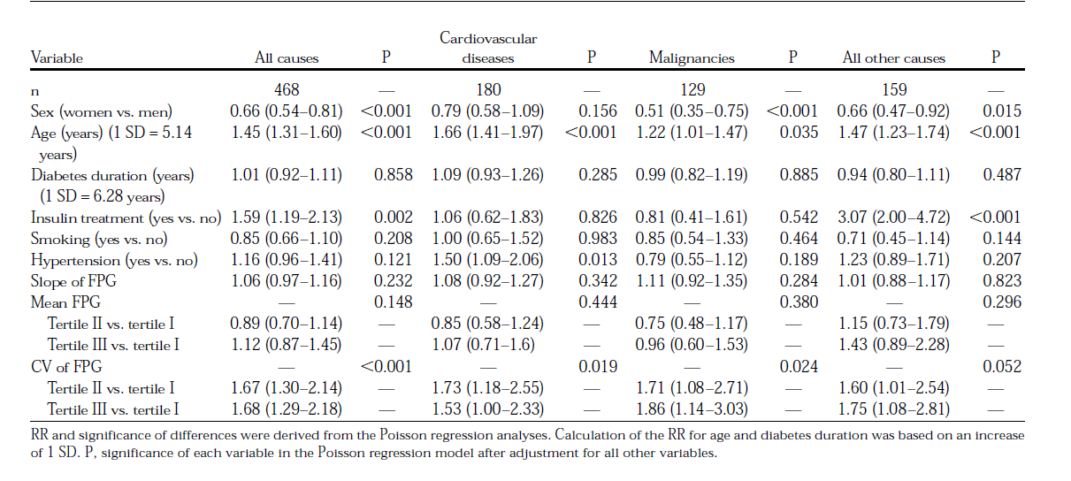
Multivariable analysis

Slide 16
Key message
Long term variability of fasting glucose is an independent predictor of mortality in patients with type 2 diabetes
The CV of FPG might be considered a useful additional parameter in the management of these patients

Slide 17
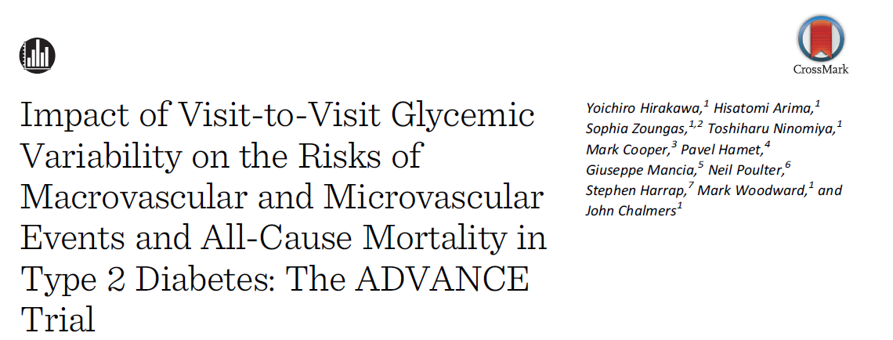
Objective: the effects of visit-to-visit variability (VVV) in HbA1c and fasting glucose on major outcomes in the ADVANCE
VVV in the intensive glucose treatment group was defined using the SD of five measurements of HbA1c and glucose taken 3–24 months after randomization among 4399 patients
Diabetes Care August 2014 37:8 2359-2365

Slide 18
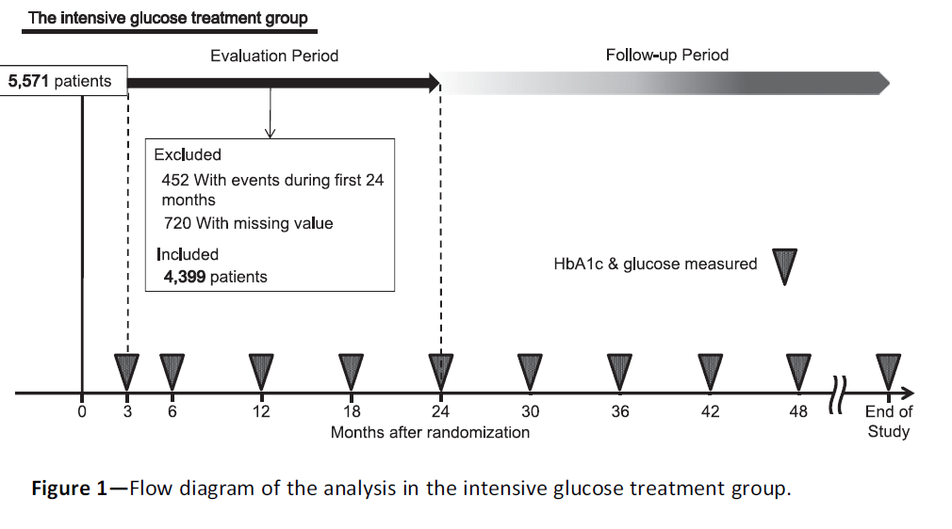

Slide 19
The effect of SD of HbA1c based on five measurements on the risks of outcomes

Slide 20
The effect of SD of fasting glucose based on five measurements on the risks of outcomes

Slide 21
Key message
VVV in HbA1c and that in fasting glucose were associated with increased risks of macrovascular events, microvascular events, and all-cause deaths in patients with type 2 diabetes

Slide 22
Objective: to identify studies investigating the relationship between short-term glucose variability and the incidence/prevalence of chronic complications in type 1 or type 2 diabetes.
a total of 28 articles ,7 in type 1 diabetes, 18 in type 2 diabetes, 1 in both type 1 and type 2, June 2002 to March 2014, in English and including ≥50 patients.
Diabetes research and clinical practice105(2014)273–284274

Slide 23
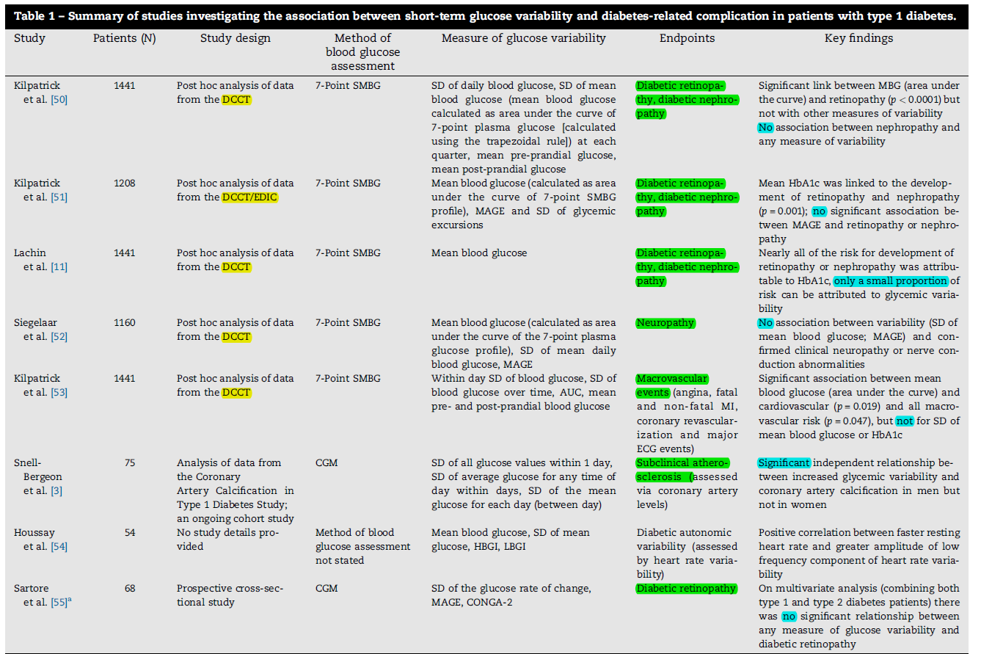

Slide 24
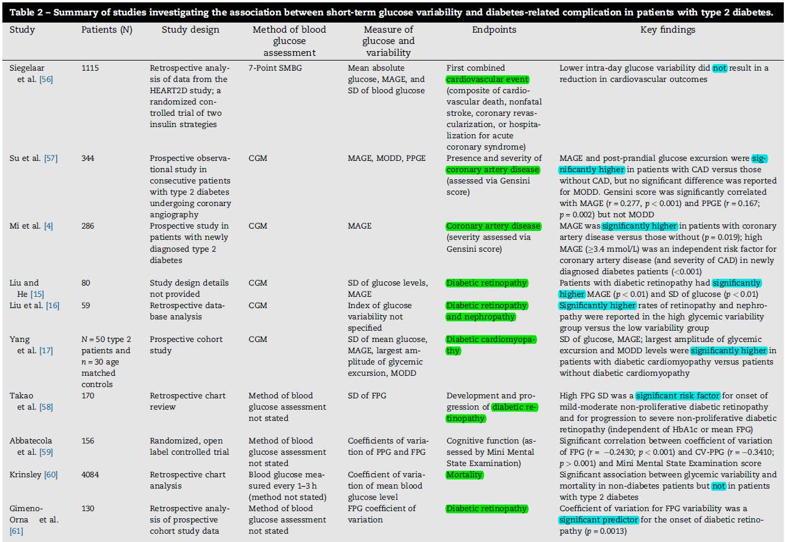

Slide 25
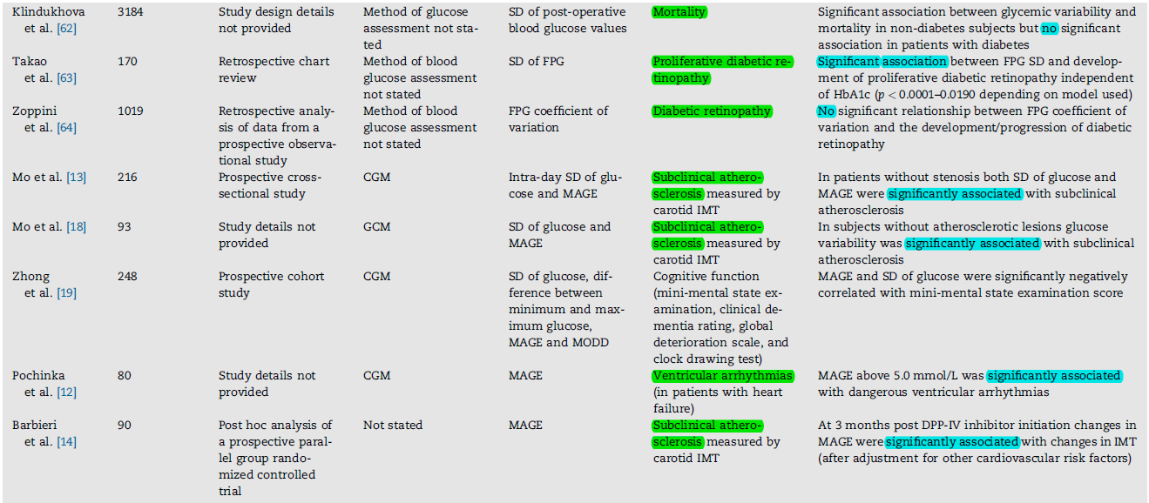

Slide 26
Discussion
A point worthy of note with regard to type 1 diabetes is that the majority of glycemic variability studies identified in the current review were performed using data from the DCCT.
the inconsistency around the role of glucose fluctuations in the development of macrovascular disease raises the question of whether increased short-term glucose variability is a causative agent of diabetes-related complications or if increased glycemic fluctuations arise as a consequence of more severe disease and/or the presence of existing complications, poor dietary management or poor adherence to antidiabetic therapy.

Slide 27
Discussion …
Another weakness in the studies in type 2 diabetes is that a substantial proportion of studies included mixed populations of patients treated with diet alone, diet and oral antidiabetic medications (OADs) and insulin. As such, this may have been a confounding factor in the findings of some analyses,
The studies identified here illustrate that a large number of different methods are currently used to assess glycemic variability The studies identified here illustrate that a large number of different methods are currently used to assess glycemic variability, there is no consensus on which, if any, method, represents the ‘‘gold standard’’ and most methods are associated with notable limitations

Slide 28
Key message
increased levels of short-term glucose variability, may contribute to the development of microvascular complications in type 2 diabetes, but uncertainty remains as to whether it is a contributing factor in the development of macrovascular complications.
In patients with type 1 diabetes, the role of increased short-term glucose variability in the development of both micro- and macrovascular complications is less evident.

Slide 29
Mechanisms ?
Glucose fluctuation has been shown to cause overproduction of superoxide
Glycemic fluctuation has been shown to cause an increase in inflammatory cytokines and monocyte and macrophage adhesion to endothelial cells
Transient hyperglycemia causes long lasting epigenetic changes
Glucose fluctuation has been shown to cause loss of pancreatic β-cells due to increased apoptotic cell death

Slide 30
Agenda
Definition and importance
Tools for measuerment
Glucose variability and diabetic complication
Postprandial excursion
How to minimize Glucose variability
conclusions

Slide 31
Postprandial excursion
Is there any relationship between post prandial glucose reduction and cardiovascular outcomes ?

Slide 32
Objective: To evaluate the effect of decreasing postprandial hyperglycemia with acarbose, on the risk of cardiovascular disease and hypertension in patients with impaired glucose tolerance (IGT).
Patients with IGT were randomized to receive either placebo (n=715)or 100 mg of acarbose 3 times a day (n=714)
JAMA. 2003;290:486-494

Slide 33
Acarbose decreased CV events in post hoc analysis by 49% during the 3.3 years of follow up
JAMA. 2003;290:486-494

Slide 34
9306 persons with IGT with CVD or CV risk factors followed for 5 years
nateglinide, as compared with placebo, did not significantly reduce the cumulative incidence of diabetes (36% and 34%, respectively), composite CV outcome 14.2% vs. 15.2% (NS); increased the risk of hypoglycemia
Among persons with impaired glucose tolerance and established cardiovascular disease or cardiovascular risk factors, assignment to nateglinide for 5 years did not reduce the incidence of diabetes or the coprimary composite cardiovascular outcomes.
NEJM , april 22, 2010

Slide 36
HEART2D trial

Slide 37
HEART2D: Design
OBJECTIVE: compare the effects of prandial vs fasting glycemic control on risk of cardiovascular outcomes in patients with T2DM after AMI
Population: T2DM Patients (aged 30–75 years) within 18 days after AMI, a total of 1,115 patients were randomly assigned (PRANDIAL n557; BASAL n
558)
intervention:
1) PRANDIAL strategy(premeal lispro;n=557)
2) BASAL strategy(NPH or glargine; n=558)
DIABETES CARE, VOLUME 32, NUMBER 3, MARCH 2009

Slide 38
HEART2D : Glycemic target
A1C<7.0%,
Postprandial BS<135mg/dl
FBS<120mg/dl
DIABETES CARE, VOLUME 32, NUMBER 3, MARCH 2009

Slide 39
PRANDIAL BASAL HR 95% CI first CV event 31.2% 32.4% 0.98 0.8 –1.21

Slide 40
HEART2D :Mean ± SD A1C

Slide 41
HEART2D: 7-point mean SMBG at baseline & throughout the study

Slide 42
key message
Risk of CVD outcomes was similar between the treatment groups

Slide 43
Agenda
Definition and importance
Tools for measuerment
Glucose variability and diabetic complication
Postprandial excursion
How to minimize Glucose variability
conclusions

Slide 44
How to minimize GV ?
Diet and weight reduction
Glucagon-like peptide-1 analogs and dipeptidyl-peptidase 4 inhibitors
Fast-acting and long-acting insulins (insulin degludece)
Continuous Subcutaneous Insulin Infusion (CSII) and bariatric surgery
Development of new technologies for diabetes education, monitoring and therapy, particularly in T1DM

Slide 46
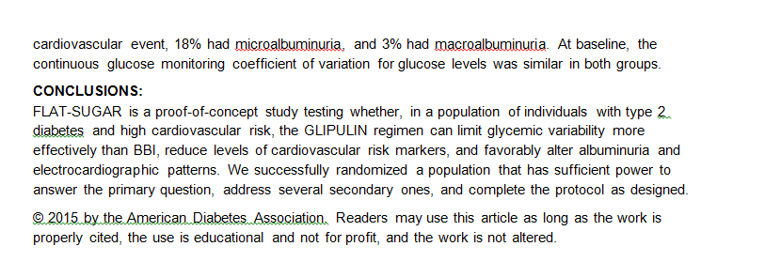
inhibitors

Slide 47
Agenda
Definition and importance
Tools for measuerment
Glucose variability and diabetic complication
Postprandial excursion
How to minimize Glucose variability
conclusions

Slide 48
CONCLUSION
GV is a physiological phenomenon that assumes an even more important dimension in the presence of diabetes because it not only contributes to increasing the mean blood glucose values but it also favors the development of chronic diabetes complications
It appears that GV is poised to become a future target parameter for optimum glycemic control over and above standard glycemic parameters, such as blood glucose and HbA1c.

Slide 49
CONCLUSION…
Avoiding both hyperglycemia and hypoglycemia by careful use of SMBG and the availability of new agents to correct hyperglycemia without inducing hypoglycemia is expected to reduce the burden of premature mortality and disabling CV events
defining GV remains a challenge primarily due to the difficulty of measuring it and the lack of consensus regarding the most optimal approach for patient management.

Slide 50
CONCLUSION…
Further studies are required (clinical trial comparing stable versus unstable glycemia) would be conclusive to prove that glucose “stability” actually reduces diabetic complications.

Slide 51
Thanks

