Slide 1
Statin Intolerance
Soghra Rabizadeh, MD.
Imam Khomeini Medical Complex,
Tehran University of Medical Sciences

Slide 2
Introduction
Statin use has increased progressively in all age groups since 1988
The American Heart Association/ American College of Cardiology guidelines have broadened the indications for their use.

Slide 3
A 21% decrease in CVD mortality and morbidity(stroke and fatal coronary events) can be achieved by lowering LDL-C by 1.0 mmol/l (38.7 mg/dl)
Cholesterol Treatment Trialists’ (CTT) Collaboration, Lancet.
2010;

Slide 4
Statin Use
Dyslipidemia
Coronary artery disease
Acute coronary syndromes
Diabetes mellitus
Stroke
Hypertension
CKD

Slide 5
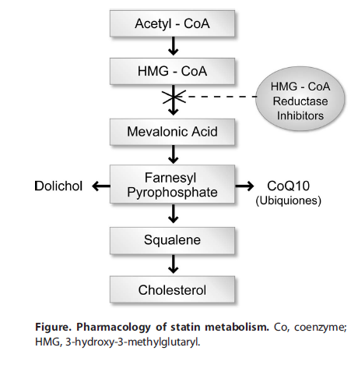
Deichmann, RE.et al. The Ochsner Journal, 2015

Slide 6
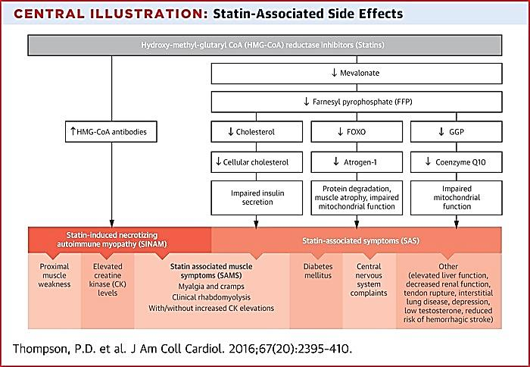
Statin associated side effects

Slide 7
Muscle symptoms
Observational data show that about 10% to 20% of patients treated with statins complain of muscle symptoms (usually muscle aches)
Analyses of muscle symptoms in double-blind, placebo-controlled randomized trials of statins have shown small numerical increases in muscle symptoms of about 0.3% (which is not statistically significant)
Ganga HV,et al. Am Heart J. 2014
Collins R,et al. Lancet. 2016

Slide 8
Serious muscle injury is rare (<1 in 1,000 patients)
Muscle aches and pains are common background symptoms in middle-aged and older people not taking statins and are rarely caused by the statin (<1 in 50 to 100 patients)

Slide 9
PRIMO study: Observational study in 7924 patients
Eric Bruckert, et al. Cardiovascular Drugs and Therapy.2005

Slide 10
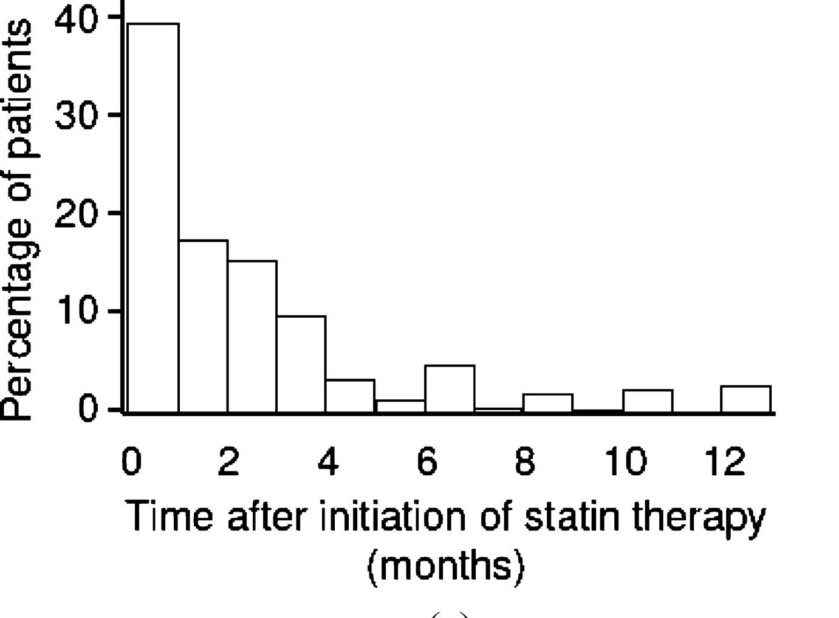
PRIMO study: temporal pattern of SAMS
Eric Bruckert, et al. Cardiovascular Drugs and Therapy.2005

Slide 11
Definition of statin intolerance International Lipid Expert Panel
The Inability to tolerate at least two statins: one statin at the lowest starting daily dose and another statin at any daily dose.
Resolution or improvement of symptoms or changes in biomarkers with dose decrease or discontinuation of drug .
Symptoms or changes in biomarkers are not attributable to established predisposition factors such as drug–drug interactions and recognized conditions increasing the risk of statin intolerance
Banach M,et al. Expert Opin Drug Saf. 2015

Slide 12
Statin Related Myotoxicity(SRM) Phenotype
Classification | Phenotype | Definition
SRM 0 | CK < 4 ˣ ULN | No muscle symptoms
SRM 1 | Myalgia, tolerable | Muscle symptoms without CK elevation
SRM 2 | Myalgia, intolerable | Muscle symptoms, CK <4× ULN, complete resolution on dechallenge
SRM 3 | Myopathy | CK elevation >4× ULN <10× ULN ± muscle symptoms, complete resolution on dechallenge
SRM 4 | Severe myopathy | CK elevation >10×ULN <50×ULN, muscle symptoms, complete resolution on dechallenge
SRM 5 | Rhabdomyolysis | CK elevation >10×ULN with evidence of renal Impairment + muscle symptoms or CK >50×ULN
SRM 6 | Autoimmune-mediated necrotizing myositis | HMGCR antibodies, HMGCR expression in muscle biopsy, incomplete resolution on dechallenge
Alfirevic et al. Clin Pharmacol Ther 2014;

Slide 13
Statin Myalgia Index Score
Clinical symptoms (new or increased unexplained muscle symptoms | Score
Regional distribution/pattern Symmetric hip flexors/thigh aches Symmetric calf aches Symmetric upper proximal aches Nonspecific asymmetric, intermittent | 3 2 2 1
Temporal pattern Symptoms onset <4 weeks Symptoms onset 4–12 weeks Symptoms onset >12 weeks | 3 2 1
Dechallenge Improves upon withdrawal (<2 weeks) Improves upon withdrawal (2–4 weeks) Does not improve upon withdrawal (>4 weeks) | 2 1 0
Challenge Same symptoms reoccur upon rechallenge <4 weeks Same symptoms reoccur upon rechallenge 4–12 weeks | 3 1
Probable :9-11
Possible : 7-8
Unlikely: < 7
Rosenson et al,journal of clinical lipidology.2014

Slide 14
Risk factors for statin associated muscle symptoms
Advance age
Female
Physical disability
Lower BMI
Hypothyroidism
Colchicin , Alcohol (toxic muscle effect)
Exercise

Slide 15
Risk factors for statin associated muscle symptoms
Medications metabolized by CYP3A4 :
Azoles, macrolids,TCA, protease inh, calcium chanel blockers, cyclosporine, tacrolimus, sirolimus, amiodarone, danazole, midazolam, nefazodone, tamoxifen, sildenafil, and warfarin
Grapefruit inhibit intestinal CYP3A4
Gemfibrozil interfere with Statin glucoronidation

Slide 16
Case1
A 54 y/o man with history of elevated cholestrol and PCI at age 52
His complaint is pain in thighs
DH: Atorvastatin 80 mg witch was decreased to 40 mg due to calf pain and discontinue it and now on ezetimibe10 /simvastatin40
FH: IHD in his father in 65 y
His examination was normal, no muscle weakness or tenderness.
BP:135/70, HR:86 , BMI: 26 kg/m²

Slide 17
case1
Question:
What laboratory tests would you recommend?

Slide 18
Approach to symptomatic Statin Related muscle problems

Slide 19
Step1
History and Ph/E to determine potential causes
Check CK level & review other labs.( cr,TSH, 25 vitD)
NL CK (myalgia)
CK < 10 × ULN
CK> 10 × ULN
(R/O rhabdomyolysis)
(check Cr , urine myoglobin)
Saxon DR, Eckel RH. Progress in Cardiovascular Diseases.2016

Slide 20
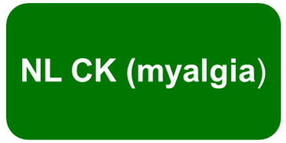
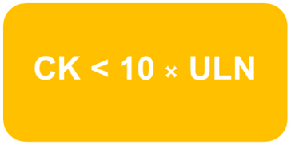
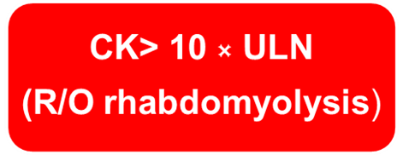
Step2
Lower statin dose OR discontinue depending severity of symptoms
Discontinue statin, intensive management
Moderate to severe symptoms,
weekly contact
If symptoms resolve:
Rechallenge with statin
If symptoms persists: appropriate referral
Severe muscle injury:
rechallenge is not appropriate
Saxon DR, Eckel RH. Progress in Cardiovascular Diseases.2016

Slide 21
Step2
If statin rechallenge : use different statin or alternative dose
Rosuvastatin 5 mg or atorvastatin 10 mg QWK,
fluva-1mg or pravastatin 10mg QOD or QD
Reassess patients within 6 weeks.
Clarify patients LDL goal based on ASCVD risk
Saxon DR, Eckel RH. Progress in Cardiovascular Diseases.2016

Slide 22
Step3
Not tolerate low dose statin
Tolerate statin, not reaching LDL goal
Tolerate statin ,reaching LDL goal:
Continue drug & follow up
Non statin agents
Ezetimibe, bile acid sequestrants, PCSK9 inhibitors, niacin and fibrate
Saxon DR, Eckel RH. Progress in Cardiovascular Diseases.2016

Slide 23
The interaction between statins and exercise
The combined use of statins and exercise training (ET) can result in health gains and decreased CVD risk
Some of the events: decreased athletic performance, muscle injury, myalgia, joint problems, decreased muscle strength, and fatigue

Slide 24
Strategies to Decrease the Risk of Adverse Interactions Between Statin and Exercise Training (ET)
Reassess the need for statin.
Decrease the dose of statin.
Change to a hydrophilic statin.(pravastatin , rosuvastatin)
Prescribe a statin holiday followed by a rechallenge.
Decrease the intensity of ET.
Decrease the duration of ET.
Prescribe vitamin D replacement.
Prescribe coenzyme Q10 supplementation.
Prescribe L-carnitine supplementation.
Avoid drug interactions that increase toxicity
Richard E. Deichmann, et al. The Ochsner Journal.2015

Slide 25
Case1
A 54 y/o man with history of elevated cholestrol and PCI at age 52
His complaint is pain in thighs
DH: Atorvastatin 80 mg witch was decreased to 40 mg due to calf pain and discontinue it and now on ezetimibe10 /simvastatin40
FH: IHD in his father in 65 y
His examination was normal, no muscle weakness or tenderness.
BP:135/70, HR:86 , BMI: 26 kg/m²

Slide 26
case1
Question:
What laboratory tests would you recommend?

Slide 27
Case 1 : Lab tests
CK: 175 U/l, chol: 175 mg/dl, LDL:112 mg/dl, HDL:45, TG:160, A1c:6 %, TSH:1, vit D: 36 ng/ml
What is the next step ?

Slide 28
Case1
A) Rechallenge with rosuvastatin immediately
B) discontinue ezetimibe/simvastatin for2 weeks
C) discontinue ezetimibe/simvastatin and prescribe PCSK9
D) Reassure the patient that symptoms are not related to statin

Slide 29
Statin use is critical in this patient because high cardiovascular risk
First step would be to reassure the patient that his muscle symptoms are rarely caused by the statin and statins are essential for people with coronary artery disease to reduce the incidence of heart attack and death.

Slide 30
A cornerstone in treating patients with SAMS is communication.
careful history taking , counseling regarding diet and other modifible risk factors, clear counseling about the benefit and low incidence of side effects with statins

Slide 31
Statin liver safety

Slide 32
Statin and liver
Reversible , dose dependent and asymptomatic elevation of liver enzymes
Persistent elevation in ALT or AST> 3× ULN in about 3% of patients receiving high dose statins
Liver enzymes elevation alone without increases in bilirubin don’t indicate severe hepatic injury
FDA .2012

Slide 33
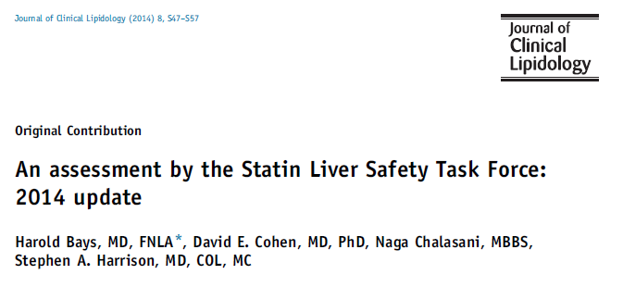
Statin liver safety

Slide 34
2014 NLA Statin Safety Task Force Questions

Slide 35
Question1
Have any unexpected safety concerns arisen since the regulatory recommendation that liver enzymes need not be measured after initiating statin therapy?
NO
Irreversible liver damage with statins is exceptionally rare and is idiosyncratic.

Slide 36
Question 2
Should baseline liver enzymes be obtained before initiating statin therapy?
Yes
Liver enzymes tests should be performed before starting statin and as clinically indicated thereafter

Slide 37
Question 3
Are statins safe to use in patients with nonalcoholic fatty liver disease?
Yes
chronic liver diseases and compensated cirrhosis were not contraindications
for statin use.

Slide 38
Question 4
Do statins have drug interactions with medications used to treat infections (eg, hepatitis B, C) that require change
in statin, change in statin dosing, or change in antiviral regimen dosing?
Yes

Slide 39
Question 4
Can statins safely be used in liver transplant recipients?
Yes
Cardiovascular events are
common among liver transplant patients

Slide 40
Question 5
Can statins safe in patients with autoimmune hepatitis?
Yes

Slide 41
Causes of elevated liver enzymes
Celiac disease
Congestive cardiomyopathy
Endocrine disease : DM, metabolic syn
Ethanol intake
Fatty liver
Gallbladder disease
Genetic diseases: Alpha 1 antitrypsin deficiency,CF, Hemochromatosis , Wilson’s disease
Infections
Malignancies
Autoimmune
HELP syn
Medications

Slide 42
Patients wit elevated liver enzymes
ALT or AST < 3 × ULN
History & Ph/E for other causes
Review prior liver enzymes tests
Repeat tests to confirm elevation
Total bilirubin normal
CK normal
Total bilirubin elevated
CK normal

Slide 43
Total bilirubin normal
CK normal
Total bilirubin elevated
CK normal
Prior bilirubin↑ (Gilbert)
If the most diagnosis is NAFLD
OK to start statin
Lifestyle change
Asymptomatic
Prior bili is periodically elevated
Indirect bili elevated
Continue statin
Repeat liver tests

Slide 44
Prior bili NL
Now bili ↑ (specially direct)
liver biopsy or imaging if liver enzymes don’t improve with discontinuing statin and lifestyle change

Slide 45
Patient with ALT or AST > 3 × ULN
History & PH/E
Review prior liver enzyme tests
Repeat tests immediately
ALT or AST >3 × ULN
CK NL

Slide 46
ALT or AST >3 × ULN
CK NL
Stop statin
Stop other drugs that may have liver toxicity
If patient is overweight or obese , lifestyle modification
Check Albumin, PT, CBC
Diagnostic tests :
Alkp, viral hepatiis,FBS, Hb A1c,TFT,ANA,ASMA ,AMA, anti liver- kidney microsomal ab, Anti TTG, ferritin ,TS, Ceruloplasmin, 𝜶𝟏 𝒂𝒏𝒕𝒊 𝒕𝒓𝒚𝒑𝒔𝒊𝒏, 𝒔𝒐𝒏𝒐𝒈𝒓𝒂𝒑𝒉𝒚 𝒐𝒇 𝒂𝒃𝒅𝒐𝒆𝒎𝒆𝒏
liver biopsy or imaging if liver enzymes don’t improve with discontinuing statin and lifestyle change

Slide 47
Case
A 65 y/o man with history of CAD, taking rosuvastatin 20 mg daily
ALT and AST about 2 times ULN
BMI : 33, LDL: 84 mg/dl, TG: 220 mg/dl
Bilirubin, Alkp, PT& platelet NL
No symptoms
No alcohol

Slide 48
How would you manage ?
A. Repeat transaminase tests and if still elevated above ULN, discontinue rosuvastatin
B. Continue rosuvastatin and repeat transaminase tests and life style modification
C. Use another statin, and repeat transaminases tests
D. Discontinue statin and refer the patient to a hepatologist

Slide 49
Thanks for your attention

