Slide 1


Slide 2
Glucose Meter Accuracy
Recommendation
7.9 Health care providers should be aware of the medications and other factors that can interfere with glucose meter accuracy and choose appropriate devices for their patients based on these factors. E
ADA2019,SEC.7

Slide 3
Factors Limiting Accuracy
Oxygen:
Currently available glucose monitors utilize an enzymatic reaction linked to an electrochemical reaction, either glucose oxidase or glucose dehydrogenase .
Glucose oxidase monitors are sensitive to the oxygen available and should only be used with capillary blood in patients with normal oxygen saturation.
Higher oxygen tensions may result in false low-glucose readings ,
and low oxygen tensions may lead to false high-glucose readings.
Glucose dehydrogenase monitors are not sensitive to oxygen.
ADA2019,SEC.7

Slide 4
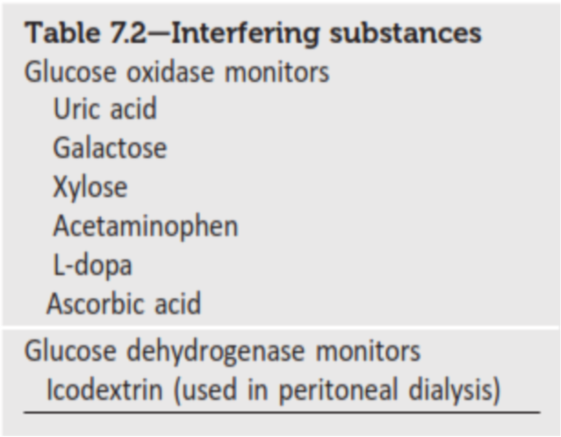
Factors Limiting Accuracy
Temperature
Because the reaction is sensitive to temperature, all monitors have an acceptable temperature range . Most will show an error if the temperature is unacceptable, but a few will provide a reading and a message indicating that the value may be incorrect.
Interfering Substances
There are a few physiologic and pharmacologic factors that interfere with glucose readings. Most interfere only with glucose oxidase systems.
ADA2019,SEC.7

Slide 5
Factors Affecting Blood Glucose Monitoring: Sources of Errors in Measurement
Barry H. Ginsberg, M.D., Ph.D.
Journal of Diabetes Science and Technology
Volume 3, Issue 4, July 2009
© Diabetes Technology Society
Glucose monitoring has become an integral part of diabetes care but has some limitations in accuracy.
Sources of Glucose Monitoring Inaccuracy
The inaccuracy of glucose monitoring systems comes from four sources: strip factors, physical factors, patient factors, and pharmacological factors.
Accuracy may be limited due to strip manufacturing variances, strip storage, and aging.
They may also be due to limitations on the environment such as temperature or altitude or to
patient factors such as improper coding, incorrect hand washing, altered hematocrit, or
naturally occurring interfering substances. Finally,
exogenous interfering substances may contribute errors to the system evaluation of blood glucose.

Slide 6
Journal of Diabetes Science and Technology ,Volume 3, Issue 4, July 2009

Slide 7
Strip Factors
As with any manufactured product, there is a small amount of strip-to-strip variation, which will therefore lead to some inaccuracy in blood glucose readings.
The oxidized mediator, however, is somewhat unstable and can be reduced, particularly at high temperature. In some meter systems, the reduced mediator is falsely reported as a higher glucose.
Figure 7 shows what might happen with mediator reduction when strips are exposed to 40 °C (104° Fahrenheit) for long periods of time. Glucose samples at approximately 110 mg/dl have been reported as having higher values, even as high as 300 mg/dl after 9 months at this temperature.
Journal of Diabetes Science and Technology ,Volume 3, Issue 4, July 2009

Slide 9
Strips have a finite lifetime, usually about 2 years under ideal storage circumstances.
Storing strips at high temperature or high humidity or with an open vial (allowing the humidity to get to the strips) can shorten the life of the strips. Because of the complexity of the reaction, different brands of glucose strips fail differently.
When a failure occurs, some brands underestimate the glucose value, whereas others will overestimate it.
Journal of Diabetes Science and Technology ,Volume 3, Issue 4, July 2009

Slide 10
Physical Factors
The most common influencers are altitude and temperature.
Glucose oxidase biosensor strips are often sensitive to oxygen concentration.
if the oxygen content of the sample is high, the active mediator will be lower and the value underestimated.
if the oxygen is low, the meter may report a value higher than the true value.
glucose oxidase biosensor strips are generally calibrated with capillary blood and are most accurate when used with capillary blood.
Strips that use glucose dehydrogenase as the enzyme are less affected by oxygen, but this enzyme presents other limitations.
Journal of Diabetes Science and Technology ,Volume 3, Issue 4, July 2009

Slide 12
DIABETES TECHNOLOGY & THERAPEUTICS Volume 7, Number 4, 2005
© Mary Ann Liebert, Inc
The Effects of Skin Temperature and Testing Site on Blood Glucose Measurements Taken by a Modern Blood Glucose Monitoring Device
A. HAUPT, M.D.,1 B. BERG, M.D.,2 P. PASCHEN, M.D.,3 M. DREYER, M.D.,4
H.-U. HÄRING, M.D.,1 J. SMEDEGAARD, M.D.,2 and S. MATTHAEI, M.D.5
The influence of temperature is less predictable.
Most meters have a temperature sensor and will report errors at extreme temperatures.
Low temperature diminishes circulation to the skin. This does not dramatically influence glucose taken from a fingertip since the arteriovenous shunts of the fingers stay open, but the blood flow to the skin of the forearm is dramatically decreased.

Slide 13
Diabetes Care. 1988 Feb;11(2):116-8.
Effect of hematocrit concentration on blood glucose value determined on Glucometer II.
Barreau PB¹, Buttery JE.
Variation in hematocrit can cause serious errors in blood glucose when measured by SMBG.
As seen in Figure 11, at a plasma glucose value of 100 mg/dl, the glucose in the red cells is approximately 70 mg/dl. The whole blood glucose at a hematocrit of 44 is approximately 88 mg/dl, but the value at a hematocrit of 66 would be 80 mg/dl and at a hematocrit of 22 would be 94 mg/dl.
This variation is due solely to the altered contribution of the red cells to the whole blood value.

Slide 16
Hand washing has always been a problem, but now, with microsample meters, the smallest amount of contaminant can significantly raise the blood glucose. With a sample of 0.3 μl, 1 μg of glucose (the weight of a dust particle) will increase the blood glucose by 300 mg/dl. ¹⁵
As seen in Figure 15, Chips Ahoy cookies (and many other candies and cookies) raised the value significantly.
Keri lotion lowered the value slightly, and Ivory soap had no effect.
Since patients generally do not wash their hands, this contamination can be a major source of inaccuracy.
Journal of Diabetes Science and Technology ,Volume 3, Issue 4, July 2009

Slide 18
Diabetes Technol Ther. 1999 Spring;1(1):3-11.
Issues and implications in the selection of blood glucose monitoring technologies.
Ervin KR¹, Kiser EJ.
there are three locations that can be affected by both naturally occurring substances and by medications (next section):
(1) the interaction of glucose with the enzyme,
(2) the transfer of electrons to the mediator from the enzyme, and
(3) interactions at the electrode.
Three naturally occurring substances interfere with electrochemical glucose oxidase based strips: triglycerides, oxygen, and uric acid.

Slide 19
Triglycerides, usually at very high levels, cause meters to be inaccurate because they take up volume, decreasing the amount of glucose in the capillary volume. Thus they cause values to be low.
Oxygen, acting at location 2, competes with mediator to take electrons from the enzyme. Since strips are generally calibrated for capillary oxygen concentrations, high oxygen values, such as those found in arterial samples or in patients utilizing oxygen, will cause falsely lower values.
Diabetes Technol Ther. 1999 Spring;1(1):3-11.

Slide 20
Low oxygen levels, such as those found in venous samples or in patients with severe chronic obstructive pulmonary disease may cause falsely high values.
uric acid, though only at very high values, can be oxidized by the electrode (location 3), giving falsely high values. Uric acid is seldom a problem, except in patients with values that would lead to severe gout.18

Slide 21
Crit Care Med. 1998 Mar;26(3):581-90.
Multicenter study of oxygen-insensitive handheld glucose point-of-care testing in critical care/hospital/ambulatory patients in the United States and Canada.
Kost GJ¹, Vu HT, Lee JH, Bourgeois P, Kiechle FL, Martin C, Miller SS, Okorodudu AO, Podczasy JJ, Webster R, Whitlow KJ.
Glucose dehydrogenase is a less specific enzyme, so some naturally occurring sugars can compete with glucose at location 1.
The monosaccharides, galactose, xylose, and the disaccharide maltose complete with glucose on glucose dehydrogenase and may give false values.
Glucose dehydrogenase sensors, however, are less sensitive to variations in oxygen concentration.

Slide 23
Clinical chemistry : principles, procedures, correlations / [edited by] Michael L. Bishop, Edward P. Fody, Larry Schoeff
Bishop, Michael L
Pharmacologic Factors
A number of medications can alter the readings from SMBG. With electrochemical glucose oxidase systems, all seem to interact with the electrode (location 3) and include acetaminophen, L-dopa, tolazamide, and ascorbic acid.

Slide 24
انواع رایج گلوکومتر در ایران :
کونتور پلاس
گلوکوکارد 01
گالا
ایزی گلوکو
Bionim g 300

Slide 26


