Slide 1
Treatment of osteoporosis
Anabolic agents
S. Kalbasi,M.D
Research Institute for Endocrine Sciences
Shahid Beheshti University of Medical Sciences
12 Jun ,2013
Tehran

Slide 2
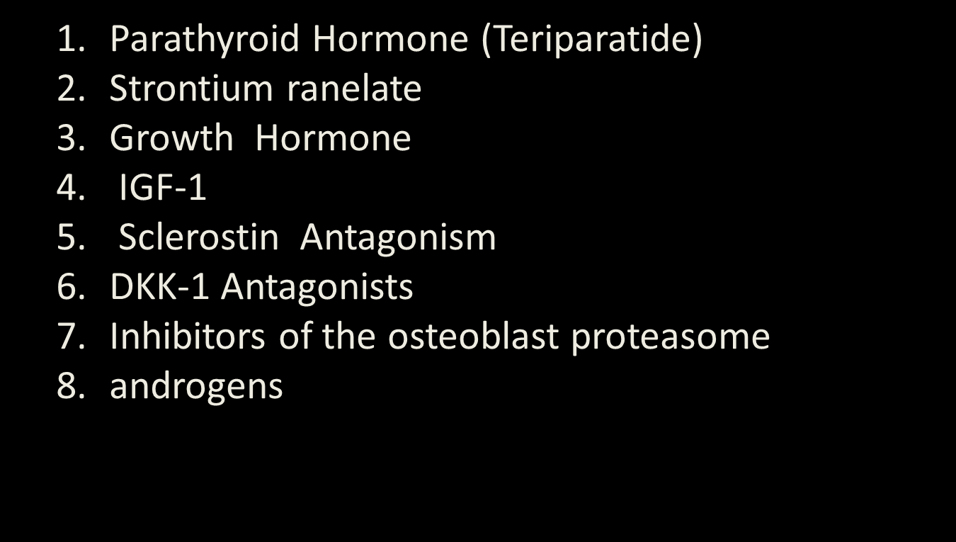
ANABOLIC AGENTS IN OSTEOPOROSIS TREATMENT

Slide 3
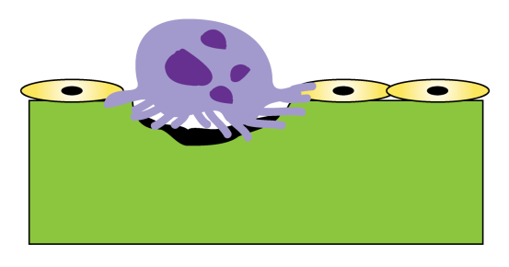
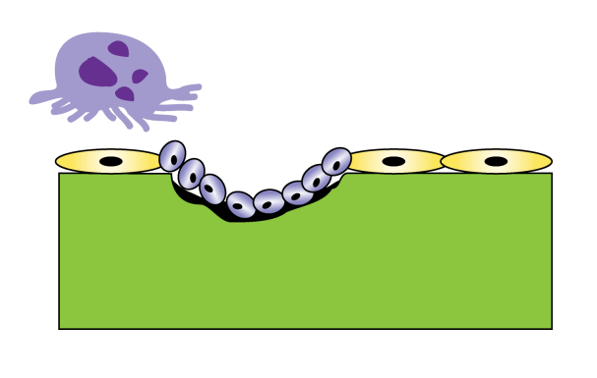
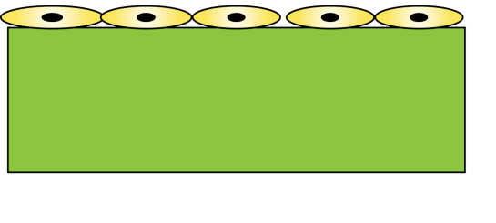
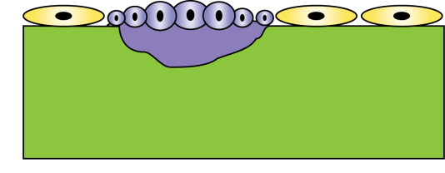
Bone Remodeling Cycle in Normal Bone
Osteoclasts
digest bone within a
sealed resorption vacuole
Resorption
Bone
Resting
Reversal
Apoptotic osteoclasts
Bone
Lining cells
Preosteoblasts
Mature osteoblasts building osteoid tissue
Mineralization
Bone
Formation
Illustration Copyright ©2009 Nucleus Medical Art, All rights reserved. www.nucleusinc.com

Slide 4
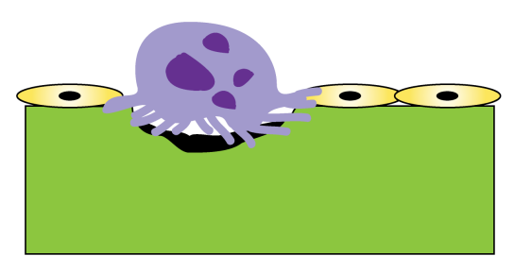


Many Factors Regulate Bone Remodeling
Resorption
Formation
GM-CSF
IL-1
IL-6
RANKL
PGE₂
TNF-α
Bone
Reversal
Bone
Formation
Resorption
Bone
Abbreviations: GM-CSF, granulocyte macrophage colony-stimulating factor; IL, interleukin; OPG, osteoprotegerin; RANKL, RANK-ligand,
PGE₂, prostaglandin E₂; TGF, transforming growth factor;
TNF, tumor necrosis factor.
OPG
TGF-β
Estrogen
Illustration Copyright ©2009 Nucleus Medical Art, All rights reserved. www.nucleusinc.com

Slide 5
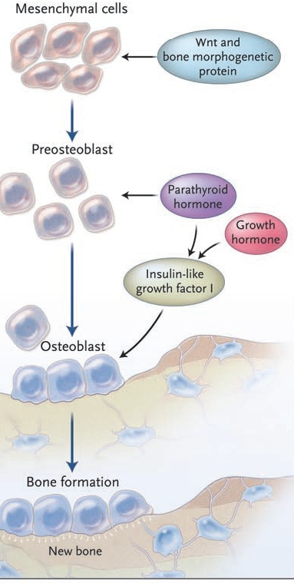
INTRODUCTION :
Two important signals that induce the differentiation of osteoblastic lineage cells into mature osteoblasts are bone orphogenetic proteins and Wnt
Another important regulator of osteoblast function is insulin-like growth factor I (IGF-I).
Anabolic therapeutic agents might be designed to stimulate the actions of these osteoblastic signals directly or to target their extracellular and intracellular regulators.
Signals Determining Mesenchymal-Cell
Differentiation toward Osteoblasts and Signals Acting
on Mature Osteoblasts to Enhance Bone Formation.
NEJM 2007

Slide 6
MECHANISMS of ANABOLIC AGENTS
Osteoblasts, the cells responsible for bone formation, are rational therapeutic anabolic targets.
increase the number of osteoblast precursors.
stimulate the differentiation of osteoblasts into mature cells.
Enhance osteoblastic function or survival.
Finally leads to a net gain of bone tissue.
NEJM 2007

Slide 7
The anabolic skeletal agents, in contrast to the antiresorptive drugs, influence processes associated with bone formation.
anabolic agents have the potential to positively affect a number of skeletal properties besides bone density. These include bone size and microarchitecture.
NEJM 2007

Slide 8
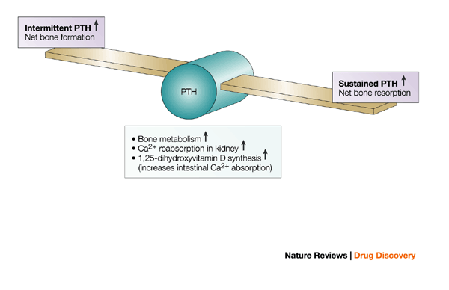
PTH(1 - 84)
teriparatide (1 – 34)
PTHrP(1 – 36)

Slide 9
Pharmacokinetics
The peak circulating concentration of teriparatide reached 45–60 minutes after administration ;complete disappearance of teriparatide occurs within 4–6 hours.
PTH(1-84) has a longer half-life than teripara-tide, with serum levels peaking at 120 minutes and disappearing from the circulation after 8 hours.
PTHrP has a very short half-life, with serum levels peaking at 15 minutes and disappearing from the circulation after only 1–2 hours.
Parathyroid Hormone as an Anabolic Skeletal Therapy. Drugs 2005

Slide 10
MECHANISMS PTH
(1)
PTH signals through the PTH-1 receptor, a G protein– coupled protein, which mediates most of the functions of PTH and of its evolutionary relative, PTH-related peptide (PTHrP).
PTH–PTHrP receptor, it is activated by peptide sequences that include the N-terminal region of either molecule.
It is unclear why the intermittent administration of low-dose PTH differs in its effect on bone cells from long-term, sustained PTH exposure in which catabolic effects at cortical sites predominate.
NEJM 2007

Slide 11
(2)
The exact signaling pathway responsible for the anabolic effect is not known, but :
The Wnt –β- catenin pathway :of the Wnt antagonist sclerostin is down-regulated by PTH
The anabolic actions of PTH involve direct effects on osteoblast lineage cells and indirect effects through growth factors (e.g., IGF-I) and growth factor antagonists, such as sclerostin.
Mitogenic properties for osteoblastic cells and decreases osteoblastic apoptosis.

Slide 12

PTH stimulates preosteoblasts to mature into bone-forming osteoblasts that lay down collagen and subsequently mineralize matrix.
Bone formation begins within the first month of PTH treatment and peaks six to nine months after initiation of daily PTH.
Since the remodeling unit is always coupled (ie, bone formation equals bone resorption), once preosteoblasts are stimulated, they release cytokines that can activate osteoclasts resulting in bone resorption.

Slide 13
(3)
beneficial effects of teriparatide on bone qualities such as bone density, microarchitecture and bone geometry are seen in the cancellous skeleton
on the other hand , PTH stimulates periosteal apposition, which leads to increases in cortical area, cortical thickness, and an overall increase in cross-sectional area

Slide 14
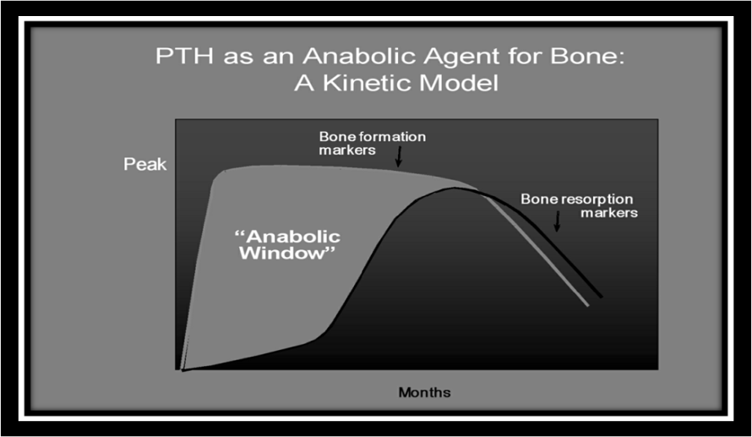
(4)
PTH likely initially stimulates processes associated with bone formation (bone modeling) and only later promotes those associated with bone remodeling in which bone resorption predominates.
This sequence of events has led to the concept of the “anabolic window,” a period of time when the actions of PTH are maximally anabolic

Slide 15
PTH Action on Bone
Major action = stimulation of osteoclastic bone resorption
However, a classical series of studies elucidated effects on osteoblasts:
PTH extract → increase in skeletal calcium (F. Albright, 1929, H. Seyle, 1932)
PTH receptor primarily located in osteoblast (Rouleau, 1986, 1989)
PTH increases osteoblast number and osteoid formation in mouse radii (Herrmann, 1976)
PTH stimulates osteoblast replication (DeBartolo, 1982, Canalis, 1989)
Anabolic action of PTH is due to stimulation of osteoblast proliferation, and subsequent stimulation of mature osteoblast function

Slide 16
PTH – Mechanism of Action
Once daily
Continuous
Osteoblast
apoptosis ↓
Lining cell
differentiation ↑
RankL ↑
OPG ↓
Osteoblast number ↑
Osteoclast ↑
Bone formation ↑
Bone resorption ↑
Bone mass ↑
Bone strength ↑
Serum calcium ↑

Slide 17
FPT study
Effect of parathyroid hormone on fractures and BMD
in postmenopausal women with osteoporosis
Subjects: 1637 post menopausal women with prior
vertebral fractures
Interventions:
20 mcg PTH , 40 mcg PTH Vs placebo
Follow up :21 mo
Primary end points: Vertebral radiographs for fracture ,BMD
Neer et al, N Engl J Med 2001;344: 1434

Slide 18
Effect of Teriparatide on Risk of Vertebral Fractures in Postmenopausal Women
16
RR 0.35 (95% CI = 0.22–0.55)ª
14
12
10
% of Patients with ≥1 Fracture
8
65% ↓
6
4
2
0
Placebo
Teriparatide 20 µg
ªP <.001 vs placebo.
Neer RM, et al. N Engl J Med. 2001;344:1434-1441.
Graphic courtesy of Dr. Paul Miller.

Slide 19
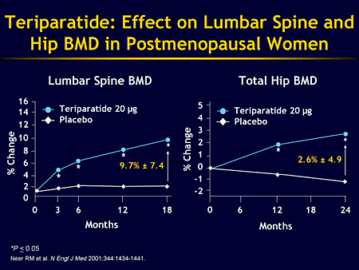

Slide 20
Nonvertebral and Hip Fractures Teriparatide
20
Control
Teriparatide 20 µg
15
10
Percent with New Fractures
RR = 0.5 (0.3,0.9)
5
NS
0
Nonvertebral Fractures
Hip Fractures
5 fragility hip fractures (control + primary treatment group).
Nonvertebral fractures = fragility fractures, otherwise not specified.
Neer R, et al. N Engl J Med. 2001;344:1434–1441.
Graphic courtesy of Dr. Paul Miller.

Slide 21
Placebo
544
20 mcg
541
40 mcg
552
New
Vertebral
fracture rate
14%
5%
4%
6%
3%
3%
Non vertebral
fractures
Number of
Hip fractures
4
2
3

Slide 22
Effect of PTH on Fracture Risk
69%↓†
54%↓§
* RR=0.35, 95% CI=0.22-0.55.
† RR=0.31, 95% CI=0.19-0.50.
‡ RR=0.47, 95% CI=0.25-0.88.
§ RR=0.46, 95% CI=0.25-0.86.
Data from Neer RM, et al. N Engl J Med. 2001;344:1434-1441.

Slide 23
Beneficial effects of teriparatide
(1)
IN POSTMENOPAUSAL WOMEN:
There is level 1 evidence that hPTH (1–34) 20 μg/d and 40 μg/d increase BMD at the lumbar spine and proximal femur and decrease the risk of both vertebral and nonvertebral fractures in postmenopausal women with prior vertebral fractures
The decline in BMD at the distal radius seen in hPTH trials BUT microarchitectural changes due to teriparatide are evident at the cortical sites such as the distal 1/3 radius as well. These geometrical and microarchitectural changes strengthen cortical bone despite the small reduction in bone density
Parathyroid hormone for the treatment of osteoporosis : a systematic review ;CMAJ • July 4, 2006.

Slide 24
(2)
There is level 1 evidence that hPTH(1–84) increases lumbar spine BMD in postmenopausal women with osteoporosis
incidence of baseline fragility fractures in the phase III PTH(1-84) study was only 19%.
Initial studies in postmenopausal women with osteoporosis suggested that PTHrP at a daily dose of approximately 400 μg for 3 months increases vertebral BMD by 4.7%. Serum osteocalcin was increased, but serum calcium and biochemical markers of bone resorption were not affected. Larger and longer trials are required

Slide 25
(3)
IN CORTICOSTEROID – INDUCED OSTEOPROSIS:
There is level 2 evidence that hPTH(1–34) increases lumbar spine BMD in postmenopausal women with corticosteroid-induced osteoporosis.
Fracture data are lacking in this population.
RESULT IN MEN :
There is level 1 evidence that hPTH(1–34) increases BMD at the lumbar spine and femoral neck in men with osteoporosis.
Neer etal reported :the risk of vertebral fracture was reduced by 51% (p= 0.07)

Slide 26
(4)
Health-related quality of life and back pain
There is no evidence of improved health-related quality of life associated with hPTH (1–34) or calcium with vitamin D in postmenopausal women with osteoporosis.
There is level 2 evidence that back pain may be reduced in patients given hPTH (1–34).

Slide 27
SEQUENTIAL THERAPY WITH TERIPARATIDE AND ANTIRESORPTIVE AGENT
WITH ESTROGEN :
Cosman et al. treated postmenopausal women, previously given estrogen for at least 1 year, with teriparatide. Increases in vertebral BMD began with no delay and increased in a linear fashion during the entire 3-year study.
WITH RALOXIFEN :
raloxifene did not impede the effects of teriparatide to increase BMD rapidly and linearly
WITH ALENDRONATE:
alendronate was associated with a 6- month delay before BMD in the lumbar spine began to increase.
some practitioners advocate a 6-month hiatus between discontinuation of treatment with alendronate and initiation of teriparatide therapy. Others suggest that teriparatide therapy be initiated immediately after the bisphosphonate.
Anabolic Skeletal Therapy for Osteoporosis. (Arq Bras Endocrinol Metab 2006

Slide 28
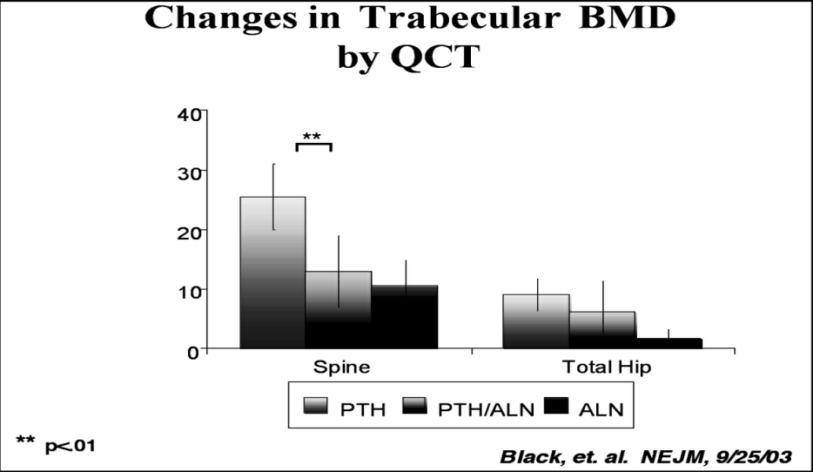
combination therapy: with alendronate(1)
hPTH(1–34) results in larger increases in lumbar spine BMD than alendronate
There is level 1 evidence that combination therapy with alendronate and hPTH(1–84) may blunt the anabolic effect of hPTH on BMD.

Slide 29

In previously untreated patients, the effects of PTH are not additive to those of a Bisphosphonate.
These observations appear to result from the ability of alendronate to impair PTH-induced stimulation of new bone formation.
Thus, we do not suggest combination PTH and bisphosphonate therapy for osteoporosis.

Slide 30
With raloxifen(2)
Combination of teriparatide and raloxifene may have more beneficial effects than monotherapy with teriparatide in postmenopausal osteoporosis .
Increased to a similar extent in the lumbar spine and femoral neck in both groups, but the increase in total hip BMD was significantly greater in subjects treated with both teriparatide and raloxifene.
Bone formation markers increased similarly in both groups. Bone resorption markers,however, were reduced in the combination group.

Slide 31
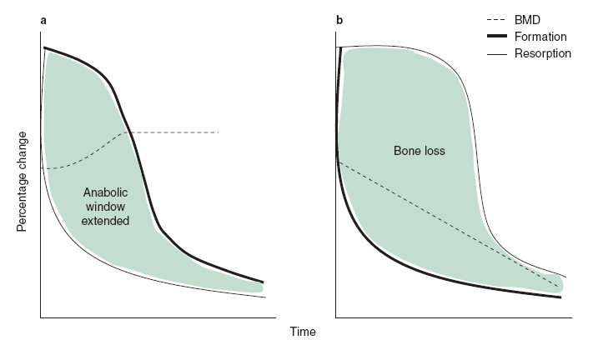
Changes in bone density after parathyroid hormone (PTH) withdrawal
(a) when PTH is followed with antiresorptive
therapy, bone resorption markers fall more rapidly leading to an increase in bone mineral
density (BMD); and
(b) when PTH is not followed by
antiresorptive therapy, bone formation
markers fall more rapidly leading to
a decrease in bone density.
Consequently, it is advisable to administer an antiresorptive agent such as a
bisphosphonate after treatment with teriparatide many experts recommend
the continuation of long-term antiresorptive therapy for its own therapeutic benefits .

Slide 32
Indications for Teriparatide
  In the US :
  postmenopausal women and men with osteoporosis who are at high risk for fracture.
  The definition of high risk:
  The T-score very low (i.e. <-3.0 itself, even without an osteoporotic fracture or a strong family history of osteoporosis .
In many countries in Europe :
  teriparatide cannot be administered unless a patient has received a previous, unsuccessful course of bisphosphonate therapy and has had a previous osteoporotic fracture. These restrictive indications are due, in part, to the fact that teriparatide is expensive and is administered by daily subcutaneous injection.

Slide 33
Teriparatide is available throughout most of the world, but full-length PTH (1–84) is available only in Europe.
Duration of teriparatide therapy (2 years in the United States and 18 months in Europe) is relatively short because its safety and efficacy were not evaluated after 2 years in clinical trials.
In Europe The cost :$US7000/year
)

Slide 34
After PTH
(1)
In the European Study of Forsteo (EUROFORS), women who had received one year of teriparatide were randomly assigned for a second year to continue teriparatide or to switch to either raloxifene or placebo.
BMD in the women who received teriparatide for a second year continued to increase, whereas BMD was maintained in the women who received raloxifene and decreased in women who received
placebo.
The overall changes in lumbar spine BMD in the three groups from baseline to 24 months were 10.7, 7.8, and 3.8 percent, respectively.

Slide 35
After PTH
(2)
Thus, after PTH treatment is discontinued, an antiresorptive, preferably a bisphosphonate, should be used to preserve or increase gains in BMD acquired with PTH alone.
Raloxifene is an alternative for women who are unable to tolerate oral or intravenous bisphosphonates.
A persistent reduction in fracture risk with the use of antiresorptive therapy after PTH is discontinued has not yet been firmly established.

Slide 36
Retreatment with PTH
Retreatment with teriparatide does appear to increase spine BMD, but the increase is less than that of initial treatment.
We do not recommend retreatment with teriparatide, particularly in patients who have already received a two-year course, owing to the lack of safety data with longer-term therapy.

Slide 37
Adverse events(1)
increased risk of osteosarcoma(?) :There have been no reports of osteosarcoma in clinical trial subjects
Nine hPTH(1–34) trials reported post dose hypercalcemia (serum calcium level > 2.6 mmol/L) that ranged from 3% to 11% among patients taking 20 μg of hPTH(1–34) and from 16.8% to 38% among patients taking 40 μg compared with 0%–3% among those taking the comparator. episodes were mild: serum calcium levels usually returned to normal within 24 hours, and no clinical sequelae were reported in subjects with transient hypercalcemia.
If they persist, they can be managed by decreasing calcium and vitamin D supplements. If these measures fail, a dosage adjustment of teriparatide from daily to everyother- day administration is usually effective.
many practitioners check the serum calcium concentration
1 month after initiating therapy.

Slide 38
(2)
Transient hypercalciuria (24-hour urine collection showing calcium level of 8 mmol/d or urine calcium/creatinine ratio > 1.0) was reported in 6 hPTH(1–34) trials and ranged from 0% to 10% difference between hPTH and comparator
There were no reported increases in renal stones
A 10% increase in serum creatinine levels was reported in one trial but did not exceed the normal range.
Hyperuricemia was reported in 2 hPTH(1–34) trials and ranged from 0% to 3% of subjects. Hyperuricemia was associated with gout in 3 subjects taking hPTH(1–84).

Slide 39
Teriparatide Contraindications:
1.any hypercalcaemic condition
2. osteosarcoma
3.metastatic bone disease
4.Active Paget’s disease of bone
5. pregnancy
6.x-ray therapy to the skeleton or to soft tissues in which a skeletal port is included(therapeutic radiation, not diagnostic skeletal radiation0.
7. CHILDREN.

Slide 40
SUMMARY AND RECOMMENDATIONS
PTH is an effective anti-osteoporosis drug that increases bone mineral density and reduces fracture risk. Given its cost, subcutaneous route of administration, long-term safety concerns, and availability of other agents, PTH is generally not used as a first-line drug for treatment or prevention of osteoporosis.
In men and women with severe osteoporosis (low bone mineral density [T score <-2.5] and at least one fragility fracture) who continue to fracture after one year of bisphosphonate therapy, we suggest human recombinant PTH therapy (Grade 2B).

Slide 41
SUMMARY AND RECOMMENDATIONS
We also suggest PTH therapy for patients with severe osteoporosis who are unable to tolerate any of the available bisphosphonates (Grade 2B).
Previous or current bisphosphonate use, particularly alendronate, "blunts" the response to PTH. However there are no data to suggest that discontinuing long-term bisphosphonate therapy requires a latency period before starting PTH. Thus, in patients who are switching from bisphosphonates to PTH, we suggest starting PTH immediately after bisphosphonates are discontinued (Grade 2C).

Slide 42
SUMMARY AND RECOMMENDATIONS
We suggest stopping PTH treatment after a maximum of 24 months, because of concerns about osteosarcomas which have been observed in rats receiving high doses of PTH (Grade 2C).
For patients at high risk for subsequent fracture after discontinuing PTH, we suggest starting a bisphosphonate after PTH is discontinued (Grade 2B).
Raloxifene is an alternative for individuals who are intolerant of the available bisphosphonates.

Slide 43
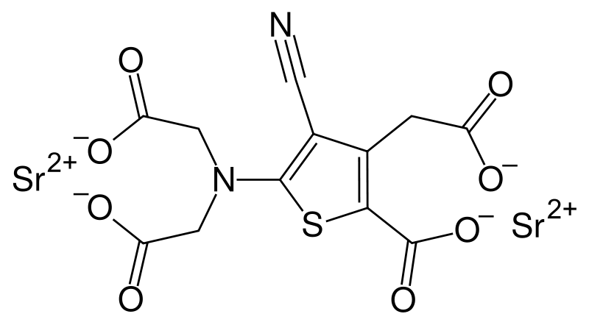
strontium ranelate

Slide 44
Introduction
(1)
Strontium was originally detected in lead mines near Strontian, Scotland, in the late 1700s.
It is present in water and food and in trace amounts throughout the skeleton
Although absorption is poor when strontium is consumed orally, calcified tissues and areas of active osteogenesis take up 50 to 80 percent of the absorbed dose.
excretion is largely renal.

Slide 45
Strontium
Discovered in 1790 and isolated in 1808 (near Scottish village Strontian)
Divalent cation
Resembles calcium and often mimics action of calcium
up to 1/10 cations incorporated in bone mineral
Anabolic properties
  stimulates osteoblast proliferation
  inhibits osteoclast activity
Activation of signaling pathways through CaSR (?)
inhibits RANKL expression

Slide 46
(2)
Uptake:
Ionic substitution at low rates at the crystal surfaces of the bone matrix, without affecting mineral structure.
An atomic number greater than that of calcium ; will weaken the penetration of x-rays and therefore result in an overestimation of measured BMD and content. Formulas have been derived to correct it.
induction of cellular differentiation and the activation of the calcium-sensing receptor and the PTH suppression

Slide 47
How does strontium act on bone cells?(1)
Enhances the replication of preosteoblastic cells and, consequently, bone matrix synthesis.
several studies indicate no alteration of bone mineralization
Induces uncoupling in bone remodeling, stimulating bone formation (osteoblast replication) and reducing resorption (osteoclast inhibition) in normal bone.decreases osteoclast activity and number by about 30%.

Slide 48
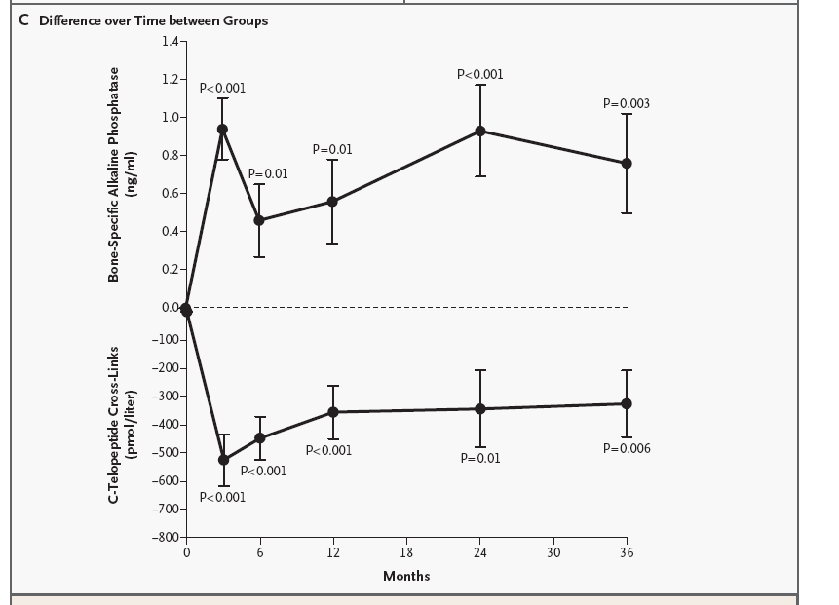
(2)
At the third month of therapy, the serum concentration of bone-specific alkaline phosphatase was higher in the strontium ranelate group than in the placebo group
The concentration of serum C-telopeptide cross-links was lower in the strontium ranelate group than in the placebo group at month 3.
Bone ALK P
C-telopeptide cross-links

Slide 49
Effects of strontium ranelate on bone mass and strength
Increases vertebral bone formation and decreases bone resorption , resulting in increased bone mass.
increased trabecular thickness and number, and decreased trabecular separation in the tibial metaphysis , indicating improved bone microarchitecture

Slide 50
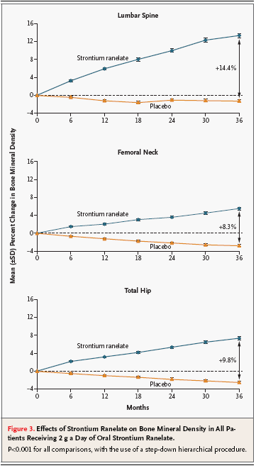
Effects on BMD
corresponding to differences between the placebo and the treatment groups at three years of 14.4 percent, 8.3 percent, and 9.8 percent, respectively. At three years.
the bone mineral density at the lumbar spine, adjusted for the strontium content, showed an increase over the base-line value of 6.8 percent in the strontium ranelate group and a decrease of 1.3 percent in the placebo group (P<0.001).

Slide 51
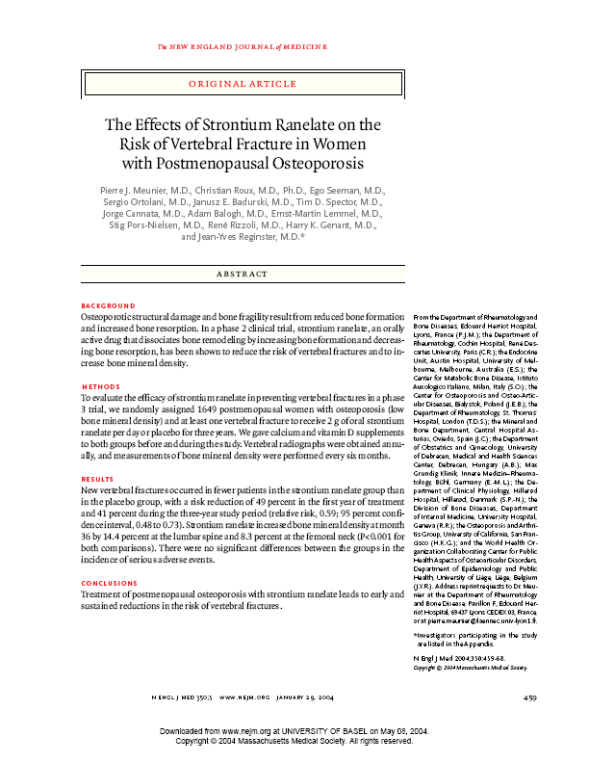
Strontium Ranelate: Effect on Bone Mineral Density
+14%
Strontium ranelate
+8%
(corrected for SR content of bone)
BMD LWS (Δ%)
Placebo
0
6
12
18
24
30
36
Months
Meunier et al., NEJM 2004; 350: 459

Slide 52
Effect of Strontium Ranelate on Fractures in Postmenopausal Osteoporosis
↓ RR -41%
(0.48 to 0.73, p<0.001)
Risk of Vertebral Fractures (%)
↓ RR -49%
(0.36 to 0.74, p<0.001)
12
36
Months
Meunier et al., NEJM 2004; 350: 459

Slide 53
Effect of Strontium Ranelate on Hip Fracture Risk
Osteoporotic women, n=1977
(age ≥74 yrs and T-score FN ≤-3 SD), post-hoc analysis
10
8
Placebo
RRR 36%
ARR 2.1%
NNT 48
6
Patients (%)
4
2
Strontium ranelate
0
0
6
12
18
24
30
36
42
Months
Reginster et al, J Clin Endocrinol Metab 2005, 90: 2816

Slide 54
Effect of Strontium Ranelate on
Non-Vertebral Fracture Risk
All non-vertebral fractures
0.84
(0.70, 0.99)
Major osteoporotic non-vertebral
fractures*
0.81
(0.66, 0.98)
Hip fractures, whole population
0.85
(0.61, 1.19)
Hip fractures, high risk group
0.64
(0.41, 0.99)
0 0.5 1 1.5
RR (95% CI) after 3 yrs
*hip, wrist, pelvis, sacrum, rib, sternum, humerus
Reginster et al, J Clin Endocrinol Metab 2005, 90: 2816

Slide 55
Anti-fracture efficacy of strontium ranelate
strontium ranelate significantly reduced the incidence of new vertebral and clinical vertebral fractures by 40–50% after one and three years of treatment.
Reduced by 16% the risk of non-vertebral fractures throughout the three year study compared with placebo.
reduced by 19% the relative risk for major fragility fractures (i.e. hip, wrist, pelvis and sacrum, ribs and sternum, clavicle, humerus).
Accompanied by decreased back pain and body height loss.

Slide 56
adverse effects(1)
Overally , well tolerated, especially in the upper gastrointestinal area.
Like SOTI study, the most common adverse effects consisted of nausea and diarrhea, which disappeared after the first three months.
There was a lower incidence of gastritis, as diagnosed clinically by the investigators, in the strontium ranelate group than in the placebo group (3.6 percent vs. 5.5 percent, P=0.07).

Slide 57
(2)
Serum calcium concentrations were lower and serum phosphate concentrations higher in the strontium ranelate group than in the control group at month 3, with a plateau thereafter.
There was a slight reduction in serum parathyroid hormone from the level at month 6 in both groups (decrease from base-line to six-month values)
No changes were observed for serum 25-hydroxyvitamin D, 1,25-dihydroxyvitamin D, or calcitonin.
Serum creatine kinase concentrations in the skeletal muscle increased in some patients ; at least twice the upper limit of the normal range. No increase in muscular symptoms or other biologic abnormalities were observed. Most of the increases in creatine phosphokinase were transient

Slide 58
Conclusions:
Treatment of postmenopausal osteoporosis with strontium ranelate leads to early and sustained reductions in the risk of vertebral fractures.

Slide 59
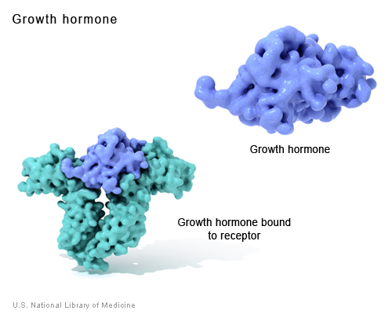
GROWTH HORMON

Slide 60
Changes in bone mass are minimal in both men and women .
The lack of a beneficial effect with GH on bone mass could be due to :
The concomitant activation of bone resorption along with formation, so that a net gain does not occur
Another explanation for a lack of effect could be the relatively short, one year, duration of many of these studies.

Slide 61
Recent evidence suggested a delayed and what was ultimately a positive effect of GH on bone
J Bone Miner Res 2006:(A cross-sectional study) patients with growth hormone deficiency who are receiving growth hormone-replacement therapy have a reduced risk of vertebral fractures as compared with untreated patients.
Rev Endocr. Metab .Disord 2005:The use of growth hormone in osteoporosis also is limited by side effects such as weight gain, carpal tunnel syndrome, glucose intolerance, and edema.

Slide 62
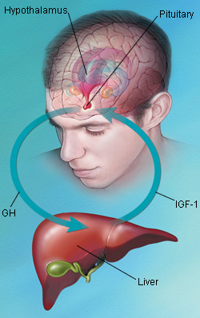
IGF - 1

Slide 63
IGF-1 promotes chondrocyte and osteoblast differentiation and growth.
In a prospective clinical studies) Low levels of IGF-1 are associated with a greater risk of spine and hip fractures.
At high doses, IGF-I increases biochemical markers of bone remodeling, whereas at low doses, it increases exclusively markers of bone formation, without an effect on bone resorption.
IGF-I has been studied in patients with anorexia nervosa, a disorder associated with low serum IGF-I levels. In such patients, the administration of IGF-I at doses that normalize serum IGF-I, in combination with estrogen-replacement therapy, increases BMD
A major drawback to the development of IGF-1 as a therapy for
osteoporosis is its ubiquitous effect on many organ systems. Similar to GH, potential serious adverse effects could surface with its chronic use.

Slide 64
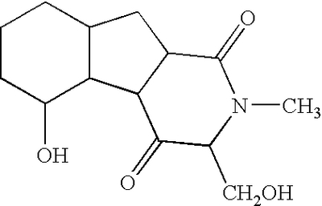
OSTEOBLAST PROTEASOME INHIBITORS

Slide 65
Proteasome is a major structure for intracellular protein degradation.
The use of proteasome inhibitors will depend on their skeletal specificity and their safety profile.
such inhibitors can induce cellular toxic effects and the intracellular accumulation of misfolded proteins.

Slide 66
DKK-1 ANTAGONIST
DKK-1 ANTAGONIST
A secreted Wnt antagonist that binds LRP5 and LRP6

Slide 67
Dkk-1 neutralization with an antibody increased BMD, trabecular bone volume, and bone formation in rodents.
suggesting that Dkk-1 inhibitors might have potential as an anabolic approach in the treatment of osteoporosis, particularly if they are targeted specifically to bone

Slide 68
SCLEROSTIN ANTAGONIST

Slide 69
Mutations in SOST, the gene that encodes sclerostin, eliminate the expression of sclerostin; this causes skeletal dysplasias characterized by increased bone mass (sclerosteosis and van Buchem’s syndrome);characterized by hyperostosis, syndactyly, facial palsy, deafness, and the absence of nails. Patients with sclerosteosis, as well as heterozygous carriers, have increased BMD.
Monoclonal antibodies against sclerostin, prevent its binding to Wnt coreceptors, enhancing Wnt signaling and increasing bone mass in rodents and nonhuman primates.
it is possible that enhancement of Wnt signaling through the inhibition of a Wnt antagonist will have unwanted effects in nonskeletal tissues.

Slide 70
ANDROGEN DRUGS

Slide 71
Studies of testosterone in men with osteoporosis are limited, and none have used fractures as a primary end point.
The effects of testosterone on cortical and trabecular bone mass are greatest when it is used in hypogonadal adolescents.
In a 3-year study of hypogonadal men over 65 years of age, those receiving testosterone-replacement therapy had an 8.9% greater increase in the bone mineral density of their spine than did those receiving placebo.

Slide 72
The failure of bone mineral density at three sites in the hip to increase during testosterone treatment even in men with relatively low pretreatment serum testosterone concentrations could be at least partly related to the slower response of this bone to changes in gonadal steroids

Slide 73
The effects of testosterone in eugonadal men are more controversial
Differences in response in eugonadal men may be related to pretreatment testosterone levels.
In a pre specified analysis , men with a testosterone level below 200 ng per deciliter had significant increases in spinal bone mineral density with treatment
This analysis showed a minimal effect (0.9%)
of testosterone treatment over that of placebo for a pretreatment serum testosterone concentration of 400 ng/dL (13.9 nmol/L), but an increase of 3.4% for testosterone of 300 ng/dL (10.4 nmol/L) and a increase of 5.9% for a testosterone of 200 ng/dL (10.9nmol/L).

Slide 74
non-aromatizable androgens like nandrolone
TESTOSTRON
Testosterone seems to be more effective in improving BMD than
other non-aromatizable androgens like nandrolone
nandrolone
placeb
BMD changes in the lumbar spine in men treated with
testosterone• nandrolone(• or placeb(o) . The dashed line through zero represents no change from baselin

Slide 75
CONCLUSION :
Androgen replacement in hypogonadal AND eugonadal mens remains a controversial issue.

Slide 76
AND FINALLY ,Selective androgen receptor modulators (SARMs) are a novel class of androgen receptor (AR) ligands that might change the future of androgen therapy dramatically.

Slide 77
Mechanisms:
Androgen receptors (ARs) are present on the osteoblasts, osteoclasts and mesenchymal stromal cells that differentiate toward the osteoblast lineage.
Androgens increase bone mass through effects on bone cells, enhancing osteoblast activity but inhibiting that of osteoclasts.
responsible for the development of a sexually dimorphic skeleton (i.e. male bones are wider than female) and is a significant determinant of bone strength. AND important for the production of peak bone mass in males.

Slide 78
Testosterone, is also a substrate for the production of estradiol through aromatase activity.
Estrogen replacement therapy tends to suppress bone resorption with only modest effects on bone formation; By contrast, androgen replacement data have demonstrated clear effects on bone formation.
The skeletal response to androgen administration is characterized as increased cortical and trabecular bone mass, together with increased bone width with surface periosteal expansion but a lack of inner endosteal deposition, in the setting of inhibition of resorption owing to reduced osteoclast activity. Thus maintains trabecular bone and expands cortical bone.

Slide 79
An unresolved clinical issue is the management of older men with low BMD who have moderately low testosterone levels
A meta-analysis of placebo-controlled trials of testosterone treatment in men with any degree of androgen deficiency (most of them showing low
normal or normal testosterone levels at baseline) suggested a beneficial effect on lumbar spine BMD, but equivocal findings at the femoral neck

Slide 80
Agent | vetebral Fx | Quality of evidence | Hip Fx | Quality of evidence
Alendronate | + | Good | + | Good
Residronate | + | Good | + | Good
Etidronate | + | Good
Ibandronate | + | Good
zolendronate | + | Good | + | Fair
HRT | + | Good | + | Good
Raloxifen | + | Good
Calcitonin | + | Fair
PTH | + | Good
Ann Intern Med. 2008;148:197-213.

Slide 81
New and Emerging Treatments
Antiresorptive (anticatabolic)
Denosumab
Odanacatib
Lasofoxifene
Bazedoxifene
CE/bazedoxifene
New delivery systems – oral salmon calcitonin
Osteo-anabolic (bone-forming)
Sclerostin inhibitor
Variations of PTH
Endogenous PTH stimulation – calcium sensing receptor antagonist (calcilytic)
New delivery systems – transdermal PTH
Strontium ranelate
Combinations of antiresorptive and anabolic

Slide 82
Conclusion
Monotherapy with calcium or vitamin D has not been shown to reduce fractures.
Combined calcium plus vitamin D , may reduce vertebral and non-vertebral fractures,
Alendronate , risedronate , zolendronate and parathyroid hormone reduce vertebral and non-vertebral fractures compared with placebo
Etidronate , ibandronate , and raloxifene reduce vertebral fractures, but have not been shown to reduce non-vertebral fractures.
Calcitonin may reduce vertebral fractures over 1–5 years, but has not been shown to reduce non-vertebral fractures.
Hormone replacement therapy may reduce fractures, but it increases the risk of breast cancer and cardiovascular events
Strontium ranelate reduces vertebral and, to some extent, non-vertebral fractures.

Slide 83
Conclusion
Adequate calcium (1200mg) and vitamin D (800IU)
Oral bisphosphonates (alendronate or residronate) as first line therapy
IV bisphosphonates (zolendronate) for patients who can not tolerate oral bisphosphonates
Raloxifen as a second line drug
Calcitonin is not recommended except for pain relief
Teriparatide for patients with severe osteoporosis who are unable to tolerate any of the available bisphosphonates or who continue to fracture after one year of bisphosphonates therapy

Slide 84


