Slide 1
Pituitary Incidentaloma
A.Amouzegar
Endocrine Research Center,
Research Instutute for Endocrine sciences

Slide 2
Definition of pituitary incidentaloma
A pituitary incidentaloma is a previously unsuspected
pituitary lesion that is discovered on an imaging study
performed for an unrelated reason
By definition, the imaging study is not done for a symptom specifically related to the lesion, such as visual loss, or a clinical manifestation of hypopituitarism or hormone excess, but rather for the evaluation of symptoms such as headache, or other head or neck neurological or central nervous system complaints or head trauma

Slide 3
The evidence
valid estimates of the pretest probability of an abnormal test of pituitary function could not be definitively determined because literature on this topic is sparse
Therefore, recommendations for the evaluation relied heavily on clinical experience
Data on the prevalence of hormone hypersecretion in pts with an incidentaloma are available from small observational studies (most retrospective) and estimated from autopsy data
Few data are available for or against a nonsurgical approach to management of asymptomatic pituitary incidentalomas

Slide 4
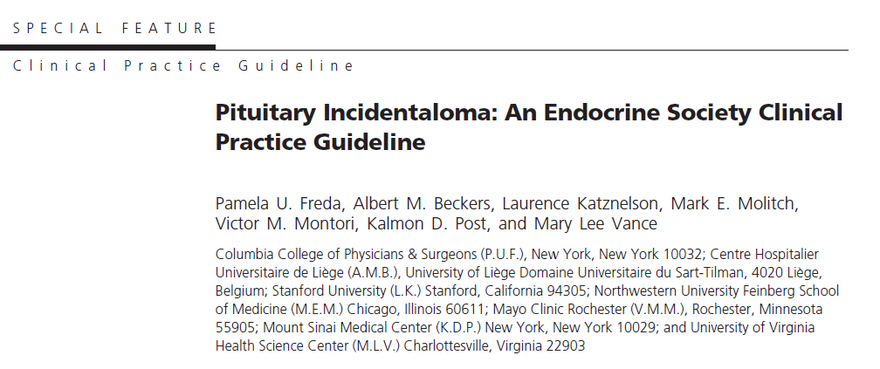

Slide 5
Etiology of pituitary incidentalomas
In a series of sellar masses that required surgery, 91% were pituitary adenomas and about 9% were nonpituitary in origin, of which most were craniopharyngiomas and Rathke’s cleft cysts
1999 Differential diagnosis of sellar masses. Endocrinol Metab Clin North Am 28:81–117, vi
The 334 pituitary adenomas found the 3048 autopsy cases have been examined, finding
39.5% staining for PRL
13.8% staining for ACTH
7.2% staining for gonadotropins or a-subunits,
1.8% staining for GH
0.6% staining for TSH
3.0% staining for multiple hormones

Slide 6
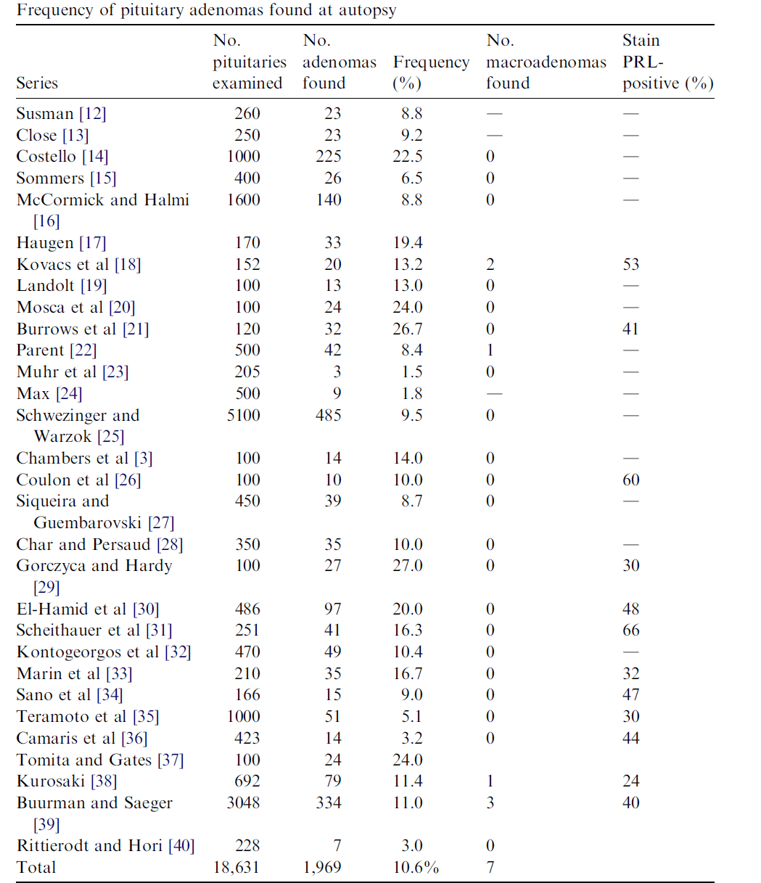

Slide 7
Epidemiology of pituitary incidentalomas
The prevalence of pituitary incidentalomas has been estimated from data on pituitary adenomas found at autopsy and from imaging in patients who underwent a CT or MRI of the head for reasons other than pituitary disease
The average frequency of a pituitary adenoma was 10.6%
The tumors were distributed equally across genders and the adult age range, and nearly all of these incidentalomas were microadenomas
Endocrinol Metab Clin North Am 37:151–171, xi
In adults who underwent cranial imaging studies for reasons other than pituitary disease, microincidentalomas were seen on CT in 4–20% or on MRI in 10–38% of patients
Macroincidentalomas were found in 0.2% of patients who underwent CT scans and by MRI in 0.16% of a population
Radiology 144:109–113

Slide 8
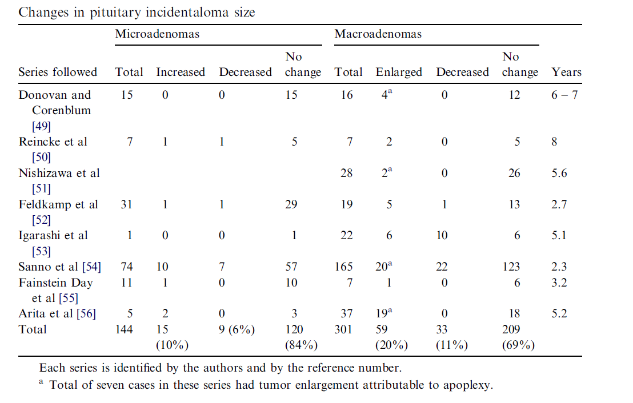
Natural history and follow-up of incidental clinically nonfunctioning adenomas
68%

Slide 9
Approach
We recommend that patients presenting with a pituitary incidentaloma undergo a complete history and physical examination that includes evaluations for evidence of hypopituitarism and a hormone hypersecretion syndrome
Patients with evidence of either of these conditions should undergo an appropriately directed biochemical evaluation

Slide 10
Diagnostic evaluation
MRI with gadolinium is preferred to CT because it can reveal far more anatomic detail of the lesion itself and its relation to surrounding structures and can provide characteristics distinguishing an adenoma from other mass lesions, such as craniopharyngiomas or Rathke’s cleft cysts
MRI can demonstrate the decreased signal of flowing blood, and therefore can better
determine the presence of aneurysms

Slide 11
Endocrinologic evaluation of the asymptomatic incidental mass
The goals of the endocrine evaluation of pituitary incidentalomas are to identify hormone hypersecretion and hypopituitarism
Screening for hypersecretion is important to perform because the prevalence of clinically evident pituitary adenomas has recently been appreciated to be as high as 1/1000 in a Belgian population , and 0.776/ 1000 (of which 0.542/1000 were hormone secreting) in a region of the United Kingdom , or as low as 0.04/1000 in Finland
J Clin Endocrinol Metab 91:4769–4775
Clin Endocrinol (Oxf) 72:377–382
J Clin Endocrinol Metab 95:4268–4275

Slide 12
Cont
Many of the changes occurring with hormone oversecretion syndromes may be quite subtle and only slowly progressive
Screening for hormonal oversecretion is warranted even in patients with no clinical evidence of hormone oversecretion

Slide 13
Cont
Because the most common lesion in the sella is a pituitary adenoma, it is reasonable to evaluate pts for hormone oversecretion, regardless of the size of the lesion seen

Slide 14
Cont
A serum PRL level should be obtained, but it may be difficult to distinguish between PRL production by a tumor versus hyperprolactinemia from stalk dysfunction in the case of macroadenomas
For such tumors, PRL levels are usually greater than 200 ng/mL with hormone-secreting tumors and lower numbers suggest stalk dysfunction
For extremely large tumors, the sample should be diluted to a 1:100 ratio to avoid the ‘‘hook effect’’

Slide 15
Cont
An insulin-like growth factor-1 (IGF-1) level is probably sufficient to screen for acromegaly, but if this test cannot be performed, it may be necessary to demonstrate nonsuppression of GH levels during an oral glucose tolerance test
The best screening tests for Cushing’s syndrome have traditionally been the overnight dexamethasone suppression test, the 24-h UFC test, and, more recently, the assessment of a midnight salivary cortisol level

Slide 16
Cont
Because gonadotropin oversecretion rarely causes clinical symptoms, however, and the finding of such hormone oversecretion would not influence therapy, there is no reason to screen for this
Any abnormality found on such screening would then need to be pursued with more definitive testing

Slide 17
Cont
Microadenomas do not generally cause disruption of normal pituitary function
Larger lesions may cause varying degrees of hypopituitarism because of compression of the hypothalamus, the hypothalamic-pituitary stalk, or the pituitary itself
Of the various series reported, between 0% and 41% of patients who had macroadenomas were found to have hypopituitarism, depending on whether the patients were reported from an endocrinology or neurosurgery service
JAMA 1990;263:2772–6.
Pituitary 2004;7:145–8
J Neurosurg 2006;104:884–91

Slide 18
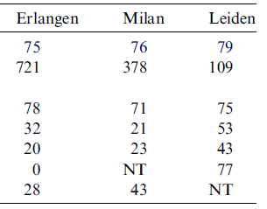
Frequency of endocrine deficiencies and hyperprolactinemia at presentation in patients who have clinically nonfunctioning adenomas

Slide 19
Indications for surgical therapy of the pituitary incidentaloma
patients with a pituitary incidentaloma be referred for surgery if they have the following:
A VF deficit due to the lesion
Other visual abnormalities, such as ophthalmoplegia
Neurological compromise due to compression Lesion abutting or compressing the optic nerves or chiasm on MRI
Pituitary apoplexy with visual disturbance
Hypersecreting tumors other than prolactinomas

Slide 20
Cont
Surgery be considered for patients with a pituitary incidentaloma if they have the following
Clinically significant growth of the pituitary
incidentaloma
Loss of endocrinological function
A lesion close to the optic chiasm and a plan to become pregnant
Unremitting headache

Slide 21
Management of incidental clinically nonfunctioning adenomas
Therapy is indicated for tumors that are hypersecreting
Therefore, prolactinomas would generally be treated with dopamine agonists and those producing GH or ACTH would be treated with surgery
For tumors not oversecreting these hormones, the indications for surgery are based primarily on size, size change, and mass effects of the tumors

Slide 22
Microadenoma
For patients who have microadenomas, the data presented previously suggest that significant tumor enlargement occurs in only 10%
Therefore, surgical resection is generally not indicated, and repeat scanning for 1 to 2 years is indicated to detect tumor enlargement; subsequently, this can be done at less frequent intervals
Surgery is performed only for significant tumor enlargement

Slide 23
Macroadenoma
Tumors greater than 1cm in diameter have already indicated a propensity for growth
Significant tumor growth can be expected in approximately 20% of such patients
A careful evaluation of the mass effects of these tumors is indicated including evaluation of pituitary function and visual field examination if the tumor abuts the chiasm
If there are visual field defects, surgery is indicated

Slide 24
Treatment
Transsphenoidal resection usually is recommended for patients who have enlarging tumors or tumors with mass effects
Rarely, craniotomy with subfrontal resection is required for extremely large tumors, but this technique is associated with higher morbidity

Slide 25
Radiotherapy
More commonly, radiotherapy is given as adjunctive therapy after surgery
In many of those series, the criteria for choosing which patients received postoperative irradiation were not specified

Slide 26
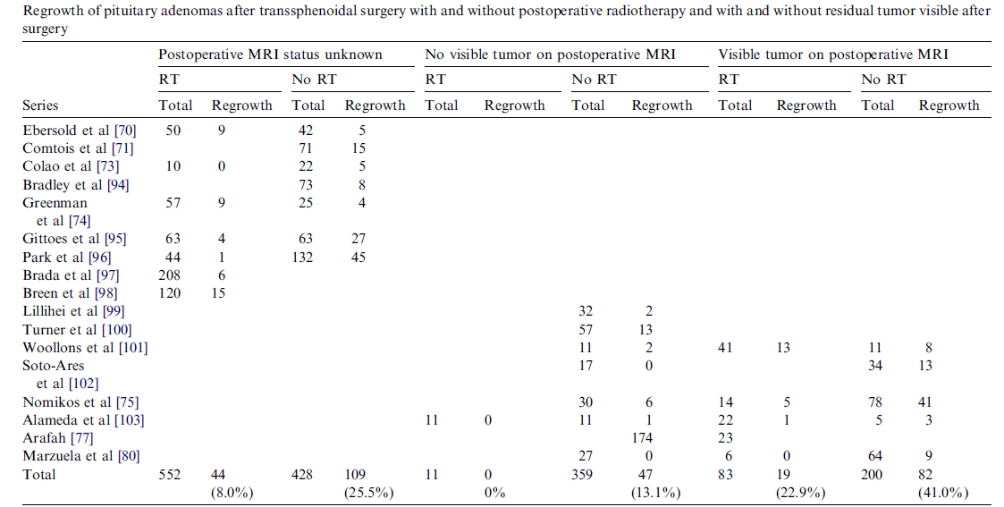

Slide 27
Follow-up testing of the pituitary incidentaloma
Patients with incidentalomas who do not meet criteria for surgical removal of the tumor should receive nonsurgical follow-up , with clinical assessments and the following tests:
MRI scan of the pituitary 6 months after the initial scan if the incidentaloma is a macroincidentaloma 1 yr after the initial scan if it is a microincidentaloma

Slide 28
Cont
In patients whose incidentaloma does not
change in size, we suggest repeating the MRI every year for macroincidentalomas and every 1–2 yr in microincidentalomas for the following 3 yr and gradually less frequently there after
VF testing in patients with a pituitary incidentaloma that enlarges to abut or compress the optic nerves or chiasm on a follow-up imaging study

Slide 29
Cont
Clinical and biochemical evaluations for hypopituitarism 6 months after the initial testing and yearly thereafter in patients with a pituitary macroincidentaloma
Although typically hypopituitarism develops with the finding of an increase in size of the incidentaloma
We suggest that clinicians do not need to test for hypopituitarism in patients with pituitary microincidentalomas whose clinical picture, history, and MRI do not change over time

Slide 30
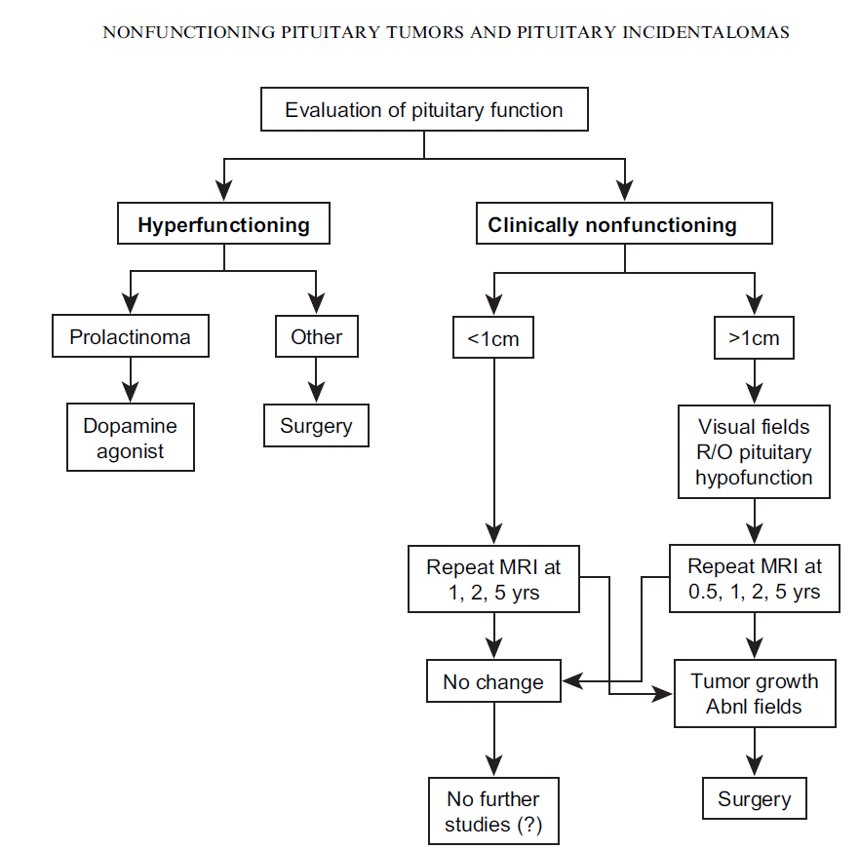

Slide 31
Recommendation
We recommend that patients presenting with a pituitary incidentaloma undergo a complete history and physical examination that includes evaluations for evidence of hypopituitarism and a hormone hypersecretion syndrome
Pts with evidence of either of these conditions should undergo an appropriately directed biochemical evaluation
We recommend that all patients with a pituitary incidentaloma, including those without symptoms, undergo clinical and laboratory evaluations for hormone hypersecretion

Slide 32
Cont
We recommend that patients with a pituitary incidentaloma with or without symptoms also undergo clinical and laboratory evaluations for hypopituitarism
We recommend that all patients presenting with a pituitary incidentaloma abutting the optic nerves or chiasm on magnetic resonance imaging (MRI) undergo a formal visual field (VF) examination

Slide 33
Cont
Patients with incidentalomas who do not meet criteria for surgical removal of the tumor should receive nonsurgical follow-up with clinical assessments and the following tests
MRI scan of the pituitary 6 months after the initial scan if the incidentaloma is a macroincidentaloma and 1 yr after the initial scan if it is a microincidentaloma

Slide 34
Cont
In patients whose incidentaloma does not change in size, we suggest repeating the MR I every year for macroincidentalomas and every 1–2 yr in microincidentalomas for the following 3 yr, and gradually less frequently thereafter

Slide 35
Cont
VF testing in patients with a pituitary incidentaloma that enlarges to abut or compress the optic nerves or chiasm on a follow-up imaging study
We suggest that clinicians do not need to test VF in patients whose incidentalomas are not close to the chiasm and who have no new symptoms and are being followed closely by MRI

Slide 36
Cont
VF testing in patients with a pituitary incidentaloma that enlarges to abut or compress the optic nerves or chiasm on a follow-up imaging study
We suggest that clinicians do not need to test VF in patients whose incidentalomas are not close to the chiasm and who have no new symptoms and are being followed closely by MRI

