Slide 1
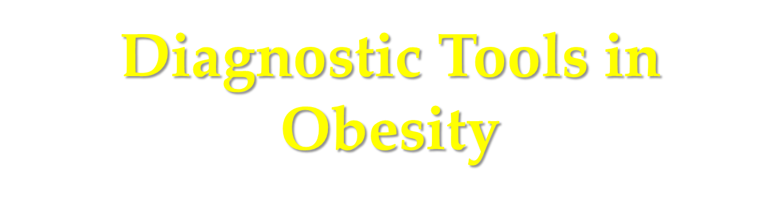



Slide 2
Anthropometric indices
BMI
Waist
W/H ratio
Skinfold thickness

Slide 3
Measurements of body composition
Densitometry
Total body water (TBW)
Dual energy X-ray absorptiometry
Bioelectrical impedance (Bioimpedance)

Slide 4
Measurements of fat distribution
Computed tomography (CT) imaging
Magnetic resonance (MR) imaging

Slide 5

Measurements of body fat that are expensive and require special equipment and highly trained personnel include:
Measurements that are simple, cheap and appropriate for routine use include:
Underwater weighing
Bioelectrical impedance
Computerized topography
BMI
waist circumference
Hip circumference
Waist-to-hip ratio
Skin fold thickness

Slide 6
Anthropometrics in Obesity
Height
Weight
Body Mass Index (BMI) [weight/height]²
  Kg/m²
  (lb/in)² x 703
Distribution of body fat
    Waist-hip ratio (WHR)
    Waist circumference

Slide 7
Advantages of anthropometry
Objective with high specificity & sensitivity
Readings are numerical & gradable on standard growth charts
Readings are reproducible.
Non-expensive & need minimal training

Slide 8
Limitations of Anthropometry
  Inter-observers errors in measurement
  Problems with reference standards, i.e. local versus international standards.
  Arbitrary statistical cut-off levels for what considered as abnormal values.

Slide 9
What is BMI?
Express weight adjusted for height
Body mass index (BMI) = weight (kg)/height (m)²
Notes:
Body Mass Index (BMI) is an anthropometric index of weight and height that is defined as body weight in kilograms divided by height in meters squared. BMI is the commonly accepted index for classifying adiposity in adults and it is recommended for use with children and adolescents.
Like weight-for-height, BMI is a screening tool used to identify individuals who are underweight or overweight. BMI is not a diagnostic tool. For example, a child who is relatively heavy may have a high BMI for his or her age or high weight-for-stature. To determine whether the child has excess fat or is overweight, further assessment is needed that might include triceps skinfold measurements, assessments of diet, health, and physical activity.
BMI is gender specific for children. Furthermore, whereas a fixed BMI cutoff is used for adults, for children, because BMI changes substantially as they get older, BMI-for-age is the measure used for ages 2 to 20 years.

Slide 10
Body Mass Index (kg/m²)
Adapted from: Gallagher et al. Am J Clin Nutr 2000;72:694.
Notes:
Body mass index (BMI) represents the relationship between weight and height. It is calculated as weight (in kilograms) divided by height (in meters squared). As shown in this figure, which contains data from 613 men and 876 women, BMI correlates with percent body fat mass in a curvilinear fashion in both men and women [1,2]. The relationship between BMI and percent body fat is sex and age dependent; at an equivalent BMI, women and older persons have a higher percent body fat than men and younger persons. In addition, persons who have a large muscle mass can have an “obese” BMI despite having a normal amount of body fat, while those with excess adiposity and reduced muscle mass can have a “normal” BMI.
1. Gallagher D, Visser M, Sepulveda D, et al. How useful is body mass index for comparison of body fatness across age, sex, and ethnic groups? Am J Epidemiol 1996;143:228-239.
2. Gallagher D, Heymsfield SB, Heo M, et al. Healthy percentage body fat ranges: an approach for developing guidelines based on body mass index. Am J Clin Nutr 2000;72:694-701.

Slide 11
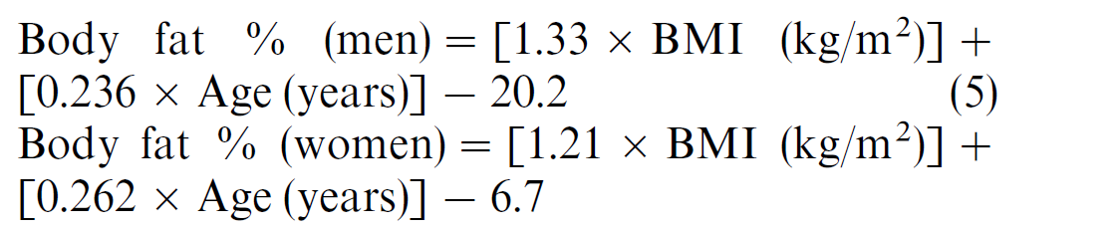
BMI and Body fat%

Slide 12
Advantages of using BMI
  low-cost and easy to use for health professionals for assessing individuals
  Reliable
  commonly used to determine desirable body weights and allows people to compare their own weight status to that of the general population

Slide 13
Advantages of using BMI
Correlates well with the amount of body fat as measured by more complex techniques
Predicts dangers associated with obesity; as BMI increases the risk for diseases increases
A useful screening tool to use at the population level and, because it is universally accepted, BMI reference data is available for many different populations
Can be used for selection of therapy

Slide 14
Disadvantages of BMI
It does not distinguish the accumulation of muscle (lean body mass) from the accumulation of adipose tissue (body fat)
It varies with age and sex in those <18 years
Different cut points in different ethnic groups

Slide 15
Disadvantages of BMI
Weight loss induced by exercise is associated with smaller losses of lean tissue (which is denser than fat), compared with dietary restriction alone.
Thus, weight and BMI may change little during an exercise program, even though significant loss of fat may occur

Slide 16
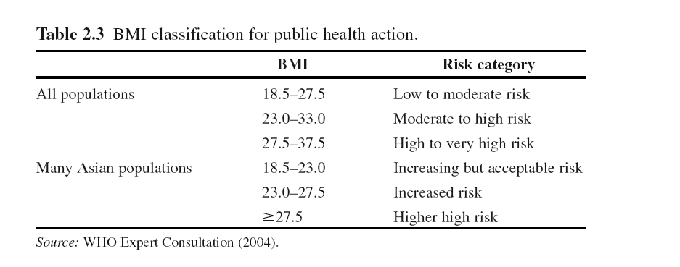

Slide 17
BMI-Associated Disease Risk
Classification BMI (kg/m²) Risk
Underweight <18.5 Increased
Normal 18.5–24.9 Normal
Overweight 25.0–29.9 Increased
Obese I 30.0–34.9 High
II 35.0–39.9 Very high
III ≥40 Extremely high
Additional risks:
    Large waist circumference (men >40 in; women >35 in)
    5 kg or more weight gain since age 18–20 y
    Poor aerobic fitness
    Specific races and ethnic groups
Clinical Guidelines on the Identification, Evaluation, and Treatment of Overweight and Obesity in Adults—The Evidence Report. Obes Res 1998;6(suppl 2).
Notes:
The use of body mass index (BMI) has been proposed by the National Institutes of Health [1] and the World Health Organization [2] as a method for defining overweight and obesity. This classification system is based on epidemiologic data indicating that the risk of premature mortality usually begins to increase at a BMI of 25 to 29.9 kg/m² and increases further at a BMI of 30 kg/m². Other factors, such as waist circumference, weight gain since young adulthood, fitness level, and ethnic or racial background, also influence the relationship between BMI and overall disease risk.
1. National Institutes of Health and National Heart, Lung, and Blood Institute. Clinical guidelines on the identification, evaluation, and treatment of overweight and obesity in adults—the evidence report. Obes Res 1998;6(suppl 2):1S-209S.
2. World Health Organization. Obesity: preventing and managing the global epidemic. Report of a WHO Consultation on Obesity. Geneva: World Health Organization, 1998.

Slide 18
1995 WHO expert committee report
BMI cut-points of 25 (overweight) and 30 (obesity) recommended by expert committees
For adults, the Expert Committee proposed classification of BMI with the cut-off points 25, 30 and 40…This classification is based principally on the association between BMI and mortality.

Slide 19
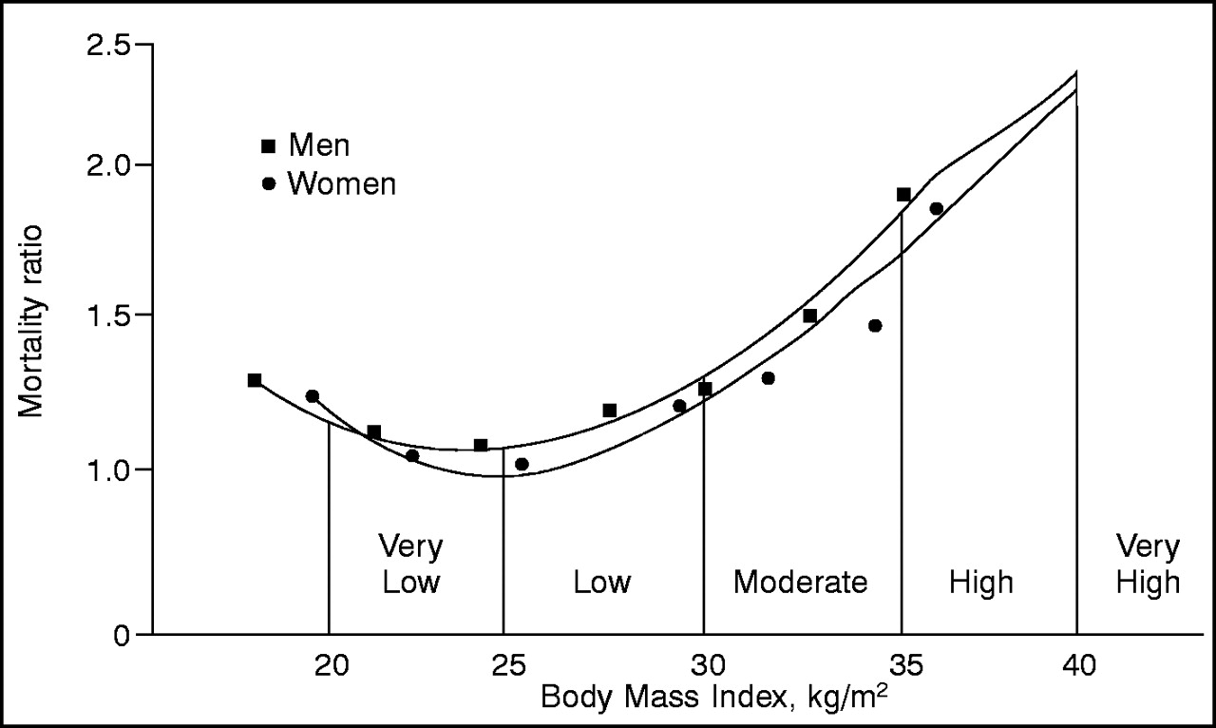
Relation between mortality and BMI
Data from Lew EA: Mortality and weight: insured lives and the American Cancer Society studies. Ann Intern Med 103:1024-1029, 1985.

Slide 20
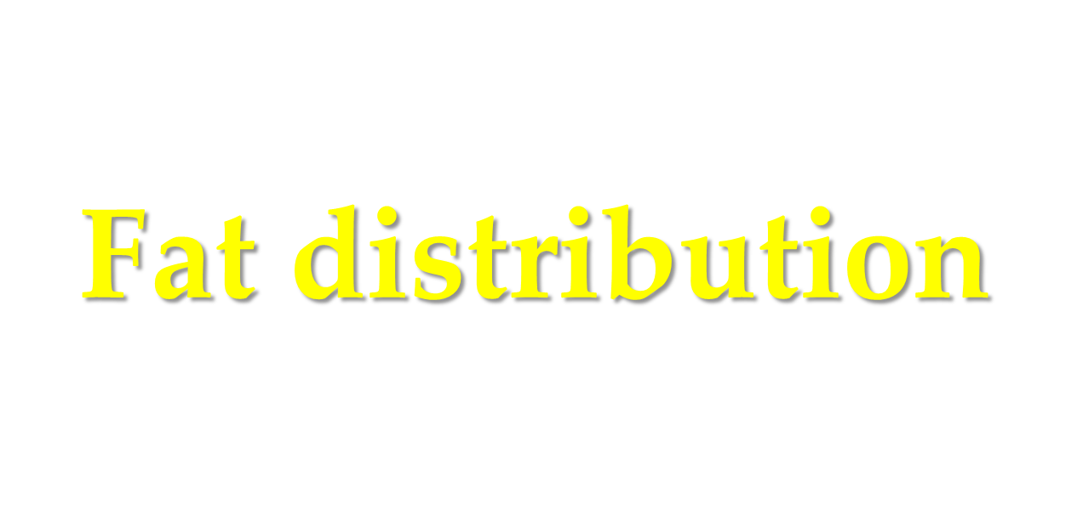
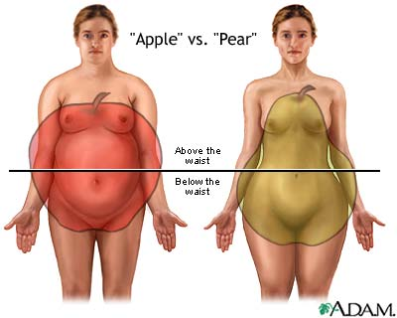
Android
Gynoid
Notes:
In 1947 Jean Vague a French physician made the association of the apple shape (i.e., android obesity or male patterned obesity of central abdominal obesity) with increased risk for CVD.
Likewise, Vague noted that the pear shape (i.e., gynoid obesity or female pattern obesity) was associated with a lower risk for CVD. Notice in gynoid obesity the weight is carried below the waist in the hips and thighs.
Why worry about Central Obesity versus BMI?
The deep abdominal fat cells that lie in the visceral area below the omental membrane have been found to be metabolically active. {The Visceral Adipose Tissue (VAT)}
The superfical fat tissue of Superfical Adipose Tissue (SAT) is believed to be less atherogenic.
Why should we worry more about deep VAT versus SAT!
The deep visceral adipose tissue or fat cells (under the omental membrane) called abdominal adipocytes are metabolically active and excrete substrates that are deleterious to the CV system.
Visceral Adipose Tissue (VAT)
As the adipocytes increase or enlarge macrophages or white blood cells are drawn to the abdominal fat cells in increased numbers. These macrophages reside in between abdominal adipose cells and release abnormal substrates called cytokines etc. (i.e., IL-6, Tumor necrosis factor etc)
Central Obesity is the cornerstone of a group of abnormalities associated with development of Type 2 Diabetes (T2D) and CVD.
There is a predictable pathway known as the “Metabolic Syndrome,” that imposes increased risk, as much as a decade prior to diagnosis of frank pathology.

Slide 21
Importance of fat distribution
What is the power of waist circumference to predict adverse cardio-metabolic outcomes?
How does the predictive power of waist circumference compare with that of BMI?

Slide 22
Health threat from abdominal obesity is largely due to intra-abdominal obesity
Increased Cardiometabolic Risk
Abdominal
Obesity
Dyslipidemia
Hypertension
Glucose Intolerance
Insulin Resistance
Intra-Abdominal
Adiposity
Adapted from Eckel et al 2005
Notes:
Health threat from abdominal obesity is largely due to intra-abdominal adiposity
This slide summarises the relationships between intra-abdominal adiposity and increased cardiometabolic risk.
Intra-abdominal adiposity drives the progression of multiple risk factors directly, through the secretion of excess free fatty acids and inflammatory adipokines, and decreased secretion of adiponectin. The important contributions of intra-abdominal adiposity to dyslipidaemia and insulin resistance provide an indirect, though clinically important, link to the genesis and progression of atherosclerosis and cardiovascular disease.
Eckel RH, Grundy SM, Zimmet PZ. The metabolic syndrome. Lancet. 2005;365:1415-28.

Slide 23
Visceral Fat:
The Critical Adipose Depot
Back

Slide 24
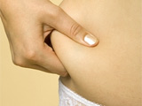
Waist Circumference
Measurement Sites
Immediately below the lowest rib
At the narrowest waist¹
Midpoint between the lowest rib and the iliac crest²
Immediately above the iliac crest^{3,4}
Anthropometric Standardization Reference Manual
World Health Organization (WHO)
National Institutes of Health (NIH)
National Health and Nutrition Examination Survey (NHANES)

Slide 25
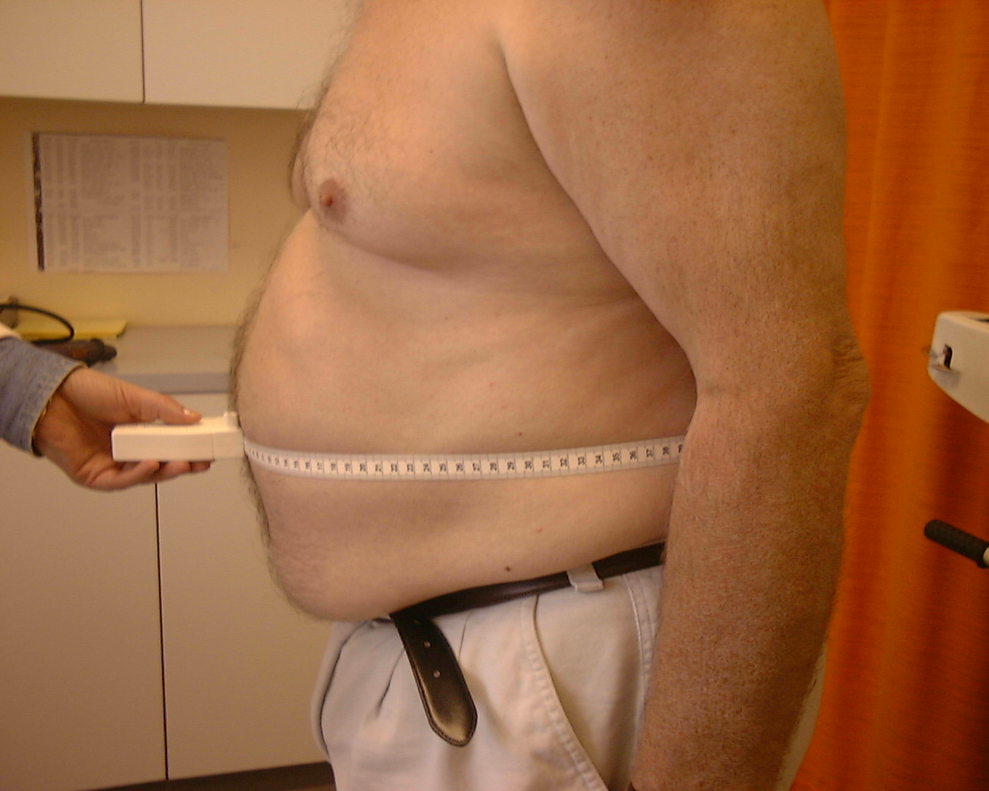
How to Measure Waist Circumference
Place a measuring tape, held parallel to the floor, around the patient’s abdomen at a designated level.
The tape should fit snugly around the waist without compressing the skin
Take the measurement
at the end of a normal expiration
Adapted from Grundy SM, et al. Circulation. 2005;112:2735-2752.
Notes:
To measure waist circumference, locate top of right iliac crest. Place a measuring tape in a horizontal plane around the abdomen at level of iliac crest. Before reading tape measure, ensure that tape is snug but does not compress the skin and is parallel to floor. Measurement is made at end of normal expiration.
Grundy SM, Cleeman JI, Daniels SR, et al. Diagnosis and management of the metabolic syndrome: an American Heart Association/National Heart, Lung, and Blood Institute Scientific Statement.
Circulation. 2005;112:2735-2752.

Slide 26
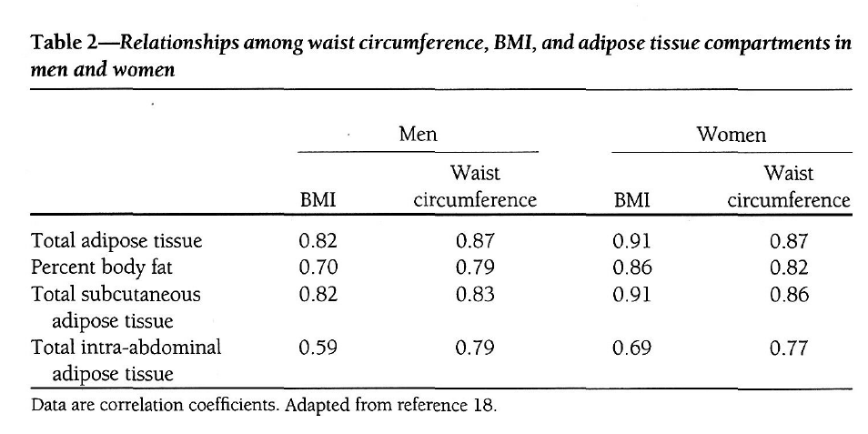
BMI and WC are highly correlated ,typically with r values in range of 0.85-0.95

Slide 27
Visceral vs subcutaneous adiposity
CT scans matched for BMI and total body fat
Visceral obesity
Fat mass: 19.8 kg
VFA: 155 cm²
Similar BMI
Subcutaneous (sc) obesity
Fat mass: 19.8 kg
VFA: 96 cm²
White = VFA
Black = sc fat
Després J-P. Eur Heart J Suppl. 2006;8(suppl B):B4-12.
Notes:
Adipose depots are located throughout the body. Some have a structural function,
eg, fat pads in the hands and feet, and the periorbital fat supporting the eyes.¹
Other adipocytes exist in loose association with the skin and are termed subcutaneous fat.¹
Abdominal (visceral) adiposity refers to fat around the viscera and within the peritoneum,
as well as at the dorsal border of the intestines, and the ventral surface of the kidney.
BMI does not accurately measure intra-abdominal fat accumulation.
This slide shows computerized tomography (CT) scans from 2 men with similar BMIs,
but different adiposity phenotypes.
The upper image is from a man with mostly intra-abdominal adiposity; this subject has at least 50% more visceral fat than the subject whose CT scan is indicated in the lower panel.
Visceral vs subcutaneous adiposity
1. Rosen ED, Spiegelman BM. Nature. 2006;444:847-53.

Slide 28
WC cut points
Lean MEJ, Han TS, Morrison CE. Waist circumference as a measure for indicating need for weight management. BMJ 1995;311:158–61.
Randomly recruited 904 men and 1014 women, aged 25 to 74 years, from the general population of north Glasgow between January and August 1992, excluding only those who were chair bound.

Slide 29
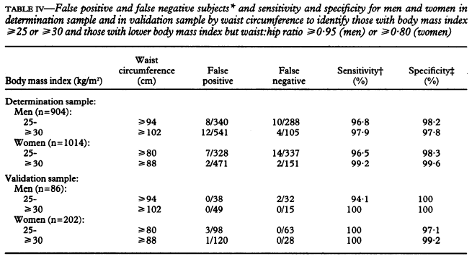
BMI as
Gold Standard
Using in ATPIII & EGIR

Slide 30
Waist circumference
It has been proposed that waist measurement alone can be used to assess obesity, and two levels of risk have been identified
MALES FEMALE
LEVEL 1 > 94cm > 80cm
LEVEL2 > 102cm > 88cm

Slide 31
Waist circumference/2
Level 1 is the maximum acceptable waist circumference irrespective of the adult age and there should be no further weight gain.
Level 2 denotes obesity and requires weight management to reduce the risk of type 2 diabetes & CVS complications.

Slide 32
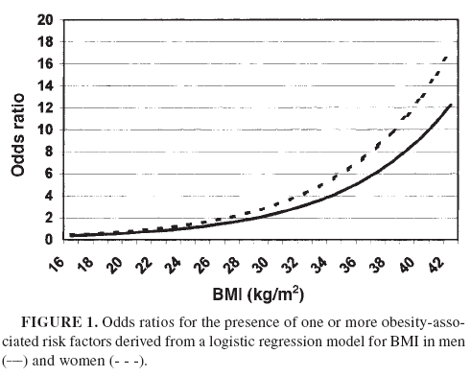
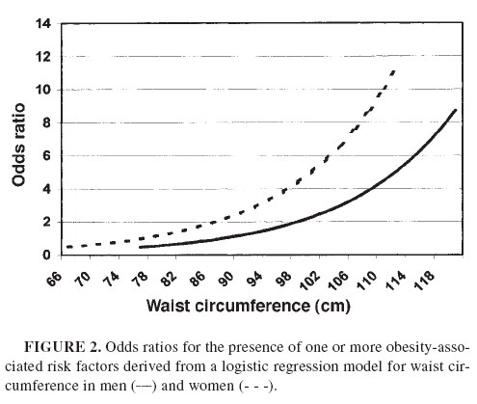

Slide 33
Metabolic Syndrome: Refined Criteria (IDF)
Population Group Waist Circumference (Cm)
        Men Women
        USA (NCEP ATP III) >102 >88
        European >94 >80
        South Asian/ >90 >80
        Chinese
        Japanese >90 >85
Notes:
http://www.idf.org/home/index.cfm?unode=32EF2063-B966-468F-928C-A5682A4E3910 Numbers converted from cm.
South and Central Americans to use South Asian criteria
SubSaharan Africans and Middle Eastern populations use European data
ATP = adult treatment panel

Slide 34
Cohort Studies to determine WC cutoff
Country
Outcome
Age
Cut off
P.Y.
Brazil HTN ----- M:87 F:80 2009
Australia CVD mortality 20-69 M:96 F:80 2007
Japan CVD ≥ 40 M:90 F:80 2009
Thailand CHD 35-59 M:82 2007
China* CVD risk 18-93 M:83-88 F:76 2007
Iran CVD ≥ 40 M:94.5 F:94.5 2009

Slide 35
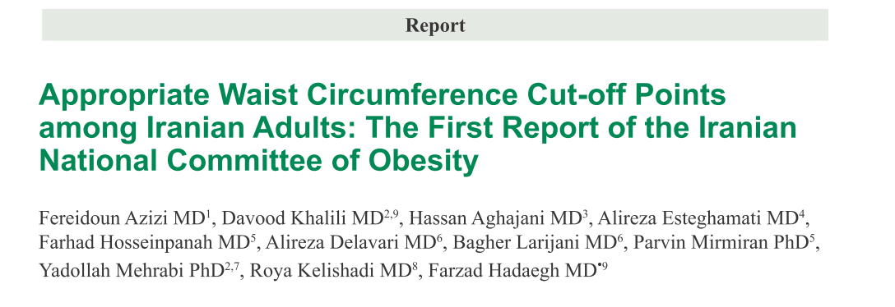
Archives of Iranian Medicine, Volume 13, Number 3, May 2010

Slide 36
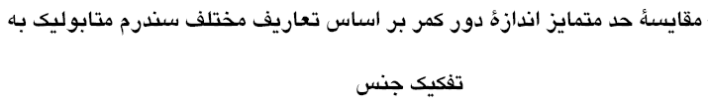
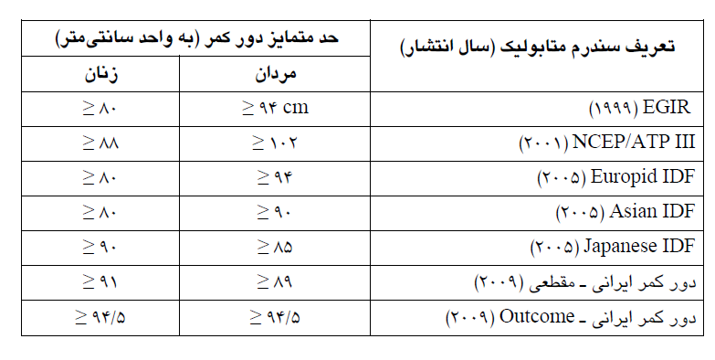

Slide 37

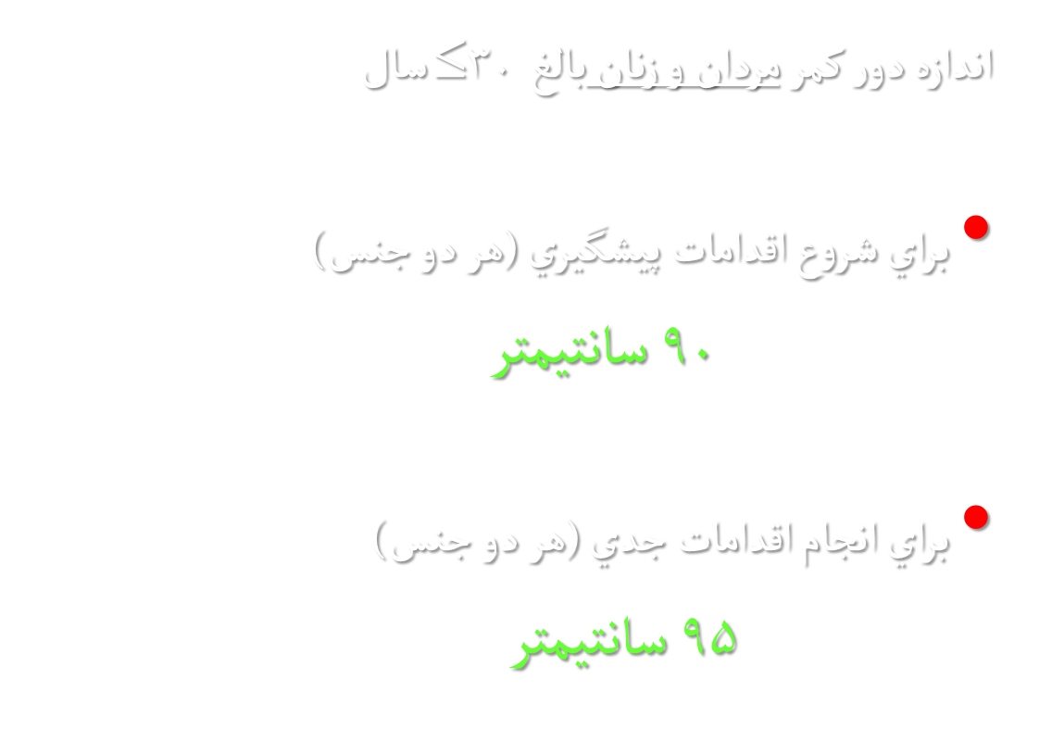

Slide 38
Hip Circumference
Is measured at the point of greatest circumference around hips & buttocks to the nearest 0.5 cm.
The subject should be standing and the measurer should squat beside him.
Both measurement should taken with a flexible, non-stretchable tape in close contact with the skin, but without indenting the soft tissue.

Slide 39
Interpretation of WHR
High risk WHR= >0.80 for females & >0.90 for males i.e. waist measurement >80% of hip measurement for women and >95% for men indicates central (upper body) obesity and is considered high risk for diabetes & CVS disorders.
A WHR below these cut-off levels is considered low risk.

Slide 40
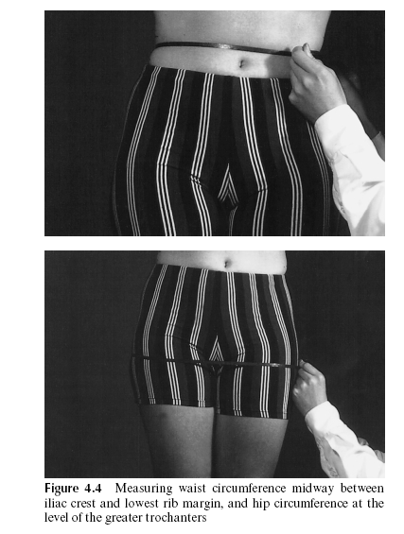

Slide 41
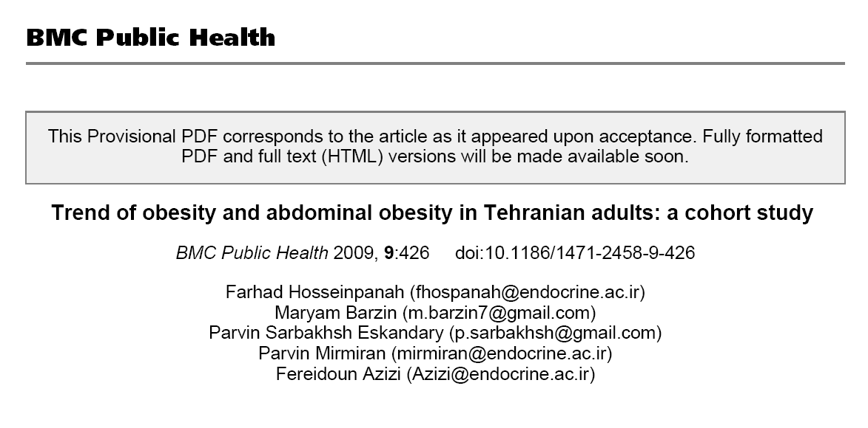
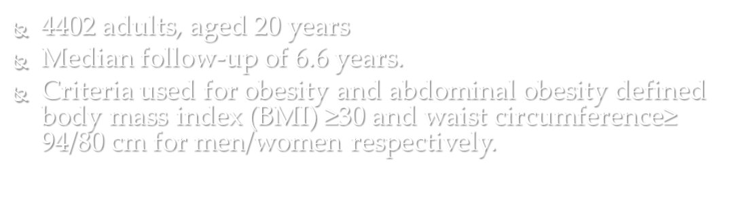

Slide 42
Median 6.6-years changes in waist circumference

Slide 43
Median 6.6-years changes in abdominal obesity

Slide 44
Skinfold Thickness
A skinfold thickness (SFT) is the double thickness of the epidermis, underlying fascia and subcutaneous fat, when the tissues are pinched between measuring calipers
Measurements are usually made at four sites: biceps, triceps, subscapular and suprailiac.
Using sex- and age-dependent, population-based linear regression equations, the sum of these values (in mm) can be used to estimate total body fat

Slide 45
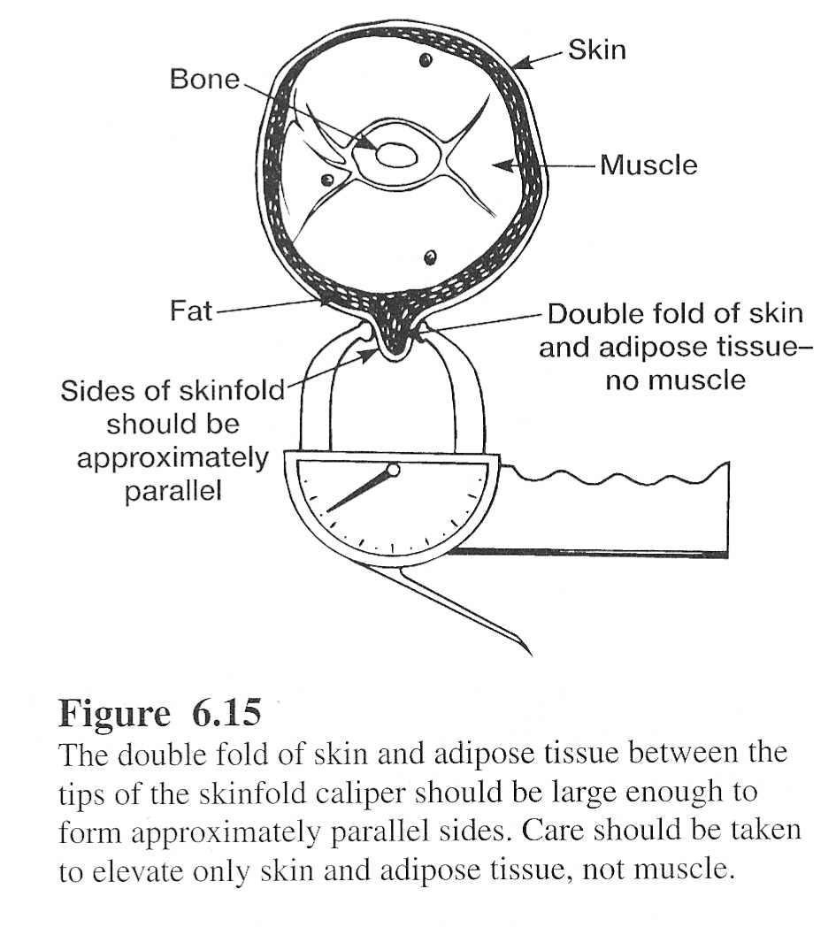
Skinfold Thickness
Measures double thickness of skin and subcutaneous fat
Advantages:
  inexpensive
  fast
  portable
  large database

Slide 46
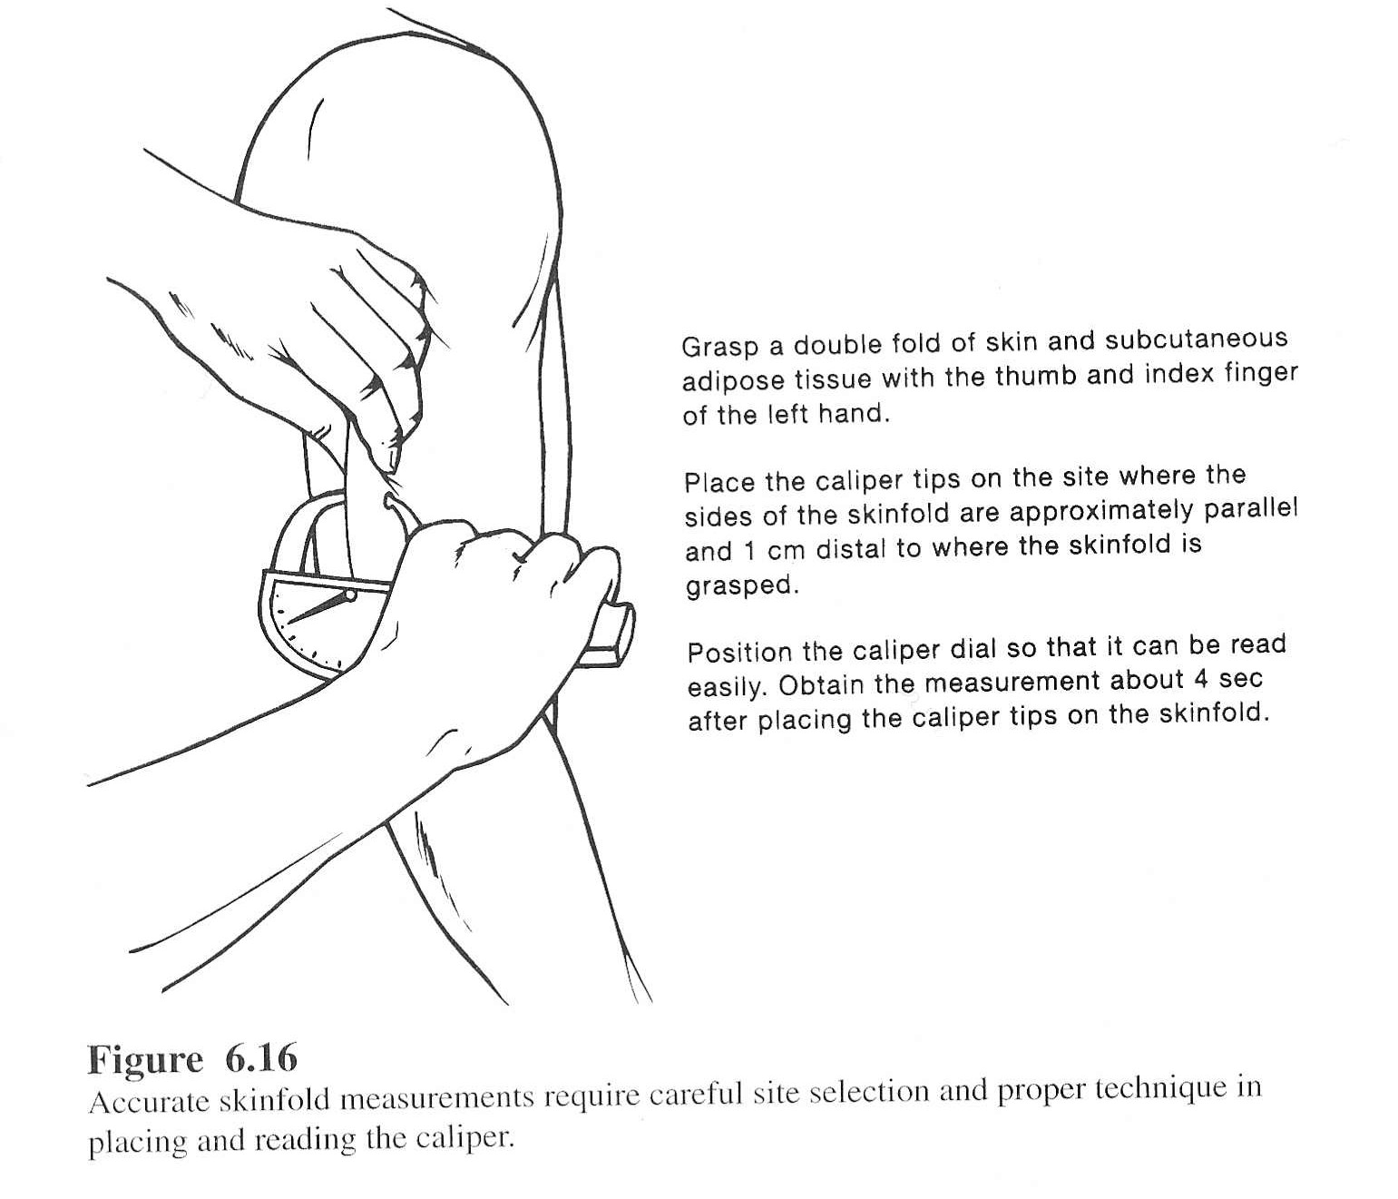

Slide 47
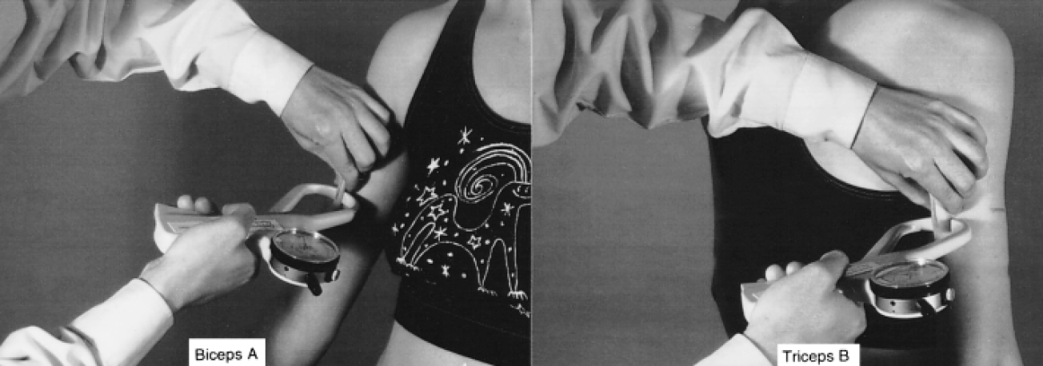

Slide 48
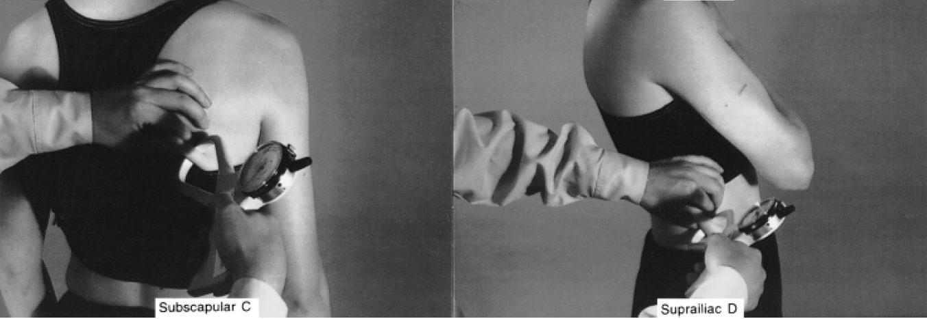

Slide 49
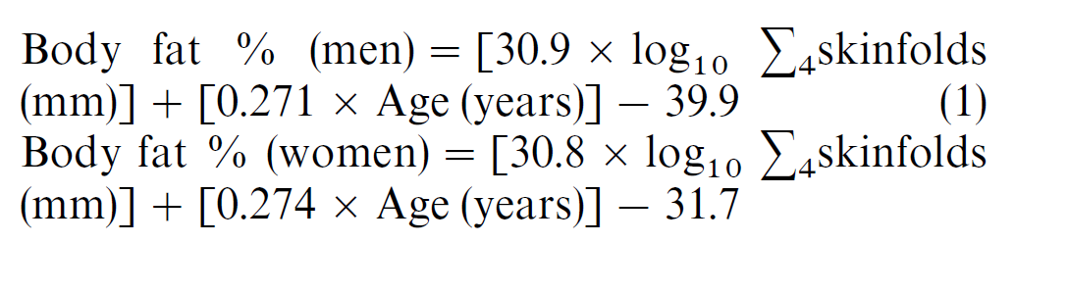
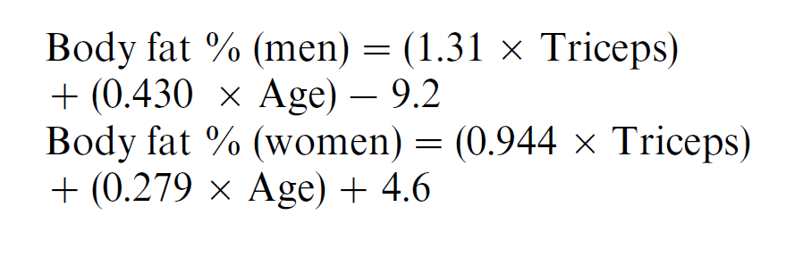

Slide 50
Limitations
Major limitation is considerable observer error
This limits the usefulness of this technique outside research environments
Skinfold thickness affected by factors other than amount of fat
  exercise increases skin thickness
  dehydration reduces skin thickness
  edema increases skin thickness
  dermatitis increases skin thickness
Poorly predicts visceral fat

Slide 51
Measurements of body composition
Densitometry
Total body water (TBW)
Dual energy X-ray absorptiometry
Bioelectrical impedance (Bioimpedance)

Slide 52
Body Composition Analysis vs. Body Weight Assessment
Advantages
“Direct” assessment of body fatness
  Overweight
    Overmuscled or overfat
      Athletes
      Assessing need for weight loss
  inadequate stores in patients
Monitor changes
  weight loss quality
  effect of medical therapy

Slide 53
Body Composition Analysis vs. Body Weight Assessment
Disadvantages
relatively limited database
all field methods are estimations
  false assumptions in all field methods
  errors by technicians
limited understanding by clients

Slide 54

Body composition (Two compartment)
Fat Mass (FM)
Fat free mass (FFM)

Slide 55

Body composition (Four compartment)
water
Protein
Fat
Minerals

Slide 56
Densitometry
Density is calculated as body mass/volume.
Traditionally, density has been measured by directly measuring mass on weighing scales, and body volume by underwater weighing, using the basic principle of water displacement
Underwater weighing requires total submergence, and can therefore be both difficult and frightening

Slide 57
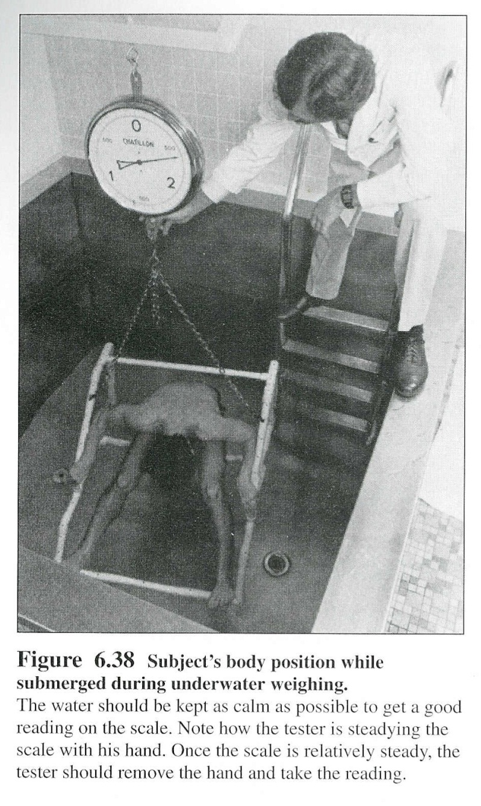
Hydrodensitometry

Slide 58
Whole Body Pethysmography
Measures body volume by air displacement
  actually measures pressure changes with injection of known volume of air into closed chamber
Large body volume displaces air volume in chamber
  results in bigger increase in pressure with injection of known volume of air

Slide 59
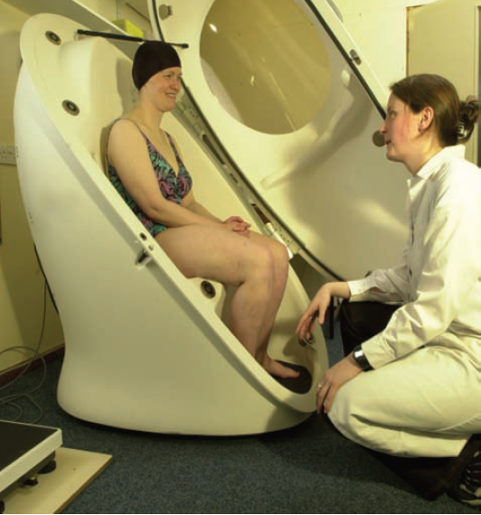
Air displacement Plethysmograph

Slide 60
TBW
Fat is essentially anhydrous and the FFM contains a known proportion of water
It is therefore possible to estimate FFM if the total body water content is known, when fat mass can be calculated as the difference from body weight
Total body water is conveniently measured by the isotope dilution method. (deuterium dilution)

Slide 61
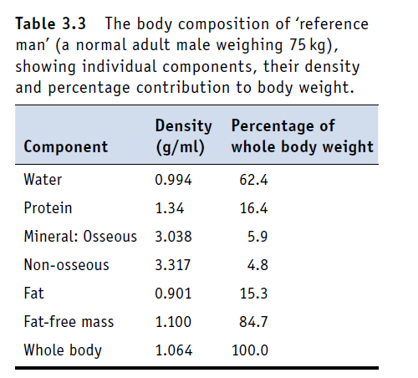
When the body’s density is known, and assuming the density of fat to be 0.9 kg/l and that of fat-free mass 1.1 kg/l, the percentage of body fat can be estimated using a standard equation

Slide 62
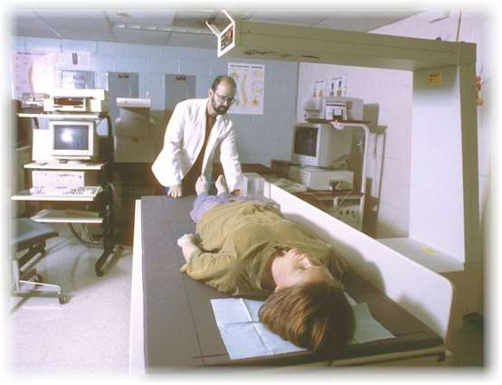
Dual-Energy X-ray Absorptiometry

Slide 63
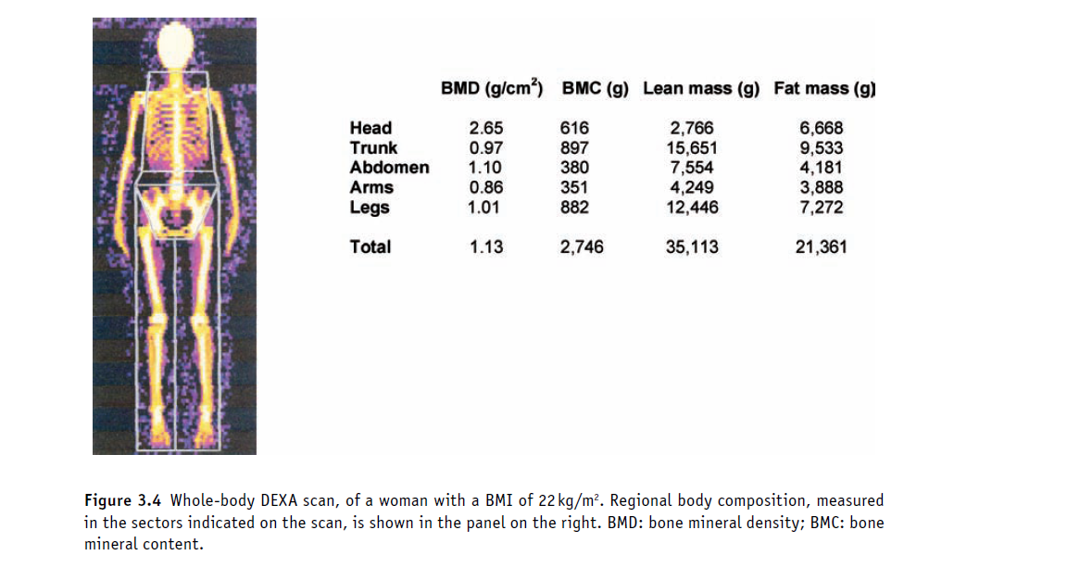

Slide 64
Bioelectrical Impedance Analysis
“BIA provides a reliable estimate of total body water under most conditions.”
“It can be a useful technique for body composition assessment in healthy individuals”

Slide 65
Bioelectrical Impedance Analysis
BIA measures impedance by body tissues to the flow of a small (<1mA) alternating electrical current (50kHz)
Impedance is a function of:
  electrical resistance of tissue
  electrical capacitance (storage) of tissue (reactance)

Slide 66



BIA: basic theory
The body can be considered to be a series of cylinders.
Resistance is proportional to the length of the cylinder
Resistance is inversely proportional to the cross-sectional area

Slide 67

BIA: basic theory
Volume is equal to length of the cylinder times its area
Therefore, knowing the resistance and the length, one can calculate volume.
Assuming that the current flows thru the path of least resistance (water) , then the volume determined is that of body water.

Slide 68
BIA: basic theory
Assume fat free mass has a constant proportion of water (about 73%)
  Then calculate fat free mass from body water
Assume BW = FFM + FM
  Then calculate fat mass and %body fat

Slide 69
NHANES III
BIA Equations
Males
  FFM = -10.68 + 0.65H²/R + 0.26W + 0.02R
Females
  FFM = -9.53 + 0.69H²/R + 0.17W + 0.02R
Where
  FFM = fat free mass (kg)
  H = height (cm)
  W = body weight (kg)
  R – resistance (ohms)
% BF = 100 x (BW-FFM)/BW

Slide 70
BIA Calculations
DATA
  R = 520 ohms
  BW = 170 lbs = 77.3 kg
  H = 70” = 178 cm
CALCULATIONS
  FFM = -10.68+(0.65H²/R)+0.26W+0.02R
  FFM = -10.68+(0.65x178²/520)+0.26(77.3)+0.02(520)
  FFM = -10.6 + 39.6 + 20.1 + 10.4 = 59.5 kg
  FM = W – FFM = 77.3 – 59.5 = 17.8 kg
  %BF = (17.8/77.3)x100 = 23%

Slide 71
BIA
It shows good agreement with deuterium dilution, densitometry and DEXA
It is generally superior to skinfold thickness measurements, with within- and between-subject coefficients of variation of around 1–2% in determining body fat mass
Advantages (costs , portable non-invasive, fast)

Slide 72
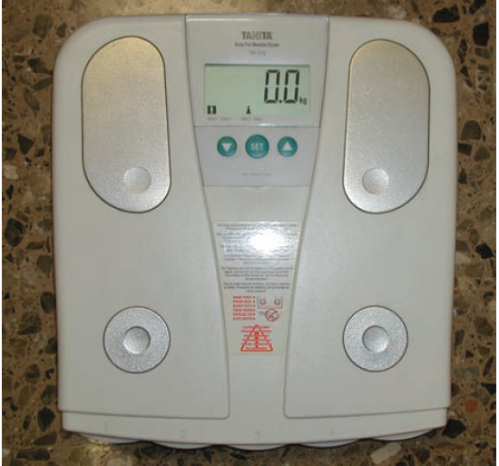

Slide 73
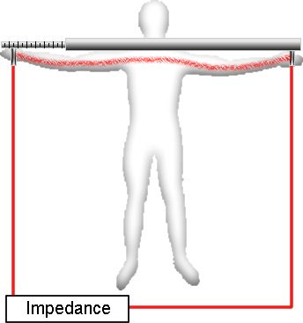
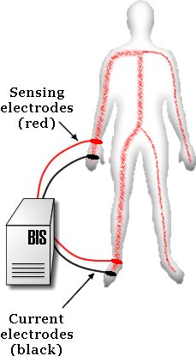
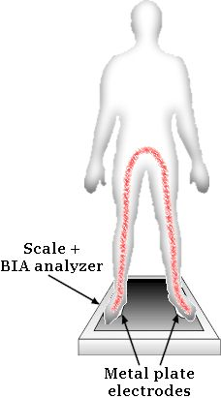
Major types of BIA analyzers

Slide 74
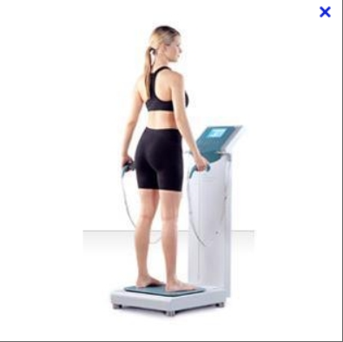

Slide 75
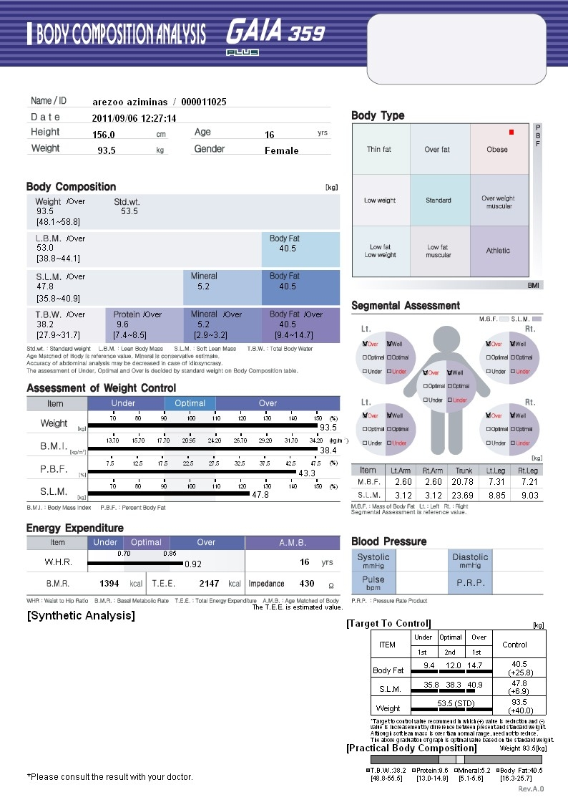

Slide 76
What is a ‘normal’ % body fat?
Classification | Males | Females
Unhealthy range (too low) | < 5% | < 8%
Acceptable range (lower end) | 6-15% | 9-23%
Acceptable range (higher end) | 16-24% | 24-31%
Unhealthy (too high) | > 25% | > 32%
Nieman, 1999 (p195)

Slide 77
Measurements of fat distribution
Computed tomography (CT) imaging
Magnetic resonance (MR) imaging

Slide 78
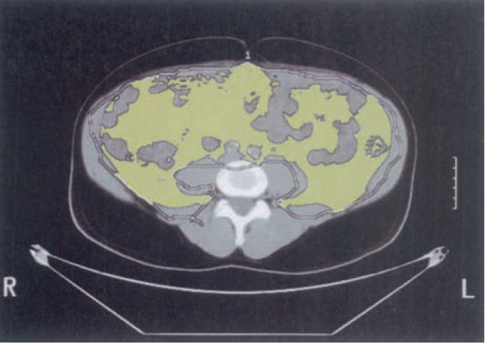

Slide 79
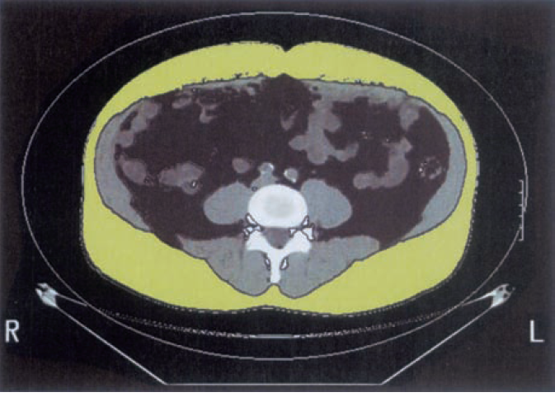

Slide 80
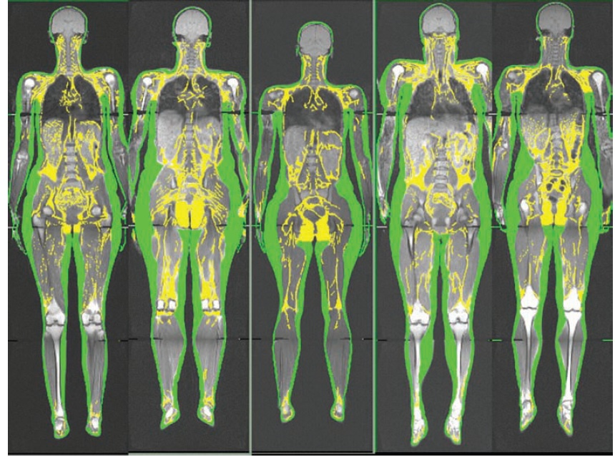

Slide 81
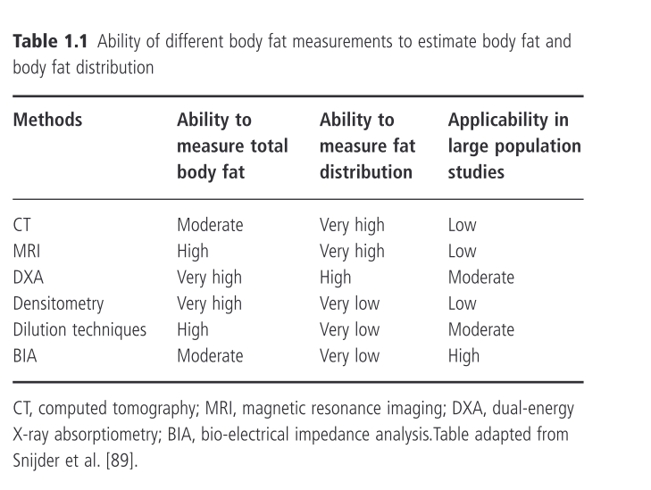

Slide 82
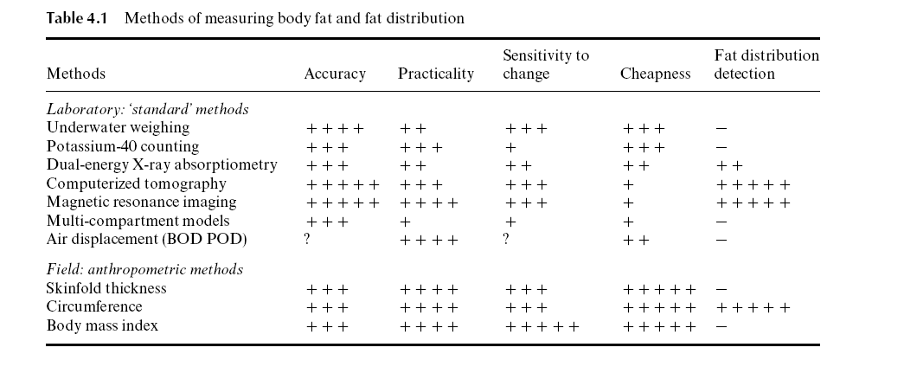

Slide 83

Thanks for your attention

