Slide 1
Approach to the Patient: Hyponatremia and the Syndrome of Inappropriate Antidiuresis (SIAD)
Leila Rahmani MD
1401/11/3

Slide 2
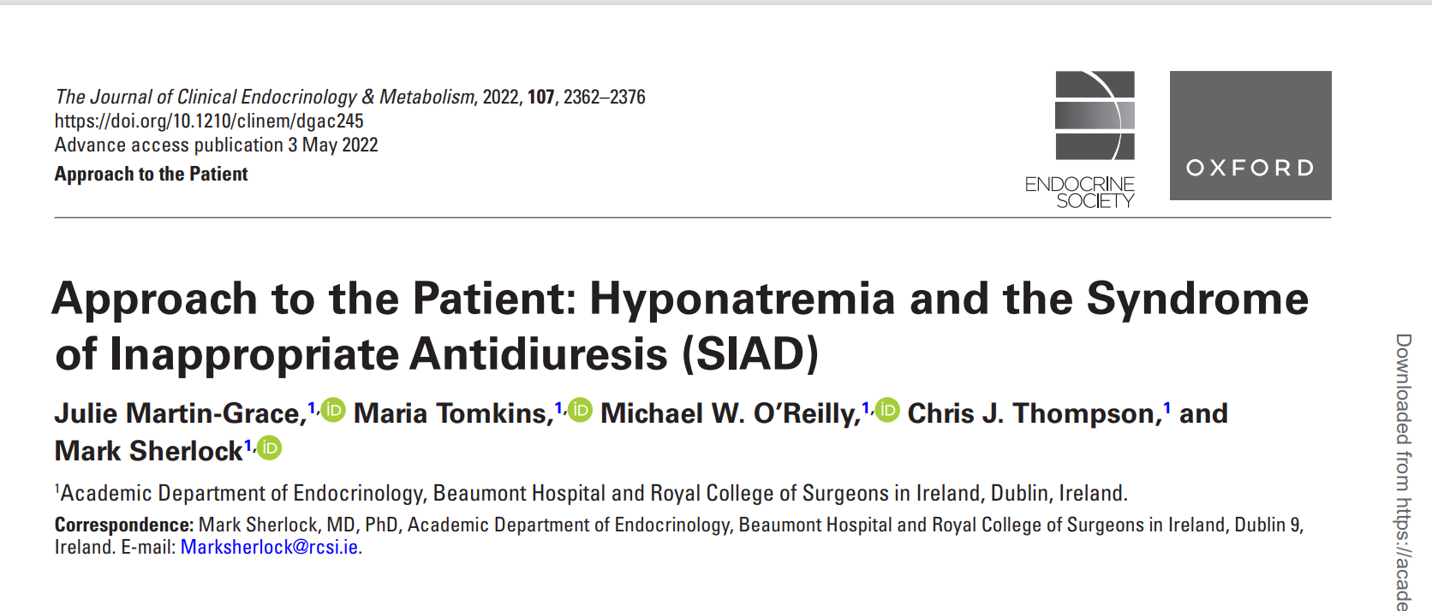

Slide 3
Case 1
A 55-year-old woman presented to the emergency department
She had reported headaches and nausea the previous evening and this morning had vomited and appeared confused
She had recently commenced a SSRI
On examination, the patient was drowsy and clinically euvolemic with no evidence of trauma or infection

Slide 4
Case 1
Her weight was 49 kg (body mass index 19 kg/m2 ), a history of alcohol excess
Laboratory : urea 2.1 mmol/L, creatinine 0.7mg/dl
sodium 113 mmol/L, and potassium 4.4 mmol/L
Samples were sent for urine osmolality, urinary sodium, thyroid function, and serum cortisol concentration

Slide 5
Case 2
A 72-year-old man was referred complaining of a persistent cough, occasional blood-streaked sputum, and unintentional weight loss
Initial biochemistry was as follows: urea 3 mmol/L
creatinine 0.9 mg/dl, sodium 124 mmol/L, and potassium 4.8 mmol/L
On clinical examination, he was clinically euvolemic

Slide 6
Case 2
Urine sodium and osmolality were 46 mmol/L and 340 m Osm/kg, respectively
Morning serum cortisol concentration was 17.7 µg/dL, and he was biochemically euthyroid.
Imaging studies detected a suspicious lung lesion, and histology of a computed tomography–guided biopsy confirmed a diagnosis of small cell lung cancer

Slide 7
Prevalence of Hyponatremia
Hyponatremia is the most commonly encountered electrolyte disturbance in clinical practice
In a hospitalized patient cohort, the reported incidence of hyponatremia is 15% to 30%
However, severe hyponatremia (<125mmol/L) is less common and is reported in 0.5% to 3% of hospitalized patients

Slide 8
Physiology of Salt and Water Balance
Plasma sodium concentration is the principle determinant of plasma osmolality
Both plasma sodium and osmolality are maintained within a narrow physiological range by osmotically regulated AVP secretion and the sensation of thirst

Slide 9
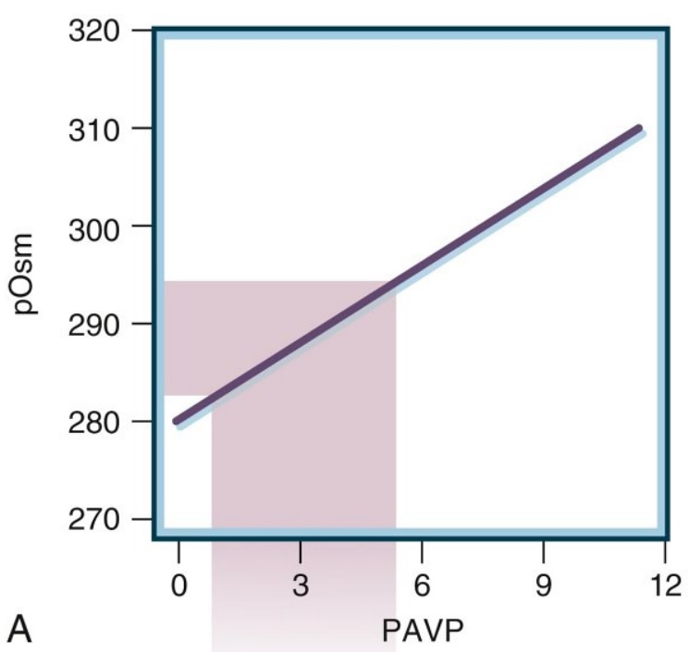
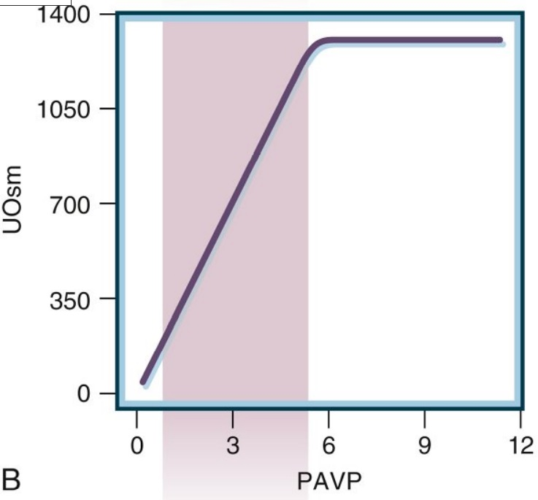
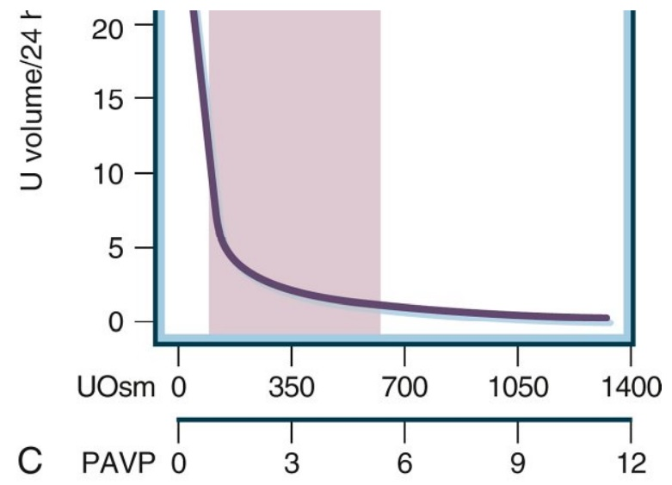
Physiology of Salt and Water Balance

Slide 10
Physiology of Salt and Water Balance

Slide 11
Physiology of Salt and Water Balance

Slide 12
Physiology of Salt and Water Balance
Mineralocorticoid and glucocorticoid activity will also influence salt and water homeostasis
Hyponatremia is almost always associated with hypotonicity, or hypo-osmolality (plasma osmolality < 280 mOsm/ kg)

Slide 13
Physiology of Salt and Water Balance
However, there are 2 circumstances where plasma sodium concentration and plasma osmolality diverge :
Pseudohyponatremia
Isotonic/hypertonic hyponatremia

Slide 14
Physiology of Salt and Water Balance
Pseudohyponatremia is an artifactual decrease in plasma sodium concentration due to displacement of free water in plasma by very high concentrations of lipids or proteins, which interfere with the accurate measurement of sodium; however, plasma osmolality remains normal
Isotonic/hypertonic hyponatremia occurs when unmeasured solutes other than sodium (such as glucose or mannitol) are present and contribute to plasma osmolality

Slide 15
Etiology of Hyponatremia

Slide 16
Hypovolemic Hyponatremia
Loss of both total body water and plasma sodium
Combined with sodium losses (renal or nonrenal), leads to a greater sodium loss relative to total body water losses
Thiazide diuretic use is an important cause of hypovolemic hyponatremia, causing both renal sodium loss and hypotension (stimulating baroregulated AVP secretion)

Slide 17
Hypovolemic Hyponatremia
Thiazide-induced hyponatremia is frequently accompanied by hypokalemia
Other renal sodium losses include mineralocorticoid deficiency, salt-wasting nephropathies and rarely cerebral salt wasting
Nonrenal sodium losses include gastrointestinal loss due to vomiting or diarrhea and transdermal loss

Slide 18
Euvolemic Hyponatremia
Commonest form of hyponatremia in hospitalized patients
Total body sodium remains unchanged
A relative increase in total body water, not appreciable on clinical examination, results in a dilutional hyponatremia
Majority of euvolemic hyponatremia is caused by SIAD

Slide 19
Syndrome of inappropriate antidiuresis
Careful clinical assessment is essential to assess for other causes of euvolemic hyponatremia (eg , glucocorticoid deficiency and hypothyroidism)
SIAD is the most common cause of hyponatremia in hospitalized patients

Slide 20
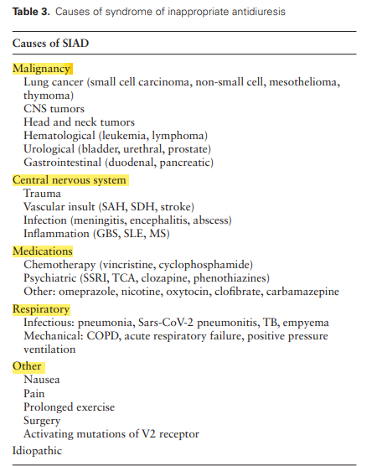
Syndrome of inappropriate antidiuresis

Slide 21
Syndrome of inappropriate antidiuresis

Slide 22
Cerebral salt-wasting syndrome
CSWS was originally described in 1950
Hyponatremia and a natriuresis observed in a neurosurgical setting
CSWS is a rare cause of hyponatremia in a neurosurgical setting
Prevalence of CSWS varies significantly which may be due to the challenge in distinguishing CSWS from SIAD

Slide 23
Cerebral salt-wasting syndrome

Slide 24
Glucocorticoid deficiency
Glucocorticoid deficiency is associated with an inappropriately elevated AVP concentration relative to plasma osmolality and a reduction in effective renal free water clearance, resulting in an increase in total body water
Primary adrenal insufficiency classically presents with hypovolemic hyponatremia due to a combination of both glucocorticoid and mineralocorticoid deficiency
Hyponatremia due to secondary adrenal insufficiency is typically euvolemic (as the renin-angiotensin-aldosterone system remain intact) and indistinguishable clinically from SIAD

Slide 25
Thyroid-stimulating hormone deficiency
The diagnostic criteria for SIAD require the exclusion of hypothyroidism
However, in clinical practice, hyponatremia due to hypothyroidism is extremely rare and only seen in patients with profound hypothyroidism

Slide 26
Exercise-induced hyponatremia
Hyponatremia that develops during or within 24 hours of exercise and is typically associated with long-distance and endurance sports
Non osmotic stimulus of AVP secretion
When large quantities of hypotonic fluids are ingested, acute hyponatremia may develop ,which can be fatal if untreated

Slide 27
High water and low solute intake
Large volumes of fluid &low solute intake, fluid intake may exceed the renal capacity to excrete free water, expanding total plasma free water relative to total body sodium
Observed in those who consume large volumes of beer (beer potomania) or, occasionally, in those with hypotonic fluid consumption in combination with low protein diets
Primary polydipsia

Slide 28
Hypervolemic Hyponatremia
It is seen in cardiac, liver, and renal failure
A fall in mean arterial pressure stimulates AVP secretion and activation of the RAS
Hyponatremia is associated with a poor prognosis in patients

Slide 29
Morbidity and Mortality Associated With Hyponatremia
Mortality in Acute Hyponatremia
The reduction in plasma osmolality (acute, severe hyponatremia) results in osmotic movement of water from the low osmolality plasma into the normal osmolality brain
Cerebral edema , increased ICP causing neurological compromise and ultimately brainstem herniation
Acute or severe symptomatic hyponatremia carries a high mortality rate if untreated

Slide 30
Morbidity and Mortality Associated With Hyponatremia
Mortality in chronic Hyponatremia
Increased in-hospital mortality risk which persists up to 1 year following discharge
Depending on the underlying etiology
SIAD was associated with an increased mortality risk
The mortality risk was even greater in patients with hypervolemic or hypovolemic hyponatremia

Slide 31
Morbidity and Mortality Associated With Hyponatremia
Morbidity in Chronic Hyponatremia
Increased admissions to intensive care
Prolonged length of stay
Increased readmissions to hospital
Cognitive dysfunction
Gait instability
Fractures
Treatment resulting in rapid correction of chronic hyponatremia can result in ODS

Slide 32
Morbidity and Mortality Associated With Hyponatremia

Slide 33
Osmotic demyelination syndrome
Known as central pontine myelinolysis
Can result in serious neurological dysfunction, seizures, and death
Can occur following rapid correction of hyponatremia of chronic duration (>48 hours) if the rate of correction of plasma sodium exceeds the rate of recovery of lost intracellular solutes
Rapid rise in plasma osmolality represents an osmotic stress, causing astrocyte apoptosis, damage to the blood-brain barrier, and demyelination

Slide 34
Osmotic demyelination syndrome
Risk factor for ODS include:
Serum sodium<105meq/l
Concurrent hypokalemia
Chronic excess alcohol intake
Acute or chronic hepatic disease
Malnourishment
Hypophosphatemia

Slide 35
Osteoporosis, falls, and fracture risk
Hyponatremia is a recognized independent risk factor for
gait instability
osteoporosis
fragility fractures
falls and fracture occurrence

Slide 36
Clinical Approach to Hyponatremia
When evaluating a patient with hyponatremia, there are 4 important points that should be considered
The presence of symptoms suggestive of cerebral edema
The estimated duration of hyponatremia
The biochemical severity of hyponatremia
A clinical assessment of the patient’s volume status

Slide 37
Presence of symptoms

Slide 38
Chronicity
The definition of acute and chronic hyponatremia is defined as hyponatremia being present for 48 hours, respectively
The rapidity of onset of hyponatremia is important for 2 reasons
First, acute hyponatremia is more likely to present with severe neurological symptoms due to cerebral edema requiring emergency treatment
Second, the safe rate of correction of hyponatremia depends on duration

Slide 39
Biochemical Severity
Mild hyponatremia as plasma sodium concentration 130 to 135 mmol/L
Moderate hyponatremia as plasma sodium concentration 125 to 129 mmol/L
Severe hyponatremia as plasma sodium concentration ≤ 120 mmol/L or ≤125 mmol/L
Severity of symptoms does not always correlate with biochemical severity
The most important determinant is speed of onset of hyponatremia

Slide 40
Clinical Volume Status
The clinical assessment of volume status is a crucial step in the identification of the etiology of hyponatremia
It can be particularly challenging to distinguish euvolemia from subtle volume depletion
Therefore, if sodium concentration either fails to improve or worsens in response to treatment based on initial volume assessment, it is worthwhile reassessing the original diagnosis

Slide 41
Defining the Etiology of Hyponatremia
Hyponatremia is often multifactorial
Clinical history and clinical examination is essential
The measurement of both urinary osmolality and urine sodium concentration can improve diagnostic accuracy

Slide 42
Urinary Sodium Concentration

Slide 43
Urine Osmolality
Urine osmolality directly reflects plasma AVP activity
Plasma osmolality (approximately 284 mosm/kg) :
AVP secretion is Suppressed Uosm< 100 mosm/kg
Uosm> 100 mosm/ kg in the setting of euvolemic hyponatremia AVP activity that is inappropriate to the plasma osmolality
In hypovolemic states Uosm is also elevated due to the renal actions of baroregulated AVP secretion

Slide 44
Urine Osmolality
A low urine osmolality is a good indicator of excess fluid intake
leading to dilutional hyponatremia:
fluid intake rapid overcorrection of hyponatremia
An elevated urinary osmolality (>500 mOsm/kg) has also been shown to be predictive of failure of fluid restriction to work in patients with SIAD

Slide 45
Fraction Excretion of Uric Acid
FEUA can be useful in patients treated with diuretics where UNa may be difficult to interpret
Fenske et al reported that in patients not treated with diuretics
both UNa and FEUA performed equally well in identifying SIAD;
however, in diuretic use, FEUA was superior
The same study reported that FEUA > 12% had a 100% positive predictive value for SIAD, and conversely, FEUA < 8% has a negative predictive value for SIAD of 100%

Slide 46
Treatment of Acute or Severe Symptomatic Hyponatremia
Acute or severe symptomatic hyponatremia is a medical emergency requiring urgent, lifesaving treatment
Hypertonic saline is the treatment of choice for acute or severe symptomatic hyponatremia to reverse cerebral edema and prevent brainstem herniation
Hypertonic saline can be administered as either an intravenous bolus or an intravenous infusion

Slide 47
Treatment of Acute or Severe Symptomatic Hyponatremia
US and European recommendations/guidelines recommend bolus therapy in acute or severe symptomatic hyponatremia
US recommendations 100 mL 3% hypertonic saline over 10 minutes (repeated up to 2 times if required) with the aim of achieving a 4- to 6-mmol/L rise in plasma sodium concentration
European guideline 150 mL bolus 3% hypertonic saline over 20 minutes for severe symptoms and giving a second bolus while checking a repeat plasma sodium concentration, with the aim of achieving a 5 mmol/L rise within the first hour of treatment

Slide 48
Treatment of Acute or Severe Symptomatic Hyponatremia

Slide 49
management of acute or symptomatic hyponatremia

Slide 50
Treatment of Chronic or Asymptomatic Hyponatremia
Management is dependent on the underlying etiology
According to volume status
The rate of correction is an important consideration for all patients with either unknown or prolonged duration (>48 hours) of hyponatremia

Slide 51
Hypovolemic Hyponatremia
Volume expansion(both guidelines recommend the use of intravenous isotonic fluids)
Suppress baroreceptor-mediated AVP secretion
Patients should be carefully monitored for a rapid increase in urinary output (>100 mL/hour) in response to intravenous fluids

Slide 52
Hypovolemic Hyponatremia
In thiazide-induced hyponatremia combination of thiazide discontinuation, correction of hypokalemia, and volume expansion rapid rise in p NA+
Hyponatremia due to primary adrenal insufficiency will respond to high-dose glucocorticoid replacement, but as patients are frequently profoundly volume deplete, they also require large volumes of isotonic fluid resuscitation

Slide 53
Euvolemic Hyponatremia
Adrenocorticotropin deficiency adequate steroid replacement is often sufficient to restore clearance of free water and eunatremia
If glucocorticoid deficiency is suspected, steroid replacement should be commenced without delay
If the underlying cause of SIAD is either transient or reversible (eg, due to pneumonia or if culpable medication is discontinued), further management beyond treatment of the cause may not be necessary

Slide 54
Fluid Restriction
FR is recommended as first line therapy in both the US and European recommendations/ guidelines
FR should achieve a negative water balance of >500 mL/day to be clinically effective in raising plasma sodium concentration
FR may not be appropriate for hyponatremia associated with SAH (increase risk for cerebral vasospasm and infarction)

Slide 55
Fluid Restriction
There are several factors that have been suggested to predict the response to FR in SIAD
A high urine osmolality (Uosm > 500mOsm/kg) or low 24-hour urine volume <1500mm predict poor response to FR, as they reflect higher plasma AVP activity
In addition, the Furst equation (urine sodium + potassium concentration/ plasma sodium concentration) > 1 suggests FR alone is unlikely to be effective

Slide 56
Oral Salt
Patients with SIADH secretion who have very mild or absent symptoms and a serum sodium above 120 meq/L can be treated with oral salt tablets in addition FR
Initial dose is 3 g or one half teaspoon three time daily , resulting in a total dose of 9 g per day (154 mEq sodium)

Slide 57
Urea
Urea is recommended as a second-line option to treat SIAD in the European guidelines, as an inexpensive method to increase solute intake
High protein diet

Slide 58
Loop diuresis
The European guidelines suggest a combination therapy of low-dose loop diuretics with oral sodium as an alternative second-line agent to oral urea
Loop diuretics to reduce the urine osmolality
In patients with more severe SIADH (Uosm/Posm>2) the efficacy of both FR & increased salt intake will be reduced

Slide 59
Loop diuresis
If further therapy is necessary , the next step is to urinary
water excretion by impairing the mechanism of urinary concentration
Furosemide (20 mg orally twice a day)
However, data from the EFFUSE-FLUID trial suggested that this approach was no more effective in hospitalized patients than FR alone and was associated with higher rates of adverse events including hypokalemia and acute kidney injury

Slide 60
Vasopressin receptor antagonists
Vaptans inhibit the activity of AVP by competitively binding to the V2 receptors of the distal collecting ducts in the kidney
The use of tolvaptan, an oral, selective V2-receptor antagonist, was shown to be an effective treatment for both SIAD and hypervolemic hyponatremia
Patients on tolvaptan (≥15 mg/day) were more 2× as likely to achieve a normal sodium by day 30 compared with placebo

Slide 61
Vasopressin receptor antagonists
Side effects thirst, dry mouth, and polyuria
Several studies have suggested that the use of 15 mg tolvaptan as a starting dose may be too high and in practice, many physicians use lower doses when initiating therapy with similar efficacy
Overcorrection is reported even in doses as low as 3.75 mg, and therefore clinicians should be vigilant to this risk, particularly in patients with an initial sodium < 125 mmol/L

Slide 62
Vasopressin receptor antagonists
should be initiated in an hospital
close monitoring of plasma sodium concentration (every 6-8 hours) to prevent overcorrection
It is crucial in the prevention of overcorrection that patients should be allowed to drink to thirst, and fluid balance should be monitored closely as a negative fluid balance is associated with increased risk of overcorrection

Slide 63
Vasopressin receptor antagonists
Conivaptan is a dual vasopressin (V1a and V2) receptor antagonist, Administration for the treatment of hospitalized patients with euvolemic and hypervolemic hyponatremia (oral and parenteral form)
Vaptan therapy is recommended as a second-line treatment (following failure of FR) for asymptomatic SIAD by the US recommendations
Vaptans are not recommended by the European guidelines

Slide 64
Demeclocycline
Demeclocycline is a tetracycline antibiotic that can be used treat SIAD by counteracting AVP activity by inducing nephrogenic diabetes insipidus
European guidelines not recommend use in hyponatremia (unpredictable onset of action and potential nephrotoxicity and photosensitivity )

Slide 65
Hypervolemic Hyponatremia
Underlying cause and the use of dietary salt restriction, diuretics, and inhibition of the RAS(angiotensin-converting enzyme inhibitors, angiotensin II receptor antagonists, and mineralocorticoid receptor antagonists)
The European guidelines currently recommend against the use of vaptans in hypervolemic hyponatremia
The US recommendations suggest that vaptan therapy in heart failure or nephrotic syndrome with preserved renal function

Slide 66
Management of chronic hyponatremia

Slide 67
Hyponatremia and COVID-19
Hyponatremia is reported in between 10% and 30% of all cases of COVID-19 admitted to acute hospital care
associated with adverse outcomes in COVID19 patients, including increased requirement for mechanical ventilation, admission to critical care, and increased mortality

Slide 68
Back to the Case 1
Severe symptoms suggestive of cerebral edema
Emergency treatment with a bolus of 100 mL over 10 minutes of hypertonic saline
After a second bolus of hypertonic saline plasma sodium concentration rose from 113 mmol/L to 118 mmol/L
Improvement in neurological status

Slide 69
Back to the Case 1
She was deemed to be at increased risk of ODS due to her history of alcohol excess and malnutrition
Target rise in plasma sodium was set at 4 to 6 mmol/L/ day, with a maximum rate of 8 mmol/L/day
An increase in urine output was noted, and repeat bloods taken 4 hours later showed a plasma sodium 121 mmol/L
Subcutaneous desmopressin (1 μg) and intravenous 5% dextrose 3 mL/kg/hour

Slide 70
Back to the Case 1
Bloods were taken hourly until plasma sodium returned to 119 mmol/L, and intravenous dextrose was continued to replace urinary losses to maintain plasma sodium < 119 mmol/L for the next 24 hours
Her SSRI medication was discontinued, and plasma sodium returned to 136 mmol/L over several days with careful monitoring and the requirement of intermittent dextrose infusions to prevent overcorrection

Slide 71
Back to the Case 2
The diagnosis is SIAD (small cell lung cancer)
1000 mL/day FR
After his sodium improved to 132 mmol/L, he was discharged from hospital
He represented several months later following several falls
Despite carefully adhering to FR, his repeat biochemistry was as follows
Urea 2.7 mmol/L
Creatinine 0.9 mg/dl
Sodium 122 mmol/L
Potassium 4.6 mmol/L
UNa+ 39 mmol/L, and Uosm 573 mOsm/kg

Slide 72
Back to the Case 2
He remained clinically euvolemic
Imaging revealed new metastatic disease
Admitted to hospital to commence 7.5 mg tolvaptan therapy
FR was discontinued
He was encouraged to drink according to thirst
His urinary output increased, and his plasma sodium rose to 125 mmol/L after 6 hours and 129 mmol/L after 12 hours
Intravenous 5% dextrose was commenced
Over the next 3 days, plasma sodium rose to 133 mmol/L and remained stable on alternate-day administration of 7.5 mg tolvaptan

Slide 73
Thank you

