Slide 1
In The Name Of GOD

Slide 2
Mild asymptomatic hyperglycemia
Soheila Sadeghi

Slide 3
What is the diagnosis ?
What are the differences between MODY and type 1 , 2 DM ?
MODYs subtypes?
Indications for genetic testing ?
What are the Benefits of Diagnosing MODY?
Treatment ?
Complication?

Slide 4
What is the diagnosis ?

Slide 5

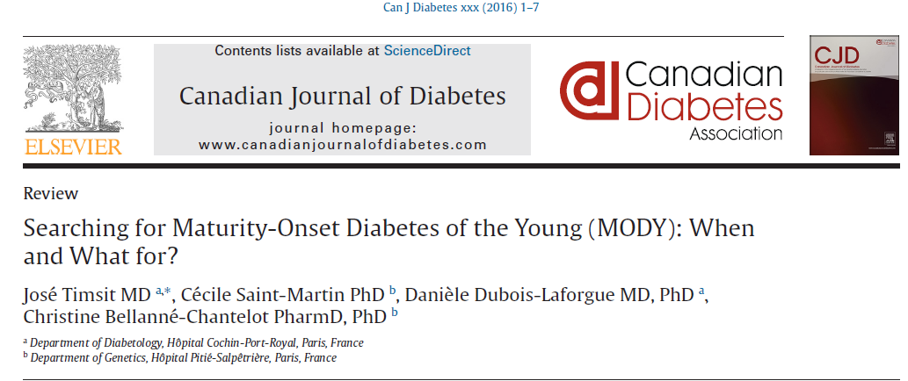
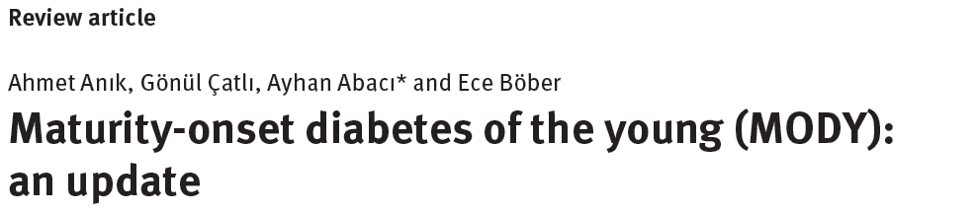
Diabetes, Maturity Onset in the Young (MODY)

Slide 6
Maturity-onset diabetes of the young (MODY) was first defined clinically as nonketotic, non-insulin-dependent diabetes mellitus of early onset, with autosomal dominant inheritance
The prevalence of MODY has been estimated to be 1-5%
In all studies, GCK-MODY and HNF1A-MODY are the most common subtypes

Slide 7
6.5% of children with antibody-negative diabetes have a form of MODY
single gene mutation that leads to a defect in beta cell insulin secretion in response to glucose stimulation
have strong family histories of diabetes spanning at least 3 generations

Slide 8
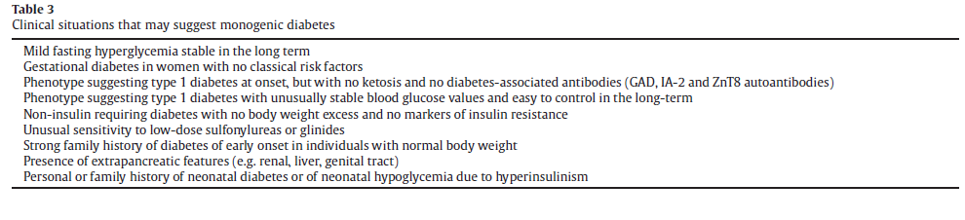

Slide 9
What are the differences between MODY and type 1 , 2 DM ?

Slide 10
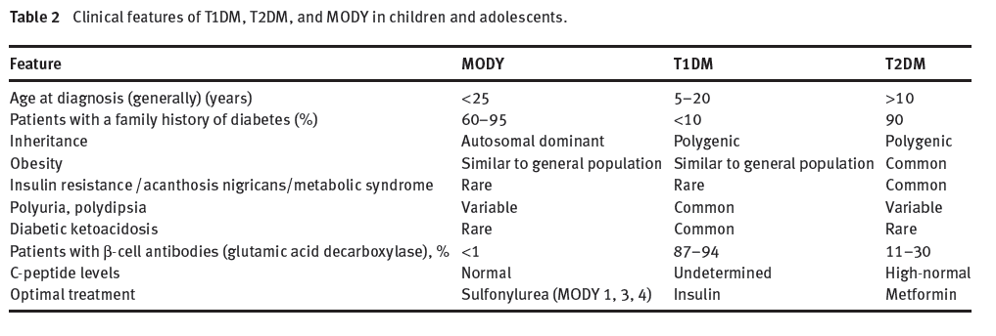

Slide 11
MODYs subtypes?

Slide 12
 | prevalence | Age at onset of diabetes | Hyperglycemia | Circumstances of diagnosis | OGTT
HNF4A (MODY 1) | 5% - 10% | Usually postpubertal, mean age 30 years | Variable postprandial increases with time sensitivity to IS | macrosomia and transient neonatal hyperinsulinism(hypoglycemia) | large increase (90 mg/dl)
GCK (MODY 2) | 30% - 60% | Very early but may be discovered in adults | Mild fasting hyperglycemia long-term stability | Screening gestational diabetes | mild increases (54 mg/dl)
HNF1A (MODY 3) | 30% - 60% | Usually postpubertal, mean age 20 years | Variable postprandial increases with time sensitivity to IS | Screening gestational diabetes | large increase (90 mg/dl)
HNF1B (MODY 5) | less than 5% | Highly variable | Variable increases with time | Association of diabetes and renal abnormalities | _

Slide 13
 | Clinical Features | Lab data | complication
HNF4A (MODY 1) | -Macrosomia - transient hyperinsulinaemic Hypoglycaemia - familial hyperlipidaemia, | Decreased HDL-C levels | prone to microvascular complications
GCK (MODY 2) | -Mild insulin deficiency -Low birth weight infants -Neonatal Diabetes | Mild hyperglycemia | low risk of microvascular (and possibly macrovascular)
HNF1A (MODY 3) | -Pancreatic exocrine failure -glycosuria | Elevated HDL-C Lower HsCRP levels | high risk of microvascular and macrovascular
HNF1B (MODY 5) | -Congenital anomalies of urinary and genital tracts - Agenesis of pancreatic tail and body -juvenile gout -primary hyperparathyroidism | Hypomagnesemia Hyperuricemia Abnormal liver enzyme | Microvascular complications

Slide 14
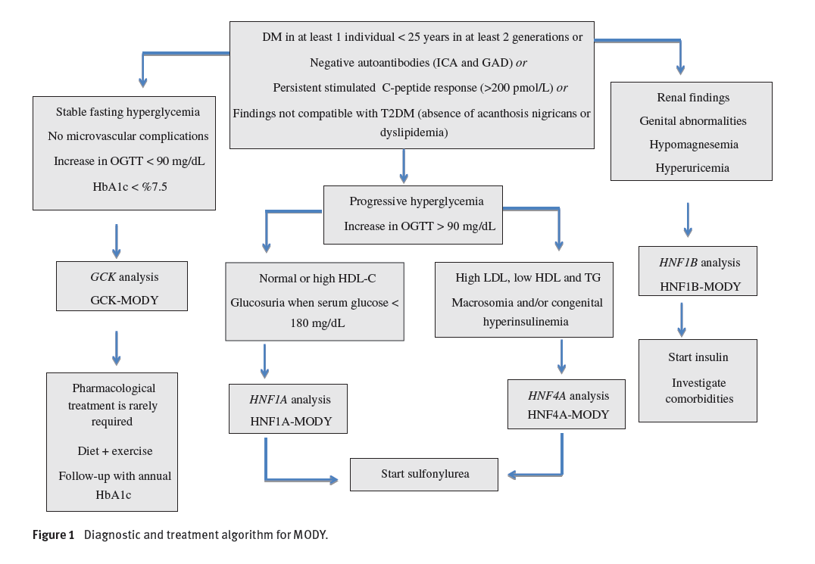

Slide 15
Indications for genetic testing ?

Slide 16
Indications for genetic testing include:
Strong FH of DM presenting in the second to fifth decade of life
Leanness
Autoantibody negative
Features inconsistent with DM1 or DM2 such as:
  Low renal threshold
  A large increase in blood sugar in OGTT
  Lower than expected CRP levels
Lower than expected HDL-C
High insulin sensitivity; although insulin resistance in a small number of MODY
Children diagnosed with DM1 with antibody-negative
Elevated C peptide levels

Slide 17
What are the Benefits of Diagnosing MODY?
The diagnosis of monogenic diabetes has many consequences in terms of prognosis, therapeutics and family screening

Slide 18
Patients with GCK-MODY may be misdiagnosed as having type 1 or 2 DM and may receive unnecessary treatments (oral agents or even insulin)
They should be reassured about the stability of hyperglycemia and the low risk for vascular complications
Their followups may be less stringent
Family screening is easy, on the basis of increased fasting blood glucose or A1C levels . It may be particularly useful in women of child-bearing age
Good prognosis

Slide 19
In patients with HNF1A-MODY or HNF4A-MODY :
- Switching from an unnecessary insulin therapy to oral treatment with sulfonylureas or glinides, even long after the onset of diabetes
- Careful followup is necessary because insulin secretion decreases with time
- Encourage to maintain normal body weights because obesity may accelerate the onset of diabetes
- Identifying siblings who carry the mutation is mandatory to prevent the insidious onset of vascular complications and, in women, to avoid unrecognized hyperglycemia in the early stages of pregnancy

Slide 20
Patients with HNF1B-MODY should be systematically evaluated for damage to other organs
because of the progression of insulin secretion defects and of renal disease, insulin therapy is needed

Slide 21
Treatment
Treatment of the hyperglycemia in GCK is generally unnecessary except during pregnancy ( ins to prevent excess fetal growth,50%, if the fetus does not carry the MODY gene )
Sulfonylureas have been shown to be effective in treating HNF1A
Similar response to sulfonylureas has been reported in HNF4A
HNF1B do not generally respond to sulfonylureas and typically require insulin early

Slide 22
Complication

Slide 23
Some patients with HNF-related MODY are at increased risk for developing tumours.
Patients with HNF1A-MODY have a 5% to 10% risk for liver adenomatosis
This risk deserves screening by liver ultrasound and avoidance of estrogen-containing contraceptives because they may favour the development of liver adenomas.

Slide 24
In patients with HNF1B-MODY, a biallelic inactivation of HNF1B has been reported in chromophobe renal carcinomas
HNF1B may also be a suppressor gene for some ovarian cancers.

Slide 25
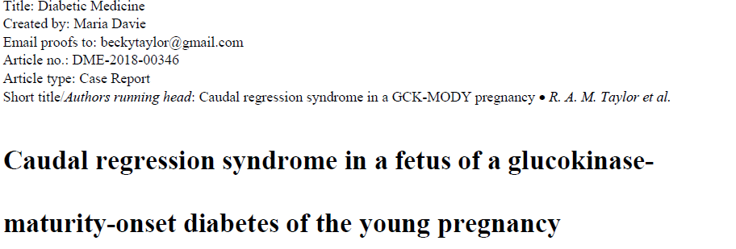

Slide 26
A 35-year-old woman, G3P1
Her first pregnancy in 2005 resulted in an early miscarriage.
Her second pregnancy in 2014 was complicated by GDM diagnosed at 13 weeks’ gestation and managed with a multiple daily insulin regimen from 20 weeks. Her pre-pregnancy weight was 52 kg (BMI 21.4 kg/m2) and gestational weight gain was 13 kg. Following induction of labour at 38+2 weeks’ gestation she had a vaginal delivery of a healthy girl weighing 3200 g.
She did not attend a postnatal 75-g oral glucose tolerance test (OGTT).

Slide 27
The couple were non-consanguineous.
There was a family history of impaired glucose tolerance affecting her sister and brother. Another sister had GDM in both her pregnancies and her father was treated for Type 2 diabetes mellitus. There was no family history of significant congenital malformations.

Slide 28
In the woman's recent pregnancy (2015) she was diagnosed with GDM at 13 weeks’ gestation on a 75-g OGTT
The woman's pre-pregnancy weight was 56 kg (BMI 23.0 kg/m2). HbA1c at 14 weeks’ was 41 mmol/mol (5.9%). At 18 weeks she was commenced on insulin and metformin.
Ultrasonography at 12+6 weeks’ gestation detected no abnormality
A routine morphology scan at 19+2 weeks’ gestation showed absence of the sacral vertebrae and abnormalities of the lumbar vertebrae at L4/L5, consistent with a Type III sacral agenesis.

Slide 29
A fetal MRI confirmed absence of the sacrum and coccyx and attenuation of the lower lumbar vertebrae. The spinal canal terminated abruptly at L4, suggestive of caudal regression syndrome.
After multidisciplinary team consultation, the family elected to terminate the pregnancy.
Postpartum fasting blood glucose was 6.7 mmol/l and HbA1c was 43 mmol/mol (6.1%), consistent with abnormal glucose tolerance but not diagnostic of diabetes.

Slide 30
A 75-g OGTT was then performed at 3 months postpartum. The elevated fasting glucose and low increment (fasting blood glucose 7.4 mmol/l, 1-h blood glucose 9.3 mmol/l, 2-h blood glucose 7.3 mmol/l) were strongly suggestive of a diagnosis of GCK-MODY, especially given her normal BMI and family history. Type 1 diabetes mellitus antibodies were negative.

Slide 31
The woman was counselled about the implications of the diagnosis for diabetes management in future pregnancies, including a 50% risk of offspring inheriting this mutation.
Mutation analysis of the GCK gene identified a novel heterozygous GCK missense mutation,
Sacral agenesis is a rare form of developmental sacral abnormality(subtype of caudal regression syndrome)

Slide 32
Caudal regression syndrome is a cardinal feature of diabetic embryopathy. The relative risk of caudal regression syndrome in infants born to mothers with pre-GDM is 170–200 times higher than in the general population
Sacral agenesis is a rare form of sacral abnormality affecting 0.005% to 0.1% of pregnancies. It is a subtype of the caudal regression sequence, a cardinal feature of diabetic embryopathy.
It is not thought to be strongly associated with major abnormalities, but with insufficient data and relatively low numbers of pregnancies in women with GCK-MODY

Slide 33
In contrast to the well established link between glycaemic control in pre-GDM and congenital abnormalities, it is unclear whether a similar association exists with the mild hyperglycaemia seen in GCK-MODY
However, the risk increase was minimal at the HbA1c levels typically seen in GCK-MODY of 38–56 mmol/mol (5.6–7.3%),

Slide 34
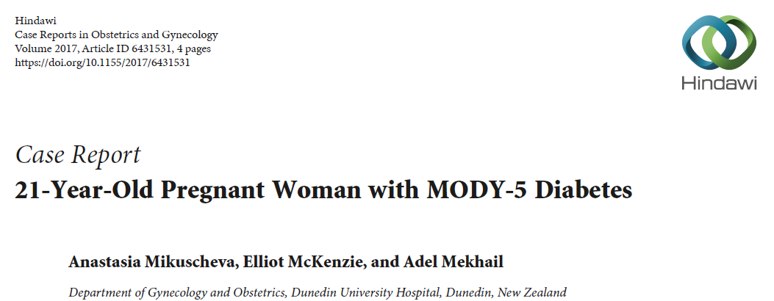

Slide 35
Miss A. was a 21-year-old fit and well woman without a prior documented significant medical or surgical history, who was referred to our antenatal clinic by her midwife because a bicornuate uterus was discovered
An HbA1C, routinely done in New Zealand for diabetes screening, was mildly elevated at 41mmol/mol(5.9 %).
She had persistent hyperglycemia and investigations to exclude type I diabetes were performed. The anti-GAD antibodies and Islet Cell Cytoplasmic autoantibodies came back negative.

Slide 36
normal renal ultrasound
a right multicystic dysplastic kidney in the fetus with no other abnormality
A repeat anatomy scan at 28 weeks showed a shrinking right kidney from 4 cm to 2.5 cm as well as a prominent in size and slightly echogenic left kidney
hyperuricemia (0.37mmol/L)
hypomagnesaemia

Slide 37
At 21 weeks when Miss A. was hospitalized for an unprovoked episode of a minor antepartum hemorrhage, MODY-5 was suspected for the first time given her unexplained early onset diabetes and uterine malformation.
The patient’s family history is strongly positive for diabetes and renal cysts have been diagnosed in her maternal cousin and her child.

Slide 38
Due to the diabetes diagnosis growth scans of the female fetus were performed every 4 weeks.
The fetus remained in breech position during the course of the pregnancy.
At 29 + 5 weeks = a polyhydramnios of 31 cm
At 32 weeks = threatened preterm labor and was started on Betamethasone intramuscularly for lung maturation and Nifedipine orally for tocolysis.
discharged after 48 hours.

Slide 39
At this point the baby was on the 96th centile of the Australasian Society of Ultrasound in Medicine ASUM charting for growth with an estimated fetal weight of 2.34kg.
The amniotic fluid index had reduced to 21.
She represented after 5 days with premature prelabor rupture of membranes and went into spontaneous labor and the baby was delivered vaginally from breech position.

Slide 40
The baby girl was born alive, and a birth weight of 2105 g. The physical examination was normal.
However, at one week postpartum a neonatal ultrasound scan confirmed an absent right kidney and the presence of a bicornuate uterus
Genetic testing was arranged and showed a heterozygous deletion of the HNF1B gene.

Slide 41
We suggest that genetic testing should be offered to young female patients with uterine abnormalities and otherwise unexplained diabetes even in the absence of kidney abnormalities on imaging if kidney impairment is present on laboratory functions.

Slide 42
The optimal care for pregnant patients with MODY-5 due to HNF1B mutations is multidisciplinary and involves obstetricians, endocrinologists, geneticists, nephrologists, and pediatricians.
Despite the more common association of MODY-5 with renal malformation we think that genetic testing is also warranted in cases where genital malformations are diagnosed and renal impairment is only present on laboratory testing.

Slide 43
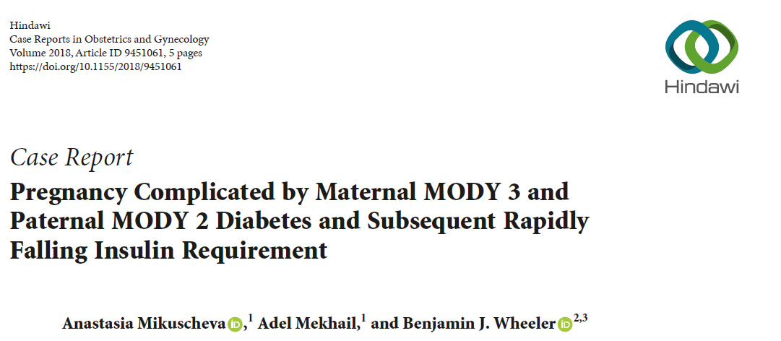

Slide 44
Miss S, a 19-year-old woman, presented to antenatal clinic at 19 weeks gestation for a first consultation because of a preexisting hepatocyte nuclear factor 𝛼 (HNF-1𝛼) mutation causing MODY 3 diabetes
Since age of 11 years when her condition first became apparent through recurrent mucosal candidiasis and mild postprandial hyperglycaemia. Due to a strong family history of diabetes and negative testing for type I diabetes, an HNF1𝛼 gene mutation was suspected and subsequently confirmed on molecular genetic testing.

Slide 45
The patient was initially successfully treated with the sulfonylurea (SU) gliclazide, which more recently was switched to insulin due to increasing hyperglycaemia.
The father of the fetus is a 21-year-old man also well
known to endocrinology and diabetes teams from age of 9 years, due to persistent mild hyperglycaemia and very significant family history of diabetes (Figure 2). Genetic testing for a Glucokinase (GCK) mutation was performed
asymptomatic and did not require any further treatment

Slide 46
She was managed with insulin glargine (Lantus) daily and insulin aspart (Novorapid) with meals, and insulin requirements gently increased over the pregnancy,
From 28 weeks, doses were further reduced, until she presented to the emergency department at 33+3 weeks of gestation for frequent hypoglycaemia.
The patient never developed hypertension, and laboratory screening for preeclampsia was performed multiple times and was always within normal limits.

Slide 47
Fetal growth until this presentation had been measured by fortnightly ultrasound and was on the 50th centile
Given the unknown significance of the falling insulin requirements, biweekly monitoring of fetal wellbeing via Doppler measurements was commenced, which was satisfactory at all times.
At 34+3 weeks of gestation the patient went into spontaneous labour and delivered a healthy baby girl via forceps, weight 2.22kg

Slide 48
Postnatal genetic testing in the baby showed a heterozygous mutation for the maternal familial likely nonpathogenic HNF1A gene variant

Slide 49
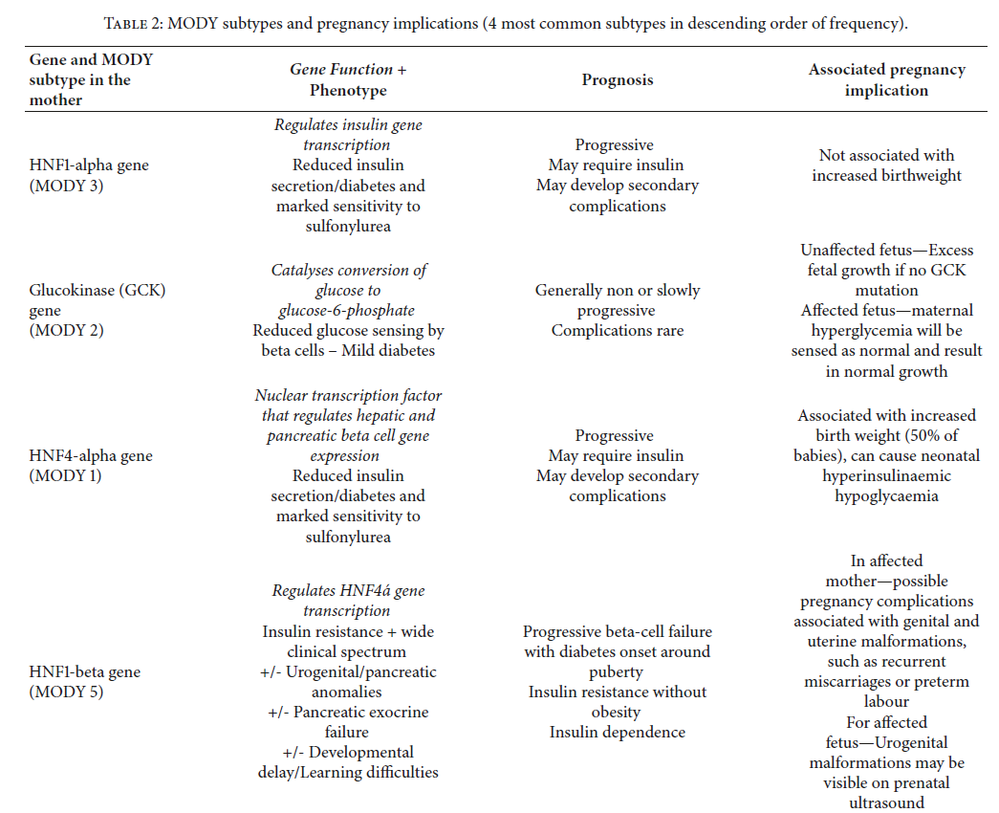

Slide 50
In a pregnancy where the mother is affected by MODY 2 the fetus will not inherit the GCK mutation in 50% of cases, and will respond to maternal hyperglycaemia by excess insulin production and therefore excess growth (by approximately 550–700g) [2]. Alternatively, if the fetus does inherit the GCK abnormality it will sense the maternal hyperglycaemia as normal, produce normal amounts of insulin, and have normal growth

Slide 51
Where mother and fetus are both affected by MODY 2, a fetus with MODY 2 to a mother with MODY 3 would be able to tolerate maternal hyperglycaemia better than a fetus with no MODY.

