Slide 1
In The Name Of GOD

Slide 2
bilateral adrenal hyperplasia and subclinical hypercortisolism
Soheila sadeghi

Slide 3
what’s the diagnosis?
Are there any aberrant hormone receptors in this patient?
Does the patient need to a surgery?
Will we do in her follow up?

Slide 4
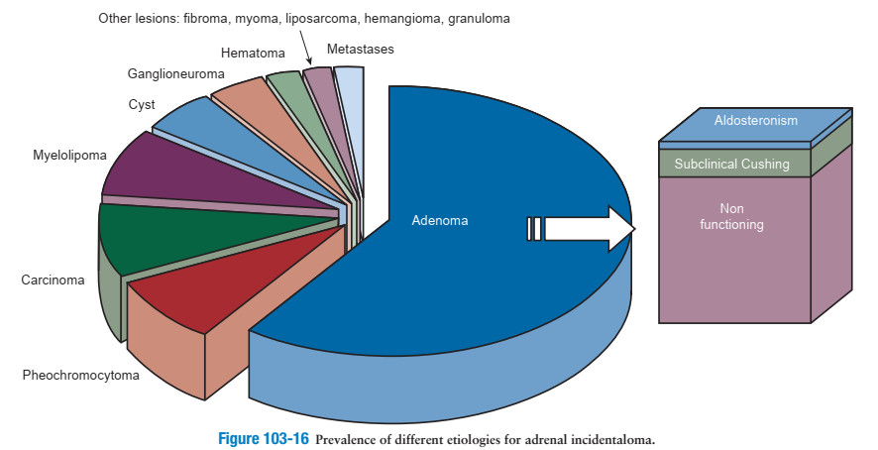
ENDOCRINOLOGY: ADULT AND PEDIATRIC (vol 2-chap 103) J. Larry Jameson Leslie J. De Groot

Slide 5
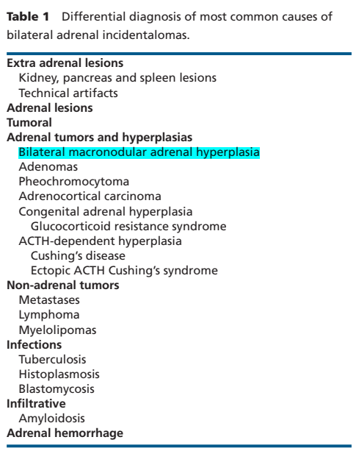
European Journal of Endocrinology (2018)
Advances in imaging techniques raised the prevalence of AI to 4.4% in radiological series compared to autopsy data (1–8.7%)
The prevalence is higher in patients with obesity, diabetes or hypertension and is increasing with age reaching 7–10% in individuals older than 70 years old
Although the majority of AIs are unilateral tumors bilateral AIs are found in up to 15% of cases
Thus, the prevalence of bilateral AI can be estimated to be 0.3–0.6% in the general population

Slide 6
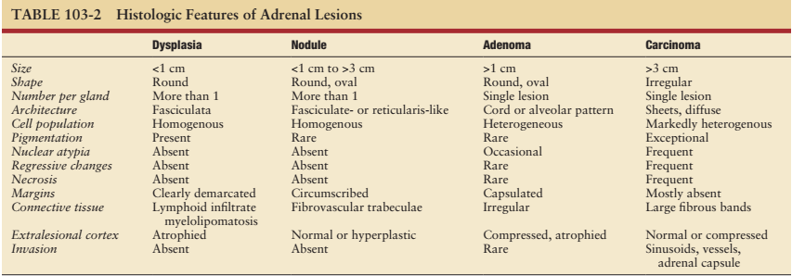
ENDOCRINOLOGY: ADULT AND PEDIATRIC (vol 2-chap 103) J. Larry Jameson Leslie J. De Groot

Slide 7
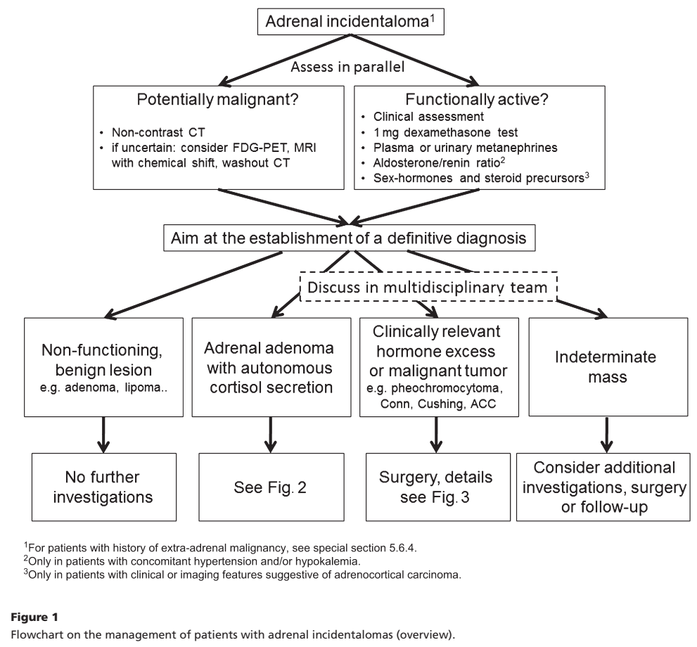
2016

Slide 8
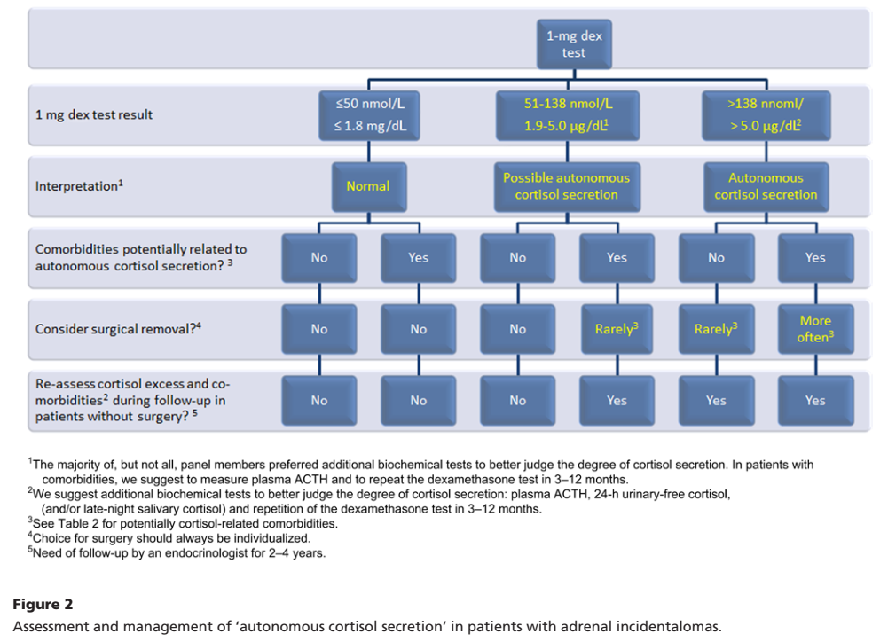
2016

Slide 9
Subclinical hypercortisolism (SH) : a pathologic condition defined as biochemical evidence of hypercortisolism in patients without typical signs or symptoms of Cushing syndrome
Diagnostic testing for subclinical hypercortisolism : - All patients with adrenal incidentalomas should undergo a 1-mg DST. - Cortisol suppression less than 1.8 mg/dL indicates a normal response, whereas values greater than 5 mg/dL define subclinical hypercortisolism. - For cortisol suppression between 1.8 and 5 mg/dL, additional tests include late-night salivary cortisol and DHEAS, whereas ACTH and UFC levels seem less helpful
Radiological diagnosis of adrenal incidentalomas - Adrenal incidentaloma definition refers to lesions that are larger than 1 cm in diameter. - CT should be used as a first-line imaging technique. - The region of interest for measurement of CT attenuation should include at least 75% of the lesion and precontrast Hounsfield Units (HU) ≤10 in a homogeneous mass define a lipid-rich adenoma. - Tumors with precontrast HU >10 should undergo CT scan with delayed contrast washout at 10 or 15 minutes to calculate absolute washout (AWO) and relative washout (RWO). - AWO greater than 60% and/or RWO greater than 40% suggest a benign adrenal mass

Slide 10
Interestingly, despite that the prevalence of SH is higher in patients with bilateral lesions versus unilateral adenomas, the prevalence of associated comorbidities is not different between these 2 conditions
Subjects with previous cardiovascular events, hypertension, and increasing cortisol levels after 1-mg DST over time showed a higher incidence of cardiovascular diseases.
Moreover, the higher the cortisol after 1-mg DST, the higher the mortality of patients with SH.
SH should be considered a cardiovascular risk factor

Slide 11
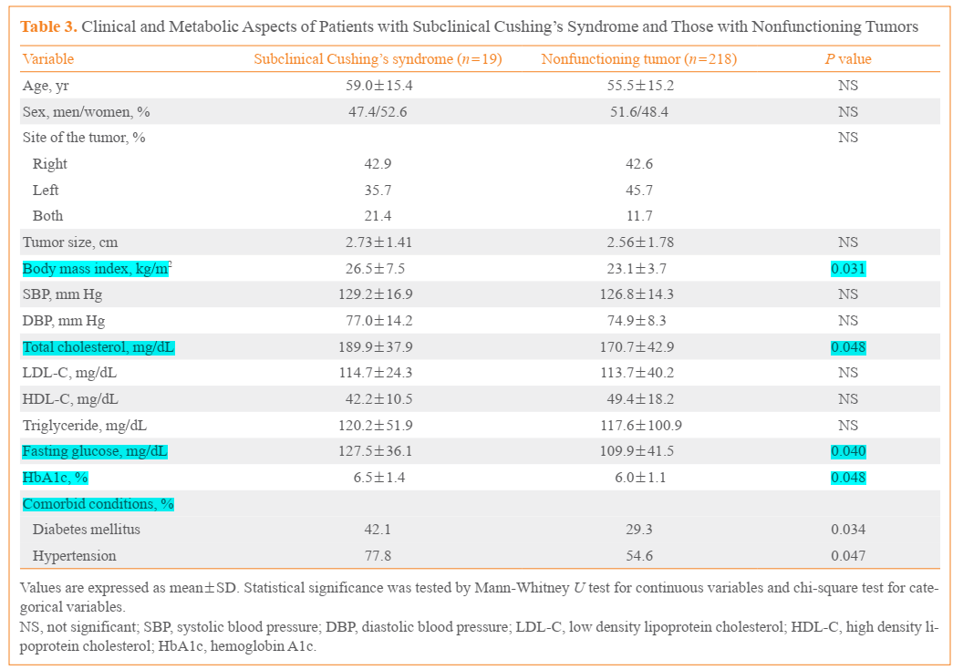
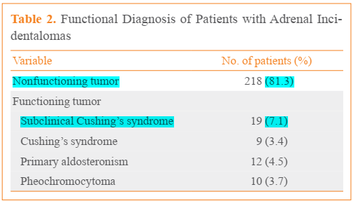
Endocrinal Metab 2014;29:457-463
retrospective study, 268 patients with adrenal incidentalomas discovered by CT
SCS : after (DST) ufc 24h higher than the reference range (75 to 270 µg/day), early-morning plasma ACTH (<10 pg/mL), lacked specific symptoms or signs of Cushing’s syndrome

Slide 12
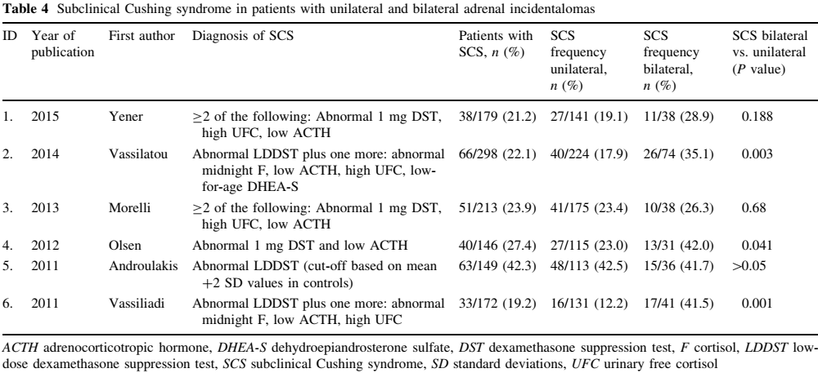

Slide 13
ENDOCRINOLOGY: ADULT AND PEDIATRIC (vol 2-chap 103) J. Larry Jameson Leslie J. De Groot

Slide 14
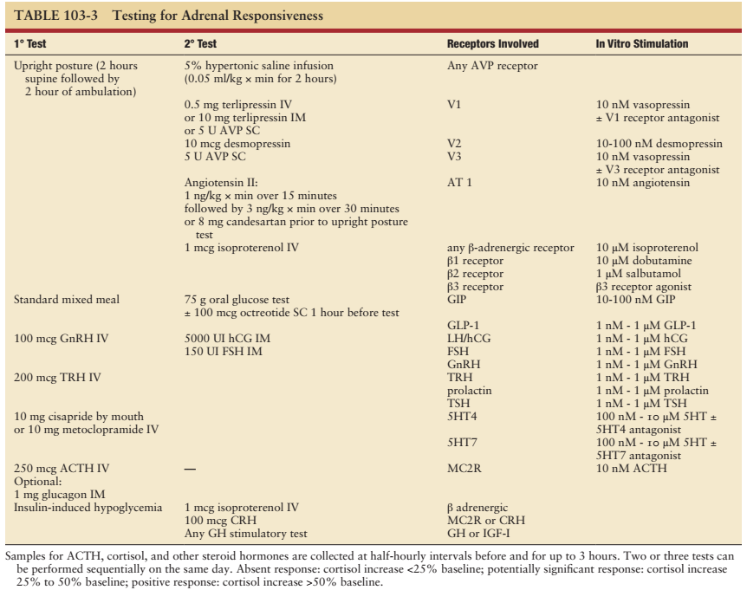
ENDOCRINOLOGY: ADULT AND PEDIATRIC (vol 2-chap 103) J. Larry Jameson Leslie J. De Groot

Slide 15
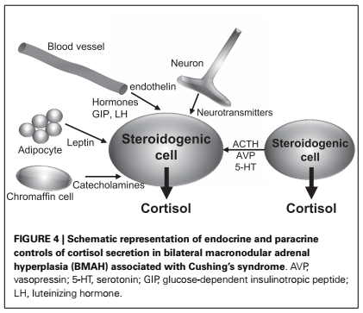

Slide 16
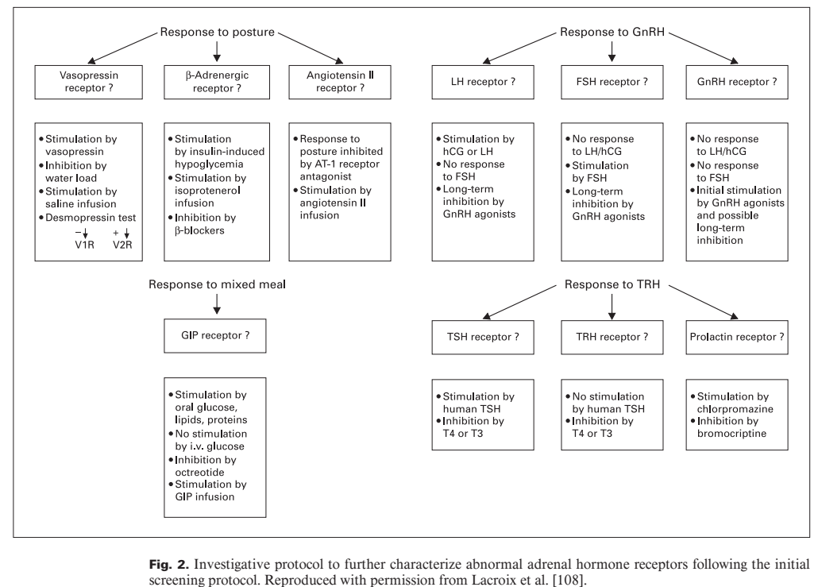

Slide 17
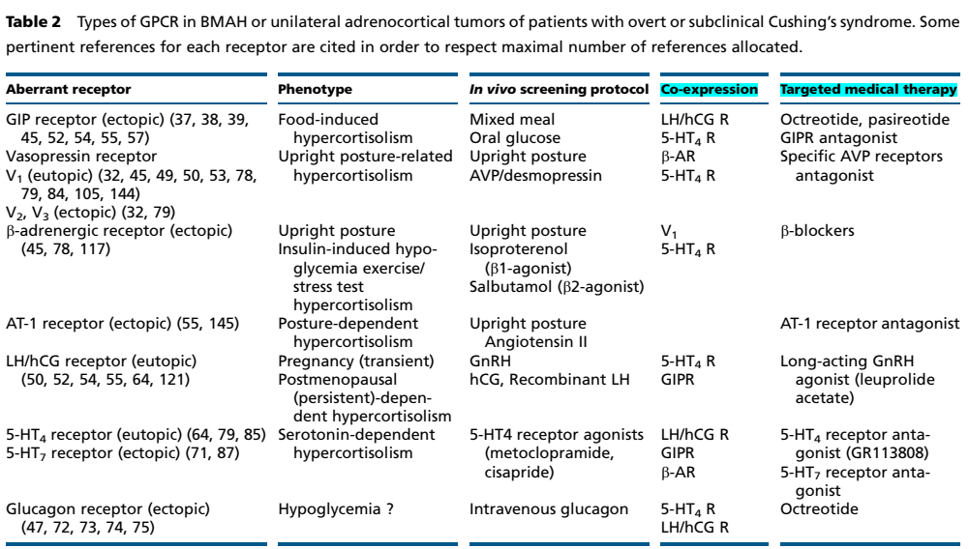
European Journal of Endocrinology (2015)

Slide 18
Six studies were included in the meta-analysis involving in total 1239 patients, 968 with UAI, and 271 with BAI
Patients with UAI had lower prevalence of SCS compared with those with BAI )RD :-0.13 (
The mass diameter of UAI did not differ from BAI (the size of the largest lesion)
Regarding the prevalence of clinical implications possibly related to cortisol hypersecretion such as obesity, diabetes, dyslipidemia and hypertension, the present meta analysis did not result in any differences between UAI and BAI
Furthermore, clinical manifestations of cortisol hypersecretion can vary and depend not only on the degree but also on the duration of hypersecretion, as well as the sensitivity of each individual to cortisol excess

Slide 19
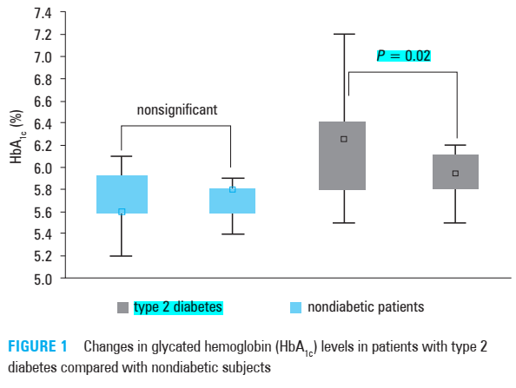
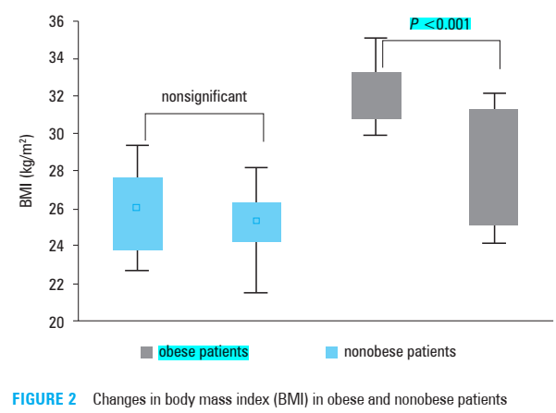
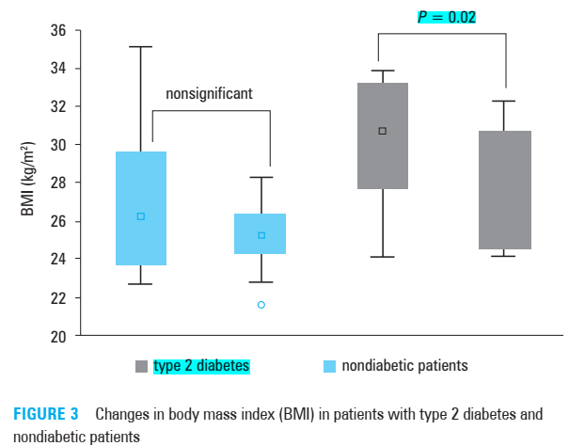
25 patients with bilateral benign adrenal tumors and subclinical hypercortisolemia
Unilateral adrenalectomy : in 24 patients

Slide 20
The concentrations of ACTH and cortisol after the dexamethasone suppression test returned to normal in 22 of 23 patients who underwent unilateral adrenalectomy
The improvement in the health status was pronounced only in patients who had the following additional indications for surgery: - poor control of blood pressure
- poor control of glycemia
- quick uncontrolled increase in body mass
A clinical improvement was achieved in 14 patients (58%)
Conclusion : although unilateral adrenalectomy allows to cure subclinical hypercortisolemia in patients with bilateral adrenal tumors, the improvement in the hormonal status does not lead to clinical improvement in all patients

Slide 21
European Journal of Endocrinology (2015)
Retrospective study, 33 patients with bilateral AI, 14 patients underwent unilateral adrenalectomy (group A), 19 patients were followed up (group B)
At baseline and at each follow-up visit
- measured 0800 h plasma ACTH, midnight serum cortisol (MSF), 24-h urinary-free cortisol (UFC) and serum cortisol following a standard 2-day low-dose-dexamethasone-suppression test (LDDST)
Evaluated the following comorbidities:
- arterial hypertension
- impaired glucose tolerance or DM
- dyslipidemia
- osteoporosis

Slide 22
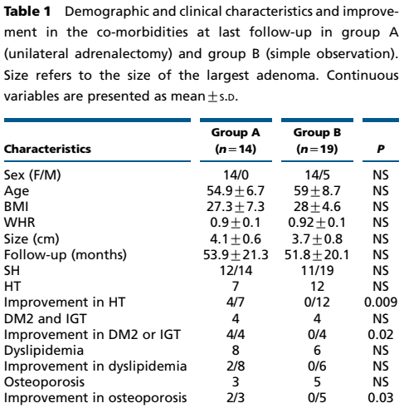
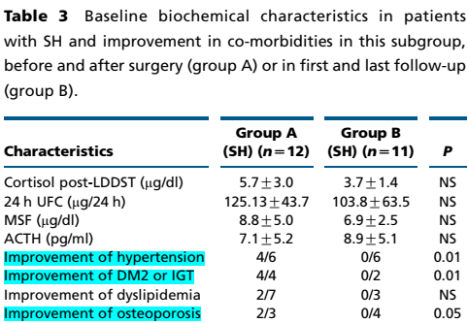
European Journal of Endocrinology (2015)

Slide 23
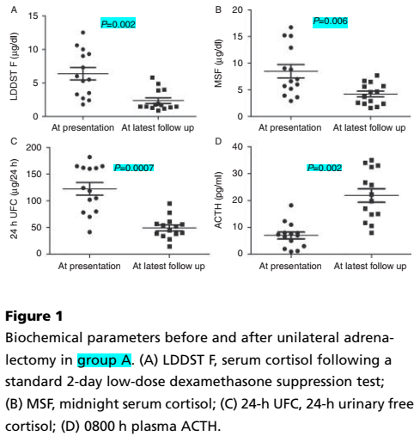
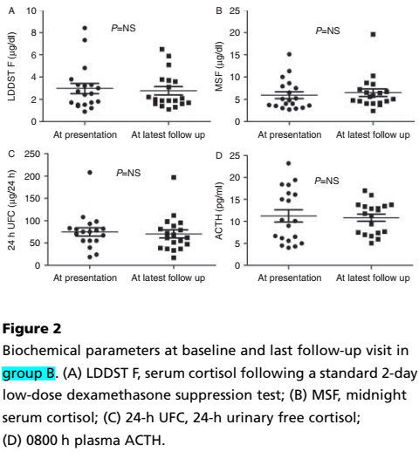
European Journal of Endocrinology (2015)

Slide 24
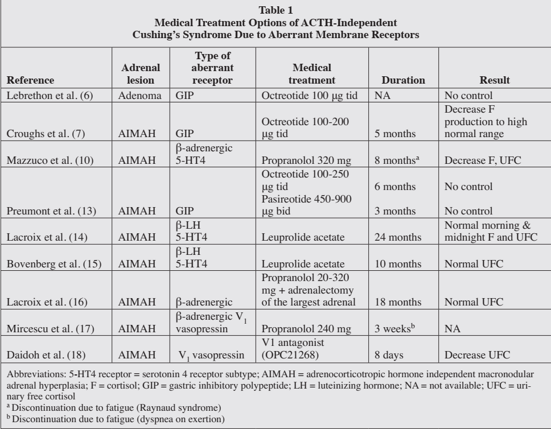

Slide 25
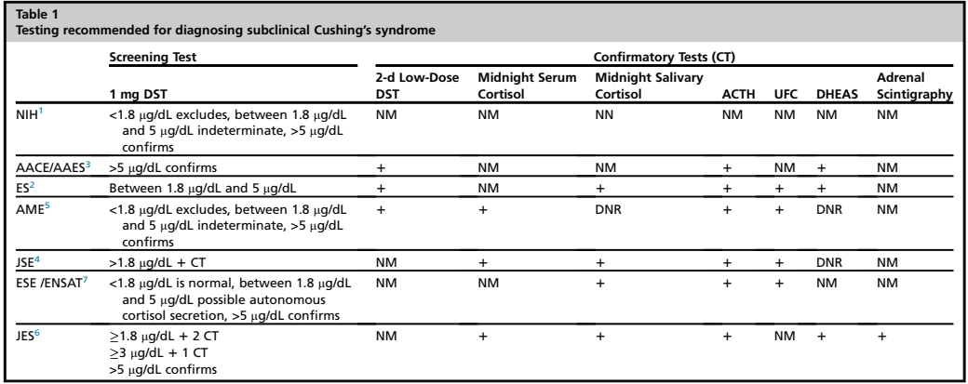
When to Intervene for Subclinical Cushing’s Syndrome (Surg Clin N Am 99 (2019))
SCS has been associated with significant morbidity, including hypertension, diabetes, hyperlipidemia, osteoporosis, and cardiovascular disease
A multidisciplinary approach between the endocrinologist and the endocrine surgeon should be used for management of SCS

Slide 26
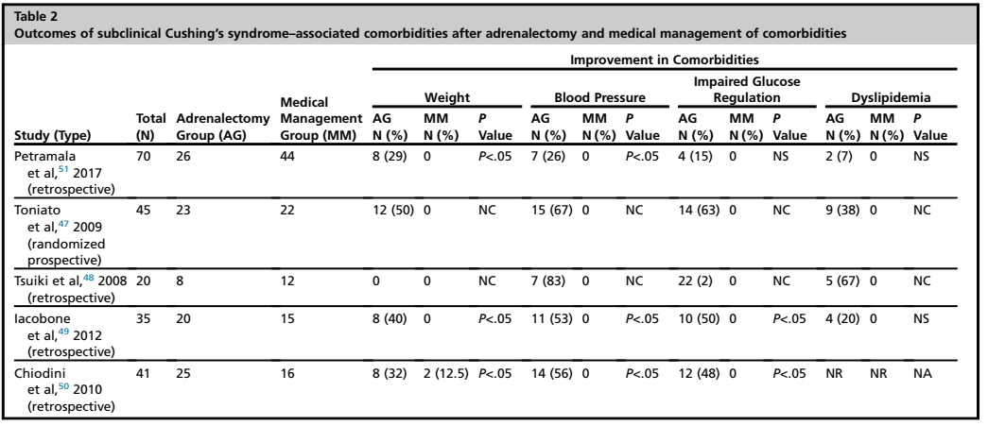
When to Intervene for Subclinical Cushing’s Syndrome (Surg Clin N Am 99 (2019))
progression of SCS to overt Cushing’s syndrome is rare, surgical consideration must be based on associated comorbidities, and size of adrenal mass, as well as its appearance on imaging
The AACE and AAES recommend adrenalectomy in SCS patients with worsening hypertension, abnormal glucose tolerance, dyslipidemia, and osteoporosis
For surgical candidates with a diagnosis of SCS, surgery is recommended for those with treatment-resistant or worsening comorbidities associated with cortisol excess: hypertension, obesity, diabetes, dyslipidemia, and a decrease in BMD

Slide 27
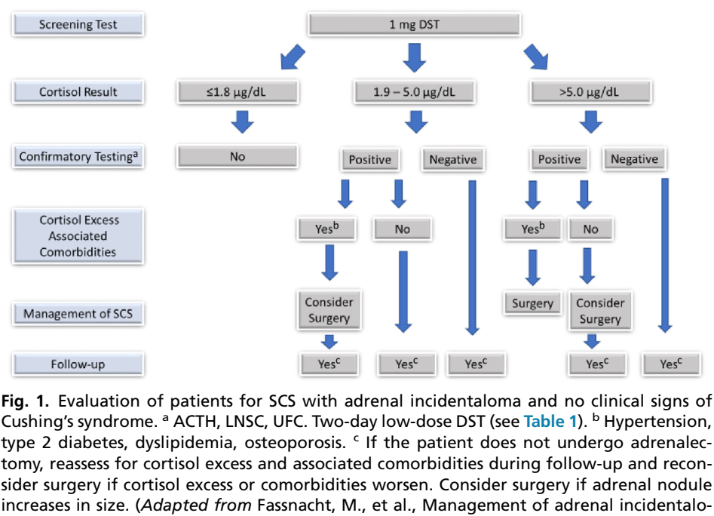
When to Intervene for Subclinical Cushing’s Syndrome (Surg Clin N Am 99 (2019))

