Slide 1
In The Name of God
Primary Aldosteronism
Salma Ahi, MD
Fellow of Endocrinology
Research Institute of Endocrine Sciences
2013 october

Slide 2
Clinical questions:
why is PA important ?
who should be screened for PA?
How to perform screening and confirmatory tests?
How to Lateralize the lesion without access to AVS?
Outcome after treatment of PA

Slide 3
Background
Why is PA important?
This condition is important not only because of its
prevalence, but also because PA patients have higher
cardiovascular morbidity and mortality than age- and
sex-matched patients with essential hypertension and
the same degree of blood pressure elevation.
Furthermore, specific treatments are available that
ameliorate the impact of this condition on patient-important outcomes.

Slide 4
A 38 yrs old female referred to our center for evaluation of resistant HTN & hypokalemia
She was hypertensive for the past 8 months under the care of a cardiologist
Her medications included Losartan (50 mg/d), Aldactone (25 mg/d), Metoprolol (100 mg/d) and Hydrochlorothiazide (25 mg/d)

Slide 5
PMH: HTN
Claims that his BP levels were almost always in the range of 150-160/90-100 mmHg
Not smoker
negtive history for use of herbal medications

Slide 6
BP=160/110 mmHg
Eyes; Heart; Lungs: Unremarkable
Muscle force: 3/5 +4/5
Serum potassium level was 3.1 meq/L
Retrospective search in her lab data revealed a serum potassium level of 2.8 meq/L in about one months ago; she was unaware about this matter and had not been treated for hypokalemia at that time

Slide 7
Hospital Course:
She was treated with oral and IV potassium
Her antihypertensive drugs changed to Diltiazem (60 mg twice daily) and Prazosin (4.5 mg daily)
Symptoms improved within 48 h
BP was 140-155/80 mmHg and serum potassium level became normal (4 meq/L)

Slide 8
Lab Data:
Hb=14.5
Cr=0.9 (GFR=87), Na=140, Mg=1.8, Ca=8.8, P=2.5
K: 2.9 3.1 4
PH=7.43, HCO3=29, Pco2=45
U/A: SG=1015; Pr (-); RBC=8-10
FBS=90, TG=171, Chol=168
LFT: Nl
TFT: Nl (on LT4 Tx)

Slide 9
Other Paraclinical Data:
EKG: NSR; Nl axis; No significant ST-T change
Echocardiography: EF=60%; Mild LVH
Mild MR & AI
Urinary tract sonography & Doppler exam.:
Normal sized kidneys
Nl renal arteries

Slide 10
Case Detection:
WHO?
JNC stage 2 and 3 HTN (8% and 13%)
Resistant HTN (17-23%)
HTN and spontaneous or diuretic-induced hypokalemia (?)
HTN and adrenal incidentaloma (1.1-10%)
5) HTN and a family history of early-onset HTN or CVA at a young age(<40ys)
all hypertensive first-degree relatives of patients
with PA.

Slide 12
Case Detection:
HOW?
ARR (plasma aldosterone-renin ratio)
Medications with minimal effects on plasma aldosterone levels:
Non-dihydropyridine Ca channel blockers (Verapamil)
Vasodilators (Hydralazine)
Alpha-adrenergic blockers
(Prazosin, Doxazosin, Terazosin)

Slide 13
Measurement of the aldosterone-renin ratio: a suggested approach
Preparation for aldosterone-renin ratio (ARR) measurement:
1.Attempt to correct hypokalemia, after measuring plasma potassium in blood collected slowly with a syringe and needle [preferably not a Vacutainer to minimize the risk of spuriously raising potassium],
Avoiding fist clenching during collection,
Waiting at least 5 seconds after tourniquet release to achieve insertion of needle, and
Ensuring separation of plasma from cells within 30 minutes of collection.

Slide 14
2. Encourage patient to liberalize sodium intake.
3. Withdraw agents that markedly affect the ARR for at least 4 weeks:
. Spironolactone, eplerenone, amiloride, and triamterene
. Potassium-wasting diuretics
. Products derived from liquorice root (e.g., confectionary licorice, chewing tobacco)

Slide 15
4. If the results of ARR off the above agents are not diagnostic, withdraw other medications that may affect the ARR for at least 2 weeks:
Beta-adrenergic blockers,
central alpha-2 agonists (e.g., clonidine, alpha-methyldopa),
NSAID drugs
Angiotensin-converting enzyme inhibitors, angiotensin receptor blockers renin inhibitors
Dihydropyridine calcium channel antagonists

Slide 16
5. If necessary to maintain hypertension control, commence other antihypertensive medications that have lesser effects on the ARR (e.g., verapamil slow-release, hydralazine [with verapamil slow-release, to avoid reflex tachycardia],prazosin, doxazosin, terazosin;

Slide 17
6. Establish oral contraceptive (OC) and hormone replacement therapy (HRT) status, as estrogen-containing medications may lower direct renin concentration (DRC) and cause false positive ARR when DRC (rather than plasma renin activity) is measured.
Do not withdraw OC unless confident of alternative effective contraception.

Slide 18
Conditions for collection of blood
1. Collect blood mid-morning, after the patient has been up (sitting, standing, or walking) for at least 2 hours and
seated for 5-15 minutes.
2. Collect blood carefully, avoiding stasis and hemolysis.
3. Maintain sample at room temperature
(and not on ice, as this will promote conversion of inactive to active renin).

Slide 19
Factors to take into account when interpreting results
Age: in patients aged >65 years, renin can be lowered more than aldosterone by age alone, leading to a raised ARR
Time of day, recent diet, posture, and length of time in that posture
Medications
Method of blood collection, including any difficulty doing so
Level of potassium
Level of creatinine (renal failure can lead to false positive ARR)

Slide 20
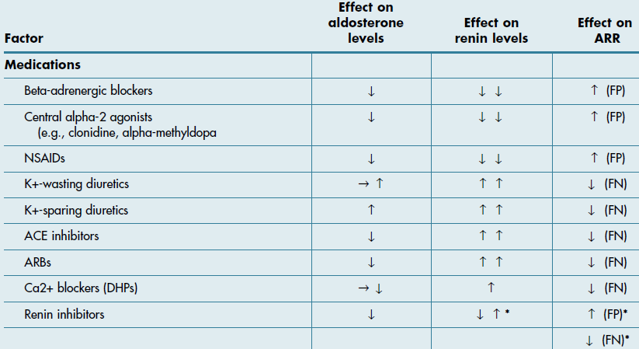
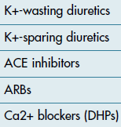
Factors that may lead to false-negative or false-positive ARR results:

Slide 21
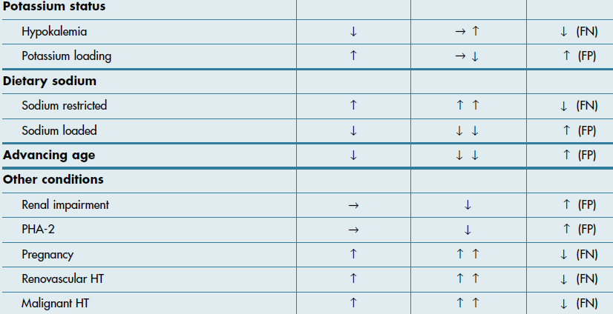
Factors that may lead to false-negative or false-positive ARR results:

Slide 22
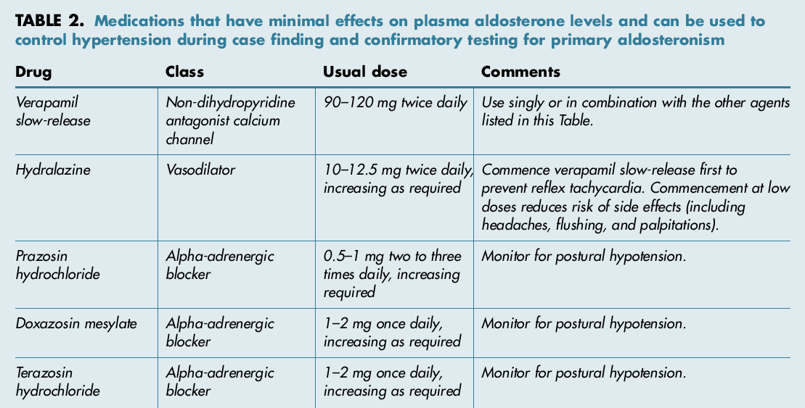

Slide 23
ARR cut-off values:

Slide 24
Our Case:
Two months after change of his medications:
PAC=40 ng/dL
PRA<0.01 ng/mL/h
ARR>4000

Slide 25
Case Confirmation:
Four testing procedures: (No gold standard)
Oral sodium loading test
Saline infusion test (SIT)
Fludrocortisone suppression test
Captopril challenge test
*Choice: cost, compliance, lab routine,
local expertise

Slide 26
SIT:
Lack powerful study designs for establishing the test accuracy
Sensitivity: 83-88%
Specificity: 75-100%

Slide 27
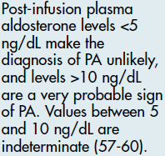
SIT:

Slide 28
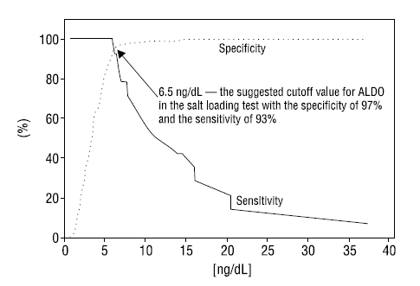
Sensitivity and Specificity of Salt Loading Test:

Slide 29
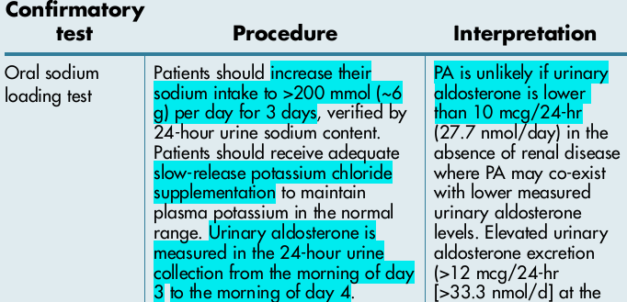
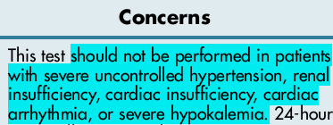

Slide 30
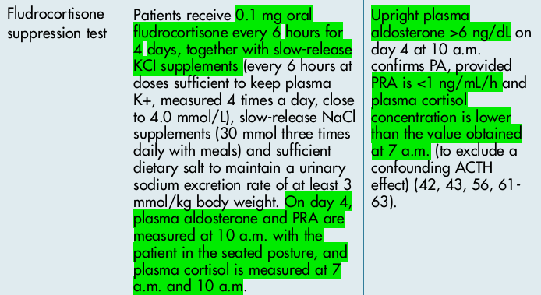
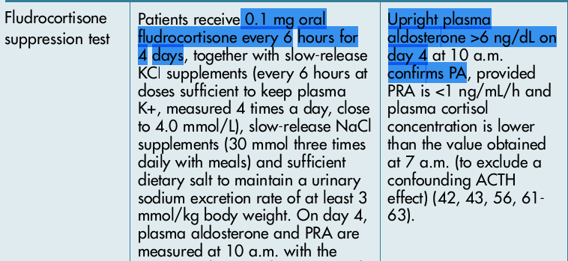

Slide 31
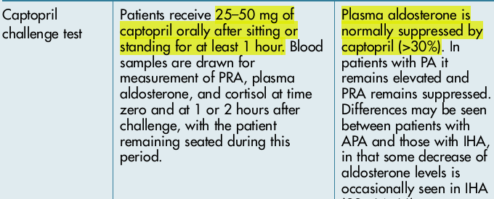

Slide 32
Our Case:
SIT:
Start End
PAC (ng/dL) 30.2 41.7
PRA (ng/mL/h) 0.01 0.01
Cortisol (micg/dL) 20 8.7
Potassium (mg/dL) 4 3.3
PAC/Cortisol 1.51 4.8

Slide 33
Subtype Classification:
Adrenal CT scan
Adrenal venous sampling (AVS):
If surgical treatment is practicable and desired by the patient
To distinguish between unilateral and bilateral adrenal disease
Ancillary tests

Slide 34
Adrenal CT Scan:
APA: usually < 2 cm, hypodense nodule
IHA: normal-appearing or unilateral or bilateral nodular changes
Aldosterone-producing adrenal carcinomas:
almost always > 4 cm and with suspicious imaging phenotype
Sensitivity: 48-58%; Specificity: 90%
Several Limitations especially in older patients (>40 yr), thus:
AVS is essential to direct appropriate therapy

Slide 35
Our Case:
Adrenal CT scan:
A 10 mm mass with soft tissue density in lateral limb of left adrenal

Slide 36
Unsuccessful or unavailable AVS:
Repeat AVS
Treat with MR antagonist
Consider surgery based on the other studies:
Adrenal CT Scan
Posture Stimulation Test
Morning Recumbent 18-OHB levels
Not available
Low accuracy

Slide 37
Posture Stimulation Test:
The absence of the significant increase (<30%) of PAC at the upright posture supports the diagnosis of APA
Test accuracy: 85%
Fontes RG, Am J Hypertens 1991;4:786-91
Young WF, Endocrinol Metab Clin North Am 1988;17:367-95
The fall in PAC during 4 h erect posture has PPV of 100% for diagnosis of unilateral lesion
Espiner EA, J Clin Endocrinol Metab 2003;88:3637-44

Slide 38
18-Hydroxycorticosterone levels
Patients with APA generally have recumbent plasma 18-OHB levels greater than 100ng/dL at 8:00 a.m.,
whereas patients with IHA have levels that are usually less than 100 ng/Dl.
However, this test lacks the accuracy needed to guide the clinician in the subtype evaluation of PA

Slide 39
Iodocholesterol scintigraphy
Because tracer uptake was poor in adenomas smaller than 1.5 cm in diameter,
this method often is not helpful in interpreting
micronodular findings obtained with high-resolution CT and rarely plays a role in subtype evaluation.Currently it is no longer used.

Slide 40
Our Case:
Posture Stimulation Test:
overnight recumbent 2 h ambulation
PAC (ng/dL) 39 47.8
PRA (ng/mL/h) 0.01 0.01
PAC increase: 8.8 ng/dL (22.5%)

Slide 41
Summary of Diagnostic Studies:
ARR > 4000 ng/dL per ng/mL/h
Post-infusion PAC= 41.7 ng/dL
Post-infusion PAC/Cortisol= 4.8 ng/dL per micg/dL (in favor of APA)
Positive posture stimulation test (in favor of APA)
An adenoma on CT scan

Slide 42
Diagnosis
Aldosterone-producing Adenoma

Slide 43
Ddx:GRA
In patients with
onset of confirmed PA earlier than at 20 years of age and
in those who have a family history of PA or of strokes at young age,
suggest genetic testing for GRA.

Slide 44
Management:
Recommendation of endocrine society guideline (2008):
Documented unilateral PA:
Unilateral laparoscopic adrenalectomy*
* No high quality evidence linking adrenalectomy with improved QoL, morbidity or mortality
* Because adrenalectomy can either eliminate the need for medication or reduce medication side effects (more cost-effective than lifelong medical therapy), is the preferred treatment

Slide 45
Outcome After Adrenalectomy:
Cure of HTN (<140/90 mmHg):
44% (95% CI:31-56%)
Improvement of BP control:
90-100%

Slide 46
Outcome After Adrenalectomy:
Predictors of complete resolution of HTN:
<=2 preoperative antihypertensive drugs**
<=1 first-degree relative with HTN**
Younger age
Shorter duration of HTN (< 6 years)
Lower BMI
Female sex
Higher preoperative ARR
Higher urinary aldosterone secretion
Positive preoperative response to Spironolactone
APA size of <= 20 mm

Slide 47
Outcome After Adrenalectomy:
Aldosteronoma Resolution Score (ARS):
4 preoperative variables: Score
Taking <=2 antihypertensive medications 2
BMI <=25 kg/m2 1
Duration of HTN <=6 years 1
Female sex 1
The greater the ARS, the greater the resolution of HTN after adrenalectomy (NPV=72.4% for ARS=0-1 and PPV=75% for ARS=4-5)

Slide 48
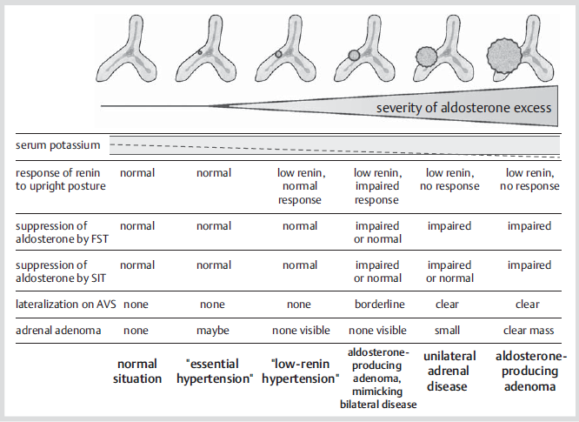

Slide 49
A Clinical Prediction Score to Diagnose Unilateral Primary Aldosteronism
A cross-sectional diagnostic study at a single center
Objective: Identification of patients` characteristics that can predict unilateral aldosterone hypersecretion hence bypass AVS before surgery
101 patients with PA
Main outcome measures: Variables independently associated with lateralized AVS

Slide 50
Results:
All 26 patients with a typical Conn`s adenoma plus serum potassium < 3.5 meq/L or eGFR of at least 100 ml/min/1.73m2 or both had unilateral PA
Sensitivity: 53% (CI:38-68)
Specificity: 100% (CI:91-100)
Kupers EM; J Clin Endocrinol Metab. 2012 Aug 23

