Slide 1
Nutrition and Diabetes
Dr. Azadeh Mottaghi
Assistant Professor of Nutrition
Institute of Endocrinology & Metabolism

Slide 2
Overview of Diabetes Mellitus
Diabetes mellitus is a group of metabolic diseases characterized by hyperglycemia resulting from defects in insulin secretion, insulin action, or both.
Hyperglycemia of diabetes is associated with long-term damage, dysfunction, and failure of various organs, especially the eyes, kidneys, nerves, heart, and blood vessels.

Slide 3
Overview of Diabetes Mellitus
Diabetes is divided into distinct types: type 1, type 2, gestational diabetes mellitus (GDM), and other types.
Type 2 diabetes (T2DM), composing 90% of diabetes cases, is affected by both genetic and environmental factors.

Slide 4
Overview of Diabetes Mellitus
Adiposity-associated inflammation and insulin resistance are strongly implicated in the development of T2DM as well as the metabolic syndrome.
Activation of nuclear transcription factor-B has been linked with a variety of inflammatory diseases, including diabetes.
Antioxidant spices, herbs, and omega-3 fatty acids help to suppress inflammatory pathways.

Slide 5
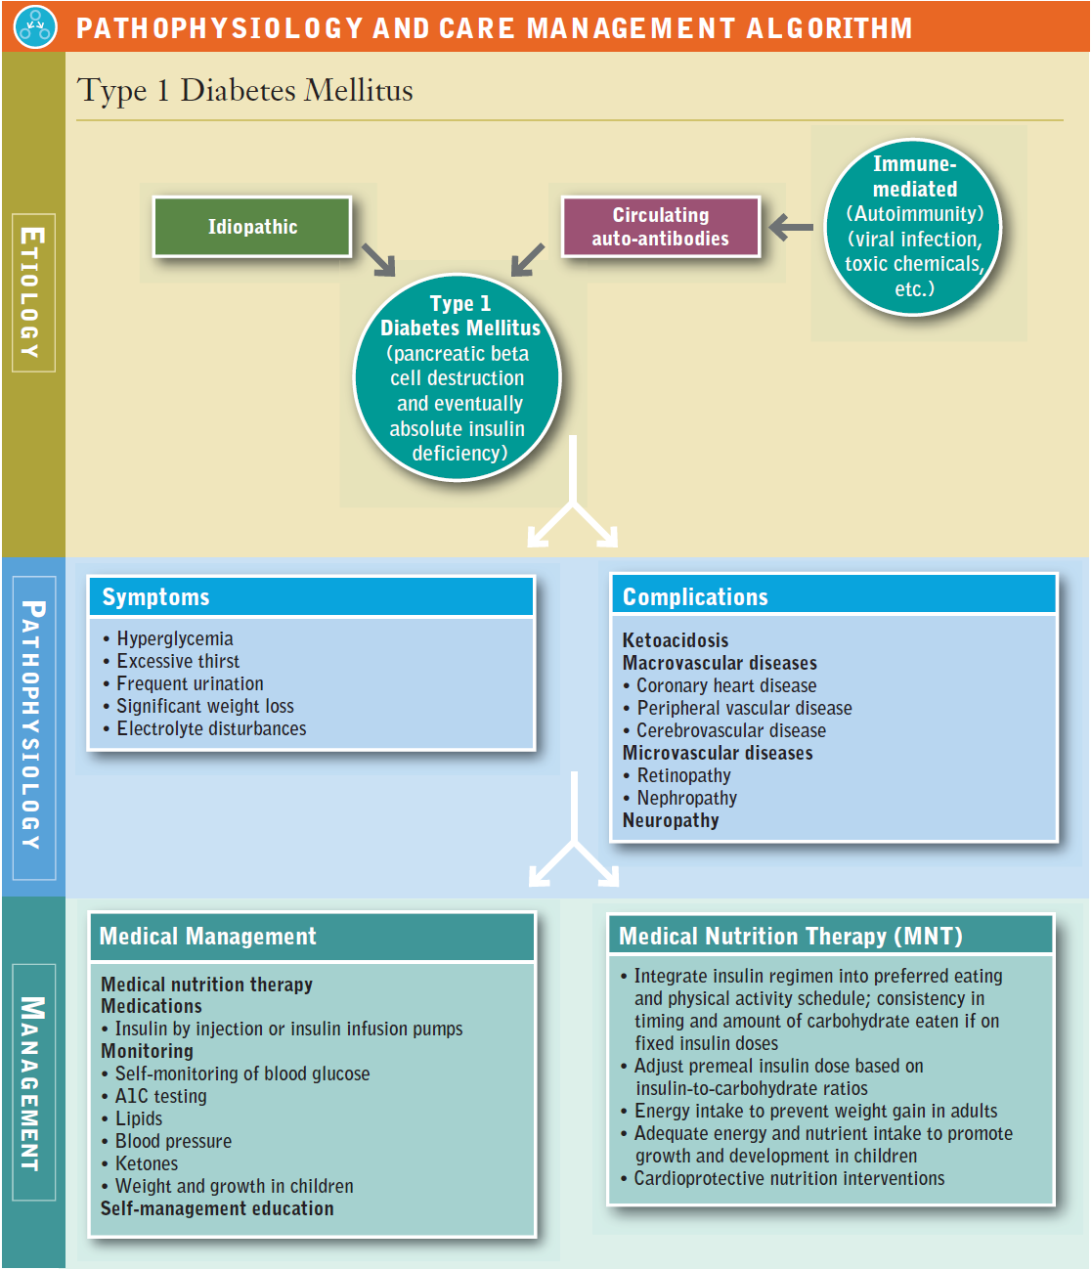

Slide 6
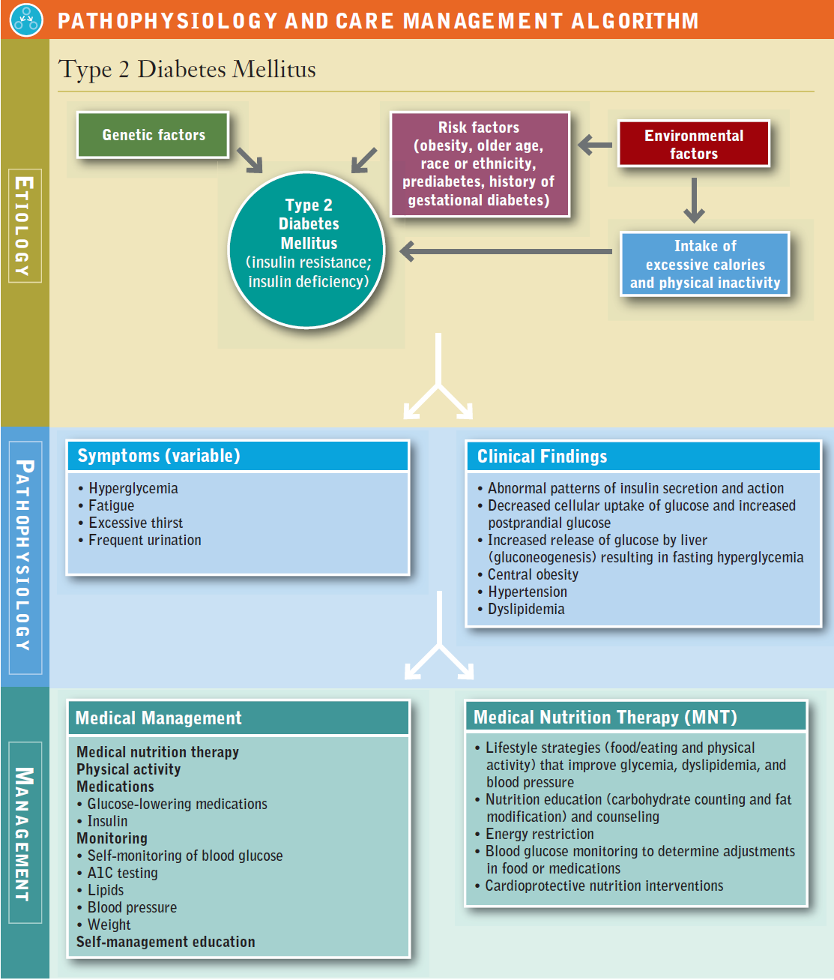

Slide 7
Gestational Diabetes Mellitus
Gestational diabetes mellitus (GDM) occurs in about 7% of all pregnancies (ranging from 1% to 14% depending on the population studied), resulting in more than 200,000 cases annually (ADA, 2014a).

Slide 8
Gestational Diabetes Mellitus
After delivery, about 90% of all women with GDM become normoglycemic but are at increased risk of developing GDM earlier in subsequent pregnancies.
Immediately after pregnancy, 5% to 10% of women with GDM are diagnosed with T2DM.
Women who have had GDM have a 35% to 60% chance of developing diabetes in the next 5 to 10 years (CDC, 2014).

Slide 9
Gestational Diabetes Mellitus
Lifestyle modifications aimed at reducing or preventing weight gain and increasing physical activity after pregnancy may reduce the risk of subsequent diabetes.
Screening: 24 to 28 weeks of gestation

Slide 10
Gestational Diabetes Mellitus
1. “One-step” 3-hr 75-g OGTT. A fasting glucose .92 mg/dl (5.1 mmol/L), a 1-hr >180 mg/dL (10 mmol/L), or a 2-hr >153 mg/dl (8.4 mmol/L) is diagnostic of GDM
2. “Two-step” approach with a 1-hr 50-g (nonfasting) screen followed by a 3-hr 100-g OGTT for those with plasma glucose ≥140 mg/dl (10.0 mmol/L).
The diagnosis of GDM is made when the plasma glucose level measured 2 hr after the test is ≥140 mg/dl (7.8 mmol/L).

Slide 11
Gestational Diabetes Mellitus
Outcomes :
  Macrosomia
  Neonatal hypoglycemia at birth
When optimal blood glucose levels are not being maintained with MNT or the rate of fetal growth is excessive, pharmacologic therapy is needed.

Slide 12
Gestational Diabetes Mellitus
Research supports the use of insulin, insulin analogs, metformin, and glyburide during pregnancy.
Women with GDM should be screened for diabetes 6 to 12 weeks postpartum and should have lifelong screening for the development of diabetes or prediabetes at least every 3 years (ADA, 2014b).

Slide 13
Management of Prediabetes
In no other disease does lifestyle—healthy and appropriate food choices and physical activity—play a more important role in prevention and treatment than in diabetes.
Clinical trials comparing lifestyle interventions to a control group have reported risk reduction for T2DM from lifestyle interventions ranging from 29% to 67%.

Slide 14
Management of Prediabetes
Medical management must include lifestyle changes.
Physical activity is important to prevent weight gain and maintain weight loss.
For cardiovascular fitness and to reduce risk of T2DM, recommendations include moderate-intensity aerobic physical activity a minimum of 30 minutes 5 days per week (150 min/week) (i.e., walking 3 to 4 miles/hr) or vigorous-intensity aerobic physical activity a minimum of 20 minutes 3 days per week (90 min/week).

Slide 15
Management of Prediabetes
Muscle-strengthening activities involving all major muscle groups two or more days per week are also recommended (US Department of Health and Human Services [USDHHS], 2008).
Physical activity independent of weight loss improves insulin sensitivity.

Slide 16
Medical Nutrition Therapy for Prediabetes
Goals of MNT for prediabetes emphasize the importance of food choices that facilitate moderate weight loss.
Structured programs that emphasize lifestyle changes that include moderate weight loss (7% of body weight) with strategies including reduced calories and reduced intake of fat are effective.

Slide 17
Medical Nutrition Therapy for Prediabetes
More recently, moderate to high adherence to a Mediterranean-style eating pattern characterized by high levels of monounsaturated fatty acids such as olive oil, high intake of plant-based foods (vegetables, legumes, fruits, and nuts), moderate amounts of fish and wine, and a low intake of red and processed meat and whole-fat dairy products versus low adherence has been associated with a lower incidence of diabetes.

Slide 18

Dietary patterns and diabetes
Mediterranean diet :
  Include:
  MUFA (olive), fruits, vegetables, whole grain cereals, dietary fiber, fish and moderate consumption of alcohol
  protect development of diabetes,
insulin sensitivity
anti-inflammatory actions
Kastorini CM. Curr Diabetes Rev. 2009 Aug

Slide 19
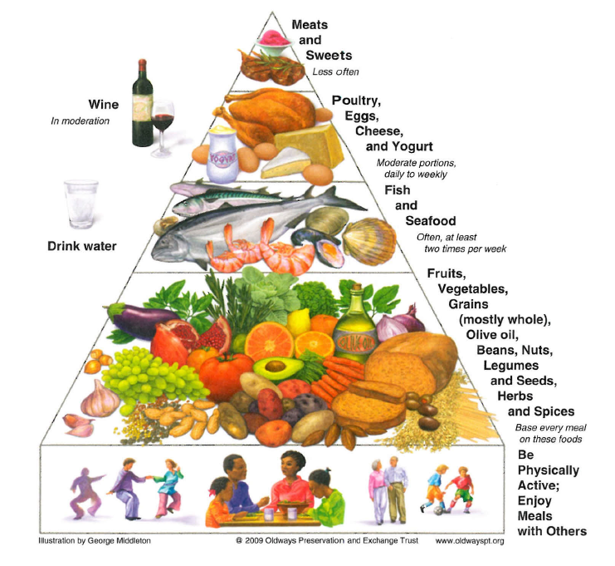
Mediterranean Diet Pyramid

Slide 20
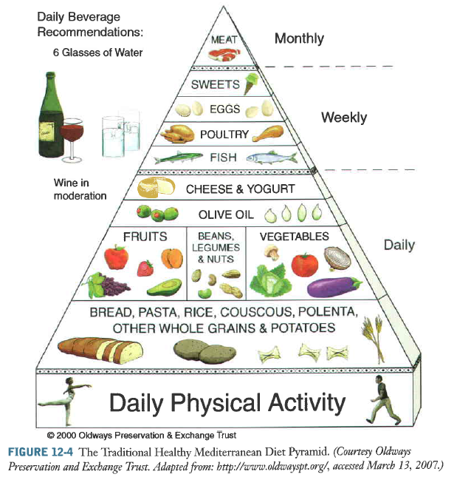
Mediterranean Diet Pyramid

Slide 21
Medical Nutrition Therapy for Prediabetes
In addition, whole grains and dietary fiber are associated with reduced risk of diabetes.
Increased intake of whole grain containing foods improves insulin sensitivity independent of body weight, and increased intake of dietary fiber has been associated with improved insulin sensitivity and improved ability to secrete insulin adequately to overcome insulin resistance.

Slide 22
Medical Nutrition Therapy for Prediabetes
High consumption of sugar-sweetened beverages, which includes soft drinks, fruit drinks, and energy and vitamin water type drinks containing sucrose, high-fructose corn syrup, and/ or fruit juice concentrates is associated with the development of T2DM (Malik et al, 2010).

Slide 23
Medical Nutrition Therapy for Prediabetes
Studies also have reported that an eating pattern high in saturated fatty acids and trans fatty acids is associated with increased markers of insulin resistance and risk for type 2 diabetes, whereas unsaturated fatty acid intake is associated inversely with risk of diabetes (Youssef, 2012).
Therefore individuals at increased risk for T2DM should be encouraged to limit their intake of sugar-sweetened beverages and decrease saturated fat intake.

Slide 24
Medical Nutrition Therapy for Prediabetes: Conclusion
Adhering to a combination of healthy lifestyle habits (a healthy eating pattern, participating in regular physical activity, maintaining a normal body weight, and being a nonsmoker) was shown to reduce the risk of developing T2DM by as much as 84% for women and 72% for men (Reis et al, 2011).

Slide 25
Bariatric Surgery and Prediabetes
Observational studies have demonstrated that bariatric surgery reduces the incidence of T2DM, but there are no randomized controlled trials (RCTs) on the role of bariatric surgery in the prevention of diabetes.
Possible mechanisms for this weight-independent impact of bariatric surgery on glucose include enterohormonal changes and neurohormonal events resulting from the anatomic changes of the surgery.

Slide 26
Medical Management of Diabetes
The management of all types of diabetes includes MNT, physical activity, monitoring, medications, and self-management education and support.
An important goal of medical treatment is to provide the individual with diabetes with the necessary tools to achieve the best possible control of glucose, lipids, and blood pressure to prevent, delay, or manage the microvascular and macrovascular complications while minimizing hypoglycemia and excess weight gain.

Slide 27
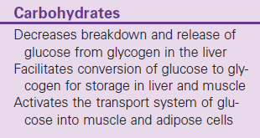
Action of Insulin on Carbohydrate, Protein, and Fat Metabolism

Slide 28
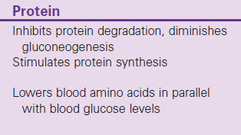
Action of Insulin on Carbohydrate, Protein, and Fat Metabolism

Slide 29
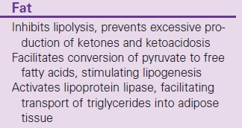
Action of Insulin on Carbohydrate, Protein, and Fat Metabolism

Slide 30
Recommendations for
Glycemic Control for Adults with Diabetes
A1C: <7.0%
Preprandial capillary plasma glucose: 80-130 mg/dL (4.4-7.2 mmol/L)
Peak postprandial capillary plasma glucose: < 180 mg/dL (<10.0 mmol/L)
  Postprandial glucose measurements should be made 1 to 2 hr after the beginning of the meal, generally peak levels in patients with diabetes.

Slide 31
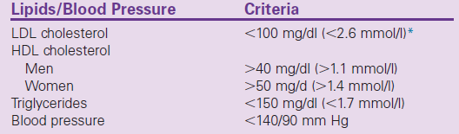
Recommendations for Lipid and Blood Pressure for Most Adults with Diabetes

Slide 32
Goals of Medical Nutrition
Therapy that Apply to Adults with Diabetes
1. To promote and support healthful eating patterns, emphasizing a variety of nutrient-dense foods in appropriate portion sizes, to improve overall diet and specifically to:
  Attain individualized glucose, blood pressure, and lipids goals
  Achieve and maintain body weight goals
  • Delay or prevent complications of diabetes

Slide 33
Goals of Medical Nutrition
Therapy that Apply to Adults with Diabetes
2. To address individual nutrition needs based on personal and cultural preferences, health literacy and numeracy, access to healthful food choices, willingness and ability to make behavioral changes.
3. To maintain the pleasure of eating by providing positive messages about food choices while limiting food choices only when indicated by scientific evidence.

Slide 34
Goals of Medical Nutrition
Therapy that Apply to Adults with Diabetes
4. To provide the individual with diabetes with practical tools for day to day meal planning rather than focusing on individual macronutrients, micronutrients, or single foods.

Slide 35
MNT
A variety of nutrition therapy interventions such as reduced energy/fat intake, carbohydrate counting, simplified meal plans, healthy food or exchange choices, use of insulin- to-carbohydrate ratios, physical activity, and/or behavioral strategies can be implemented.

Slide 36
Energy Balance and Weight Management
Overweight and obesity are, however, common health problems in persons at risk for and with T2DM.
Weight loss frequently is recommended as the solution to improve glycemic control.
Weight loss interventions implemented in persons with prediabetes and newly diagnosed with T2DM have been shown to be effective in improving glycemic control, but the benefit of weight loss interventions in T2DM of longer duration is controversial

Slide 37
Energy Balance and Weight Management
The weight losses greater than 5% resulted in consistent improvements in A1C, lipids, and blood pressure; however, weight losses less than 5% did not result in consistent 1 year improvements in A1C, lipids, or blood pressure

Slide 38
Bariatric Surgery
Bariatric surgery can be an effective weight loss treatment for severely obese patients with T2DM and can result in marked improvements in glycemia.
The ADA states it may be considered for adults with BMI of at least 35 kg/m² and T2DM, especially if the diabetes or associated comorbidities are difficult to control with lifestyle and pharmacologic therapy (ADA, 2014b).

Slide 39
Macronutrient Percentages and Eating Patterns
Although numerous studies have attempted to identify the optimal percentages of macronutrients for the Eating Plan of persons with diabetes, review of the evidence shows clearly that there is not an ideal percentage of calories from carbohydrate, protein, and fat for all persons with diabetes (Evert et al, 2013).

Slide 40
Macronutrient Percentages and Eating Patterns
Total energy intake rather than the source of the energy is the priority. However, even total energy intake is determined by changes that the individual with diabetes is willing
The ADA also reviewed research on eating patterns (Mediterranean-style, vegetarian and vegan, low-fat, low-carbohydrate, and DASH) implemented for diabetes management and concluded that a variety of eating patterns are acceptable and able to make.

Slide 41
Macronutrient Percentages and Eating Patterns
Although numerous factors influence glycemic response to foods, monitoring total grams of carbohydrates, whether by use of carbohydrate counting or experienced based estimation remains a key strategy in achieving glycemic control.
Evidence exists that the quantity and type of carbohydrate eaten influence blood glucose levels; however, the total amount of carbohydrate eaten is the primary predictor of glycemic response.

Slide 42
Carbohydrate counting
Carbohydrate counting is an Eating Plan method based on the principle that all types of carbohydrate (except fiber) are digested with the majority being absorbed into the bloodstream as molecules of glucose and that the total amount of carbohydrate consumed has a greater effect on blood glucose elevations than the specific type.

Slide 43
Carbohydrate counting
One carbohydrate choice or serving is a portion of food containing 15 grams of carbohydrate.
There are two main Eating Plans using carbohydrate counting;
  using insulin-to-carbohydrate ratios to adjust premeal insulin doses for variable carbohydrate intake (physiologic insulin regimens),
  or following a consistent carbohydrate Eating Plan when using fixed insulin regimens.

Slide 44
Carbohydrate counting
Testing premeal and postmeal glucose levels is important for making adjustments in either food intake or medication to achieve glucose goals.

Slide 45
Carbohydrate Intake
  Sugar, Starch and Fiber
The long-held belief that sucrose must be restricted based on the assumption that sugars are more rapidly digested and absorbed than starches is not justified.
Total amount of carbohydrate regardless of source

Slide 46
Carbohydrate Intake
The glycemic effect of carbohydrate foods cannot be predicted based on their structure (i.e., starch versus sugar) owing to the efficiency of the human digestive tract in reducing starch polymers to glucose.

Slide 47
Carbohydrate Intake
Starches are rapidly metabolized 100% glucose during digestion
Sucrose is metabolized approximately 50% glucose and approximately 50% fructose
Fructose has a very low glycemic response.

Slide 48
Well-balanced diet
key strategy in achieving glycemic control (ADA, 2014):
  Monitoring total grams of carbohydrates

Slide 49
Well-balanced diet (cont’)
Other strategy for improve glycemic control (especially in persons on either MNT alone, glucose lowering medications, or fixed insulin regimens):
  Day-to-day consistency in the amount of carbohydrate eaten at meals and snacks

Slide 50
Well-balanced diet (cont’)
In persons with T1DM or T2DM who adjust their mealtime insulin doses or who are on insulin pump therapy:
insulin doses should be adjusted to match carbohydrate intake, known as the insulin-to-carbohydrate ratios (ADA, 2008).

Slide 51
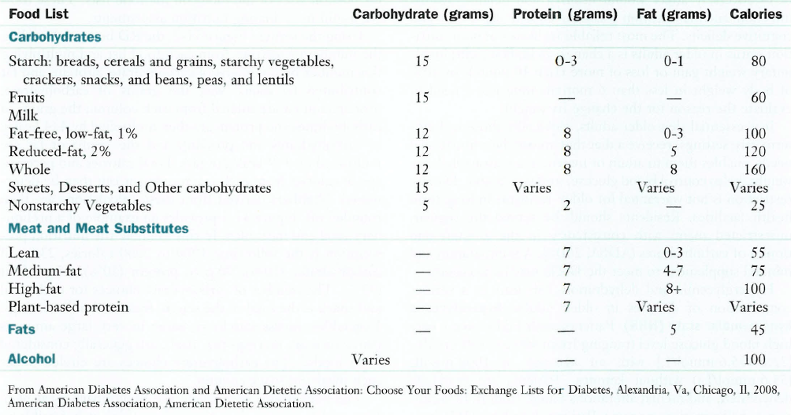
Well-balanced diet (cont’)
Exchange List

Slide 52
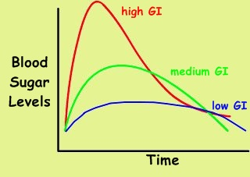
Glycemic Index
The glycemic index (GI) of food was developed to compare the physiologic effects of carbohydrates on glucose.
The GI measures the relative area under the postprandial glucose curve of 50 g of digestible carbohydrates compared with 50 g of a standard food, either glucose or white bread.

Slide 53
Glycemic Index
When bread is the reference food, the GI index for the food is multiplied by 0.7 to obtain the value that is comparable to glucose being used as the reference food (glycemic index of glucose = 100, white bread = 70).

Slide 54
Glycemic Load
The estimated glycemic load (GL) of foods, meals, and dietary patterns is calculated by multiplying the GI by the amount of carbohydrates (divided by 100) in each food and then totaling the values for all foods in a meal or dietary pattern.
For example, two slices of white bread with a GI of 75 and 30 g of carbohydrate has a GL of 22.5 (75 × 30/100 = 22.5)

Slide 55
Why GL?
A major problem with the GI is the variability of response to a specific carbohydrate food.
For example, Australian potatoes are reported to have a high GI, whereas potatoes in the United States and Canada have moderate GI (Fernandes et al., 2005).

Slide 56
Why GL? (cont’)
More recently, two trials, each one year in duration, reported no significant differences in A₁C levels from low GI versus high GI diets (Wolever et al., 2008) and (Ma et al., 2008).
Furthermore, most people likely already consume a moderate GI diet.

Slide 57
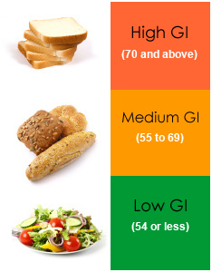
Glycemic Index of Foods
Low GI Foods (55 or less)
  Sweet potato, corn, yam, peas, legumes and lentils
  Oatmeal (rolled or steel-cut), oat bran, muesli
  Most fruits, non-starchy vegetables and carrots
  Pasta, barley
  pumpernickel bread
  Ref. American dietetic Association (ADA)

Slide 58
Glycemic Index of Foods (cont’)
Medium GI (56-69)
Whole wheat, rye and pita bread
basmati rice
  Ref. American dietetic Association (ADA)

Slide 59
Glycemic Index of Foods (cont’)
High GI (70 or more)
White bread or bagel
Corn flakes, puffed rice, bran flakes, instant oatmeal
Short grain white rice, rice pasta, macaroni and cheese from mix
Russet potato, pumpkin
Pretzels, rice cakes, popcorn, saltine crackers
melons and pineapple
  Ref. American dietetic Association (ADA)

Slide 60
What affects the GI of a food?
Fat and fiber tend to lower the GI of a food.
Ripeness and storage time: the more ripe a fruit or vegetable is, the higher the GI
Processing: juice has a higher GI than whole fruit; mashed potato has a higher GI than a whole baked potato.
Cooking method: how long a food is cooked (al dente pasta has a lower GI than soft-cooked pasta)
  Ref. American dietetic Association (ADA)

Slide 61
Carbohydrate Counting
Carbohydrate counting, or "carb counting," is a meal planning technique for managing your blood glucose levels.
Knowing how much carbohydrate should be eaten, can help to keep blood glucose levels in target range.
Finding the right amount of carbohydrate depends on many things including activity level of patient and what, if any, medicines taken.

Slide 62
Carbohydrate Counting (cont’)
How Much Carb?
A place to start is at about 45-60 grams of carbohydrate at a meal.
It may need more or less carbohydrate at meals depending on how manage diabetes.
The two most important lines with carbohydrate counting are the serving size and the total carbohydrate amount.

Slide 63
Carbohydrate Counting (cont’)
For example there is about 15 grams of carbohydrate in:
  1 small piece of fresh fruit (4 oz)
  1/2 cup of canned or frozen fruit
  1 slice of bread (1 oz) or 1 (6 inch) tortilla
  1/3 cup of pasta or rice
  4-6 crackers
  1/2 cup of black beans or starchy vegetable
  1/4 of a large baked potato (3 oz)
  2/3 cup of plain fat-free yogurt or sweetened with sugar substitutes

Slide 64
Carbohydrate Counting (cont’)
  2 small cookies
  2 inch square brownie or cake without frosting
  1/2 cup ice cream or sherbet
  1 Tbsp syrup, jam, jelly, sugar or honey
  2 Tbsp light syrup
  6 chicken nuggets
  1 cup of soup
  1/4 serving of a medium french fry

Slide 65

Using Food Labels
Carbohydrate counting is easier when food labels are available.
Patient can look at how much carbohydrate is in the foods and she/he decide how much of the food can eat.

Slide 66
Using Food Labels (cont’)
Look at the serving size.
All the information on the label is about this serving of food. If patient will be eating a larger serving, then she/he will need to double or triple the information on the label.
Look at the grams of total carbohydrate.
  Total carbohydrate on the label includes sugar, starch, and fiber.

Slide 67
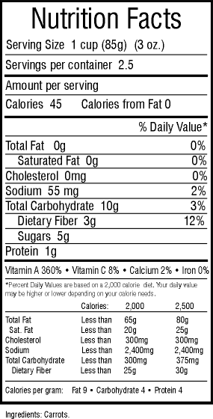
Food Label

Slide 68
Is the GI a better tool than carbohydrate counting?
There is no one diet or meal plan that works for everyone with diabetes.
The important thing is to follow a meal plan that is tailored to personal preferences and lifestyle and helps achieve goals for blood glucose, cholesterol and triglycerides levels, blood pressure, and weight management.
  Ref. American dietetic Association (ADA)

Slide 69
Is the GI a better tool than carbohydrate counting? (cont’)
Based on the research, for most people with diabetes, the first tool for managing blood glucose is some type of carbohydrate counting.
Balancing total carbohydrate intake with physical activity and diabetes pills or insulin is key to managing blood glucose levels.
  Ref. American dietetic Association (ADA)

Slide 70
Is the GI a better tool than carbohydrate counting? (cont’)
Because the type of carbohydrate does have an effect on blood glucose, using the GI may be helpful in "fine-tuning" blood glucose management.
In other words, combined with carbohydrate counting, it may provide an additional benefit for achieving blood glucose goals for individuals who can and want to put extra effort into monitoring their food choices.
  Ref. American dietetic Association (ADA)

Slide 71
Fiber and Whole Grains
recommendations for fiber intake for people with diabetes are similar to the recommendations for the general public.

Slide 78
Sweeteners
Even though sucrose restriction cannot be justified on the basis of its glycemic effect, it is still good advice to suggest that persons with diabetes be careful in their consumption of foods containing large amounts of sucrose.

Slide 79
Sweetners (cont’)
There appears to be no significant advantage of alternative nutritive sweeteners such as fructose versus sucrose.
Fructose provides 4 kcal/g, as do other carbohydrates, and even though it does have a lower glycemic response than sucrose and other starches, large amounts (15% to 20% of daily energy intake) of fructose have an adverse effect on plasma lipids.

Slide 80
Sweeteners (cont’)
Reduced-calorie sweeteners approved by the Food and Drug Administration (FDA) include sugar alcohols (erythritol, sorbitol, mannitol, xylitol, isomalt, lactitol, and tagatose.
They produce a lower glycemic response and contain, on average, 2 calories/g, as for fiber.
Persons using insulin to carbohydrate ratios can subtract one half of sugar alcohol grams from total carbohydrate when the grams are more than 5 (Wheeler et al., 2008).

Slide 81
Sweeteners (cont’)
Saccharin, aspartame, neotame, acesulfame potassium, and sucralose are nonnutritive sweeteners currently approved by the FDA.
For all food additives, including nonnutritive sweeteners, the FDA determines an acceptable daily intake (ADI), defined as the amount of a food additive that can be safely consumed on a daily basis during a person's lifetime without risk.

Slide 82
Sweeteners (cont’)
The ADI generally includes a 100-fold safety factor and greatly exceeds average consumption levels.
For example, aspartame actual daily intake in persons with diabetes is 2 to 4 mg/kg of body weight daily, well below the ADI of 50 mg/kg daily.
In December 2008 the FDA stated that the stevia-derived sweetener, Rebaudioside A, is generally recognized as safe and it is currently being marketed.

Slide 83
Sweeteners (cont’)
All FDA-approved nonnutritive sweeteners, when consumed within the established daily intake levels, can be used by persons with diabetes, including pregnant women (ADA, 2008).

Slide 84
Assessment of diabetic patients

Slide 85
Case study

Slide 86
Subjective
آقای 58 ساله
ابتلا به دیابت نوع 2 از یک سال پیش
دریافت گلی بنگلامید و متفورمین
بیمار کارمند یکی از ادارات است و فعالیت بدنی وی سبک است
سیگار می کشد
بیماری کلیوی ندارد

Slide 87
Subjective
یادآمد معمول 24 ساعته غذایی:
صبحانه: چای یک لیوان+ 3 عدد خرما+ 1 قاشق غذا خوری عسل+ 3 کف دست نان بربری+ 1 قوطی کبریت پنیر خامه ای+ 3 عدد گردو
میان وعده: یک استکان چای + 2 عدد خرما
ناهار: نصف لیوان ماست پرچرب + 20 قاشق غذاخوری برنج + یک ران مرغ سرخ شده
عصرانه: 1 عدد موز + یک استکان چای + 2 عدد خرما
شام: 3 کف دست نان + یک سیخ کباب کوبیده+ 1 واحد سبزی خوردن + نصف لیوان ماست پر چرب
قبل از خواب: یک استکان چای + 2 عدد خرما + یک عدد پرتقال متوسط + یک عدد سیب متوسط

Slide 88
Objective
اندازه گیری های آنتروپومتری:
وزن 89 کیلو گرم
قد 171 سانتی متر
دور کمر 98 سانتی متر

Slide 89
Objective
نتایج آزمایشات:
FBS: 190 mg/dl
HgA₁C: 7.2
TG: 150 mg/dl
LDL-C: 120 mg/dl
HDL-C: 40 mg/dl

Slide 90
Assessment
تعداد واحدهای دریافتی از هر گروه غذایی |  |  |  |  | غذا
گوشت، ... | شیر ، ... | میوه ها | سبزی ها | نان، ...
1/5 |  |  |  | 3 | صبحانه 3 کف دست نان بربری + 3 عدد گردو
1 | 0/5 |  |  | 4 | ناهار: نصف لیوان ماست پرچرب + 20 قاشق غذاخوری برنج + یک ران سرخ شده مرغ
 |  | 1 |  |  | میان وعده عصر: 1 عدد موز
1 | 0/5 |  | 1 | 3 | شام: 3 کف دست نان + یک سیخ کباب کوبیده+ 1 واحد سبزی خوردن + یک لیوان دوغ
 |  | 2 |  |  | میان وعده قبل از خواب: یک عدد پرتقال و یک عدد سیب
3/5 | 1 | 3 | 1 | 10 | جمع واحدهای مصرفی
2 | 2 | 3 | 4 | 9 | جمع واحدهای توصیه شده
10 | 5 | 10 | 2/5 | 10 | امتیاز

Slide 91
امتياز تنوع = 10 (با توجه به جدول زير)
امتياز دهي تنوع غذايــــي
اين نمرات تعلق مي گيرند | اگر تمام واحدهاي انواع مختلف غذايي مصرف شود
10 9 8 7 6 5 4 3 2 1 0 | 9/5 يا بيشتر 9 8/5 8 7/5 7 6/5 6 5/5 5 4/5 يا كمتر

Slide 92
Assessment
نمره امتیاز از 5 گروه غذایی: 37/5 از 50
نمره امتیاز تنوع غذایی:10
امتیاز کل 47/5= 37/5+10
خصوصیات رژیم غذایی امتیاز
تنوع وانتخاب عالی است 60
کفایت وتنوع رژیم تا حدی مناسب 60 -50
رژیم غذایی بایستی بررسی و اصلاح گردد 50 >

Slide 93
Assessment
BMI= 89/ ( 1.71)² = 30.5 Kg/m²
Ideal body weight = normal BMI x (height)²
Ideal body weight = 22.5 x 1.7 x 1.7 = 66 kg
AIBW = (ABW – IBW) × 25% +IBW
AIBW = 66 + [(89 – 66 ) x 0.25] = 72 kg

Slide 94
Assessment
محاسبه انرژی مورد نیاز بیمار:
BEE = 1 x 24 x 72 = 1728
E for PA = 30% x 1728 = 518
TEF = 10% (1728 + 518) = 224
TEE = 1728 + 518 + 224 = 2470
میزان 2400 کیلوکالری را برای تنظیم برنامه غذایی بیمار استفاده می نماییم

Slide 95
Assessment
محاسبه توزیع درشت مغذی ها:
CHO= %55 x 2400 = 1320÷ 4 = 330 g
Pro= %15 x 2400 = 360÷ 4= 90 g
Fat= %30 x 2400 = 720 ÷ 9= 80 g
Simple sugar: %7 x 2400 = 168 ÷ 4 = 42 g
42 ÷ 5 = 8.5 serving

Slide 96
Assessment
محاسبه توزیع کربوهیدرات های رژیم غذایی:
میان وعده | شام | میان وعده | ناهار | میان وعده | صبحانه
15% | 22/5% | 12/5% | 22/5% | 12/5% | 15%
g49/5 | g74/25 | g41/25 | g74/25 | g41/25 | g49/5

Slide 97
جدول تلفیق واحدهای هرم راهنمای غذایی با سیاهه جانشینی و توزیع عادلانه واحدهای توصیه شده
گروه غذایی | تعداد واحد | CHO | Pro | Fat | Kcal | صبحانه | s1 | ناهار | s2 | شام | s3
شیر | 2.5 | 30 | 20 | 12.5 | 300 | - | 0.5 | 0.5 | 1 | 0.5 | -
سبزی | 6 | 30 | 12 | - | 150 | 1 | - | 2 | - | 3 | -
میوه | 4 | 60 | - | - | 240 | - | 2 | - | - | - | 2
قند ساده | 9 | 45 | - | - | 180 | 3 | 1 | - | 2 | - | 2
غلات | 11 | 165 | 33 | - | 880 | 2 | - | 4 | 1 | 3.5 | 0.5
گوشت | 3.5 | - | 24.5 | 17.5 | 262.5 | 0.5 | - | 2 | - | 1 | -
چربی | 10 | - | - | 50 | 450 | 1 | - | 5 | 1 | 3 | -
مجموع | - | 330 | 89.5 | 80 | 2462.5 | - | - | - | - | - | -

Slide 98
Planning
جهت تنظیم رژیم غذایی ابتدا اصول پنج گانه زیر را رعایت کنیم:
1- تامین کفایت مواد غذایی
2- رعایت تعادل در مصرف انواع غذاها
3- دریافت انرژی مطابق با فعالیت های روزانه و شیوه زندگی
4- رعایت میانه روی در مصرف انواع غذاها
5- رعایت تنوع در بین گروه ها و درون گروه های راهنمای غذایی

Slide 99
Planning
برنامه غذایی بیمار:
صبحانه (ساعت 8-7 صبح):
  گروه نان و غلات 2 واحد (2 کف دست نان سنگک)
  گروه گوشت نصف واحد (نصف قوطی کبریت)
  گروه روغن 1 واحد (2 عدد مغز گردو)
  گروه سبزی 1 واحد (یک عدد گوجه فرنگی و خیار)
  گروه قندهای ساده 3 واحد (2 قاشق مربا خوری عسل و یک عدد خرما)
  یک استکان چای

Slide 100
Planning
برنامه غذایی بیمار:
میان وعده (ساعت 10/5 – 9/5 صبح):
  گروه میوه 2 واحد (یک عدد پرتقال متوسط و یک عدد سیب)
  گروه شیر و لبنیات 0/5 واحد (نصف لیوان شیر کم چرب 1/5 درصد)
  گروه قندهای ساده یک واحد (یک عدد خرما یا دو حبه قند)
  یک استکان چای

Slide 101
Planning
برنامه غذایی بیمار:
ناهار (ساعت 12:30-1):
  گروه نان و غلات 4 واحد (4 کف دست نان یا 20 قاشق غذاخوری سرصاف برنج)
  گروه گوشت 2 واحد (یک ساق ران مرغ یا یک چهرام سینه کامل مرغ یا 2 قطعه گوشت 30 گرمی)
  گروه سبزی 2 واحد (یک پیش دستی سالاد و نصف لیوان سبزی های پخته)
  گروه لبنیات 0/5 واحد (نصف لیوان ماست کم چرب 1/5 درصد یا یک لیوان دوغ)
  گروه چربی 5 واحد (3 قاشق مرباخوری روغن برای پخت غذا، یک قاشق مرباخوری روغن برای پخت سبزی ها، 8 عدد زیتون)

Slide 102
Planning
برنامه غذایی بیمار:
میان وعده (5 – 4 بعد از ظهر):
  گروه نان و غلات 1 واحد (3 عدد بیسکوئیت ساقه طلایی یا سه چهارم لیوان کورن فلکس)
  گروه شیر و لبنیات 1 واحد (یک لیوان شیر کم چرب 1/5 درصد)
  گروه قند ساده 2 واحد (2 عدد خرما)
  گروه چربی 1 واحد (10 عدد مغز های مخلوط)
  یک استکان چای

Slide 103
Planning
برنامه غذایی بیمار:
شام( ساعت 8 – 7 شب) :
  گروه نان و غلات 3/5 واحد (یک عدد سیب زمینی کوچک و 1/5 کف دست)
  گروه گوشت 1 واحد (یک عدد تخم مرغ یا یک فیله مرغ)
  گروه لبنیات (نصف لیوان ماست کم چرب 1/5 درصد)
  گروه سبزیجات 3 واحد (1/5 لیوان سبزی های پخته مانند اسفناج)
  گروه چربی 3 واحد

Slide 104
Planning
برنامه غذایی بیمار:
قبل از خواب (ساعت 11 – 10 شب):
  گروه میوه 2 واحد
  گروه نان و غلات 0/5واحد (نصف کف دست نان)
  گروه قندهای ساده 2 واحد (2 حبه قند و یک عدد خرما)
  یک استکان چای

Slide 105
توصیه های تغذیه ای
1- رعایت وعده ها و میان وعده ها الزامی است
2- از لبنیات کم چرب ( 1/5 % ) استفاده شود
3- مصرف میوه و سبزی در کنار وعده های غذایی الزامی است
4- از کدو سبز، سیر، شوید، قارچ ، اسفناج، کرفس، لوبیا سبز، بادمجان، گوجه فرنگی، فلفل دلمه ای به عنوان سبزی های پخته در برنامع غذایی استفاده شود
5- از نان های سبوسدار مانند سنگگ استفاده شود
6- سالاد اول غذا میل شود
7 – ورزش ها هوازی و پیاده روی روزانه به مدت 45 دقیقه الزامی است .
8- از روغن مایع گیاهی استفاده شود ( بهترین روغن، کانولا است )
9- برنج بهتر است به صورت سبزی پلو، عدس و یا لوبیا پلو تهیه شود
تذکر: لیست جانشین های غذایی حتما برای بیمار توضیح داده شود

Slide 106
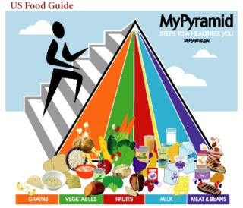
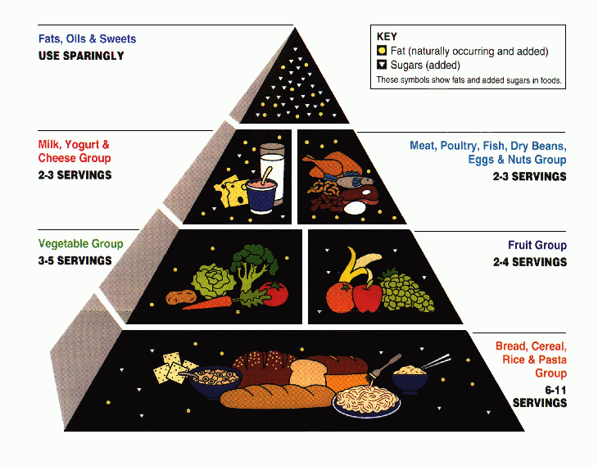
Any question?

