Slide 1


Slide 2

Glucose Metabolism in Pregnancy
Dr. Maryam Tohidi
Associate professor of anatomical & clinical pathology
Research Institute for Endocrine Sciences
Shaheed Beheshti University of Medical Science

Slide 3
Carbohydrate metabolism
Organs involving in maintaining blood glucose level
  Liver
  Muscle
  Adipose tissue

Slide 4
Liver
⇨ In the well-fed state:
1- Excess glucose is converted to glycogen.
Glucose Glycogen
Insulin +
2- Remaining glucose is used for fatty acid synthesis.
Glucose Fatty acid
Insulin +
In the fasting state:
1- Glycogenolysis
Glycogen Glucose
Glucagone +
Catecholamine +
2- Gluconeogenesis
  Glycerol from adipose tissue
  Lactate from RBCs & muscle
  Aminoacids from muscle

Slide 5
Major hormones in CHO metabolism
Insulin
Counterregulatory hormones :
 Glucagon
 Catecholamines
⇧ Cortisol
⇧ Growth hormone

Slide 6
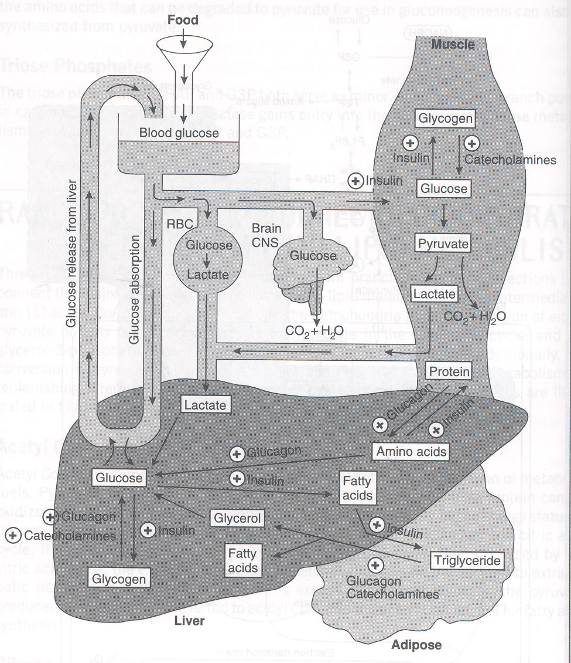

Slide 7
Insulin
Glucagon
 An anabolic hormone
 Secreted from beta- cells of pancreas
 Functions:
In the liver stimulates:
Glycogenesis
Fatty acid synthesis
Protein synthesis
⇧ In adipose tissue stimulates:
Triglycerides synthesis
Glucose uptake
⇧ In muscles stimulates:
Glucose uptake & glycogenesis
Amino acids uptake
 An catabolic hormone
 Secreted from alpha- cells of pancreas
Functions:
In the liver stimulates:
Glycogenolysis
Gluconeogenesis
⇧ In adipose tissue stimulates lypolysis
⇧ In muscles stimulates protein degradation

Slide 8
Catecholamine
Secreted from adrenal medulla
Functions:
In the liver stimulates:
Glycogenolysis
Gluconeogenesis
⇧ In adipose tissue stimulates lypolysis
⇧ In muscles stimulates release of AA & lactate
⇧ Stimulatory effect on glucagon release from alpha-cells
⇧ Inhibitory effect on release of insulin from beta-cells

Slide 9
Glucose metabolism in normal pregnancy
Pregnancy is characterized by a complex endocrine - metabolic adaptations, which don’t reflect a pathological condition.
These adaptations are necessary to ensure a continuous supply of nutrients & energy demands of the growing fetus and to prepare maternal organism for delivery & lactation.
These metabolic adaptations are progressive & may highlighted in gestational diabetes mellitus (GDM).

Slide 10
Adaptations:
Impaired insulin sensitivity
Increased beta- cell response
Altered blood glucose level (particularly after meal)
Change in circulatory FFAs, TGs, CHOL & phospholipids.

Slide 11
Insulin Resistance (IR)
During the first trimester of pregnancy, insulin sensitivity is normal if not higher than normal.
As pregnancy progresses, a condition of IR come in progress.
The deterioration of insulin action being more marked at the skeletal muscle than adipose tissue.

Slide 12
Insulin Resistance (IR)
The development of GDM is associated with more severity of IR.
In GDM mothers, a lower insulin sensitivity is likely to be present both before and after pregnancy.
The degree of IR seems to be influenced by obesity & inheritance.

Slide 13
Catalano et al., using the euglycemic-hyperinsulinemic clamp, estimated a 47% reduction in insulin sensitivity in obese women and a 56% reduction in normal-weight women in the third trimester of gestation.
Am J Obstet Gynecol 1991; 165: 1667-72.
Am J Obstet Gynecol 1999; 180: 903- 16.

Slide 14
In Di Cianni et al. study:
Women with previous gestational diabetes present, compared to control women, a modification in the indices of insulin sensitivity obtained both in basal conditions [Homeostatic model assessment of insulin resistance (HOMA- IR)] and after oral administration of glucose [insulin sensitivity index].
Diabetes Metab Res Rev 2003; 19: 259- 270

Slide 15
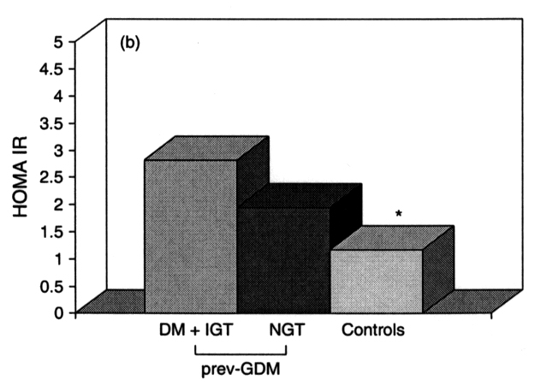
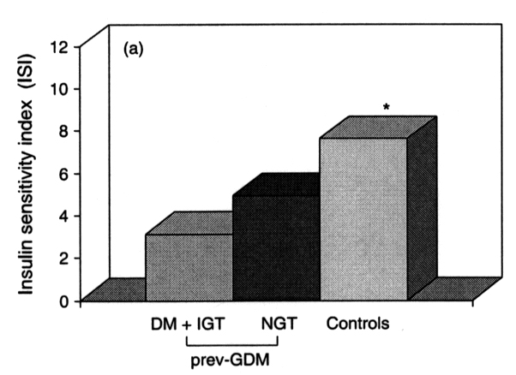

Slide 16
According to other studies, with the progression of pregnancy, insulin sensitivity can be reduced as much as 60 to 80%.

Slide 17
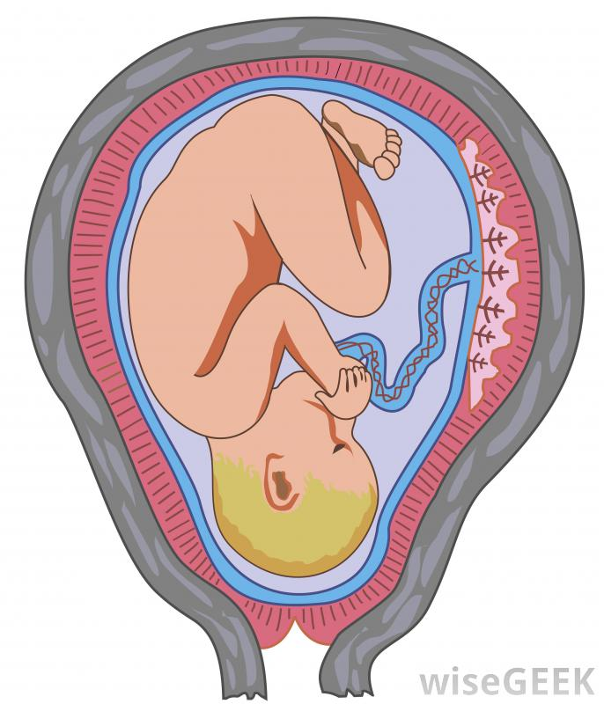
Why insulin resistance?
A physiological event favoring glucose supply to the fetus.
The reduced insulin-mediated utilization of glucose switches the maternal energy metabolism from carbohydrates to lipid substrates (free fatty acids), redirecting carbohydrates toward the fetal tissues.
Even the slight, though prolonged, postprandial hyperglycemia associated with impaired insulin sensitivity can contribute to rerouting nutrients from the mother to the fetus.

Slide 18
Mechanism of insulin resistance in pregnancy
The cellular mechanism of insulin resistance in pregnancy is multifactorial and involves several steps of the intracellular generation and propagation of the insulin signal.

Slide 19
Reduced activity of Insulin receptor
The study of the insulin binding has not demonstrated significant modifications either in normal pregnancy or in GDM.
A reduced activity (30-40%) of insulin receptor tyrosine kinase has been observed in the skeletal muscle of obese women in both normal and diabetic pregnancy.
The insulin receptor (IR) is a transmembrane receptor that is activated by insulin, IGF- I, IGF-II and belongs to the large class of tyrosine kinase receptors.

Slide 20
Binding of insulin to the extracellular a-subunit of the insulin receptor induces autophosphorylation of the β-subunit of the receptor and phosphorylation of selected intracellular proteins, such as Shc and the IRS family.These latter phosphoproteins interact with other targets, thereby activating phosphorylation cascades, which result in glucose uptake (in adipose tissue and skeletal muscle), glucose metabolism, synthesis (of glycogen, lipid, and proteins), enhanced gene expression, cell growth, and differentiation.

Slide 21
Reduced expression of insulin receptor substrate (IRS-1)
IRS-1 is a molecule in the signal transduction pathway.
Expression of IRS-1 is reduced in experimental animals during pregnancy , a finding that has been confirmed in the skeletal muscle of normotolerant and GDM women in the last weeks of pregnancy.
Tyrosine phosphorylation (activation) of IRS-1 is reduced, compared to the pre-pregnancy state, by:
28% in normal pregnancy
41% in a pregnancy with GDM

Slide 22
Reduced GLUT4
Reduction in GLUT4 (glucose transporter) in the late stage of pregnancy, and to a greater extent in GDM.
The alterations of the insulin-signaling cascade, modulated by humoral factors:
  PC-1(an inhibitor of insulin receptor signaling)
  TNF- α:

Slide 23
THF-α
TNF-α in plasma of obese patients is much lower compared with that found in burn & cachectic patients.
Paracrine effect of TNF-α on skeletal muscle insulin resistance.
TNF-α impairs insulin signaling by:
  ↑ Serine phosphorylation of IRS-1
  ↓ Insulin receptor tyrosine kinase activity
Barbour et al. Diabetes care 2007; 30 S: s112-s119.

Slide 24
TNF- α
The impairment in insulin action correlates with TNF-α levels (r = -0.69; p < 0.006) . When measured along with hCG, estradiol, progesterone, hPL, and prolactin, TNF-α remains the only significant predictor of the change in insulin sensitivity in late pregnancy (r = -0.60; p < 0.02).
Kirwan et al.Diabetes 2002; 51: 2207-13

Slide 25
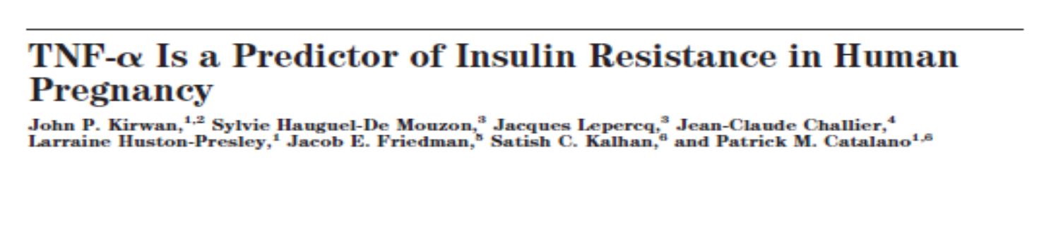
TNF- α
Though the placenta can produce TNF-α , over 90% of the circulating TNF-α is of maternal origin.
The rise in cytokines is associated with the enlargement of the maternal fat mass.
Kirwan et al.Diabetes 2002; 51: 2207-13

Slide 26
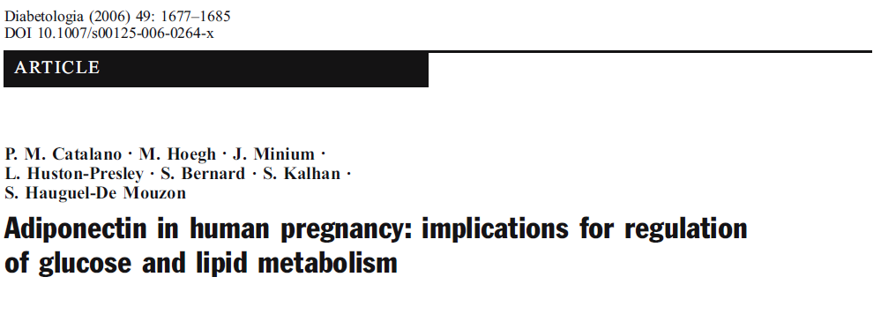
Adiponectin
A protein synthesized exclusively in adipocytes.
Low plasma adiponectin concentration correlate highly with insulin resistance in obesity, DM II & GDM.
Decline adiponectin secretion & its mRNA level in white adipose tissue with advancing pregnancy even in lean women ( due to pregnancy associated factors).
Catalano et al. Diabetologia 2006; 49: 1677-85.

Slide 27
Insulin Secretion
Both in normal pregnancy and in GDM, insulin secretion increases steadily from the first trimester and reaches to its peak in the third, returning to normal values after delivery.
The insulin response to the oral glucose intake is associated with a 120% increase in first-phase insulin secretion by the 12th to 14th gestational week.
The second phase does not seem to be affected, at least in the first weeks of pregnancy.
The insulin response after an intravenous glucose tolerance test (IVGTT) is increased with respect to values observed before and after pregnancy.

Slide 28
In GDM:
There is a peculiar loss of first-phase insulin secretion in women with GDM.
There is a delay in the peak of insulin concentration after oral intake of glucose observed in GDM.

Slide 29
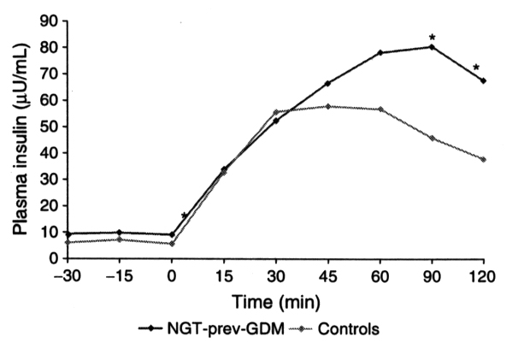
Di Cianni et al. study:
Plasma insulin levels in women with previous gestational diabetes (prev-GDM) or with normal glucose tolerance during pregnancy (controls) during an oral glucose tolerance test (OGTT).
Normo-tolerant women with prev-GDM showed fasting insulin levels similar to controls. Peak insulin level was higher and delayed in pGDM women compared to controls
(*p < 0.05)
Diabetes Metab Res Rev 2003; 19: 259- 270.

Slide 30
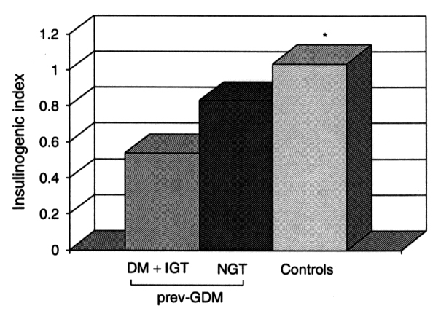
Di Cianni et al. study:
Women with previous gestational diabetes have a lower Insulinogenic index* as compared to control women.
Among women with previous GDM, the reduction of Insulinogenic index is greater in those with impaired glucose tolerance as compared to the normotolerant women.
* An index of β-cell function
(Δ Ins 30 / Δ Gluc 30)
Diabetes Metab Res Rev 2003; 19: 259- 270

Slide 31
Hyperinsulinemia
Increased circulating immunoreactive insulin in late pregnancy compared with non-pregnant women (intact form).
Whole-body insulin kinetic are similar in pregnant & non-pregnant women.
No difference in hepatic insulin extraction.
Hyperinsulinemia of pregnancy is due to enhanced pancrearic beta-cell function.

Slide 32
To satisfy these needs during normal pregnancy and in pregnancy with GDM:
The β-cell undergoes significant structural and functional changes including:
  (1) increased insulin secretion
  (2) increased insulin synthesis
  (3) enhanced utilization and oxidation of glucose
  (4) accelerated β-cell proliferation and increased islet volume
  (5) higher cAMP metabolism

Slide 33
Insulin degradation
Increased insulin degradation during pregnancy due to:
  Placental enzymes with insulinase activity
   Membrane- associated insulin-degrading activity

Slide 34
Glucagon
Plasma glucagon concentrations increase during the last trimester of pregnancy.
A slight increase may contribute to insulin resistance.
Plasma glucagon levels are even higher in women with GDM.
It is not clear whether elevated glucagon levels have:
any role in the pathogenesis of GDM
Or
if they simply reflect the relative insulin deficiency of these women.

Slide 35
Hormones associated with modifications in insulin secretion and action
Estrogens ↑ Insulin concentration
↑ Insulin binding
Progesterone ↓ Glucose transport
↓ Insulin binding
↓ Suppression of insulin- induced hepatic gluconeogenesis

Slide 36
Continue:
Cortisol ↑ Insulin resistance
↓ Phosphorylation of insulin receptor
↓IRS-1
placental hormones (hPL, GH)
↓ Insulin sensitivity
↑ Insulin secretion
↑ Insulin synthesis
↑ Utilization and glucose oxidation
↑ cAMP metabolism
↑ β-cell number
↑ β-cell mass
Leptin ↑ Insulin resistance (?)
Glucagon ↑ Insulin resistance

Slide 37
Human Placental lactogen (hPL)
Produced by syncytiotrphoblasts
Most strong antagonist of insulin during pregnancy
Appeared about 10 weeks of gestation
Daily production at term: 1-2 g/day
Growth hormone- like properties (96% structural similarity)

Slide 38
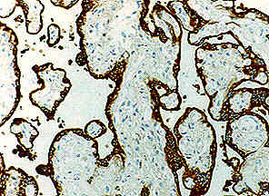

Slide 39
Other effects of hPL on glucose metabolism
Antagonistic effect to insulin-stimulated glucose uptake
Enhanced lipolysis Free fatty acid
Stimulation of gluconeogenesis
Promotes maternal production of insulin-like growth factors (IGFs)
Directing energy substrates toward the fetus

Slide 40
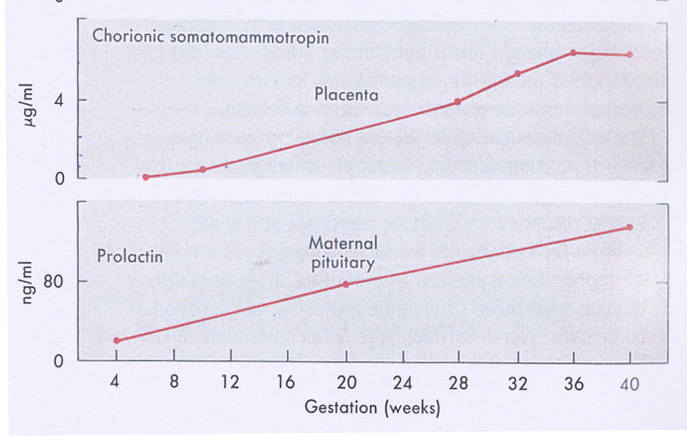
Prolactin
Stimulated by rising titer of estrogen
Structural similarity to GH
Effect on CHO metabolism in con. >200 ng/ml

Slide 41
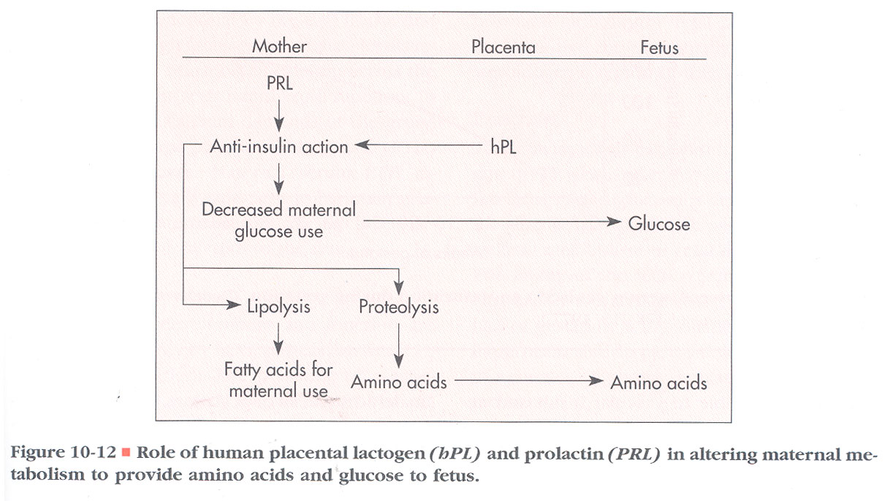

Slide 42
Leptin
A hormone predominantly made by adipose cells, acts at the hypothalamic level and helps to regulate energy balance by inhibiting hunger.
Plasma Leptin levels increase significantly during pregnancy reaching a peak in the second trimester.
At 36 weeks' gestation, it is 1.7-fold
higher than it is postpartum.
Circulating plasma Leptin
correlate with insulin levels as
well as with maternal adipose mass.
So, it can be considered a marker of
insulin resistance and obesity.
Butte NF et al. J Clin Endocrinol Metab. 1997;82(2):585-9.

Slide 43
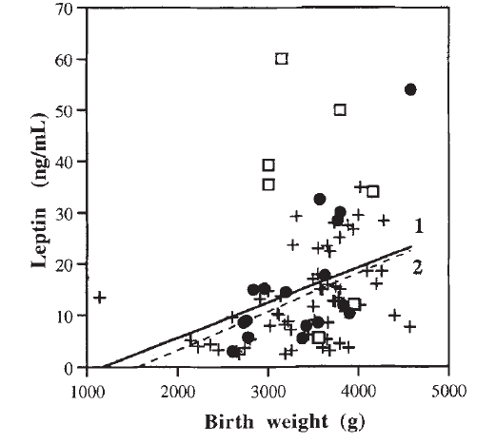
Relationship between Leptin and birth weight in babies from normal (+), from gestational diabetes (•) and insulin dependent diabetes mellitus mothers (□).
Regression analysis showed a significant correlation between Leptin & baby birth-weight.
Maffei et al. Horm Metab Res. 1998;30(9):575-80.

Slide 44
Leptin
Women with GDM have increased plasma Leptin levels during and after pregnancy.
Leptin concentration is positively related to HbA1c and the newborn's body weight, suggesting that poor glycemic control may favor adipose tissue accumulation in the newborn from women with GDM.
Thus, Leptin may play a role in fetal growth and can affect the maternal glucose metabolism.

Slide 45
Glucose Metabolism in normal pregnancy
 Early pregnancy
Increased glucose-stimulated insulin secretion
Unchanged or enhanced peripheral (muscle) insulin sensitivity
Unchanged basal hepatic glucose production
Normal or slightly improved glucose tolerance
Normal sensitivity to the blood glucose–lowering effect of exogenously administered insulin.
Greater insulin responses to oral glucose in the first trimester than before pregnancy.
120% increase at 12–14 wk gestation in the first phase of insulin response.
No significant difference in the second phase of insulin response between early pregnancy & the pre-gravid state.

Slide 46
Results:
Basal fasting glucose and insulin concentrations do not differ significantly from non-gravid values.
Fat accumulation due to lipogenic effect of insulin

Slide 47
 Late pregnancy
Rising concentrations of several diabetogenic hormones
Increased peripheral insulin resistance
Progressive increase in basal & postprandial insulin (up to 2 fold in third trimester)
50-70% lower insulin action in late normal pregnancy than in nonpregnant women
Basal endogenous hepatic glucose production increases by 16–30%.( Increased total gluconeogenesis)
* to meet the increasing needs of the placenta and fetus
* Glucose production increases with maternal body weight
Decreased CHO oxidation ( in obese women)
Decreased suppression of endogenous glucose production ( in obese women)

Slide 48
Results:
Plasma glucose tends to decrease by 10 to 15 mg/dL
Significantly elevated postprandial glucose concentrations
Prolonged glucose peak
Presence of a two fold increase in plasma insulin concentration.
Depletion of maternal adipose tissue depots

Slide 49
Adaptations:
Impaired insulin sensitivity
Increased beta- cell response
Altered blood glucose level (particularly after meal)
Change in circulatory FFAs, TGs, CHOL & phospholipids.

Slide 50



